Slide 1

COMP90050
Advanced Database Systems
Semester 2, 2024
Lecturer: Farhana Choudhury (PhD)
Live lecture – Week 6

Slide 2
Concurrency problem
Multiple concurrently running transactions may cause conflicts
- Still we try to allow concurrent runs as much as possible for a better performance, while avoiding conflicts as much as possible
What we need to know –
- What are the possible conflicts/dependencies
- Given a set of concurrent transactions, can we/DBMS determine whether there will be any conflict or not?
- Can conflicts be avoided (without making any change to the intended final output/final state of the database)?

Slide 3
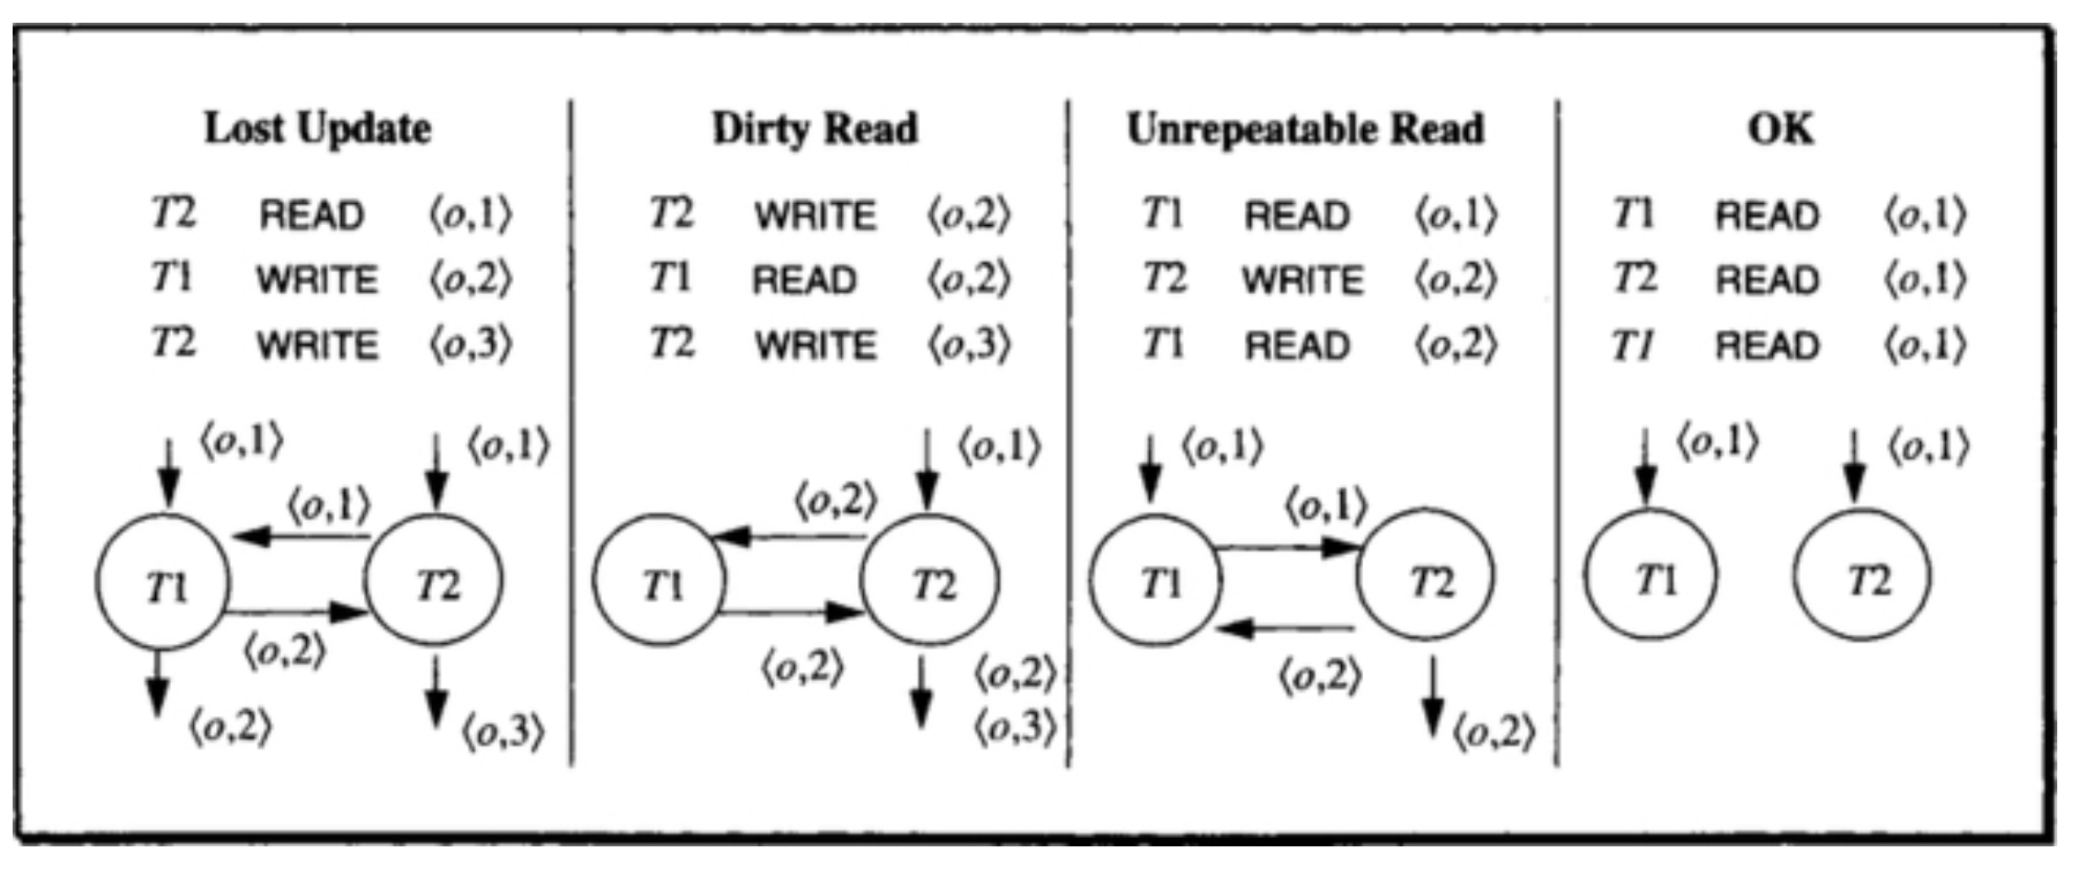
Dependencies
When dependency graph has cycles then there is a violation of isolation and a possibility of inconsistency.

Slide 4

Some activities !
Time for a poll - Pollev.com/farhanachoud585

Slide 5
Dependency relations - equivalence
Given two different order of executions, can we have some insight on the final output/state of the database?
H1 = <(T1,R,O1), (T2, W, O5), (T1,W,O3), (T3,W,O1), (T5,R,O3), (T3,W,O2), (T5,R,O4), (T4,R,O2), (T6,W,O4)>
DEP(H1) = {<T1, O1,T3>, <T1,O3,T5>, <T3,O2,T4>, <T5,O4,T6> }
H2 = <(T1,R,O1), (T3,W,O1), (T3,W,O2),(T4,R,O2),(T1,W,O3), (T2, W, O5), (T5,R,O3), (T5,R,O4), (T6,W,O4)>
DEP(H2) = {<T1, O1,T3>, <T1,O3,T5>, <T3,O2,T4>, <T5,O4,T6> }
DEP(H1) = DEP(H2)

Slide 6
Dependency relations - equivalence
DEP(H1) = {<T1, O1,T3>, <T1,O3,T5>, <T3,O2,T4>, <T5,O4,T6> }
DEP(H2) = {<T1, O1,T3>, <T1,O3,T5>, <T3,O2,T4>, <T5,O4,T6> }
O1
T3
O2
T4
T1
D1
O1,O2,O3,O4
H1
O3
D0
O1,O2,O3,O4
T2
T5
H2
D2
O1,O2,O3,O4
O4
T6
State of D1 = State of D2

Slide 7
Dependency relations
Goal: Can we run transactions concurrently, but still have the same final output/state of the database as if the transactions are serially executed?

Slide 8
Isolated history
Given a history, how can we determine whether it is ‘isolated history’ (that is, equivalent to a serial history)? – We try to find a cycle.
Presence of a wormhole transaction in a history implies it is not isolated. A transaction T’ is called a wormhole transaction if
This implies there is a cycle
E.g. After(T1) = {T5,T6, T3, T4}
After(T3) = {T4}
Before(T3) = {T1}
T1 will be both in Before(T6) and After(T6)
T3
T4
T1
T2
Example cycle
T5
T6

Slide 9
Isolation Concepts ...
A history is serial if it runs one transaction at a time sequentially, or equivalent to a serial history.
A serial history is an isolated history.
Wormhole theorem: A history is isolated if and only if it has no wormholes.
Give an example order of execution avoiding conflicts (without making any change to the intended final output/final state of the database)?
Hint: If T3 runs before T1, that will change the output
T3
T4
T1
T2
T5
T6

Slide 10
Some activities !
Time for a poll - Pollev.com/farhanachoud585
T3
T4
T1
T2
T5
T6

Slide 11
Isolated history
How can we ensure there’s no wormhole?
Solution: Through appropriate locks.
But we also need to carefully think about types of locks based on the application and requirement.
T3
T4
T1
T2
Example cycle
T5
T6

Slide 12
Degrees of Isolation
Degree 3Degree 3
Slock(A)
Xlock(B)
Xlock(C)
Read(A)
Write(B)
Read(A)
Write(C)
Unlock(A)
Unlock(B)
Unlock(C)
Degree 2
Slock(A)
Read(A)
Unlock(A)
Xlock(C)
Xlock(B)
Write(B)
Slock(A)
Read(A)
Unlock(A)
Write(C)
Unlock(B)
Unlock(C)
Degree 1
Read(A)
Xlock(C)
Xlock(B)
Write(B)
Read(A)
Write(C)
Unlock(B)
Unlock(C)
Degree 0
Read(A)
Xlock(B)
Write(B)
Unlock(B)
Read(A)
Xlock(C)
Write(C)
Unlock(C)
Phase1
Phase1
With X-locks
Phase1
Protecting
writes
Phase2
Protecting
writes
Phase2
Phase2
With X-locks
More restrictive locks mean less/no conflict,
but the overall transaction throughput gets slower

Slide 13
Isolation Concepts ...
In SQL2 one can declare isolation level as follows:
SET TRANSACTION ISOLATION LEVEL {READ UNCOMMITTED | READ COMMITTED| REPEATABLE READ | SERIALIZABLE}
Slight difference with the four degrees of isolation
SERIALIZABLE – degree 3
REPEATABLE READ – like degree 3, but other transactions can insert new rows
READ COMMITTED – Degree 2*
READ UNCOMMITTED – Degree 0
*Options can also be paired with SNAPSHOT on/off
Source: https://docs.microsoft.com/en-us/sql/t-sql/statements/set-transaction-isolation-level-transact-sql?view=sql-server-ver15

Slide 14
Summary
Multiple concurrently running transactions may cause conflicts
- Different types of conflicts
- Avoiding conflicts – using locks
Later we will see –
- More types of locks
- Relaxed isolation – for better performance

