Slide 1

COMP90050
Advanced Database Systems
Semester 2, 2024
Lecturer: Farhana Choudhury (PhD)
Live lecture – Week 7

Slide 2
Concurrent transactions – Conflicts and performance issues
Multiple concurrently running transactions may cause conflicts
- Still we try to allow concurrent runs as much as possible for a better performance, while avoiding conflicts as much as possible
Solutions:
1. Use granular locks

Slide 3
Database
Rules:
Lock root to leaf
To set X or S below, get IX or IS above respectively (or higher mode)
If no conflict/locks are compatible, multiple transactions run concurrently
If T1 reads record R_{a1} then T1 needs to lock the database, node A, and File – A1 in IS mode (or higher mode). Finally, it needs to lock R_{a1} in S mode.
If T2 modifies record R_{a3} then it can do so after locking the database, node A, and File – A1 in IX mode. Finally, it needs to lock the R_{a3} in X mode.
A
B
C
File- A3
File-A1
File – B1
R_{a3}
R_{a1}

Slide 4
Source: https://docs.microsoft.com/en-us/sql/relational-databases/sql-server-transaction-locking-and-row-versioning-guide?view=sql-server-ver15
Compatibility Mode of Granular Locks
Current | None | IS | IX |  | S |  | SIX |  | U |  | X
Request | +|- (Next mode) + granted / - delayed
IS | +(IS) | +(IS) |  | +(IX) |  | +(S) |  | +(SIX) |  | -(U) | -(X)
IX | +(IX) | +(IX) |  | +(IX) |  | -(S) |  | -(SIX) |  | -(U) | -(X)
S | +(S) | +(S) |  | -(IX) |  | +(S) |  | -(SIX) |  | -(U) | -(X)
SIX | +(SIX) | +(SIX) |  | -(IX) |  | -(S) |  | -(SIX) |  | -(U) | -(X)
U | +(U) | +(U) |  | -(IX) |  | +(U) |  | -(SIX) |  | -(U) | -(X)
X | +(X) | -(IS) |  | -(IX) |  | -(S) |  | -(SIX) |  | -(U) | -(X)

Slide 5
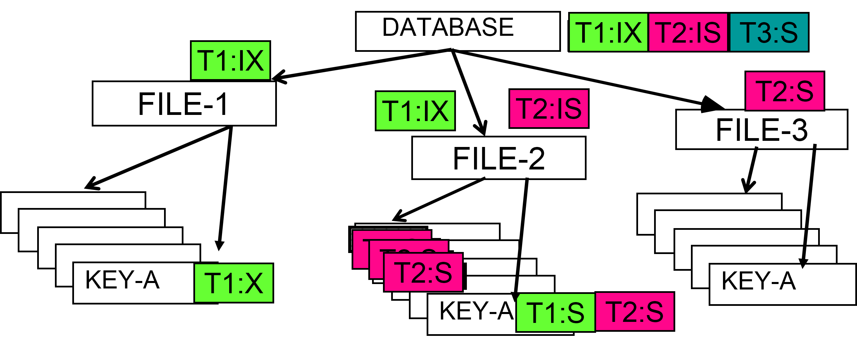
Tutorial: Which transactions can run concurrently and which transactions need to wait if the transactions arrive in the order T1-T2-T3?

Slide 6
Update mode Locks – why necessary
T1:
SLock A
Read A
If (A== 3)
{
% Upgrading Slock to Xlock
Xlock A
Write A
}
Unlock A
T2:
SLock A
Read A
If (A==3)
{
% Upgrading Slock to Xlock
Xlock A
Write A
}
Unlock A
T3:
SLock A
Read A
Unlock A
This can cause very simple deadlock. As per Jim Gray virtually all deadlocks in System R were found to be of this form!

Slide 7
Concurrent transactions – Conflicts and performance issues
Multiple concurrently running transactions may cause conflicts
- Still we try to allow concurrent runs as much as possible for a better performance, while avoiding conflicts as much as possible
Solutions:
Use granular locks
Optimistic and snapshot isolation

Slide 8
Optimistic locking
When conflicts are rare, transactions can execute operations without managing locks and without waiting for locks - higher throughput
- Use data without locks
- Before committing, each transaction verifies that no other transaction has modified any data that it needs (by taking appropriate locks) – duration of locks are very short
- If any conflict found, the transaction repeats the attempt
- If no conflict, make changes and commit

Slide 9
Snapshot Isolation
Read C into C1
Read D into D1
Loop:
Read A into A1
Read B into B1
Compute new values based on A1 and B1
% Start taking locks on records that need modification.
Let new value for C is C3 and for D is D3
Xlock C
Xlock D
Read C into C2
Read D into D2
if (C1 = = C2 & D1 = = D2)
% first writer commits
write C3 to C
write D3 to D
commit
unlock(C and D)
else % not first modifier
C1 = C2
D1 = D2
unlock(C and D)
goto Loop
end
Snapshot Isolation method is used in Oracle but it will not guarantee Serializability. However, its transaction throughput is very high compared to two phase locking scheme.

Slide 10
Isolation Concepts ...
SET TRANSACTION ISOLATION LEVEL {READ UNCOMMITTED | READ COMMITTED| REPEATABLE READ | SERIALIZABLE}
Slight difference with the four degrees of isolation
SERIALIZABLE – degree 3
REPEATABLE READ – like degree 3, but other transactions can insert new rows
READ COMMITTED – prevents dirty reads like degree 2*
READ UNCOMMITTED – Like degree 0
*Options can also be paired with SNAPSHOT on/off
Source: https://docs.microsoft.com/en-us/sql/t-sql/statements/set-transaction-isolation-level-transact-sql?view=sql-server-ver15

Slide 11
Isolation Concepts ...
SET TRANSACTION ISOLATION LEVEL {READ UNCOMMITTED | READ COMMITTED| REPEATABLE READ | SERIALIZABLE}
READ_COMMITTED_SNAPSHOT can be set on or off
If on – Shared locks are not used for reading
- Read committed with READ_COMMITTED_SNAPSHOT off – degree 2
- Read committed with READ_COMMITTED_SNAPSHOT on – *like degree 1
Source: https://docs.microsoft.com/en-us/sql/t-sql/statements/set-transaction-isolation-level-transact-sql?view=sql-server-ver15

Slide 12

Isolation Concepts ...
What kind of applications use relaxed isolation?
- Have you experienced any inconsistency in reading values as users?
Time for a poll - Pollev.com/farhanachoud585

Slide 13
Other types of locks
Phantoms: They commonly occur when a transaction lock records/table but another transaction adds new records in that table
So reading the same table twice by one transaction presents two different sets of records as the other has inserted some in the meantime
Predicate locks solve this problem. Rather than locking records, lock based on condition
Select * from Employee where salary > 80000
Another transaction will be able to insert new records in Employee table as long as the salary is not within this predicate range
Page Locks can solve this problem too. In this case, the storage should be organized based on values of attributes.

Slide 14
Concurrency and Isolation summary
Why concurrency control is needed
Concepts of isolation
    What causes conflicts
    Conflict types
How to avoid conflicts (by locking)
    Different types of locks
    Issues caused by locks (deadlocks, convoy)

Slide 15
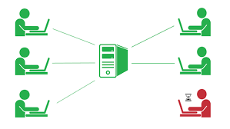

Core Concepts of Database management system
Efficiency
- Disks and I/O bandwidth
- Main memory
- Type of architecture
Database performance metrics
Hardware
Software/ DB tuning
- Types of DB
- Indexing
- Query optimisation
Efficiency/speed
Effectiveness
Effectiveness
Concurrent users
Users reading and writing over the same data
Security & Reliability
Transactions
Required tasks are all done together
Reliability
Crash recovery
Fault tolerance
Data duplication

