Slide 1
PROJECT PROGRESS REPORT
ZCharMC
Monitoring
CO₂ adsorption monitoring system
Frontend on Vercel
Django backend on Railway
15 October 2026
01
Notes:
Progress report for the full repository. The project supports monitoring of a CO2 adsorption system. The user confirms Vercel frontend hosting and Railway Django hosting. Report scope includes implemented source, current hosted UI observations and outstanding physical integration. It does not claim industrial readiness or live physical sensor measurements.
Sources and evidence:
https://zcharmc-monitoring.vercel.app/dashboard
https://github.com/Edaokie/zcharmc.monitoring/blob/e0933f5/README.md
User-provided hosting confirmation, 15 October 2026.

Slide 2
Current project status
The web prototype is deployed. Physical device integration remains the next major phase.
Workstream | Current status | Next evidence needed
Web interface | Deployed on Vercel | Real user authentication
Django service | Hosted on Railway | Confirm deployed OTA configuration
ESP32 firmware | Three native builds pass | Compatible-board acceptance
Firmware delivery | Automation implemented | Successful tagged cloud run
Equipment integration | Pending | Native sensing and safe control
02
Notes:
Distinguish deployed web applications from implemented firmware delivery and unverified equipment behavior. Avoid reporting an overall completion percentage because there is no agreed weighted baseline. Backend hosting comes from the user; exact deployed commit and environment variables were not independently inspected.
Sources and evidence:
https://github.com/Edaokie/zcharmc.monitoring/blob/e0933f5/README.md
https://github.com/Edaokie/zcharmc.monitoring/blob/e0933f5/docs/OTA_VERIFICATION.md
https://zcharmc-monitoring.vercel.app/dashboard

Slide 3
Repository architecture
One repository separates the browser application, cloud service and ESP32 applications.
Layer | Technology and location | Responsibility
Browser interface | React / TypeScript / TanStack frontend/ on Vercel | Readings, charts, reports and alerts
Cloud API and storage | Django / DRF / PostgreSQL backend/ on Railway | Validation, persistence, live events and admin
Embedded devices | ESP-IDF / FreeRTOS firmware/ on ESP32 | Provisioning and OTA now Sensing/control integration pending
Delivery and operations | GitHub Actions / docs/ | Builds, signed releases, setup and test records
ESP32 telemetry uploads to the cloud remain planned. No Raspberry Pi is required.
03
Notes:
The diagram in README describes the target telemetry path. Browsers load from Vercel and connect to Railway. Backend code expects PostgreSQL in production. Do not claim direct ESP32 telemetry currently reaches it: active native firmware provides provisioning, status and OTA only. The architecture excludes a required Raspberry Pi.
Sources and evidence:
https://github.com/Edaokie/zcharmc.monitoring/blob/e0933f5/README.md
https://github.com/Edaokie/zcharmc.monitoring/blob/e0933f5/backend/config/settings.py
https://github.com/Edaokie/zcharmc.monitoring/blob/e0933f5/firmware/src/CMakeLists.txt

Slide 4
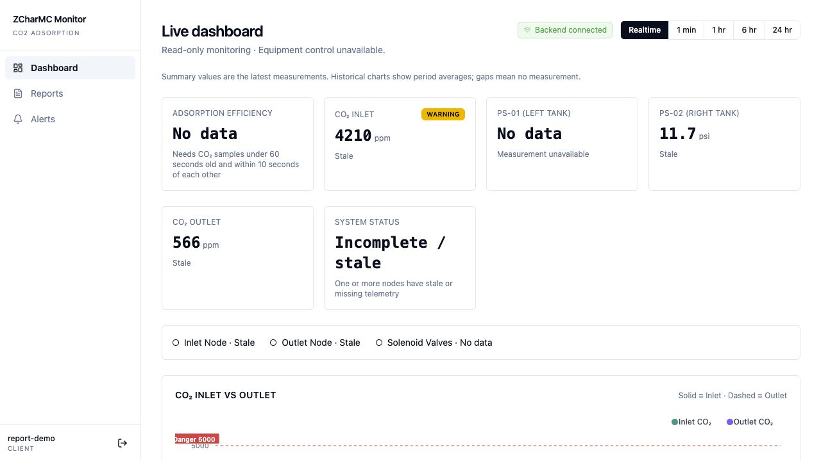
Hosted monitoring dashboard
Read-only monitoring is accessible through the Vercel deployment.
Observed online
Backend connected
Charts and status display
Stale and missing data remain explicit
Mock sign-in
Equipment control unavailable
04
Notes:
Actual hosted dashboard screenshot captured on 15 October 2026 using the demonstration client login, not a real institutional credential. The page showed Backend connected, stale inlet/outlet readings, no adsorption efficiency, missing solenoid telemetry and unavailable equipment control. Do not interpret displayed values as validated physical measurements or performance results. Image is evidence of deployed UI behavior, not plant connectivity. Local auth code simulates sign-in and roles.
Sources and evidence:
https://zcharmc-monitoring.vercel.app/dashboard
https://github.com/Edaokie/zcharmc.monitoring/blob/e0933f5/frontend/src/lib/auth.tsx
https://github.com/Edaokie/zcharmc.monitoring/blob/e0933f5/frontend/src/routes/_app.dashboard.tsx

Slide 5
Django backend progress
Railway hosts the API and administration service.
Capability | Implemented behavior
Telemetry ingestion | Bearer-key access, finite values and sensor bounds
Stored readings | Message deduplication and measurement-time ordering
History and reports | Filtered readings, aggregates, chart series and CSV
Realtime status | Socket.IO updates and persisted reconnect state
OTA administration | Device credentials, signed releases and audited approval
The current public demo and mock browser login do not provide private operator access.
05
Notes:
Backend capabilities are source-verified. Ingestion commits data before acknowledgement and broadcasts after commit. Duplicate identities are scoped by node/message ID. Device OTA credentials are distinct from the existing shared telemetry ingestion credential. Staff permissions gate device approval. User confirms hosting on Railway, but no exact production commit comparison was made for every listed feature.
Sources and evidence:
https://github.com/Edaokie/zcharmc.monitoring/blob/e0933f5/backend/monitoring/services.py
https://github.com/Edaokie/zcharmc.monitoring/blob/e0933f5/backend/monitoring/views.py
https://github.com/Edaokie/zcharmc.monitoring/blob/e0933f5/backend/monitoring/ota.py
https://github.com/Edaokie/zcharmc.monitoring/blob/e0933f5/backend/monitoring/admin.py
https://github.com/Edaokie/zcharmc.monitoring/blob/e0933f5/backend/Dockerfile

Slide 6
ESP32 firmware progress
Shared ESP-IDF infrastructure produces three distinct application images.
Image | Current scope | Application work remaining
inlet.bin | Provisioning, Wi-Fi, status and OTA | Native inlet sensor drivers and uploads
outlet.bin | Provisioning, Wi-Fi, status and OTA | Native outlet sensor drivers and uploads
control.bin | Maintenance outputs, status and OTA | Operating cycle, feedback and interlocks
Shared code
One OTA implementation serves many uniquely provisioned boards.
06
Notes:
Active CMake compiles src/idf only. Legacy Arduino files remain reference code and are excluded. PlatformIO has inlet/outlet/control profiles, shared native C sources and build-time role identity. Each physical board still needs its own device ID and bearer token. Current generic ESP32 4 MB hardware assumption is not yet validated against the LilyGO T-SIM7000G diagram. LOW outputs are bench behavior, not proof of safe actuator states.
Sources and evidence:
https://github.com/Edaokie/zcharmc.monitoring/blob/e0933f5/firmware/platformio.ini
https://github.com/Edaokie/zcharmc.monitoring/blob/e0933f5/firmware/src/CMakeLists.txt
https://github.com/Edaokie/zcharmc.monitoring/blob/e0933f5/firmware/src/idf/main.c
https://github.com/Edaokie/zcharmc.monitoring/blob/e0933f5/firmware/README.md

Slide 7
Firmware release and OTA workflow
Release publication and device installation have separate approval steps.
01
Source review and version tag
Firmware changes run CI. A firmware-vX.Y.Z tag selects the release commit.
02
Build, sign and publish
GitHub builds the three images and publishes signed manifests and binaries.
03
Verify and register
The delivery job checks published assets and registers disabled Django records.
04
Approve and install
Staff assigns a device. The ESP32 verifies, installs and checks its next boot.
07
Notes:
Pipeline implementation exists in .github/workflows/firmware-release.yml, firmware/tools/register_release.py and backend/monitoring/release_registration.py. A manual workflow_dispatch retries registration of an existing release without rebuilding or republishing. Registration uses its own scoped credential, supports idempotent retries, and preserves enablement/assignments. Actual tagged execution, environment setup and physical OTA acceptance are still unverified. Device downloads to an inactive slot and uses ESP-IDF pending-boot verification/rollback.
Sources and evidence:
https://github.com/Edaokie/zcharmc.monitoring/blob/e0933f5/.github/workflows/firmware-release.yml
https://github.com/Edaokie/zcharmc.monitoring/blob/e0933f5/firmware/tools/register_release.py
https://github.com/Edaokie/zcharmc.monitoring/blob/e0933f5/backend/monitoring/release_registration.py
https://github.com/Edaokie/zcharmc.monitoring/blob/e0933f5/firmware/src/idf/ota.c
https://github.com/Edaokie/zcharmc.monitoring/blob/e0933f5/docs/FIRMWARE_CICD.md

Slide 8
Software verification
Passing software checks provide a baseline for the next integration tests.
39
10
10
3
Backend tests
Firmware host tests
Frontend tests
Native builds
Isolated SQLite test database
Release package and delivery client
Data handling and alert behavior
Inlet, outlet and control
Also checked
Frontend type check/build and firmware workflow validation passed.
Local tests and compilation do not establish production deployment or physical-device acceptance.
08
Notes:
Counts refer to completed local checks during the 15 October 2026 repository review, not counts of end-to-end plant tests. Latest backend and host reruns passed 39 and 10 tests. Backend used SQLite; PostgreSQL was not repeated in that pass. Frontend previously passed 10 tests, TypeScript and production build, with 8 lint warnings and 0 lint errors. All 3 native profiles compiled. Host tests use Python/OpenSSL and do not execute the ESP32 application C code. Actionlint ran with optional ShellCheck/Pyflakes integrations disabled.
Sources and evidence:
https://github.com/Edaokie/zcharmc.monitoring/blob/e0933f5/docs/OTA_VERIFICATION.md
https://github.com/Edaokie/zcharmc.monitoring/blob/e0933f5/backend/tests/test_ota.py
https://github.com/Edaokie/zcharmc.monitoring/blob/e0933f5/firmware/tests_host/test_register_release.py
https://github.com/Edaokie/zcharmc.monitoring/blob/e0933f5/frontend/tests/monitoring.test.ts
https://github.com/Edaokie/zcharmc.monitoring/blob/e0933f5/frontend/tests/readings.test.ts
Local command outputs from the 15 October 2026 review.

Slide 9
Open issues and readiness limits
The next work addresses recovery, access and reporting accuracy.
01
Device recovery
Interrupted provisioning and OTA attempt bookkeeping need hardening.
02
Board and equipment acceptance
Confirm LilyGO compatibility, actuator behavior and physical rollback.
03
Web access and server capacity
Replace mock authentication and address WebSocket thread saturation.
04
Report correctness
Charts currently use a records page. Custom dates and filter requests need fixes.
09
Notes:
Source review found partial multi-key provisioning can be accepted as provisioned, backend origin validation is incomplete, and persisting an attempt before selecting a boot partition can mislabel rollback. Earlier local Gunicorn test reproduced HTTP success with 7 open WebSockets and timeout with 8, matching one worker/eight gthread threads. Report charts use the current 50-row page, timezone-free custom inputs become UTC, and Apply can race old/new-page requests. These findings were not fixed by CI/CD or documentation work. Do not include old tracked-secret finding as current: commit e4a8bc6 stopped tracking secrets.h, although any historical live credentials still require owner handling.
Sources and evidence:
https://github.com/Edaokie/zcharmc.monitoring/blob/e0933f5/docs/OTA_VERIFICATION.md
https://github.com/Edaokie/zcharmc.monitoring/blob/e0933f5/firmware/src/idf/config.c
https://github.com/Edaokie/zcharmc.monitoring/blob/e0933f5/firmware/src/idf/ota.c
https://github.com/Edaokie/zcharmc.monitoring/blob/e0933f5/backend/gunicorn.conf.py
https://github.com/Edaokie/zcharmc.monitoring/blob/e0933f5/frontend/src/routes/_app.reports.tsx
https://github.com/Edaokie/zcharmc.monitoring/blob/e0933f5/frontend/src/lib/auth.tsx
Local WebSocket capacity test and source review, 15 October 2026.

Slide 10
Documentation and operational handoff
The repository now includes a first-use path and an evidence record.
Document | Purpose
OTA beginner guide | Setup, USB installation, provisioning and first OTA
Firmware CI/CD guide | Secrets, release tags and registration retries
OTA verification record | Completed checks and outstanding limitations
OTA acceptance template | Board identity, test evidence and readiness decision
Cloud and maintenance guides | Hosting configuration, diagnostics and recovery
10
Notes:
New documentation is included in local commit e0933f5. Beginner instructions distinguish software-only tests, cloud delivery, initial USB flashing and supervised physical acceptance. The acceptance template starts NOT RUN and is not an assertion that boards passed tests. Setup commands have placeholders rather than real secrets. Repository documentation was checked for local links, shell syntax and JSON validity.
Sources and evidence:
https://github.com/Edaokie/zcharmc.monitoring/blob/e0933f5/docs/OTA_BEGINNERS_GUIDE.md
https://github.com/Edaokie/zcharmc.monitoring/blob/e0933f5/docs/FIRMWARE_CICD.md
https://github.com/Edaokie/zcharmc.monitoring/blob/e0933f5/docs/OTA_VERIFICATION.md
https://github.com/Edaokie/zcharmc.monitoring/blob/e0933f5/docs/OTA_TEST_RECORD.md
https://github.com/Edaokie/zcharmc.monitoring/blob/e0933f5/docs/CLOUD_SETUP.md
https://github.com/Edaokie/zcharmc.monitoring/blob/e0933f5/docs/MAINTENANCE.md

Slide 11
Next milestones
Acceptance evidence determines progression. No completion dates are assumed.
Order | Milestone | Evidence of completion
1 | Cloud release trial | Signed assets and three disabled Django records
2 | First compatible bench board | Provisioning, OTA and recovery evidence
3 | Native telemetry integration | Real readings and durable outage buffering
4 | Autonomous equipment cycle | Verified feedback, interlocks and local control
5 | Operational release review | Access, load, reporting and hardware checks pass
11
Notes:
These are proposed priorities, not a dated project commitment. First address provisioning/recovery defects as part of the bench phase. GitHub owner must configure signing and registration secrets; backend admin must deploy/configure the registration endpoint; hardware maintainer must verify board and actuator compatibility. Integration must keep local control independent of cloud availability. No personnel names, budgets or deadlines were supplied.
Sources and evidence:
https://github.com/Edaokie/zcharmc.monitoring/blob/e0933f5/docs/OTA_BEGINNERS_GUIDE.md
https://github.com/Edaokie/zcharmc.monitoring/blob/e0933f5/docs/FIRMWARE_CICD.md
https://github.com/Edaokie/zcharmc.monitoring/blob/e0933f5/docs/OTA_TEST_RECORD.md
https://github.com/Edaokie/zcharmc.monitoring/blob/e0933f5/README.md

Slide 12
Project demonstration
The current demonstration covers the deployed web prototype and the delivery implementation.
1 Dashboard
https://zcharmc-monitoring.vercel.app/dashboard
2 Reports and alerts
Show stored records, exports and recorded threshold breaches.
3 OTA delivery evidence
Show workflows and acceptance steps. Demonstrate physical OTA after bench validation.
12
Notes:
Suggested presentation demonstration. Navigate the hosted Vercel dashboard, Reports and Alerts. Existing readings may be stale or test data; do not present them as a live adsorption experiment. Then show repository workflows and beginner documentation. A real physical update should be shown only after successful controlled bench acceptance, with the corresponding record. Exact production backend code/version and release environment settings have not been independently verified in this presentation task.
Sources and evidence:
https://zcharmc-monitoring.vercel.app/dashboard
https://github.com/Edaokie/zcharmc.monitoring
https://github.com/Edaokie/zcharmc.monitoring/blob/e0933f5/docs/OTA_BEGINNERS_GUIDE.md
https://github.com/Edaokie/zcharmc.monitoring/blob/e0933f5/docs/OTA_TEST_RECORD.md

