Slide 1
STUDY 3 PROGRESS REPORT
Development of Near Real-time
Microcomputer-based
Monitoring System
ZCharMC repository progress mapped to the work plan
Web platform deployed
Sensor integration and evaluation remain pending
15 October 2026
01
Notes:
Report framing follows the supplied Study 3 work plan. The title preserves the study subject. Software progress is supporting work toward the study outputs; no completion percentage is calculated. The user confirms the frontend on Vercel and Django on Railway. The original report remains unchanged in a separate file.
Sources and evidence:
User-supplied Study 3 work-plan excerpt, codex-clipboard-1e0460cd-ba95-4c86-b68d-7b88cef4d70e.png, supplied 15 October 2026.
https://github.com/Edaokie/zcharmc.monitoring/blob/e0933f5/README.md
https://github.com/Edaokie/zcharmc.monitoring/blob/e0933f5/docs/OTA_VERIFICATION.md
https://zcharmc-monitoring.vercel.app/dashboard

Slide 2
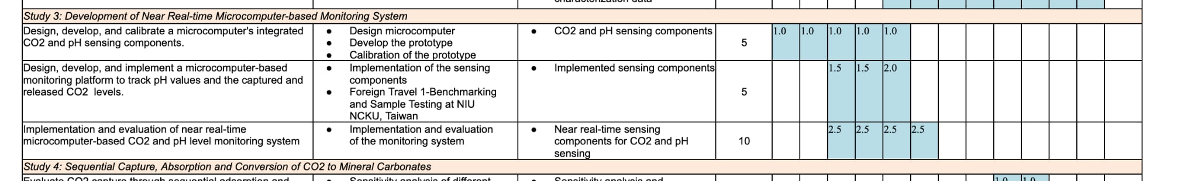
Study 3 work-plan basis
Three planned outputs provide the structure for this progress report.
Work-plan row | Expected output in the supplied plan
Objective 1 | CO₂ and pH sensing components
Objective 2 | Implemented sensing components
Objective 3 | Near real-time sensing components for CO₂ and pH sensing
The excerpt has no visible schedule headers or numerical units. No dates or completion rates are inferred.
02
Notes:
Source transcription. Study 3: Development of Near Real-time Microcomputer-based Monitoring System. Objective 1: Design, develop, and calibrate a microcomputer's integrated CO2 and pH sensing components. Activities: Design microcomputer; Develop the prototype; Calibration of the prototype. Output: CO2 and pH sensing components. Objective 2: Design, develop, and implement a microcomputer-based monitoring platform to track pH values and the captured and released CO2 levels. Activities: Implementation of the sensing components; Foreign Travel 1-Benchmarking and Sample Testing at NIU NCKU, Taiwan (wording as displayed). Output: Implemented sensing components. Objective 3: Implementation and evaluation of near real-time microcomputer-based CO2 and pH level monitoring system. Activity: Implementation and evaluation of the monitoring system. Output: Near real-time sensing components for CO2 and pH sensing. Values 5, 5 and 10 and a blue schedule grid are visible, but their column headings and units are not provided. They are not interpreted as accomplishment percentages, financial amounts, dates or confirmed progress.
Sources and evidence:
User-supplied Study 3 work-plan excerpt, codex-clipboard-1e0460cd-ba95-4c86-b68d-7b88cef4d70e.png, supplied 15 October 2026.

Slide 3
Objective-to-progress mapping
Repository evidence supports partial implementation. Each study output still requires physical evidence.
Objective | Output focus | Repository contribution | Current reporting status
1 | CO₂ and pH sensing components | ESP32 roles and shared firmware infrastructure | Design/software preparation Calibration not evidenced
2 | Implemented sensing components | Deployed web interface, Django APIs and data storage | Platform software implemented Physical sensing pending
3 | Near real-time sensing components | Live-event transport, status and software tests | Software checks completed System evaluation pending
Hosted software, successful builds and automated tests do not establish calibrated sensing or study completion.
03
Notes:
This is a qualitative crosswalk. It distinguishes infrastructure and software implementation from achievement of the sensing outputs. Objective 1 calibration data, Objective 2 hardware sensing implementation and the benchmarking/sample-testing activity, and Objective 3 physical near-real-time evaluation are not established by repository evidence supplied here. No numerical progress score is assigned.
Sources and evidence:
User-supplied Study 3 work-plan excerpt, codex-clipboard-1e0460cd-ba95-4c86-b68d-7b88cef4d70e.png, supplied 15 October 2026.
https://github.com/Edaokie/zcharmc.monitoring/blob/e0933f5/README.md
https://github.com/Edaokie/zcharmc.monitoring/blob/e0933f5/docs/OTA_VERIFICATION.md
https://github.com/Edaokie/zcharmc.monitoring/blob/e0933f5/firmware/README.md

Slide 4
Objective 1: Design and calibration
Planned work: design the microcomputer, develop the prototype and calibrate its CO₂ and pH sensing.
Planned activity | Available repository evidence | Evidence still needed
Design microcomputer | Inlet, outlet and control roles ESP-IDF / FreeRTOS foundation | Confirmed board, wiring and pin map
Develop the prototype | Three firmware profiles build Provisioning and OTA implemented | Native sensor drivers and bench assembly
Calibration of prototype | No calibration results established by this repository review | Reference readings, method, error and repeatability records
Reportable progress
Software architecture and firmware preparation support prototype development.
04
Notes:
Objective 1 output is CO2 and pH sensing components. Do not claim that a compiled ESP32 image is a calibrated sensing prototype. Active CMake builds only src/idf, providing provisioning/Wi-Fi/status/OTA. Native sensor adapters and hardware acceptance remain pending. The generic 4 MB WROOM profile has not been validated against the LilyGO T-SIM7000G diagram. Calibration records may exist outside the repository; none were supplied, so status is not evidenced rather than a claim they do not exist.
Sources and evidence:
User-supplied Study 3 work-plan excerpt, codex-clipboard-1e0460cd-ba95-4c86-b68d-7b88cef4d70e.png, supplied 15 October 2026.
https://github.com/Edaokie/zcharmc.monitoring/blob/e0933f5/firmware/platformio.ini
https://github.com/Edaokie/zcharmc.monitoring/blob/e0933f5/firmware/src/CMakeLists.txt
https://github.com/Edaokie/zcharmc.monitoring/blob/e0933f5/firmware/README.md
https://github.com/Edaokie/zcharmc.monitoring/blob/e0933f5/docs/OTA_VERIFICATION.md

Slide 5
Objective 2: Monitoring platform
Planned work: track pH and captured/released CO₂ levels through an integrated monitoring platform.
Platform element | Implemented contribution | Study linkage / limit
Frontend on Vercel | Charts, readings, reports and alerts | Interface for reviewing CO₂ and pH
Django on Railway | Validated ingestion, storage, query APIs and live-event transport | Software path for future device readings
ESP32 integration | Distinct role images and device identities | Native sensor sampling/uploads pending
Benchmarking and sample testing | No supporting evidence supplied | NIU / NCKU, Taiwan activity in the plan
Concentration displays alone do not establish a validated CO₂ capture/release balance.
05
Notes:
Objective 2 output is Implemented sensing components. The repository implements the web platform and supporting APIs, but active firmware does not yet deliver native sensor telemetry. The plan lists Foreign Travel 1-Benchmarking and Sample Testing at NIU NCKU, Taiwan. No visit, benchmark protocol, sample-test results or travel completion evidence was supplied. Names are retained without inferring expanded institution names or that an activity occurred. Capture/release interpretation requires a validated measurement method; the dashboard comparison/efficiency calculation is not a validated material balance.
Sources and evidence:
User-supplied Study 3 work-plan excerpt, codex-clipboard-1e0460cd-ba95-4c86-b68d-7b88cef4d70e.png, supplied 15 October 2026.
https://github.com/Edaokie/zcharmc.monitoring/blob/e0933f5/README.md
https://github.com/Edaokie/zcharmc.monitoring/blob/e0933f5/backend/monitoring/views.py
https://github.com/Edaokie/zcharmc.monitoring/blob/e0933f5/backend/monitoring/services.py
https://github.com/Edaokie/zcharmc.monitoring/blob/e0933f5/frontend/src/lib/monitoring.ts
https://zcharmc-monitoring.vercel.app/dashboard

Slide 6
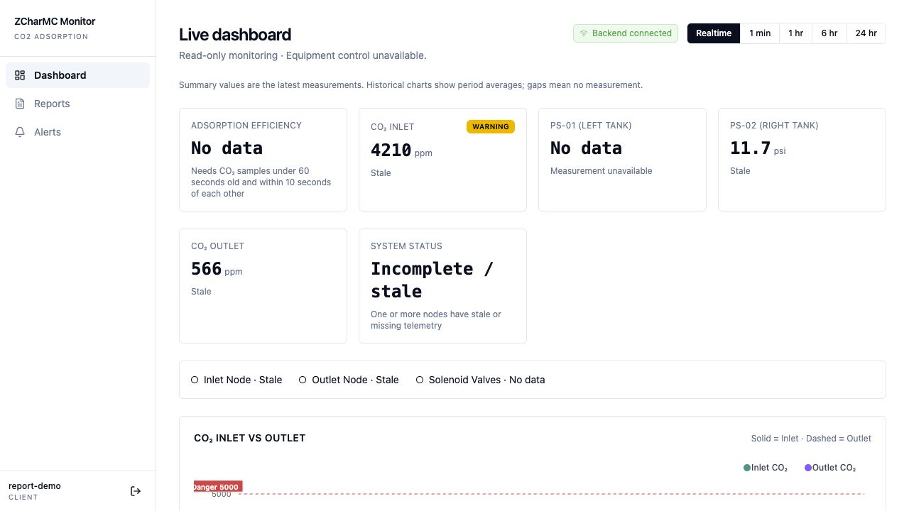
Objective 2: Deployed interface evidence
The hosted dashboard demonstrates the web layer of the planned monitoring platform.
Platform evidence
Backend connected
Stored readings and charts
Stale/missing data shown
Physical CO₂ / pH sensing
not established by this view
06
Notes:
This is the actual hosted screenshot captured in the original report on 15 October 2026, reused as evidence rather than a new observation. It shows Backend connected, stale inlet/outlet values and missing measurements. Source code uses mock browser sign-in. The screenshot is evidence of deployment and interface behavior only, not calibrated CO2/pH measurements, physical equipment connectivity, near-real-time experiment results or achieved capture efficiency.
Sources and evidence:
User-supplied Study 3 work-plan excerpt, codex-clipboard-1e0460cd-ba95-4c86-b68d-7b88cef4d70e.png, supplied 15 October 2026.
https://zcharmc-monitoring.vercel.app/dashboard
https://github.com/Edaokie/zcharmc.monitoring/blob/e0933f5/frontend/src/lib/auth.tsx
https://github.com/Edaokie/zcharmc.monitoring/blob/e0933f5/frontend/src/routes/_app.dashboard.tsx

Slide 7
Objective 3: Implementation and evaluation
Planned output: near real-time sensing components for CO₂ and pH sensing.
Evaluation area | Current software contribution | Physical evidence to collect
Measurement correctness | Finite values, bounds and timestamps | CO₂/pH comparison with references
Near real-time response | Socket.IO updates and freshness display | Measurement-to-display latency
Reliability and continuity | Persistence, deduplication, reconnect state | Outage/reconnect records and data gaps
System operation | OTA identity and startup checks | Integrated sensing and recovery trials
Agree the test protocol and acceptance thresholds before claiming near real-time performance.
07
Notes:
Objective 3 is implementation and evaluation of the near real-time microcomputer-based CO2 and pH level monitoring system. No physical latency, sensing accuracy, drift or reliability results were supplied. The proposed evidence areas are recommendations for completing evaluation, not additional approved work-plan requirements or reported measurements. Latency should be measured end-to-end using a defined event origin, synchronized clocks where applicable, and a recorded test configuration. The software tests do not substitute for that evaluation.
Sources and evidence:
User-supplied Study 3 work-plan excerpt, codex-clipboard-1e0460cd-ba95-4c86-b68d-7b88cef4d70e.png, supplied 15 October 2026.
https://github.com/Edaokie/zcharmc.monitoring/blob/e0933f5/backend/monitoring/realtime.py
https://github.com/Edaokie/zcharmc.monitoring/blob/e0933f5/backend/monitoring/services.py
https://github.com/Edaokie/zcharmc.monitoring/blob/e0933f5/frontend/src/lib/monitoring.ts
https://github.com/Edaokie/zcharmc.monitoring/blob/e0933f5/docs/OTA_TEST_RECORD.md

Slide 8
OTA and CI/CD as supporting work
Firmware delivery supports repeatable prototype deployment across the Study 3 devices.
01
Build and sign role images
GitHub workflows build inlet, outlet and control from a versioned commit.
02
Publish and register releases
The delivery job verifies assets and creates disabled Django release records.
03
Approve individual devices
Staff selects a matching release. Each board retains its own identity and token.
04
Verify installation and recovery
Physical update, interrupted-transfer and rollback acceptance remain pending.
08
Notes:
OTA and CI/CD are enabling engineering contributions for Objectives 1–3. They are not separate sensing outputs in the supplied plan and must not be counted as calibration or system-evaluation completion. The automatic pipeline implementation is present in source, but owner secrets, actual tagged cloud execution and physical board acceptance have not been independently established. Device assignment remains a human decision. Current code has provisioning and attempt-bookkeeping recovery issues documented in OTA_VERIFICATION.
Sources and evidence:
User-supplied Study 3 work-plan excerpt, codex-clipboard-1e0460cd-ba95-4c86-b68d-7b88cef4d70e.png, supplied 15 October 2026.
https://github.com/Edaokie/zcharmc.monitoring/blob/e0933f5/.github/workflows/firmware-release.yml
https://github.com/Edaokie/zcharmc.monitoring/blob/e0933f5/firmware/tools/register_release.py
https://github.com/Edaokie/zcharmc.monitoring/blob/e0933f5/backend/monitoring/release_registration.py
https://github.com/Edaokie/zcharmc.monitoring/blob/e0933f5/docs/FIRMWARE_CICD.md
https://github.com/Edaokie/zcharmc.monitoring/blob/e0933f5/docs/OTA_VERIFICATION.md

Slide 9
Software checks supporting Study 3
Local verification supports the platform baseline. Physical sensing and calibration remain separate.
39
10
10
3
Backend tests
Firmware host tests
Frontend tests
Native builds
Validation, APIs and OTA registration
Signed packages and delivery client
Readings and alert behavior
Inlet, outlet and control
Scope of evidence
Software regression and build results, not CO₂/pH calibration or physical latency results.
09
Notes:
Preserves the original report counts. 39 backend tests and 10 firmware host tests passed in the latest 15 October 2026 rerun. Backend tests used isolated SQLite. 10 frontend tests and all three native builds passed earlier in that review, together with frontend type/build checks. Host tests execute Python/OpenSSL packaging/client logic, not ESP32 application C on hardware. Tests have no one-to-one percentage mapping to the study outputs.
Sources and evidence:
User-supplied Study 3 work-plan excerpt, codex-clipboard-1e0460cd-ba95-4c86-b68d-7b88cef4d70e.png, supplied 15 October 2026.
https://github.com/Edaokie/zcharmc.monitoring/blob/e0933f5/docs/OTA_VERIFICATION.md
Original project progress report and local test evidence from 15 October 2026.

Slide 10
Evidence still needed for the planned outputs
Items below are unverified in the supplied repository evidence, not assumed completed activities.
Work-plan linkage | Missing evidence | Record to prepare
Objective 1 | Sensor hardware and calibration | Board/wiring record, reference data and calibration results
Objective 2 | Implemented physical sensing path | Native sampling, upload and display trace
Objective 2 activity | Benchmarking / sample testing in Taiwan | Protocol, participation and results if the activity has occurred
Objective 3 | Integrated performance evaluation | Latency, sensing accuracy and reliability test results
Documentation and an acceptance template are available. Completed test records still require actual observations.
10
Notes:
Evidence-gap matrix follows the supplied activities/output structure. No evidence of foreign travel or sample testing was supplied. Do not infer that these activities were cancelled, delayed or completed. Additional source-review risks include mock login, WebSocket thread capacity, report pagination/timezone accuracy, device-origin validation and provisioning recovery. Resolve those relevant to measurement/evaluation before treating the prototype as operationally accepted. No schedule or percentage is inferred from the unlabeled grid.
Sources and evidence:
User-supplied Study 3 work-plan excerpt, codex-clipboard-1e0460cd-ba95-4c86-b68d-7b88cef4d70e.png, supplied 15 October 2026.
https://github.com/Edaokie/zcharmc.monitoring/blob/e0933f5/docs/OTA_BEGINNERS_GUIDE.md
https://github.com/Edaokie/zcharmc.monitoring/blob/e0933f5/docs/OTA_TEST_RECORD.md
https://github.com/Edaokie/zcharmc.monitoring/blob/e0933f5/docs/OTA_VERIFICATION.md
https://github.com/Edaokie/zcharmc.monitoring/blob/e0933f5/frontend/src/routes/_app.reports.tsx
https://github.com/Edaokie/zcharmc.monitoring/blob/e0933f5/backend/gunicorn.conf.py

Slide 11
Next milestones mapped to Study 3
Suggested sequence for producing the remaining evidence. Dates and acceptance limits need agreement.
Sequence | Next milestone | Linked objective
1 | Confirm board configuration and recovery behavior | Objective 1
2 | Implement native CO₂/pH drivers and calibrate | Objective 1
3 | Connect real sensor data to the hosted platform | Objective 2
4 | Document benchmarking/sample testing evidence | Objective 2 activity
5 | Evaluate integrated accuracy, latency and reliability | Objective 3
11
Notes:
This sequence is a proposed reporting and engineering plan. It is not a new approved timetable, grant requirement or claim of percent completion. Cloud release setup and device acceptance are supporting steps. Hardware calibration and integrated measurement work depend on the actual sensor models and hardware configuration, which must be confirmed. Benchmarking evidence should be included only when supported by the responsible project records.
Sources and evidence:
User-supplied Study 3 work-plan excerpt, codex-clipboard-1e0460cd-ba95-4c86-b68d-7b88cef4d70e.png, supplied 15 October 2026.
https://github.com/Edaokie/zcharmc.monitoring/blob/e0933f5/docs/OTA_BEGINNERS_GUIDE.md
https://github.com/Edaokie/zcharmc.monitoring/blob/e0933f5/docs/OTA_TEST_RECORD.md
https://github.com/Edaokie/zcharmc.monitoring/blob/e0933f5/README.md

Slide 12
Study 3 progress statement
A report-ready summary aligned with the supplied objectives and outputs.
Completed software contribution
The project has deployed the web monitoring interface on Vercel and the Django backend on Railway. The repository also provides distinct ESP32 firmware builds and a signed OTA delivery implementation.
Remaining study evidence
Completion of the planned sensing outputs requires confirmed hardware integration, CO₂ and pH calibration, relevant benchmarking/sample-test records, and evaluation of the integrated near real-time monitoring system.
12
Notes:
Suggested progress-report wording, grounded in the available software/source evidence and the user-confirmed hosting status. It deliberately avoids claiming calibration, benchmarking travel, physical sensing, capture/release measurement or near-real-time evaluation has been completed. Exact deployed backend commit and successful cloud/physical OTA execution still need confirmation. The original work-plan excerpt has incomplete schedule/weight headers, so no numeric accomplishment assessment is provided.
Sources and evidence:
User-supplied Study 3 work-plan excerpt, codex-clipboard-1e0460cd-ba95-4c86-b68d-7b88cef4d70e.png, supplied 15 October 2026.
https://zcharmc-monitoring.vercel.app/dashboard
https://github.com/Edaokie/zcharmc.monitoring/blob/e0933f5/README.md
https://github.com/Edaokie/zcharmc.monitoring/blob/e0933f5/docs/OTA_VERIFICATION.md

