Slide 1

Poor man’s air gapped network
@edauksis

Slide 2
Alligator Con 2017
Objectives
How I built a cheap, but effective air gapped device
Some use cases
Ideas for your own offline network
Call for participation

Slide 3
RFC 4949 (Internet Security Glossary)
$ air gap
(I) An interface between two systems at which (a) they are not connected physically and (b) any logical connection is not automated (i.e., data is transferred through the interface only manually, under human control). (See: sneaker net. Compare: gateway.)
Example: Computer A and computer B are on opposite sides of a room. To move data from A to B, a person carries a disk across the room. If A and B operate in different security domains, then moving data across the air gap may involve an upgrade or downgrade operation.

Slide 4
WhatTF an air gapped network is?
An air gap, air wall or air gapping is a network security measure employed on one or more computers to ensure that a secure computer network is physically isolated from unsecured networks, such as the public Internet or an unsecured local area network. The name arises from the technique of creating a network that is physically separated (with a conceptual air gap) from all other networks. The air gap may not be completely literal, as networks employing the use of dedicated cryptographic devices that can tunnel packets over untrusted networks while avoiding packet rate or size variation can be considered air gapped, as there is no ability for computers on opposite sides of the gap to communicate.
Source: Wikipedia

Slide 5
What it is used for?
Mainly: confidentiality
Classified environments
Some banking, and other data sensitive owners
Low side conversion before getting high side
Alice sends cat.png → Bob gets cat.jpg

Slide 6
My requirements
To be fully portable, so anything is better trought a web browser
Decrypt -> read -> answer -> Encrypt
Sexy enoght to be plugged at work

Slide 7
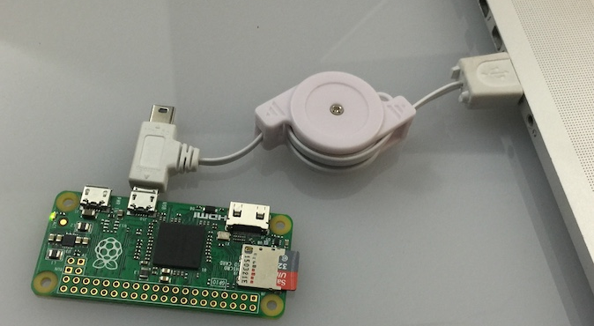
This is not sexy

Slide 8
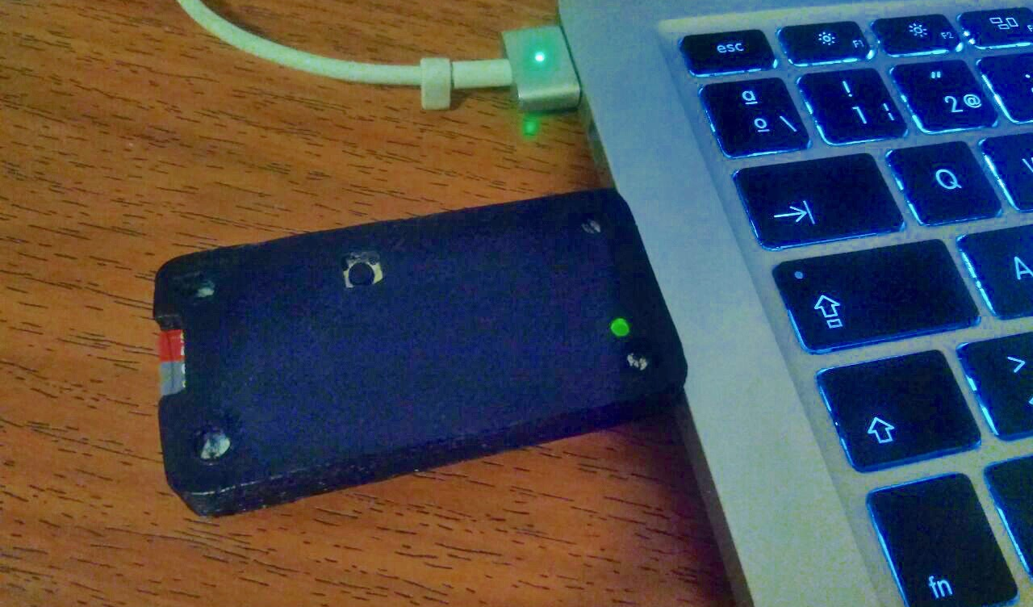
This is much better

Slide 9
Use Cases
Protect your privacy.
To plug storage in an untrusted computer.
To acquire files
To exfiltrate info
Private && portable repos, wiki, …
Attack (google poisontap)

Slide 10
Easy Steps
Pick a Raspberry Pi Zero || Pi Zero W
Add a male USB connector & switch
Design & 3d print an enclosure
Buy M2.5 bolts and nuts!
Configure the software
Have fun!

Slide 11
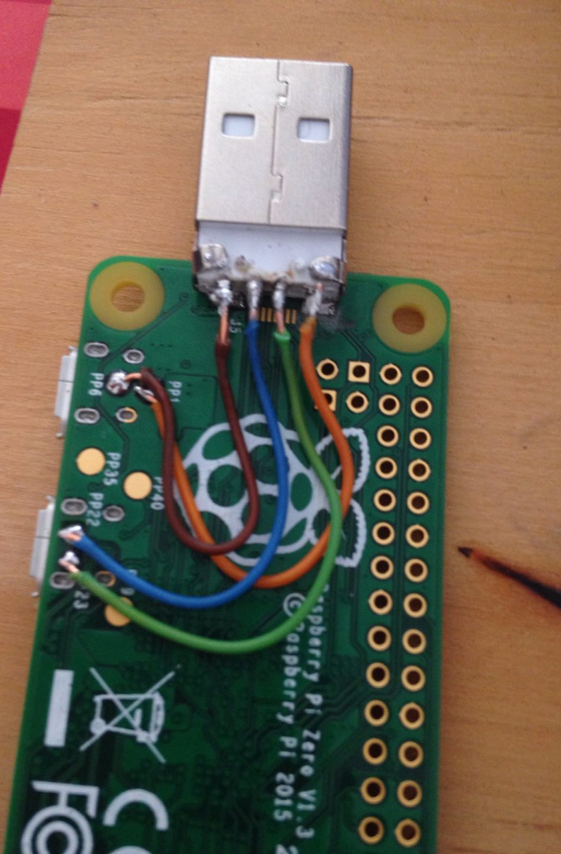

The USB

Slide 12

Pads for easy modding

Slide 13



Safety first: Wear glasses !

Slide 14
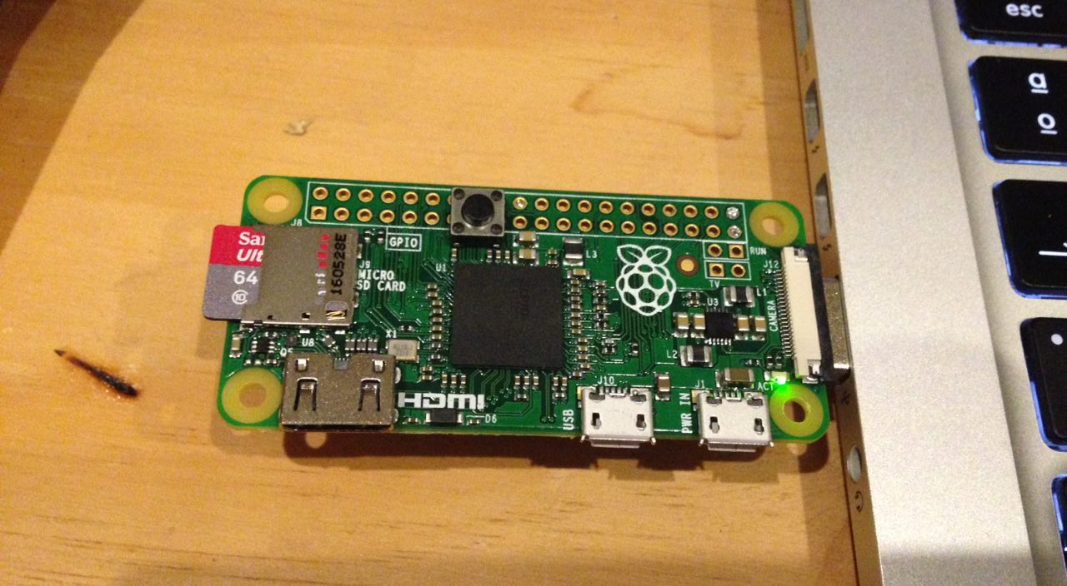
The (power off*) switch

Slide 15
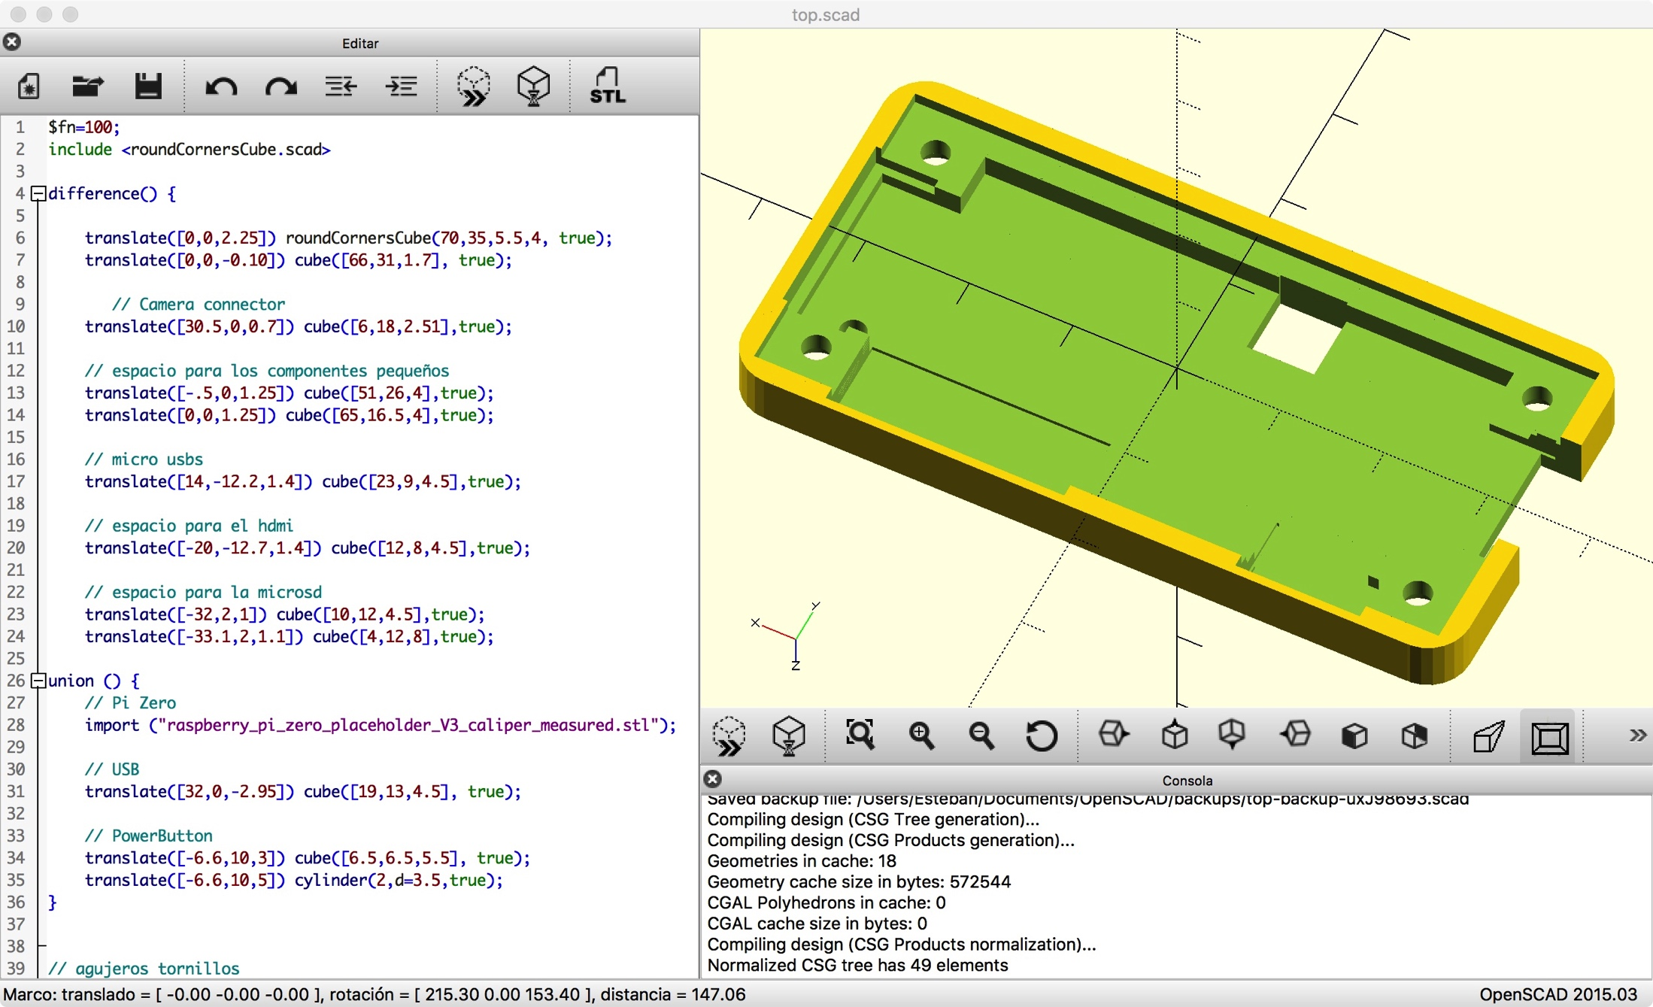
Enclosure design: openscad
https://github.com/Edauksis/ZeroTrustInNet

Slide 16
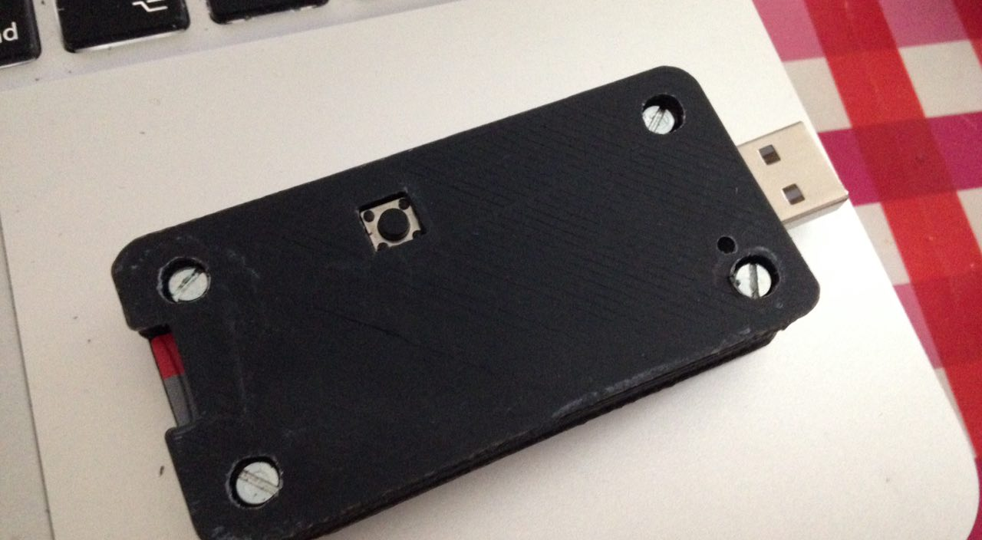
The enclosure

Slide 17
Configure the software
Get a raspbian image and set Ethernet device over USB
Install a DHCP server
All the staff you need (in my case wiki, gogs)
Put a power off script for the switch
novnc
…

Slide 18
Raspberry Pi Zero OTG Mode
https://gist.github.com/gbaman/50b6cca61dd1c3f88f41
echo "dtoverlay=dwc2" >> /boot/config.txt
echo -e "dwc2\ng_ether" >> /etc/modules

Slide 19
Set up network interface
cat /etc/network/interfaces
auto usb0
iface usb0 inet static
address 192.168.44.22
netmask 255.255.255.0
** For initial setup and upgrades**
NAT in host PC
A static route in the Raspberry for the default gw
route add default gw 192.168.44.XXX
DNS, echo “nameserver 8.8.8.8” > /etc/resolv.conf

Slide 20
Apagar.py
Call the script from /etc/rc.local just before exit 0
python /path/apagar.py
import RPi.GPIO as GPIO
import time
import os
GPIO.setmode(GPIO.BCM)
GPIO.setup(24, GPIO.IN, pull_up_down = GPIO.PUD_UP)
def Int_shutdown(channel):
os.system("sudo shutdown -h now")
# it will react on a falling edge and call our interrupt routine "Int_shutdown"
GPIO.add_event_detect(24, GPIO.FALLING, callback = Int_shutdown, bouncetime = 2000)
# do nothing while waiting for button to be pressed
while 1:
time.sleep(1)

Slide 21
Install && configure ISC DHCP
$ cat /etc/dhcp/dhcpd.conf | grep -v ^\#
ddns-update-style none;
option domain-name "local”;
default-lease-time 600;
max-lease-time 7200;
Authoritative;
log-facility local7;
subnet 192.168.44.0 netmask 255.255.255.0 {
range 192.168.44.33 192.168.44.100;
option broadcast-address 192.168.44.255;
}
# cat /etc/default/isc-dhcp-server | grep -v ^\#
INTERFACES="usb0"

Slide 22
Install your favorite services
apt-get install dokuwiki
apt-get install git
git clone https://github.com/gogits/gogs
noVNC https://www.raspberrypi.org/forums/viewtopic.php?t=81165
Etc…

Slide 23
Let me show…
Live DEMO

Slide 24
Questions?

Slide 25
Thank you!

