Slide 1
Business: Vincent
SALE OF CLOTHES FOR KNIGHTS

Slide 2
Team members:
Juan Luis Santamaria Vázquez
Eder Romero Tamariz
Ángel Arturo Ruiz Aguilera
Mauro Emmanuel Vivanco Zayas
Michael Juárez Morales
Emmanuel Barceínas García

Slide 3
Roles of the members
- The team leader: Is responsible for a phase of the project. It has assigned specific tasks in the project. Motivates and organizes the participants. Follows the project and resolves conflicts. - Communication officers: They are the point of contact between the participants. It addresses all questions, conflicts, correspondence, emails, communication between team members and the most qualified people, such as team leader and support person. - Responsible for information: It will be responsible for capturing, recording, reporting, controlling and disseminating the information needed or generated by the equipment. - Responsible for support: It will be in charge of providing logistical support to the activities of the group, that the members learn and use their skills, to train and train the group according to their needs.

Slide 4
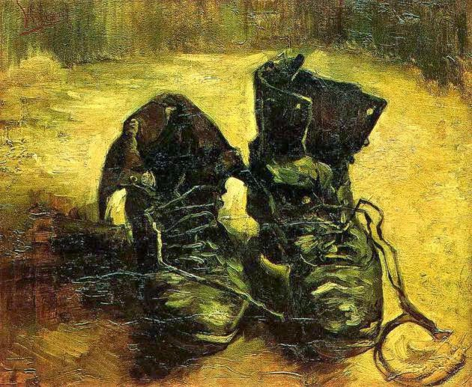
Vincent company
The name of our project is Vincent company
Why did we choose this name?
It is inspired by the painter Vincent Van Gogh, a famous post-impressionist painter. Our company is dedicated to the sale of menswear, of the highest quality and at a low price.

Slide 5
Objective
Our aim as a company is to innovate in the field of men's fashion, creating exclusive and unique designs in your area. With this, we intend to increase the self-esteem of our clients.

Slide 6
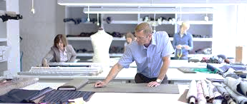
Social impact
With the creation of our company we plan to benefit the textile market. Giving way to a great variety of suppliers of the textile market. Also helping people generate jobs.

Slide 7
System reach
We intend to make a database where all the products and data that the client requests are stored, the database will have an access limit, the administrator will take charge of registering the products and canceling. Customers will only be able to inquire about the prices of the products and provide their personal data.

Slide 8
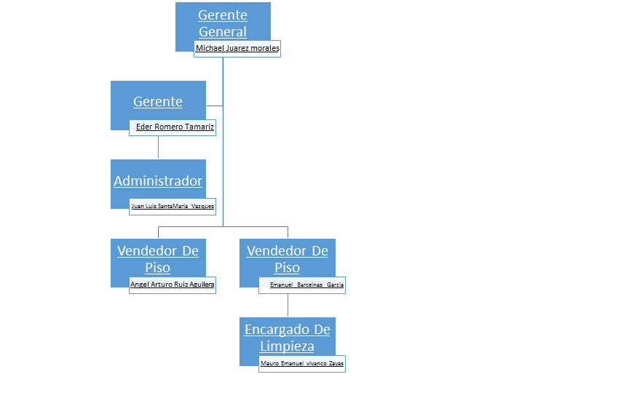
Organization chart

