Slide 1
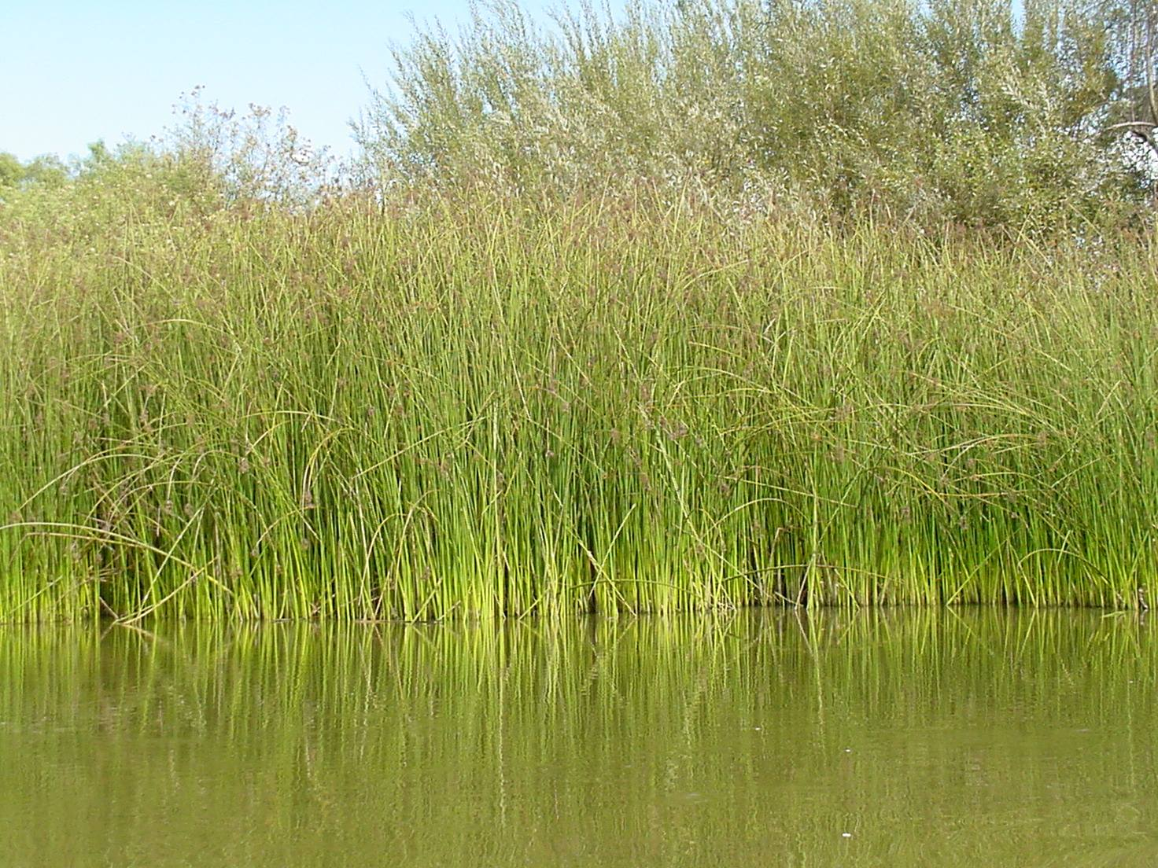
Tules or not tules, that is the question

Slide 2
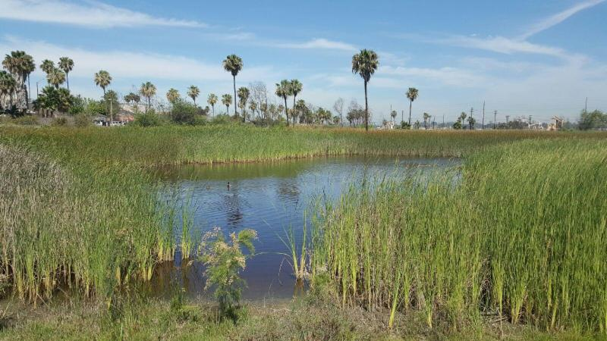
Marketplace Marsh is a freshwater pond on the Los Cerritos Wetlands, a Traditional Tribal Property within the Sacred Site of Puvungna. The Marsh is considered ESHA and enjoys protection as both a biological and tribal coastal resource.

Slide 3
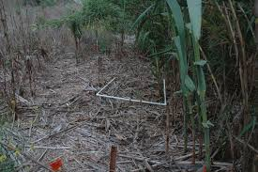
Although the Coastal Act prohibits the use of pesticides and herbicides on native plants and ESHA, the City of Long Beach is requesting a permit to poison the tules in the marsh with the chemical herbicide Imazapyr for the next 5 years.

Slide 4
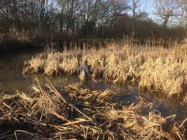
Imazapyr is a broad-spectrum herbicide designed to eradicate entire areas of unwanted vegetation and should not be used in spot applications (as is proposed here) because it leaks out of targeted plant roots and poisons other root systems and soils for a year or more after application.

Slide 5
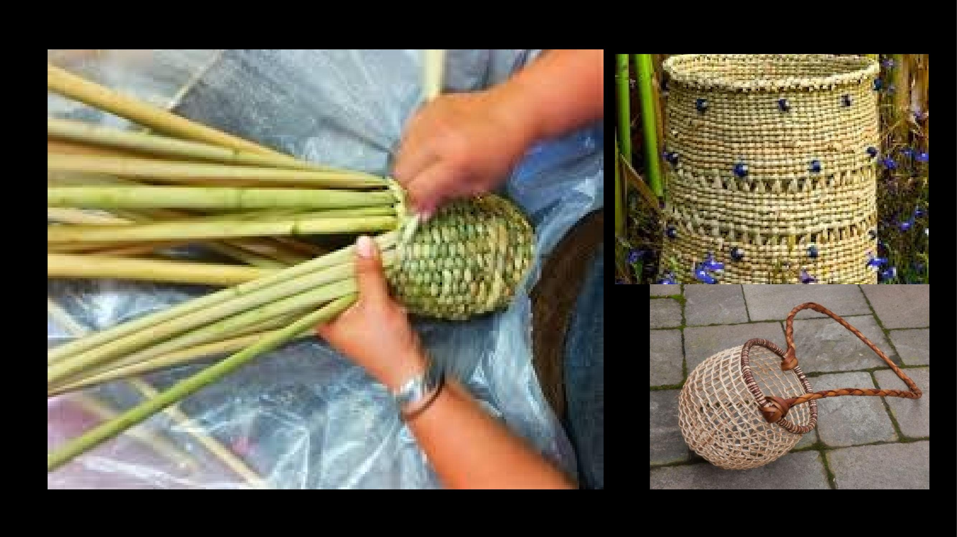
In addition to introducing a toxin into the ecosystem, poisoning native tules impacts the ability of local tribal peoples to maintain and revive cultural and spiritual practices.

Slide 6
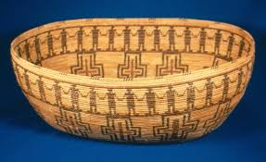
Tribal culture keepers Anthony Morales, Tongva and Rebecca Robles, Acjachemen, and Payoomaawichum Ethnobotanist, Richard Bugbee have formally stated their opposition to the use of Imazpyr at Marketplace Marsh.

Slide 7
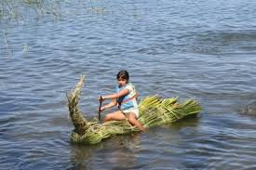
The California Indian Basketweavers Association, the Tribal Pesticide Council, Region 9 EPA, and global Innovative Pesticide Management Programs are all moving forward to end our deadly dependence on chemical toxins to produce our food and to manage our parks and wilderness areas.

Slide 8
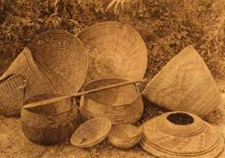
In 1994 the California Indian Basketweavers Association adopted a policy opposing the use of pesticides which states in part that, The web of life that connects all living things is harmed when poisons are applied to our environment. Many of these same plants provide us with our food and teas, are used in baskets and for healing, ceremonial and other traditional purposes. When we harvest and use these plants, or take fish or game, we want to know that they are free of poisons. We want the assurance that we are not endangering our health or that of our children and unborn generations. We condemn the policy of acceptable risk, which maintains that there is an acceptable level of human suffering and environmental degradation that can be balanced out by the benefits of using pesticides.

Slide 9
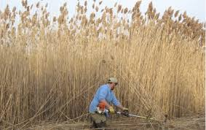
Less harmful alternatives to the application of Imazapyr do exist and must be considered to both retain and expand the open water in the pond and to control the mosquito population.

Slide 10
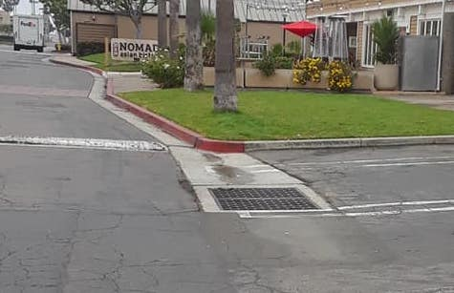
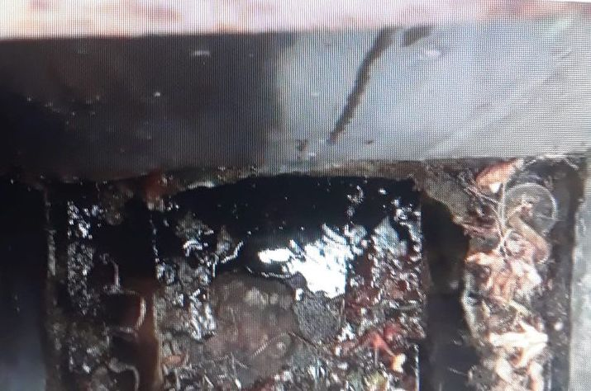
Instead of poisoning the tules the City must identify the source of and regulate or eliminate the continuous flow of nutrient-rich water entering the marsh through a storm drain on the adjoining mall property which ensures the proliferation of both mosquitos and tules.

Slide 11
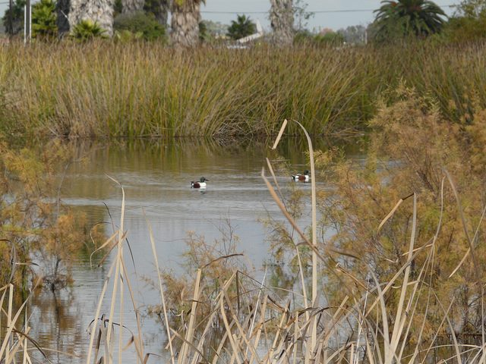
Collaboration between all parties is required to ensure a sustainable future for Marketplace Marsh. Until then some annual trimming and uprooting of the tules, by hand or with machinery, as is being done in our local El Dorado Park and elsewhere, is all that is required to reestablish and maintain a healthy marsh ecosystem.

