Slide 1
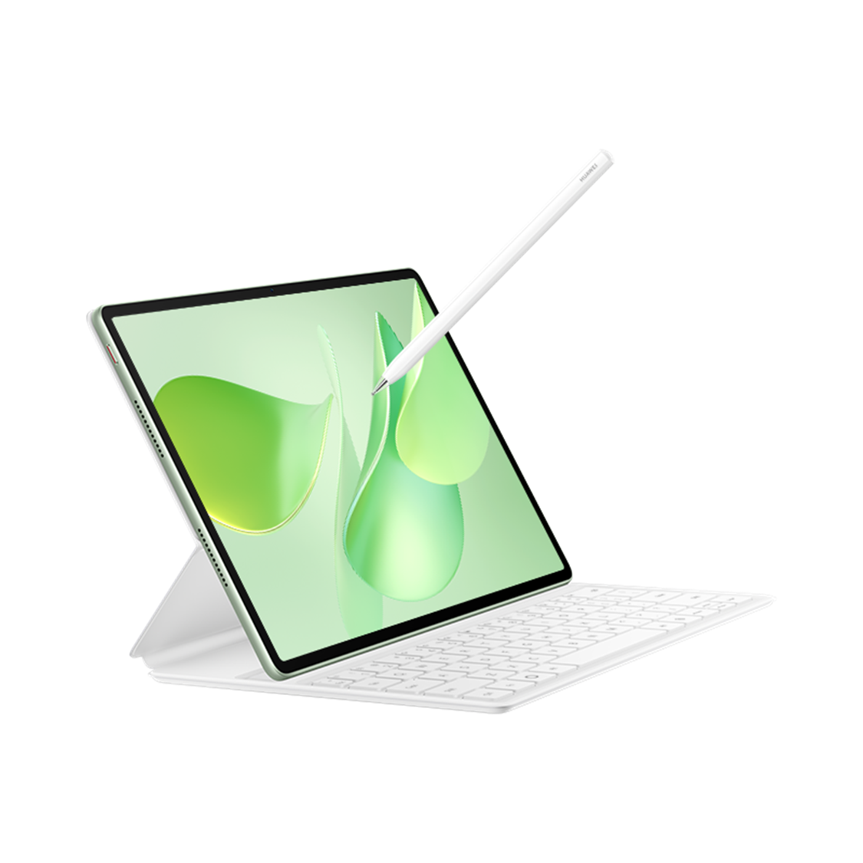
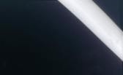
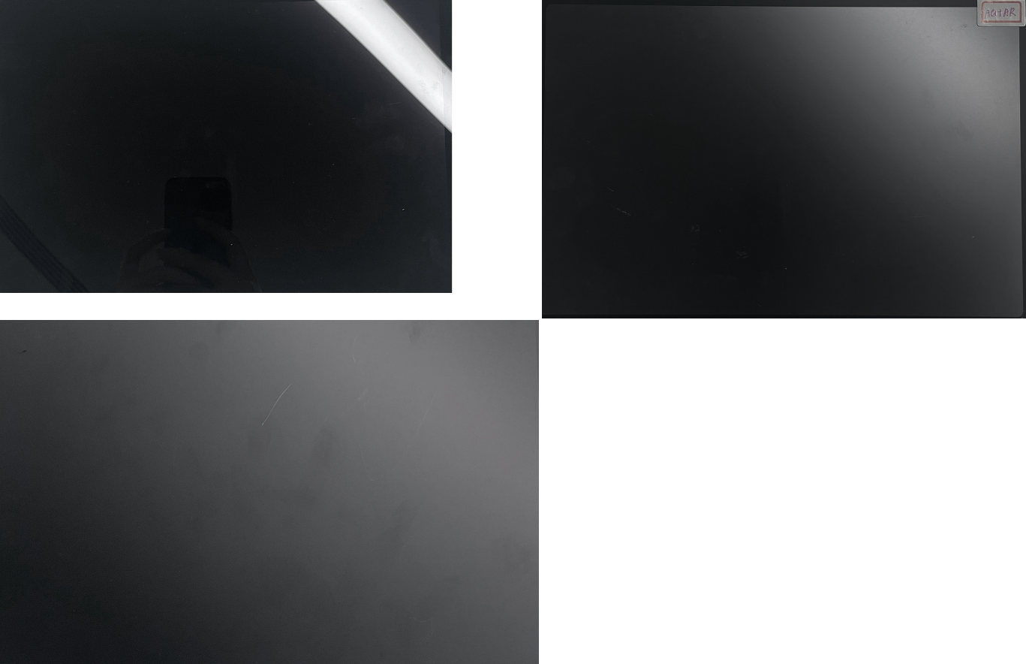
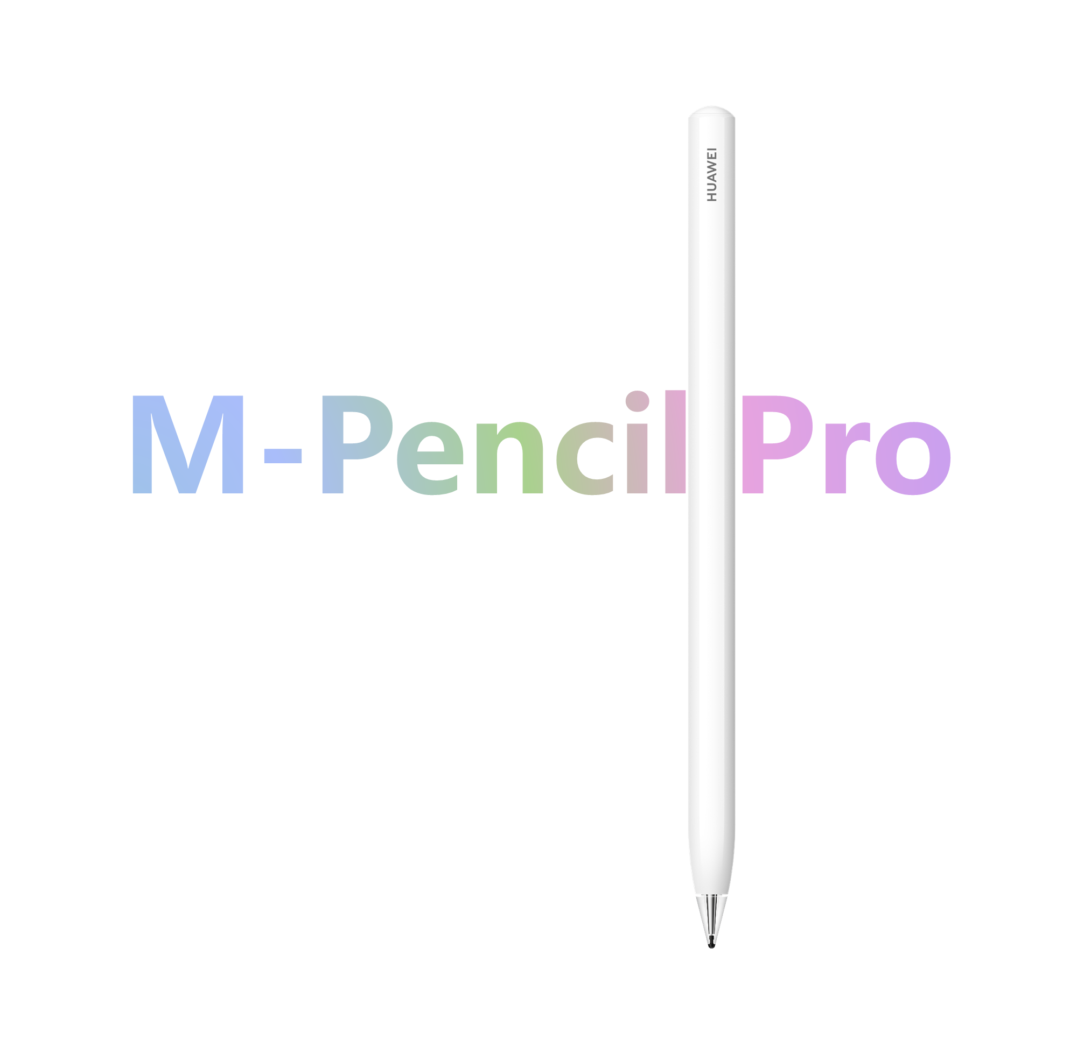
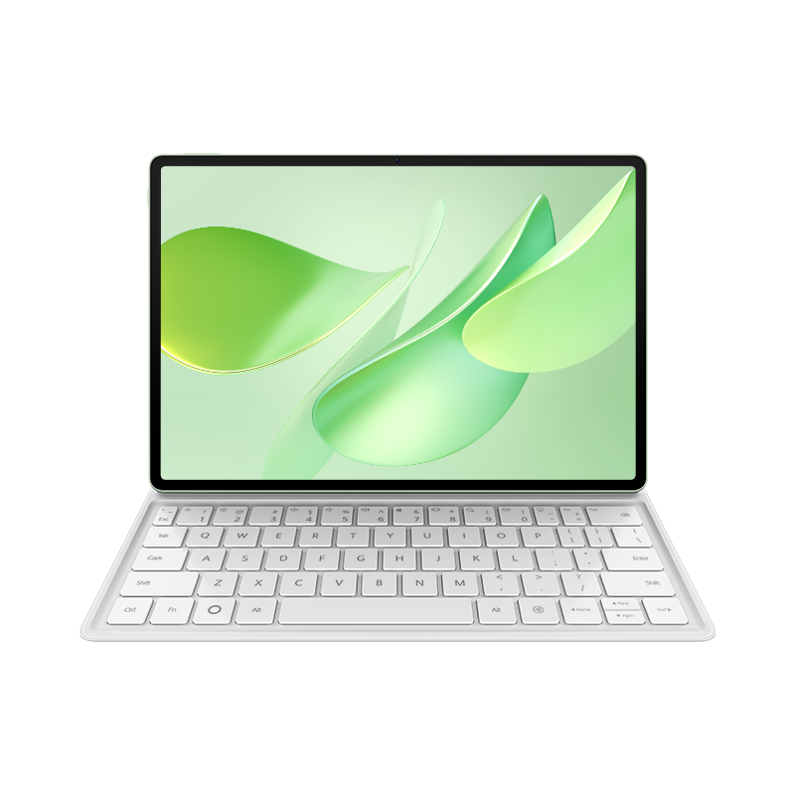
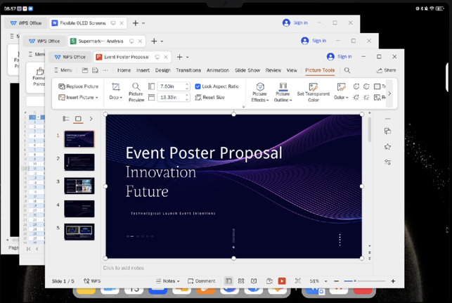
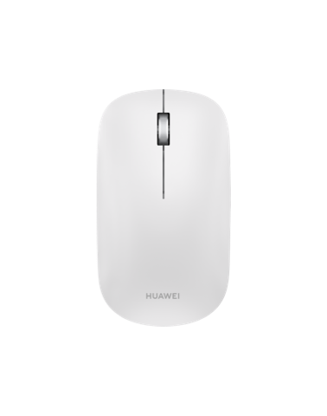
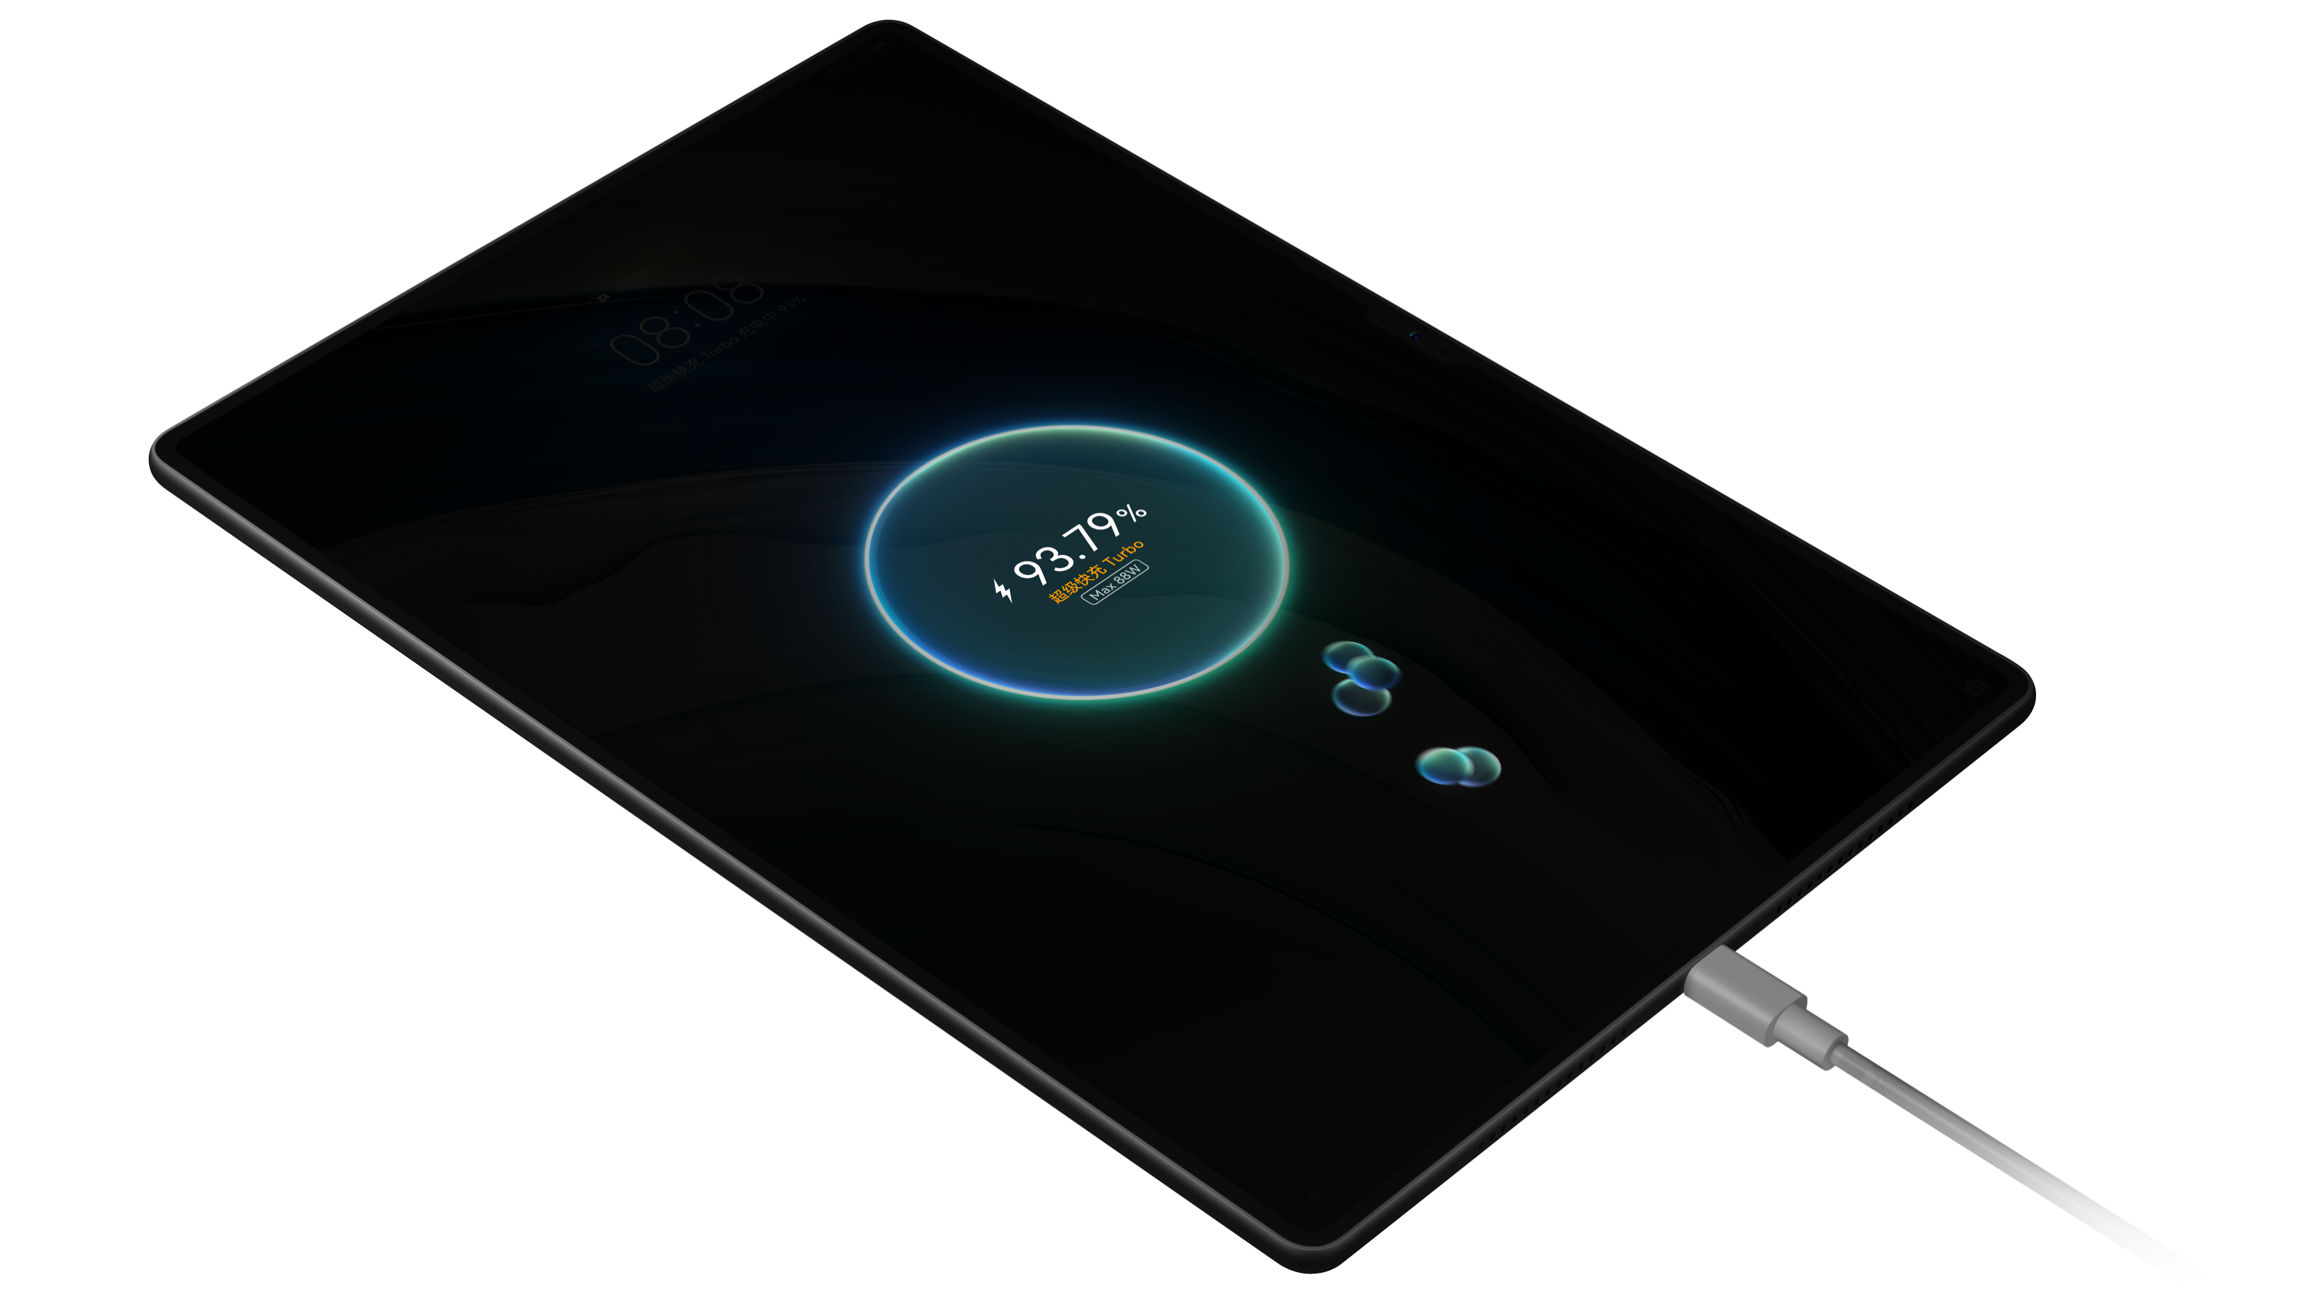
SAY
HUAWEI MatePad 12 X
IN-STORE TRAINING
One Sentence Introduction
HUAWEI MatePad 12 X is a productivity-oriented tablet designed for younger. It is fashion and lightweight, and comes with the ultra-clear PaperMatte display, professional M-Pencil Pro, and flagship-level performance to boost your productivity. Please have a try!
Key Selling Points
① Ultra-clear PaperMatte Display that enhance eye comfort and clear images：
With our PaperMatte Display, you get ultra-clear, glare-free viewing in any light. Whether you’re by a sunlit plane window or relaxing on the sofa under a bright lamp, reflections won’t get in the way.
It also reduces screen sparkle by 50%, keeping your eyes comfortable while still delivering a full UHD experience.
*Recommended to say with Demo 2
VS
Normal screen
Ultra-clear
PaperMatte Display
② Professional Stroke & Considerate Stylus Controlling
Our all-new M-Pencil Pro comes with three pen tips, including a carbon fiber one that feels just like a real pencil. Paired with the PaperMatte Display, it delivers an authentic pencil-on-paper writing experience.
It also has smart interactions: pinch to open menus in HUAWEI Notes or GoPaint, and tap the tail button once to launch your favorite app instantly.
*Recommended to say with Demo 3
③ PC-level Productivity, a perfect companion on the go
With MatePad 12 X and its ultra-light keyboard—the thinnest and lightest in its class—plus exclusive PC-level WPS and the HUAWEI Mouse, you can finally leave the bulky laptop and charger behind on business trips and travel light.
*Recommended to say with Demo 4
④ Say goodbye to power anxiety
The 10,100 mAh battery sustains up to 14 hours of video playback. When the tablet's official 66 W SuperCharge charger is used, the battery rockets to 100% in less than 1.5 hours.
This Material is for Internal Use Only and should not be used for Media Presentations or, Consumer Training without prior written consent

Slide 2
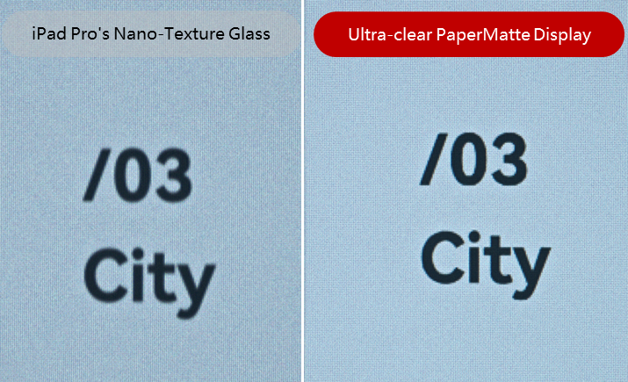
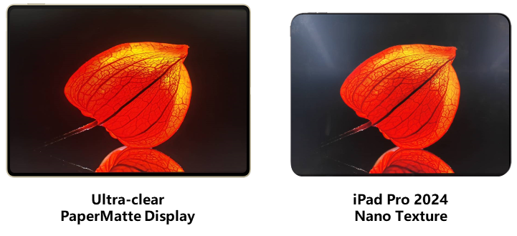
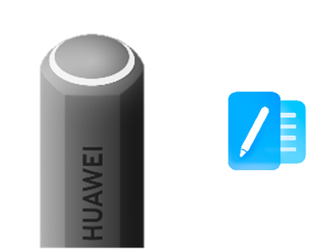
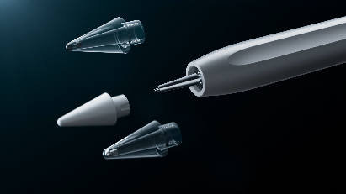
COMPETE
HUAWEI MatePad 12 X
IN-STORE TRAINING
Key Attack Points vs iPxx Air 11
① Brighter, clearer, and more eye-comfort display:
With a PaperMatte Display, which you won’t find on the iPxx Air, MatePad 12 X delivers crystal-clear detail without the glare. Even compared to the iPad Pro, it stands out with superior anti-glare and much less sparkle to enhance clarity, keeping your eyes comfortable for hours whether you're reading by the window or sketching ideas late at night.
② More professional stroke & instant access:
Some may think the Axx Pencil Pro stands out with fun interactions—but the M-Pencil Pro goes further, delivering smarter instant access and professional-grade strokes. With its exclusive quick button on the tail, you can launch any app you choose in a single tap. Plus, it comes with three pen tips to fit all your creative needs. These are experiences the Axx simply can’t match.
③ Faster charging and longer battery life:
While iPxx Air charges at a maximum of 20 W, taking 2.5 hours to fully charge, our tablet features 66 W SuperCharge, fully charging in less than 1.5 hours and offering a battery life of a whole day. With MatePad 12 X, you can work or study from dawn to dusk.
Core Specs
Screen: 1000 nits peak brightness, 2.8K resolution, 144 Hz adaptive refresh rate, and P3 wide color gamut.
Sound quality: 6 speakers with clear high/low frequency division and HUAWEI SOUND.
Weight: 555 g, thin to 5.9 mm; 863 g (with the ultra-sleek NearLink keyboard that weighs at 308 g)
Charging and battery life: 10,100 mAh battery, 66 W SuperCharge, and 14 hours of local video playback.
System: HarmonyOS 4.3
This Material is for Internal Use Only and should not be used for Media Presentations or, Consumer Training without prior written consent
Notes:
图片改成PNG

Slide 3
RESPOND
HUAWEI MatePad 12 X
IN-STORE TRAINING
Frequently Asked Questions
1. What’s the difference between the new MatePad 12 X 2025 and the previous generation?
The MatePad 12 X 2025 brings major upgrades in display, performance, and connectivity. It now features an ultra-clear PaperMatte Display that’s both eye-friendly and clear; performance has been boosted by 27% with flagship-level performance; and Wi-Fi has been upgraded from Wi-Fi 6 to Wi-Fi 7 for a faster, more stable connection.
2. Should I choose the standard display or the PaperMatte display on MatePad 12 X 2025?
Both deliver excellent visuals and eye comfort—the main difference lies in the viewing experience.
The standard display offers vivid colors and crisp detail, perfect for watching movies or scrolling TikTok. The PaperMatte display reduces glare, staying clear even under strong light, and with its paper-like texture, it gives you a natural, pen-on-paper feel when writing or drawing.
3. How should I choose between MatePad 12 X and MatePad Pro 12.2?
Both are highly praised, but they target different needs. The 12 X is a “light flagship,” while the Pro is the top flagship.
The MatePad Pro 12.2 delivers the best performance, with a Tandem OLED display that reduces glare and protects your eyes—ideal for business, office use, or professional creation.
The MatePad 12 X also has flagship-level powerful performance, flagship-level long battery life, and the ultra-clear PaperMatte Display that’s sharp yet eye-friendly, plus trendy color options. If your focus is light office work or study, the 12 X is the better choice.
4. What’s the difference between MatePad 12 X and MatePad 11.5 S?
The MatePad 12 X is a light flagship, offering flagship-level performance, a 12-inch high-brightness high-refresh display, and a 10,100 mAh large battery. If you prefer a bigger screen, stronger performance, and longer endurance, the 12 X is recommended.
The MatePad 11.5 S is compact yet well-equipped to handle everyday study and entertainment. If you prefer a smaller, lighter device and don’t need as much performance power, the 11.5 S is also a great choice.
This Material is for Internal Use Only and should not be used for Media Presentations or, Consumer Training without prior written consent

Slide 4
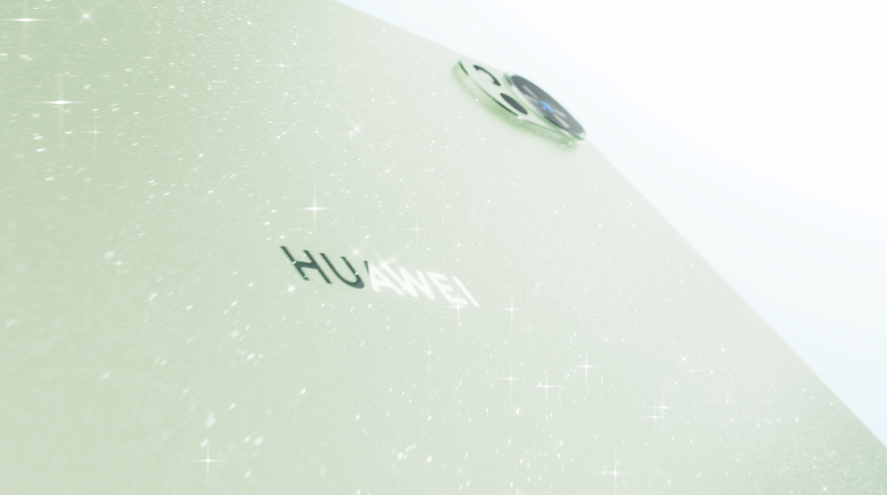



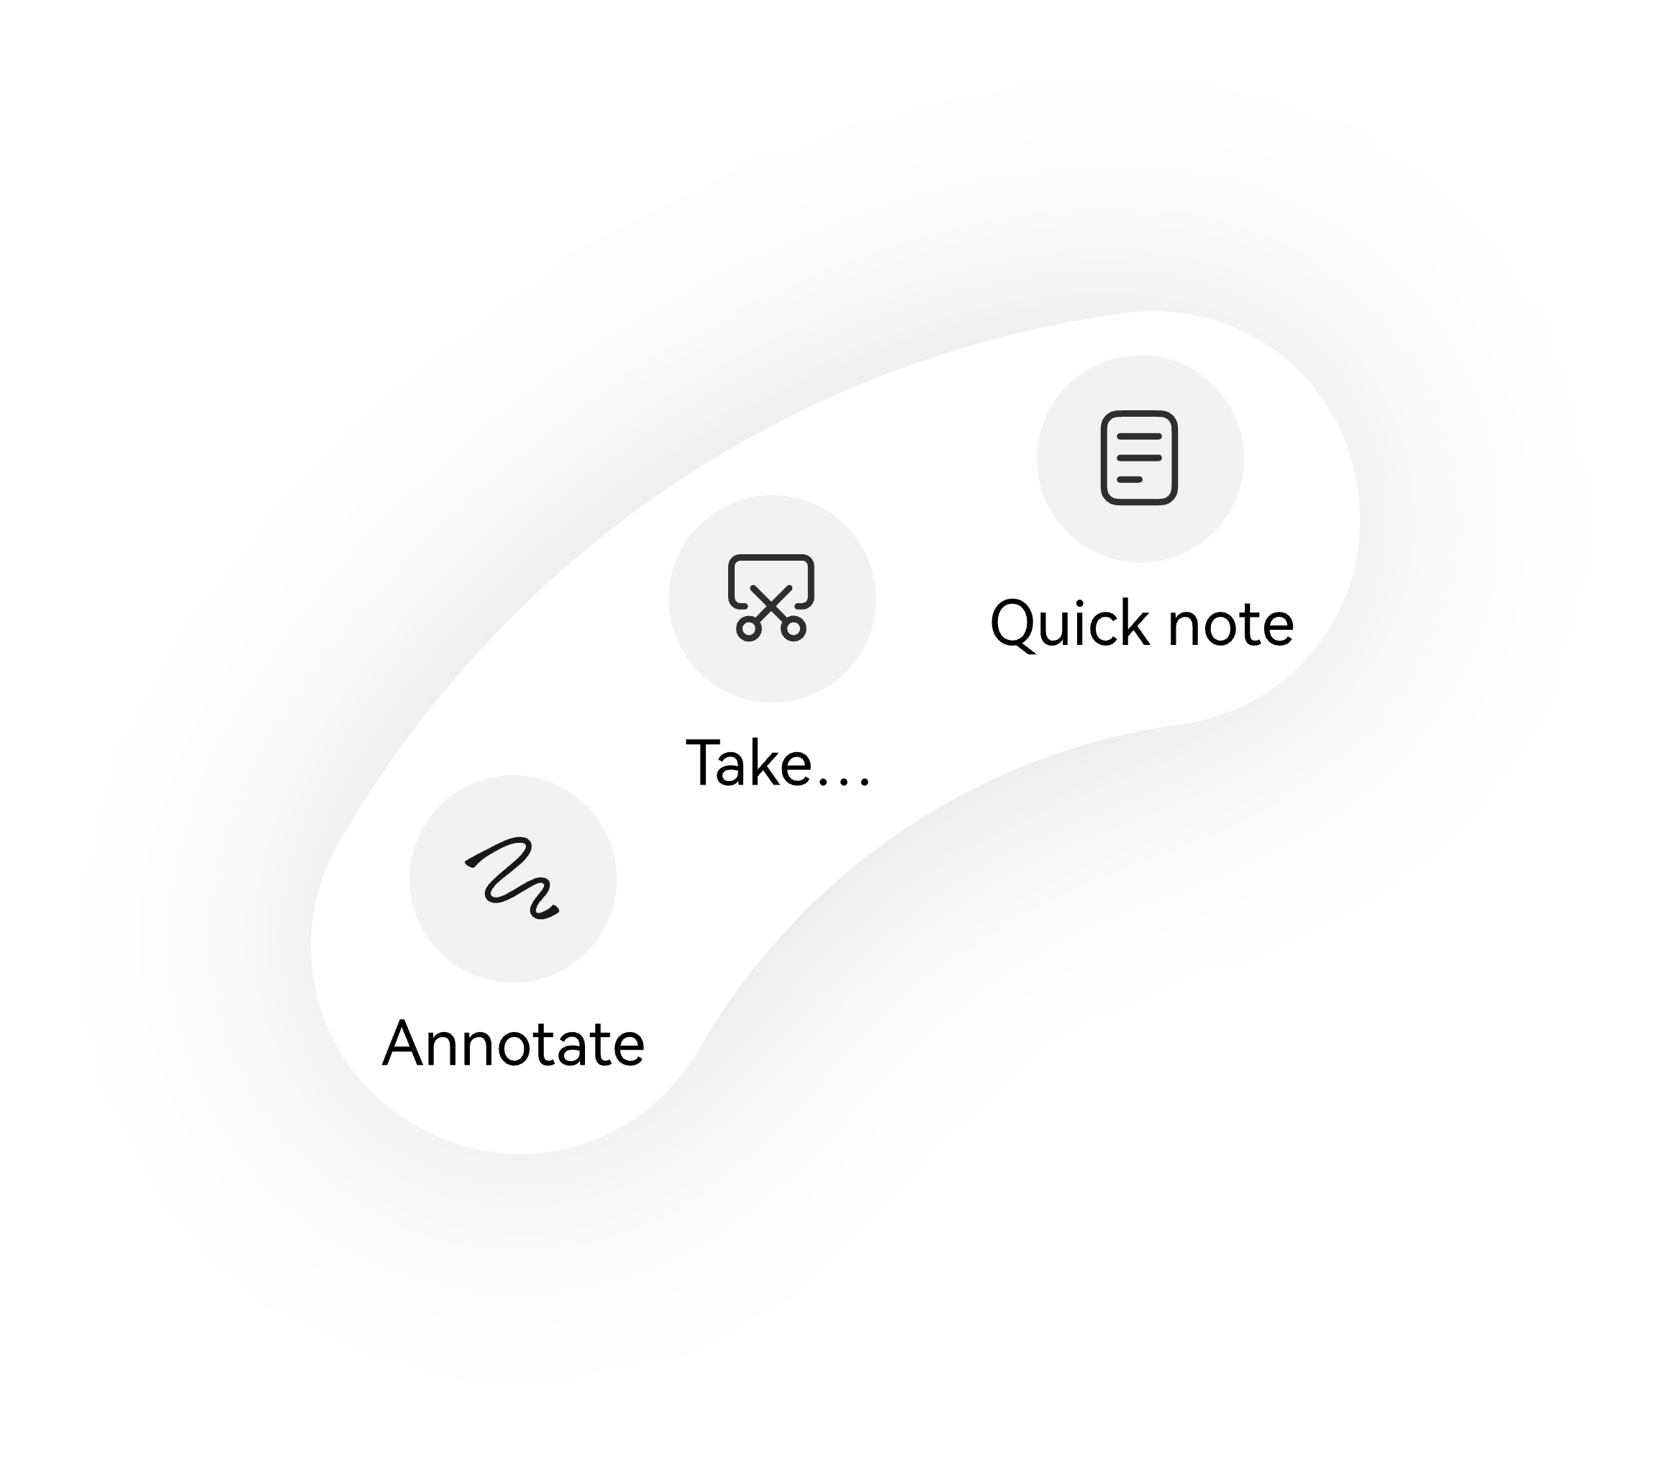
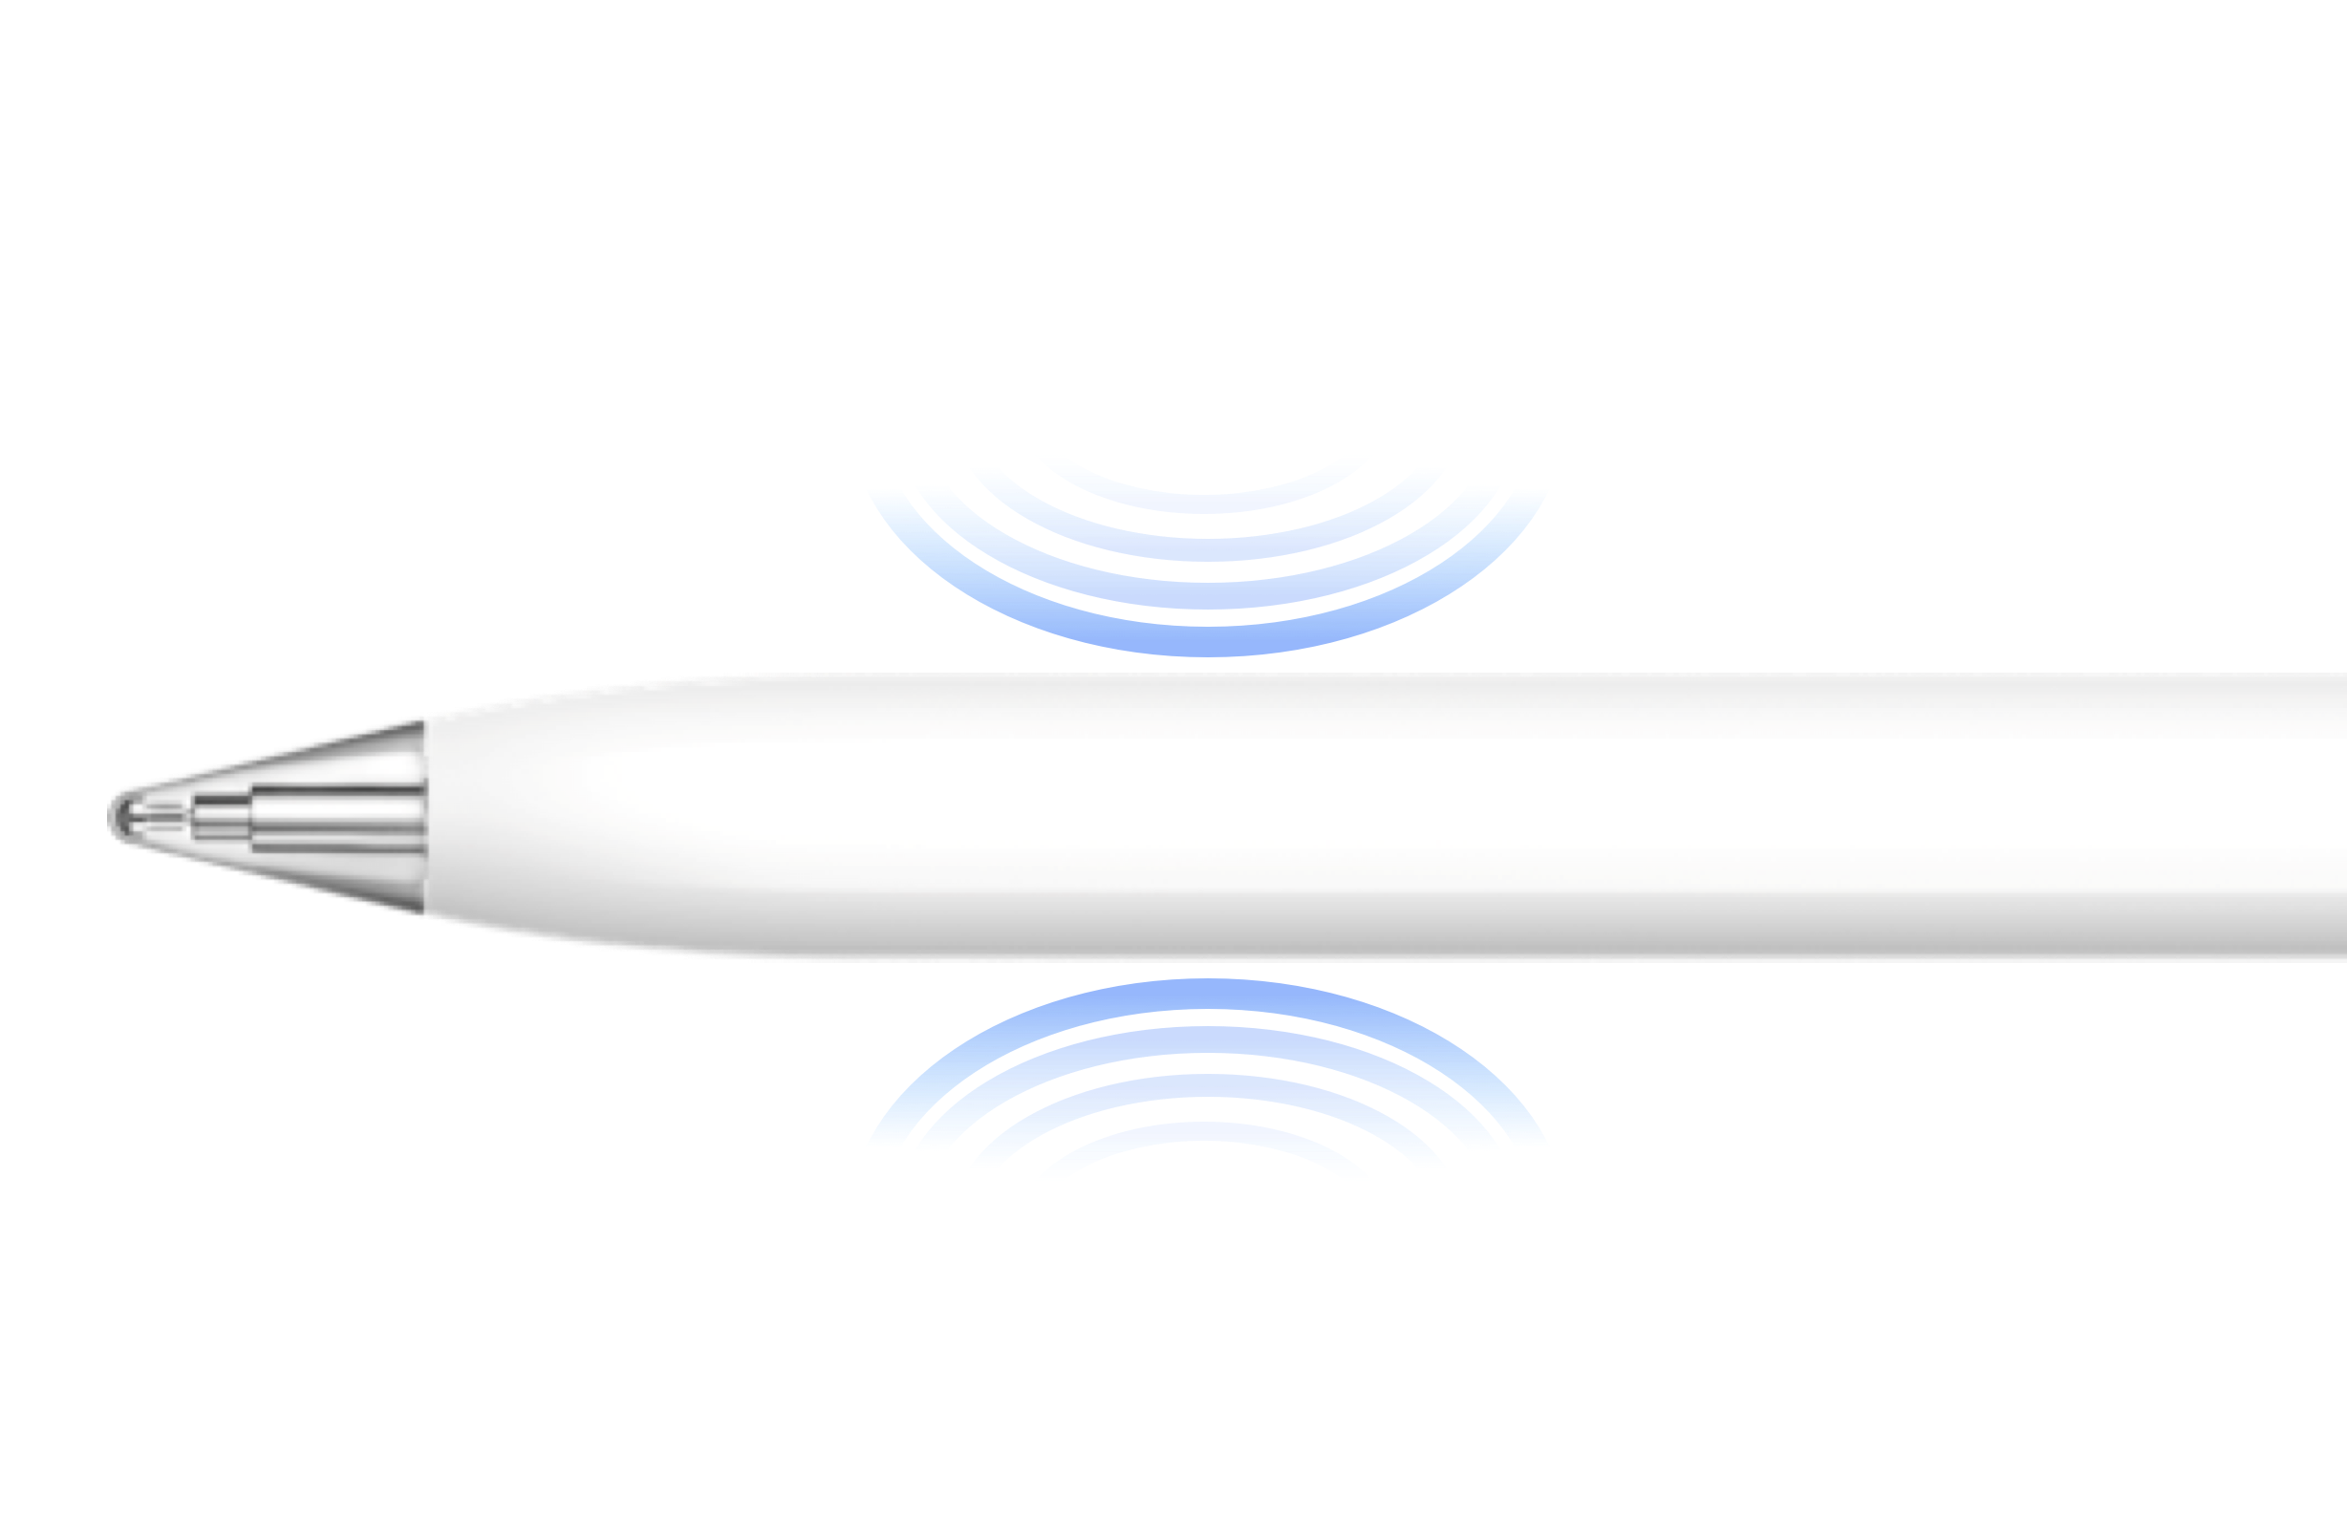
SHOW
HUAWEI MatePad 12 X
IN-STORE TRAINING
Key Demo
Demo 1: Pearlescent Sheen design
Demo 2: Ultra-clear PaperMatte Display
Shine: Invite the customer to look at the glitter on back of the tablet when you shine a flashlight on it.
Shine: Shine a light on the screen to show the anti-glare effect
Watch: Watch the HD video
Compare: Compare the anti-sparkle effect in the retail demo
Demo 3: M-Pencil Pro
Demo 4: PC-level Productivity
Pinch: Open GoPaint and pinch the stylus between your thumb and finger
Draw: Click Marker brush to draw in GoPaint
Tap: Tap the pen tail button
Weigh: Weigh the tablet and keyboard
Insert: Open PC-level WPS and insert a table of contents in a document
Set: Set complex animations in a PowerPoint
Create: Create a Pivot Table in SpreadSheet
This Material is for Internal Use Only and should not be used for Media Presentations or, Consumer Training without prior written consent

