Slide 1


Slide 2
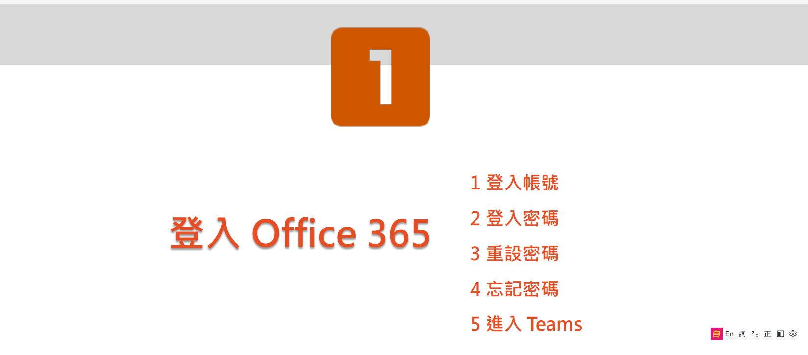

Slide 3
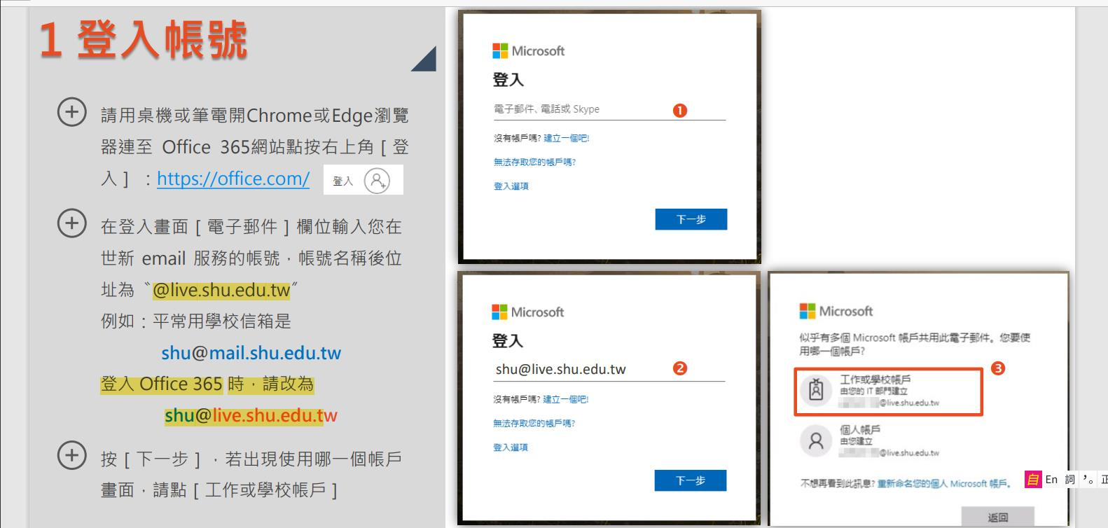

Slide 4
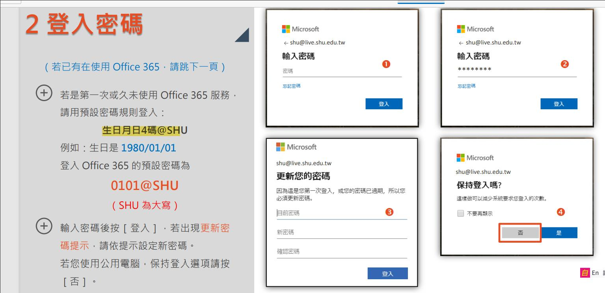

Slide 5
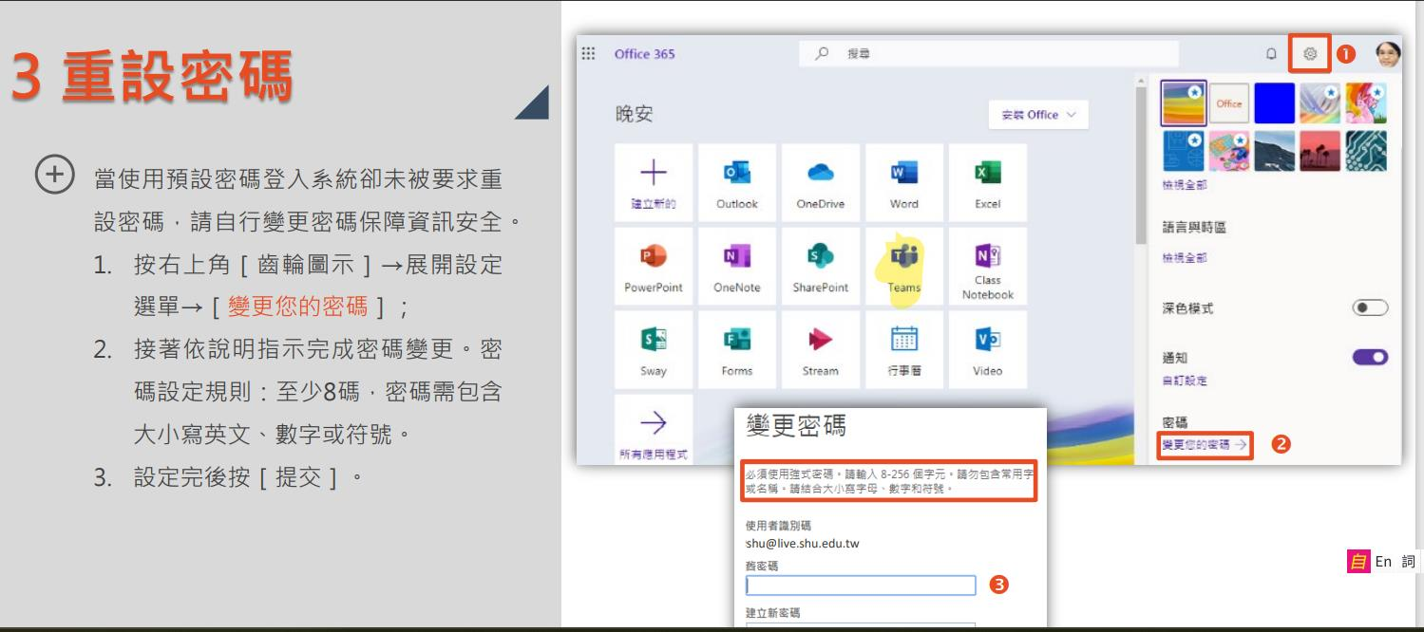

Slide 6
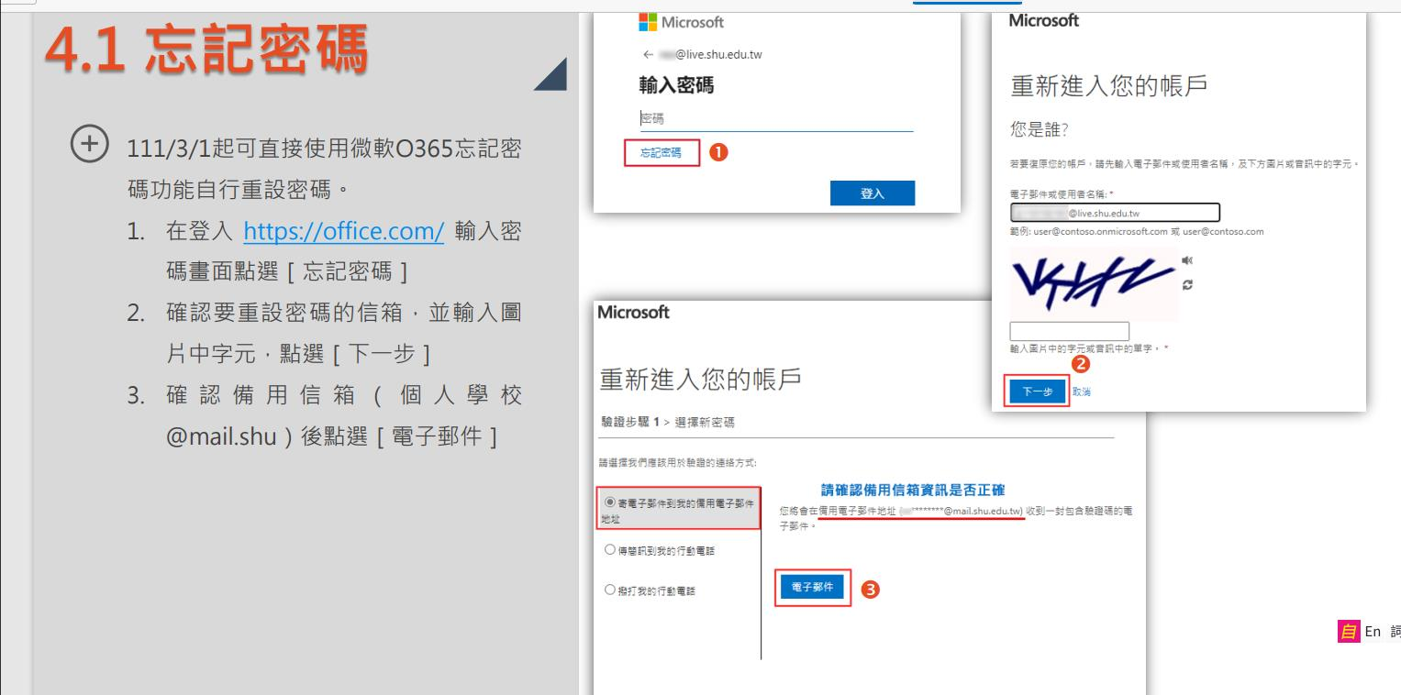

Slide 7
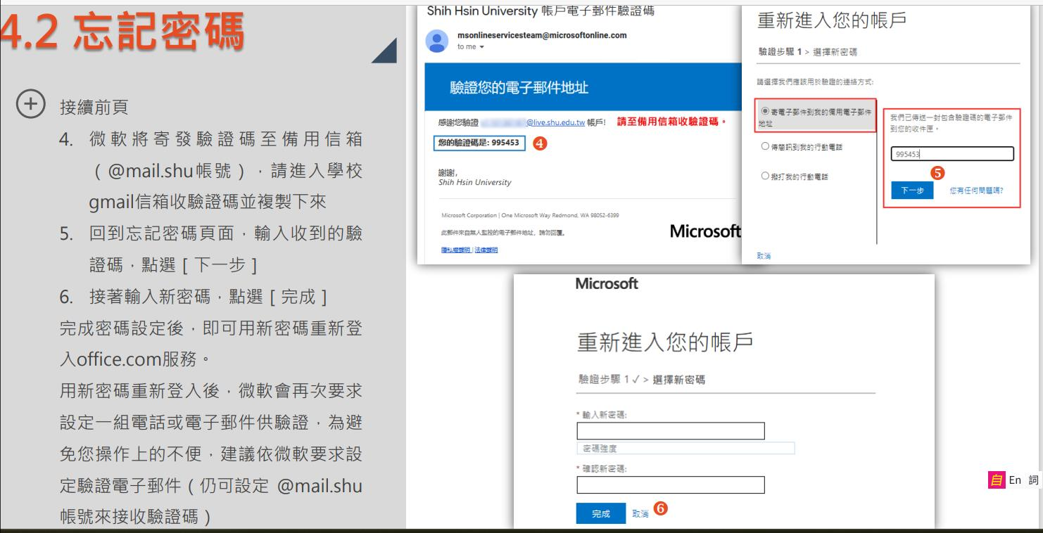

Slide 8
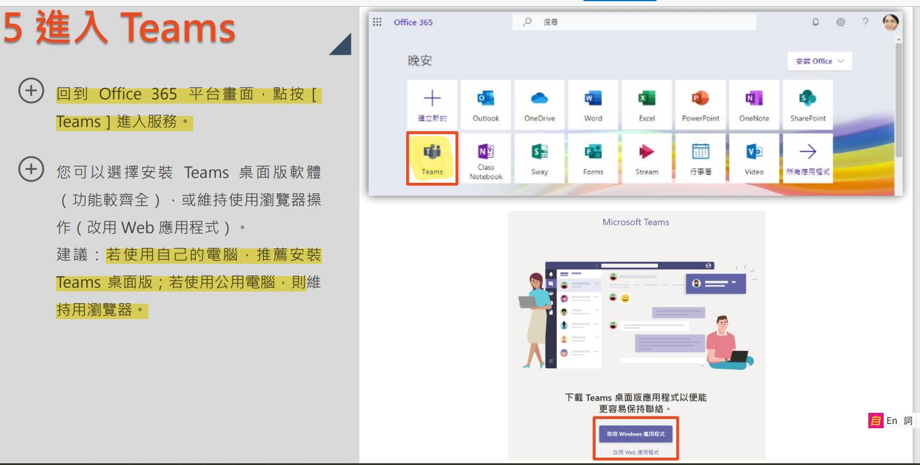

Slide 9
加入課程團隊
請按課程連結

Slide 10
運算思維與程式設計(Thinking)
https://teams.microsoft.com/l/team/19%3aElBwOAHcNMUBMejqUcnRs_rr-J0jKpEQ-Iy22ckhxQk1%40thread.tacv2/conversations?groupId=2d13b1a7-ca83-4e91-bdf0-ff07e61f1643&tenantId=4a28fc97-b766-4520-8a32-79999f14dfcb

Slide 11
電腦軟體應用(Basic R)
https://teams.microsoft.com/l/team/19%3aIlTmD7Bk4q2fxDLPAPpuxY2spsyLEa-dbnKSa0h4Wyk1%40thread.tacv2/conversations?groupId=0a3c85ad-84b3-463b-8c6e-cd7ae1071753&tenantId=4a28fc97-b766-4520-8a32-79999f14dfcb

Slide 12
批准加入團隊後，照以往的方式進入
MS Teams 連結網址

