Slide 1
SAT-RAR
B07901020劉昀昇

Slide 2
Outline
Introduction
Backgorund
Fault model & Fault testability
Mandatory assignment
Necessary condition for redundant wire
General Idea
Algorithm
Implementation Issues

Slide 3
Backgound
Fault Model
s-a-0
s-a-1
Fault Testability
A fault is untestable if the fault can not be sensitized or be propagated to outputs

Slide 4
Background
Mandatory asssignment (MA)
Logic implication on (1. fualt sensitization, 2. fault propagation)
MA is the union of (1.) and (2.)
They are only necessary conditions

Slide 5
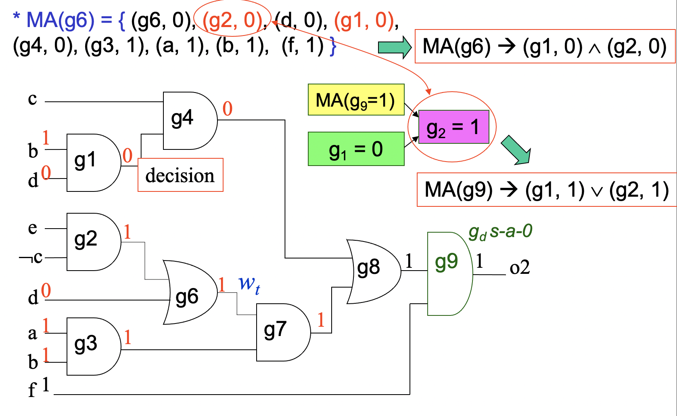
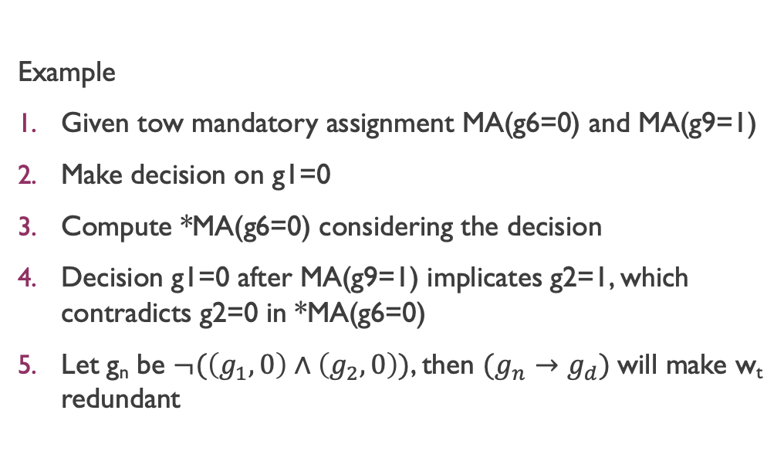
Background
Example
Given tow mandatory assignment MA(g6=0) and MA(g9=1)
Make decision on g1=0
Compute *MA(g6=0) considering the decision
Decision g1=0 after MA(g9=1) implicates g2=1, which contradicts g2=0 in *MA(g6=0)
Let g_{n} be $¬(\left(g_{1},0\right)∧\left(g_{2},0\right))$, then $(g_{n}→g_{d})$will make w_{t} redundant

Slide 6
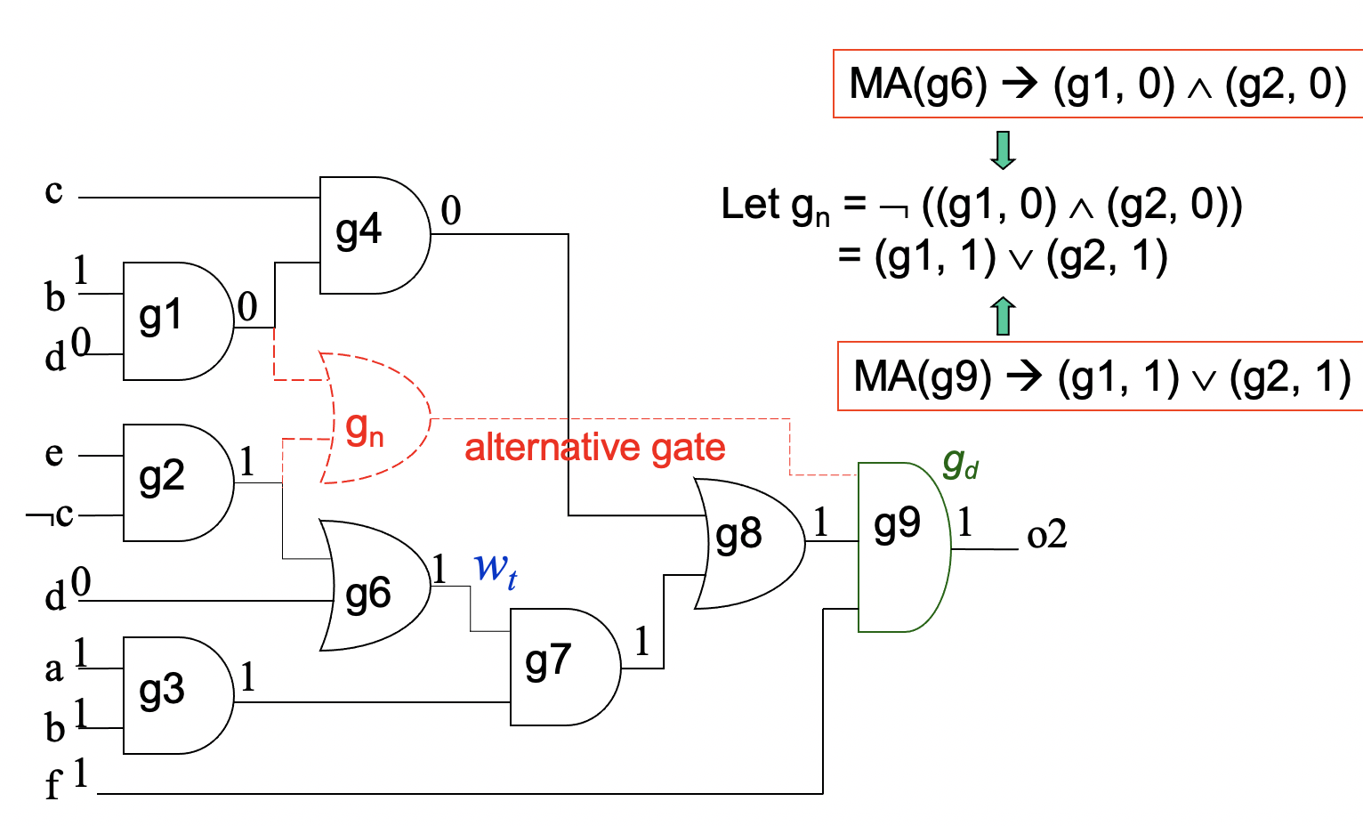
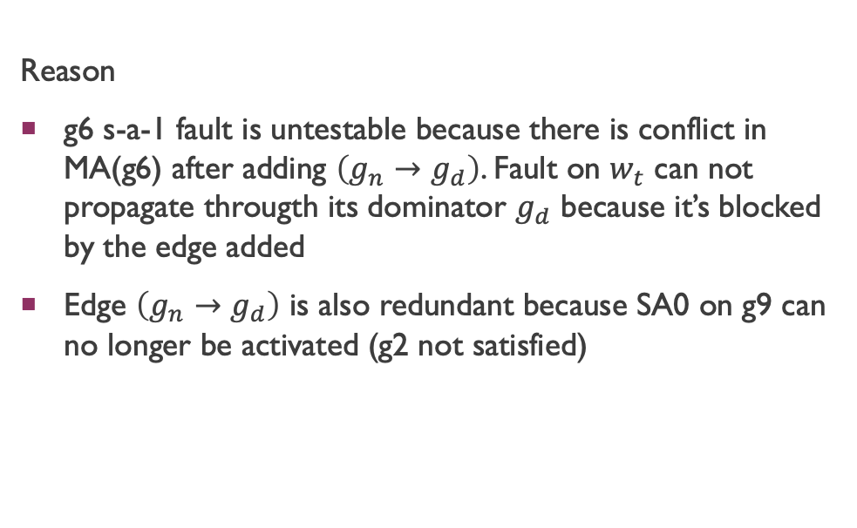
Background
Reason
g6 s-a-1 fault is untestable because there is conflict in MA(g6) after adding $\left(g_{n}→g_{d}\right)$. Fault on $w_{t}$ can not propagate througth its dominator $g_{d}$ because it’s blocked by the edge added
Edge $\left(g_{n}→g_{d}\right)$ is also redundant because SA0 on g9 can no longer be activated (g2 not satisfied)

Slide 7
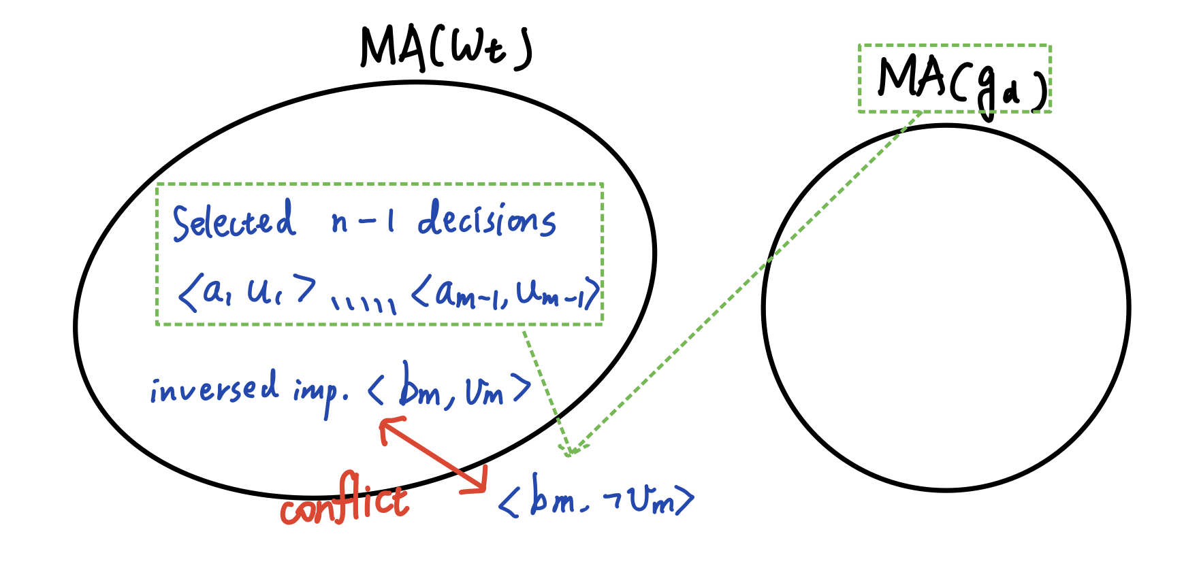
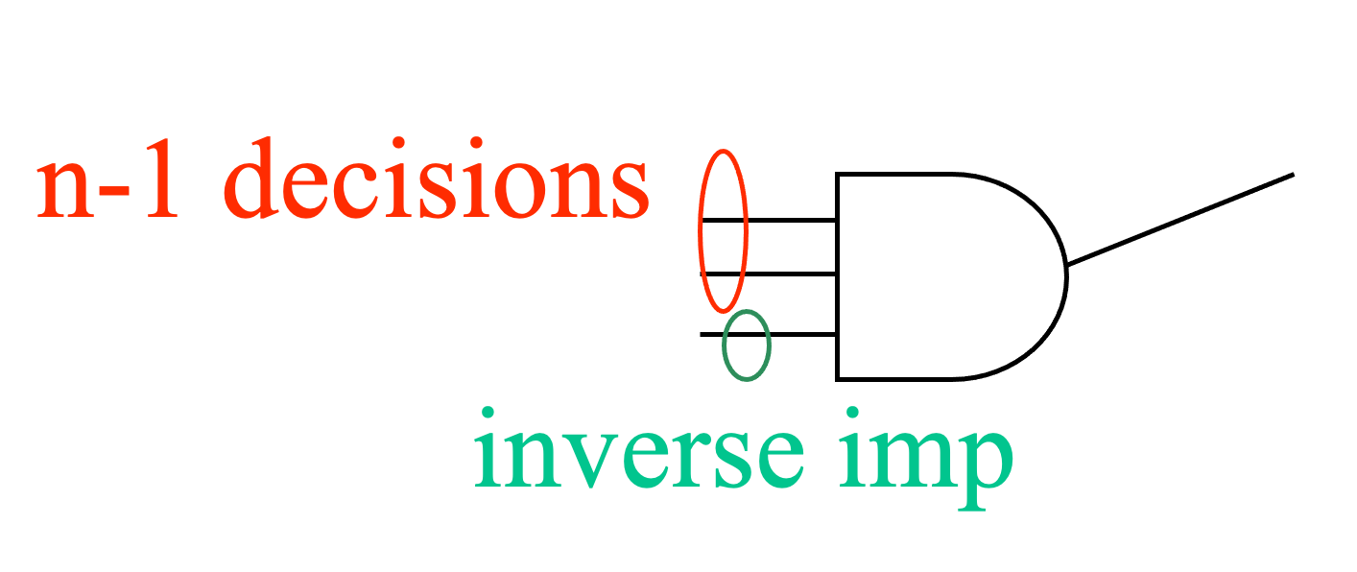
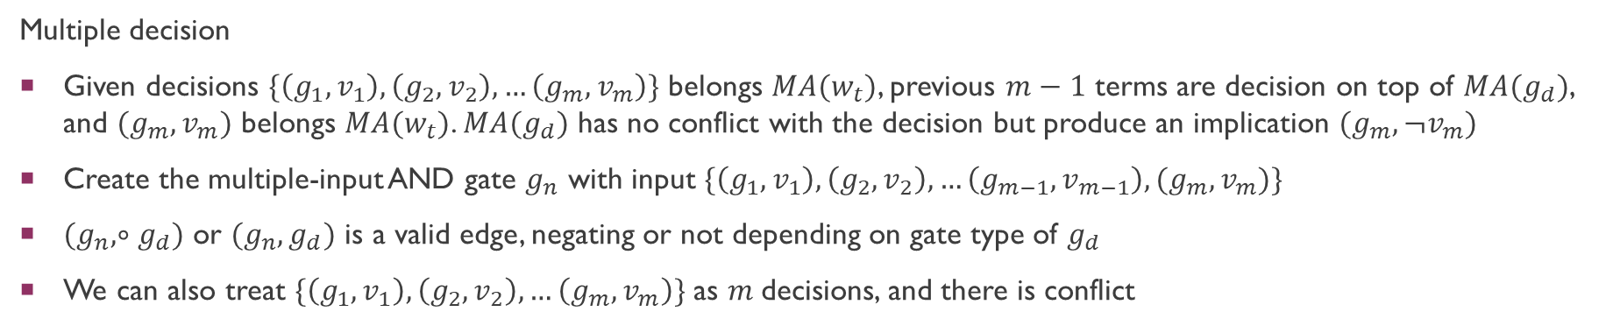
Background
Multiple decision
Given decisions $\{\left(g_{1},v_{1}\right),\left(g_{2},v_{2}\right),…\left(g_{m}, v_{m}\right)\}$ belongs $MA(w_{t})$, previous $m−1$ terms are decision on top of $MA(g_{d})$, and $(g_{m}, v_{m})$ belongs $MA(w_{t})$. $MA(g_{d})$ has no conflict with the decision but produce an implication $(g_{m}, ¬v_{m})$
Create the multiple-input AND gate $g_{n}$ with input $\{\left(g_{1},v_{1}\right),\left(g_{2},v_{2}\right),…\left(g_{m−1}, v_{m−1}\right),(g_{m}, v_{m})\}$
$(g_{n}, ∘g_{d})$ or $(g_{n}, g_{d})$ is a valid edge, negating or not depending on gate type of $g_{d}$
We can also treat $\{\left(g_{1},v_{1}\right),\left(g_{2},v_{2}\right),…\left(g_{m}, v_{m}\right)\}$ as $m$decisions, and there is conflict

Slide 8
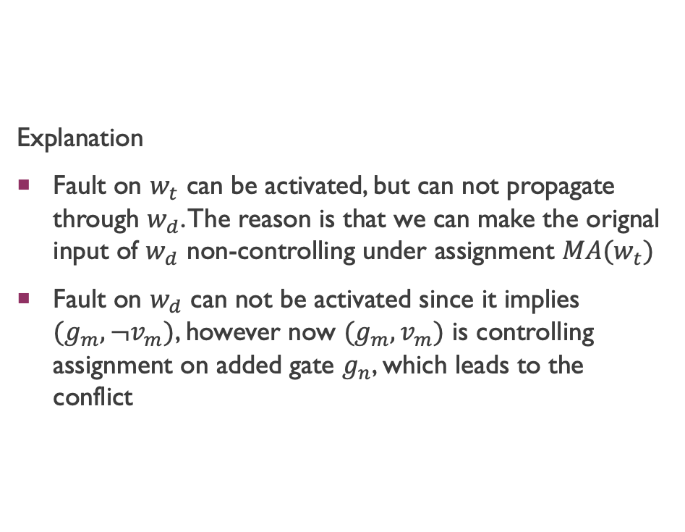
Background
Explanation
Fault on $w_{t}$ can be activated, but can not propagate through $w_{d}$. The reason is that we can make the orignal input of $w_{d}$ non-controlling under assignment $MA(w_{t})$
Fault on $w_{d}$ can not be activated since it implies $(g_{m}, ¬v_{m})$, however now $(g_{m}, v_{m})$ is controlling assignment on added gate $g_{n}$, which leads to the conflict
decision
Inversed imp.
SA0
SA1

Slide 9
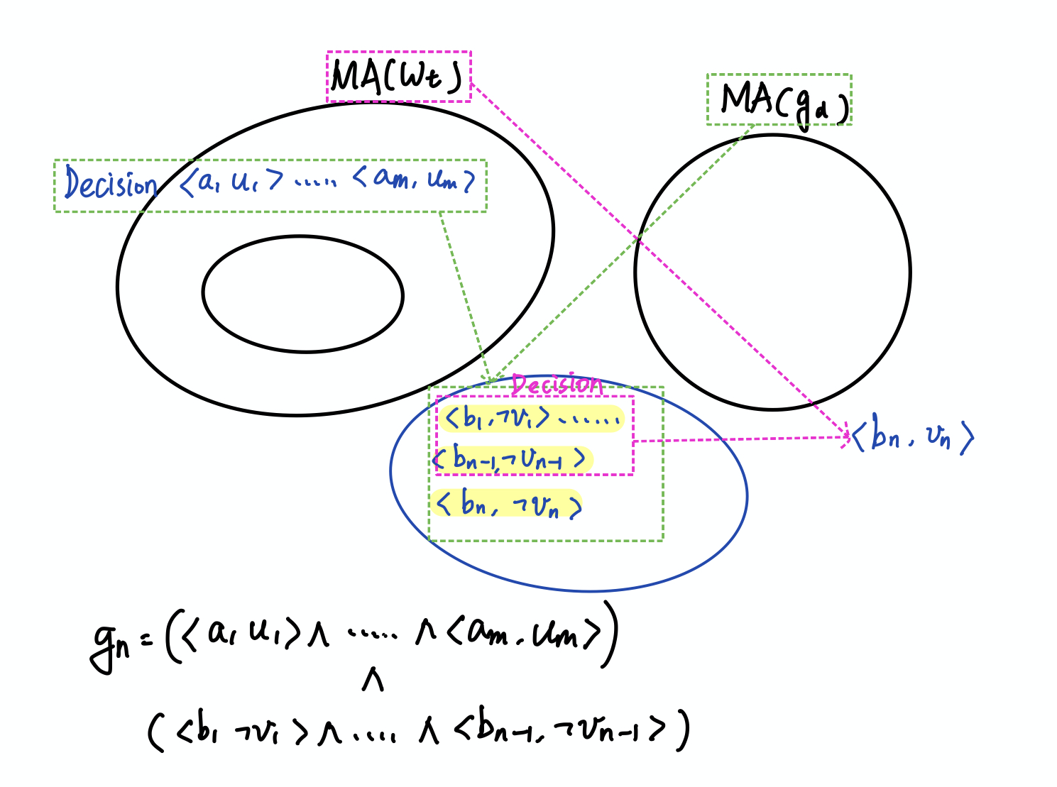
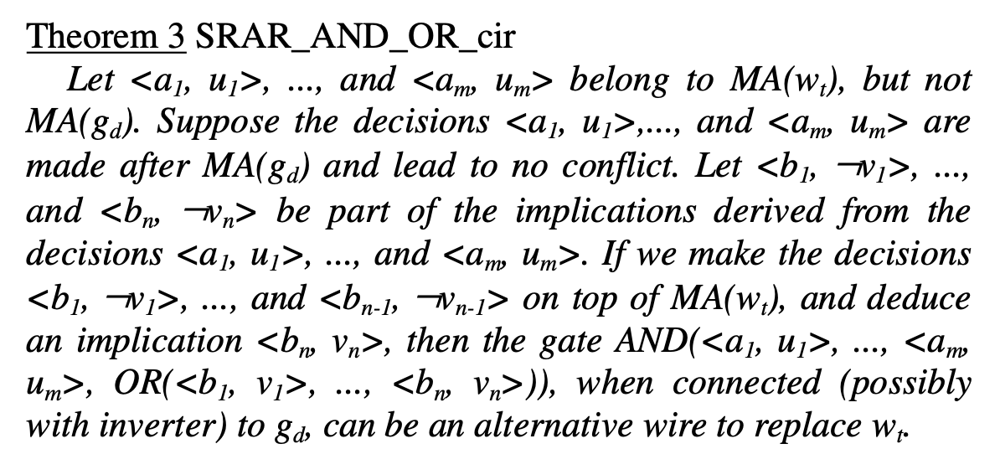
Background
Cosntruct an arbitrary circuit to replace target wire
This may be expensive
General Case:

Slide 10
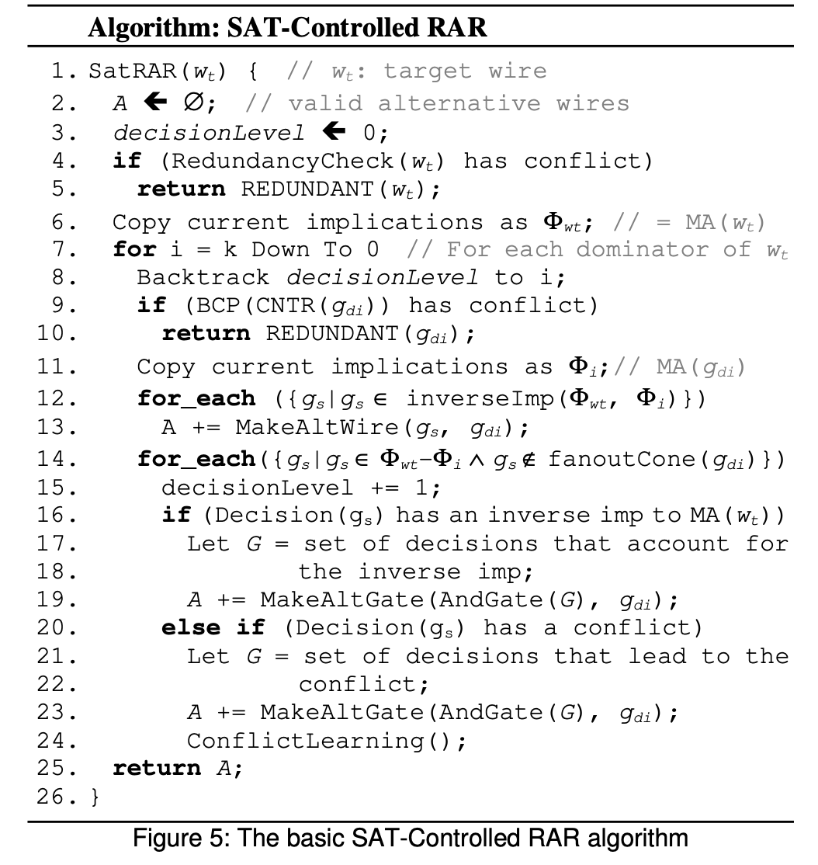

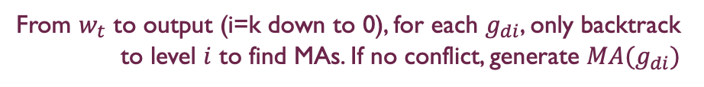
Algorithm
Given $w_{t}$
Redundancy check and copy implications to set $Φ_{wt}$
From $w_{t}$ to output (i=k down to 0), for each $g_{di}$, only backtrack to level $i$ to find MAs. If no conflict, generate $MA(g_{di})$
2-Way RAR
Select a gate from $Φ_{wt}$ - $Φ_{i}$ as the SAT decision
SAT-controlled RAR, based on selected set of decision,
If conflict, compute alternative wire
Conflict driven learning can prune the decision tree

Slide 11
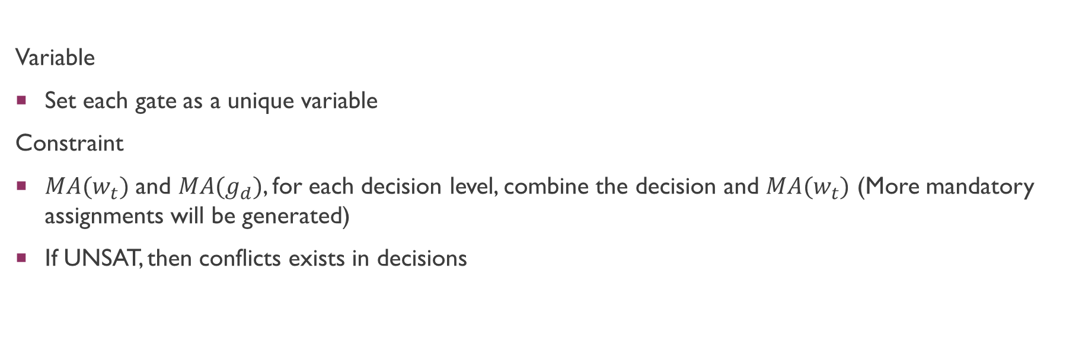
Incorporate SAT Solver into the Algorithm
Variable
Set each gate as a unique variable
Constraint
$MA(w_{t})$ and $MA(g_{d})$, for each decision level, combine the decision and $MA(w_{t})$ (More mandatory assignments will be generated)
If UNSAT, then conflicts exists in decisions

Slide 12
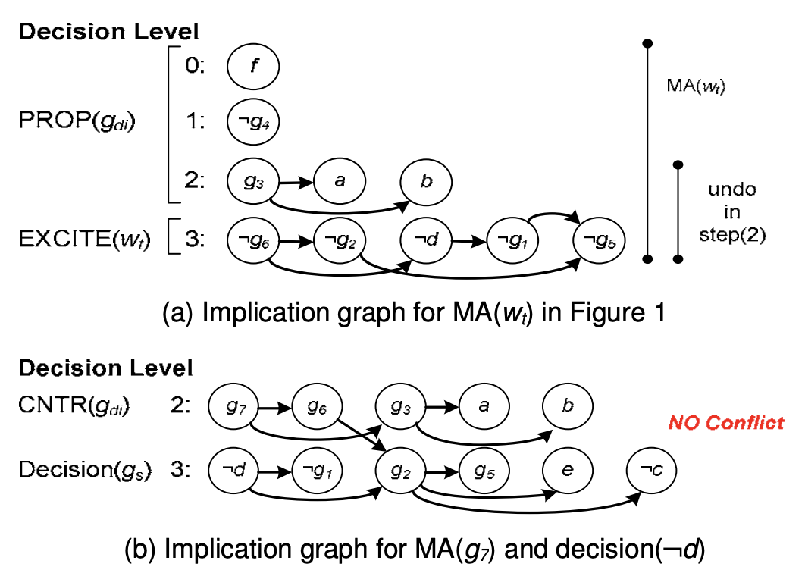

Algorithm
We can remove $g_{1}$ from the decision list

Slide 13
Implementation Issues
Represent a AND-OR circuit in .aag format.
How to find a node’s dominator ?

Slide 14
Experiment
Application
Timing optimization
See whether RAR can reduce delay
See command “reduce”, ‘fraig”, ”reduce” can have better result

