Slide 1
Lecture 1 Introduction to Machine Learning
Dmytro Progonov,
PhD, Associate Professor

Slide 2
Content
Machine learning – what and why?
Types of machine learning;
Practical applications and open-problems in machine learning;
System identification task.

Slide 3
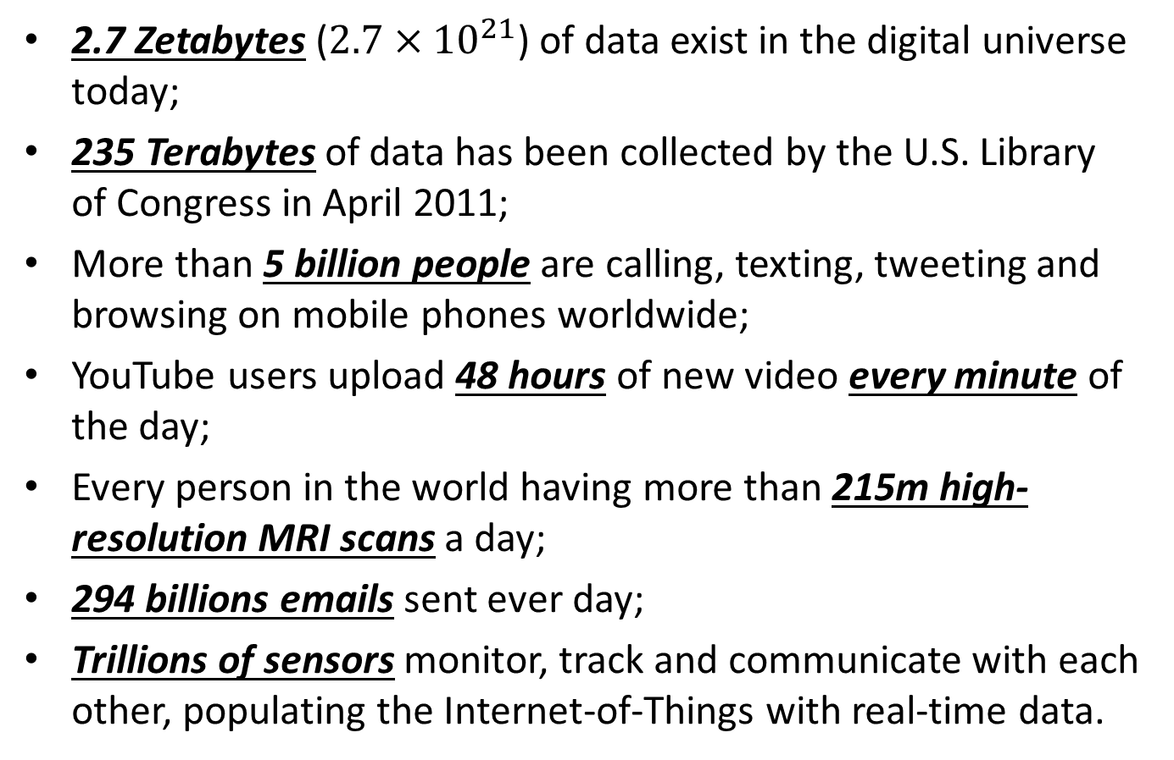
Problem statement
2.7 Zetabytes ($2.7×{10}^{21}$) of data exist in the digital universe today;
235 Terabytes of data has been collected by the U.S. Library of Congress in April 2011;
More than 5 billion people are calling, texting, tweeting and browsing on mobile phones worldwide;
YouTube users upload 48 hours of new video every minute of the day;
Every person in the world having more than 215m high-resolution MRI scans a day;
294 billions emails sent ever day;
Trillions of sensors monitor, track and communicate with each other, populating the Internet-of-Things with real-time data.

Slide 4
Machine learning
Machine learning provides automated methods of data analysis. In particular, we define machine learning as a set of methods that can automatically detect patterns in data, and then use the uncovered patterns to predict future data, or to perform other kind of decision making under uncertainty.

Slide 5
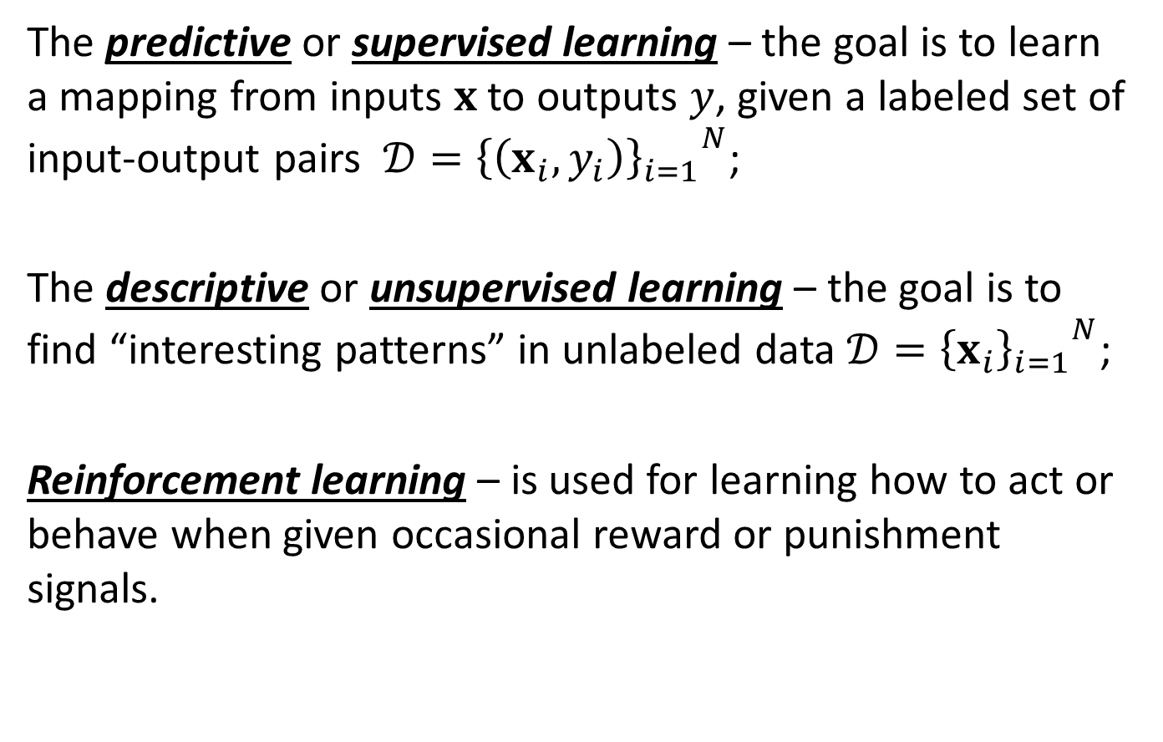
Types of machine learning (1/2)
The predictive or supervised learning – the goal is to learn a mapping from inputs $x$ to outputs $y$, given a labeled set of input-output pairs $𝒟={{\left\{\left(x_{i}, y_{i}\right)\right\}}_{i=1}}^{N}$;
The descriptive or unsupervised learning – the goal is to find “interesting patterns” in unlabeled data $𝒟={{\left\{x_{i}\right\}}_{i=1}}^{N}$;
Reinforcement learning – is used for learning how to act or behave when given occasional reward or punishment signals.

Slide 6
Types of machine learning (2/2)
Supervised learning
Unsupervised learning
Reinforcement learning
Classification
Regression
Knowledge discovery
Density estimation
Cluster discovering
Latent factor discovering
Matrix completion
Learning and acting under partial information
Transfer learning
System identification
Large-scale empirical evaluations

Slide 7
Practical applications
Supervised learning
Unsupervised learning
Document classification and email spam filtering
Discovering graph structure
Classifying flowers
Image classification and handwriting recognition
Face detection and recognition
Predict tomorrow’s stock market state
Dimensionality reduction
Latent factors revealing
Image inpainting
Collaborative filtering
Market basket analysis

Slide 8
Open-problems in machine learning
Parametric vs. non-parametric models
The curse of dimensionality
Overfitting and underfitting
Model selection
No free lunch theorem
All models are wrong, but some models are useful – there is no single best model that works optimally or all kind of data (George Box, 1987)

Slide 9
System identification
System identification – the discipline in statistics and machine learning that builds mathematical models of dynamical systems from measured data. It also includes the optimal design of experiments for efficiently generating informative data for fitting such models as well as model reduction.

Slide 10
System identification models
White-box model – the mathematical model of system is known in advanced. But in many cases such model will be overly complex and possibly even impossible to obtain in reasonable time due to the complex nature of many systems and processes;
Grey-box model – a certain model based on both insight into the system and experimental data is constructed. This model does however still have a number of unknown free parameters which can be estimated using system identification;
Black-box model – No prior model is available. Most system identification algorithms are of this type.

Slide 11
Conclusion
The main types of machine learning task were considered;
Practical applications and challenges in machine learning domain were shown;
The problem of system identification as machine learning task is established. Key types of system models were considered.

