Slide 1
Lecture 10 Objects and Systems Identification Methods. Logistic Regression
Dmytro Progonov,
PhD, Associate Professor

Slide 2
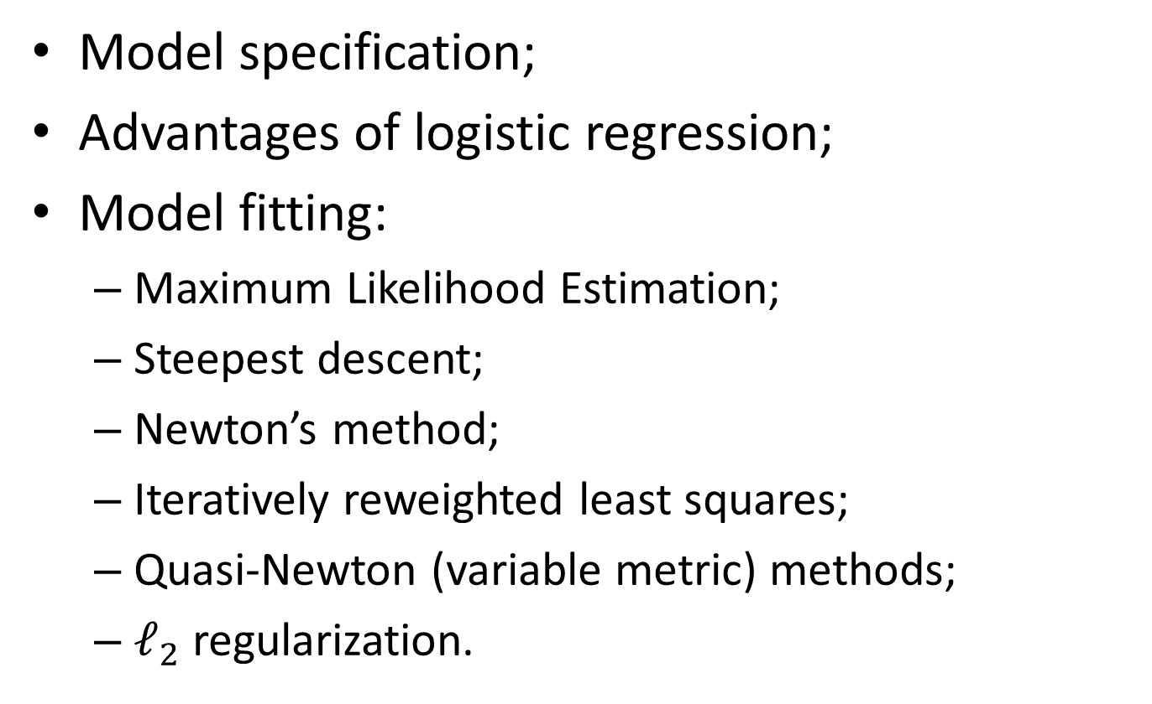
Content
Model specification;
Advantages of logistic regression;
Model fitting:
Maximum Likelihood Estimation;
Steepest descent;
Newton’s method;
Iteratively reweighted least squares;
Quasi-Newton (variable metric) methods;
$𝓁_{2}$ regularization.

Slide 3

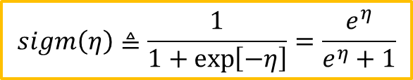



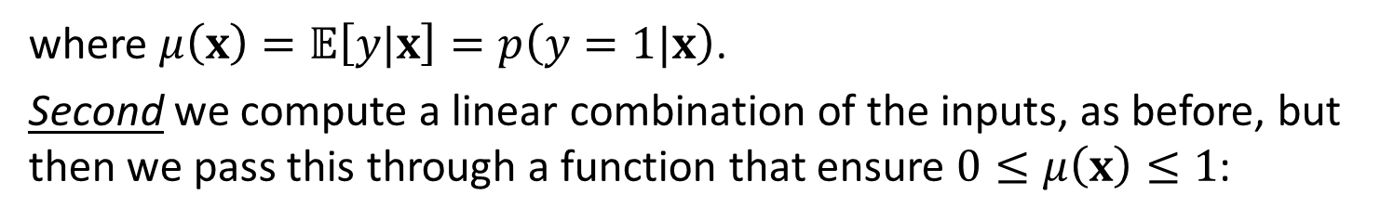
Model specification
We can generalized linear regression to the (binary) classification setting by making two changes. First we replace the Gaussian distribution for $y$ with a Bernoulli distribution:
$$p\left(y|x, θ\right)=Ber\left(y|μ\left(x\right)\right)$$
where $μ\left(x\right)=𝔼\left[y|x\right]=p\left(y=1|x\right)$.
Second we compute a linear combination of the inputs, as before, but then we pass this through a function that ensure $0≤μ\left(x\right)≤1$:
$$μ\left(x\right)=sigm\left(w^{T}x\right)$$
where $sigm\left(∙\right)−$ sigmoid (logistic or logit) function.
$$sigm\left(η\right)≜\frac{1}{1+\exp\left[−η\right]}=\frac{e^{η}}{e^{η}+1}$$
Then final form of logistic regression model is:
$$p\left(y|x, w\right)=Ber\left(y|sigm\left(w^{T}x\right) \right)$$

Slide 4
Advantages of logistic regression
Logistic regression (LR) are easy to fit – we mean that the algorithms are simple to implement, and are very fast (even linear time in the number of non-zeros in the dataset);
LR models are easy to interpret;
LR model are easy to extend to multi-class classification;
LR model can be easily be extended to handle non-linear decision boundaries by using kernels or by learning features from data.

Slide 5
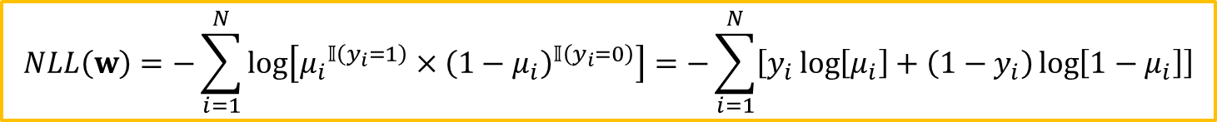
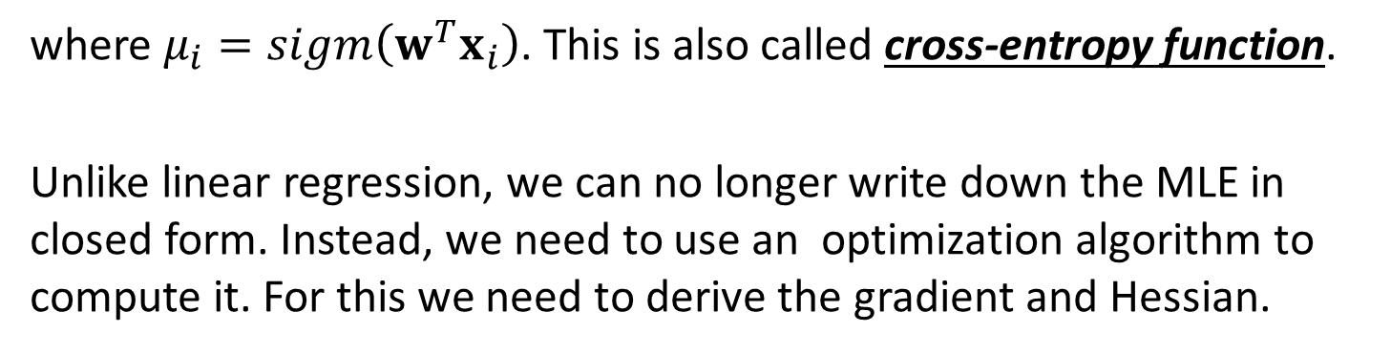
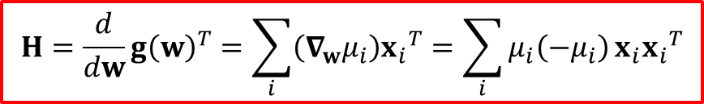
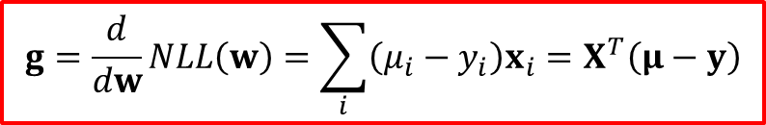
Model fitting. Maximum Likelihood Estimation
The negative log-likelihood for logistic regression is given by:
$$NLL\left(w\right)=−\sum_{i=1}^{N}{\log\left[{μ_{i}}^{𝕀\left(y_{i}=1\right)}×{\left(1−μ_{i}\right)}^{𝕀\left(y_{i}=0\right)}\right]}=−\sum_{i=1}^{N}{\left[y_{i}\log\left[μ_{i}\right]+\left(1−y_{i}\right)\log\left[1−μ_{i}\right]\right]}$$
where $μ_{i}=sigm\left(w^{T}x_{i}\right)$. This is also called cross-entropy function.
Unlike linear regression, we can no longer write down the MLE in closed form. Instead, we need to use an optimization algorithm to compute it. For this we need to derive the gradient and Hessian.
$$g=\frac{d}{dw}NLL\left(w\right)=\sum_{i}{\left(μ_{i}−y_{i}\right)x_{i}}=X^{T}\left(μ−y\right)$$
$$H=\frac{d}{dw}{g\left(w\right)}^{T}=\sum_{i}{\left(∇_{w}μ_{i}\right){x_{i}}^{T}}=\sum_{i}{μ_{i}\left(−μ_{i}\right)}x_{i}{x_{i}}^{T}$$

Slide 6




Model fitting. Steepest descent
Perhaps the simplest algorithm for unconstrained optimization is gradient descent, also known as steepest descent:
$$θ_{k+1}=θ_{k}−η_{k}g_{k}$$
where $η_{k}$ is the step size or learning rate.
The common approach to determine the step size is usage of line minimization or line search algorithm:
$$η_{optim}=\underset{η}{argmin}\left(θ_{k}+ηg_{k}\right)$$
To suppress the zig-zag behavior, we use a simple heuristic – add a momentum term:
$$θ_{k+1}=θ_{k}−η_{k}g_{k}+μ_{k}\left(θ_{k}−θ_{k−1}\right)$$
where $μ_{k} \left(μ_{k}∈\left[0;1\right]\right)$ control the importance of momentum term.

Slide 7
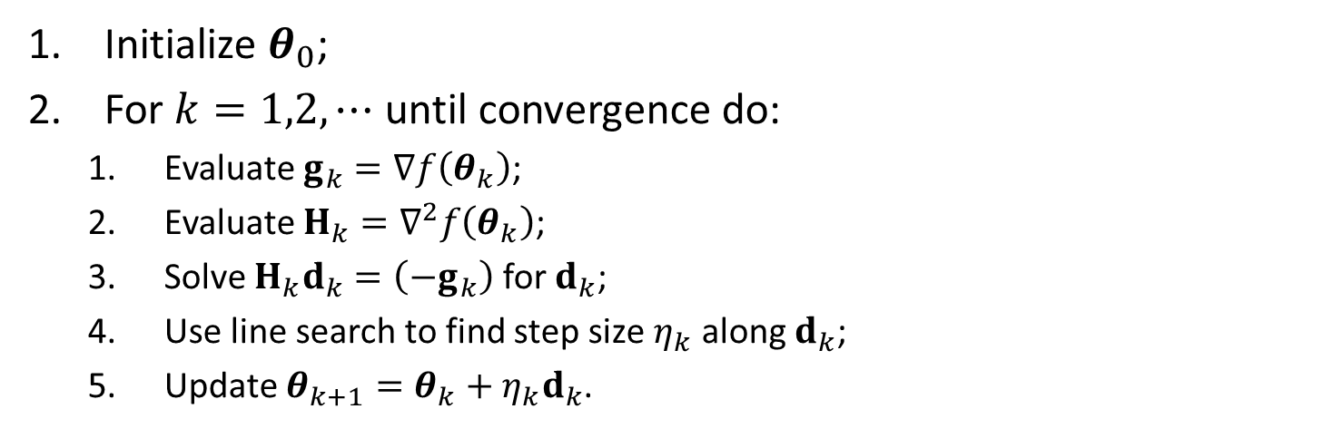
Model fitting. Newton’s method
Initialize $θ_{0}$;
For $k=1,2,⋯$ until convergence do:
Evaluate $g_{k}=∇f\left(θ_{k}\right)$;
Evaluate $H_{k}=∇^{2}f\left(θ_{k}\right)$;
Solve $H_{k}d_{k}=\left(−g_{k}\right)$ for $d_{k}$;
Use line search to find step size $η_{k}$ along $d_{k}$;
Update $θ_{k+1}=θ_{k}+η_{k}d_{k}$.
Newton’s method called second order optimization method.

Slide 8
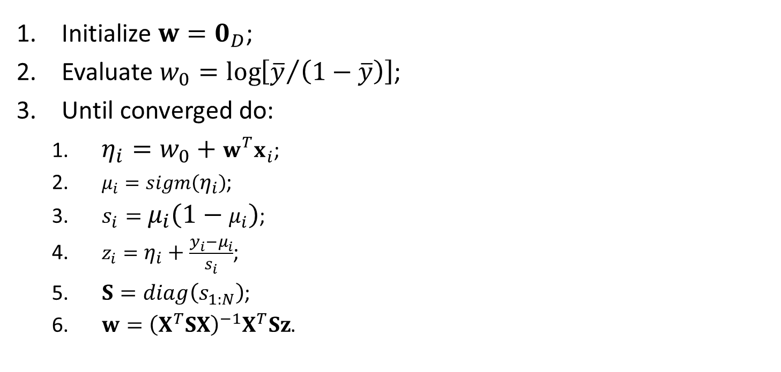
Model fitting. Iteratively reweighted least squares
Initialize $w=0_{D}$;
Evaluate $w_{0}=\log\left[{\overline{y}}/{\left(1−\overline{y}\right)}\right]$;
Until converged do:
$η_{i}=w_{0}+w^{T}x_{i}$;
$μ_{i}=sigm\left(η_{i}\right)$;
$s_{i}=μ_{i}\left(1−μ_{i}\right)$;
$z_{i}=η_{i}+\frac{y_{i}−μ_{i}}{s_{i}}$;
$S=diag\left(s_{1:N}\right)$;
$w={\left(X^{T}SX\right)}^{−1}X^{T}Sz$.

Slide 9

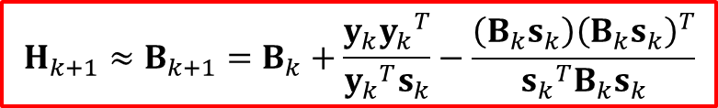

Model fitting. Quasi-Newton (variable metric) methods
Limitation of practical usage the Newton’s method is necessary to compute the Hessian that can be expensive for some cases.
Quasi-Newton methods iteratively build up an approximation to the Hessian using information gleaned from the gradient vector at each step (Broyden, Fletcher, Goldfarb and Shanno):
$${H_{k+1}≈B}_{k+1}=B_{k}+\frac{y_{k}{y_{k}}^{T}}{{y_{k}}^{T}s_{k}}−\frac{\left(B_{k}s_{k}\right){\left(B_{k}s_{k}\right)}^{T}}{{s_{k}}^{T}B_{k}s_{k}}$$
$$s_{k}=θ_{k}−θ_{k−1}$$
$$y_{k}=g_{k}−g_{k−1}$$

Slide 10
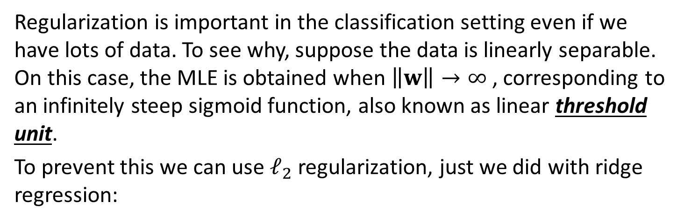




Model fitting. $𝓵_{2}$ regularization
Regularization is important in the classification setting even if we have lots of data. To see why, suppose the data is linearly separable. On this case, the MLE is obtained when $\left\|w\right\|→∞$, corresponding to an infinitely steep sigmoid function, also known as linear threshold unit.
To prevent this we can use $𝓁_{2}$ regularization, just we did with ridge regression:
$$\acute{f}\left(w\right)=NLL\left(w\right)+λw^{T}w$$
$$\acute{g}\left(w\right)=g\left(w\right)+2λw$$
$$\acute{H}\left(w\right)=H\left(w\right)+2λI$$

Slide 11
Conclusion
Model specification for Logistic regression was shown;
Common and special methods for fitting the Logistic regression were considered.

