Slide 1
Lecture 2 Review of Probability Theory
Dmytro Progonov,
PhD, Associate Professor

Slide 2
Content
Historical background;
Definition of probability;
Basic rules for probabilities
Parameters of distributions.

Slide 3
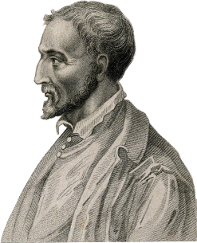
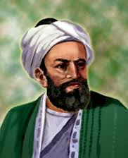
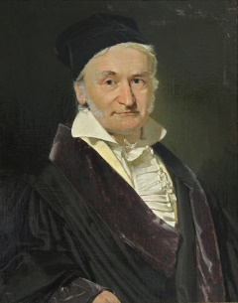
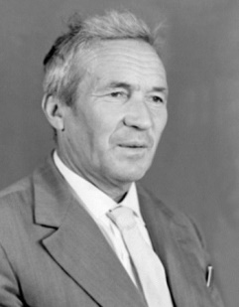
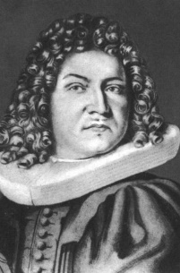
History of probability theory
Ancient and Medieval time
Renaissance time
18th century
Risk theory foundation.
Mathematical foundation of classic probability theory.
19th century
Theory of errors;
statistical mechanics.
20th century
Markov process theory.
Hypothesis testing;
Law of evidence.
Gerolamo Cardano
(1501-1576)
Abu Yūsuf Yaʻqūb ibn ʼIsḥāq aṣ-Ṣabbāḥ al-Kindī
(803-873)
Carl Friedrich Gauss
(1777-1855)
Andrey Kolmogorov
(1903-1987)
Jacob Bernoulli
(1655-1705)

Slide 4
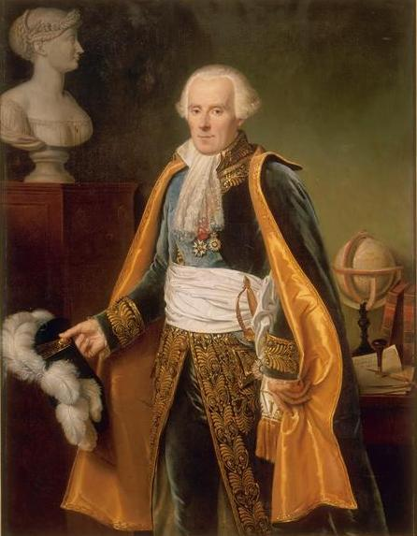
Definitions of probability (1/2)
Pierre-Simon Laplace
(1749-1827)
Probability theory is nothing but common sense reduced to calculation (Pierre Laplace, 1812)

Slide 5
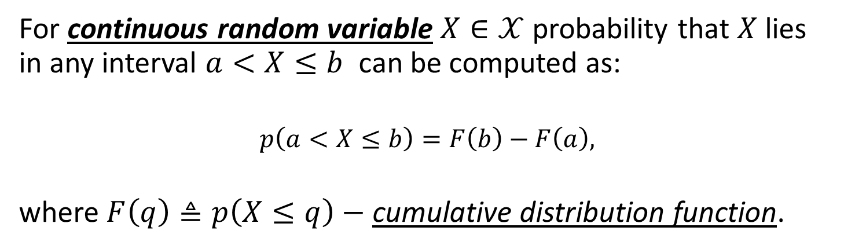
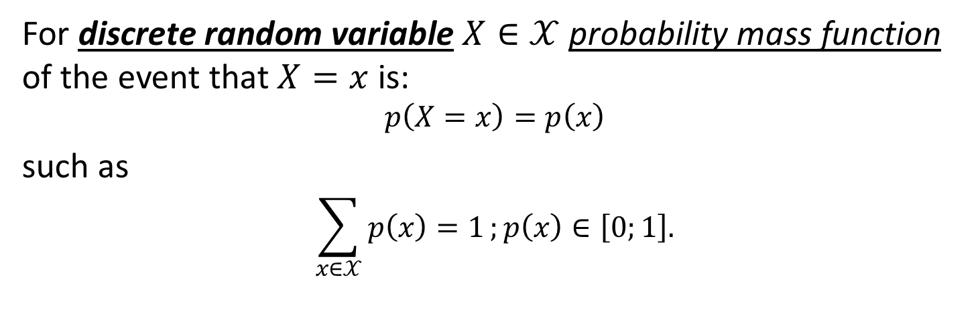
Definitions of probability (2/2)
For discrete random variable $X∈𝒳$ probability mass function of the event that $X=x$ is:
$$p\left(X=x\right)=p\left(x\right)$$
such as
$$\sum_{x∈𝒳}{p\left(x\right)=1};p\left(x\right)∈\left[0;1\right].$$
For continuous random variable $X∈𝒳$ probability that $X$lies in any interval $a<X≤b$ can be computed as:
$$p\left(a<X≤b\right)=F\left(b\right)−F\left(a\right),$$
where $F\left(q\right)≜p\left(X≤q\right)−$ cumulative distribution function.

Slide 6
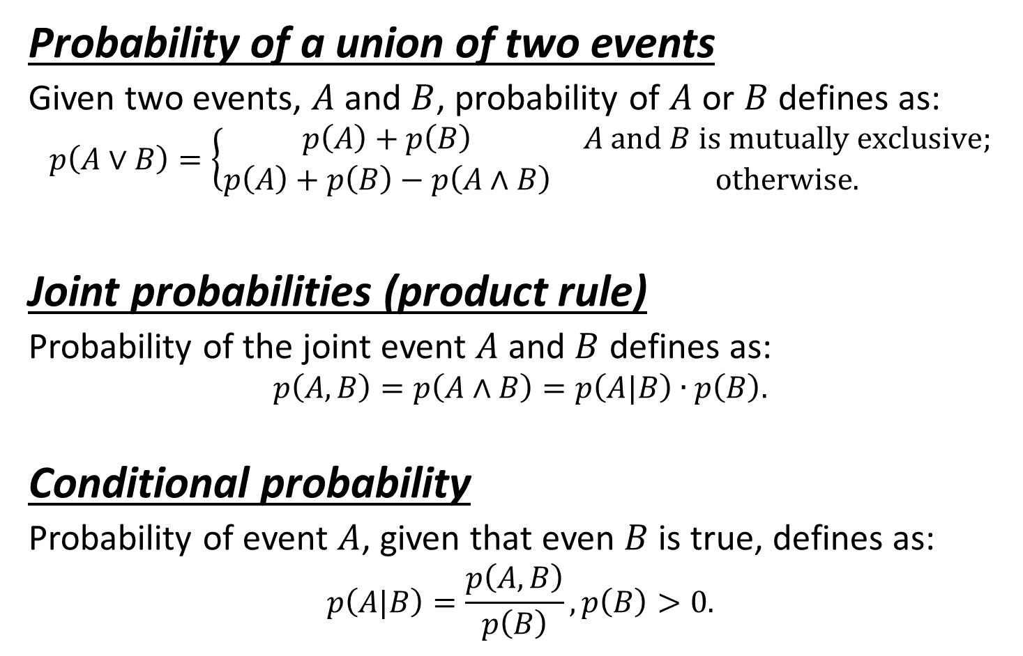
Basic rules of probability (1/3)
Probability of a union of two events
Given two events, $A$ and $B$, probability of $A$ or $B$ defines as:
$$p\left(A∨B\right)=\left\{\begin{matrix}p\left(A\right)+p\left(B\right) & A and B is mutually exclusive; \\ p\left(A\right)+p\left(B\right)−p\left(A∧B\right) & otherwise.\end{matrix}\right.$$
Joint probabilities (product rule)
Probability of the joint event $A$ and $B$ defines as:
$$p\left(A,B\right)=p\left(A∧B\right)=p\left(A|B\right)∙p\left(B\right).$$
Conditional probability
Probability of event $A$, given that even $B$ is true, defines as:
$$p\left(A|B\right)=\frac{p\left(A,B\right)}{p\left(B\right)},p\left(B\right)>0.$$

Slide 7
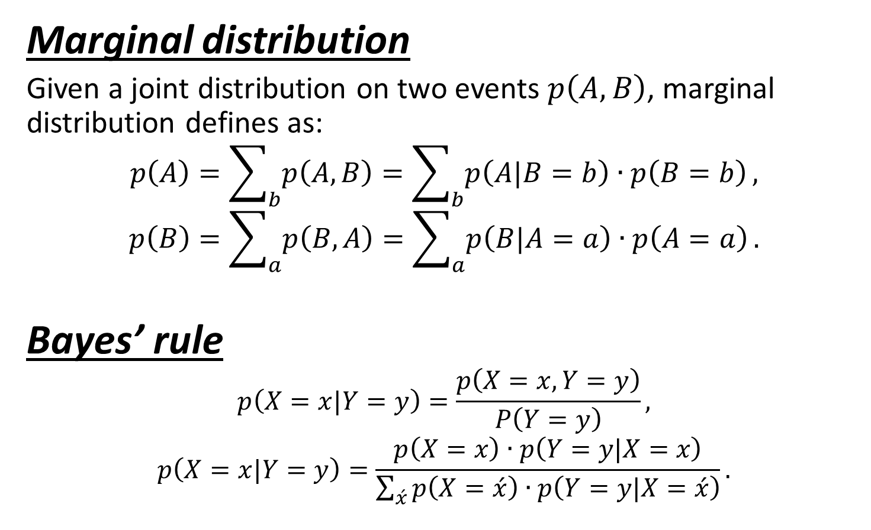
Basic rules of probability (2/3)
Marginal distribution
Given a joint distribution on two events $p\left(A,B\right)$, marginal distribution defines as:
$$p\left(A\right)=\sum_{b}{p\left(A,B\right)}=\sum_{b}{p\left(A|B=b\right)∙p\left(B=b\right)},$$
$$p\left(B\right)=\sum_{a}{p\left(B,A\right)}=\sum_{a}{p\left(B|A=a\right)∙p\left(A=a\right)}.$$
Bayes’ rule
$$p\left(X=x|Y=y\right)=\frac{p\left(X=x, Y=y\right)}{P\left(Y=y\right)},$$
$$p\left(X=x|Y=y\right)=\frac{p\left(X=x\right)∙p\left(Y=y|X=x\right)}{\sum_{\acute{x}}{p\left(X=\acute{x}\right)∙p\left(Y=y|X=\acute{x}\right)}}.$$

Slide 8
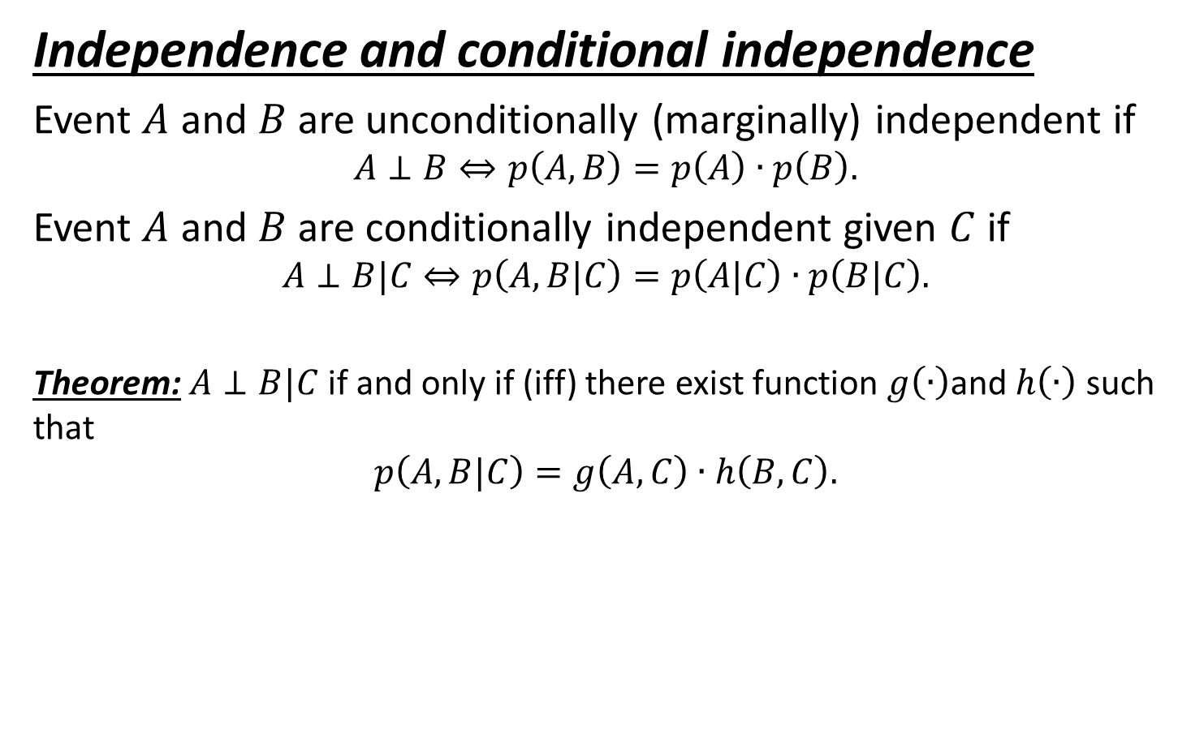
Basic rules of probability (3/3)
Independence and conditional independence
Event $A$ and $B$ are unconditionally (marginally) independent if
$$A⊥B⇔p\left(A,B\right)=p\left(A\right)∙p\left(B\right).$$
Event $A$ and $B$ are conditionally independent given $C$ if
$$A⊥B|C⇔p\left(A,B|C\right)=p\left(A|C\right)∙p\left(B|C\right).$$
Theorem: $A⊥B|C$ if and only if (iff) there exist function $g\left(∙\right)$and $h\left(∙\right)$ such that
$$p\left(A,B|C\right)=g\left(A,C\right)∙h\left(B,C\right).$$

Slide 9
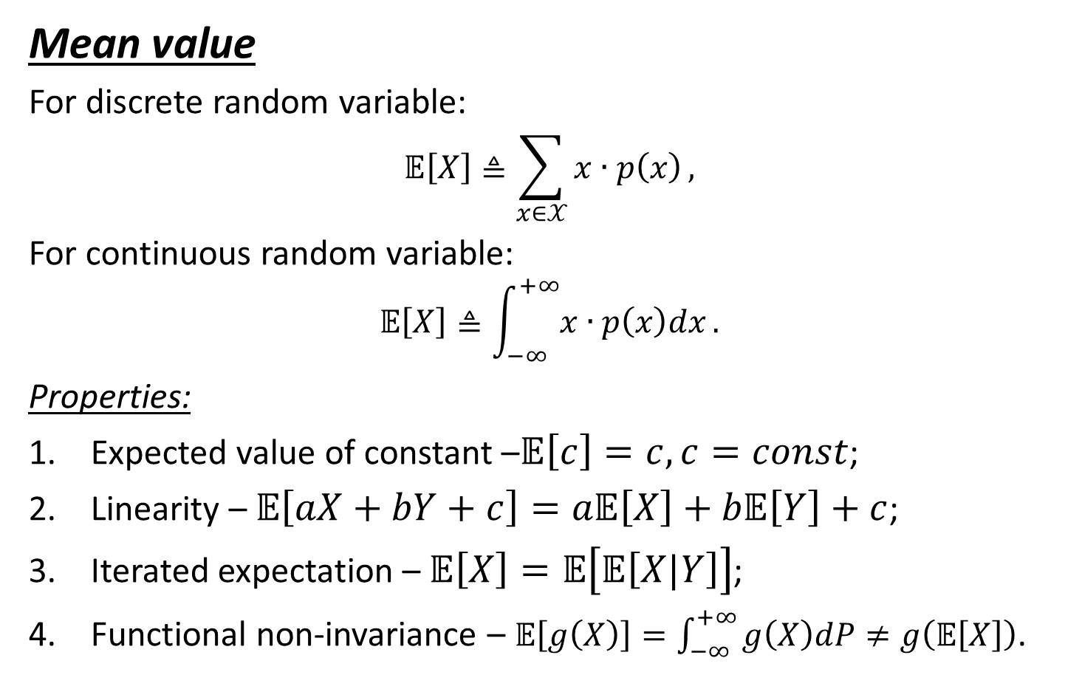
Parameters of distributions (1/5)
Mean value
For discrete random variable:
$$𝔼\left[X\right]≜\sum_{x∈𝒳}{x∙p\left(x\right)},$$
For continuous random variable:
$$𝔼\left[X\right]≜\int_{−∞}^{+∞}{x∙p\left(x\right)dx}.$$
Properties:
Expected value of constant –$𝔼\left[c\right]=c,c=const$;
Linearity – $𝔼\left[aX+bY+c\right]=a𝔼\left[X\right]+b𝔼\left[Y\right]+c$;
Iterated expectation – $𝔼\left[X\right]=𝔼\left[𝔼\left[X|Y\right]\right]$;
Functional non-invariance – $𝔼\left[g\left(X\right)\right]=\int_{−∞}^{+∞}{g\left(X\right)dP}≠g\left(𝔼\left[X\right]\right)$.

Slide 10
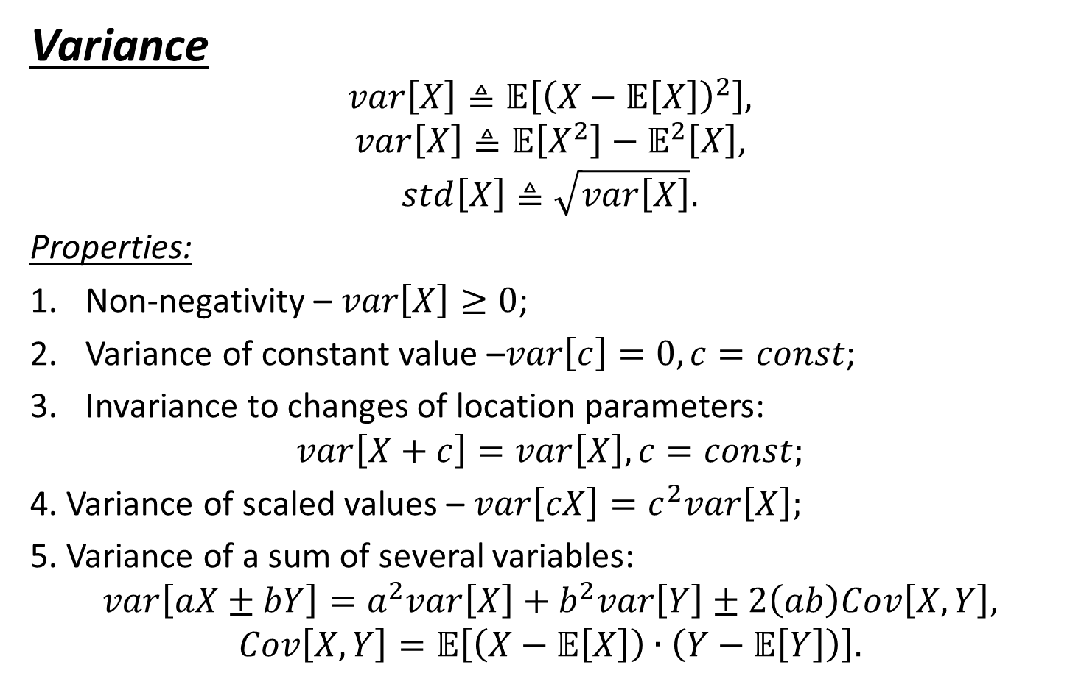
Parameters of distributions (2/5)
Variance
$$var\left[X\right]≜𝔼\left[{\left(X−𝔼\left[X\right]\right)}^{2}\right],$$
$$var\left[X\right]≜𝔼\left[X^{2}\right]−𝔼^{2}\left[X\right],$$
$$std\left[X\right]≜\sqrt{var\left[X\right]}.$$
Properties:
Non-negativity – $var\left[X\right]≥0$;
Variance of constant value –$var\left[c\right]=0, c=const$;
Invariance to changes of location parameters:
$$var\left[X+c\right]=var\left[X\right], c=const;$$
4. Variance of scaled values – $var\left[cX\right]=c^{2}var\left[X\right];$
5. Variance of a sum of several variables:
$$var\left[aX±bY\right]=a^{2}var\left[X\right]+b^{2}var\left[Y\right]±2\left(ab\right)Cov\left[X,Y\right],$$
$$Cov\left[X,Y\right]=𝔼\left[\left(X−𝔼\left[X\right]\right)∙\left(Y−𝔼\left[Y\right]\right)\right].$$

Slide 11
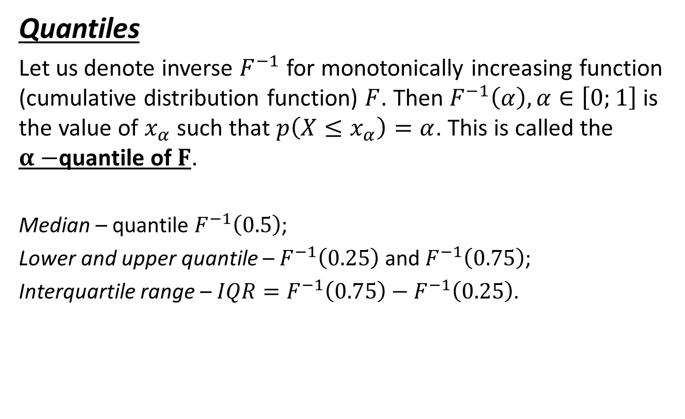
Parameters of distributions (3/5)
Quantiles
Let us denote inverse $F^{−1}$ for monotonically increasing function (cumulative distribution function) $F$. Then $F^{−1}\left(α\right),α∈\left[0;1\right]$ is the value of $x_{α}$ such that $p\left(X≤x_{α}\right)=α$. This is called the $α−$quantile of $F$.
Median – quantile $F^{−1}\left(0.5\right)$;
Lower and upper quantile – $F^{−1}\left(0.25\right)$ and $F^{−1}\left(0.75\right)$;
Interquartile range – $IQR=F^{−1}\left(0.75\right)−F^{−1}\left(0.25\right)$.

Slide 12
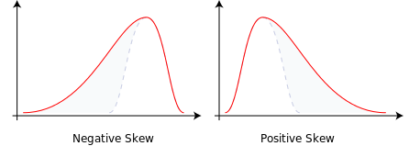
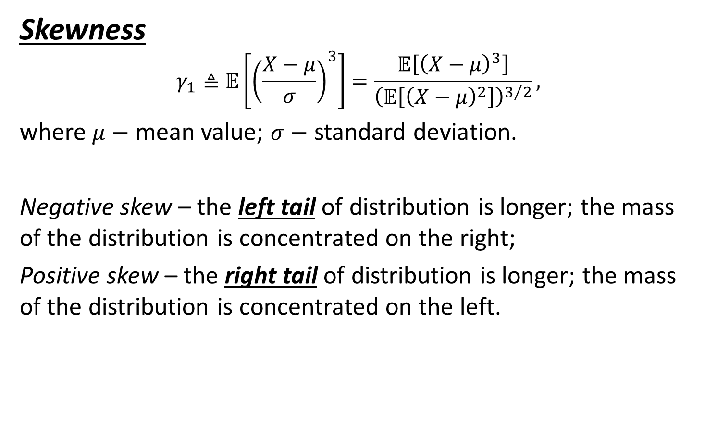
Parameters of distributions (4/5)
Skewness
$$γ_{1}≜𝔼\left[{\left(\frac{X−μ}{σ}\right)}^{3}\right]=\frac{𝔼\left[{\left(X−μ\right)}^{3}\right]}{{\left(𝔼\left[{\left(X−μ\right)}^{2}\right]\right)}^{3/2}},$$
where $μ−$ mean value; $σ−$ standard deviation.
Negative skew – the left tail of distribution is longer; the mass of the distribution is concentrated on the right;
Positive skew – the right tail of distribution is longer; the mass of the distribution is concentrated on the left.

Slide 13
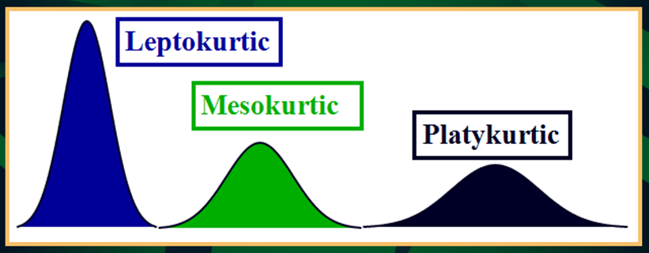
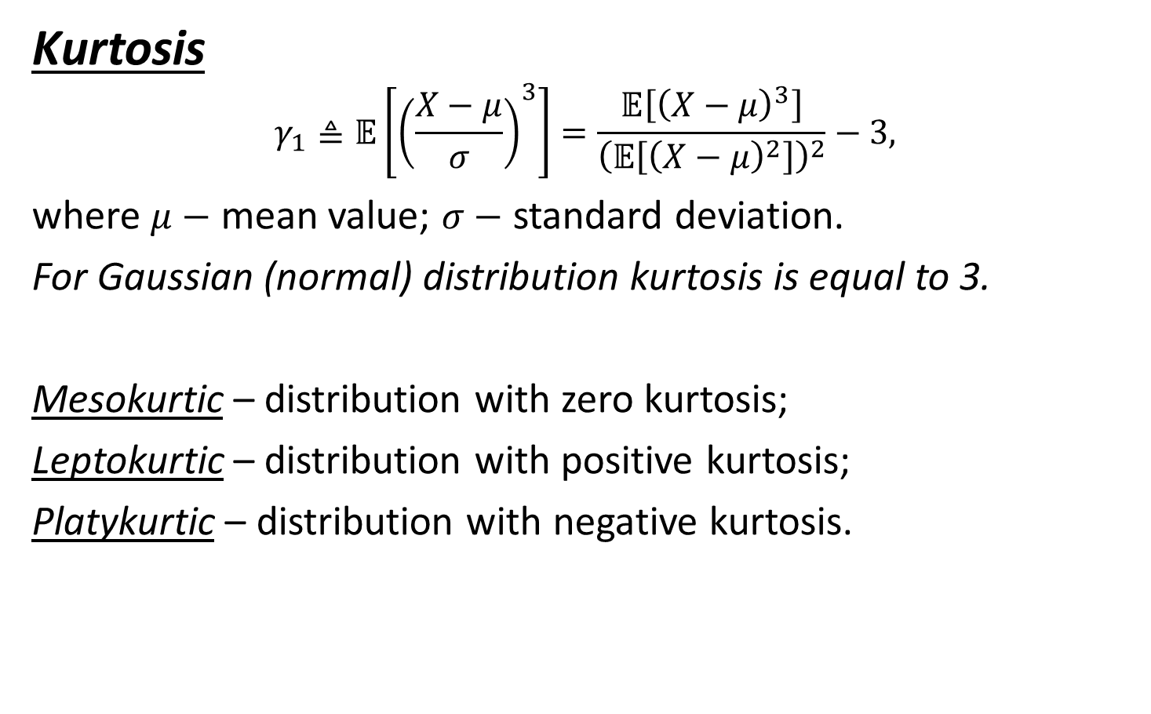
Parameters of distributions (5/x)
Kurtosis
$$γ_{1}≜𝔼\left[{\left(\frac{X−μ}{σ}\right)}^{3}\right]=\frac{𝔼\left[{\left(X−μ\right)}^{3}\right]}{{\left(𝔼\left[{\left(X−μ\right)}^{2}\right]\right)}^{2}}−3,$$
where $μ−$ mean value; $σ−$ standard deviation.
For Gaussian (normal) distribution kurtosis is equal to 3.
Mesokurtic – distribution with zero kurtosis;
Leptokurtic – distribution with positive kurtosis;
Platykurtic – distribution with negative kurtosis.

Slide 14
Conclusion
History of probability theory was considered;
Definition and basic rules for probabilities were presented;
Key parameters of distribution and methods for theirs estimation were presented.

