Slide 1
Lecture 3 Generative Models for Discrete Data. Classical Probabilistic Models
Dmytro Progonov,
PhD, Associate Professor

Slide 2
Content
Discrete distributions;
Continuous distributions;
Joint probability distributions;
Characteristics of distributions.

Slide 3
Common distributions
Discrete distributions
Binomial and Bernoulli distributions
Continuous distribution
Gaussian (normal) distribution
Multinomial and multinoulli distributions
Poisson distribution
Empirical distribution
Degenerate distribution
Student’s t distribution
Laplace distribution
Gamma distribution
Beta distribution
Pareto distribution
Joint probability distribution
Multivariate Gaussian
Multivariate Student t distribution
Dirichlet distribution

Slide 4
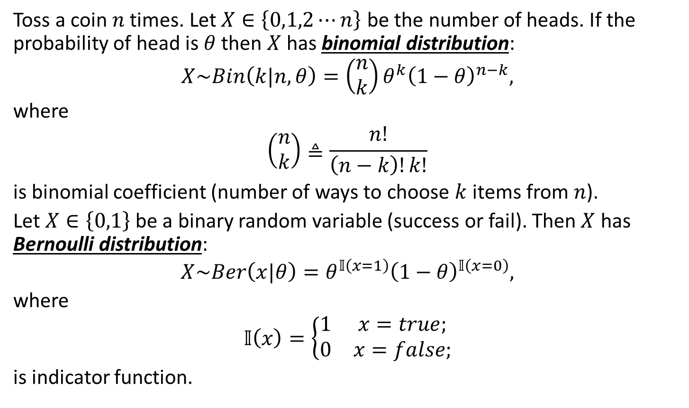
Discrete distributions (1/4). Binomial and Bernoulli distributions
Toss a coin $n$ times. Let $X∈\left\{0,1,2⋯n\right\}$ be the number of heads. If the probability of head is $θ$ then $X$ has binomial distribution:
$$X\sim Bin\left(k|n, θ\right)=\left(\begin{matrix}n \\ k\end{matrix}\right)θ^{k}{\left(1−θ\right)}^{n−k},$$
where
$$\left(\begin{matrix}n \\ k\end{matrix}\right)≜\frac{n!}{\left(n−k\right)!k!}$$
is binomial coefficient (number of ways to choose $k$ items from $n$).
Let $X∈\left\{0,1\right\}$ be a binary random variable (success or fail). Then $X$ has Bernoulli distribution:
$$X\sim Ber\left(x|θ\right)=θ^{𝕀\left(x=1\right)}{\left(1−θ\right)}^{𝕀\left(x=0\right)},$$
where
$$𝕀\left(x\right)=\left\{\begin{matrix}1 & x=true; \\ 0 & x=false;\end{matrix}\right.$$
is indicator function.

Slide 5
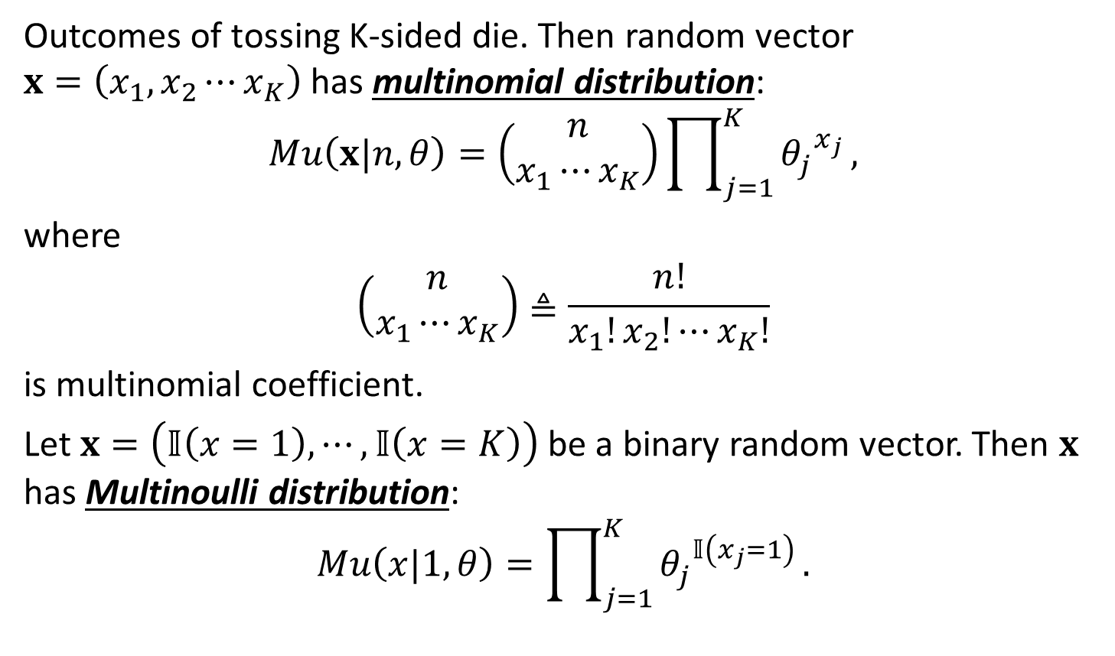
Discrete distributions (2/4). Multinomial and multinulli distributions
Outcomes of tossing K-sided die. Then random vector $x=\left(x_{1},x_{2}⋯x_{K}\right)$ has multinomial distribution:
$$Mu\left(x|n, θ\right)=\left(\begin{matrix}n \\ x_{1}⋯x_{K}\end{matrix}\right)\prod_{j=1}^{K}{{θ_{j}^{}}^{x_{j}}},$$
where
$$\left(\begin{matrix}n \\ x_{1}⋯x_{K}\end{matrix}\right)≜\frac{n!}{x_{1}!x_{2}!⋯x_{K}!}$$
is multinomial coefficient.
Let $x=\left(𝕀\left(x=1\right),⋯,𝕀\left(x=K\right)\right)$ be a binary random vector. Then $x$ has Multinoulli distribution:
$$Mu\left(x|1,θ\right)=\prod_{j=1}^{K}{{θ_{j}^{}}^{𝕀\left(x_{j}=1\right)}}.$$

Slide 6
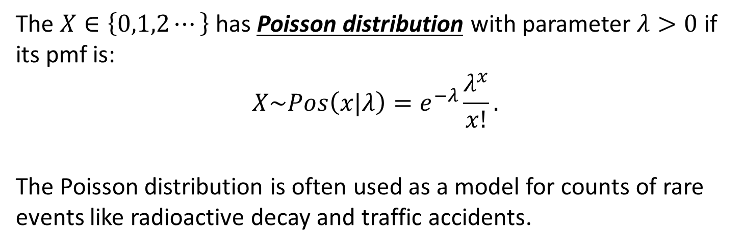
Discrete distributions (3/4). Poisson distribution
The $X∈\left\{0,1,2⋯\right\}$ has Poisson distribution with parameter $λ>0$ if its pmf is:
$$X\sim Pos\left(x|λ\right)=e^{−λ}\frac{λ^{x}}{x!}.$$
The Poisson distribution is often used as a model for counts of rare events like radioactive decay and traffic accidents.
pmf – probability mass function.

Slide 7
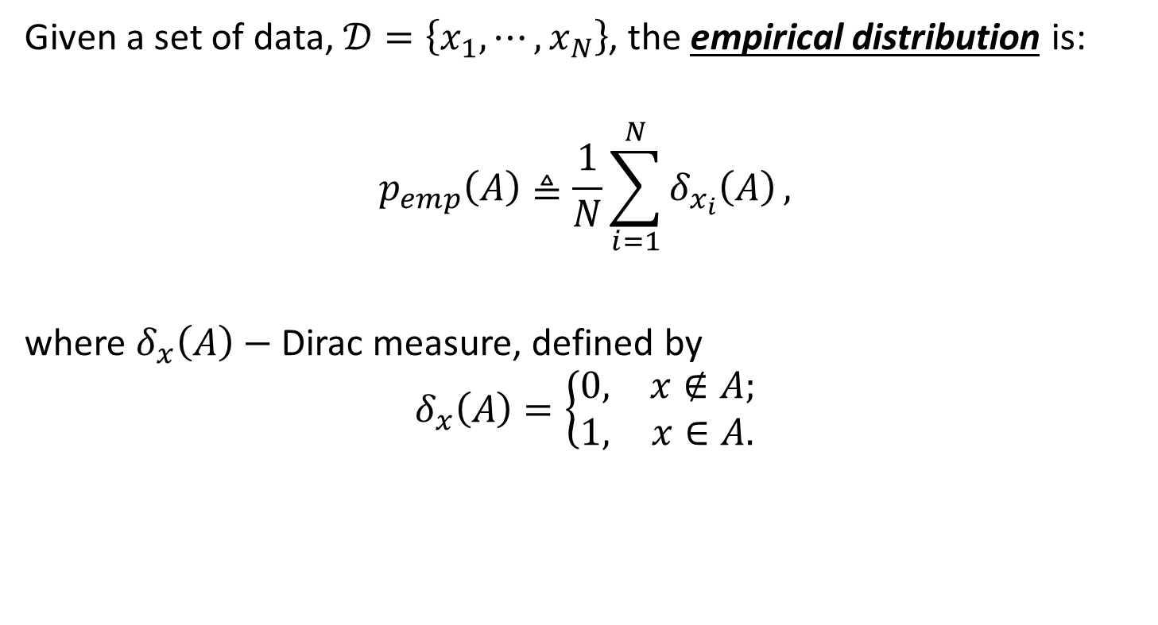
Discrete distributions (4/4). Empirical distribution
Given a set of data, $𝒟=\left\{x_{1},⋯,x_{N}\right\}$, the empirical distribution is:
$$p_{emp}\left(A\right)≜\frac{1}{N}\sum_{i=1}^{N}{δ_{x_{i}}\left(A\right)},$$
where $δ_{x}\left(A\right)−$ Dirac measure, defined by
$$δ_{x}\left(A\right)=\left\{\begin{matrix}0, & x∉A; \\ 1, & x∈A.\end{matrix}\right.$$

Slide 8
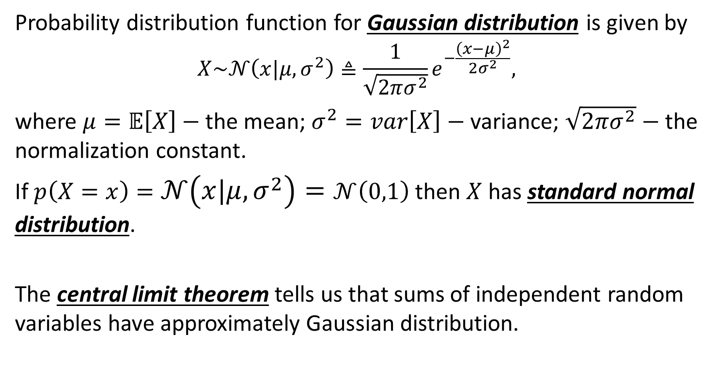
Continuous distributions (1/8). Gaussian (normal) distribution
Probability distribution function for Gaussian distribution is given by
$$X\sim 𝒩\left(x|μ, σ^{2}\right)≜\frac{1}{\sqrt{2πσ^{2}}}e^{−\frac{{\left(x−μ\right)}^{2}}{2σ^{2}}},$$
where $μ=𝔼\left[X\right]−$ the mean; $σ^{2}=var\left[X\right]−$ variance; $\sqrt{2πσ^{2}}−$ the normalization constant.
If $p\left(X=x\right)=𝒩\left(x|μ, σ^{2}\right)=𝒩\left(0,1\right)$ then $X$ has standard normal distribution.
The central limit theorem tells us that sums of independent random variables have approximately Gaussian distribution.

Slide 9
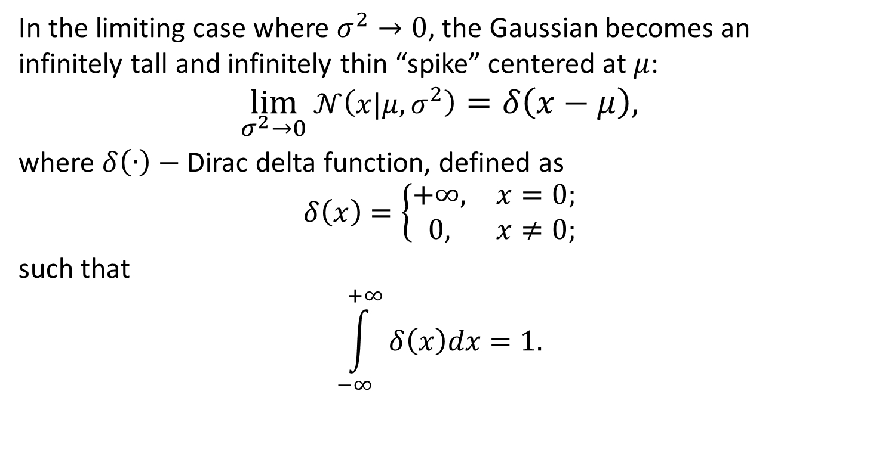
Continuous distributions (2/8). Degenerate distribution
In the limiting case where $σ^{2}→0$, the Gaussian becomes an infinitely tall and infinitely thin “spike” centered at $μ$:
$$\lim_{σ^{2}→0}{𝒩\left(x|μ, σ^{2}\right)}=δ\left(x−μ\right),$$
where $δ\left(∙\right)−$ Dirac delta function, defined as
$$δ\left(x\right)=\left\{\begin{matrix}+∞, & x=0; \\ 0, & x≠0;\end{matrix}\right.$$
such that
$$\int_{−∞}^{+∞}{δ\left(x\right)dx}=1.$$

Slide 10
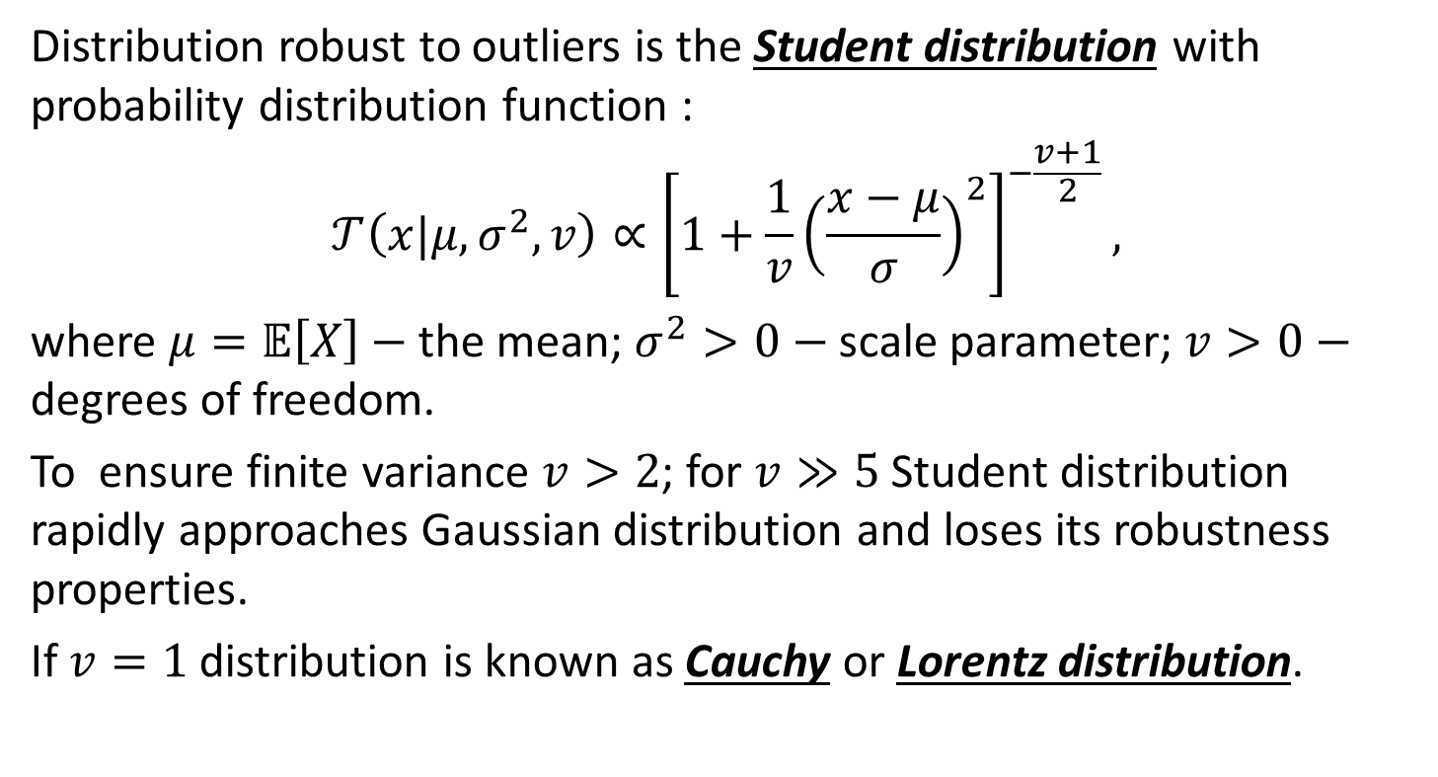

Continuous distributions (3/8). Student’s $t$ distribution
Distribution robust to outliers is the Student distribution with probability distribution function :
$$𝒯\left(x|μ,σ^{2},v\right)∝{\left[1+\frac{1}{v}{\left(\frac{x−μ}{σ}\right)}^{2}\right]}^{−\frac{v+1}{2}},$$
where $μ=𝔼\left[X\right]−$ the mean; $σ^{2}>0−$ scale parameter; $v>0−$ degrees of freedom.
To ensure finite variance $v>2$; for $v≫5$ Student distribution rapidly approaches Gaussian distribution and loses its robustness properties.
If $v=1$ distribution is known as Cauchy or Lorentz distribution.

Slide 11
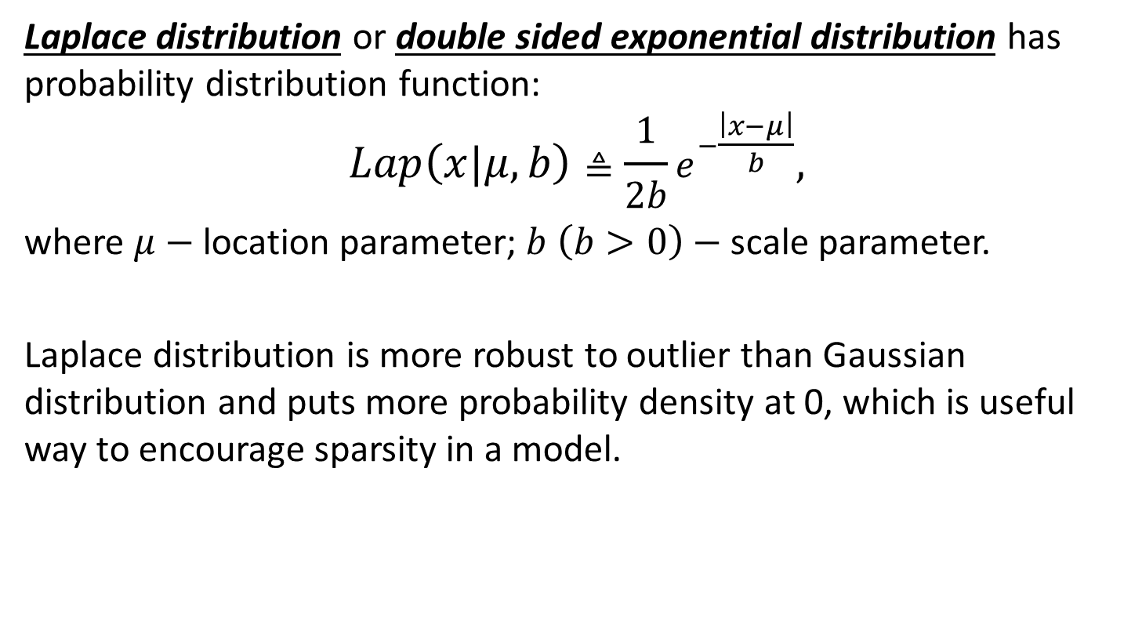
Continuous distributions (4/8). Laplace distribution
Laplace distribution or double sided exponential distribution has probability distribution function:
$$Lap\left(x|μ,b\right)≜\frac{1}{2b}e^{−\frac{\left|x−μ\right|}{b}},$$
where $μ−$ location parameter; $b \left(b>0\right)−$ scale parameter.
Laplace distribution is more robust to outlier than Gaussian distribution and puts more probability density at 0, which is useful way to encourage sparsity in a model.

Slide 12
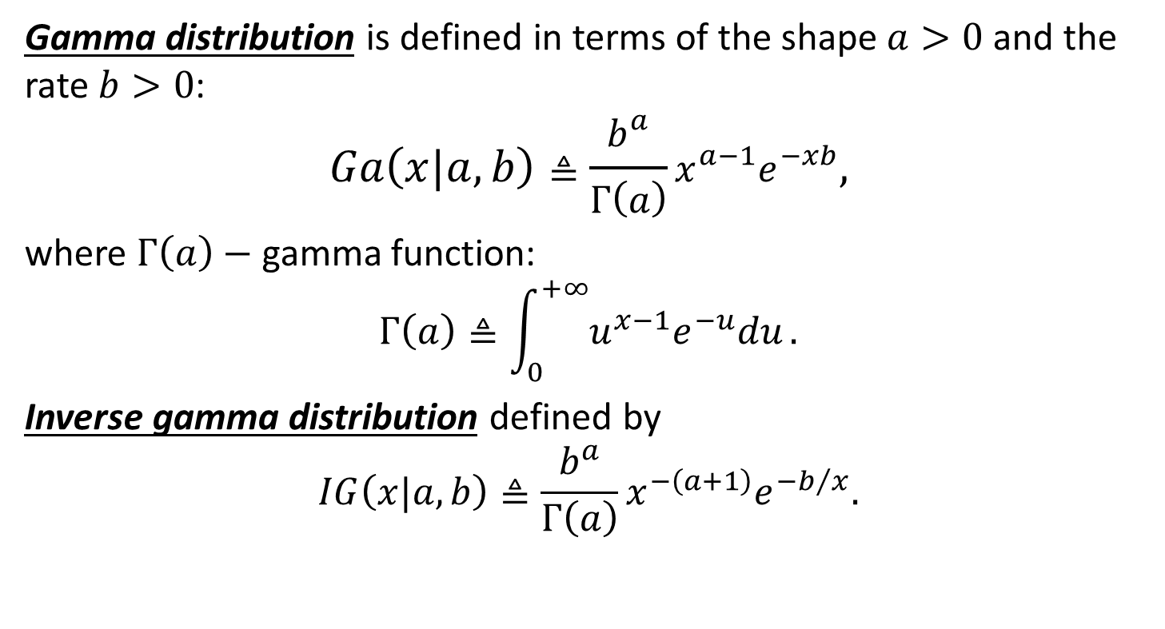
Continuous distributions (5/8). Gamma distribution
Gamma distribution is defined in terms of the shape $a>0$ and the rate $b>0$:
$$Ga\left(x|a,b\right)≜\frac{b^{a}}{Γ\left(a\right)}x^{a−1}e^{−xb},$$
where $Γ\left(a\right)−$ gamma function:
$$Γ\left(a\right)≜\int_{0}^{+∞}{u^{x−1}e^{−u}du}.$$
Inverse gamma distribution defined by
$$IG\left(x|a,b\right)≜\frac{b^{a}}{Γ\left(a\right)}x^{−\left(a+1\right)}e^{{−b}/x}.$$

Slide 13
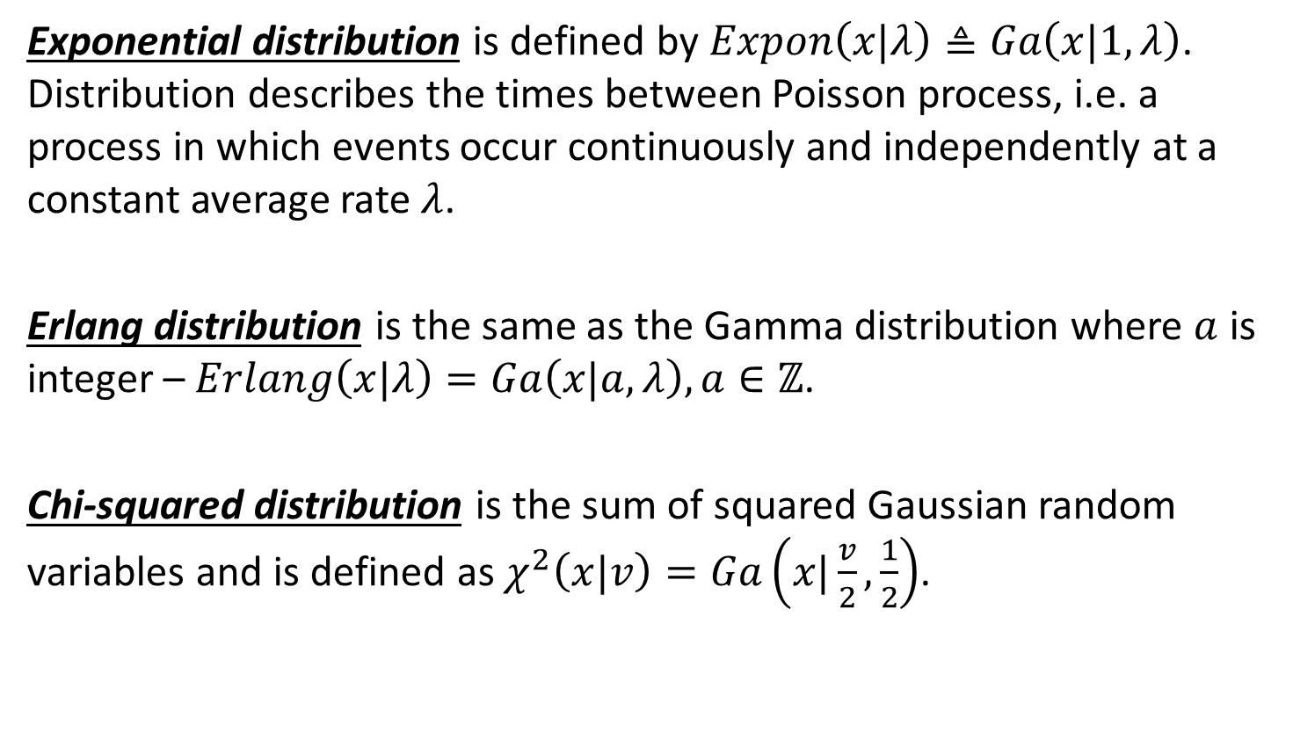
Continuous distributions (6/8). Special cases of gamma distribution
Exponential distribution is defined by $Expon\left(x|λ\right)≜Ga\left(x|1,λ\right)$. Distribution describes the times between Poisson process, i.e. a process in which events occur continuously and independently at a constant average rate $λ$.
Erlang distribution is the same as the Gamma distribution where $a$ is integer – $Erlang\left(x|λ\right)=Ga\left(x|a,λ\right), a∈ℤ$.
Chi-squared distribution is the sum of squared Gaussian random variables and is defined as $χ^{2}\left(x|v\right)=Ga\left(x|\frac{v}{2}, \frac{1}{2}\right)$.

Slide 14
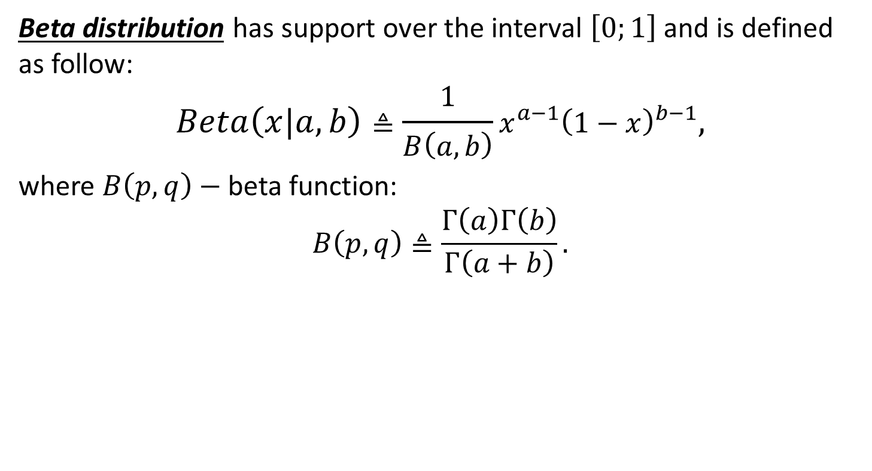
Continuous distributions (7/8). Beta distribution
Beta distribution has support over the interval $\left[0;1\right]$ and is defined as follow:
$$Beta\left(x|a,b\right)≜\frac{1}{B\left(a, b\right)}x^{a−1}{\left(1−x\right)}^{b−1},$$
where $B\left(p, q\right)−$ beta function:
$$B\left(p, q\right)≜\frac{Γ\left(a\right)Γ\left(b\right)}{Γ\left(a+b\right)}.$$

Slide 15
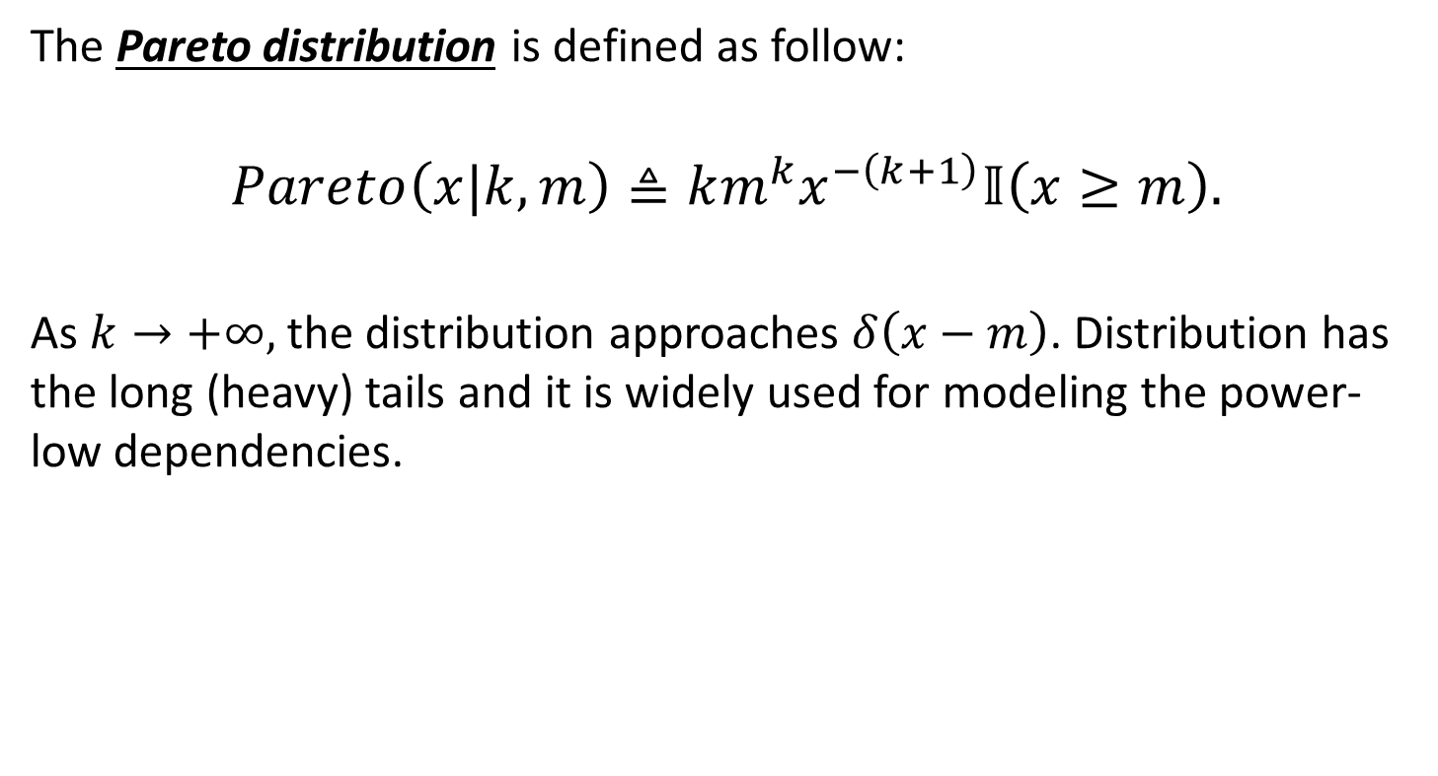
Continuous distributions (8/8). Pareto distribution
The Pareto distribution is defined as follow:
$$Pareto\left(x|k,m\right)≜km^{k}x^{−\left(k+1\right)}𝕀\left(x≥m\right).$$
As $k→+∞,$ the distribution approaches $δ\left(x−m\right)$. Distribution has the long (heavy) tails and it is widely used for modeling the power-low dependencies.

Slide 16
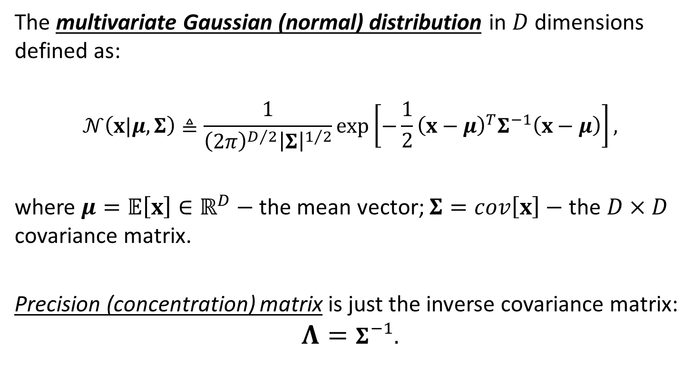
Joint probability distributions (1/3). Multivariate Gaussian
The multivariate Gaussian (normal) distribution in $D$ dimensions defined as:
$$𝒩\left(x|μ, Σ\right)≜\frac{1}{{\left(2π\right)}^{D/2}{\left|Σ\right|}^{1/2}}exp\left[−\frac{1}{2}{\left(x−μ\right)}^{T}Σ^{−1}\left(x−μ\right)\right],$$
where $μ=𝔼\left[x\right]∈ℝ^{D}−$ the mean vector; $Σ=cov\left[x\right]−$ the $D×D$ covariance matrix.
Precision (concentration) matrix is just the inverse covariance matrix:
$$Λ=Σ^{−1}.$$

Slide 17
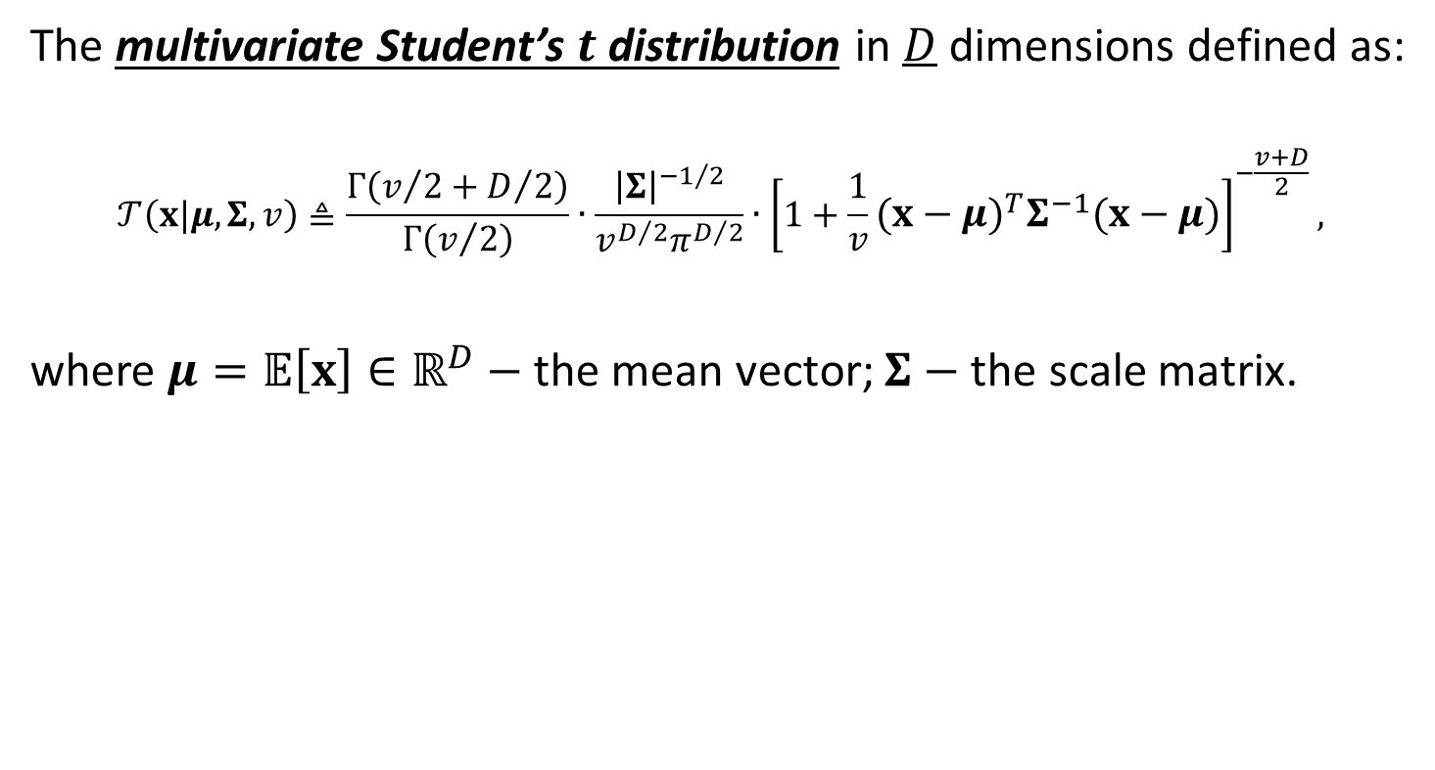
Joint probability distributions (2/3). Multivariate Student distribution
The multivariate Student’s $t$ distribution in $D$ dimensions defined as:
$$𝒯\left(x|μ, Σ,v\right)≜\frac{Γ\left(v/2+D/2\right)}{Γ\left(v/2\right)}∙\frac{{\left|Σ\right|}^{{−1}/2}}{v^{D/2}π^{D/2}}∙{\left[1+\frac{1}{v}{\left(x−μ\right)}^{T}Σ^{−1}\left(x−μ\right)\right]}^{−\frac{v+D}{2}},$$
where $μ=𝔼\left[x\right]∈ℝ^{D}−$ the mean vector; $Σ−$ the scale matrix.

Slide 18
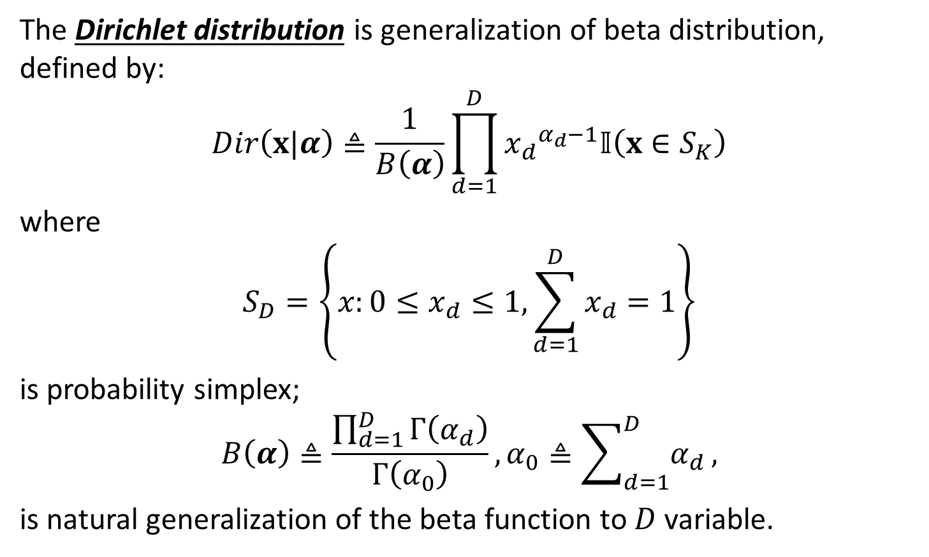
Joint probability distributions (3/3). Dirichlet distribution
The Dirichlet distribution is generalization of beta distribution, defined by:
$$Dir\left(x|α\right)≜\frac{1}{B\left(α\right)}\prod_{d=1}^{D}{{x_{d}}^{α_{d}−1}𝕀\left(x∈S_{K}\right)}$$
where
$$S_{D}=\left\{x:0≤x_{d}≤1,\sum_{d=1}^{D}{x_{d}=1}\right\}$$
is probability simplex;
$$B\left(α\right)≜\frac{\prod_{d=1}^{D}{Γ\left(α_{d}\right)}}{Γ\left(α_{0}\right)}, α_{0}≜\sum_{d=1}^{D}{α_{d}},$$
is natural generalization of the beta function to $D$ variable.

Slide 19
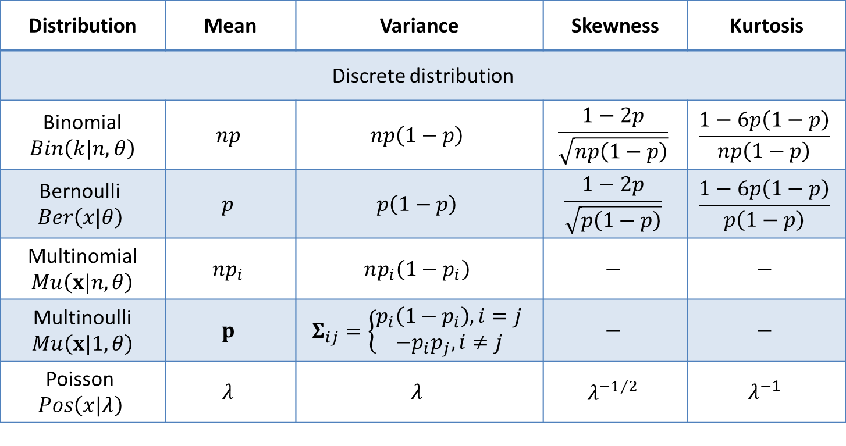
Characteristics of discrete and continuous distributions
Distribution | Mean | Variance | Skewness | Kurtosis
Discrete distribution
Binomial $Bin\left(k|n, θ\right)$ | $$np$$ | $$np\left(1−p\right)$$ | $$\frac{1−2p}{\sqrt{np\left(1−p\right)}}$$ | $$\frac{1−6p\left(1−p\right)}{np\left(1−p\right)}$$
Bernoulli $$Ber\left(x|θ\right)$$ | $$p$$ | $$p\left(1−p\right)$$ | $$\frac{1−2p}{\sqrt{p\left(1−p\right)}}$$ | $$\frac{1−6p\left(1−p\right)}{p\left(1−p\right)}$$
Multinomial $Mu\left(x|n, θ\right)$ | $$np_{i}$$ | $$np_{i}\left(1−p_{i}\right)$$ | $$−$$ | $$−$$
Multinoulli $Mu\left(x|1, θ\right)$ | $$p$$ | $$Σ_{ij}=\left\{\begin{matrix}p_{i}\left(1−p_{i}\right), i=j \\ −p_{i}p_{j}, i≠j\end{matrix}\right.$$ | $$−$$ | $$−$$
Poisson $$Pos\left(x|λ\right)$$ | $$λ$$ | $$λ$$ | $$λ^{−1/2}$$ | $$λ^{−1}$$

Slide 20
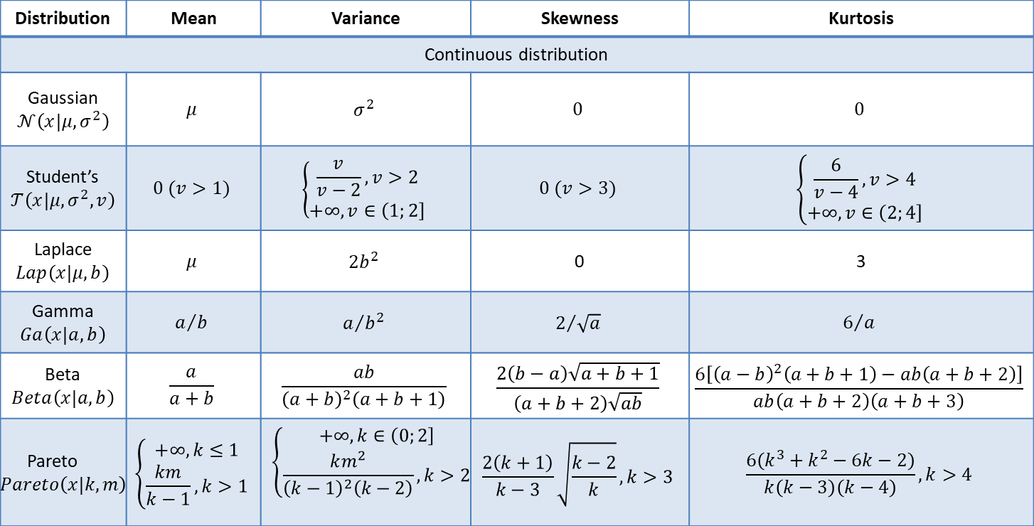
Characteristics of discrete and continuous distributions
Distribution | Mean | Variance | Skewness | Kurtosis
Continuous distribution
Gaussian $𝒩\left(x|μ, σ^{2}\right)$ | $$μ$$ | $$σ^{2}$$ | $$0$$ | $$0$$
Student’s $𝒯\left(x|μ,σ^{2},v\right)$ | $$0 (v>1)$$ | $$\left\{\begin{matrix}\frac{v}{v−2}, v>2 \\ +∞,v∈\left(\left.1;2\right]\right.\end{matrix}\right.$$ | $$0 (v>3)$$ | $$\left\{\begin{matrix}\frac{6}{v−4}, v>4 \\ +∞,v∈\left(\left.2;4\right]\right.\end{matrix}\right.$$
Laplace $Lap\left(x|μ,b\right)$ | $$μ$$ | $$2b^{2}$$ | 0 | 3
Gamma $Ga\left(x|a,b\right)$ | $$a/b$$ | $$a/{b^{2}}$$ | $$2/{\sqrt{a}}$$ | $$6/a$$
Beta $Beta\left(x|a,b\right)$ | $$\frac{a}{a+b}$$ | $$\frac{ab}{{\left(a+b\right)}^{2}\left(a+b+1\right)}$$ | $$\frac{2\left(b−a\right)\sqrt{a+b+1}}{\left(a+b+2\right)\sqrt{ab}}$$ | $$\frac{6\left[{\left(a−b\right)}^{2}\left(a+b+1\right)−ab\left(a+b+2\right)\right]}{ab\left(a+b+2\right)\left(a+b+3\right)}$$
Pareto $Pareto\left(x|k,m\right)$ | $$\left\{\begin{matrix}+∞, k≤1 \\ \frac{km}{k−1}, k>1\end{matrix}\right.$$ | $$\left\{\begin{matrix}+∞, k∈\left(\left.0;2\right]\right. \\ \frac{km^{2}}{{\left(k−1\right)}^{2}\left(k−2\right)}, k>2\end{matrix}\right.$$ | $$\frac{2\left(k+1\right)}{k−3}\sqrt{\frac{k−2}{k}}, k>3$$ | $$\frac{6\left(k^{3}+k^{2}−6k−2\right)}{k\left(k−3\right)\left(k−4\right)}, k>4$$

Slide 21
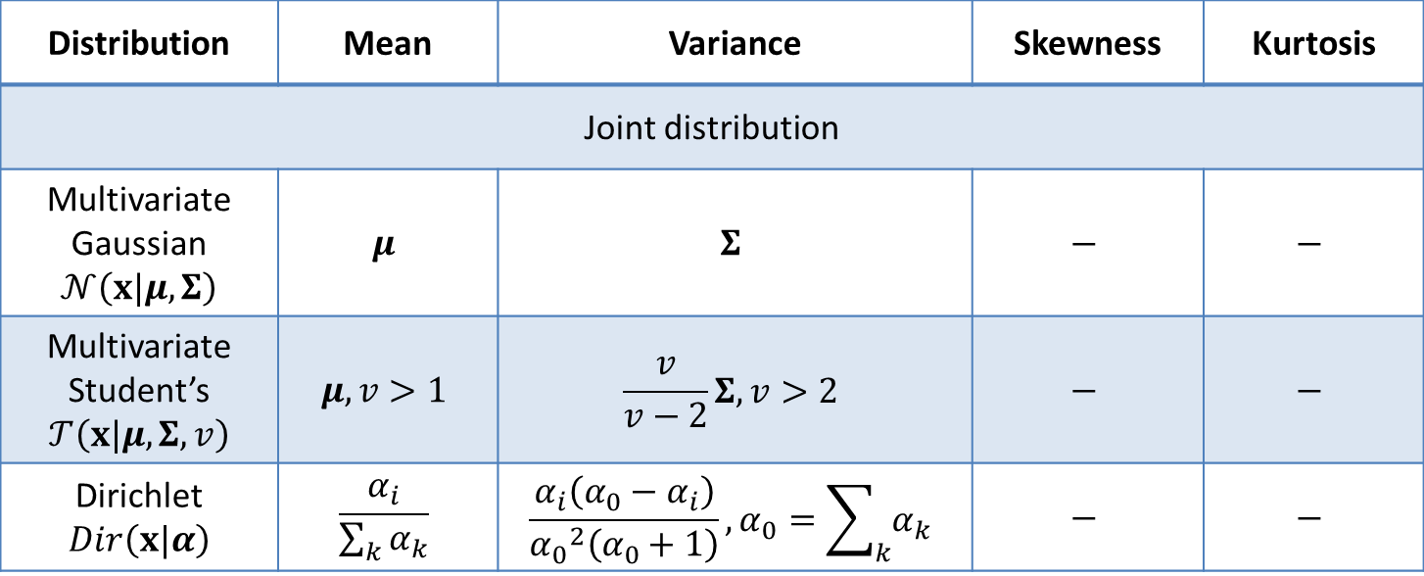
Characteristics of discrete and continuous distributions
Distribution | Mean | Variance | Skewness | Kurtosis
Joint distribution
Multivariate Gaussian $𝒩\left(x|μ, Σ\right)$ | $$μ$$ | $$Σ$$ | $$−$$ | $$−$$
Multivariate Student’s $𝒯\left(x|μ, Σ,v\right)$ | $$μ, v>1$$ | $$\frac{v}{v−2}Σ, v>2$$ | $$−$$ | $$−$$
Dirichlet $Dir\left(x|α\right)$ | $$\frac{α_{i}}{\sum_{k}{α_{k}}}$$ | $$\frac{α_{i}\left(α_{0}−α_{i}\right)}{{α_{0}}^{2}\left(α_{0}+1\right)},α_{0}=\sum_{k}{α_{k}}$$ | $$−$$ | $$−$$

Slide 22
Conclusion
Common discrete, continuous and joint probability distributions were considered;
Key parameters of these distributions were presented.

