Slide 1
Lecture 4 Generative Models for Discrete Data. Gaussian Models
Dmytro Progonov,
PhD, Associate Professor

Slide 2
Content
Gaussian models definitions;
Maximum Likelihood Estimation for MVN;
Gaussian Discriminant Analysis;
MLE for Discriminant Analysis;
Strategies for preventing overfitting;
Interference in jointly Gaussian distribution;
Linear Gaussian systems.

Slide 3
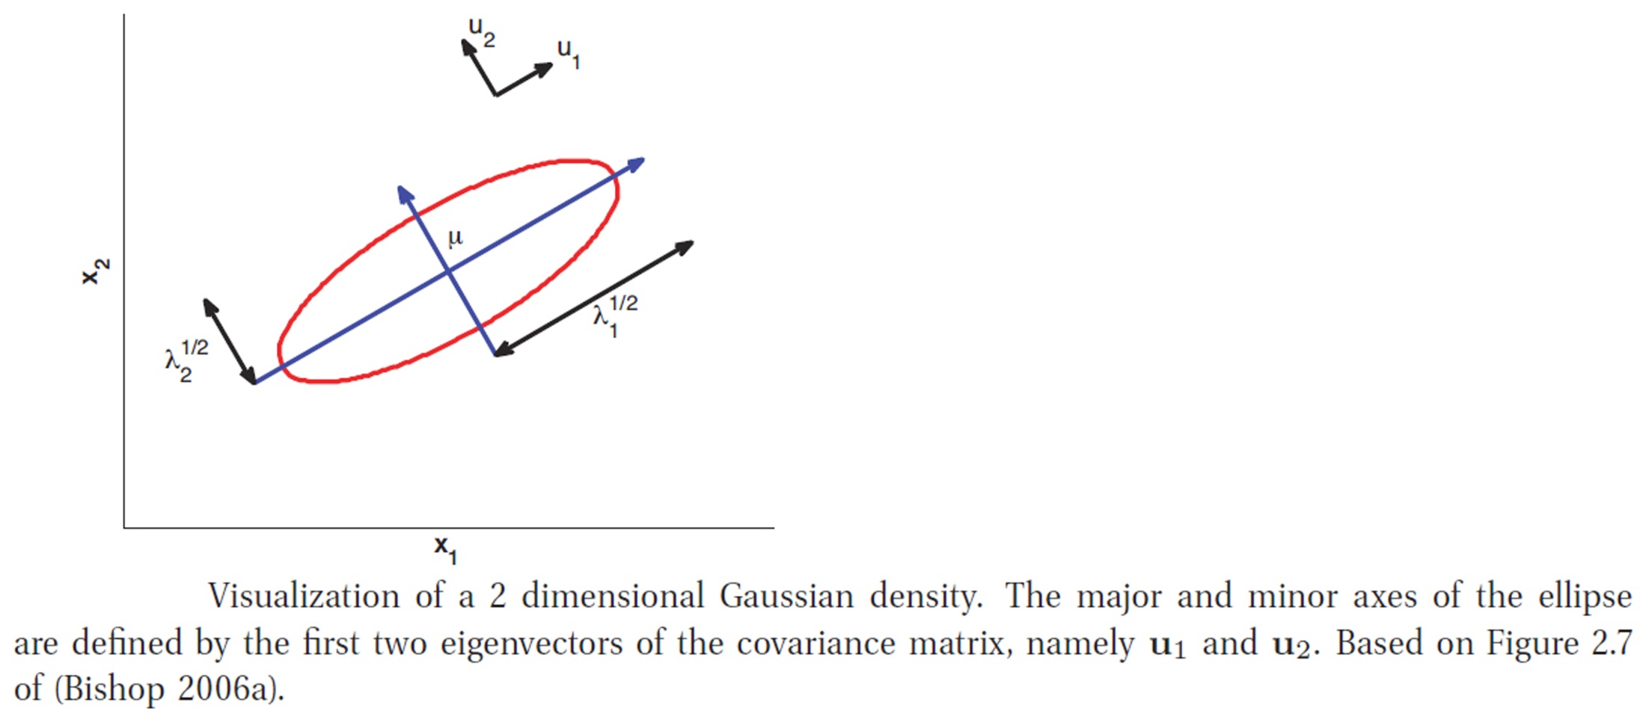
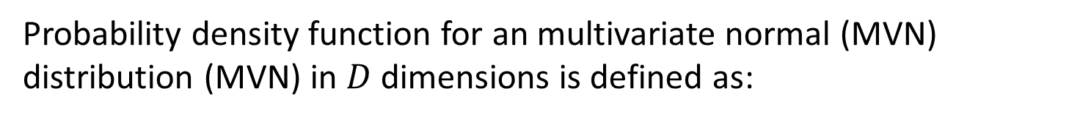

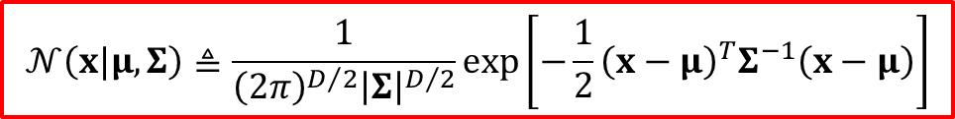
Gaussian models definitions
Probability density function for an multivariate normal (MVN) distribution (MVN) in $D$ dimensions is defined as:
$$𝒩\left(x|μ, Σ\right)≜\frac{1}{{\left(2π\right)}^{D/2}{\left|Σ\right|}^{D/2}}\exp\left[−\frac{1}{2}{\left(x−μ\right)}^{T}Σ^{−1}\left(x−μ\right)\right]$$
Mahalanobis distance between a data vector $x$ and the mean vector $μ$

Slide 4
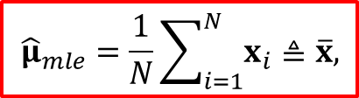
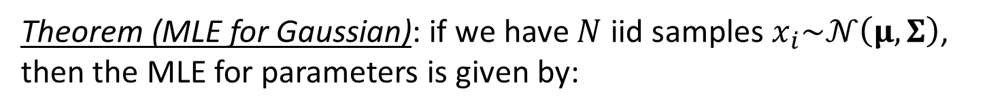
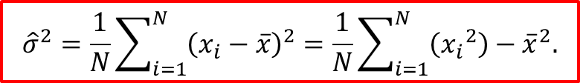
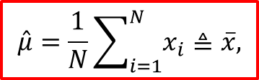
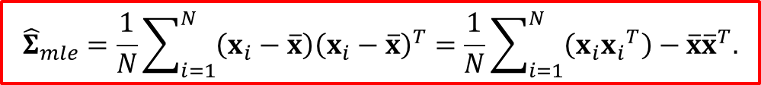
Maximum Likelihood Estimation for MVN
Theorem (MLE for Gaussian): if we have $N$ iid samples $x_{i}\sim 𝒩\left(μ, Σ\right)$, then the MLE for parameters is given by:
$${\hat{μ}}_{mle}=\frac{1}{N}\sum_{i=1}^{N}{x_{i}}≜\overline{x},$$
$${\hat{Σ}}_{mle}=\frac{1}{N}\sum_{i=1}^{N}{\left(x_{i}−\overline{x}\right){\left(x_{i}−\overline{x}\right)}^{T}}=\frac{1}{N}\sum_{i=1}^{N}{\left(x_{i}{x_{i}}^{T}\right)}−\overline{x}{\overline{x}}^{T}.$$
That is, the MLE is just the empirical mean and empirical covariance.
For univariate case, we get the following familiar results:
$$\hat{μ}=\frac{1}{N}\sum_{i=1}^{N}{x_{i}}≜\overline{x},$$
$${\hat{σ}}^{2}=\frac{1}{N}\sum_{i=1}^{N}{{\left(x_{i}−\overline{x}\right)}^{2}}=\frac{1}{N}\sum_{i=1}^{N}{\left({x_{i}}^{2}\right)}−{\overline{x}}^{2}.$$

Slide 5


Gaussian Discriminant Analysis (1/3)
One important application of MVN is to define the class conditional density in a generative classifier:
$$p\left(x|y=c, θ\right)=𝒩\left(x|μ_{c}, Σ_{c}\right)$$
We can classify the feature vector using the following decision rule (nearest centroid classifier):
$$\hat{y}\left(x\right)=\underset{c}{argmax}\left[\log\left(p\left(y=c|π\right)\right)+\log\left(p\left(x|θ_{c}\right)\right)\right]$$

Slide 6

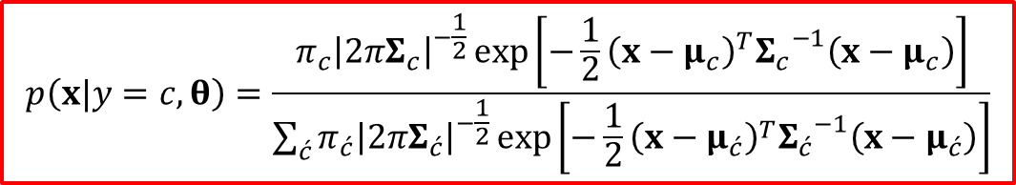

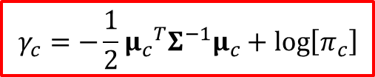
Gaussian Discriminant Analysis (2/3)
By plugging in the definition of Gaussian density the posteriors over the class labels, we obtain quadratic discriminant analysis:
$$p\left(x|y=c, θ\right)=\frac{π_{c}{\left|2πΣ_{c}\right|}^{−\frac{1}{2}}\exp\left[−\frac{1}{2}{\left(x−μ_{c}\right)}^{T}{Σ_{c}}^{−1}\left(x−μ_{c}\right)\right]}{\sum_{\acute{c}}{π_{\acute{c}}{\left|2πΣ_{\acute{c}}\right|}^{−\frac{1}{2}}\exp\left[−\frac{1}{2}{\left(x−μ_{\acute{c}}\right)}^{T}{Σ_{\acute{c}}}^{−1}\left(x−μ_{\acute{c}}\right)\right]}}$$
Consider a special case in which the covariance matrices are tied or shared across classes ($Σ_{c}=Σ$):
$$p\left(x|y=c, θ\right)∝\exp\left[{μ_{c}}^{T}Σ^{−1}x−\frac{1}{2}{μ_{c}}^{T}Σ^{−1}μ_{c}+\log\left[π_{c}\right]\right]\exp\left[−\frac{1}{2}x^{T}Σ^{−1}x\right]$$
Let us define:
$$γ_{c}=−\frac{1}{2}{μ_{c}}^{T}Σ^{−1}μ_{c}+\log\left[π_{c}\right]$$
$$β_{c}=Σ^{−1}μ_{c}$$

Slide 7

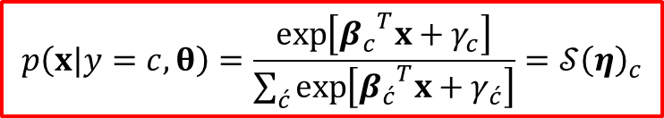
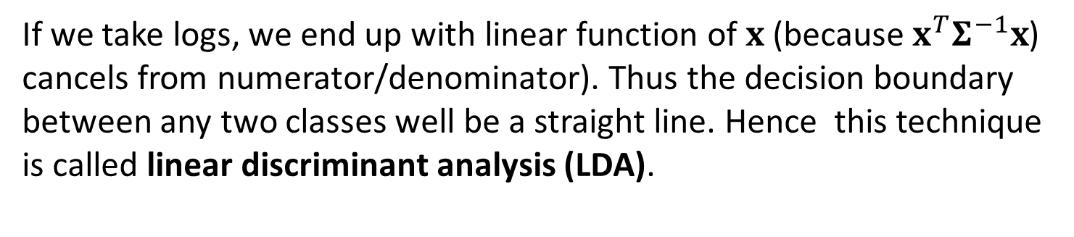
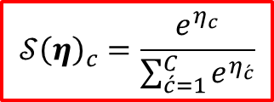
Gaussian Discriminant Analysis (3/3)
Then we can write:
$$p\left(x|y=c, θ\right)=\frac{\exp\left[{β_{c}}^{T}x+γ_{c}\right]}{\sum_{\acute{c}}{\exp\left[{β_{\acute{c}}}^{T}x+γ_{\acute{c}}\right]}}=𝒮{\left(η\right)}_{c}$$
where $η=\left[{β_{1}}^{T}x+γ_{1},⋯{{,β}_{C}}^{T}x+γ_{C}\right]$, and $𝒮$ is softmax function defined as:
$$𝒮{\left(η\right)}_{c}=\frac{e^{η_{c}}}{\sum_{\acute{c}=1}^{C}{e^{η_{\acute{c}}}}}$$
If we take logs, we end up with linear function of $x$ (because $x^{T}Σ^{−1}x$) cancels from numerator/denominator). Thus the decision boundary between any two classes well be a straight line. Hence this technique is called linear discriminant analysis (LDA).

Slide 8
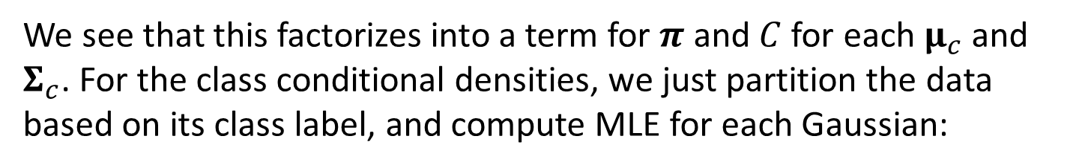
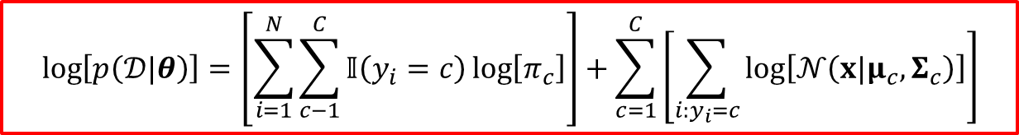
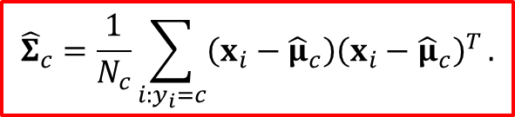
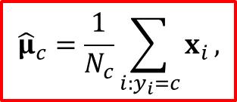
MLE for Discriminant Analysis
The simplest way to fit a discriminant analysis model I to use maximum likelihood:
$$\log\left[p\left(𝒟|θ\right)\right]=\left[\sum_{i=1}^{N}{\sum_{c−1}^{C}{𝕀\left(y_{i}=c\right)\log\left[π_{c}\right]}}\right]+\sum_{c=1}^{C}{\left[\sum_{i:y_{i}=c}{\log\left[𝒩\left(x|μ_{c}, Σ_{c}\right)\right]}\right]}$$
We see that this factorizes into a term for $π$ and $C$ for each $μ_{c}$ and $Σ_{c}$. For the class conditional densities, we just partition the data based on its class label, and compute MLE for each Gaussian:
$${\hat{μ}}_{c}=\frac{1}{N_{c}}\sum_{i:y_{i}=c}{x_{i}},$$
$${\hat{Σ}}_{c}=\frac{1}{N_{c}}\sum_{i:y_{i}=c}{\left(x_{i}−{\hat{μ}}_{c}\right){\left(x_{i}−{\hat{μ}}_{c}\right)}^{T}}.$$

Slide 9
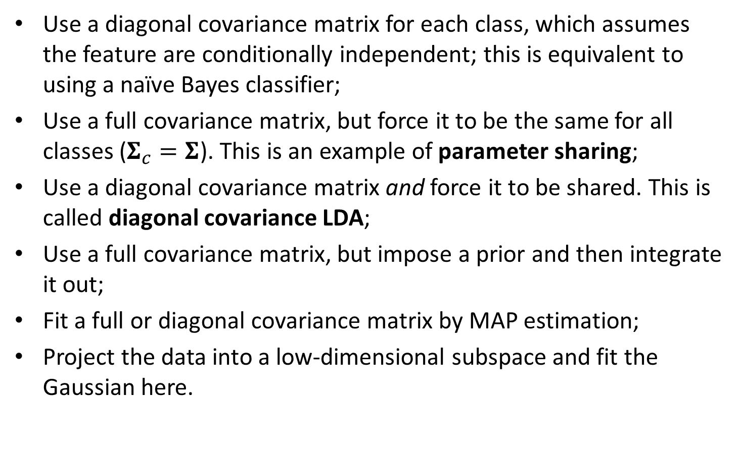
Strategies for preventing overfitting
Use a diagonal covariance matrix for each class, which assumes the feature are conditionally independent; this is equivalent to using a naïve Bayes classifier;
Use a full covariance matrix, but force it to be the same for all classes ($Σ_{c}=Σ$). This is an example of parameter sharing;
Use a diagonal covariance matrix and force it to be shared. This is called diagonal covariance LDA;
Use a full covariance matrix, but impose a prior and then integrate it out;
Fit a full or diagonal covariance matrix by MAP estimation;
Project the data into a low-dimensional subspace and fit the Gaussian here.

Slide 10


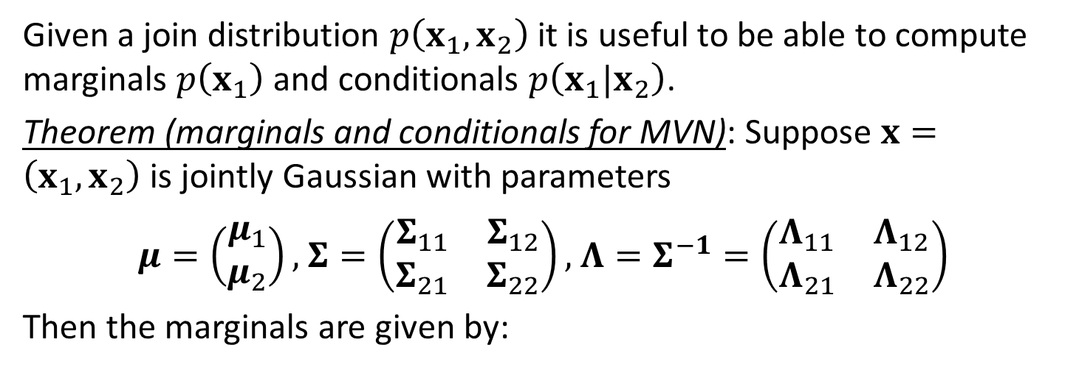



Interference in jointly Gaussian distribution
Given a join distribution $p\left(x_{1},x_{2}\right)$ it is useful to be able to compute marginals $p\left(x_{1}\right)$ and conditionals $p\left(x_{1}|x_{2}\right)$.
Theorem (marginals and conditionals for MVN): Suppose $x=\left(x_{1},x_{2}\right)$ is jointly Gaussian with parameters
$μ=\left(\begin{matrix}μ_{1} \\ μ_{2}\end{matrix}\right),$ $Σ=\left(\begin{matrix}Σ_{11} & Σ_{12} \\ Σ_{21} & Σ_{22}\end{matrix}\right),$ $Λ=Σ^{−1}=\left(\begin{matrix}Λ_{11} & Λ_{12} \\ Λ_{21} & Λ_{22}\end{matrix}\right)$
Then the marginals are given by:
$$p\left(x_{1}\right)=𝒩\left(x_{1}|μ_{1},Σ_{11}\right)$$
$$p\left(x_{2}\right)=𝒩\left(x_{2}|μ_{2},Σ_{22}\right)$$
and the posterior conditional is given by:
$$p\left(x_{1}|x_{2}\right)=𝒩\left(x_{1}|μ_{1|2},Σ_{1|2}\right)$$
$$μ_{1|2}=Σ_{1|2}\left(Λ_{11}μ_{1}−Λ_{12}\left(x_{2}−μ_{2}\right)\right)$$
$$Σ_{1|2}=Σ_{11}−Σ_{12}{Σ_{22}}^{−1}Σ_{21}={Λ_{11}}^{−1}$$

Slide 11



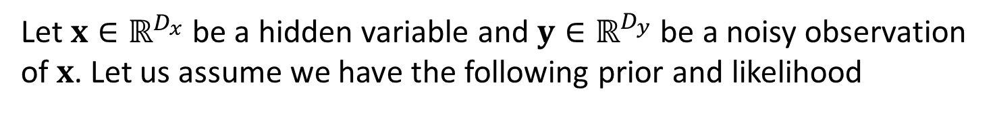

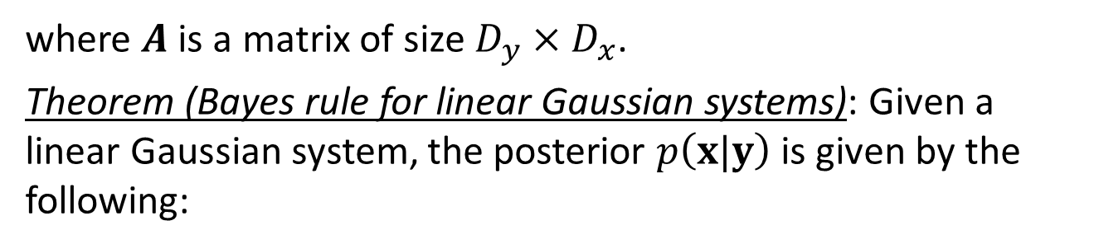


Linear Gaussian systems
Let $x∈ℝ^{D_{x}}$ be a hidden variable and $y∈ℝ^{D_{y}}$ be a noisy observation of $x$. Let us assume we have the following prior and likelihood
$$p\left(x\right)=𝒩\left(x|μ_{x},Σ_{x}\right)$$
$$p\left(y|x\right)=𝒩\left(y|Ax+b,Σ_{y}\right)$$
where $A$ is a matrix of size $D_{y}×D_{x}$.
Theorem (Bayes rule for linear Gaussian systems): Given a linear Gaussian system, the posterior $p\left(x|y\right)$ is given by the following:
$$p\left(x|y\right)=𝒩\left(x|μ_{x|y},Σ_{x|y}\right)$$
$$μ_{x|y}=Σ_{x|y}\left(A^{T}{Σ_{y}}^{−1}\left(y−b\right)+{Σ_{x}}^{−1}μ_{x}\right)$$
$${Σ_{x|y}}^{−1}={Σ_{x}}^{−1}+A^{T}{Σ_{y}}^{−1}A$$
The normalization constant $p\left(y\right)$ is given by:
$$p\left(y\right)=𝒩\left(y|Aμ_{x}+b,Σ_{y}+A^{T}Σ_{x}A \right)$$

Slide 12
Conclusion
Definitions of Gaussian models and Linear Gaussian systems were considered;
Maximum Likelihood Estimation procedure for Gaussian Discriminant Analysis was introduced;
Strategies for preventing overfitting were presented;
Methods for interference in jointly Gaussian distribution was shown.

