Slide 1
Lecture 8 Generative Models for Discrete Data. Markov Models
Dmytro Progonov,
PhD, Associate Professor

Slide 2
Content
Markov models;
Transition matrix;
Stationary distribution of a Markov chain:
Computing the stationary distribution;
Conditions of stationary distribution;
Detailed balance
Hidden Markov models;
Types of inference problems in HMMs;
Generalizations of HMMs.

Slide 3
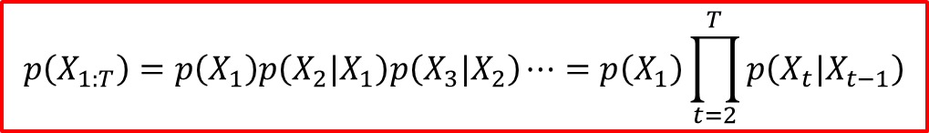
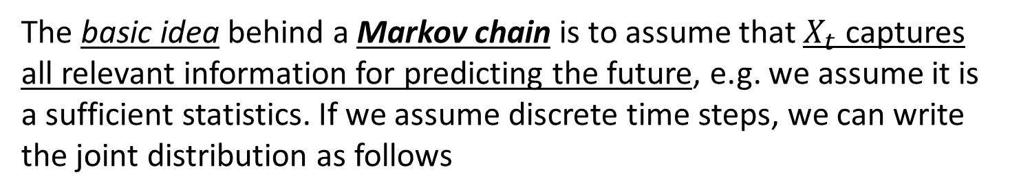
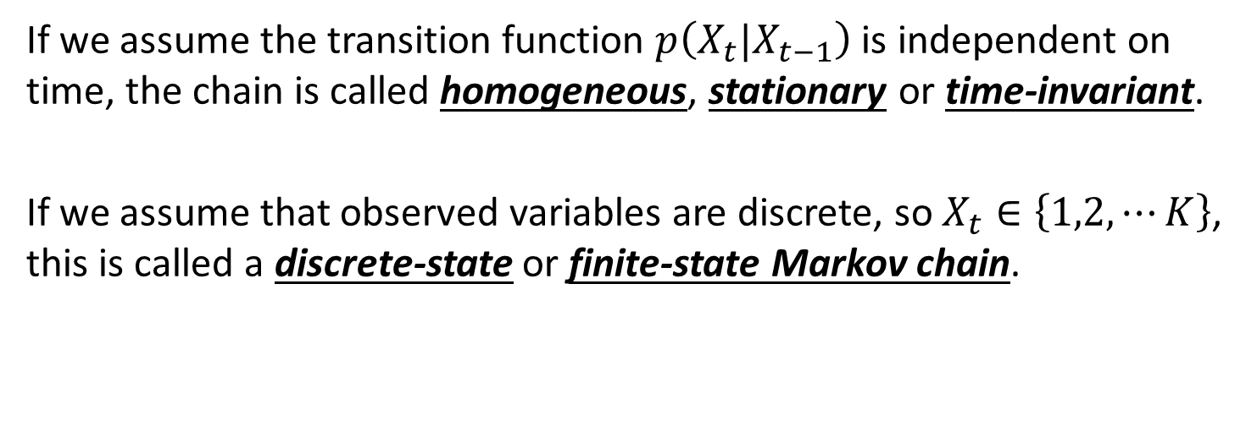
Markov models
The basic idea behind a Markov chain is to assume that $X_{t}$ captures all relevant information for predicting the future, e.g. we assume it is a sufficient statistics. If we assume discrete time steps, we can write the joint distribution as follows
$$p\left(X_{1:T}\right)=p\left(X_{1}\right)p\left(X_{2}|X_{1}\right)p\left(X_{3}|X_{2}\right)⋯=p\left(X_{1}\right)\prod_{t=2}^{T}{p\left(X_{t}|X_{t−1}\right)}$$
If we assume the transition function $p\left(X_{t}|X_{t−1}\right)$ is independent on time, the chain is called homogeneous, stationary or time-invariant.
If we assume that observed variables are discrete, so $X_{t}∈\left\{1,2,⋯K\right\}$, this is called a discrete-state or finite-state Markov chain.

Slide 4
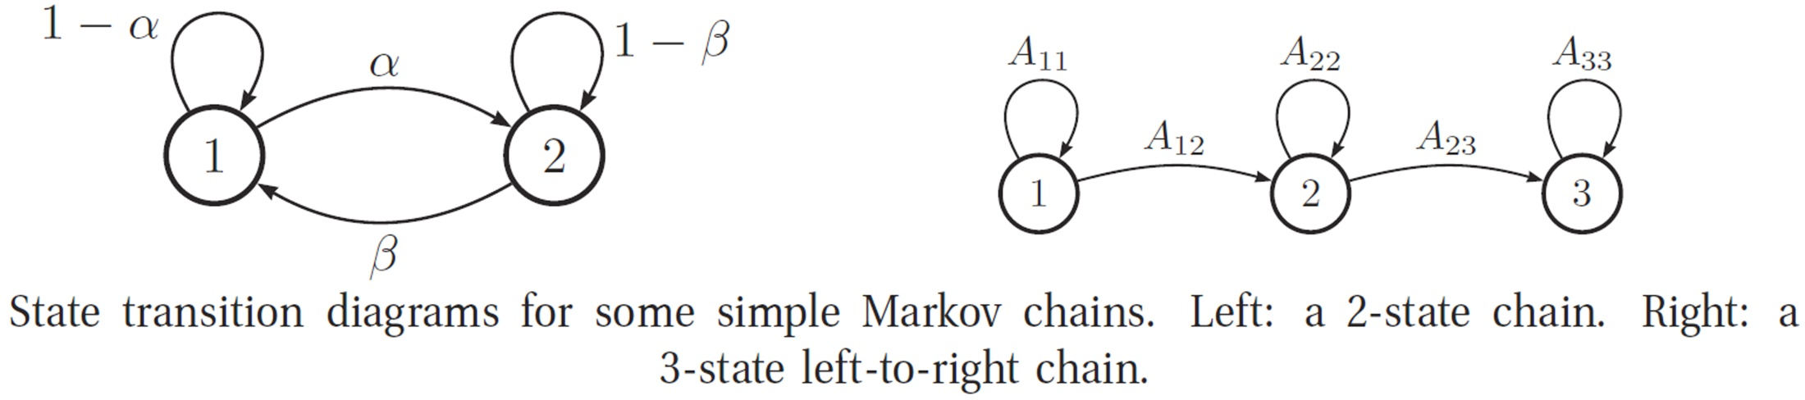
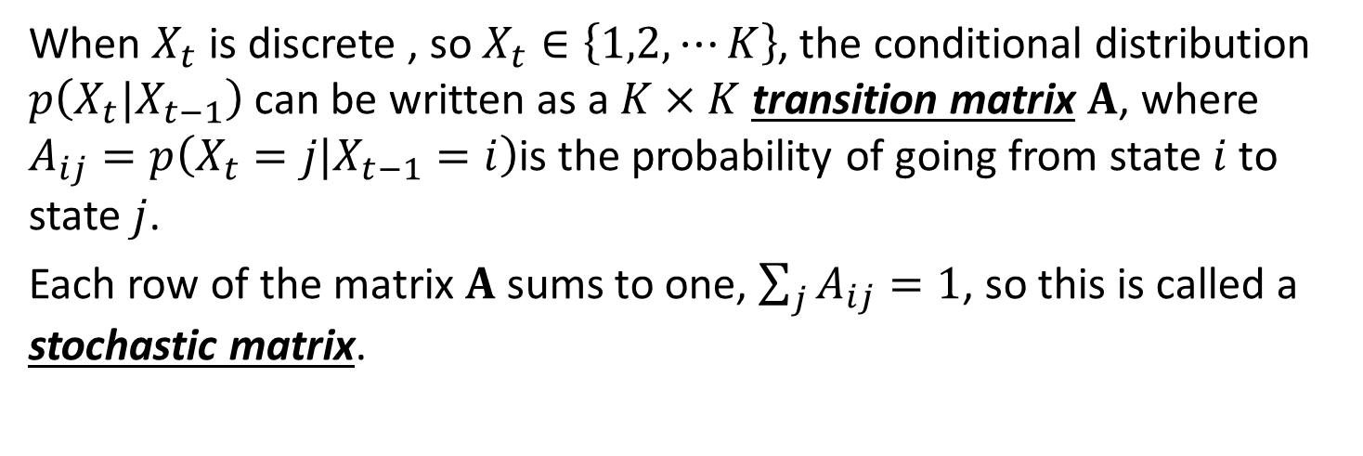
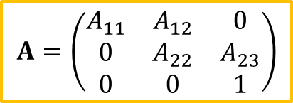
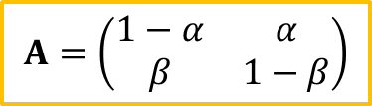
Transition matrix (1/2)
When $X_{t}$ is discrete , so $X_{t}∈\left\{1,2,⋯K\right\}$, the conditional distribution $p\left(X_{t}|X_{t−1}\right)$ can be written as a $K×K$ transition matrix $A$, where $A_{ij}=p\left(X_{t}=j|X_{t−1}=i\right)$is the probability of going from state $i$ to state $j$.
Each row of the matrix $A$ sums to one, $\sum_{j}{A_{ij}}=1$, so this is called a stochastic matrix.
$$A=\left(\begin{matrix}1−α & α \\ β & 1−β\end{matrix}\right)$$
$$A=\left(\begin{matrix}A_{11} & A_{12} & 0 \\ 0 & A_{22} & A_{23} \\ 0 & 0 & 1\end{matrix}\right)$$

Slide 5



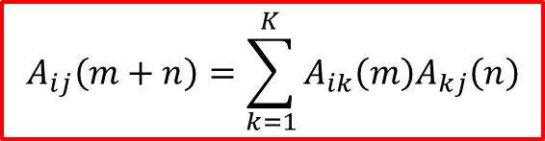

Transition matrix (2/2)
The $n−$step transition matrix $A\left(n\right)$ is defined as
$$A_{ij}\left(n\right)≜p\left(X_{t+n}=i| X_{t}=j\right)$$
which is the probability of getting from $i$ to $j$ in exactly $n$ steps. Obviously $A\left(1\right)=A$. The Chapman-Kolmogorov equations state that
$$A_{ij}\left(m+n\right)=\sum_{k=1}^{K}{A_{ik}\left(m\right)A_{kj}\left(n\right)}$$
We can write the above as a matrix multiplication
$$A\left(m+n\right)=A\left(m\right)A\left(n\right)$$
$$A\left(n\right)=A^{n}$$

Slide 6
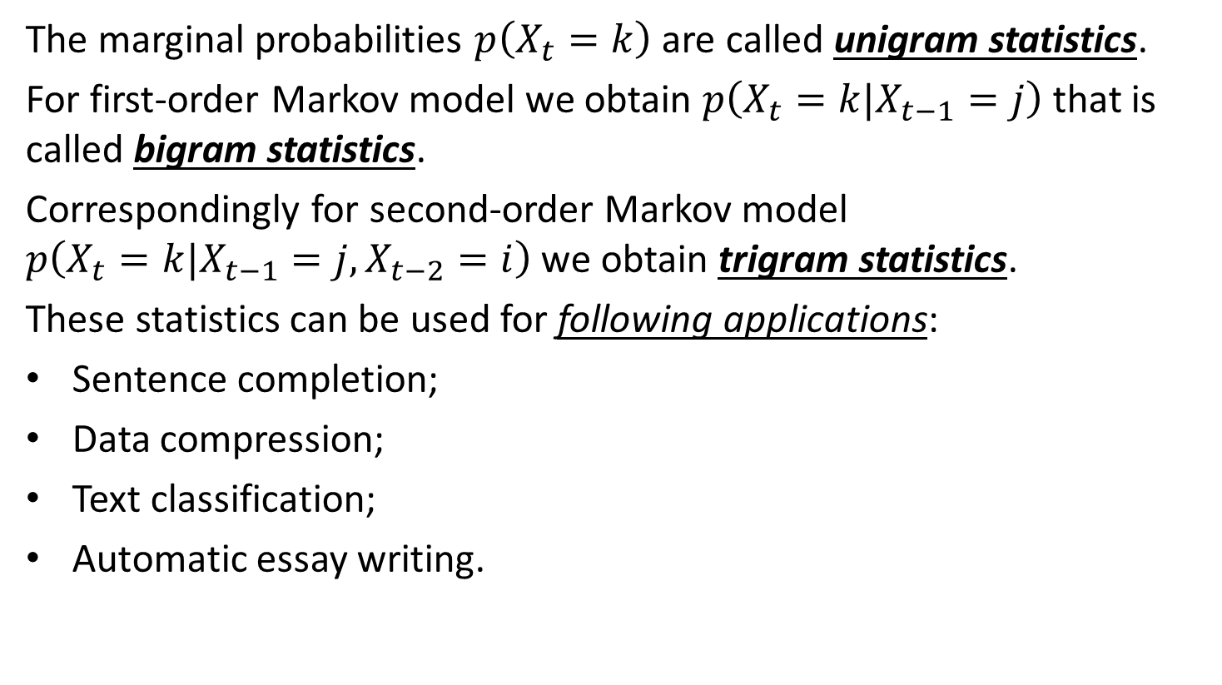
Markov model application: Language modelling
The marginal probabilities $p\left(X_{t}=k\right)$ are called unigram statistics.
For first-order Markov model we obtain $p\left(X_{t}=k|X_{t−1}=j\right)$ that is called bigram statistics.
Correspondingly for second-order Markov model $p\left(X_{t}=k|X_{t−1}=j,X_{t−2}=i\right)$ we obtain trigram statistics.
These statistics can be used for following applications:
Sentence completion;
Data compression;
Text classification;
Automatic essay writing.

Slide 7
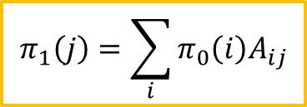
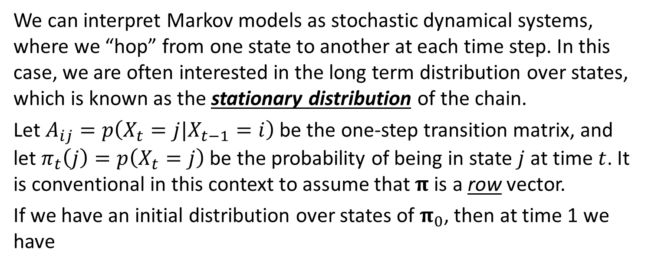

Stationary distribution of a Markov chain (1/2)
We can interpret Markov models as stochastic dynamical systems, where we “hop” from one state to another at each time step. In this case, we are often interested in the long term distribution over states, which is known as the stationary distribution of the chain.
Let $A_{ij}=p\left(X_{t}=j|X_{t−1}=i\right)$ be the one-step transition matrix, and let $π_{t}\left(j\right)=p\left(X_{t}=j\right)$ be the probability of being in state $j$ at time $t$. It is conventional in this context to assume that $π$ is a row vector.
If we have an initial distribution over states of $π_{0}$, then at time 1 we have
$$π_{1}\left(j\right)=\sum_{i}{π_{0}\left(i\right)A_{ij}}$$
$$π_{1}=π_{0}A$$

Slide 8

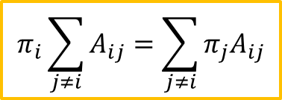
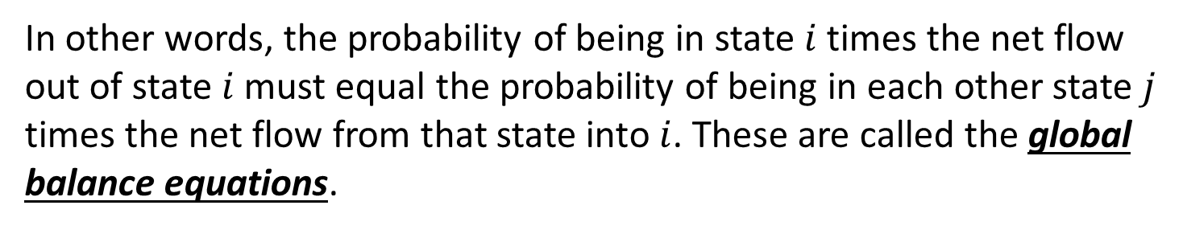
Stationary distribution of a Markov chain (2/2)
We can imagine iterating these equations. IF we ever reach a stage where
$$π=πA$$
then we say we have reached the stationary distribution, also called the invariant or equilibrium distribution. Once we enter the stationary distribution, we will never leave.
In general, we have
$$π_{i}\sum_{j≠i}{A_{ij}}=\sum_{j≠i}{π_{j}A_{ij}}$$
In other words, the probability of being in state $i$ times the net flow out of state $i$ must equal the probability of being in each other state $j$ times the net flow from that state into $i$. These are called the global balance equations.

Slide 9
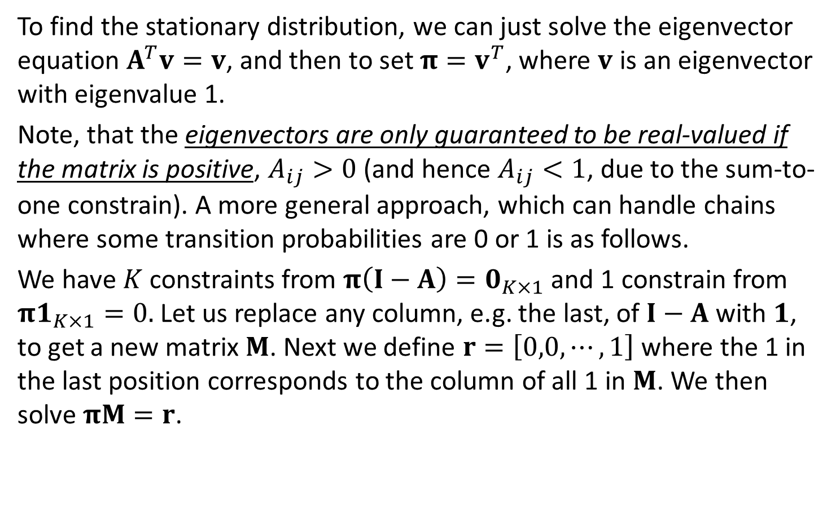
Computing the stationary distribution
To find the stationary distribution, we can just solve the eigenvector equation $A^{T}v=v$, and then to set $π=v^{T}$, where $v$ is an eigenvector with eigenvalue 1.
Note, that the eigenvectors are only guaranteed to be real-valued if the matrix is positive, $A_{ij}>0$ (and hence $A_{ij}<1$, due to the sum-to-one constrain). A more general approach, which can handle chains where some transition probabilities are 0 or 1 is as follows.
We have $K$ constraints from $π\left(I−A\right)=0_{K×1}$ and 1 constrain from $π1_{K×1}=0.$Let us replace any column, e.g. the last, of $I−A$ with $1$, to get a new matrix $M$. Next we define $r=\left[0,0,⋯,1\right]$ where the 1 in the last position corresponds to the column of all 1 in $M$. We then solve $πM=r$.

Slide 10
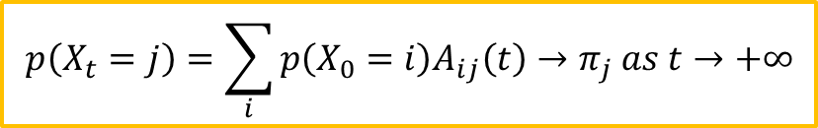
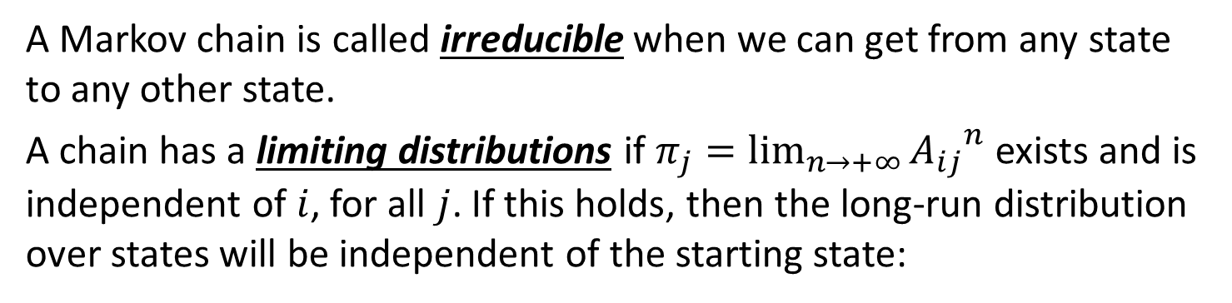
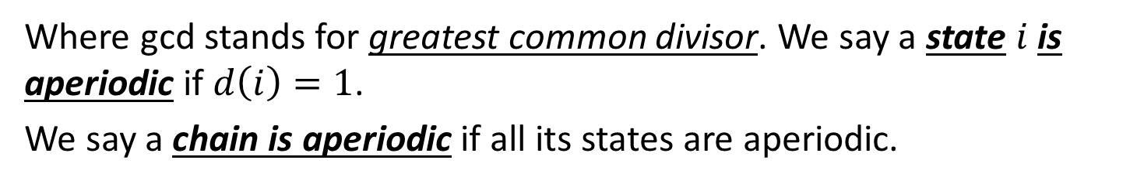

Conditions of stationary distribution (1/2)
A Markov chain is called irreducible when we can get from any state to any other state.
A chain has a limiting distributions if $π_{j}=\lim_{n→+∞}{{A_{ij}}^{n}}$ exists and is independent of $i$, for all $j$. If this holds, then the long-run distribution over states will be independent of the starting state:
$$p\left(X_{t}=j\right)=\sum_{i}{p\left(X_{0}=i\right)A_{ij}\left(t\right)}→π_{j} as t→+∞$$
Define the period of state $i$ to be
$$d\left(i\right)=\gcd\left\{t:A_{ii}\left(t\right)>0\right\}$$
Where gcd stands for greatest common divisor. We say a state $i$ is aperiodic if $d\left(i\right)=1$.
We say a chain is aperiodic if all its states are aperiodic.

Slide 11
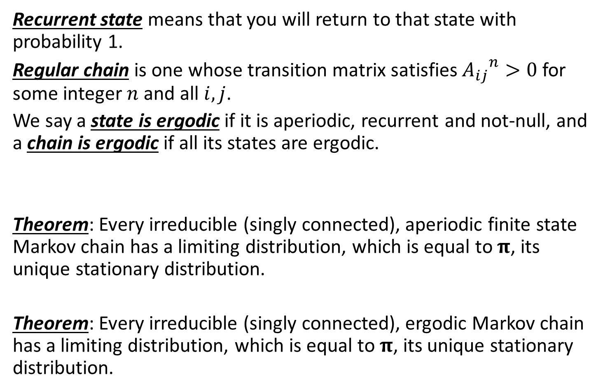
Conditions of stationary distribution (2/2)
Recurrent state means that you will return to that state with probability 1.
Regular chain is one whose transition matrix satisfies ${A_{ij}}^{n}>0$ for some integer $n$ and all $i,j$.
We say a state is ergodic if it is aperiodic, recurrent and not-null, and a chain is ergodic if all its states are ergodic.
Theorem: Every irreducible (singly connected), aperiodic finite state Markov chain has a limiting distribution, which is equal to $π$, its unique stationary distribution.
Theorem: Every irreducible (singly connected), ergodic Markov chain has a limiting distribution, which is equal to $π$, its unique stationary distribution.

Slide 12

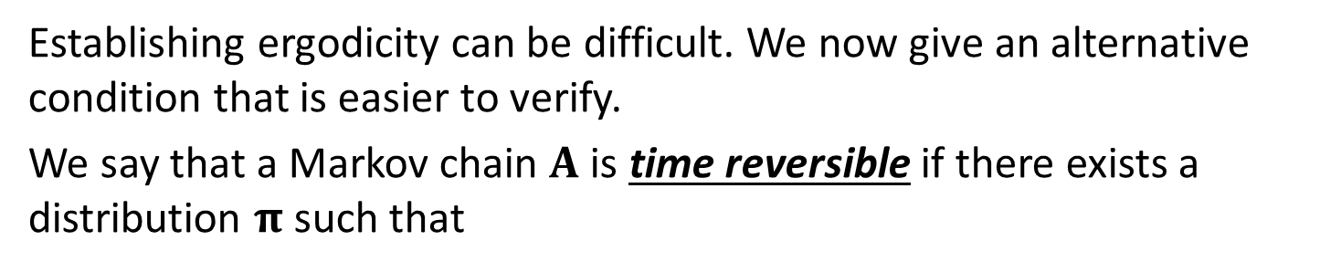
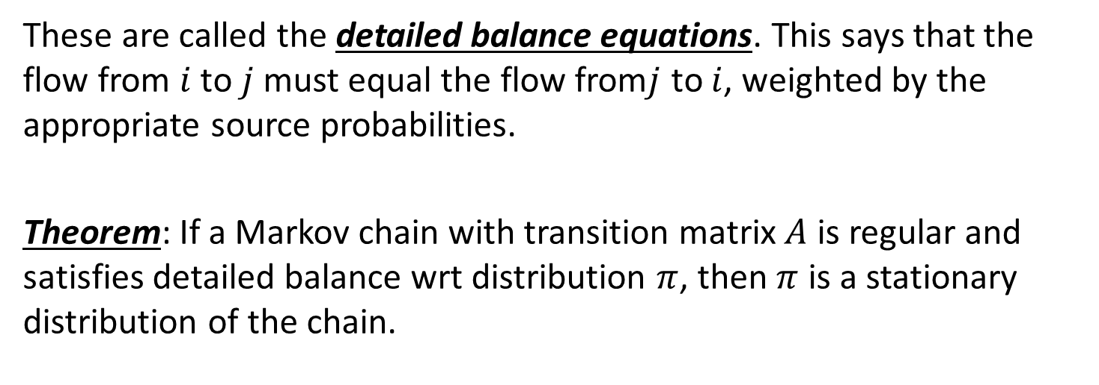
Detailed balance
Establishing ergodicity can be difficult. We now give an alternative condition that is easier to verify.
We say that a Markov chain $A$ is time reversible if there exists a distribution $π$ such that
$$π_{i}A_{ij}=π_{j}A_{ji}$$
These are called the detailed balance equations. This says that the flow from $i$ to $j$ must equal the flow from$j$ to $i$, weighted by the appropriate source probabilities.
Theorem: If a Markov chain with transition matrix $A$ is regular and satisfies detailed balance wrt distribution $π$, then $π$ is a stationary distribution of the chain.

Slide 13
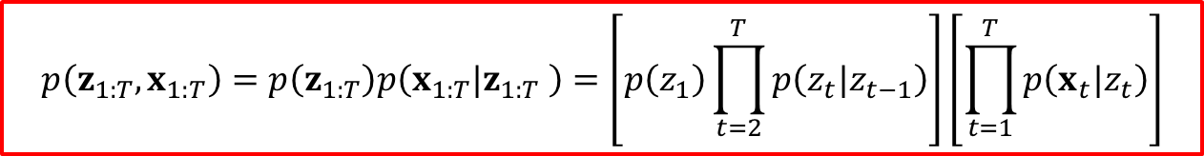
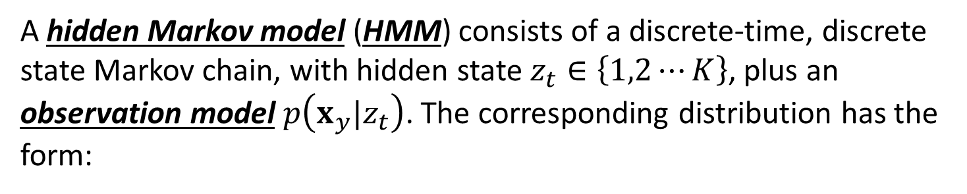


Hidden Markov models
A hidden Markov model (HMM) consists of a discrete-time, discrete state Markov chain, with hidden state $z_{t}∈\left\{1,2⋯K\right\}$, plus an observation model $p\left(x_{y}|z_{t}\right)$. The corresponding distribution has the form:
$$p\left(z_{1:T},x_{1:T}\right)=p\left(z_{1:T}\right)p\left(x_{1:T}|z_{1:T} \right)=\left[p\left(z_{1}\right)\prod_{t=2}^{T}{p\left(z_{t}|z_{t−1}\right)}\right]\left[\prod_{t=1}^{T}{p\left(x_{t}|z_{t}\right)}\right]$$
The observation in an HMM can be discrete or continuous. If they are discrete, it is common for the observation model to be an observation matrix:
$$p\left(x_{t}=l|z_{t}=k,θ\right)=B\left(k,l\right)$$
If the observations are continuous, it is common for the observation model to be a conditional Gaussian:
$$p\left(x_{t}|z_{t}=k,θ\right)=𝒩\left(x_{t}|μ_{k}, Σ_{k}\right)$$

Slide 14
Applications of HMMs
Automatic speech recognition;
Activity recognition;
Part of speech tagging;
Gene finding;
Protein sequence alignment.

Slide 15
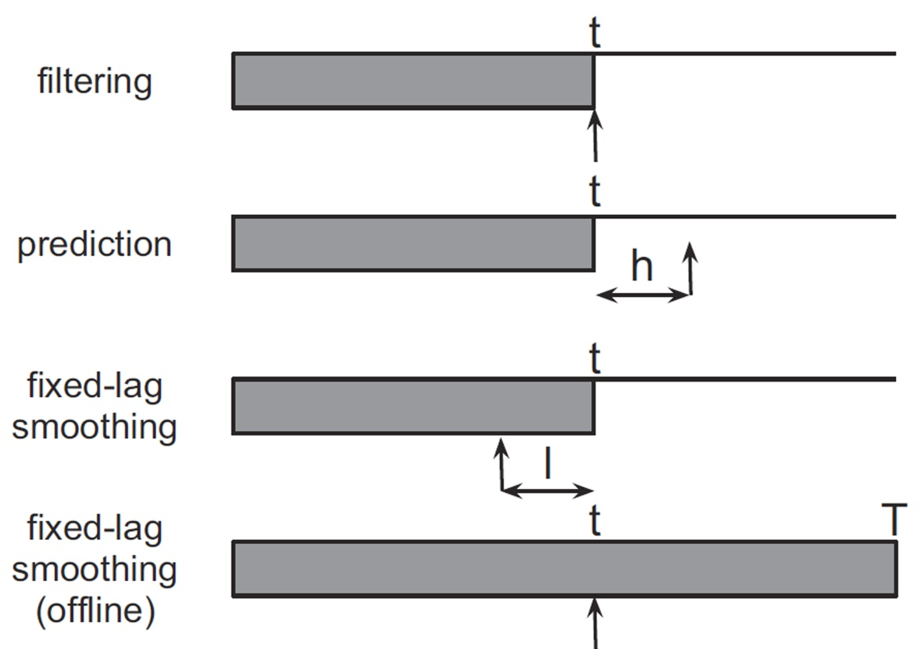
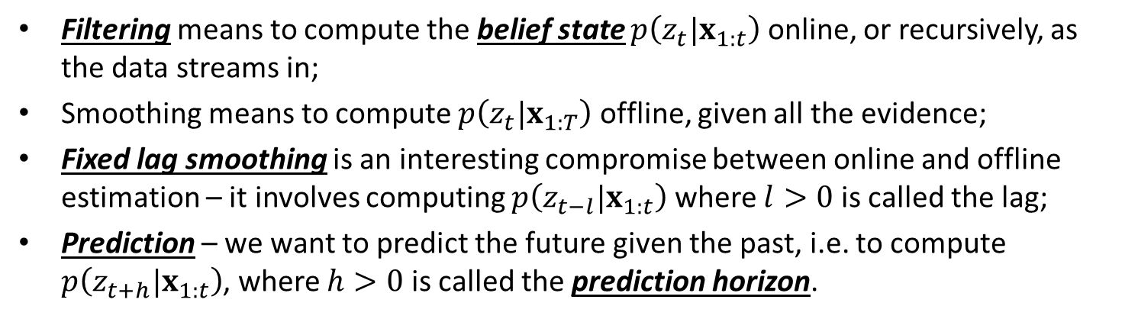
Types of inference problems in HMMs (1/2)
Filtering means to compute the belief state $p\left(z_{t}|x_{1:t}\right)$ online, or recursively, as the data streams in;
Smoothing means to compute $p\left(z_{t}|x_{1:T}\right)$ offline, given all the evidence;
Fixed lag smoothing is an interesting compromise between online and offline estimation – it involves computing $p\left(z_{t−l}|x_{1:t}\right)$ where $l>0$ is called the lag;
Prediction – we want to predict the future given the past, i.e. to compute $p\left(z_{t+h}|x_{1:t}\right)$, where $h>0$ is called the prediction horizon.

Slide 16

Types of inference problems in HMMs (2/2)
MAP estimation means computing $\underset{z_{1:T}}{argmax}{p\left(z_{1:T}|x_{1:T}\right)}$, which is a most probable state sequence;
Posterior samples $z_{1:T}\sim p\left(z_{1:T}|x_{1:T}\right)$;
Probability of the evidence means summing up over all hidden paths, $p\left(x_{1:T}\right)=\sum_{z_{1:T}}{p\left(z_{1:T},x_{1:T}\right)}$

Slide 17
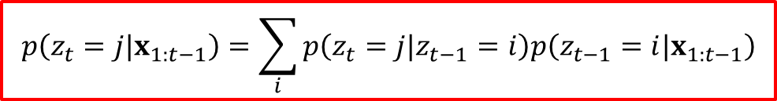
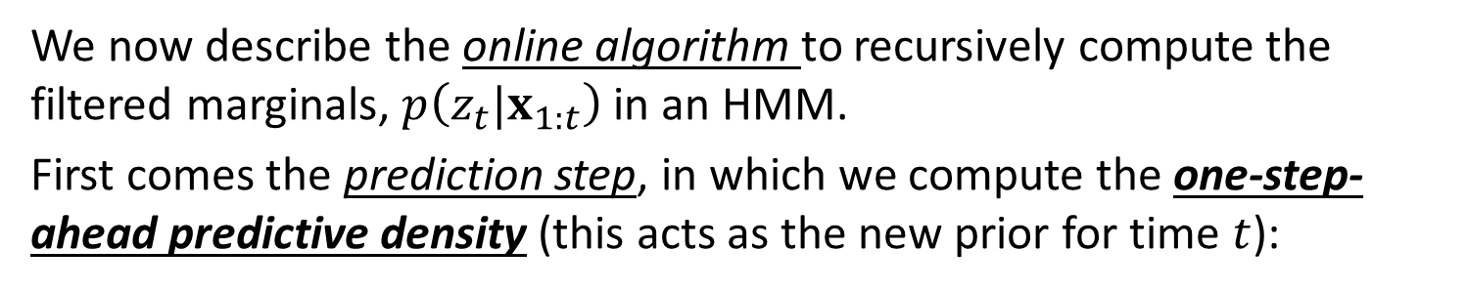
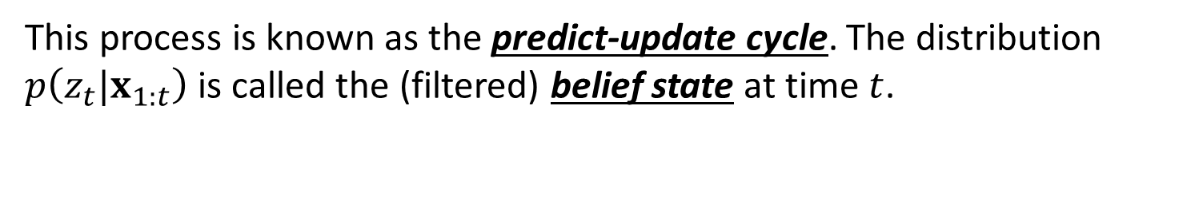
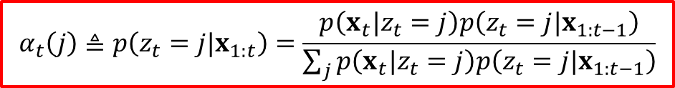

The forwards algorithm
We now describe the online algorithm to recursively compute the filtered marginals, $p\left(z_{t}|x_{1:t}\right)$ in an HMM.
First comes the prediction step, in which we compute the one-step-ahead predictive density (this acts as the new prior for time $t$):
$$p\left(z_{t}=j|x_{1:t−1}\right)=\sum_{i}{p\left(z_{t}=j|z_{t−1}=i\right)p\left(z_{t−1}=i|x_{1:t−1}\right)}$$
Next comes the update step, in which we absorb the observed data from time $t$ using Bayes rule:
$$α_{t}\left(j\right)≜p\left(z_{t}=j|x_{1:t}\right)=\frac{p\left(x_{t}|z_{t}=j\right)p\left(z_{t}=j|x_{1:t−1}\right)}{\sum_{j}{p\left(x_{t}|z_{t}=j\right)p\left(z_{t}=j|x_{1:t−1}\right)}}$$
This process is known as the predict-update cycle. The distribution $p\left(z_{t}|x_{1:t}\right)$ is called the (filtered) belief state at time $t$.

Slide 18
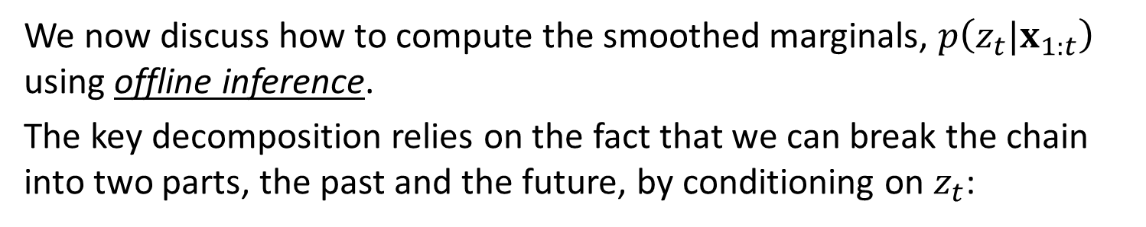
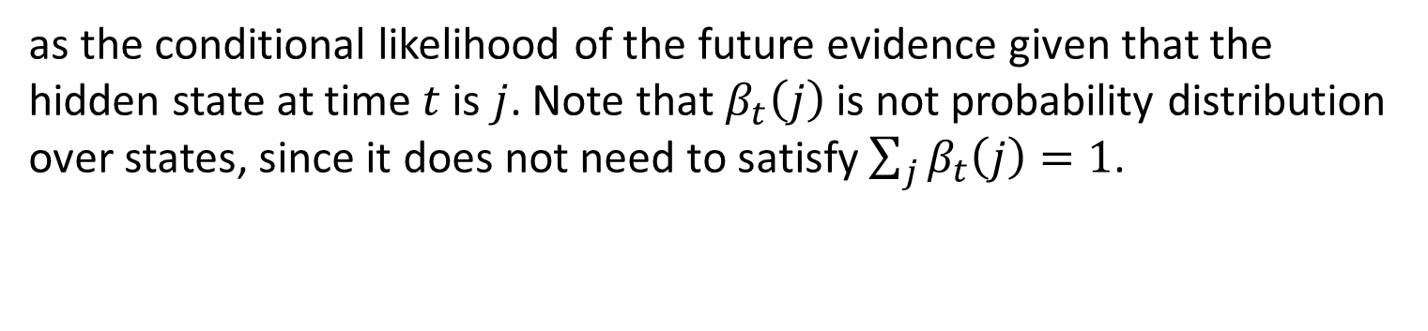

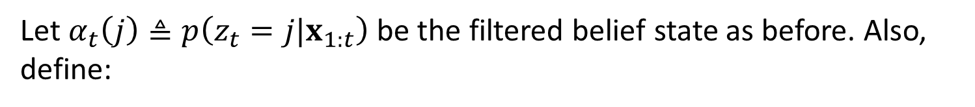
The forwards-backwards algorithm (1/2)
We now discuss how to compute the smoothed marginals, $p\left(z_{t}|x_{1:t}\right)$ using offline inference.
The key decomposition relies on the fact that we can break the chain into two parts, the past and the future, by conditioning on $z_{t}$:
$$p\left(z_{t}=j|x_{1:T}\right)∝p\left(z_{t}=j, x_{t+1:T}|x_{1:t}\right)∝p\left(z_{t}=j|x_{1:t}\right)p\left(x_{t+1:T}|z_{t}=j\right)$$
Let $α_{t}\left(j\right)≜p\left(z_{t}=j|x_{1:t}\right)$ be the filtered belief state as before. Also, define:
$$β_{t}\left(j\right)≜p\left(x_{t+1:T}|z_{t}=j\right)$$
as the conditional likelihood of the future evidence given that the hidden state at time $t$ is $j$. Note that $β_{t}\left(j\right)$ is not probability distribution over states, since it does not need to satisfy $\sum_{j}{β_{t}\left(j\right)}=1$.

Slide 19
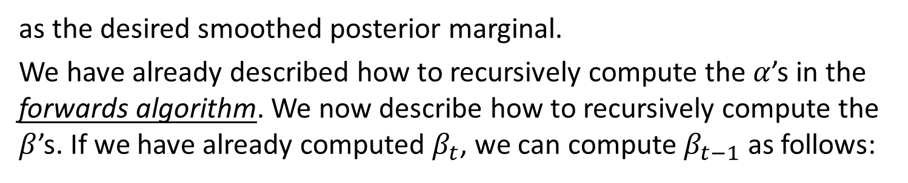

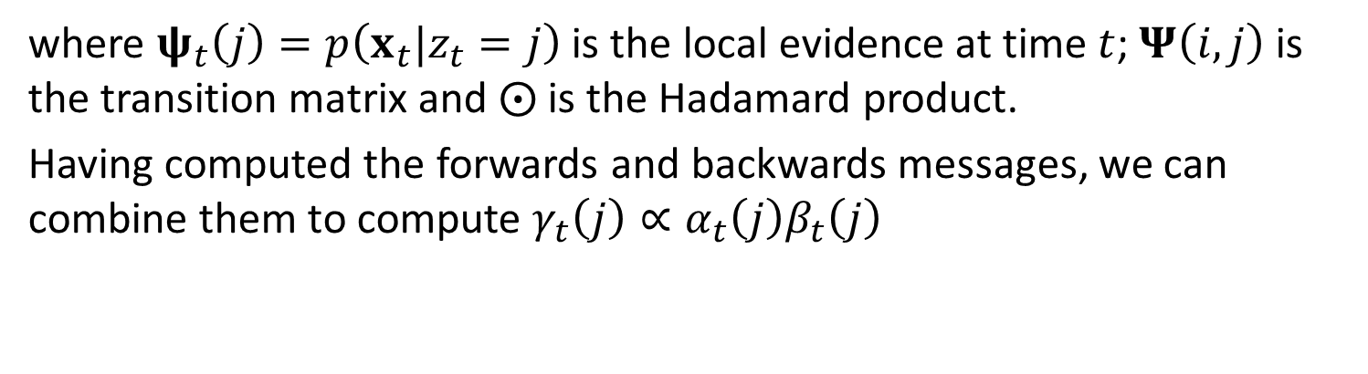

The forwards-backwards algorithm (2/2)
Finally, we define
$$γ_{t}\left(j\right)≜p\left(z_{t}=j|x_{1:T}\right)$$
as the desired smoothed posterior marginal.
We have already described how to recursively compute the $α$’s in the forwards algorithm. We now describe how to recursively compute the $β$’s. If we have already computed $β_{t}$, we can compute $β_{t−1}$ as follows:
$$β_{t−1}=Ψ\left(ψ_{t}⨀β_{t}\right)$$
where $ψ_{t}\left(j\right)=p\left(x_{t}|z_{t}=j\right)$ is the local evidence at time $t$; $Ψ\left(i,j\right)$ is the transition matrix and $⨀$ is the Hadamard product.
Having computed the forwards and backwards messages, we can combine them to compute $γ_{t}\left(j\right)∝α_{t}\left(j\right)β_{t}\left(j\right)$

Slide 20
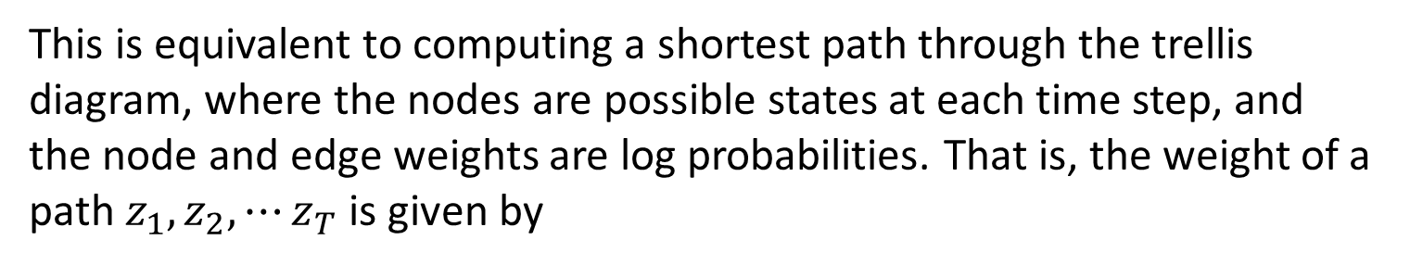

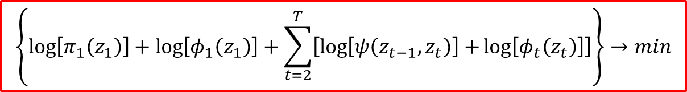
Viterbi algorithm
The Viterbi algorithm can be used to compute the most probable sequence of states in a chain-structured graphical model, i.e. it can compute
$$z^{∗}=\underset{z_{1:T}}{argmax}{p\left(z_{1:T}|x_{1:T}\right)}$$
This is equivalent to computing a shortest path through the trellis diagram, where the nodes are possible states at each time step, and the node and edge weights are log probabilities. That is, the weight of a path $z_{1},z_{2},⋯z_{T}$ is given by
$$\left\{\log\left[π_{1}\left(z_{1}\right)\right]+\log\left[φ_{1}\left(z_{1}\right)\right]+\sum_{t=2}^{T}{\left[\log\left[ψ\left(z_{t−1},z_{t}\right)\right]+\log\left[φ_{t}\left(z_{t}\right)\right]\right]}\right\}→min$$

Slide 21
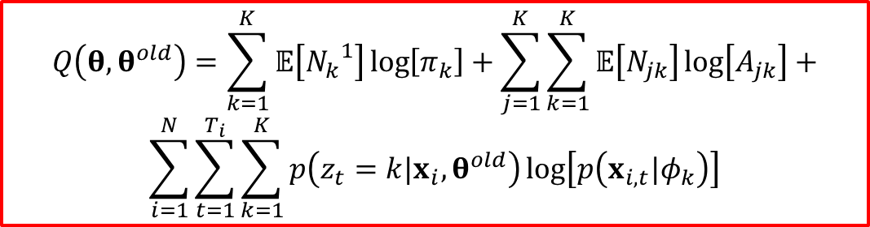
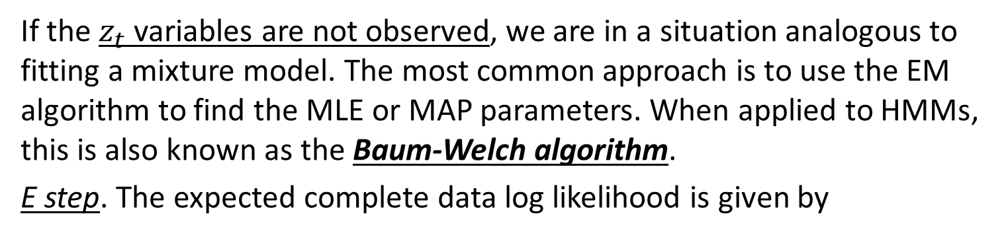
EM for HMMs (Baum-Welch algorithm, 1/2)
If the $z_{t}$ variables are not observed, we are in a situation analogous to fitting a mixture model. The most common approach is to use the EM algorithm to find the MLE or MAP parameters. When applied to HMMs, this is also known as the Baum-Welch algorithm.
E step. The expected complete data log likelihood is given by
$$Q\left(θ,θ^{old}\right)=\sum_{k=1}^{K}{𝔼\left[{N_{k}}^{1}\right]\log\left[π_{k}\right]}+\sum_{j=1}^{K}{\sum_{k=1}^{K}{𝔼\left[N_{jk}\right]\log\left[A_{jk}\right]}}+$$
$$\sum_{i=1}^{N}{\sum_{t=1}^{T_{i}}{\sum_{k=1}^{K}{p\left(z_{t}=k|x_{i},θ^{old}\right)\log\left[p\left(x_{i,t}|φ_{k}\right)\right]}}}$$

Slide 22
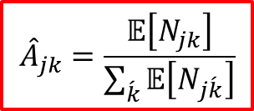
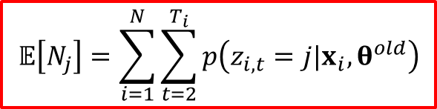
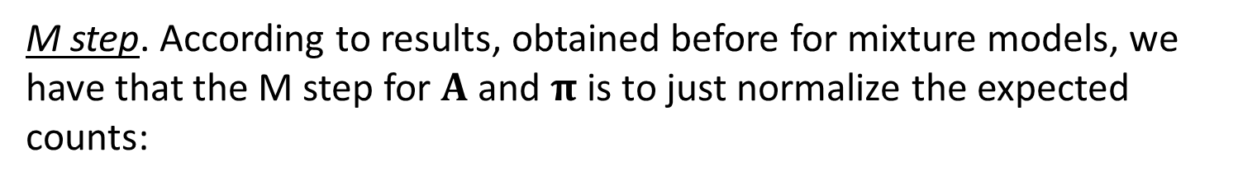
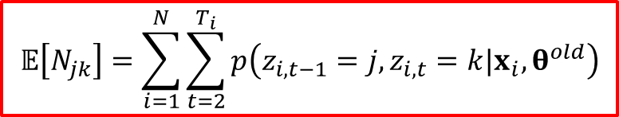

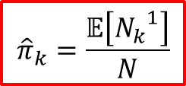
EM for HMMs (Baum-Welch algorithm, 2/2)
E step (continuation).
$$𝔼\left[{N_{k}}^{1}\right]=\sum_{i=1}^{N}{p\left(z_{i1}=k|x_{i},θ^{old}\right)}$$
$$𝔼\left[N_{j}\right]=\sum_{i=1}^{N}{\sum_{t=2}^{T_{i}}{p\left(z_{i,t}=j|x_{i},θ^{old}\right)}}$$
$$𝔼\left[N_{jk}\right]=\sum_{i=1}^{N}{\sum_{t=2}^{T_{i}}{p\left(z_{i,t−1}=j,z_{i,t}=k|x_{i},θ^{old}\right)}}$$
M step. According to results, obtained before for mixture models, we have that the M step for $A$ and $π$ is to just normalize the expected counts:
$${\hat{A}}_{jk}=\frac{𝔼\left[N_{jk}\right]}{\sum_{\acute{k}}{𝔼\left[N_{j\acute{k}}\right]}}$$
$${\hat{π}}_{k}=\frac{𝔼\left[{N_{k}}^{1}\right]}{N}$$

Slide 23
Generalizations of HMMs
Variable duration (semi-Markov) HMMs;
Hierarchical HMMs;
Input-output HMMs;
Auto-regressive and buried HMMs;
Factorial HMMs;
Coupled HMM and the influence model;
Dynamic Bayesian networks (DBNs).

Slide 24
Conclusion
Definition of Markov and Hidden Markov models was presented;
Methods for Markov model parameters estimation were considered;
Conditions for revealing the stationary distribution of a Markov chain were shown;
Generalizations of HMMs were considered.

