Slide 1
TUN CHALLENGE
Team 7
Ahmed Asraf - Gabriel Rodriguez - Fady Freeny - Brian Smedley

Slide 2
Problem
Steady decline in monthly donors
Decline in average monthly donations each year.
The average monthly donations in 2012 has declined by approximately 43.3% by the year 2017.

Slide 3
Approach
For this project we decided to answer a development question regarding the lifespan of a monthly donor, the rate of monthly donor retention, and whether monthly donors retained for more than a year increase their donations or otherwise.
Answering these questions and identifying measuring discrepancies in the findings will help identify the focus of the solution.

Slide 4
Datasets/Tools
Tableau Prep and Tableau Desktop
These tools helped us clean the data, aggregate and create calculated fields as well as illustrate our results using graphs.

Slide 5
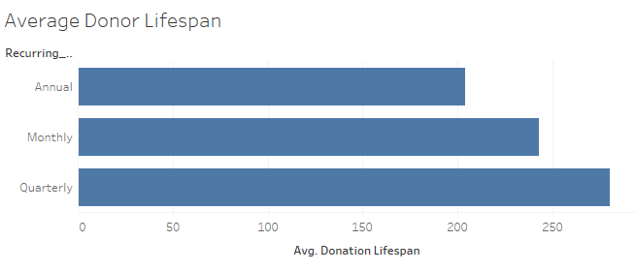
Results

Slide 6
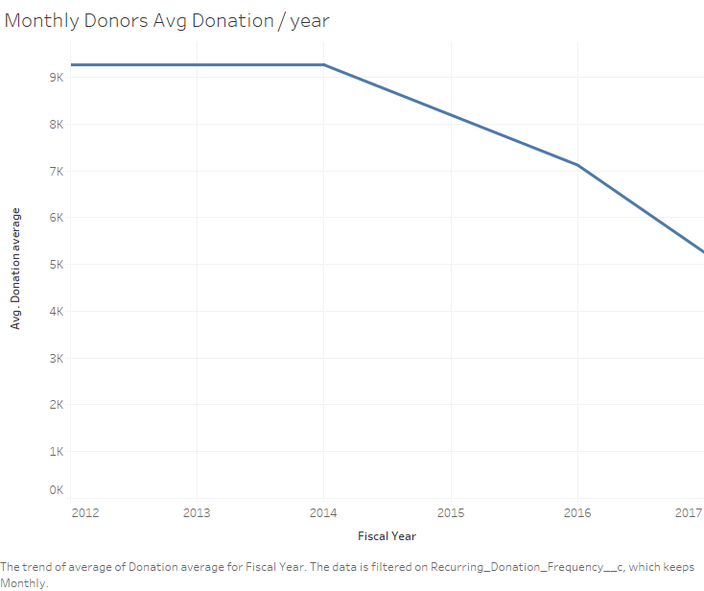
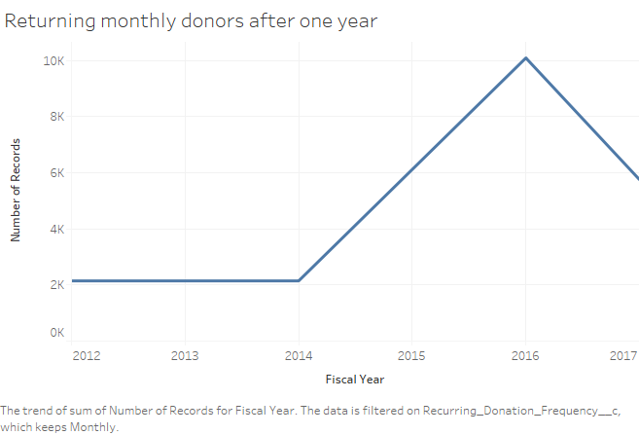
Results (Contd.)

