Slide 1
Organic Chemistry
NOMENCLATURE (NAMING)
Find the longest continuous carbon chain. Choose the stem name based on the number of carbon atoms in the longest continuous carbon chain.
Number of Carbons | Stem Name
One | meth-
Two | eth-
Three | prop-
Four | but-
Five | pent-
Six | hex-
Seven | hept-
Eight | oct-
Nine | non-
Ten | dec-

Slide 2
Number the carbon atoms sequentially so that the principle functional group has the lowest number.
The order of priority of the principle functional groups is (from highest to lowest): carboxylic acid (‒COOH), ester (‒COO‒), amide (‒CONH₂), aldehyde (‒CHO), ketone (‒CO‒), alcohol (‒OH), amine (‒NH₂), alkene (‒C=C‒), haloalkane (‒CX) and alkane.
For example:

Slide 3
If there is a functional group, number the carbons from the end which gives the lowest number to the functional group. The functional group dictates the stem name. For example:
If there is an alkyl group (other carbon atoms not part of the main chain – also called a branch), name this using the stem name for the number of carbons and use the suffix -yl. Put a number in front to indicate which carbon it comes from then write the stem name. For example: ―CH₃ methyl-
―CH₂CH₃ ethyl-

Slide 4
If there is more than one of a substituted group, write the numbers to indicate which carbon they come off, then follow with the prefix di, tri, tetra, penta, etc, then the branch name and -yl. Always finish with the straight chain name. For example:
Note that numbers are separated from words by hyphens and numbers are separated from each other by commas. There should be no spaces or capital letters in the name at all (unless it is the beginning of a sentence).

Slide 5
If there are different types of alkyl groups in the same chain, again use numbers, and put the alkyl groups in alphabetical order according to the stem name (note: you disregard the numerical prefix when alphabetizing).
If there are substituted halogens, the same rules apply as for alkyl groups, but use fluoro-, chloro-, bromo- and/or iodo-. If the substituted group is ‒OH use hydroxy- and if it is ‒NH₂ use amino- Again, substituted groups are named alphabetically.

Slide 6
If there is only one option for a substituted halogen, hydroxy, amino or alkyl groups, do not use numbers. For example:
ALKANES
General formula: C_{n}H_{2n+2}
Molecules contain single bonds only and are saturated.
Names end with the suffix –ane.
Structural isomers exist where they have the same molecular formula but different structures. Chain isomers exist when the main chain length is changed and positional isomers exist when the position of a branch changes

Slide 7
For example: C₄H₁₀
Intermolecular forces present in alkanes are dispersion forces (if there is a halogen present, dipole-dipole forces are then also present). Dispersion forces are weak intermolecular forces that occur in non-polar species due to the formation of temporary dipoles which then induce temporary dipoles in the surrounding species.
The longer the alkane, the greater the dispersion forces (due to increased number of electrons). Straight chain alkanes possess stronger dispersion forces than branched alkanes as their shape allows maximum surface contact between the molecules.

Slide 8
Increased dispersion forces results in higher melting and boiling points.
Compound | Melting Point (°C) | Boiling Point (°C)
propane | ‒187.7 | ‒42.25
butane | ‒140.0 | ‒1.0
pentane | ‒129.1 | 35.9
methylbutane | ‒161.0 | 27.8
Alkanes are soluble in non-polar substances and insoluble in polar substances. In order for a substance to be soluble in another substance the intermolecular forces formed between the solute and solvent must be equal to or stronger (energetically) than the solute-solute and solvent-solvent intermolecular forces. In the case of alkanes, the dispersion forces present in the alkane are not strong enough to overcome the hydrogen bonding present in water but will dissolve in non-polar substances such as oil.

Slide 9
Alkanes undergo substitution reactions. Typical example is halogenation reaction. For example:
ALKENES
General formula: C_{n}H_{2n}
Molecules contain a double bond and are unsaturated.
Names end with the suffix –ene.
When numbering, the longest continuous chain must include the double bond.

Slide 10
Cis/trans (geometric) isomers exist where they have the same molecular and structural formula but different spatial arrangement of the atoms about the double bond (due to the inability of rotation to occur around a double bond). Cis/trans isomerism can only exist if both carbon atoms on the double bond have two different groups attached. If cis/trans isomerism is present, this is indicated by including either cis- or trans- at the beginning of the compounds name.

Slide 11
The intermolecular force present in alkenes is dispersion forces and their melting and boiling points tend to be slightly lower than their counterpart alkanes. This is because due to their stereochemistry they are not able to pack as close to each other as alkanes.
Compound | Melting Point (°C) | Boiling Point (°C)
propene | ‒188.2 | ‒47.6
but-1-ene | ‒185.0 | ‒6.7
pent-1-ene | ‒165.2 | 30.0
Alkenes undergo addition reactions where two atoms are added across the double bond (converting it to a single bond). Reactions include:

Slide 12
Hydrogenation – reaction with hydrogen gas and a Ni, Pt or Pd catalyst. E.g.
Halogenation – reaction with a halogen. This is a classic chemical test to distinguish an alkene from other organic compounds. E.g.

Slide 13
Hydrohalogenation – reaction with a hydrogen halide. In this case Markovnikov’s rule may need to be followed (the hydrogen will be added to the carbon across the double bond that already possesses the most hydrogens. If both carbons have the same number of hydrogens, a 50/50 mixture of both possible compounds will be produced). E.g.

Slide 14
Hydration – reaction with water (Markovnikov’s rule comes into play). E.g.

Slide 15
ALCOHOLS
Contain the functional group ‒OH (hydroxyl)
Names end with the suffix –ol.
General formula:
For example:

Slide 16
Can be classified as primary (1°), secondary (2°)or tertiary (3°) alcohols based on the number of other carbons the ‒OH carbon is bonded to. E.g.
Intermolecular forces present: hydrogen bonding, dipole-dipole AND dispersion forces. Hydrogen bonding is an extreme form of dipole-dipole forces that only occurs when a hydrogen atom bonded to a fluorine, oxygen or nitrogen interacts with a non-bonding pair of electrons on another fluorine, oxygen or nitrogen atom (either on the same molecule or from different polar molecules). Hydrogen bonding is due to the highly electronegative nature of fluorine, oxygen and nitrogen that have a high charge density due to their relatively small size.

Slide 17
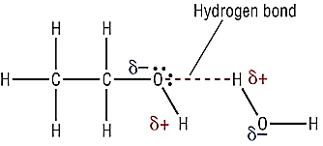
Melting and boiling points are higher than analogous alkanes due to presence of stronger hydrogen bonding forces present (in addition to dipole-dipole and dispersion forces). As the chain length becomes longer, the melting and boiling points increase as the dispersion forces then “add” to the strength of the overall intermolecular forces taking place between the alcohol molecules.
(D. Larsen n.d.)

Slide 18
In general, for alcohols of the same size, primary alcohols have higher boiling and melting points than secondary alcohols which have higher boiling and melting points than tertiary alcohols. This is (in essence) due to the exposure of the hydroxyl group.
Alcohol | Boiling Point (ºC)
butan-1-ol | 118
butan-2-ol | 99
methylpropan-2-ol | 82

Slide 19
Soluble in water and polar molecules due to similar strength of hydrogen bonding in the alcohol and either hydrogen bonding or dipole-dipole bonding in the other substance. The solubility decreases with increasing chain length as dispersion forces become more significant and prevent solvation in polar substances (they then become more soluble in non-polar substances).
ALDEHYDES
Contain the functional group ‒CHO (carbonyl) on the first carbon
Names end with the suffix –al.
General formula:

Slide 20
For example:
Intermolecular forces present: dipole-dipole AND dispersion forces. Dipole-dipole forces occur in polar molecules. It is due to the electrostatic attraction between oppositely charged ends of the overall dipole. Although the strength of a dipole moment increases with the increased difference in electronegativities between atoms in a molecule, the dispersion intermolecular force increases with increasing number of electrons (that is, the dispersion forces become more significant and impact the melting and boiling points).

Slide 21
Melting and boiling points are higher than analogous alkanes due to presence of stronger dipole-dipole forces (in addition to dispersion forces) present but lower than analogous alcohols (due to absence of hydrogen bonds). As the chain length becomes longer, the melting and boiling points increase as the dispersion forces then “add” to the strength of the overall intermolecular forces taking place between the aldehyde molecules.
Soluble in water and polar molecules due to similar strength of dipole-dipole forces in the aldehyde and either hydrogen bonding or dipole-dipole bonding in the other polar substance. The solubility decreases with increasing chain length as dispersion forces become more significant and prevent solvation in polar substances (they then become more soluble in non-polar substances).

Slide 22
KETONES
Contain the functional group ‒C=O (carbonyl) on a non-terminal carbon
Names end with the suffix –one.
General formula:
For example:

Slide 23
Intermolecular forces present: dipole-dipole bonding AND dispersion forces.
Melting and boiling points are higher than analogous alkanes due to presence of stronger dipole-dipole bonding forces (in addition to dispersion forces) but lower than analogous alcohols (due to absence of hydrogen bonds) and similar to analogous aldehydes. As the chain length becomes longer, the melting and boiling points increase as the dispersion forces then “add” to the strength of the overall intermolecular forces taking place between the ketone molecules.

Slide 24
Soluble in water and polar molecules due to similar strength of dipole-dipole bonding in the ketone and either hydrogen bonding or dipole-dipole bonding in the other substance. The solubility decreases with increasing chain length as dispersion forces become more significant and prevent solvation in polar substances (they then become more soluble in non-polar substances).
CARBOXYLIC ACIDS
Contain the functional group ‒COOH (carboxyl) on the first carbon
Names end with the suffix –oic acid.
General formula:

Slide 25
For example:
Intermolecular forces present: hydrogen bonding, dipole-dipole bonding AND dispersion forces.
Melting and boiling points are higher than analogous alkanes, aldehydes, ketones and alcohols due to presence of stronger hydrogen bonding and dipole-dipole bonding forces (in addition to dispersion forces). As the chain length becomes longer, the melting and boiling points increase as the dispersion forces then “add” to the strength of the overall intermolecular forces taking place between the carboxylic acid molecules.

Slide 26
Soluble in water and polar molecules due to similar strength of hydrogen bonding or dipole-dipole bonding in the carboxylic acid and either hydrogen bonding or dipole-dipole bonding in the other substance. The solubility decreases with increasing chain length as dispersion forces become more significant and prevent solvation in polar substances (they then become more soluble in non-polar substances).
AMINES
Contain the functional group ‒NH₂ (amine or amino)
Names end with the suffix –amine.
General formula:

Slide 27
For example:
Intermolecular forces present: hydrogen bonding, dipole-dipole AND dispersion forces.
Melting and boiling points are higher than analogous alkanes, aldehydes and ketones due to presence of stronger hydrogen bonding forces (in addition to dispersion forces). Melting points and boiling points are lower than analogous carboxylic acids and alcohols (indicating the hydrogen bond strength in alcohols is stronger than the hydrogen bonding in amines).

Slide 28
As the chain length becomes longer, the melting and boiling points increase as the dispersion forces then “add” to the strength of the overall intermolecular forces taking place between the amine molecules.
Soluble in water and polar molecules due to similar strength of hydrogen bonding or dipole-dipole bonding in the amine and either hydrogen bonding or dipole-dipole bonding in the other substance. The solubility decreases with increasing chain length as dispersion forces become more significant and prevent solvation in polar substances (they then become more soluble in non-polar substances).

Slide 29
AMIDES
Contain the functional group ‒CONH₂ on the first carbon.
Names end with the suffix –amide.
General formula:
For example:

Slide 30
Intermolecular forces present: hydrogen bonding, dipole-dipole bonding AND dispersion forces.
The hydrogen bonding present in amides is much stronger than analogous amines or carboxylic acids. This is due to a greater number of hydrogen atoms available for hydrogen bonding in an amide compared to an amine or carboxylic acid. Each amide molecule has three lone pairs of electrons and two hydrogen atoms that are available for hydrogen bonding. Also, the close proximity of the highly electronegative oxygen atom causes hydrogen atoms from the NH₂ group to develop a larger dipole (+δ) than would occur on the nitrogen only.

Slide 31
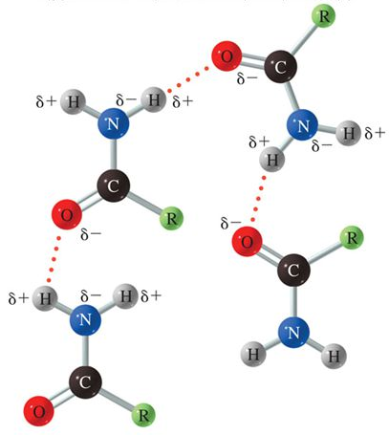
(Iveson n.d.)
Melting and boiling points are higher than analogous alkanes, aldehydes, ketones, amines, alcohols and carboxylic acids due to presence of stronger hydrogen bonding forces (in addition to dipole-dipole forces and dispersion forces). As the chain length becomes longer, the melting and boiling points increase as the dispersion forces then “add” to the strength of the overall intermolecular forces taking place between the amide molecules.

Slide 32
Soluble in water and polar molecules due to similar strength of hydrogen bonding or dipole-dipole bonding in the amide and either hydrogen bonding or dipole-dipole bonding in the other substance. The solubility decreases with increasing chain length as dispersion forces become more significant and prevent solvation in polar substances (they then become more soluble in non-polar substances).
ESTERS
Contain the functional group ‒COO‒ (carboxylate) linking two alkane chains
Names end with the suffix –oate and the alkyl group attached to the single oxygen is named as a prefix.

Slide 33
General formula:
For example:

Slide 34
Intermolecular forces present: dipole-dipole forces AND dispersion forces.
Melting and boiling points are higher than analogous alkanes, similar to analogous aldehydes and ketones but lower than analogous amines, amides, carboxylic acids and alcohols. As the chain length becomes longer, the melting and boiling points increase as the dispersion forces then “add” to the strength of the overall intermolecular forces taking place between the ester molecules.
Soluble in water and polar molecules due to similar strength of dipole-dipole forces in the ester and either hydrogen bonding or dipole-dipole bonding in the other substance. The solubility decreases with increasing chain length as dispersion forces become more significant and prevent solvation in polar substances (they then become more soluble in non-polar substances).

Slide 35
Esters have a characteristic sweet, fruity smell that makes them useful in the food and cosmetic industry.

Slide 36
AMINO ACIDS
Contain the functional groups ‒NH₂ and ‒COOH.  (Alpha) -amino acids have the amino group (‒NH₂) attached to the carbon right next to the carboxyl group (‒COOH) i.e. the -carbon.
General formula:

Slide 37
For example:

Slide 38
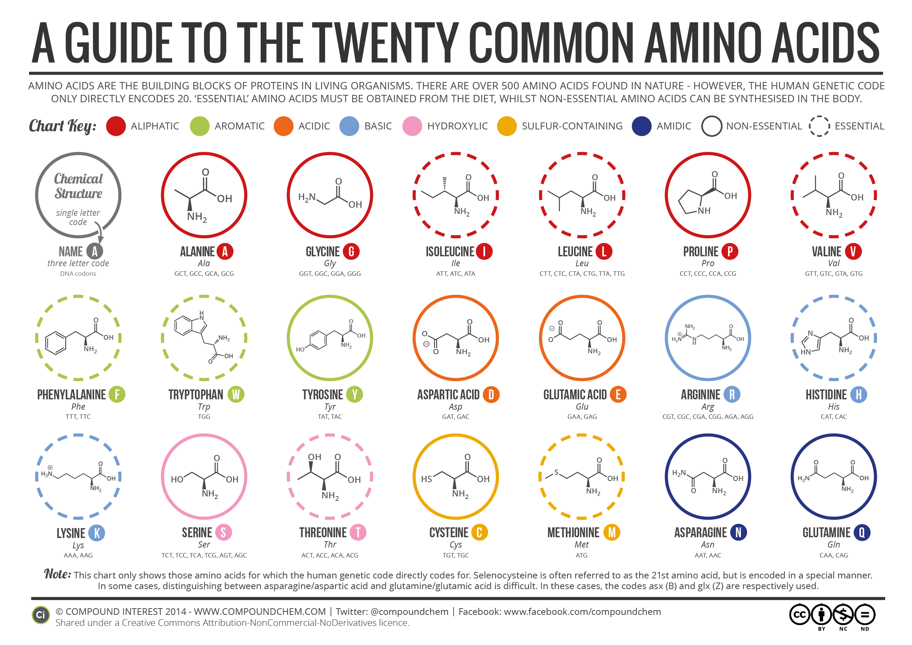
(Creative Commons Attribution-NonCommercial-NoDerivatives 4.0 International License 2014)

Slide 39
-amino acids act as monomers and combine to form proteins and polypeptides (unbranched polymers)
In solid state and neutral aqueous solutions they exist as a dipolar ion called a zwitterion (i.e. contains a positive and negative charge but no net charge). In this form, the carboxyl group gives up an acidic proton (leaving behind anionic ‒COO⁻) which is accepted by the amino group (producing the cationic ‒⁺NH₃).
+
Notes:
Note placement of positive charge on nitrogen (very important).

Slide 40
As zwitterions, they possess relatively high melting points (much higher than analogous carboxylic acids, amines, amides, alcohols, etc). This is because they possess ionic bonding.
The dipolar nature of zwitterions also makes them very soluble in water (interacting through ion-dipole interactions).
+

Slide 41
The dipolar nature of zwitterions also allows them to act as acids or bases and can also act as buffers.
In acidic media:
In basic media:
Notes:
In acidic media example, zwitterion is acting as a base to produce a conjugate acid.
In basic media example, zwitterion is acting as an acid to produce a conjugate base.

Slide 42
ORGANIC REACTIONS
Combustion of organic compounds – react with oxygen to produce carbon dioxide and water in complete combustion and carbon monoxide and water in incomplete combustion (note: this is the only time when you can write the formula of organic compounds as highly condensed formula). For example:
2C₅H_{10(l)} + 15O_{2(g)} → 10CO_{2(g)} + 10H₂O_{(g)}
C₃H₇COOH_{(l)} + 3O_{2(g limited)} → 4CO_{(g)} + 4H₂O_{(g)}
2C₃H₆O₂(g) + 7O_{2(g)} → 6CO_{2(g)} + 6H₂O_{(g)}

Slide 43
Oxidation of alcohols – react with oxidising agents such as acidified KMnO_{4(aq)} or acidified K₂Cr₂O_{7(aq)}.
Primary alcohols oxidise to produce an aldehyde and then further oxidise to produce a carboxylic acid. For example: the oxidation of propan-1-ol using acidified KCr₂O_{7(aq)}
x3

Slide 44
followed by (unless an inhibitor is added)
x3

Slide 45
as one step
x3
x2

Slide 46
Secondary alcohols oxidise to produce a ketone. For example: the oxidation of propan-2-ol using acidified KMnO_{4(aq)}
x5
x2

Slide 47
Tertiary alcohols do not readily oxidise.
Acid-base reactions of carboxylic acids – carboxylic acids are weak acids and partially ionise in solution.
They also react as typical acids

Slide 48
Esterification – reaction of an alcohol and a carboxylic acid in the presence of sulfuric acid (it is usually heated to speed up the reaction rate). In this reaction, the carboxylic acid gives away the hydroxyl group (‒OH) and the alcohol gives away a hydrogen. For example:

Slide 49
Ester hydrolysis – reacting an ester with an hydroxide produces a carboxylate ion and an alcohol. For example:
CHEMICAL TESTS
Remember, when asked to distinguish between 2 or more substances using a chemical test:
You must add at least one chemical to produce at least one new product.
You must name each substance and its related observation (this differs from giving observations with chemical reactions where you are not to name any substance! 😵)

Slide 50
E.g. Use a chemical test to distinguish between the following:
Propan-1-ol and 2-methylpropan-2-ol
Add acidified K₂Cr₂O_{7(aq)} to each.
Propan-1-ol will produce a deep green solution, 2-methylpropan-2-ol will give no observable change.
Propan-1-ol and propanal
Add ethanoic acid and some sulfuric acid (and heat) to each.
The propan-1-ol will produce a sweet, fruity smell, propanal will not.
Butan-1-ol and butan-2-ol
Add acidified KMnO_{4(aq)} to each followed by a piece of Zn_{(s)}.
Butan-1-ol will produce bubbles of colourless odourless gas, butan-2-ol will not.

Slide 51
EMPIRICAL FORMULA
The empirical formula of any compound is the simplest whole number ratio in which the atoms of the elements are present.
The molecular formula is the actual number of each type of atom present in the molecule.

Slide 52
The following formula may need to be used (it is on the Chemistry data sheet):
pressure (kPa) × volume (L) = number of moles (mol) × Universal gas constant (8.314 J K⁻¹ mol⁻¹) × temperature (K) i.e PV = nRT
You are expected to recognise when to multiply by 2, 3, 4, or 5 when the ratios are not whole numbers
Examples:
A 2.50 g sample of an unknown compound with a molar mass of 201.3 g mol⁻¹ was found to contain 60 % carbon, 8 % hydrogen and 32 % oxygen. Calculate the empirical formula and determine the molecular formula of the compound.

Slide 53
 | C | H | O
% | 60 | 8 | 32
m in 100 g | 60 | 8 | 32
n | 60/12.01 = 4.995836803 | 8/1.008 = 7.936507939 | 32/16.00 = 2
smallest ratio | 4.995836803/2 = 2.50 | 7.936507939/2 = 3.97 | 2/2 = 1.00
rounding | 2.5 × 2 = 5 | 4 × 2 = 8 | 1 × 2 = 2
∴ Empirical formula = C₅H₈O₂
Empirical formula mass = 100.114 g mol⁻¹
Molecular formula = (201.3/100.114) × C₅H₈O₂
≃ 2 × C₅H₈O₂
∴ Molecular formula = C₁₀H₁₆O₄

Slide 54
Elementary analysis of an organic compound indicated it that contained only carbon, hydrogen, oxygen and nitrogen. A 1.279 g sample was burnt in oxygen and produced 1.600 g of carbon dioxide and 0.770 g of water. A separate 5.729 g sample was reacted and produced 1.289 L of ammonia gas at 300 K and 105 kPa. Calculate the empirical formula of the compound.

Slide 55
C_{X}H_{Y}O_{Z}N_{W} + O₂ → XCO₂ + Y/2H₂O
C_{X}H_{Y}O_{Z}N_{W} → WNH₃
n(CO₂) = 1.600/44.01
≃ 3.636×10⁻² mol = n(C)
m(C) = (3.636×10⁻²)×12.01
≃ 4.366×10⁻¹ g
%(C) = ((4.366×10⁻¹)/1.279)×100
≃ 34.14%

Slide 56
n(H₂O) = 0.770/18.016
= 4.274×10⁻² mol
n(H) = 2×n(H₂0)
= 8.548×10⁻² mol
m(H) = (8.548×10⁻²)×1.008
≃ 8.616×10⁻² g
%(H) = ((8.616×10⁻²)/1.279)×100
≃ 6.737%

Slide 57
n(NH₃) = PV/RT
= (105×1.289)/(8.314×300)
≃ 5.426×10⁻² mol = n(N)
m(N) = (5.426×10⁻²)×14.01
≃ 7.602×10⁻¹ g
%(N) = ((7.602×10⁻¹)/5.729)×100
≃ 13.26%
%(O) = 100 ‒ (34.14+6.737+13.26)
≃ 45.86%

Slide 58
 | C | H | N | O
% | 34.14 | 6.737 | 13.26 | 45.86
m in 100 g | 34.14 | 6.737 | 13.26 | 45.86
n | 34.14/12.01 = 2.842484267 | 6.737/1.008 = 6.683313035 | 13.26/14.01 = 0.947179127 | 45.76/16.00 = 2.865937802
smallest ratio | 2.842484267/ 0. 947179127 = 3.00 | 6.683313035/ 0. 947179127= 7.06 | 0. 947179127/ 0. 947179127 = 1.00 | 2.865937802/ 0.947179127 = 3.03
rounding | = 3 | = 7 | = 1 | = 3
∴ Empirical formula = C₃H₇NO₃

Slide 59
MACROMOLECULES
Polymers
Polymers consist of long chains of repeating smaller units called monomers.
Polymers can consist of long straight chains or they may have side chains that join to other chains (cross linking).
Two types of polymerisation reactions that lead to the formation of polymers

Slide 60
Addition Polymerisation
Involves small molecule alkenes acting as monomers and joining up with the use of a catalyst and an initiator. The double bond is broken which results in spare electrons that can pair with spare electrons in the next monomer.
General reaction given by:
The polymer is named by adding the prefix poly- to the monomer name (sometimes in brackets). Some polymers have common names that are used more often.

Slide 61
IUPAC Name | Common Name
polyethene | polyethylene
poly(propene) | polypropylene
poly(chloroethene) | polyvinyl chloride (PVC)
poly(1,1,2,2-tetrafluoroethene) | polytetrafluoroethylene (PTFE)
poly(phenylethene) | polystyrene

Slide 62
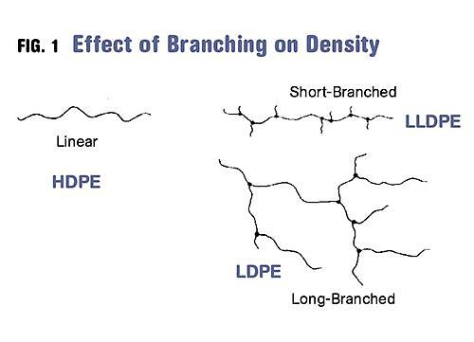
(Sepe 2012)
Depending on the conditions used in its manufacture, polyethylene can either be classified as high density polyethene (HDPE – mostly straight chains with very few side chains resulting in a stronger (greater dispersion forces present), rigid plastic) or low density polyethene (LDPE – side chains are present on the main chain resulting in a softer, flexible plastic).

Slide 63
Examples:
Draw the addition polymerisation occurring with the following monomers:

Slide 64
Determine the monomers that produced the following polymers.

Slide 65
Condensation Polymerisation
Involves the joining of monomers to produce the polymer and a small molecule such as water (most often) or carbon dioxide. The monomers must have a reactive functional group at either end of the molecule. Monomers can include diols (dialcohols), dicarboxylic acids and diamines or a combination of these functional groups on one monomer.
The polymers produced can include polyesters and polyamides.
General reaction given by:

Slide 67
Examples:
Draw the condensation polymerisation occurring with the following monomers:

Slide 68
Determine the monomers that produced the following polymers.

Slide 69
PROTEINS
Natural polymers formed through the combination of -amino acids (condensation polymerisation).
The link that forms between the amino functional group of one -amino acid and the carboxylic acid functional group of another -amino acid is called a peptide link.
Peptide link
Peptide bond

Slide 70
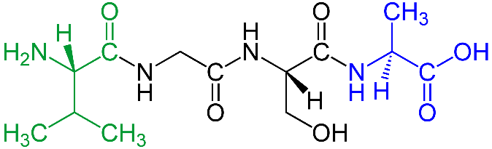
When two -amino acids combine, the resulting structure is sometimes referred to as a dipeptide.
If more -amino acids then add to the dipeptide, it is referred to as a polypeptide. In general, if more than fifty -amino acids are present in a peptide chain, it is referred to as a protein.
When writing the structure of proteins it is common to begin (on the left) with a N-terminus (-NH₂ group) and end (on the right) with a C-terminus (-COOH group).
Val-Gly-Ser-Ala
(Ju 2010)
There are 20 common -amino acids that occur in most proteins.

Slide 71
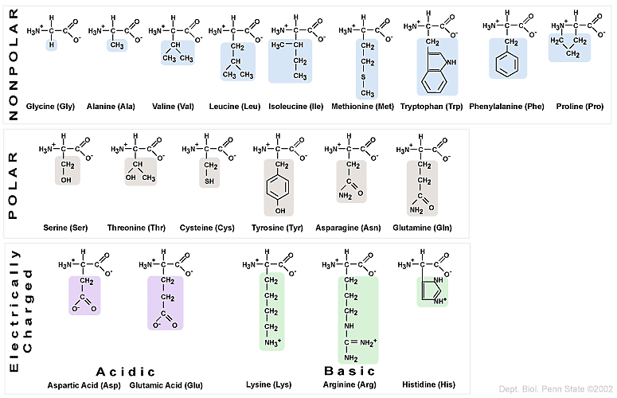
Negatively charged
Positively charged
(Proteins 2004)
Notes:
Get students to try question 41a) from the 2019 ATAR paper and question 39a) from the 2018 ATAR paper

Slide 72
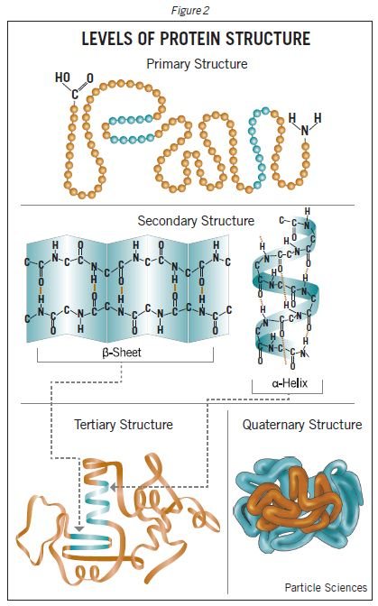
Proteins possess four levels of structure.
(Particle Sciences 2009)

Slide 73
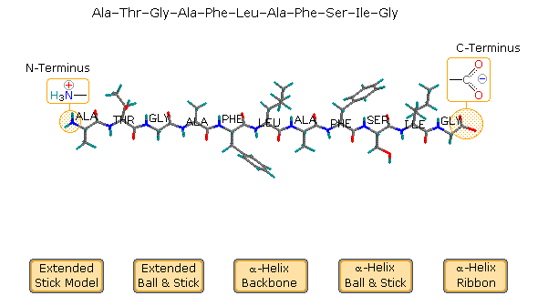
Primary structure
This is the specific linear sequence of the individual -amino acids in the protein.
(Reusch 2013)

Slide 74
Secondary structure
The regular arrangements of the various sections of the protein which depend on hydrogen bonding present. Two common protein secondary structures are:
-helix
β-pleated sheets

Slide 75
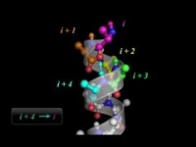
-helix
https://www.youtube.com/watch?v=PeFdl6KmxYM

Slide 76
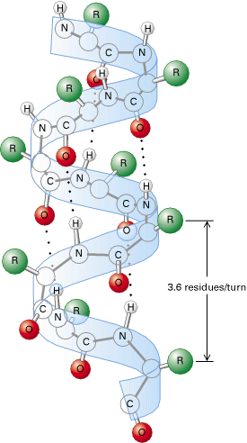
-helix – interactions within the peptide chain. Hydrogen bonding occurs between a lone pair of electrons from the oxygen in the carbonyl group and the polar hydrogen atom of an amine group. The amine group interacts with the carbonyl group of a peptide bond four amino acids away from it. This produces a right-hand coiled helix.
(Cruz 2011)
Notes:
Hydrogen bonding occurs between (say) the NH group on amino acid 1 and the C=O group on amino acid 1+4 (ie 5th).

Slide 77
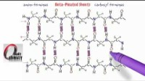
β-pleated sheets
https://www.youtube.com/watch?v=4SZ-s4Zq_rE

Slide 78
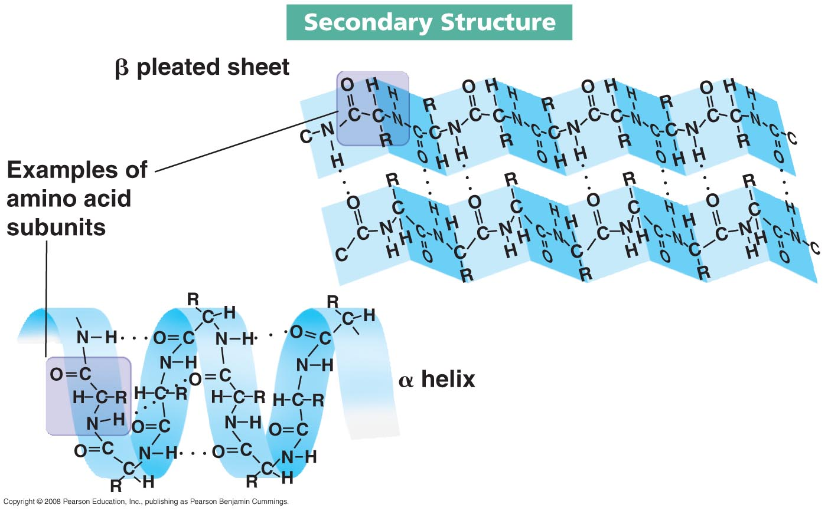
β-pleated sheets – interactions between adjacent polypetides. Polypeptides line up alongside one another (either the same protein chain or a different protein chain) and hydrogen bonding forms between closely placed oxygens in a carbonyl group and the hydrogen in an amine group. This results in hydrogen bonds within the plane of the sheet structure. All amino groups and carbonyl groups are involved in hydrogen bonds in β-pleated sheets.
(Kimberley 2013)
Notes:
β-pleated sheets contain more hydrogen bonds than α-helices and so are attributed more to the strength of the polymer.

Slide 79
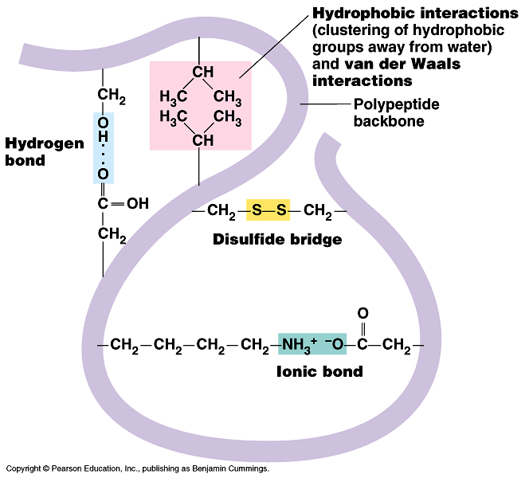
Tertiary Structure
Interactions that occur between the side chains of the -amino acids in the proteins. These may include hydrogen bonding, ionic bonding, dipole-dipole forces, covalent bonding and/or dispersion forces. The protein molecule will bend and twist in such a way as to achieve maximum stability.
(Adam-Day 2015)

Slide 80
In an aqueous environment, the protein will orient itself such that the hydrophobic side chains are oriented inwards and the hydrophilic side chains are oriented outwards.
Disulfide bridges are covalent in nature and are produced through the oxidation (loss of hydrogen) of two cysteine α-amino acids in the protein.
The structure and function of a protein is most dependent on its primary structure. This determines the nature of its most stable secondary and tertiary structures.

Slide 81
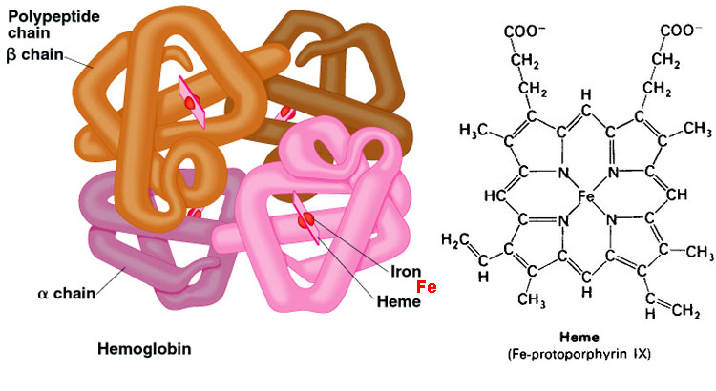
Quaternary structure
This involves multiple proteins interacting to form larger conglomerate proteins.
(Proteins and Amino Acids 2013)

Slide 82
The Protein Data Bank (PDB)
Online archive of macromolecular structural data. It is now overseen by the Worldwide Protein Data Bank (wwPDB) organisation and has four member organisations from USA, Japan and Europe.
wwPDB was formed to formalise and standardise the presentation and annotation of protein structural data. The data is freely accessed by anyone and allows collaboration and communication between scientists all over the world.
Each PDB entry contains information about the primary, secondary, tertiary and quaternary structures of a protein.

Slide 83
Bibliography
Adam-Day, Sam. 2015. "A Level Notes." Protein Structure. Accessed June 6, 2016. http://alevelnotes.com/protein-structure/61.
Creative Commons Attribution-NonCommercial-NoDerivatives 4.0 International License. 2014. "A Brief Guide to the Twenty Common Amino Acids." Compound Interest. September 16. Accessed June 6, 2016. http://www.compoundchem.com/2014/09/16/aminoacids/.
Cruz, Wilhelm. 2011. "Peptide Bonds and Protein Structure." Washington University in St. Louis. Accessed June 6, 2016. http://www.nslc.wustl.edu/courses/bio2960/labs/02Protein_Structure/PS2011.htm.
Ehingers, M. 2014. "How Organic Chemistry Recations Work." Magnus Ehingers Teaching. January 13. Accessed June 7, 2016. http://ehinger.nu/undervisning/index.php/starta-haer/nyheter/1249-avd-f-kemiska-fanigheter/5959-avd-f-kemiska-fanigheter-del-20-hur-sker-organiska-reaktioner.html.
Helmenstine, A.M. 2015. "Chemistry Jokes and Puns - With Explanations." About Education. October 24. Accessed June 7, 2016. http://chemistry.about.com/od/chemistryjokes/ss/Chemistry-Jokes-and-Puns-With-Explanations.htm#step1.
Iveson, J. n.d. "Amines, Amides and Heterocycles. ." Slide Player. Accessed June 2, 2016. http://slideplayer.com/slide/4214444/.
Ju. 2010. "N-Terminus." Wikipedia. August 27. Accessed August 2, 2018. https://en.wikipedia.org/wiki/N-terminus.
Kimberley. 2013. "Biochem Rocks." Amino Acids and Proteins Part 2. February 26. Accessed June 6, 2016. https://kimberlybiochemist.wordpress.com/2013/02/26/.
Larsen, D. n.d. "Noncovalent Interactions Between Molecules." UCDavis Chemwiki. Accessed June 1, 2016. http://chemwiki.ucdavis.edu/Textbook_Maps/Organic_Chemistry_Textbook_Maps/Map%3A_Organic_Chemistry_(McMurray)/Unit_02%3A_Polar_Covalent_Bonds%3B_Acids_and_Bases/2.12_Noncovalent_Interactions_Between_Molecules.
Moffit, M. 2012. "Asap Science." Twitter. May. Accessed June 7, 2016. https://twitter.com/asapscience/status/721458193172271105.
Particle Sciences. 2009. "Protein Structure." Particle Sciences. Accessed June 6, 2016. http://www.particlesciences.com/news/technical-briefs/2009/protein-structure.html.
2004. "Proteins." Basic Chemistry. Accessed June 6, 2016. http://www.personal.psu.edu/staff/m/b/mbt102/bisci4online/chemistry/chemistry8.htm.
2013. "Proteins and Amino Acids." aberdeenc. February 18. Accessed June 6, 2016. https://aberdeenc.wordpress.com/2013/02/18/proteins-and-amino-acids/.
Reusch, William. 2013. "Peptides and Proteins." Natural Products. May 5. Accessed June 6, 2016. https://www2.chemistry.msu.edu/faculty/reusch/virttxtjml/protein2.htm.
Sepe, Michael. 2012. "Denisty and Molecular Weight in Polyethylene." Plastics Technology. June. Accessed June 7, 2016. http://www.ptonline.com/columns/density-molecular-weight-in-polyethylene.
Swimm, Alison. n.d. "Science Fun." Pinterest. Accessed June 7, 2016. https://au.pinterest.com/pin/175851560422914032/.
Yuku. 2013. "Survivorsucks." Survivorsucks. February 18. Accessed June 7, 2016. http://survivorsucks.yuku.com/topic/102810/Stephen-hate-thread?page=4#.V1Z3rzV97IU.

