Slide 1
Circuits

Slide 2
So Far
We have covered what current is;
The flow of charges through a circuit
We have covered what Voltage is;
The difference in potentials between two points in a circuit

Slide 3
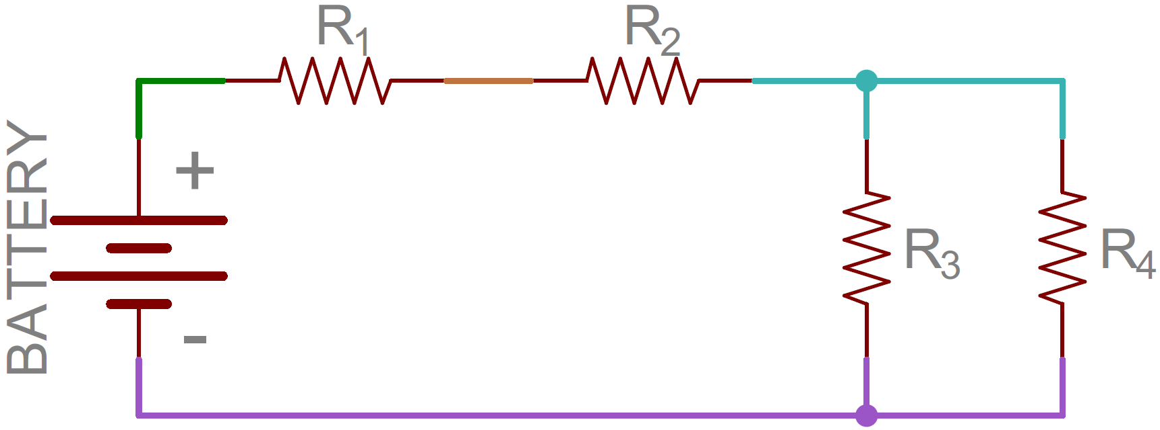
Nodes
Simply, a node is an electrical junction between two or more components. So often, the nodes in a circuit are the wires joining the different components together.

Slide 4
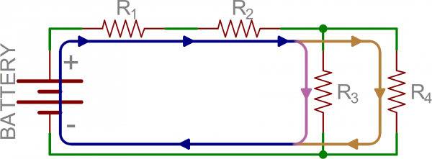
Current flow
Current will flow from a high voltage to a lower voltage in a circuit. Some amount of current will flow through every path available that leads to this lower voltage.

Slide 5
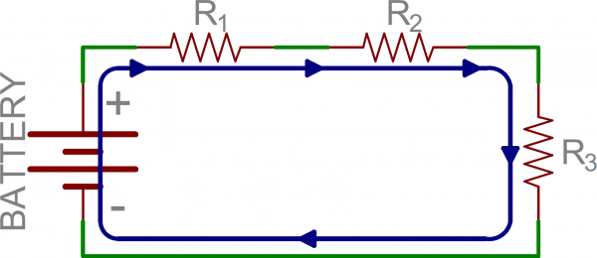
Series circuits
The flow of charged particles (Current) only have one pathway to go along.
At each point in this path, the current will be the same. This is due to the conservation of charge.

Slide 6
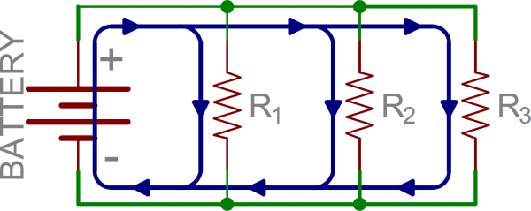
Parallel Circuits
There are at least two pathways for the current to flow through.
As charge is conserved, The total current entering the junction must equal the total current leaving the junction.

Slide 7
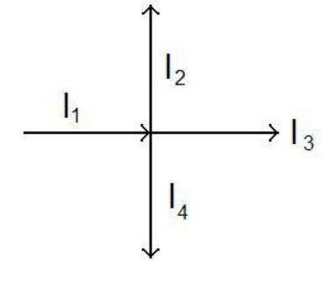

Kirchoff’s current law
$$ΣI_{in}=ΣI_{out}$$
Or
$$I_{1}=I_{2}+I_{3}+I_{4}$$

Slide 8
What does Voltage do in parallel circuits?
The answers you seek are on page 155 in the Nelson book.
You tell me.

