Slide 1
Waves

Slide 2
Term | Symbol | Definition | Unit
Phase |  | Identifies one or more specific points on a harmonic wave train, by reference to the angle in the Sin expression for the wave
Wavelength | λ | The distance between two adjacent points in a wave which are in phase | m
Frequency | f | The number of crests or troughs which pass a point per unit time. Or, the number of cycles per second | Hz or cycles/s
Period | T | The time taken for one complete cycle, or the time taken for one complete wave to pass a given point | s
Wave speed | v | The speed at which a crest or trough moves through the medium | m/s
Amplitude | a | The maximum displacement of a particle from its mean position | m

Slide 3

2 rules to remember
$$v=λf$$
and
$$f=\frac{1}{T}$$

Slide 4
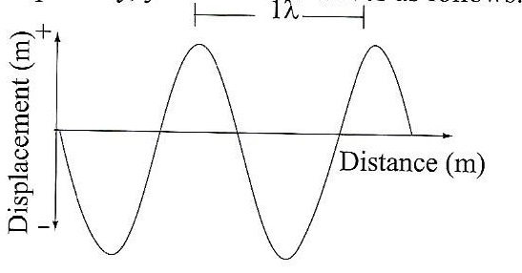

Slide 5
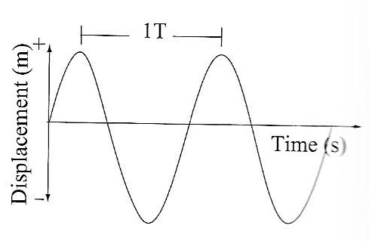

Slide 6
Transverse Waves
The displacement of the medium is perpendicular to the direction of propagation of the wave (direction energy in the wave is moving).
If the wave is moving to the right, the displacement of the particles is up and down.
Examples include the jelly baby wave from Wednesday, ripples on a pond, wave on a string.

Slide 7
Image from http://www.acs.psu.edu/drussell/Demos/waves/wavemotion.html

Slide 8
Longitudinal Waves
The displacement of the medium is parallel to the propagation of the wave.
If the wave is moving to the right, the particles oscillate left and right.
Examples are sound waves, waves through a slinky.

Slide 9
Image from http://www.acs.psu.edu/drussell/Demos/waves/wavemotion.html

Slide 11
Reflection and Refraction

Slide 12
Reflection
Reflection is when a wave changes direction at the boundary between two mediums.
The wave returns to the medium it came from.
Can be thought of the wave (light, sound, radio waves, water waves, etc.) hitting an object and bouncing off it.
When a wave is reflected, its direction of travel changes.

Slide 13
Wavefronts
When drawing waves, it can become a bit difficult to draw sine waves for every wave on the diagram, so we can use wavefronts.
A wavefront is a line that represents positions in the wave of identical phase.
Distance between wavefronts are equal to the wavelength of the wave.

Slide 14
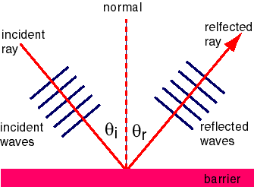
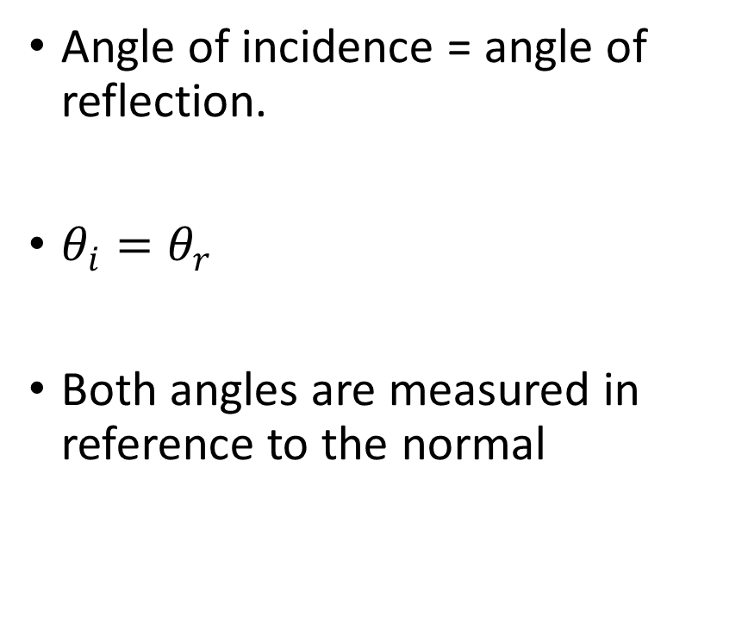
Law of reflection
Angle of incidence = angle of reflection.
$θ_{i}=θ_{r}$
Both angles are measured in reference to the normal

Slide 15
Refraction
When a wave moves into one medium from another, its speed will change.
This is because the speed of the wave is dependant on the medium through which it is travelling.
This change in speed can cause a change in direction of the wave.

Slide 16
Wave velocity
Velocity depends on the medium through which a wave is travelling.
Three properties affect the wave speed;
-Elasticity- Waves travel faster through mediums that are more elastic
-Density- the higher the density the slower the wave.
-Temperature- Increased wave speed in higher temperatures.

Slide 17
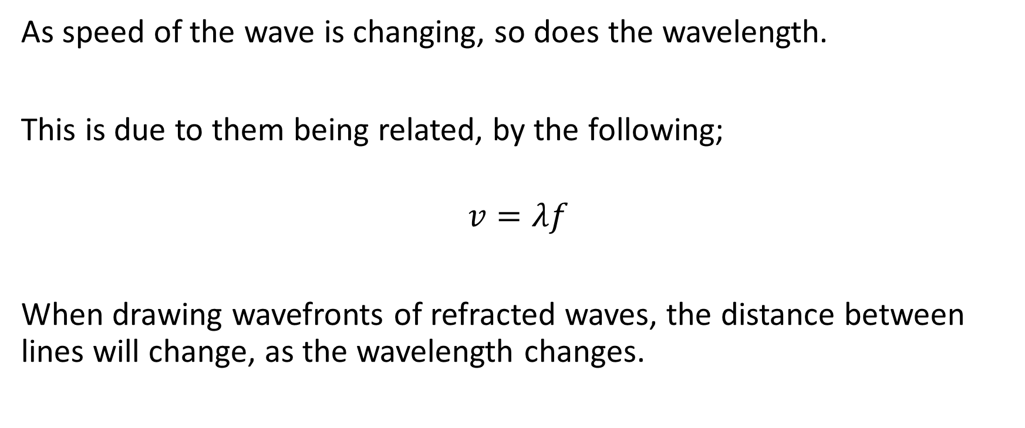
As speed of the wave is changing, so does the wavelength.
This is due to them being related, by the following;
$$v=λf$$
When drawing wavefronts of refracted waves, the distance between lines will change, as the wavelength changes.

Slide 18
Angle of refraction
For a decrease in speed.
Angle of refraction is smaller than the angle of incidence
For an increase in wave speed;
Angle of refraction is larger than the angle of incidence.
All angles are measured from the normal.

Slide 19
Interference of waves
When two waves meet while travelling in the same medium, they will interfere with each other.
The cause the medium to take on a shape that results from the net effect of the individual waves.

Slide 20

Constructive Interference
This is when the interfering waves have a displacement in the same direction.
The displacement of the resultant wave is greater than the displacement of the two interfering pulses.

Slide 21
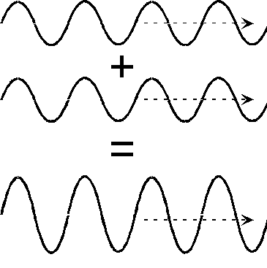

Slide 22
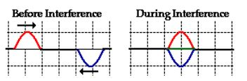
Destructive Interference
This is when the interfering waves have displacements in opposite directions.
The displacement of the resultant wave is less than the displacement of the incident waves.

Slide 23
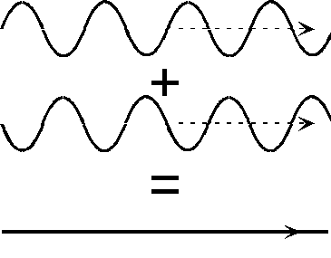

Slide 25
Interference of sound waves
Remember, when drawing wavefronts, we draw the lines at points of equal phase. These are usually the maximums.
Therefore, halfway between these wavefronts, the amplitude is at a minimum. This is called a rarefaction

Slide 26
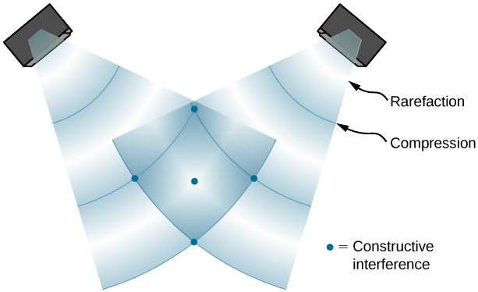

Slide 27
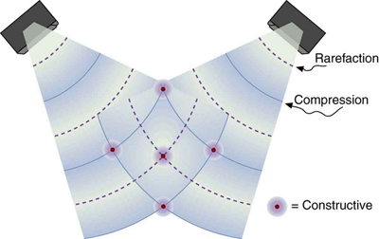

Slide 28
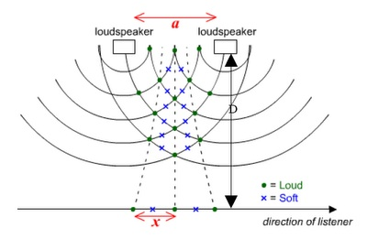

Slide 29
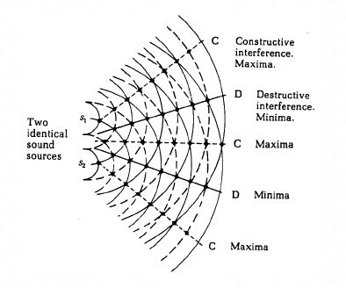

Slide 30
Natural Frequency
When any object at rest is struck or disturbed, it will vibrate at a particular frequency.
This frequency is determined by the objects shape, mass, dimensions, composure, elasticity, etc.
This is called the natural vibration of the object and it will vibrate at its natural frequency.

Slide 31
Forced Vibration
We can force any object to vibrate at different frequencies to its natural frequency by using a force.
This is called forced vibration.
The energy for this vibration comes from the external force, so once this force is removed the vibrations die away quickly.

Slide 32
Resonance
If the applied and natural frequencies are the same, an object begins to resonate.
The individual vibrations will constructively interfere and large amplitude vibrations will develop.
Each subsequent vibration that is added to this system at this frequency will continue to add to the energy of the vibration.

Slide 33
Designing for natural frequencies
Resonance due to winds, water waves and any other natural or otherwise waves needs to be accounted for when designing buildings, bridges, vehicles, oil rigs, etc.
These are often designed so that winds and waves cannot strike the structure at the natural frequencies.
Otherwise, they are designed to dampen the effect of any increased amplitude in vibration due to resonance.

Slide 34
Why?
https://www.youtube.com/watch?v=RihcJR0zvfM
https://www.youtube.com/watch?v=D2tHA7KmRME
https://www.youtube.com/watch?v=8xE_nT3QySo

Slide 35
Standing waves in tubes
We have previously established that the pressure at an open end of a tube must be equal to the ambient pressure (the pressure outside the tube).
Further more, at a closed end, we will have whatever pressure hits the closed end interfering with itself, so we can have maximum differences between pressures at this point (pressure antinodes.)

Slide 36
Standing waves in tubes
But what are the particles within the tube doing?
What about their displacement?

Slide 37
Standing waves in tubes
At a closed end, the particles are pressed against the barrier, they have nowhere to move.
At an open end, they can move fairly freely.
Displacement-distance diagrams are the inverse of pressure-distance.
Pressure nodes are displacement antinodes and pressure antinodes are displacement nodes.

