Slide 1
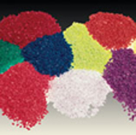
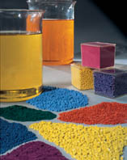
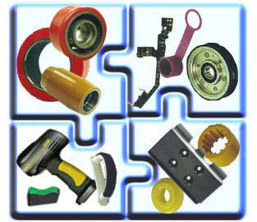
Polymers
& Plastics

Slide 2
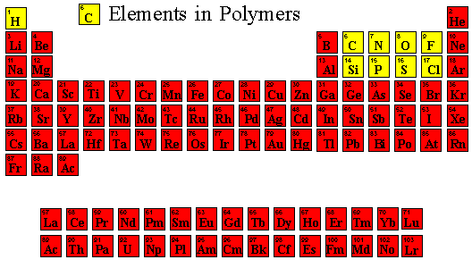

Slide 3
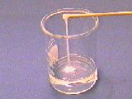
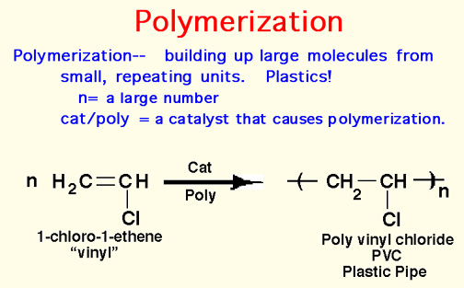
Monomer - a small molecule which may react chemically to link together with other molecules of the same type to form a large molecule called a polymer.

Slide 4
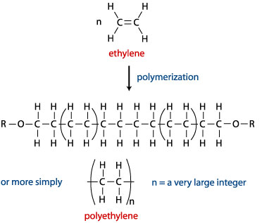
Eg.1

Slide 5
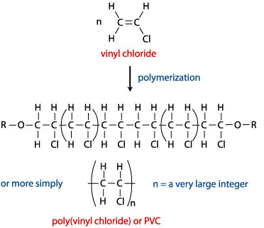
Eg.2

Slide 6
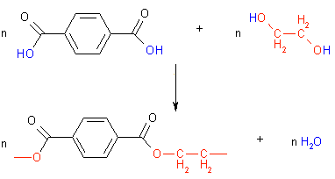
Condensation Polymerisation
n Dicarboxylic Acid + n Diol(or Diamine)  Polymer + 2n H₂O
The reactions involved in the synthesis of PET.

Slide 7
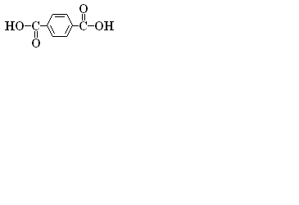
Condensation Polymerisation Animation

Slide 8
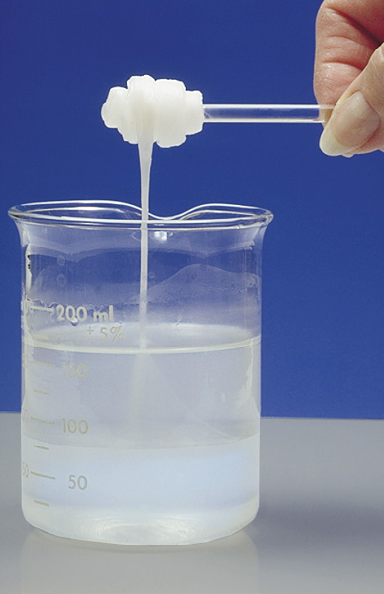
Nylon Production

Slide 9
Some Definitions
Thermoplastic - a material that can be molded and shaped when it's heated.
Thermoset - a hard and stiff crosslinked material. Thermosets are different from thermoplastics, which become moldable when heated. Thermosets are crosslinked, so they don't. Also, they are different from crosslinked elastomers. Thermosets are stiff and don't stretch the way elastomers do. (see: elastomer, thermoplastic)
Crosslinking - crosslinking is when individual polymer chains are linked together by covalent bonds to form one giant molecule. (see: elastomer, thermoset)
Elastomer - rubber. Hot shot scientists say a rubber or elastomer is any material that can be stretched many times its original length without breaking, and will snap back to its original size when it is released.

Slide 10

Elastomers
Elastomers are long polymer chains which are usually lightly crosslinked and are easily deformed. Common elastomers include polybutadiene (used in shoe soles), polyisobutylene (used in automobile tires), and polyisoprene (natural rubber).

Slide 11

Elastomers - ctd
Elastomeric polymer chains can be crosslinked, or connected by covalent bonds. This process is sometimes called vulcanization. Crosslinking is initiated by heat, light, or the addition of chemicals.
Crosslinking makes elastomers reversibly stretchable for small deformations. When stretched, the polymer chains become elongated and ordered along the deformation direction. When no longer stretched, the chains randomize again. The crosslinks guide the elastomer back to its original shape.

Slide 12

Thermosets
Thermoset polymers have covalent bonds linking the polymer chains in three dimensions. These links prevent the chains from sliding past one another. Usually thermosets are more brittle than thermoplastics.
Note that thermosets are similar to elastomers. The polymer chains in thermosets are glassy. In contrast, the polymer chains in elastomers are rubbery.

Slide 13

Thermoset formation
Thermosets are formed from thermoplastic polymer chains which are then covalently bonded to each other in a process known as crosslinking. The thermoplastic polymer flows easily and can be molded into the desired shape, like the box below.
Once the precursor is cast into the desired shape the polymer is crosslinked, creating the thermoset material. Crosslinking is initiated by heat, light, or the addition of other chemicals. It is not a reversible process resulting in materials which cannot be recycled.

Slide 14
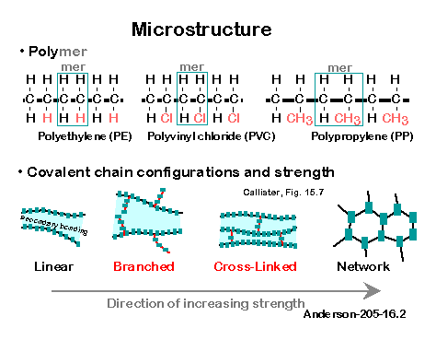

Slide 15
Polymer Processing
Polymers are formed by many low temperature processes.
Extrusion. The polymer is heated to the liquid state and forced through a die under pressure resulting in an endless product of constant cross section. 60% of polymers are prepared in this way. Examples include: tubing, pipes, window frames, sheet, insulated wire.
Film Blowing. Using the same method as extrusion the material coming out of the die is blown into a film. An example is plastic wrap.

Slide 16
Blow molding. The melted polymer is put into a mold, then compressed air is used to spread the polymer into the mold. It is used to make many containers such as plastic soda containers and milk jugs.
Compression molding. Solid polymer is placed in a mold, the mold is heated and puts pressure on the polymer to form the part.
Reaction injection molding. Liquid monomers are placed in the mold avoiding the need to use temperature to melt the polymer or pressure to inject it. The monomers polymerize in the mold forming the part.

Slide 17
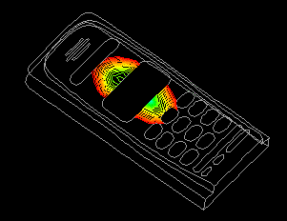
INJECTION MOULDING Similar to extrusion, the polymer is heated to the liquid state, but It is prepared in metered amounts, and the melt is forced into a mold to create the part.
It is not a
continous process.
Many toys are made by injection molding.

Slide 18
End of Slide Show
To Return to Year 12 Tutorial List
Choose Back from Menu above

