Slide 1
Web Scraping
MUSA 620: Week 3

Slide 2
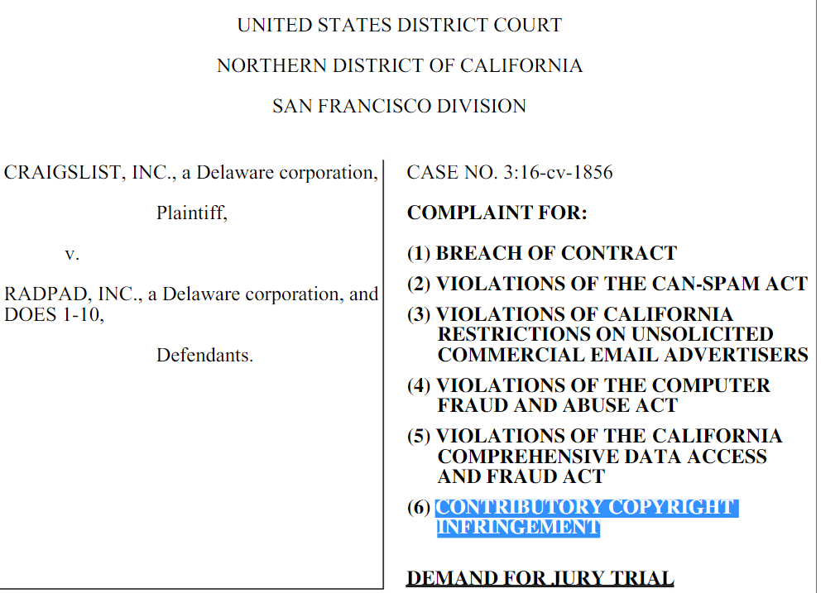
Legal Issues: Two Types of Claims
Copyright infringement
Terms of use violation
Only creative works can receive copyright protection. Facts cannot.
Examples:
Facts (no copyright): listing price for a home, number of floors, square footage.
Creative works (copyright): written description of a home, photographs.
Generally, must meet three standards:
Unauthorized: Is scraping prohibited in the website’s terms of use?
Intentional: Was the person aware of the terms? Did they check an “I agree to these terms” box?
Causes damage: Did the scraping overload the website, blocking user access?

Slide 3
Legal Issues: Continued
Web scraping defense
When web scraping is more likely to be ok
CAPTCHA
Web traffic monitoring
IP / user agent blocking
IP blacklists
Cease and desist letter
Legal action
.gov sites, .edu sites (to a lesser degree)
Website owner has no business reason to protect the information
IF not prohibited in terms of use
Limited number of requests
Not too many requests all at once
Done at night, when web traffic is low
Web scraping defense defense
When it’s less likely to be ok
NEVER WITH SEARCH ENGINES
E-commerce sites (e.g. Zillow, Expedia, Amazon)
Social media
If prohibited in terms of use
Large number of requests
High frequency of requests
Proxies
VPN (Virtual Private Network)
Simulating human behaviors (mouse movements, delays)

Slide 4
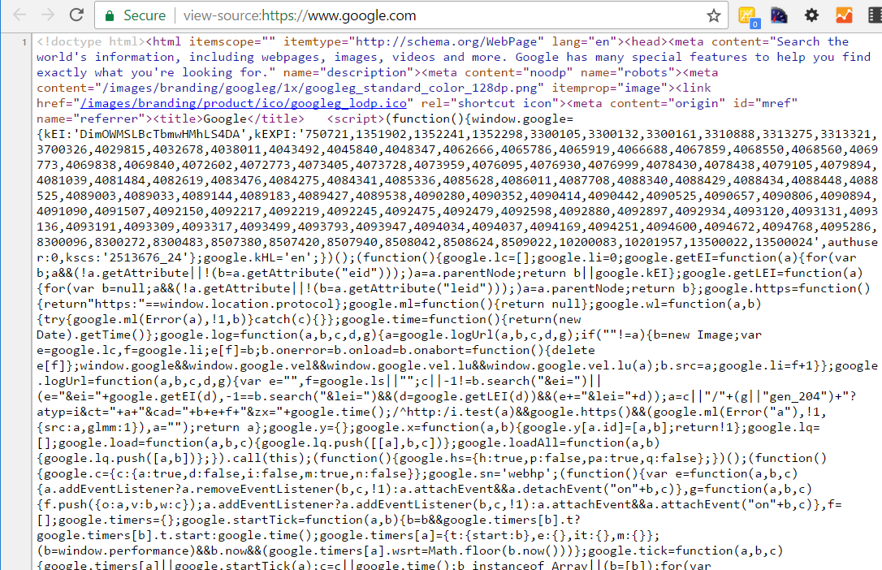
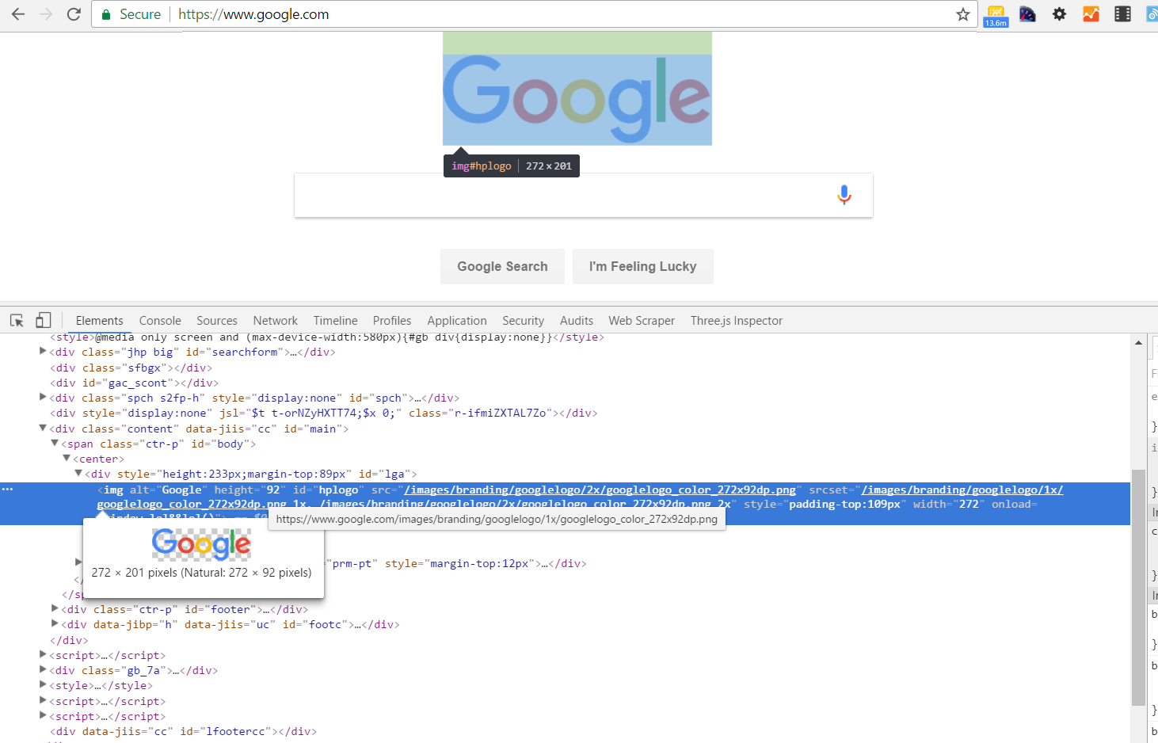
Web Definitions: HTML Document vs DOM
HTML Document An HTML document is a static document that describes the structure of a web page.
DOM (Document Object Model) The DOM is a dynamic HTML object that describes the structure of a web page in its current state.
What a web crawler sees (usually)
What a web browser sees

Slide 5

Web Definitions: Element, Tag, & Attribute
Element:
Tags:
Attributes:

Slide 6
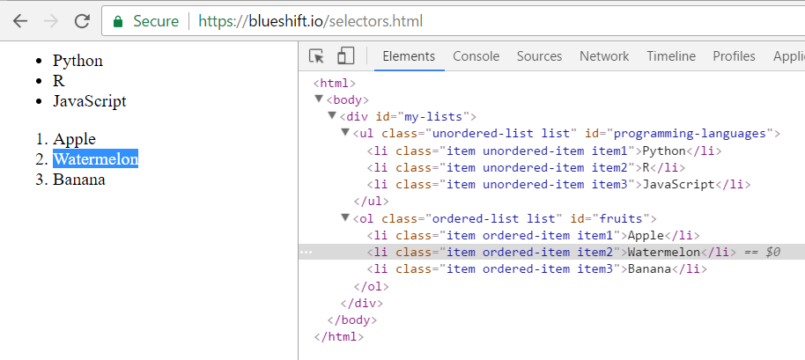
Web Definitions: Selectors
Describing the element you want to “select”
Basic Selectors
Class (e.g. “item”, “ordered-list”)
ID (e.g. “my-lists”, “fruits”)
Tag (e.g. “div”, “li”)
Complex Selectors
CSS Selectors
XPath

Slide 7
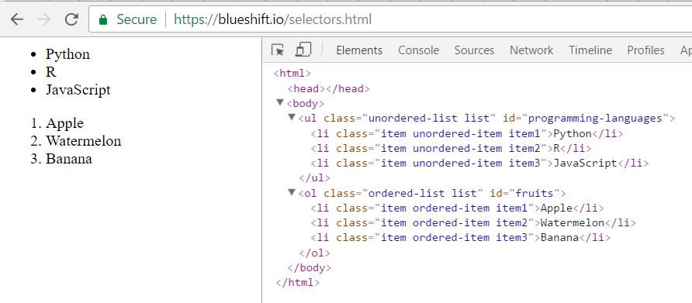
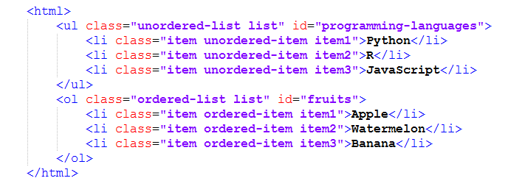

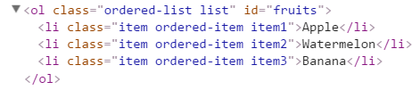

Basic Selectors: Class, ID, Tag
findElements("class name", "item1") ->
findElement("id", "fruits") ->
findElements( ‘tag name', “li") ->

Slide 8
Basic Selectors: Understanding IDs and Classes
IDs serve as unique identifiers. No two elements on a page will have the same ID.
Classes can be unique, but more often they function as categories. Often many elements will have the same class (there are six elements above with the class “list”). Also a single element may have many different classes (the “Python” element above has three: item, ordered-item, and item1).

Slide 9
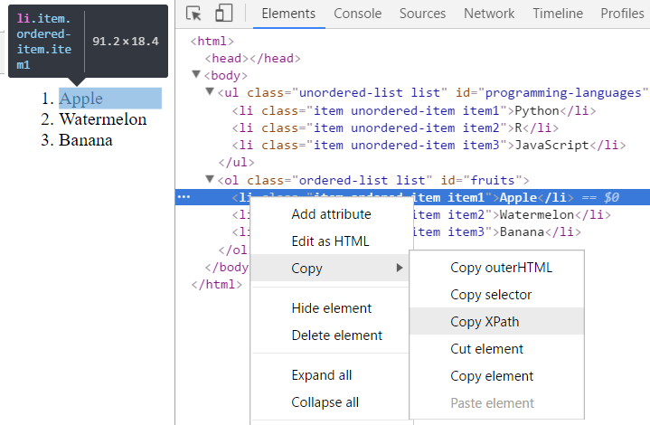
Complex Selectors: CSS & XPath
NOTE: Don’t get overwhelmed by the syntax. Your browser will give it to you.
For our purposes, there is no need to understand how these complex selectors work. But, as a reference…

Slide 10
CSS selectors (Not Always Complex)
CSS prefixes:
Period (.) = class
Hash (#) = id
No prefix = tag
Simple Selectors
CSS Equivalent
findElements("class name", "item1") =
findElement("css selector", “.item1")
findElement("id", "fruits") =
findElement("css selector", "#fruits")
findElements( ‘tag name', “li") =
findElements('css selector', "li")

Slide 11
Complex Selectors: XPath, CSS
CSS allows for compound selectors (“>” symbol means child elements)
findElement("css selector", "#programming-languages > .item2") ->
XPath selector for the same element
findElement(using = ‘xpath', value = “//*[@id=" programming-languages "]/li[2]") ->

Slide 12
Two Types of Web Scraping
The simpler method involves downloading a web page’s HTML Document and parsing it. For simple web pages, this works great.
The more complex method involves parsing and manipulating the DOM – interacting with the web page as a human would, through a web browser. For web pages that rely on JavaScript (the majority), this is the only option.

