Slide 1
2024 Colgate-Palmolive Global Analytics Hackathon

Slide 2

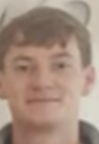

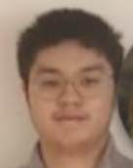

The Team - Team Analytics Grads
Based in Dublin, Ireland.
Eddy Chan - Associate Data Engineer
Sean O’Neill - Data Engineer Graduate
Kim Thai - Data Engineer Graduate
Jamie Carney - Data Engineer Graduate
Saurabh Yeramwar - Data Engineer

Slide 3
Problem Statement
Behavior Classification in Shelter Housed Dogs
Behavior Classification: Develop a model to classify a subset of annotated behaviors from accelerometer data. This task involves creating a sophisticated algorithm to accurately identify different behaviors based on data patterns.

Slide 4
Why we chose this problem Statement
The coding aspect influenced our decision to select this option.
Opportunity to utilize AI models with Colgate's data.
This presents us with an opportunity to engage with data that we are not typically accustomed to handling.
An opportunity to collaboratively apply our skills and expertise over the next few days to achieve a common goal.

Slide 5
What our goals are for this
Develop our skills even more and challenge ourselves in a different way that most of are not use to.
A chance to expand our network around global team and collaborate with others. Possibly view how other teams around the world tackled this problem. This would offer learning opportunities and assist us with any future AI work we may complete.
Hands-on learning - Gain practical, hands-on experience in applying AI tools and technologies in real-world scenarios.
For fun! - To enjoy the experience by partaking in this event.

Slide 6
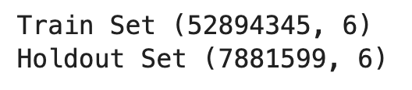
Data Exploration
Initially we saw how large the dataset was and how long it would have taken so we down sampled to only work on 5 behaviours.
We selected these behaviors due to their strong association with movement, and we recognized that there is a substantial amount of data available pertaining to them.

Slide 7
Pre-processing
We experimented with multiple preprocessing techniques and testing them on our models but we found that this was the best process for our model to get the best accuracy in the time we had:
Exploding
Dropping Duplicates
Dropping Nulls
Scaling

Slide 8
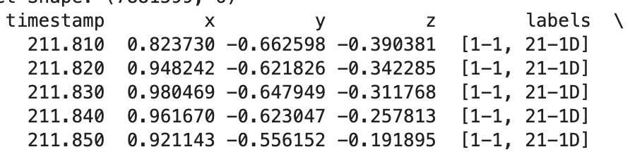
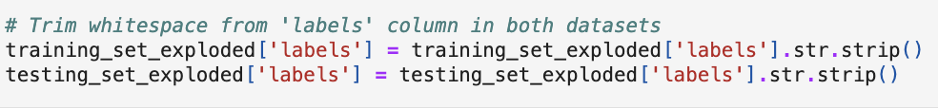

Pre-processing - Exploding
In the dataset we noticed that some labels were in arrays which couldn't be handled by the model.
So we exploded the dataset on the labels column which created a separate row for each label in the array.
We also trimmed white spaces in the exploded labels assure consistency.

Slide 9
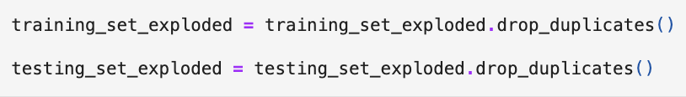
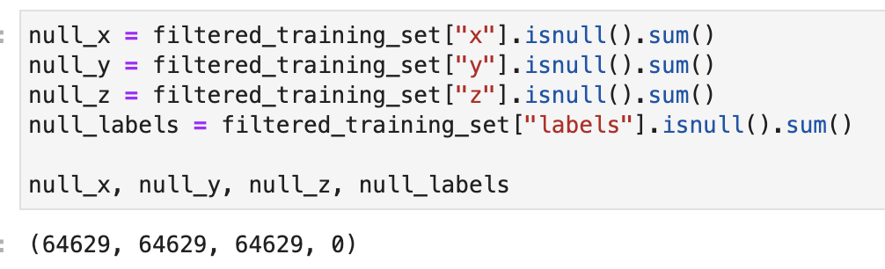
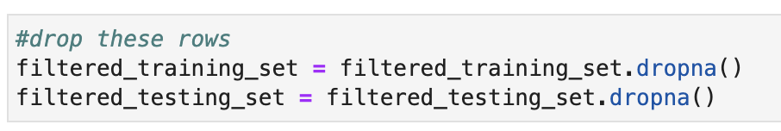
Pre-processing - Drop Duplicates + Drop Nulls
After we exploded, we knew there would be an increase in the number of rows, so we made sure to drop any duplicates present in the dataset.
When printing out the labels we saw that NULL was very common.
We then dropped any data that had null values.

Slide 10
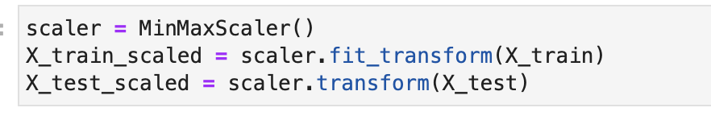
Pre-processing - Scaling
Experimented with both Min Max Scaler and Standard Scaler.
Found Min Max Scaler to produce the best results.
Transforms the features by scaling each feature between 0 & 1.

Slide 11
Model 1 - Random Forest
The first model we experimented with was a Random Forest Classifier. A Random Forest Classifier utilises many decision trees and uses majority voting to classify an instance. We began with a basic Random Forest Classifier on a sample of our data. This achieved an accuracy of 66.8%.
After experimenting with hyperparameters we achieved an accuracy of 68.06% with the following configuration:

Slide 12
Model 2 - KNN (K-Nearest Neighbors)
The second model we experimented with was a K-Nearest Neighbors classifier. A K-Nearest Neighbors classifier classifies an instance by identifying the 'k' nearest data points in the training set and determining the majority class among these neighbors. We used grid search to find the best hyperparameters.
After experimenting with hyperparameters. We used a bagging technique to counter potential variance in the model. After this we achieved a weighted F1 Score of 67.01% with the following parameters:

Slide 13
Model 3 - Decision Tree
The third model we experimented with was a Decision Tree classifier. A Decision Tree classifier makes decisions based on feature values, splitting the data at each node according to specific criteria to reach a decision at the leaf nodes. We used grid search to find the best hyperparameters.
After experimenting with hyperparameters, we applied a bagging technique to counter potential variance in the model. After this, we achieved a weighted F1 Score of 69.02% with the following parameters:

Slide 14
Model 4 - Neural Network
The fourth model we experimented with was a Multi-Layer Perceptron (MLP) classifier. An MLP is a type of neural network that consists of multiple layers of nodes, each layer fully connected to the next, and it applies non-linear transformations using activation functions to model complex relationships in the data.
After experimenting with hyperparameters we achieved a weighted F1 Score of 67.31% with the following parameters:

Slide 15
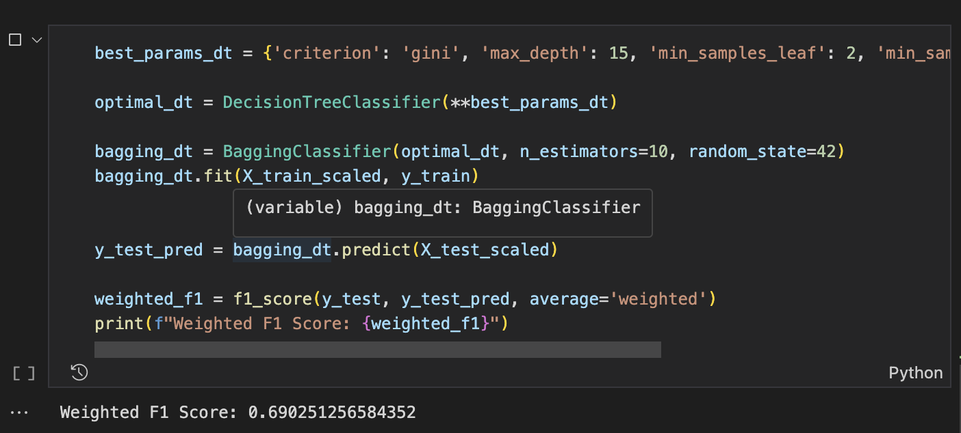
Final Model
After doing exploration on all 4 models we found that the best one was the Decision Tree based on the weighted F1 Score.

Slide 16
Conclusion
The best accuracy we could achieve was 69%. While this is not bad and a lot better than pure guesswork, there is some room for improvement.
If we had more time we could definitely improved on the accuracy of the models.
A potential improvement could be engineering more features, such as looking at the rate of change of x, y and z.

Slide 17
Thank you!!

