Slide 1
homebrewed BEER RECIPES
JUNJIE CAI – 43937780
itec873, Master of IT in Internetworking & Cyber Security
05/06/2018

Slide 2

DATA SET
Data source: https://www.kaggle.com/jtrofe/beer-recipes
Over 70,000 homemade beer recipes (rows)
22 variables

Slide 3
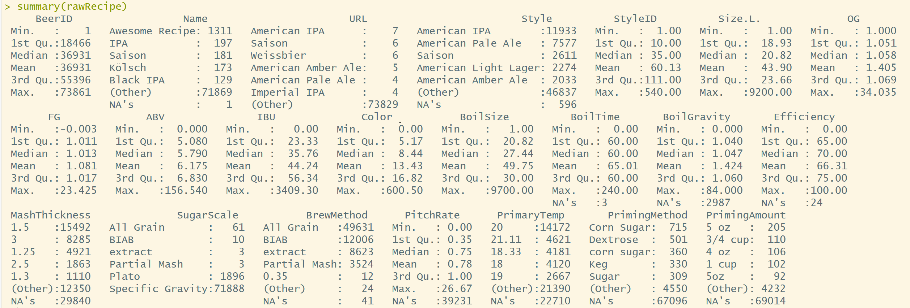

Slide 4
Pre-process data
A lot of useless columns
With a lot of NAs
Some do not make sense
As suggested from Kaggle.com, 5 most useful features are selected.
OG (original gravity) : specific gravity measured before fermentation
FG (final gravity): specific gravity measured at the completion of fermentation
ABV (Alcohol by volume): alcohol concentration represented by Volume
IBU (International Bitterness Units): a numeric measure of bitterness of beer
COLOR: numeric value of beer color (see next slide)

Slide 5
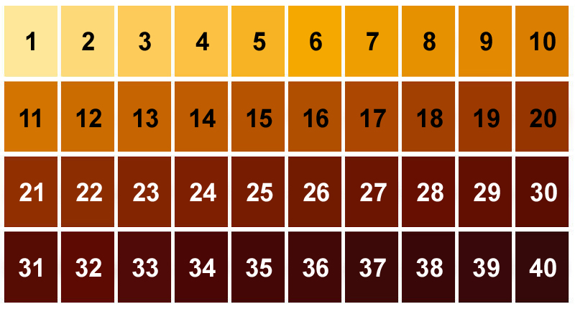
Pre-process data
Source: http://brewersvault.com/index.php?p=b_m_tips&id=6893

Slide 6
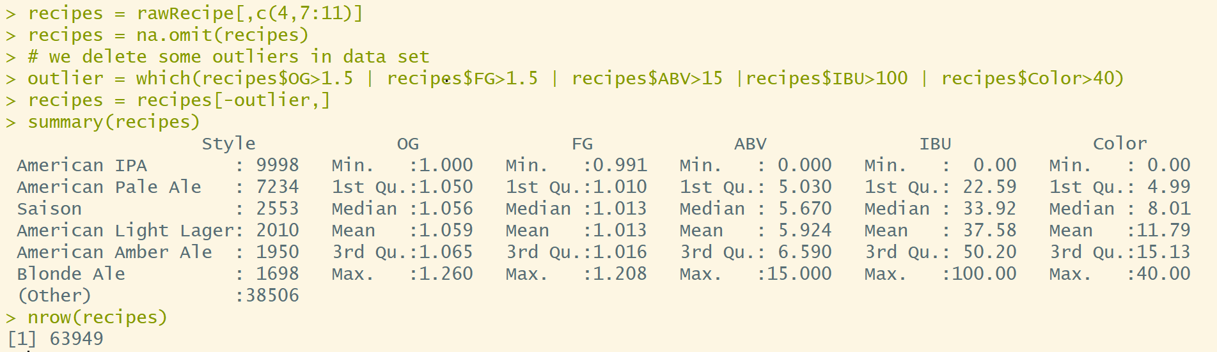
Pre-process data
We finally get the data which will be actually analyzed later.

Slide 7
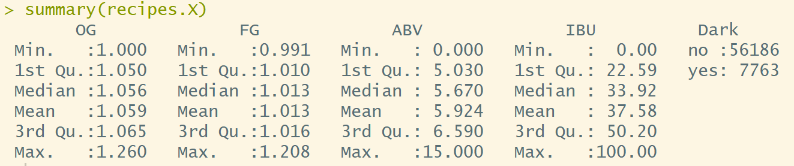
Pre-process data
I will create a new qualitative variable called “Dark” with the two values (“yes” or “no”) to indicate that whether the color of beers is “dark” or not.
A dark beer has the value of “Color” larger than 25

Slide 8
Project goal
The relationship between Dark and other features.
Can we predict that whether a beer is “dark” or not.
The relationship between Style and other features.
Can we predict the style of beers when using these features as predictors

Slide 9
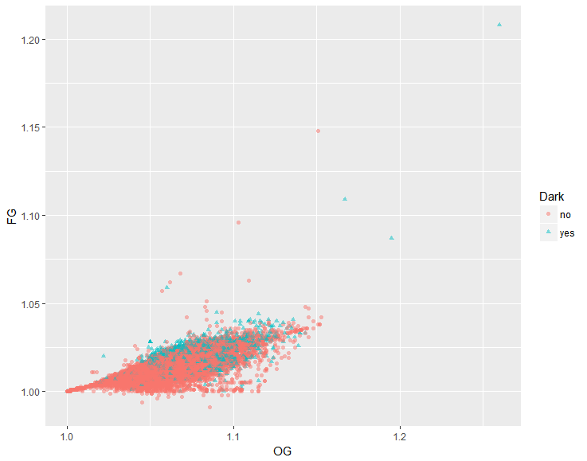
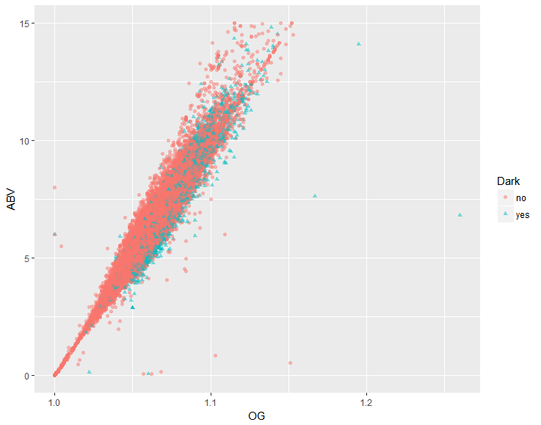
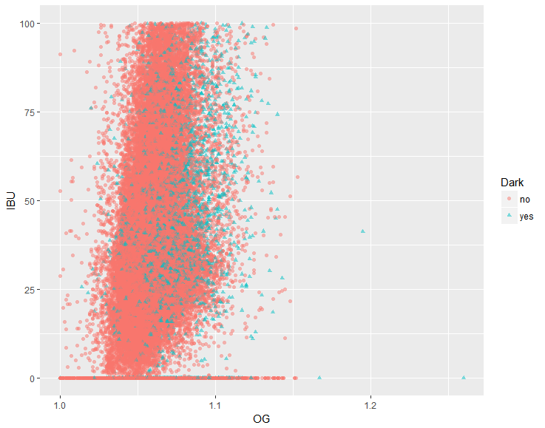
General Data analysis

Slide 10
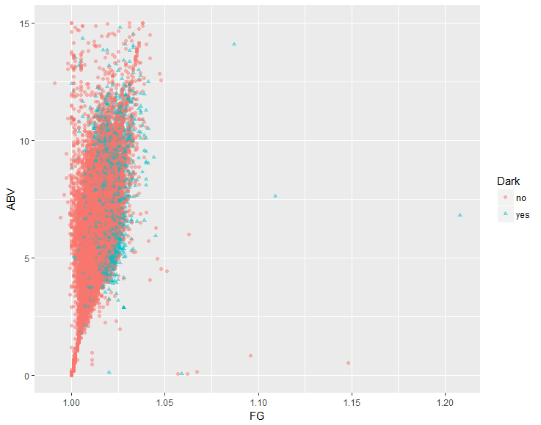
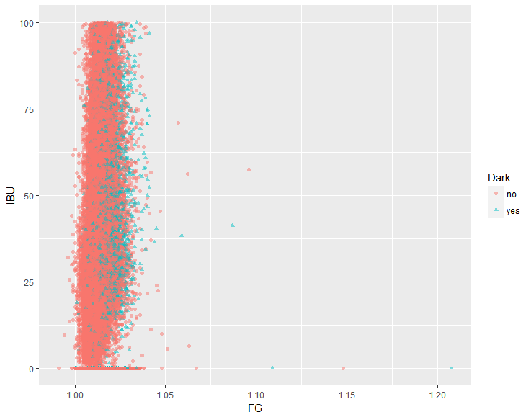
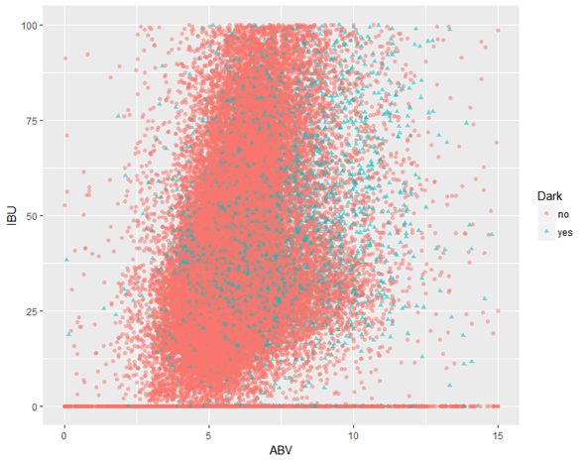
General Data analysis

Slide 11
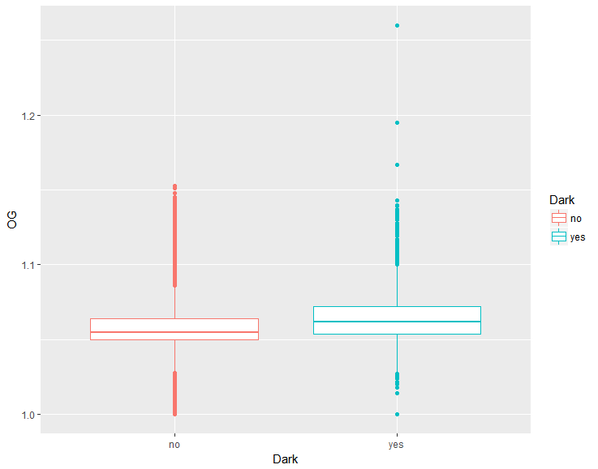
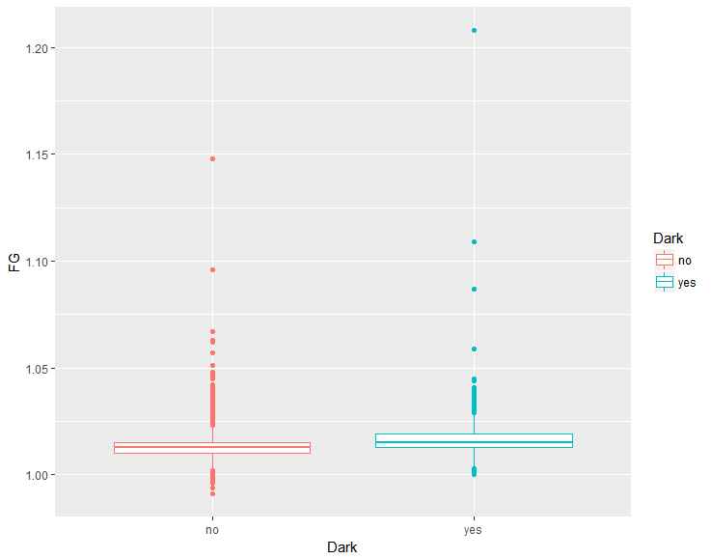
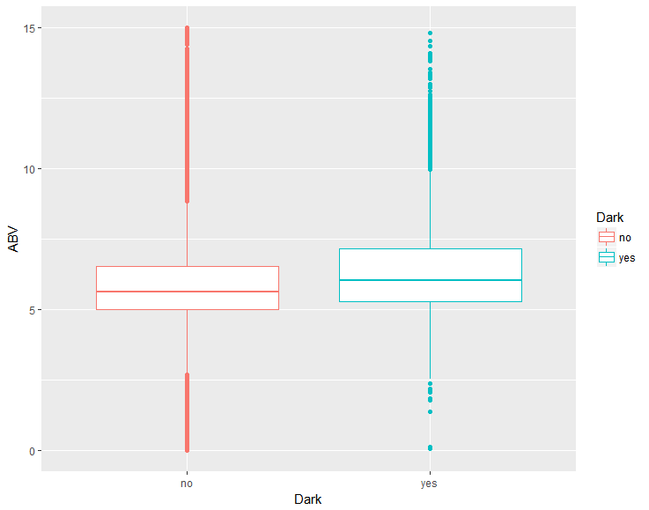
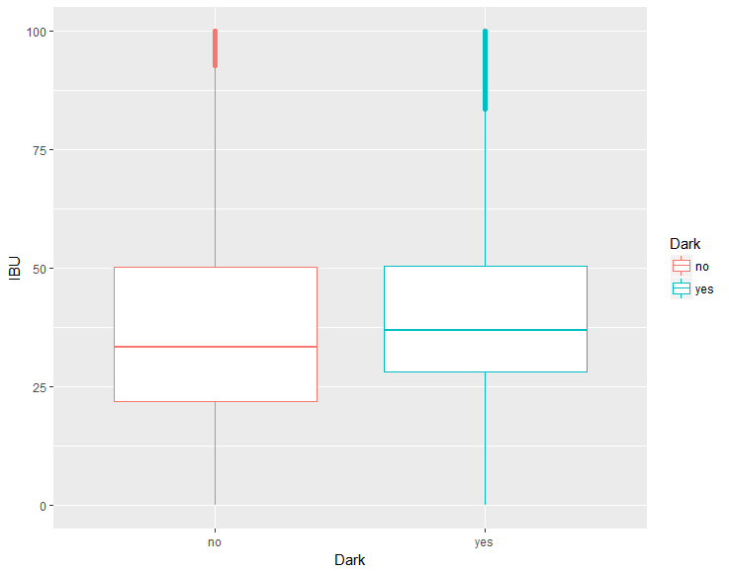

Slide 12
METHODS TO BE USED
Random guessing
Logistic regression
Linear transformation
Non-linear transformation
Linear Discriminant Analysis
KNN function
Decision tree

Slide 13
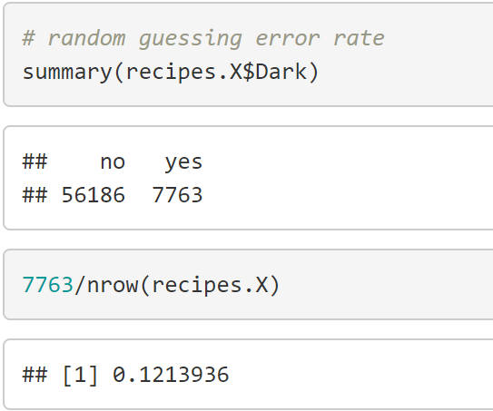
Random guessing
The picture shows 7763 observations are dark beer.
We guess every observation is not dark beer.
The error rate of this method is 12.14%.

Slide 14
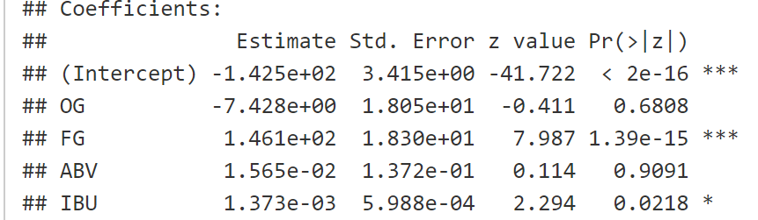
Logistic regression
Firstly I choose all features as predictors to build logistic regression.
P value shows ABV is not statistically significant with the response.
Next, I will remove ABV, and recall the model.
Repeat the step.

Slide 15
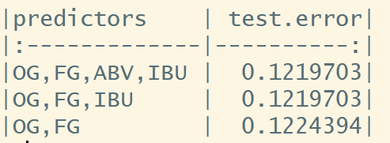
Logistic regression
ABV does not contribute to the model.
IBU contributes to test error rate, as the test error rate increases when “IBU” is removed.
Finally we get the optimal predictors – OG, FG IBU.
One problem: larger than random guessing.

Slide 16
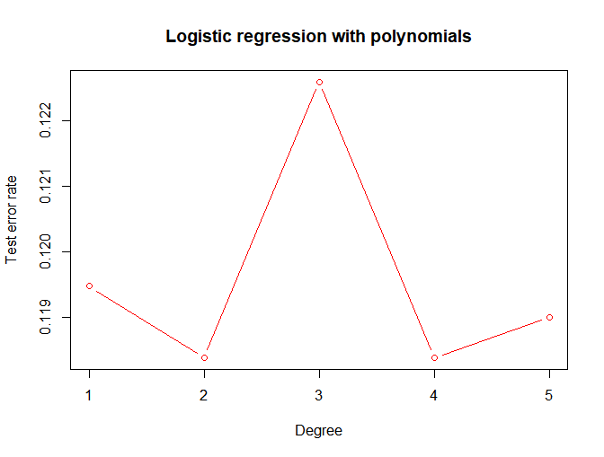
Logistic regression WITH NON-LINEAR TRANSFORMATION
We use OG, FG, IBU to build the model with non-linear transformation.
Polynomials degree from 1 to 5 is applied to find the best degree.
Degree 2 and 4 are best, with the 11.85% test error rate.

Slide 17
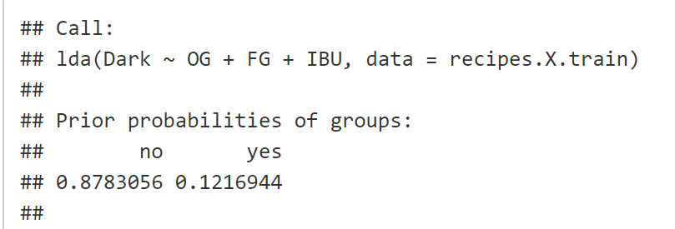
Linear Discriminant Analysis
LDA is similar with logistic regression.
The Prior probabilities of groups show that 12.17% of the training observations are dark beer.
Test error rate is 12.12%.

Slide 18
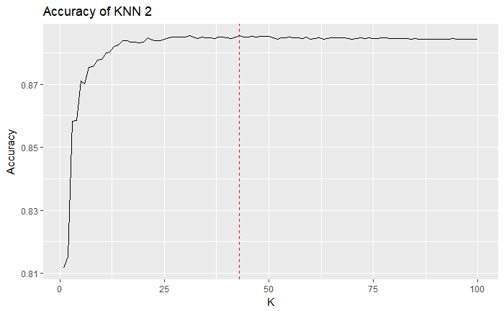
KNN
2-labels classification
Need to be standardized
Accuracy rapidly increases when K increases up to 15.
The highest accuracy is 88.55%, so the test error rate is only 11.45%.

Slide 19
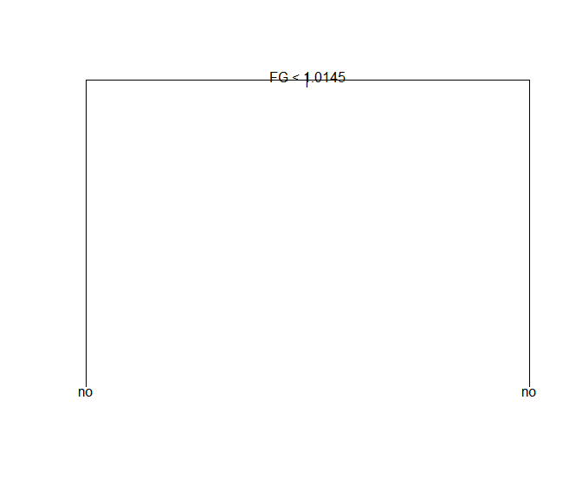
Decision tree
Decision tree is not suitable in my dataset.
Main reason is that there are only two in my dataset, and most of observations belong to the “no” class.
All data items are predicted as not dark beers, just like random guessing.

Slide 20
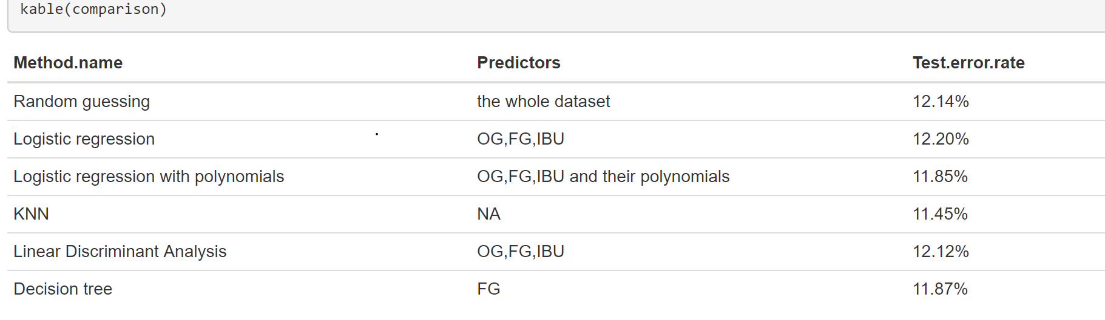
Comparison and conclusion
In conclusion, for the problem of predicting whether a given color is dark or not, the KNN function with the K = 43 works best, and the test error rate is around 11.45%, which seems acceptable.

Slide 21
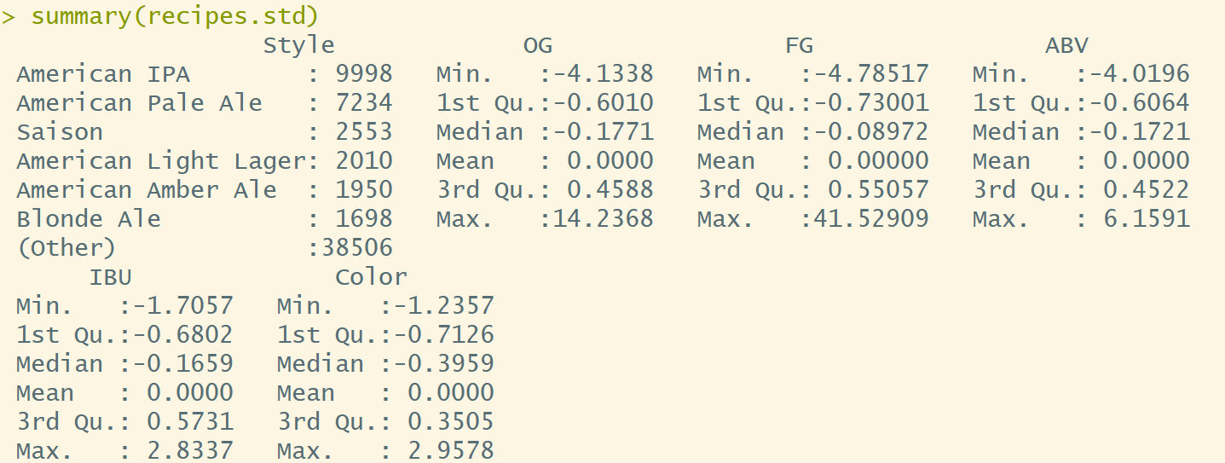
Style and other features
KNN is used to predict the style of beers.
Need to be standardized

Slide 22
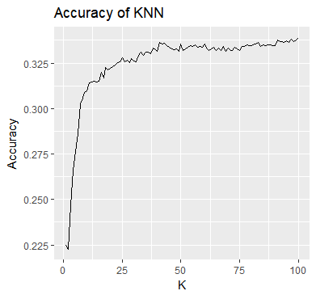
KNN
Increases rapidly from 22% to 31% when K increases from 1 to 12.
A slow increase before K reaches 36.
Fluctuates at 33%.

Slide 23
conclusion
KNN method is not working very well in the second question.
A low accuracy of KNN method is foreseeing, since there are more than 60 thousands observations and over 200 labels in the dataset.
KNN method does not work well for the dataset with a lot of labels.
A large K will result in a huge amount of computing process, which consumes more memory and computing resources
Variables in the dataset is not good enough to precisely predict the beer styles when using KNN function.

Slide 24
Future work
Future work can be focused on how to improve the accuracy of predicting the beer styles.
Use more variables as predictors.
Apply other method
Support vector machine
Decision Tree Model
Naive Bayes

Slide 25
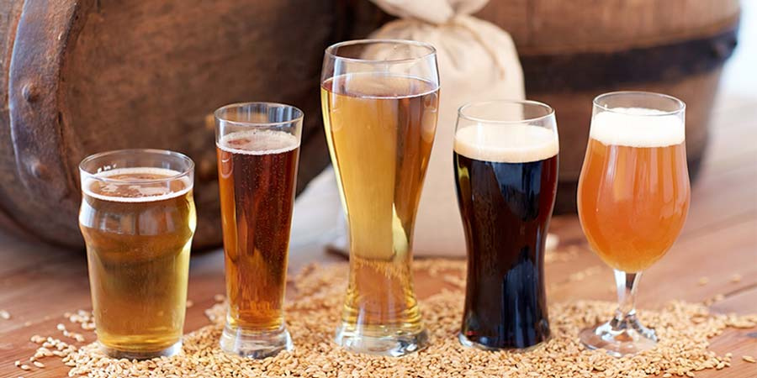
Questions

