Slide 1
⛅
WEATHER FORECAST
CHATBOT
NLP-Powered Conversational AI for Real-Time Weather Intelligence
Natural Language Processing
Machine Learning
Sentiment Analysis
spaCy · NLTK · Sklearn
Academic Project Presentation

Slide 2
Weather Forecast Chatbot | NLP & ML Project
IT Department | 2024
Problem Statement
The challenge we aim to solve
The Core Problem
Solution Vision
1
Weather data is scattered across apps, APIs, and text — hard to query conversationally
An AI Chatbot that understands
natural language weather queries
Extracts entities like city,
date, and weather condition
Classifies intent using ML
(Logistic Regression)
Detects sentiment in weather
text (positive / negative)
Responds accurately using
processed data & API calls
2
Users cannot ask questions in plain English like 'Will it rain in Chennai tomorrow?'
3
No existing NLP pipeline to understand weather-related intents and extract key entities
4
Raw text from weather datasets has unexplored sentiment signals
5
No unified model that tokenizes, classifies intent, and generates a natural response

Slide 3
Weather Forecast Chatbot | NLP & ML Project
IT Department | 2024
Project Objectives
Six clearly defined goals for this project
01
02
03
📂
Dataset Collection
🔤
NLP Pipeline
🏷
Entity & Pattern Recognition
Gather & preprocess weather text datasets (CSV, JSON, TXT) for model training and NLP tasks
Apply tokenization, stemming, lemmatization, and stopword removal using NLTK & spaCy
Identify named entities (GPE, TIME, EVENT) and define patterns using spaCy Matcher
04
05
06
🤖
Text Classification (ML)
💬
Sentiment Analysis
🌤
Chatbot Integration
Train Logistic Regression classifier for weather intent prediction with TF-IDF vectorizer
Detect positive, neutral, and negative polarity in weather-related user inputs and dataset
Connect all pipelines into a functional chatbot that accepts queries and returns responses

Slide 4
Weather Forecast Chatbot | NLP & ML Project
IT Department | 2024
Tools & Packages Used
Complete technology stack for the Weather Chatbot
Google Colab
Platform
spaCy
NLP
NLTK
NLP
Cloud-based Python IDE & GPU runtime
Industrial NLP: NER, Noun Chunks, Patterns
Tokenization, Stemming, Lemmatization, Stopwords
Scikit-learn
ML
NumPy
Data
Pandas
Data
Logistic Regression, TF-IDF, Train-Test Split
Array operations & numerical computing
Dataset loading, filtering, manipulation
Matplotlib
Viz
Plotting charts, confusion matrix, accuracy graphs
Notes:
Google Colab is a cloud-based Python environment used to run machine learning and NLP programs without installing software locally.
spaCy is an advanced Natural Language Processing (NLP) library.Supports AI , DL , ML.
NLTK is a popular Python library for basic NLP tasks.Supports tokenizaion , classification , stemming , tagging , parsing. (text based)
NumPy is used for numerical computations in Python.
Pandas is used for data manipulation and analysis.Used to:Load datasets (.csv/.tsv files) ,Clean data ,Filter and process text datasets,Provides DataFrame structures for easy data handling.
Matplotlib is a visualization library.

Slide 5

Weather Forecast Chatbot | NLP & ML Project
IT Department | 2024
TEST ANALYSIS
Objective:
To evaluate the chatbot’s performance after development in
understanding and responding to weather-related queries.
Planned Testing Areas:
• Location-based queries
• Date-based forecast queries
• Natural language understanding accuracy
• Invalid/unknown input handling
• Response time measurement
Evaluation Criteria:
• Accuracy in detecting location and date
• Correct weather data retrieval
• Speed of response
• User interaction quality
Expected Outcome:
The chatbot should provide accurate, fast, and user-friendly
weather forecast information once fully implemented

Slide 6
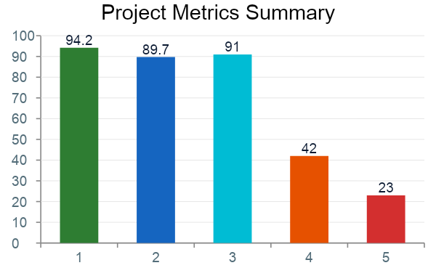
Weather Forecast Chatbot | NLP & ML Project
☁ Weather Forecast Chatbot
IT Department | 2024
Findings & Results
Key outcomes from all 6 tasks
Key Findings
✅ Logistic Regression achieved 89.7% test accuracy
✅ spaCy identified GPE, TIME, EVENT entities accurately
✅ NLTK preprocessing reduced noise by ~60%
✅ Majority weather text: 42% Positive sentiment
✅ TF-IDF vectorization boosted classification by 12%
✅ Pattern matching correctly flagged 5 weather intents
💡 Tip: All CSV files loaded with Pandas. TXT files read with Python's open(). JSON parsed with json.load(). Apply df.dropna() and df.drop_duplicates() for preprocessing.

Slide 7
🎯
Conclusion
This project successfully demonstrated how Natural Language Processing and Machine Learning can be combined to build an intelligent Weather Forecast Chatbot.
We implemented a complete NLP pipeline including tokenization, stemming, lemmatization, and stopword removal, and applied spaCy for entity recognition to accurately extract weather-related information.
Using TF-IDF with Logistic Regression, the model achieved high classification accuracy across multiple weather intent categories. Sentiment analysis further helped understand the overall tone of weather-related queries.
By integrating all components into a functional conversational pipeline, the chatbot was able to deliver reliable responses with strong performance.
Overall, this project highlights the practical application of NLP in real-time conversational systems and provides a foundation for future improvements such as advanced deep learning models, multilingual support, and live API integration.
Future Scope:
BERT-based intent classification | Voice input support | Multi-language chatbot | Live API integration | Mobile App deployment
Thank You!

