Slide 1

IG3D project Real-Time Lens Blur Effects and Focus Control
Edward Daou (ID: 21400357) Edward.Daou@etu.sorbonne-universite.fr
22/04/2025

Slide 2
Plan
1. Introduction
I. Paper Overview: research paper summary
II. A Retro Flight over Paris: process behind the scene construction
2. Project Code Implementation
I. Depth of Field
II. Lens artifact: Chromatic Aberration
III. Compositing and Integration
3. Conclusion
I. Results
II. Challenges and Further Implementations

Slide 3
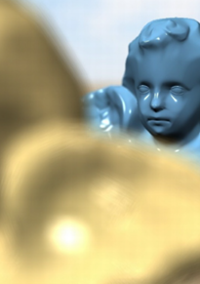
Paper Overview
Techniques:
Layer Construction via Efficient Depth Peeling
Computing Lens Rays
Efficient Intersection Test
Optical Aberration Simulation
Focus Control
Novel enhancements:
Optimized Efficiency for Real-Time Performance
A Hybrid Rendering Approach

Slide 4
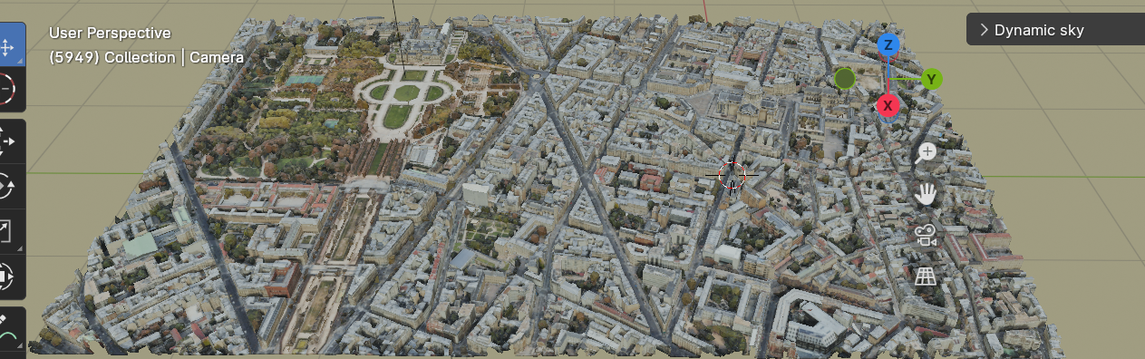
A Retro Flight over Paris
SCENE: We loaded onto Blender a panoramic view of the Pantheon-Jardin du Luxembourg area. This complex scene was chosen for its architectural richness, allowing us to effectively showcase the depth-peeling process.
A camera panning slowly over the city was added through manual keyframes.
MESHES EXTRACTION: Using RenderDoc (version 1.3), we extracted 3D data from Google Maps in the form of a .rdc file, enabling us to import them as polygonal textured meshes into Blender.
To facilitate the process, we used the MapsModelsImporter add-on, available on GitHub: GitHub - eliemichel/MapsModelsImporter: A Blender add-on to import models from google maps
VISUAL ECONOMY: To manage computational load, we intentionally preserved a low-poly representation of the scene.
For visual enhancement, a dynamic sky was added onto the scene.

Slide 5
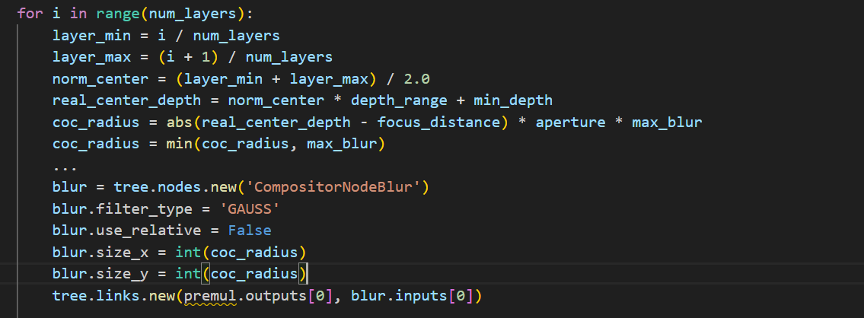
Depth of Field
- Implementation of a layered depth of field effect using Blender's compositor.
- The depth pass is normalized and divided into multiple layers.
- For each layer, a Circle of Confusion (CoC) radius is calculated based on the distance from the focus plane.
- A mask is generated to isolate each layer, and this mask sets the layer's alpha.
- Each layer is blurred according to its CoC.

Slide 6
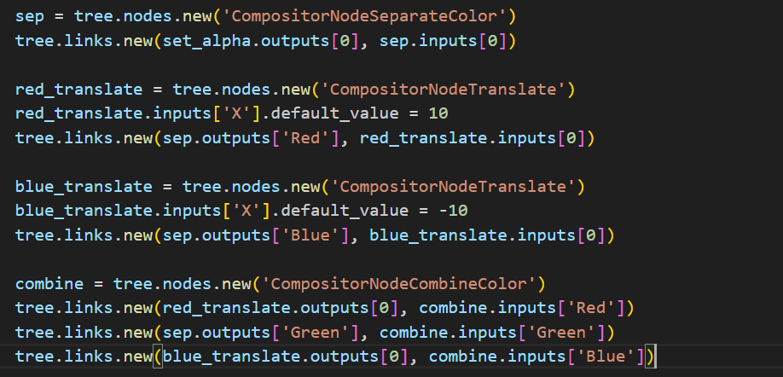
Lens artifact: Chromatic Aberration
Chromatic aberration is simulated by separating the color channels (R, G, B) of each blurred layer
The red and blue channels are translated horizontally (offset).
The channels are then recombined, creating color fringing, particularly in out-of-focus areas.

Slide 7
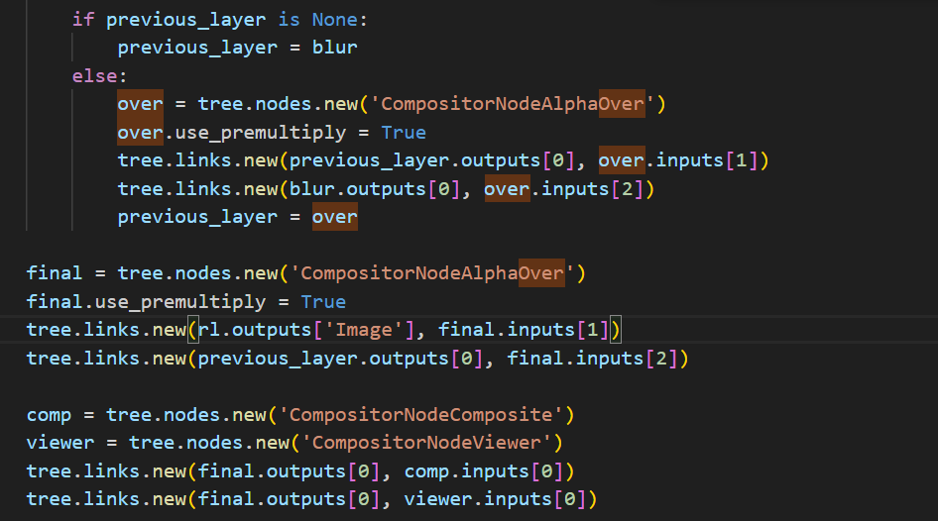
Compositing and Integration
Blurred layers are composited using Alpha Over nodes, stacking them from back to front.
The alpha channel of each layer, derived from the depth mask, ensures correct blending and occlusion.
The final composited image is then overlaid onto the original rendered image.
The result is sent to the composite output and a viewer node.

Slide 8
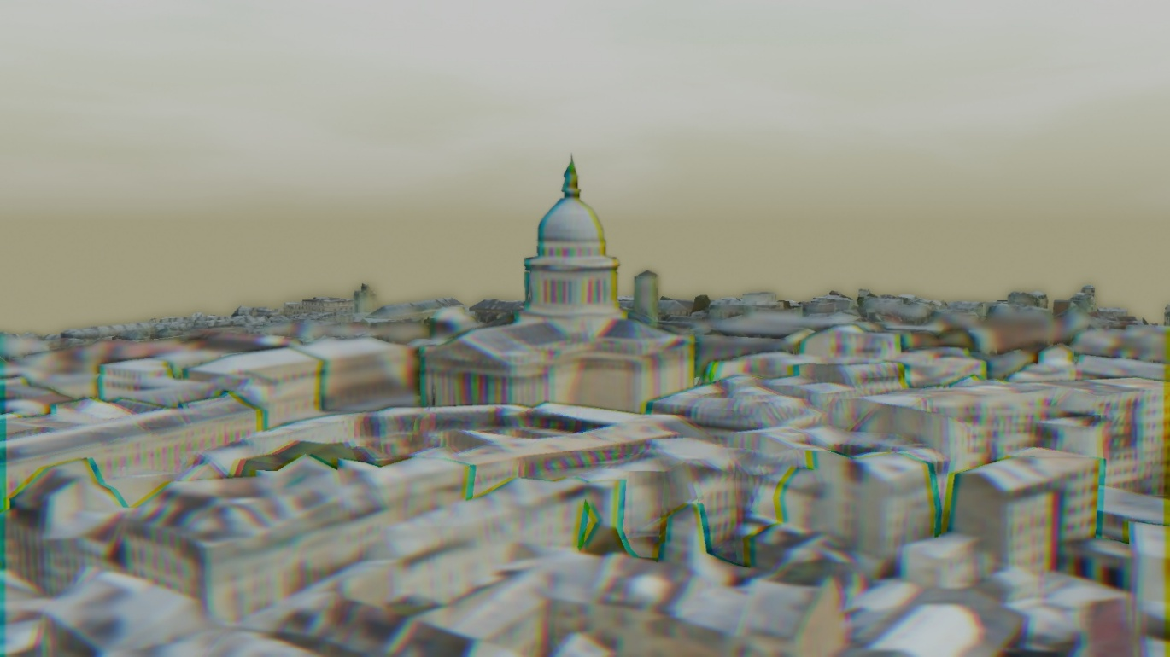
Results
Frame with emphasized chromatic aberration and different blur levels
across the depth

Slide 9

Challenges and Further Implementations
Challenges/Limitations:
Significant Rendering Time and Computational Demands
Dependency on Post-Rendered Compositing
Example of enhancements:
Ray tracing implementation
Spherical aberration
Physical Lens Model Integration

Slide 10
Reference
Lee, S., Eisemann, E., & Seidel, H.-P. (2010). Real-time lens blur effects and focus control. ACM Transactions on Graphics (Proceedings of SIGGRAPH), 29(4), Article 65. https://doi.org/10.1145/1778765.1778802

