Slide 1
AROL telemetry report agent
Capping closure data, deterministic analytics and a scoped BOT interface
Software and Device Programming project review

Slide 2
Project objective
Load curated machine telemetry into a consistent event dataset.
Select analytical tools from a user question and generate a report.
Show methods, data scope, limitations and evidence with each result.
Scope: torque and closure diagnostics
02

Slide 3
Telemetry and event pool
89 CSV files · 7,623,968 raw rows · 36 heads
Each raw row provides timestamp, per-head counter, torque and status.
The builder writes raw and observed-event Parquet partitions plus a manifest.
The manifest records 54,722,936 exact +1 observations across the pool.
03

Slide 4
Observed closure construction
Per head: compare the counter with its previous observation.
A change of exactly +1 emits one event with the new torque and status.
The previous value carries across files: 667 boundary events were verified.
Jumps and decreases are measured; individual unseen closures are not invented.
04

Slide 5
Architecture
Offline pool build
CSV readings → validation → counter check → Parquet + manifest
Question and report
CLI query → planner → scoped source → registered tools
Tool results → report + trace + optional figures
05

Slide 6
Deterministic analysis tools
Torque: statistics, histogram, trailing mean, anomaly flags and head pairing.
KPIs: explicit cap-present success, per-head comparison and time buckets.
Machine-wide No Load: consecutive raw readings on every head.
Reported rates and flags describe observations; they do not prove cause.
06

Slide 7
Agent decision flow
The rules planner maps supported phrasing to registered tools and filters.
The source reads the selected machine, heads and requested time window.
Tools calculate results; report templates describe the result and its limits.
Ambiguous requests stop for clarification without calling analysis tools.
Optional Ollama routing validates a model proposal against the same scope.
07

Slide 8
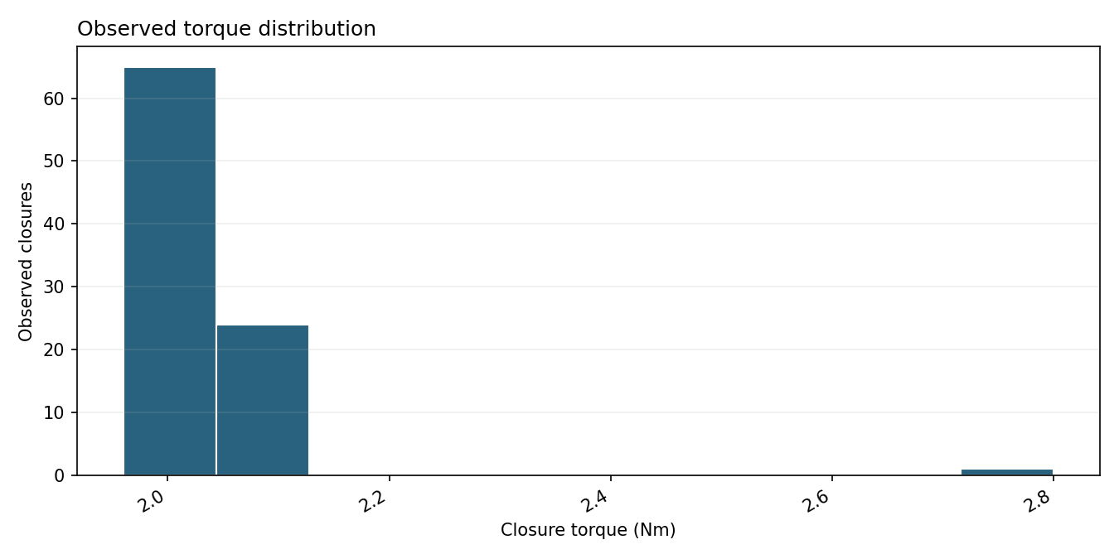
Sample torque report
A synthetic two-file pool
The histogram plots the bin edges and counts returned by the tool.
The same report gives sample size, mean, spread and threshold caveats.
08

Slide 9
Success-rate denominators
H05, one 12-hour window on the supplied machine
13,167
7,575
5,592
observed exact +1 events
confirmed cap-present
No Load class events
Cap-present success: 7,575 / 7,575 = 100% in this scope.
Status-0 as a fraction of all observed events: 57.53%. Each report labels its denominator.
09

Slide 10
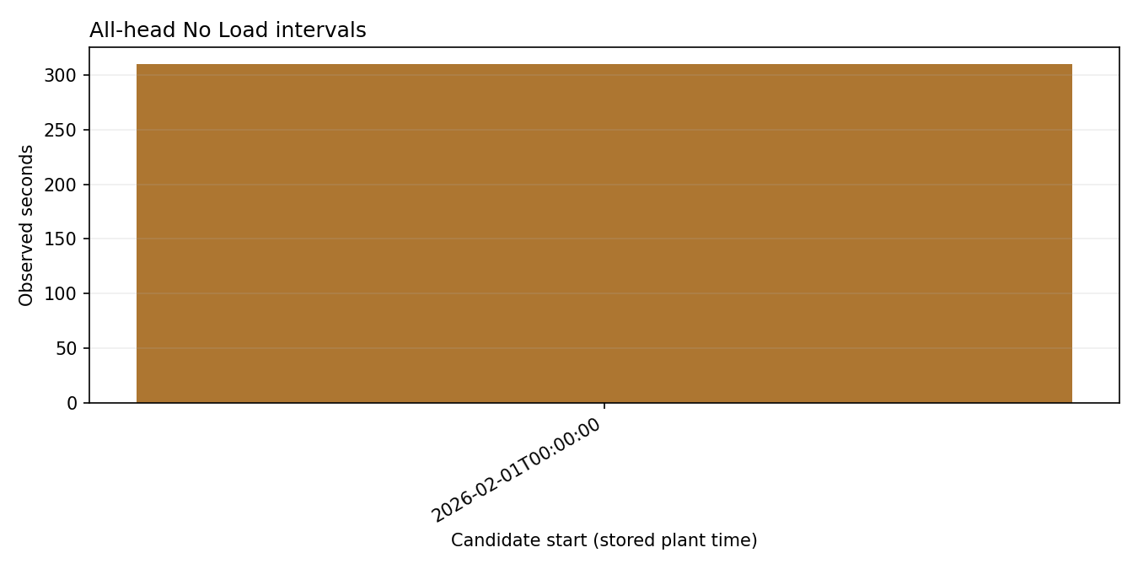
All-head No Load intervals
Synthetic example:
310 consecutive seconds with No Load on both heads.
Gaps and repeated timestamps break a run. A status pattern alone cannot confirm downtime.
10

Slide 11
Verification evidence
Uploaded source snapshot: 856 tests passed; 4 standalone-repo tests skipped.
Controlled question set: 28 of 28 cases passed in the prior evaluation.
Planted torque labels: 4 detected, 1 missed, and 0 false positives.
A scoped live Qwen request matched the independent torque calculation.
Controlled results do not estimate reliability on arbitrary questions or physical faults.
11

Slide 12
Live demonstration
1. Select the completed local pool manifest.
2. Ask for torque statistics and a histogram in a bounded scope.
3. Ask for a per-head KPI or an hourly rate as a second report type.
4. Open the Markdown reports, PNGs and JSON tool-call traces.
Run from a clean checkout; keep original telemetry under ignored data/.
12

Slide 13
Interpretation and next checks
Counter jumps leave unknown individual closures. Duplicate raw rows remain visible.
No Load and zero observed events need operating context before a downtime claim.
Torque limits and failure definitions require process-owner confirmation.
The agent reports evidence and traceable tool choices; it does not diagnose physical causes.
13

