Slide 1
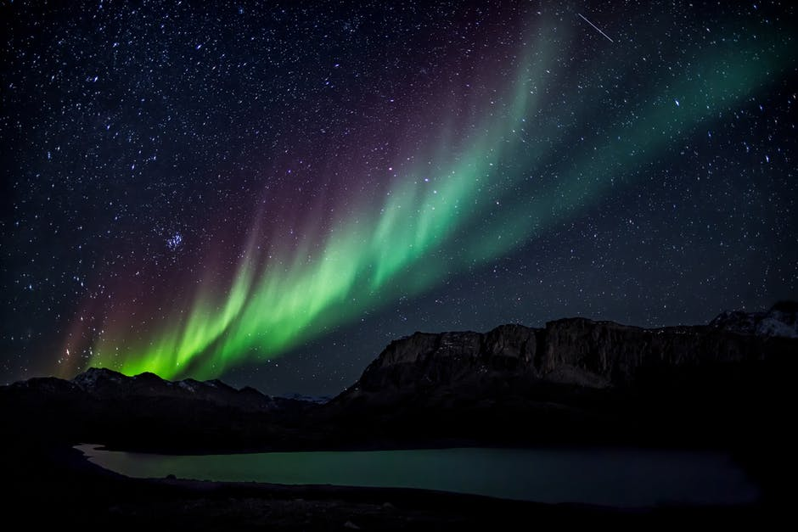
Aurora Borealis Detection
Stephane Tremblay
Eddy Merhej
Chedli Rdissi
Team CSA 5

Slide 2
It is known that the Northern Lights are accompanied by and produce magnetic disturbances that are measurable from the Earth’s surface.

Slide 3

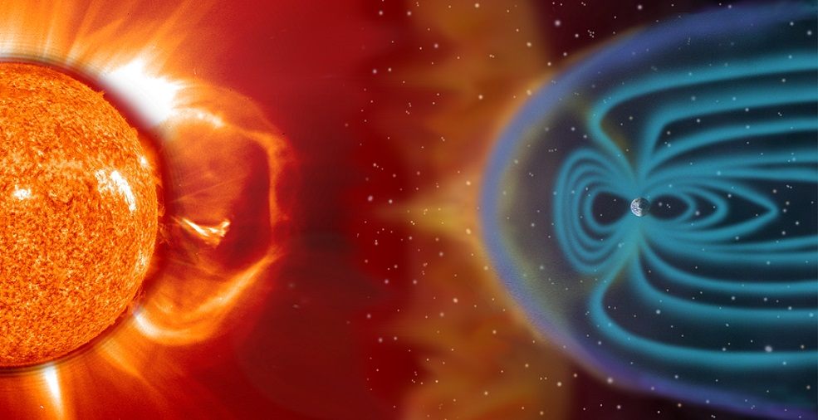
Problem Statement
Magnetic disturbances → Northern lights
Measurable from Earth’s surface
Improve forecasting of the Northern lights
It is known that the Northern Lights are accompanied by and produce magnetic disturbances that are measurable from the Earth’s surface.
Notes:
It is known that the Northern Lights are accompanied by and produce magnetic disturbances that are measurable from the Earth’s surface.

Slide 4
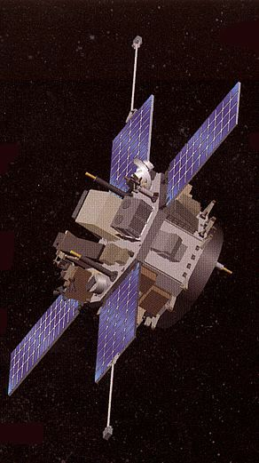
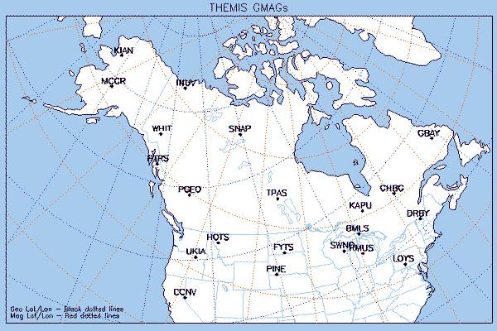
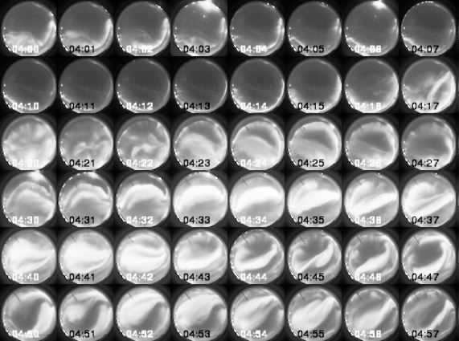
Data Used
Advanced Composition Explorer (ACE) data
Ground-based magnetometer (GMAG) data
Images of the Northern Lights → often poor viewing conditions and interference
It is known that the Northern Lights are accompanied by and produce magnetic disturbances that are measurable from the Earth’s surface.
Notes:
Ground-based magnetometer (GMAG) data
Advanced Composition Explorer (ACE) is a NASA exploration mission to study several matters, the data we care about is the energetic particles from the solar wind
Images of the Northern Lights, despite at times being compromised by poor viewing conditions and interference

Slide 5
Solution
Filtering the data
Sorting out ACE and GMAG data
Analyzing data and determining threshold
Determining the function
Predicting aurora appearance
It is known that the Northern Lights are accompanied by and produce magnetic disturbances that are measurable from the Earth’s surface.
Notes:
Filtering the data
Sorting out ACE and GMAG data
Analyzing data and determining threshold
Determining the function THAT BEST REPRESENTS THE BEHAVIOUR OF THE MAGNETIC FIELD
Predicting aurora appearance

Slide 6
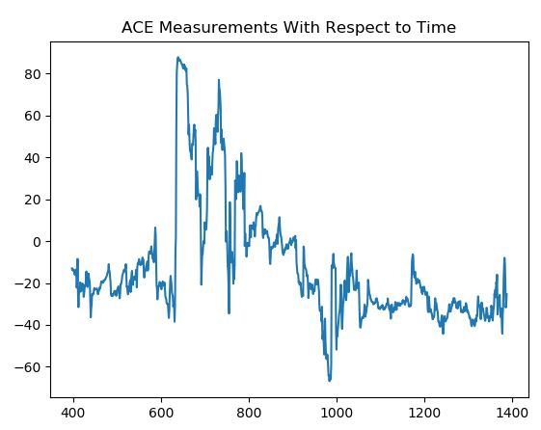
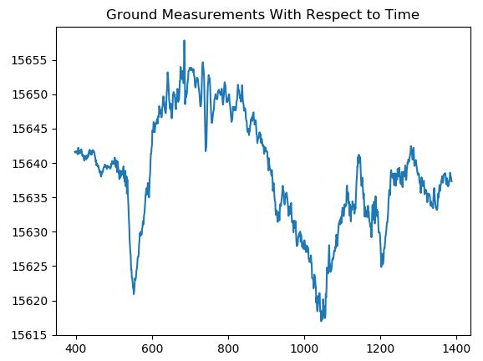
Our Solution
It is known that the Northern Lights are accompanied by and produce magnetic disturbances that are measurable from the Earth’s surface.
Notes:
Since ACE gives the speed of the solar flare, and the distance between ACE and Earth is known, the time the solar flare takes to get to ground can be known.

Slide 7

It is known that the Northern Lights are accompanied by and produce magnetic disturbances that are measurable from the Earth’s surface.

