Slide 1
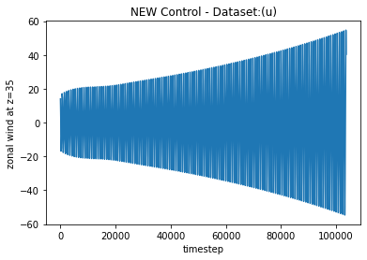

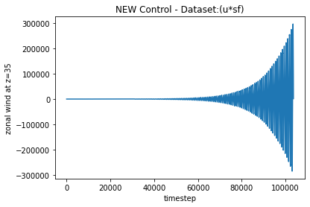
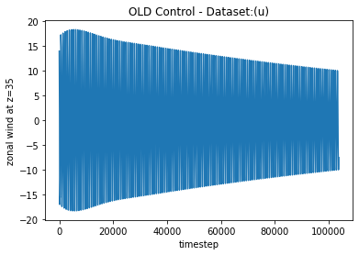
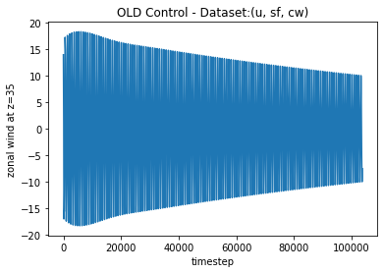
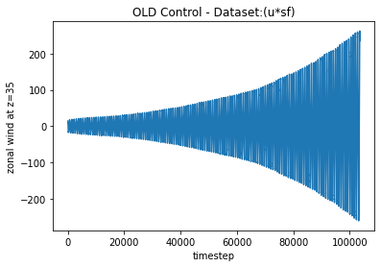
NEW control – sfe=3.8e-3, sfv=9e-8, cwe=32, cwv=225, corr=.75, seed=196
OLD control – sfe=3.7e-3, sfv=1e-8, cwe=32, cwv=225, corr=.75, seed=197

