Slide 2
Studies
new_user
More user = more potential for revenue
is_paid
Completed transaction is a revenue
gmv (Gross Merchandise Value)
More GMV = more income
basket_amount
Notes:
Actually, I don’t like basket amount. It is quite short sighted.
We know that AOV = basket amount. And those will affect GMV.
This means that GMV is a dependent variable, while AOV and basket amount are independent variable
We want to know how to increase GMV by changing AOV and basket amount
basket amount and AOV is also flawed, a user can buy small amount everyday. The GMV will high, but AOV and basket amount will show as low, giving a false negative

Slide 3
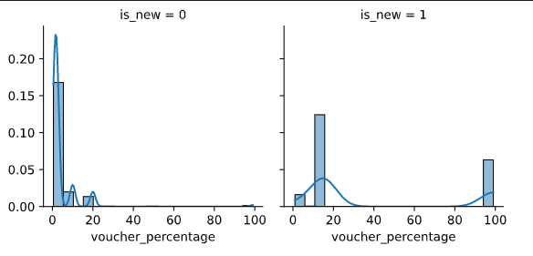
new_user Voucher percentage
Zero voucher is removed
Voucher correlates to new user joining
Vouchers mainly used

Slide 4
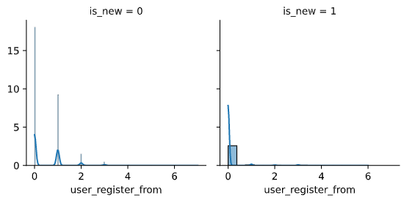
new_user User registered from
New user mainly come from platform 0

Slide 5
new_user – Other Findings
New user are likely to use valid vouchers
New user are likely to do transaction with vouchers

Slide 6
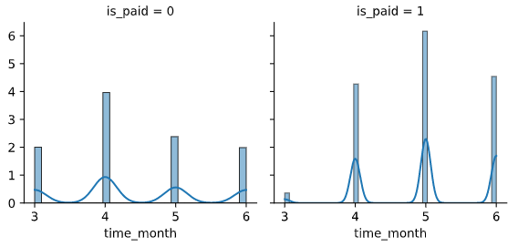
is_paid Voucher percentage
May and June
More completed transaction
March
More incomplete transaction

Slide 7
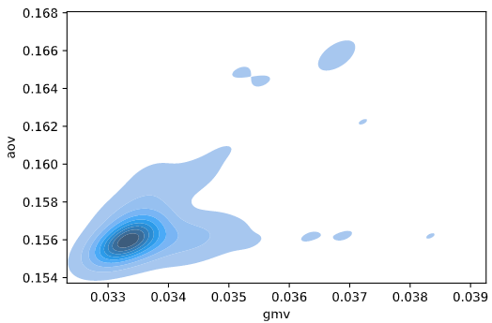
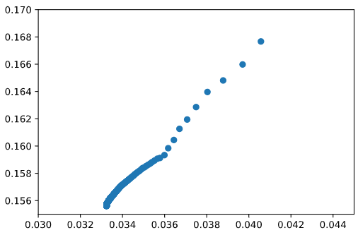

gmv Average Order Value
Linear Relationship
$aov∝gmv$
More aov = more gmv

Slide 8
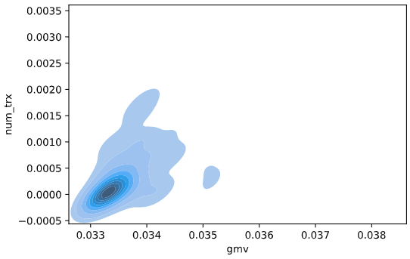
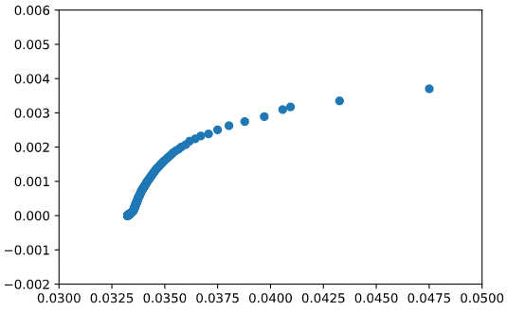

gmv Number of transaction
Squared Relationship
$n_{trx}^{2}∝gmv$
More transaction = more gmv

Slide 9
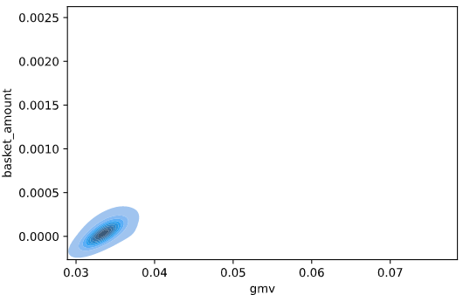
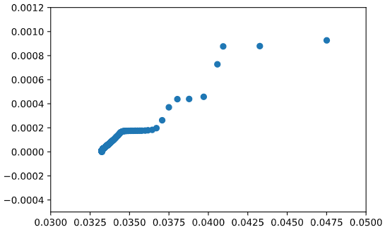

gmv Basket Amount
Linear Relationship
$basketAmount∝gmv$
More basket amount = more gmv

Slide 10
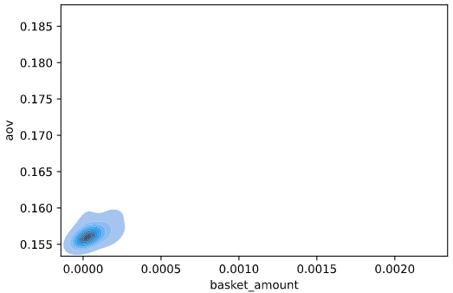
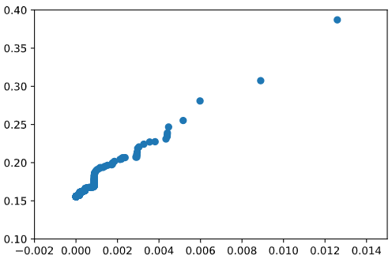

basket_amount Average order Value
Linear Relationship
$basketAmount∝aov$
More average order volume = more aov (obvious relationship)

Slide 11
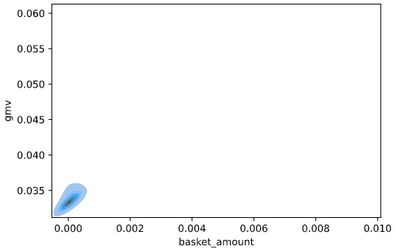
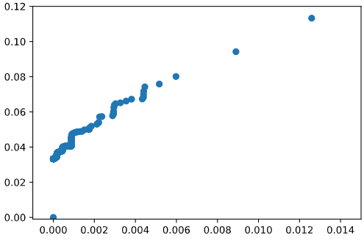
basket_amount gmv
Linear Relationship
$basketAmount∝gmv$
More basket amount = more gmv

Slide 12
basket_amount – Other Findings
Higher basket amount will unlikely to be purchased nor paid

Slide 13
Machine Learning
Outliners
Not removed
Lowers accuracy
Normalisation
Feature scaling (0-1)
Most data don’t follow normal distribution
Poor normal-probability plot
Poor kurtosis value
Good Q-Q plot
10% testing, 90% training
5 Kfold (18% validation, 72% training)

Slide 14
Machine Learning
Large data = Slow performance
Random Under-Sampling (fast)
Model can be built into API
Python backend (i.e. Flask or Django)
Easy implementation
Get request / REST API
Dockerised
AWS ECS

Slide 15
new_user
Classification
Data is unevenly distributed (87% vs 13%)
Oversampling
Increases false positive for new user
Decreases false positive for old user
Uneven = don’t use
Baseline model = Logistic Regression (95% paper accuracy)
78% Accuracy for new_user = 1
Best model = XGBoost (98% paper accuracy)
Also the fastest due to GPU support

Slide 16
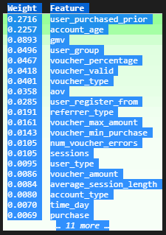
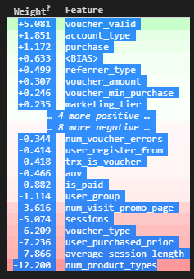
new_user Feature importance
XGBoost
Logistic Regression
Voucher Valid
Account type
Referrer type
Possible Features:
Voucher percentage
Voucher amount
Confirms data exploration

Slide 17
is_paid
Classification
Data is unevenly distributed (96% vs 4%)
Baseline model = Logistic Regression (96% paper accuracy)
95% Accuracy for is_paid = 0
Best model

Slide 18
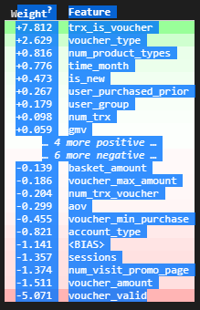
is_paid Feature importance
Logistic Regression
Transaction using voucher
Voucher type
Number of product types
Time of the month
Possible Features:
User group
Negative (opposite):
Voucher needs to be valid
High voucher amount
Visiting promo page
Sessions

Slide 19
gmv
Regression
Normalisation
Optional
Feature Selection
Safe model = Linear Regression (98.85%)
Best model = Decision Tree (99.98%)
Possible overfitting on outside of dataset

Slide 20
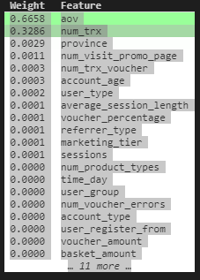
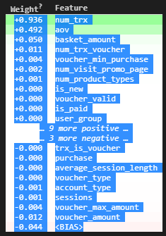
gmv Feature importance
Decision Tree
Linear Regression
aov
Number transaction
Possible features:
Province
Basket amount
Visiting promo page
Number of transaction voucher
Confirms the data exploration

Slide 21
basket_amount
Regression
Normalisation
Standatisation
Safe model = Linear Regression (96.69%)
Best model = Decision Tree (98.38%)
Possible overfitting on outside of dataset

Slide 22
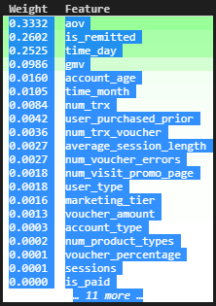
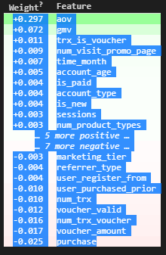
basket_amount Feature importance
Decision Tree
Linear Regression
aov
Gmv
is_remitted
Days of the month
Possible features:
Account age
Month of the year
Number of transaction
User purchased before
Confirms the data exploration

Slide 23
Correlation ≠ Causation
Need more study
Need to find the context of the data
A/B testing

Slide 24
Action Plans – Short term
Allow more voucher validity
Deadline, Usage restrictions
However, min/max amount doesn’t matter

Slide 25
Action Plans – Long term
Hypothesis
Voucher amount doesn’t matter for new users
Promo page is repulsive to new user
Expensive item gives more revenue
Quality > Quantity
Sale follows a seasonal monthly cycle of years
Sale follows a seasonal daily cycle of months
Users with high transaction will buy more expensive item
High session doesn’t increase completed transaction
Notes:
New user might be overwhelmed by the sheer amount of features and functions of the e-commerce app.
Also shows by the number of session new user browse and number of products metrics
A good example is amazon, huge features, but mostly hidden
A bad example is Taobao, lots of places to go. But easy once users get used to it
This means that high transaction not only increase quantity, but also increase quality.
However, new user aren’t willing to spend as much

