Slide 1


Team:Time Limit Exceeded
Stock Option Chain
Edelweiss Hackathon Presentation
Presented To
Presented By
Edelweiss Team
Time Limit Exceeded

Slide 2
Team Members
Student Name | Student Roll No | Student Email
Hardik Panchal | 16010121805 | hhp8@somaiya.edu
Krish Panchal | 16010121806 | krish27@somaiya.edu
Aryan Parekh | 16010121807 | aryan.parekh@somaiya.edu
Manav Rupani | 16010121813 | manav.rupani@somaiya.edu
Bhavya Sura | 16010121818 | bhavya.sura@somaiya.edu

Slide 3
AGENDA
Unique Selling Points
Why Select Us!
5
Problem Solution
Flow Chart
4
Problem Statement
3
2
1

Slide 4
Problem Statement
Create a realtime Option Chain Webpage for provided stocks and simulate realtime price updates
Also calculate IV(Implied Volatility) for every Option Trade and corresponding Time to Maturity as well
Process the data received in realtime which is provided using TCP/IP Protocol via execution of JAR file

Slide 5
Proposed Solution
Our MoneyFlow webpage is a realtime and responsive webpage that displays the Options prices of CALL and PUT for several Strike Prices.
Calculation of IV and Expiration time for different Strike Prices.
The data received after execution of JAR file is received via socket programming.
The data is processed upon further by the backend and then relayed to the frontend over realtime.

Slide 6
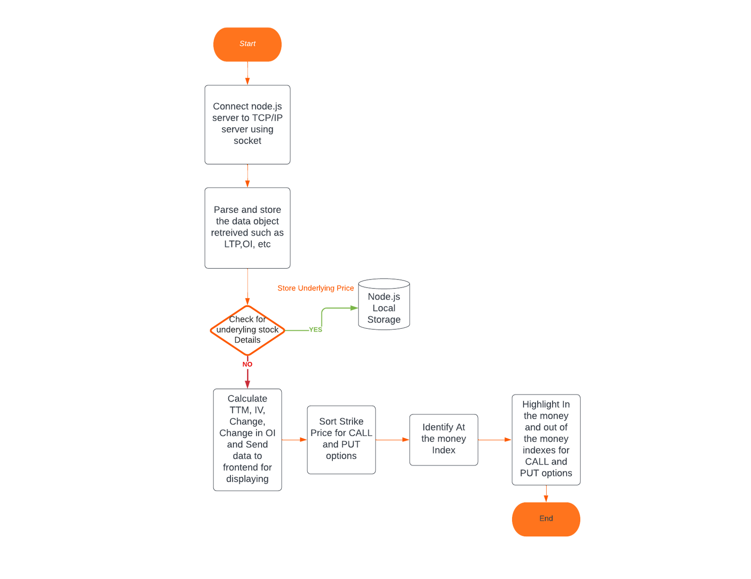
Flow Chart

Slide 7
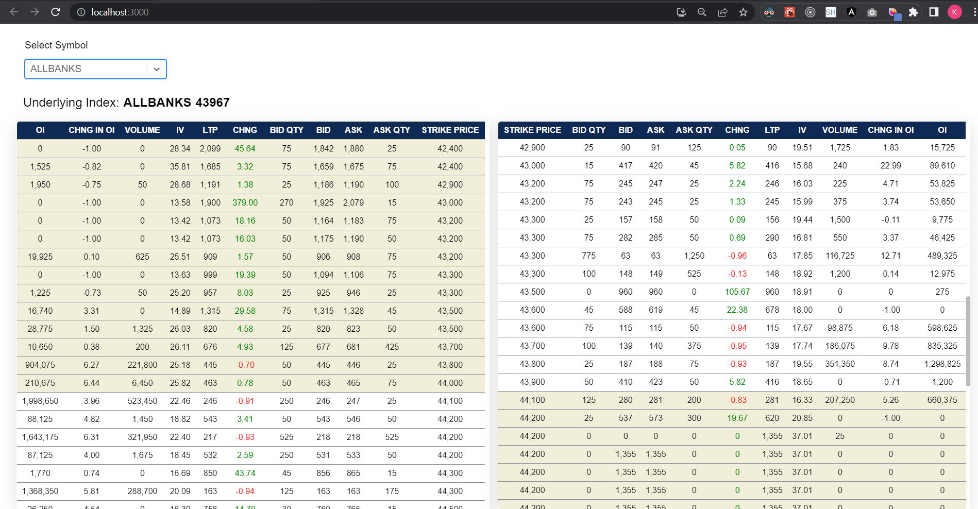
SCREENSHOT OF WEB PAGE

Slide 8






Interactive and Clean User Interface
Filtering Options based on Option Name.
UNIQUE SELLING POINTS
In the money and Out of the money options
highlighted
Minimal latency while relaying data
Realtime updates without manual reload
Trying to offer the best we can

Slide 9
Why select us?
All three primary conditions which were connection to TCP/IP using socket, Calculation of IV, and development of UI were satisfied.
Calculated IV value is pretty accurate.
We have highlighted the in the money and out of the money indexes for Call and Put options.
Simplistic solution avoiding complexity and achieving maximum performance

Slide 10






Resource Page
FrontEnd | HTML CSS ReactJS
BackEnd | NodeJS ExpressJS
Database | Server Local Storage

Slide 11
Thank you!
For your precious time & consideration

