Slide 1
Milk Quality Classification with supervised learning methods
Group 10 Eden & Jade

Slide 2
Four basic steps
25%
50%
75%
100%
Visualization
Wrangling
Modeling
Communication
Exploration data analysis
Data cleaning
Feature Scaling
Feature Selection
Build Models
Tuning parameters
Compare metrics
Interpret the result

Slide 3
Table of contents
01
02
03
Introduction
Model Building
Result Evaluation
Logistic/LDA/QDA
KNN/TREE
RandomForest/XGB
Exploration Data Analysis
Compare the performances of models

Slide 4
01
Introduction
Fundamental Features of Data

Slide 5

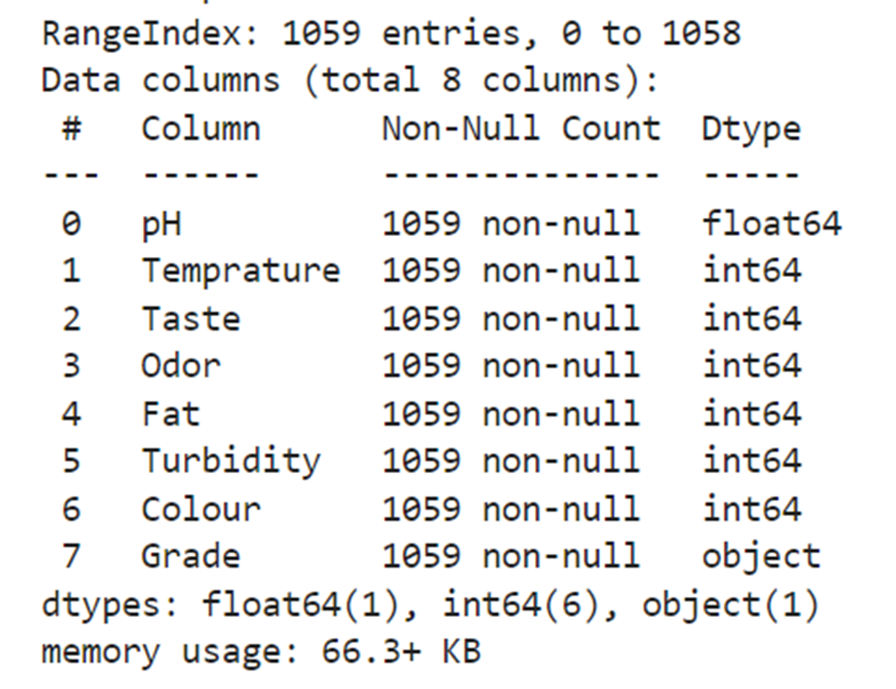
1059 samples
7 variables
Three classes
No missing values
3 quantitative, 4 categorical
Targeted variable: Grade (high, medium and low)

Slide 6
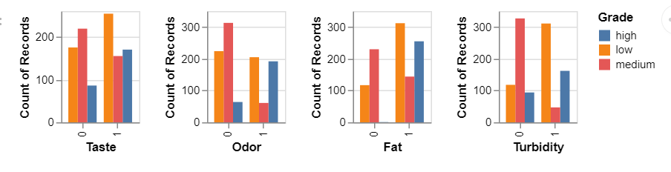
Categorical Variables
Taste is a good indicator for distinguishing between high-quality and low-quality.
Odor is a good indicator for distinguishing between high-quality and medium-quality.
Fat is a good indicator for identifying high-quality.
Turbidity is a good indicator for distinguishing between medium-quality and low-quality.
Notes:
In the dataset where Taste equals 0, high-quality instances are rare while low-quality instances are numerous.
When Odor equals 0, high-quality instances are scarce, but there are many instances of medium-quality milk. The opposite trend is observed when Odor equals 1.
In cases where Fat equals 0, there are even no instances of high-quality milk.

Slide 7
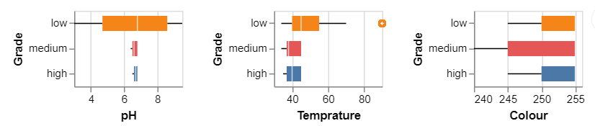
Quantitative Variables
From the graph, we can see that the pH range of low-quality milk is quite wide, spanning from 3 to 9.
The temperature of low-quality milk tends to exhibit extreme values, with the data peaking around 90 degrees.
We can identify medium-quality milk from the colors that are relatively better.

Slide 8
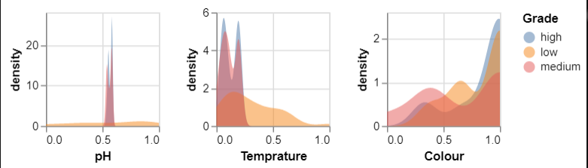
Feature Scaling
Splitting the data into training and testing sets in a 4:1 ratio
To establish MinMax scaling rules based on the training data
Apply the trained scaler to the test data
Draw the distribution of the normalized data

Slide 9
02
Model Building
Notes:
In this part, we will use 6 different models which are logistic regression, lda, qda, knn, decision tree, random forest and xgboost to build our classifier and we will evaluate the performances of these models using accuracy score.
Just to make it clear, for cv we will make it 10 fold.

Slide 10
Logistic Regression
accuracy score:
training data: 0.799
average accuracy score on CV: 0.736
test data: 0.754
Notes:
It’s quite straightforward. We used scikit-learn library to perform lr. Max iteration set to 1000 and it’s a multinomial problem obviously.

Slide 11
LDA&QDA
accuracy score:
training data: 0.727 & 0.848
average accuracy score on CV: 0.689 & 0.807
test data: 0.741 & 0.818
Notes:
For LDA and QDA, the accuracy score of our fitted model on training is… and the accuracy scores of cv and test data are as following.

Slide 12
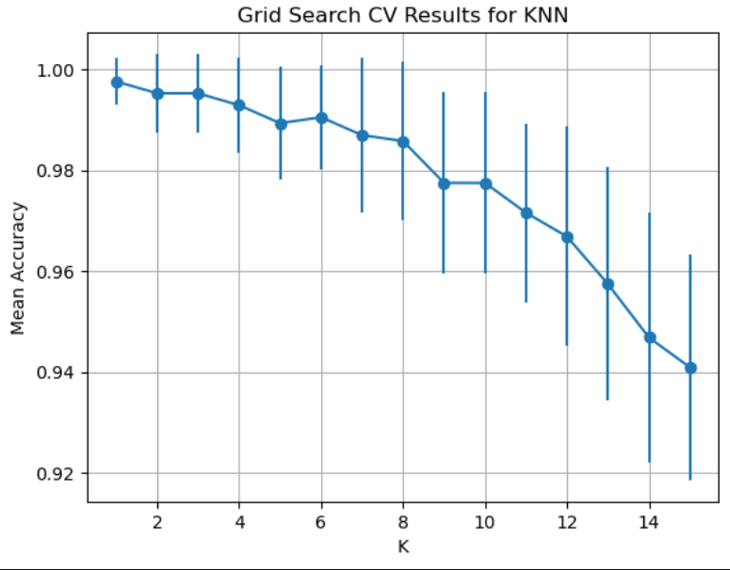
KNN
Maximum average accuracy score
on CV: 0.998
Notes:
For KNN method, we first try to find the best parameter K with cross validation. We used grid search algorithm and it turns out the best K is 1. We then use this model to fit our test data set

Slide 13
KNN
accuracy score:
training data: 1.00
test data: 0.995
Notes:
The result is promising.

Slide 14
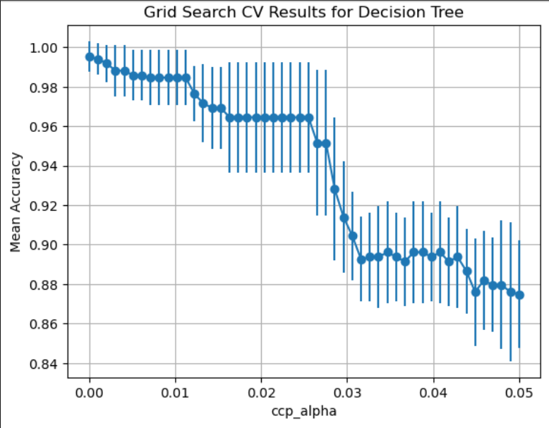
Decision Tree
tuned parameter:
ccp_alpha= 0
Maximum average accuracy score on CV: 0.994
Notes:
For decision tree, by default, no pruning will be performed. Fortunately, there is a tuning parameter of decision tree classifier of scikit-learn library called ‘ccp_alpha’, which is used for minimal cost complexity pruning. Just like we previously presented, we first conduct grid search cross validation algorithm, trying to find the parameter with the best performance on the data range from 0 to 0.05. Still 10 fold cv and the best value here

Slide 15
Decision Tree
accuracy score:
training data: 1.00
test data: 0.991
Notes:
The tuned model has a good performance with the accuracy score on training data 1.00

Slide 16
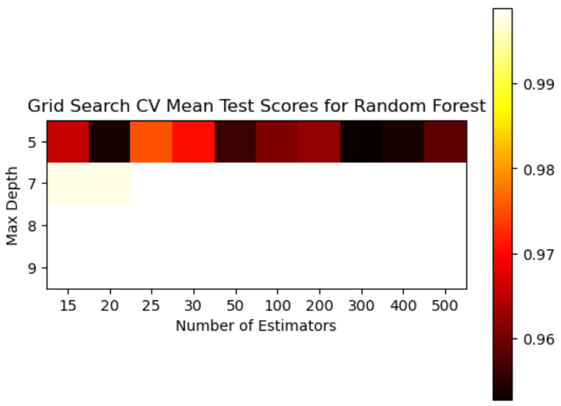
Random Forest
tuned parameter:
max_depth=7
n_estimators=25
Maximum average accuracy score on CV: 0.999
training data: 1.00
test data: 0.991
Notes:
For random forest, we tuned two parameters.

Slide 17
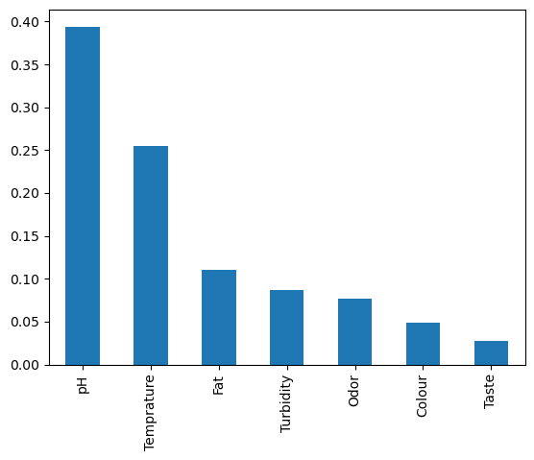
Feature Importance
Notes:
This is one of many widespread applications of random forest. As we see from here, pH value plays the most vital role in determining the grade of milk. So for milk quality control, ph value should be paid special attention to.

Slide 18
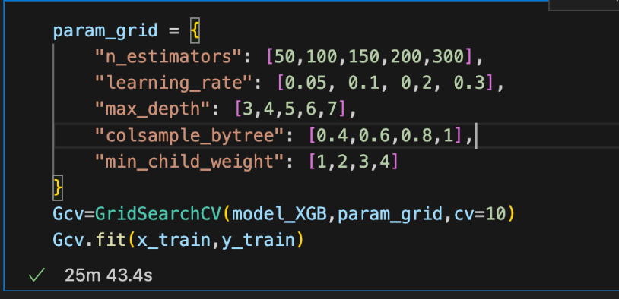
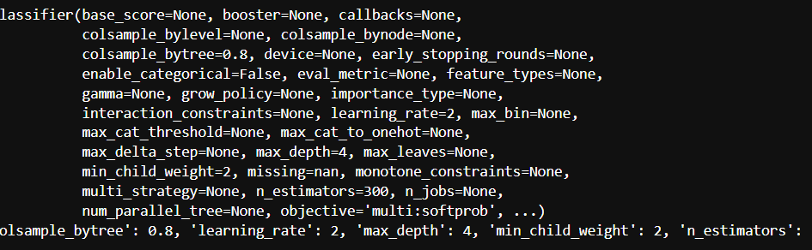
XGBoost
accuracy score:
training data: 1
average accuracy score on CV: 1
test data: 0.991
Notes:
And surprise, we also performed a xgboost classifier. It takes around 25 minutes to tune the 5 parameters. And the best values are … here.
This is a powerful model with great performance.

Slide 19
03
Result Evaluation

Slide 20
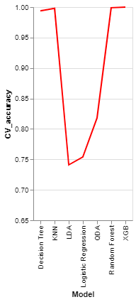
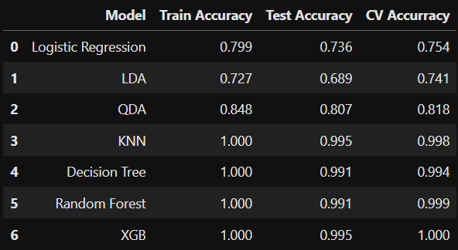
Notes:
For all the accuracy scores here, we are particularly interested in that on the the training dataset mainly because it reflects the potential long term performance of our models. We see from this line chart that lda qda and lr are not doing well. Our nonparametric methods are doing good on this data set.

Slide 21
Analysis and discussion
Logistic regression violates the assumption of no multicollinearity, and its linear relationship is relatively weak.
The reason why LDA & QDA do not show good outcome is because the predictor values do not follow a multivariate normal distribution.
Because of the weak linear relationship, LDA is worse.
Even though XGB is the best model we have, tree and Random Forest are also a good model and easy to interpret
Based on Random Forest: PH and Temperature
On tree model: PH and Fat

Slide 22
Thank You

Slide 23
