Slide 1
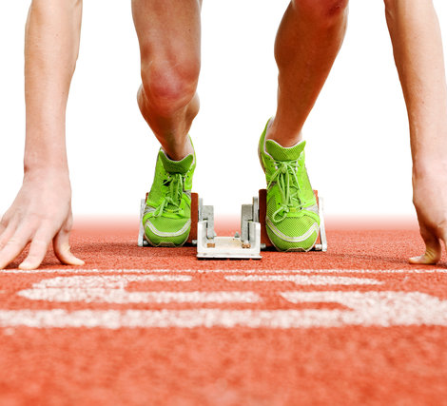
100 Meters World Record
machine learning final project
Github-Athlete-100meters
Eden Ben Simhon
Dan Yakobi

Slide 2

Our research - Intro
Can we predict the best record a runner can break? And if so, what is it?
Data acquisition
Exploratory data analysis
Machine Learning
Data cleaning

Slide 3

Data sources - crawling
World athletics
Wikipedia-Mens’ 100 meters world record progression
Wikipedia-Womens’ 100 meters world record progression

Slide 4

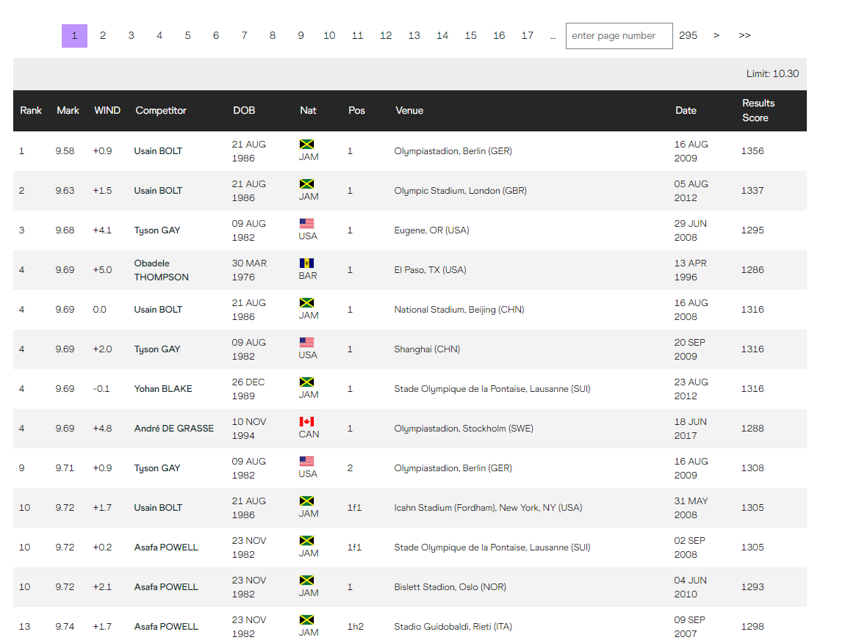
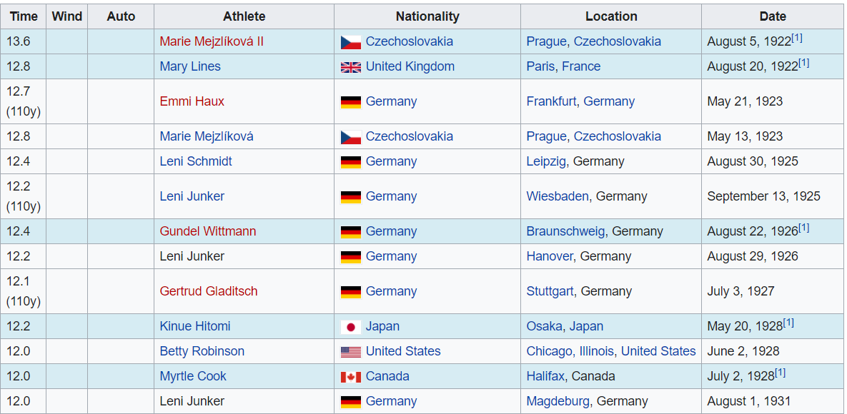
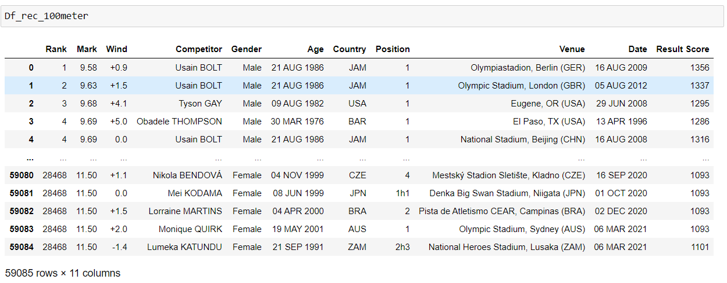
Crawling - world athletics
We used the functions found in the “Pandas” directory such as “BeautifulSoup” and “Request” to crawl the tables of Top list 100 meter in world athletic and wikipedia
Finally, the records were saved into Df_rec_100meter dataframe

Slide 5

Data cleaning process
Clean string from suffix
Filter duplicates
Add column
Change type column
Remove outliers

Slide 6
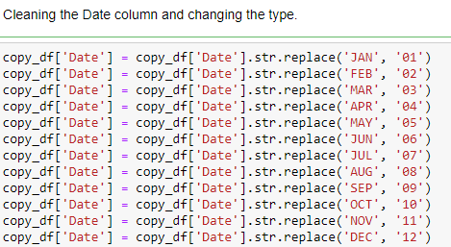
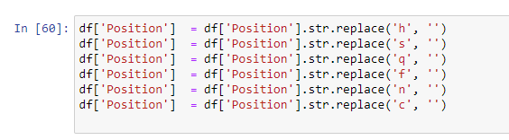
Data cleaning
Information that came through crawling had a suffix of code and ethics which enabled filtering.
For example, the months were given by name and they were changed to have numerical values.

Slide 7
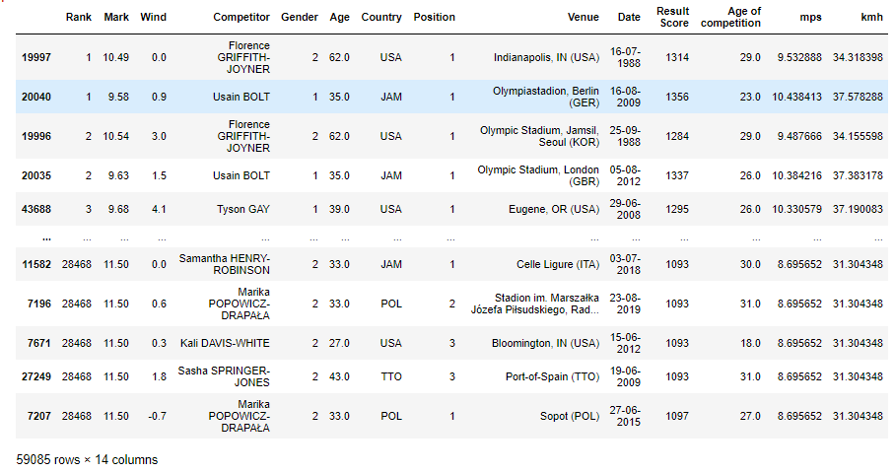
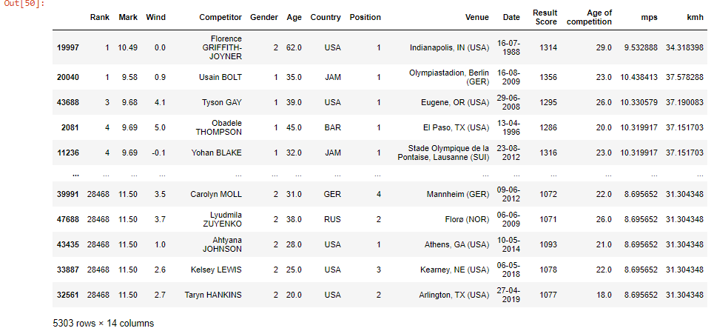
Data cleaning - filters
The information came from various sources. In addition, we collected several different results for one competitor. We searched for duplicates and removed them. 59,085 rows × 14 columns=827,190 after cleaning duplicates: 5,303 rows × 14 columns=74,242

Slide 8
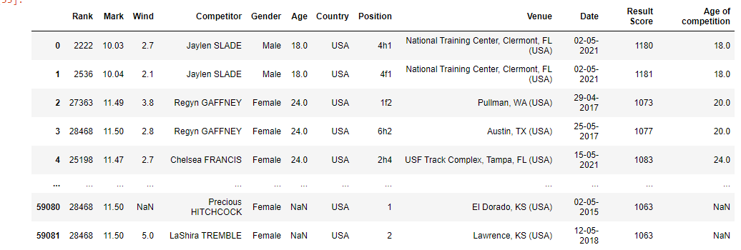
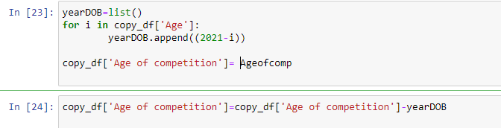
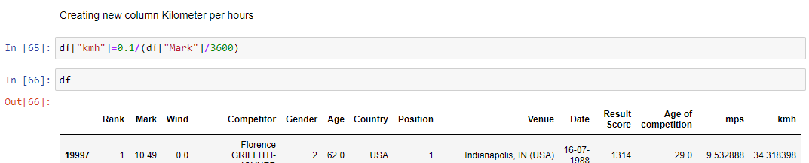
Data cleaning - adding columns
After examining the data, we decided that columns should be added.
Therefore, using the formula: speed * time = distance.
The speed of each participant and how many meters passed per second.
A column was added to determine the age of each participant next to the given date of birth

Slide 9
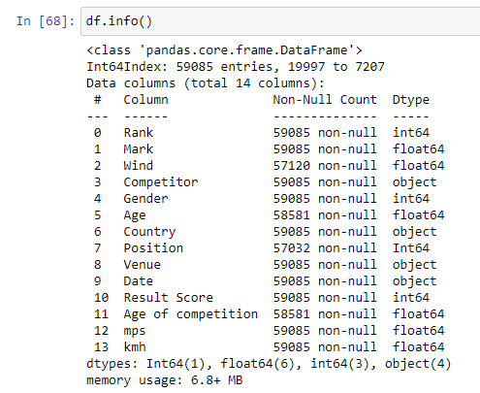
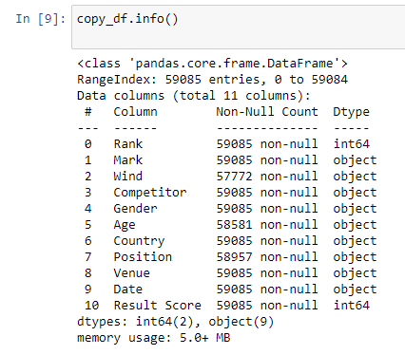
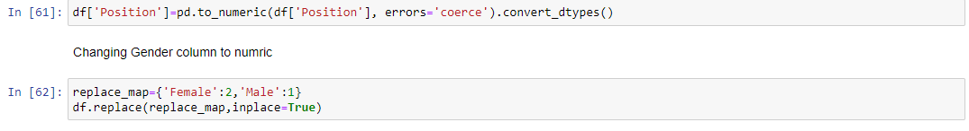
Data cleaning - types
After the cleaning stage, the column types were converted so that the information would be relevant to the machine learning.
The types were changed from
string to int
string to float

Slide 10
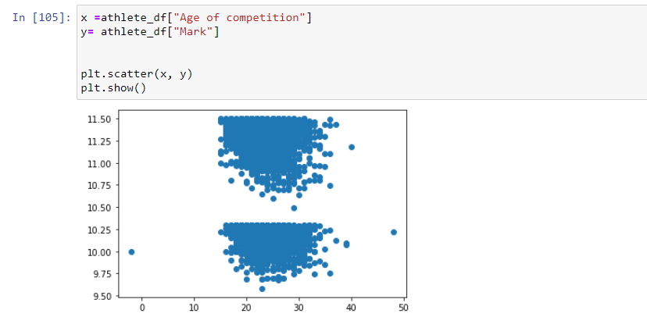
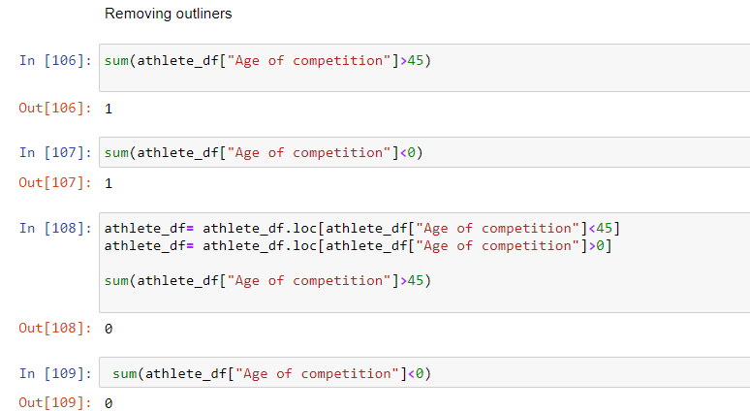
Data cleaning - defining outliers
We then defined what age range is to be considered normal, age 15-45.
The values outside of the range were defined as outliers.
We dismissed the outliers.

Slide 11

EDA - visualization
Pie charts
Scattering
Cat plot
Cross tab

Slide 12
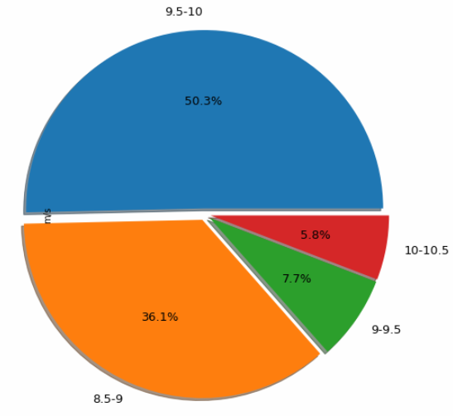
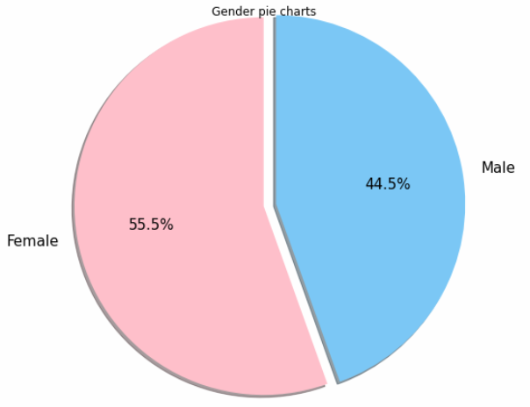
EDA - Pie charts
Mark range
Gender

Slide 13
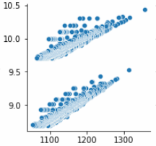
EDA - scattering
What does the graph contain?
X=Result Score
Y=Meters per Second
Conclusions
The graph is divided into two different groups due to the gender.
According to the x-axis, it can be noted that the Result Score Column shows different results for each gender.

Slide 14
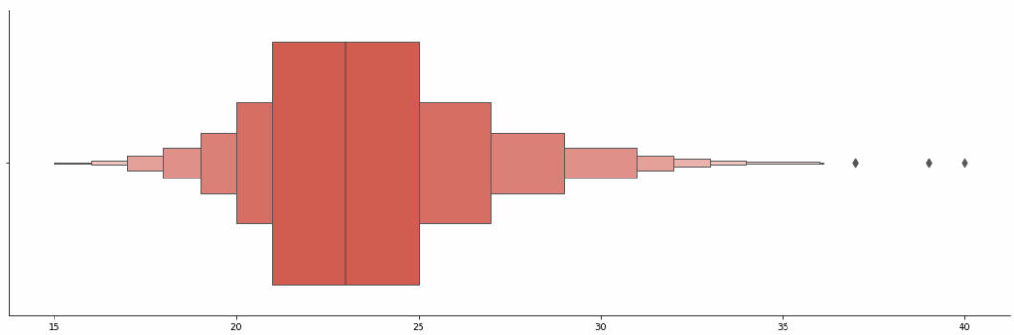
EDA - cat plot
What does the graph contain?
X=Age of competitor
Y=Finishing Position
Conclusions
It should be noted the first places were in the age range 21-25

Slide 15
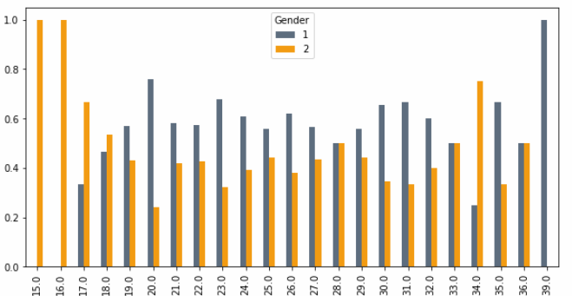
EDA - cross tab
What does the graph contain?
X= Competitor’s Age
Y=Gender
Orange – Female
Gray – Male
Conclusions
It can be understood that women up to the age of 18 compete more than men.

Slide 16

Machine learning
Using `sklearn` library and linear regression,
we were able to tweak the model that predicts
the best potential Mark of Competitor.

Slide 17
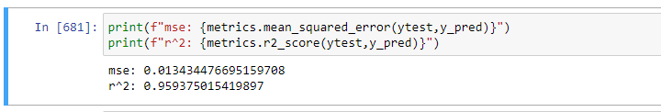
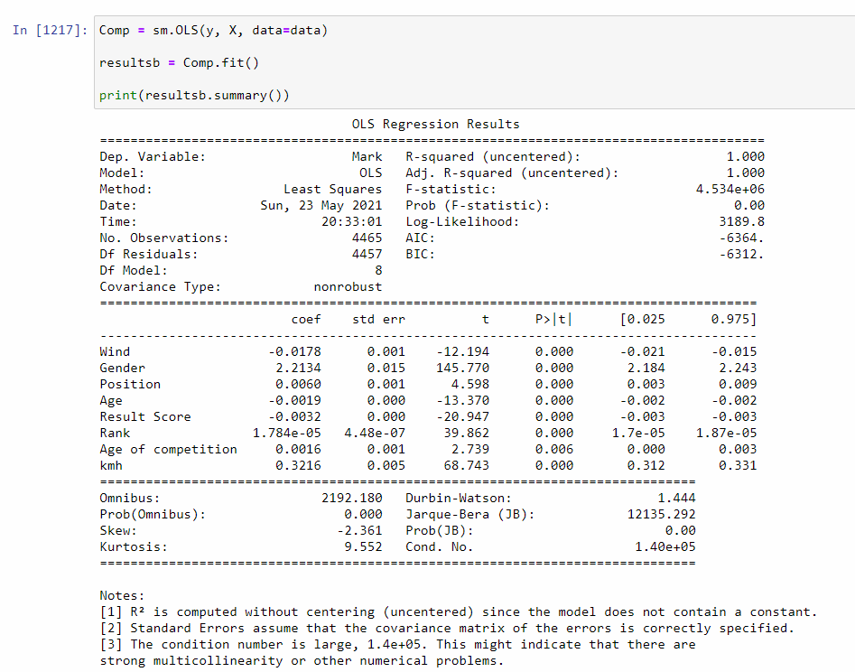
Machine learning - linear regression
The columns studied in the machine are: Ranking, Wind, Gender, Age, Position, Score Results, Age of Competitor and km/h.
There is an accuracy of almost 96%.
But when the OLS regression results were checked, we realized that there was an error and that the condition was too high, so we had to pinpoint the model.

Slide 18
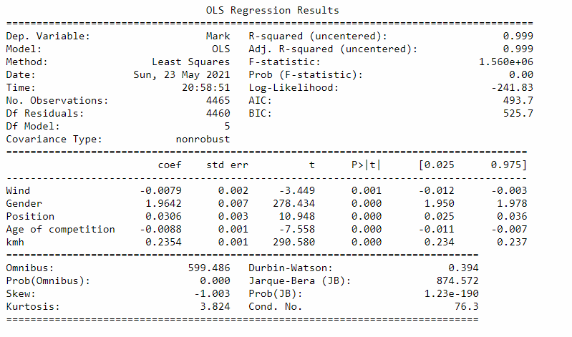
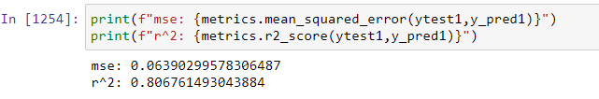
Machine learning - evaluating model’s result
The following columns were established in order to improve accuracy
Wind, Gender, Position, Age of Competition and km/h.
There was an accuracy of almost 81%.

Slide 19
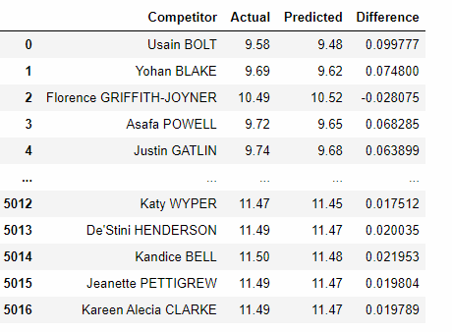
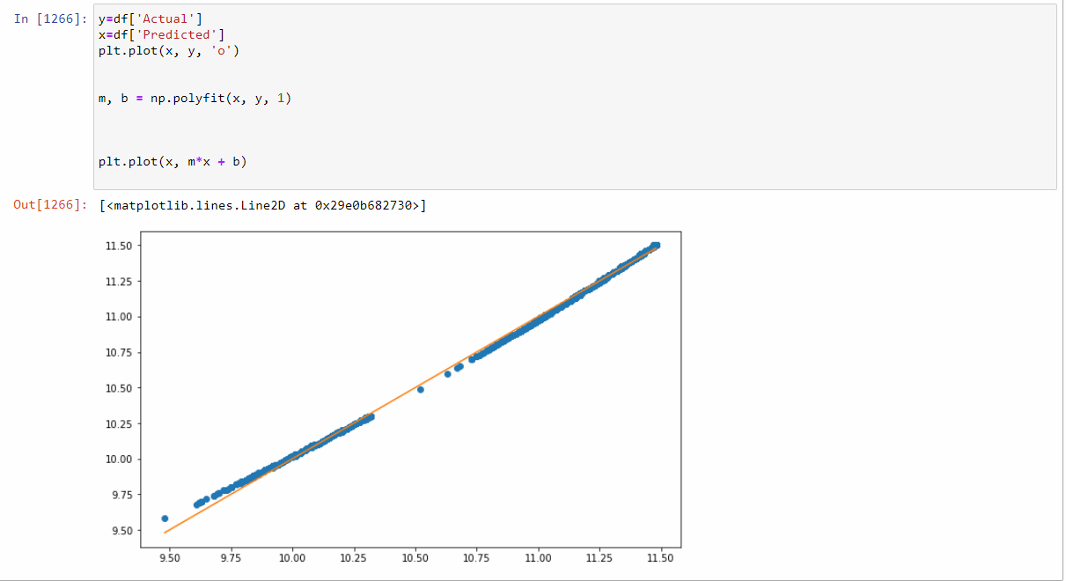
Machine learning - model’s result
In conclusion, if the (actual) result is better, a larger difference can be seen and therefore, it can be concluded that the world record will be broken in the future
Actual
predict

