Slide 1
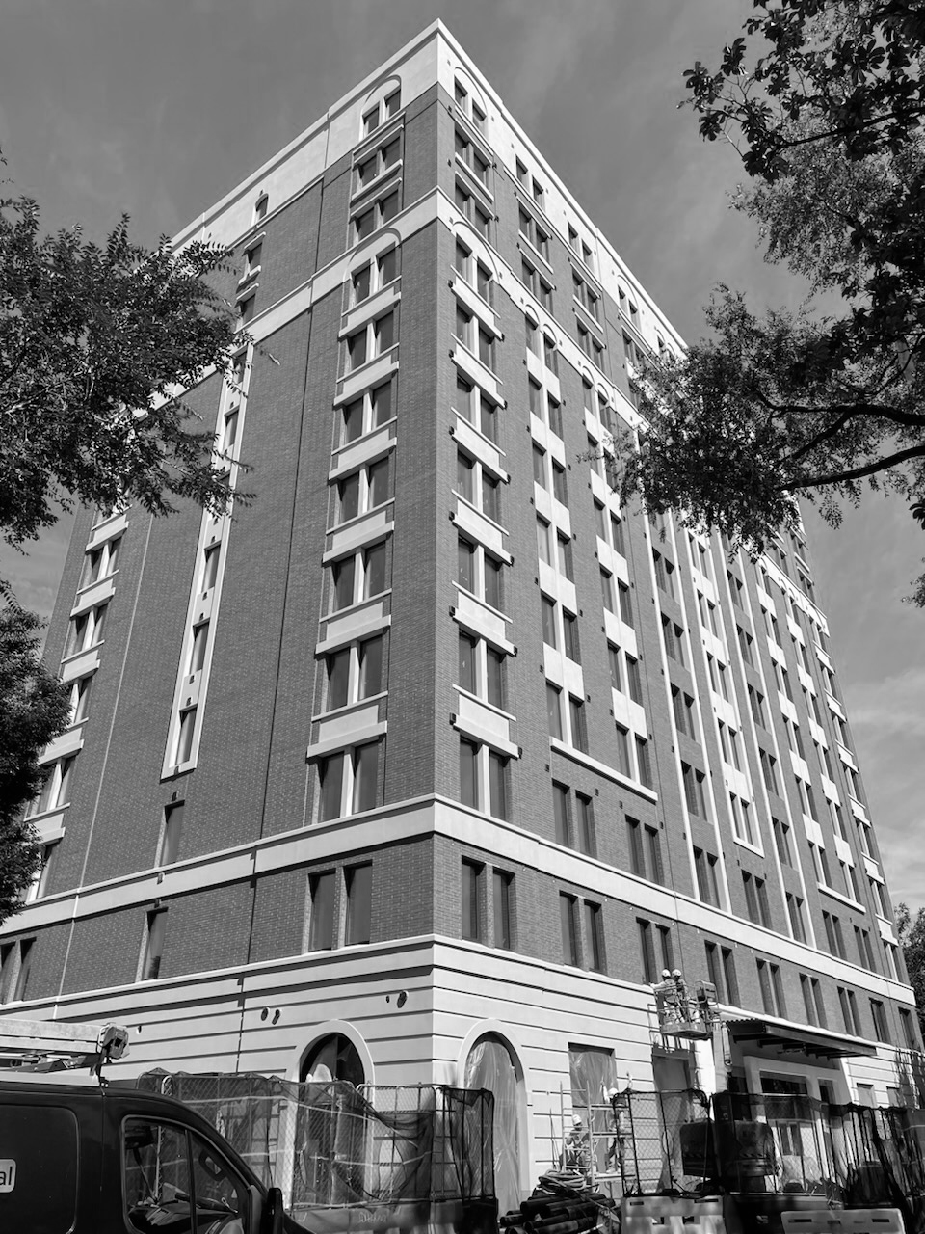
PB SOUTH CONSTRUCTION · WEST PALM BEACH
Welcome to
PB South.
Your new-hire guide: who we are, how we work, and everything you need for day one.
New Hire Guide · [Edition date]

Slide 2

WELCOME
Glad you're here.
Every person on this team was picked to be a true builder: sharp, resourceful and proud of the work.
This guide is your map for the first 90 days. Keep it handy, and ask your coach anything.
01
Who we are and our story
02
Leadership
03
Your first week
04
Your role, your coach, your 30/60/90
05
Pay, benefits and time off
06
How we work: hours, dress, tools
07
Policies to know
08
Day 1 checklist
Welcome to PB South · 02

Slide 3
ABOUT US
Who we are: true builders.
We challenge the status quo, rethink how things get built, and deliver extraordinary results without compromising quality.
Bold and creative
Resourceful
Quality first
Unafraid to push boundaries and rethink the way things are done.
Smart solutions, whatever the challenge, and productive every day.
Bold ideas, fearless execution, and never at the cost of the work.
Welcome to PB South · 03

Slide 4
OUR BRIEF HISTORY
Our story so far.
2024
2024
2025
2025
2025
2026
PB South Construction founded
Awarded Phillips Point
Awarded 15 City Place
Awarded 10 City Place
Backlog built to $500MM
A growing team, with more ahead
Welcome to PB South · 04

Slide 5
LEADERSHIP
The people you'll hear from.
Robert Hubner
Jeff Rosser
PRESIDENT
GENERAL MANAGER
25 years in the industry, most recently as a Vice President and Construction Executive at Turner. Leads PB South's vision: a return to the master builder ethos.
30+ years of complex commercial and healthcare work in New York and Florida, including 13 years at Skanska. Drives growth, client relationships and operational excellence.
Vincent Ranieri
John Fedeli
OPERATIONS MANAGER
PROJECT EXECUTIVE
20+ years of field leadership, much of it at Turner on high-profile NYC projects. Owns pre-planning, logistics, scheduling and field operations.
30+ years delivering complex projects, including 11 years leading design and construction at Howard Hughes Holdings. Oversees projects from precon to turnover.
Welcome to PB South · 05

Slide 6
YOU START WITH A COHORT
Your first week.
New hires start together on the 1st and 3rd Monday of each month, so your first week is planned before you walk in.
MON
TUE
WED
THU
FRI
Welcome
How we build
Your team
Your role
Week one check-in
Welcome breakfast, leadership kickoff, Insperity and paperwork, laptop and accounts, meet your coach.
Company standards, tools (Procore, Smartsheet, Teams), safety orientation for field roles.
Shadow your team or site. Learn the project, the people and the rhythm of the week.
Role-specific training with your coach. Set your first 30-day goals.
30-minute sit-down with your coach: what's clear, what isn't, what you need.
Welcome to PB South · 06

Slide 7
FILLED IN FOR YOU
Your role and your coach.
Your role
Your coach
[Title]
[Two lines: what this role owns and why it matters to the project.]
Core responsibilities:
[3 to 5 lines from the job description]
Reports to: [Name, title]
[Name, title] · [email]
Your coach is your first call for anything. They will:
— Walk you through your first 30/60/90 days
— Explain how the team and our workflows fit together
— Answer questions and give you honest feedback
— Introduce you to the people you need to know
— Share the tips and tools that get you up to speed
Welcome to PB South · 07

Slide 8
30 / 60 / 90
Your first 90 days.
30 days
60 days
90 days
Integrate and get clear
Contribute
Grow
— Handbook confirmed and benefits elected
— You can explain your role and who does what
— Early feedback from your coach
— First 90-day goals agreed
— Blockers raised and handled
— Owning real work on your project or desk
— Using our tools without help
— Mid-point check-in with your coach
— One improvement idea shared
— Yearly goals tied to your role and our strategy
— Progress review and verbal feedback
— Your view on culture, support and resources
— Open forum: what should we do better?
Welcome to PB South · 08

Slide 9
THROUGH INSPERITY, OUR HR PARTNER
Pay and benefits.
Bi-weekly
Day 31+
4% match
15 days
Paydays, every other week, through Insperity
Health insurance starts the 1st of the month after 30 days
401(k), eligible three months after your start date
PTO a year (years 1 to 5), usable after day 30
— Insperity Premier portal.insperity.com: pay stubs, tax forms, benefits, PTO balance and company training
— Questions Insperity Contact Center, 866-715-3552, Mon to Fri, 7am to 7pm CT
— Sick leave Up to 40 hours a year, usable from day one
— PTO 20 days a year from year 6; request 2 weeks ahead; unused PTO does not roll over
— The fine print Your benefits book and the Employee Handbook govern
Welcome to PB South · 09

Slide 10
TIME OFF
2026 holidays.
New Year's Day
Thu, Jan 1
Juneteenth
Fri, Jun 19
Martin Luther King Jr. Day
Mon, Jan 19
Independence Day (observed)
Fri, Jul 3
Presidents' Day
Mon, Feb 16
Labor Day
Mon, Sep 7
Good Friday
Fri, Apr 3
Thanksgiving Day
Thu, Nov 26
Memorial Day
Mon, May 25
Christmas Day
Fri, Dec 25
Holiday pay starts 30 days after hire. Work the scheduled day before and after a holiday to be paid for it.
Welcome to PB South · 10

Slide 11
HOURS, DRESS AND THE OPEN DOOR
How we work.
Hours
Dress
Open door
8:00 am to 5:00 pm, Monday to Friday, unless your project or site sets its own schedule.
Overtime for hourly team members needs your manager's approval first.
Office: business casual. Neat jeans are fine; no ripped jeans, athletic wear or flip-flops.
Meeting a client? Dress for it.
On site: the site's safety and PPE rules come first.
Ideas, questions or concerns go straight to your coach, your manager or leadership.
Nobody here is too busy to hear how we can build better.
Welcome to PB South · 11

Slide 12
SET UP IN WEEK ONE
Your tools.
Chat and meetings
Email and calendar
Projects and field
Microsoft Teams
Microsoft Outlook
Procore and Smartsheet
HR, pay and benefits
IT support
Wi-Fi and building access
Insperity Premier
CTS Service Department, service@ctscts.com
Given to you in person on Day 1
Welcome to PB South · 12

Slide 13
COMMUNICATION STANDARDS
Email like a pro.
DO
DON'T
— Ask if it needs to be an email at all
— Write a clear subject line
— Reply within 24 hours, even if it's "working on it, by Friday"
— Answer every question asked
— Give a timeframe
— Proofread before you hit send
— Reply All unless everyone needs it
— Write in anger or ALL CAPS
— Start a new thread for the same topic
— Forget the attachment, or send huge ones
— Put confidential or sensitive information in email
— Use slang
Welcome to PB South · 13

Slide 14
FROM THE EMPLOYEE HANDBOOK
Policies to know.
Equal opportunity
Respect
Drug and alcohol free
We hire, pay and promote on merit. No discrimination or retaliation.
Zero tolerance for harassment. Report concerns; you're protected.
A safe jobsite and office, always.
Artificial intelligence
Systems and confidentiality
Workplace safety
Follow the handbook's AI policy before using AI tools with company information.
Company systems are for company business; protect project and client information.
No weapons, no violence, and speak up about anything unsafe.
This is a summary. The Employee Handbook is the official policy; read it and sign the acknowledgement in your first week.
Welcome to PB South · 14

Slide 15
BRING IT, DO IT, ASK IT
Day 1 checklist.
Bring
Do
Ask your coach
Photo ID and work authorization documents for your I-9
Banking details for direct deposit
Emergency contact information
Create your Insperity Premier account
Pick up your laptop and log in
Get building access and Wi-Fi in person
Sign the handbook acknowledgement (this week)
Who's on my team and my project?
What does a great first 30 days look like?
When is our week-one check-in?
Welcome to PB South · 15

Slide 16
Welcome aboard.
We're here to support your journey, and we can't wait to see what you build.
PB SOUTH CONSTRUCTION · WEST PALM BEACH

