Slide 1
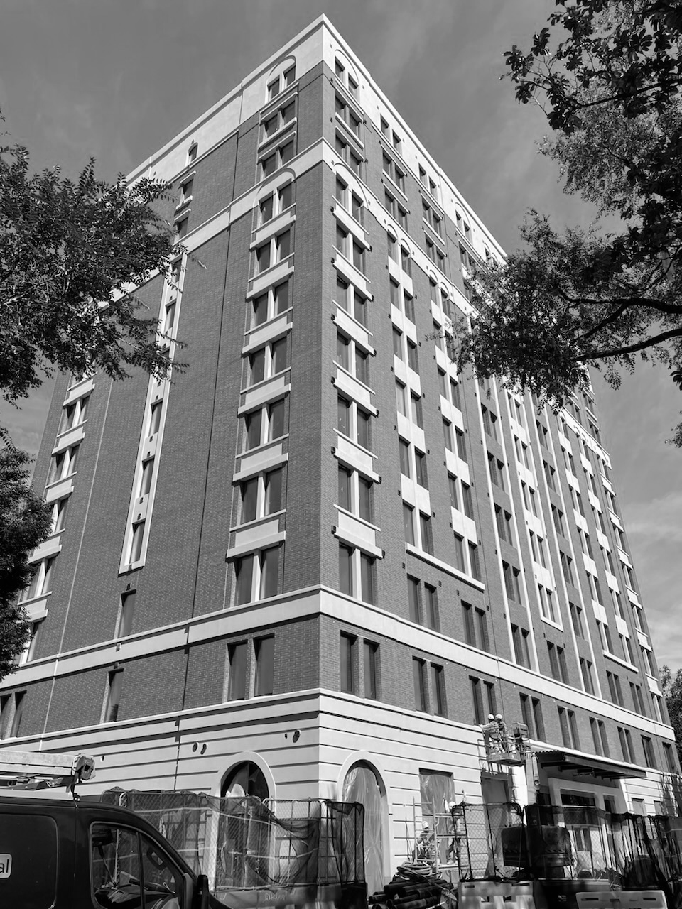
PB SOUTH CONSTRUCTION · WEST PALM BEACH
Welcome to
PB South.
Your new-hire guide: who we are, how we work, and everything you need for day one.
New Hire Guide · [Edition date]

Slide 2

WELCOME
Glad you're here.
Every person on this team was picked to be a true builder.
This guide is your map for the first 90 days. Keep it handy, and ask your coach anything.
01
Who we are
02
Leadership
03
Your first week
04
Your role, coach and 90 days
05
Pay, benefits and time off
06
How we work and policies
07
Day 1 checklist and tools
Welcome to PB South · 02

Slide 3
WHO WE ARE
True builders.
We challenge the status quo, rethink how things get built, and deliver extraordinary results without compromising quality.
2024
2025
2026
— PB South Construction founded
— Awarded Phillips Point
— Awarded 15 City Place
— Awarded 10 City Place
— Backlog built to $500MM
— A growing team, with more ahead
Welcome to PB South · 03

Slide 4
LEADERSHIP
The people you'll hear from.
Robert Hubner
Jeff Rosser
PRESIDENT
GENERAL MANAGER
25 years in the industry, including Turner. Leads our master-builder vision.
30+ years in New York and Florida, including 13 at Skanska. Drives growth and execution.
Vincent Ranieri
John Fedeli
OPERATIONS MANAGER
PROJECT EXECUTIVE
20+ years of field leadership. Owns pre-planning, logistics and field operations.
30+ years on complex projects. Oversees delivery from precon to turnover.
Welcome to PB South · 04

Slide 5
YOU START WITH A COHORT
Your first week.
New hires start together on the 1st and 3rd Monday of each month.
MON
TUE
WED
THU
FRI
Welcome
How we build
Your team
Your role
Check-in
Leadership kickoff, paperwork, laptop, meet your coach
Standards, tools and safety orientation
Shadow your team or your site
Role training; set 30-day goals
30 minutes with your coach
Welcome to PB South · 05

Slide 6
YOUR MANAGER FILLS THIS IN
Your role and your coach.
Your role
Your coach
— Title [Title]
— What you own [One line]
— Reports to [Name, title]
— Your first project [Project or desk]
— Who [Name, title, email]
— Week 1 Walks you through how we work
— Every week Questions, feedback, introductions
— Day 30, 60, 90 Your check-ins
Welcome to PB South · 06

Slide 7
30 / 60 / 90
Your first 90 days.
30 days
60 days
90 days
GET CLEAR
CONTRIBUTE
GROW
— Benefits elected, handbook signed
— You can explain your role
— 90-day goals agreed
— Owning real work
— Using our tools on your own
— Mid-point check-in
— Yearly goals set
— Progress and feedback
— Your ideas: what should we do better?
Welcome to PB South · 07

Slide 8
THROUGH INSPERITY, OUR HR PARTNER
Pay and benefits.
Bi-weekly
Day 31+
4% match
15 days
Paydays, every other week
Health insurance starts the 1st of the month after 30 days
401(k), eligible after 3 months
PTO a year in years 1 to 5, usable after day 30
— Insperity Premier portal.insperity.com for pay, benefits and PTO
— Questions 866-715-3552, weekdays 8am to 8pm Eastern
— Sick leave Up to 40 hours a year, from day one
— PTO Request 2 weeks ahead; doesn't roll over
— Fine print The benefits book and handbook govern
Welcome to PB South · 08

Slide 9
TIME OFF
2026 holidays.
New Year's Day
Thu, Jan 1
Juneteenth
Fri, Jun 19
Martin Luther King Jr. Day
Mon, Jan 19
Independence Day (observed)
Fri, Jul 3
Presidents' Day
Mon, Feb 16
Labor Day
Mon, Sep 7
Good Friday
Fri, Apr 3
Thanksgiving Day
Thu, Nov 26
Memorial Day
Mon, May 25
Christmas Day
Fri, Dec 25
Holiday pay starts 30 days after hire. Work the scheduled day before and after to be paid for it.
Welcome to PB South · 09

Slide 10
HOURS, DRESS AND POLICIES
How we work.
Hours
Dress
Policies
— 8 to 5, Monday to Friday
— Sites may set their own
— Overtime needs approval first
— Office: business casual
— Meeting a client? Dress up
— On site: safety and PPE first
— Equal opportunity, zero harassment
— Drug and alcohol free
— Follow the AI and systems policy
The Employee Handbook is the official policy. Read it and sign the acknowledgement in your first week. Questions? Our door is open.
Welcome to PB South · 10

Slide 11
BRING IT, DO IT, USE IT
Day 1 checklist.
Bring
Do
Your tools
☐ Photo ID and work documents (I-9)
☐ Bank details for direct deposit
☐ Emergency contact
☐ Create your Insperity account
☐ Log in to your laptop
☐ Get Wi-Fi and access in person
— Teams and Outlook
— Procore and Smartsheet
— IT: service@ctscts.com
Welcome to PB South · 11

Slide 12
Welcome aboard.
We're here to support your journey, and we can't wait to see what you build.
PB SOUTH CONSTRUCTION · WEST PALM BEACH

