Slide 1


PB SOUTH CONSTRUCTION · WEST PALM BEACH
Welcome to
PB South.
Your new-hire guide: who we are, how we work, and everything you need for day one.
New Hire Guide · [Edition date]
Notes:
Welcome the cohort by name. Introduce yourself and your role. 30 seconds on why PB South exists: a return to the master builder.

Slide 2

WELCOME
Glad you're here.
Every person on this team was picked to be a true builder.
This guide is your map for the first 90 days. Keep it handy, and ask your coach anything.
01
Who we are
02
Leadership
03
Your first week
04
Your first 90 days and reviews
05
Pay, benefits and time off
06
How we work and who to ask
07
Day 1 checklist and tools
Welcome to PB South · 02
PB SOUTH
Notes:
Set expectations: this deck is theirs to keep. Every question is a good one this week.

Slide 3
WHO WE ARE
True builders.
We challenge the status quo, rethink how things get built, and deliver extraordinary results without compromising quality.
2024
2025
2026
— PB South Construction founded
— Awarded Phillips Point
— Awarded 15 City Place
— Awarded 10 City Place
— Backlog built to $500MM
— A growing team, with more ahead
Welcome to PB South · 03
PB SOUTH
Notes:
Tell one real story about a PB South project. Point to the timeline: how fast we've grown, and why that means room to grow with us.

Slide 4
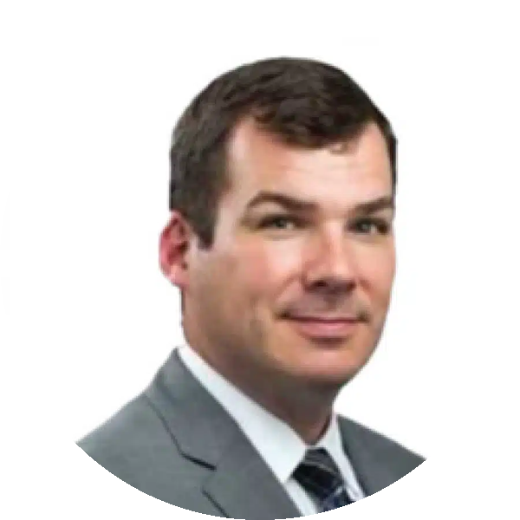
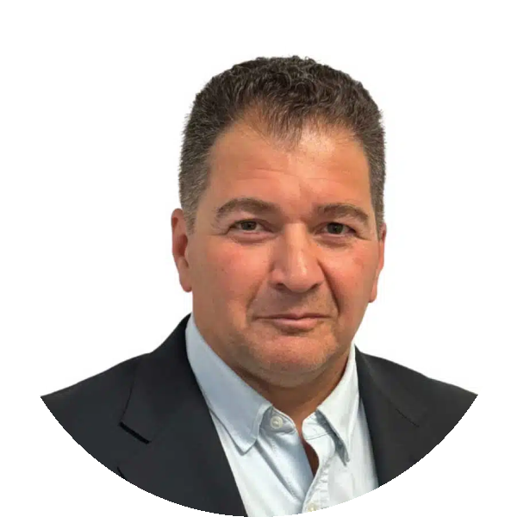
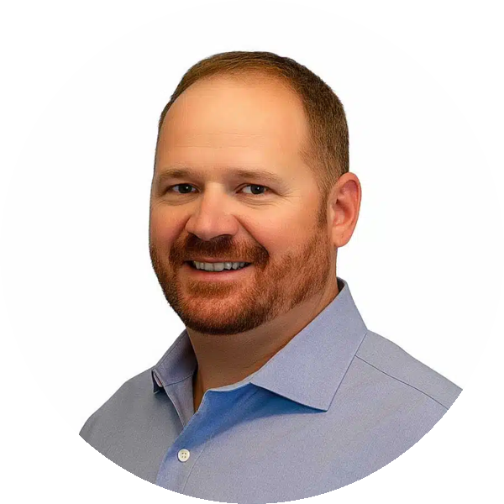
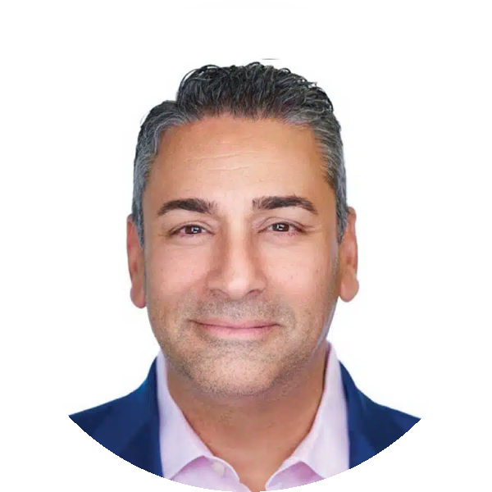
LEADERSHIP
The people you'll hear from.
Robert Hubner
Jeff Rosser
FOUNDER, PRESIDENT & CEO
GENERAL MANAGER
25 years building high-profile projects in New York and Florida. Leads our master-builder vision.
30+ years in New York and Florida, including 13 at Skanska. Drives growth and execution.
Vincent Ranieri
John Fedeli
VP OF OPERATIONS
VP OF EXECUTIVES
20+ years of field leadership. Owns pre-planning, logistics and field operations.
30+ years on complex projects. Oversees delivery from precon to turnover.
Welcome to PB South · 04
PB SOUTH
Notes:
If a leader can drop in for five minutes, do it here. Otherwise say who each person is to the new hire in practice.

Slide 5
YOU START WITH A COHORT
Your first week.
New hires start together on the 1st and 3rd Monday of each month.
MON
TUE
WED
THU
FRI
Welcome
How we build
Your team
Your role
Check-in
Leadership kickoff, paperwork, laptop, meet your coach
Standards, tools and safety orientation
Shadow your team or your site
Role training; set 30-day goals
30 minutes with your coach
Welcome to PB South · 05
PB SOUTH
Notes:
Walk the week. Name each new hire's coach out loud, and when Friday's check-in is.

Slide 6
30 / 60 / 90
Your first 90 days.
30 days
60 days
90 days
GET CLEAR
CONTRIBUTE
GROW
— Benefits elected, handbook signed
— You can explain your role
— 90-day goals agreed
— Owning real work
— Using our tools on your own
— Mid-point check-in
— Yearly goals set
— Progress and feedback
— Your ideas: what should we do better?
Welcome to PB South · 06
PB SOUTH
Notes:
Per new hire, cover YOUR ROLE AND YOUR COACH here (see the presenter guide): title, what they own, who they report to, first project or desk, coach name and contact. Then walk the 30/60/90 and book the 30-day check-in now.

Slide 7
WHEN WE SIT DOWN TOGETHER
Reviews and development.
Day 30
Day 60
Day 90
June / July
December
Check-in
Check-in
Check-in and yearly goals
Mid-year review
Year-end review
Twice a year, every year: a mid-year review in June or July, and a year-end review in December.
Each one covers your performance, your goals and how you want to grow here. Come with your own notes.
Welcome to PB South · 07
PB SOUTH
Notes:
Set the calendar now: 30, 60 and 90 day check-ins, then mid-year (June or July) and year-end (December) reviews every year. Ask them to keep their own notes.

Slide 8
THROUGH INSPERITY, OUR HR PARTNER
Pay and benefits.
Bi-weekly
Day 31+
4% match
15 days
Paydays, every other week
Health insurance starts the 1st of the month after 30 days
401(k), eligible after 3 months
PTO a year in years 1 to 5, usable after day 30
— Insperity Premier portal.insperity.com for pay, benefits and PTO
— Questions 866-715-3552, weekdays 8am to 8pm Eastern
— PTO Request 2 weeks ahead; doesn't roll over
— Sick leave See the handbook, or ask HR
— Fine print The benefits book and handbook govern
Welcome to PB South · 08
PB SOUTH
Notes:
Insperity questions go to Insperity first, then HR. Don't quote numbers beyond the slide; the benefits book governs.

Slide 9
TIME OFF
2026 holidays.
New Year's Day
Thu, Jan 1
Juneteenth
Fri, Jun 19
Martin Luther King Jr. Day
Mon, Jan 19
Independence Day (observed)
Fri, Jul 3
Presidents' Day
Mon, Feb 16
Labor Day
Mon, Sep 7
Good Friday
Fri, Apr 3
Thanksgiving Day
Thu, Nov 26
Memorial Day
Mon, May 25
Christmas Day
Fri, Dec 25
PB South's published 2026 schedule; HR confirms each year. Holiday pay starts 30 days after hire.
Welcome to PB South · 09
PB SOUTH
Notes:
HR confirms the holiday list each year. Mention the day-before and day-after rule.

Slide 10
HOURS, DRESS AND POLICIES
How we work.
Hours
Dress
Policies
— 8 to 5, Monday to Friday
— Sites may set their own
— Overtime needs approval first
— Office: business casual
— Meeting a client? Dress up
— On site: safety and PPE first
— Equal opportunity, zero harassment
— Drug and alcohol free
— Follow the AI and systems policy
The Employee Handbook is the official policy. Read it and sign the acknowledgement in your first week. Questions? Our door is open.
Welcome to PB South · 10
PB SOUTH
Notes:
Hours, dress and policies. Hand over the Employee Handbook and the acknowledgement to sign this week.

Slide 11
BEYOND YOUR COACH
Who to ask.
Every contact is in the Outlook and Teams directory: search a name, see their title, phone and email.
Your work and priorities
Your manager
How things work here, or anything at all
Your coach
Pay, benefits, PTO balance
Insperity Premier first, then HR
HR and admin questions
Carol Carabba, HR
Laptop, email, systems
CTS IT: service@ctscts.com
Safety on site
Your site superintendent; stop work if unsure
Something you can't take to your manager
Open door: Jeff Rosser, General Manager
Welcome to PB South · 11
PB SOUTH
Notes:
Show them how to search the Outlook or Teams directory. Make it clear they can always come to HR or the GM.

Slide 12
BRING IT, DO IT, USE IT
Day 1 checklist.
Bring
Do
Your tools
☐ Photo ID and work documents (I-9)
☐ Bank details for direct deposit
☐ Emergency contact
☐ Create your Insperity account
☐ Log in to your laptop
☐ Get Wi-Fi and access in person
— Teams and Outlook
— Procore and Smartsheet
— IT: service@ctscts.com
Welcome to PB South · 12
PB SOUTH
Notes:
Do the checklist live: Insperity account, laptop login, Wi-Fi and building access given in person, never in this deck.

Slide 13
Welcome aboard.
We're here to support your journey, and we can't wait to see what you build.
PB SOUTH CONSTRUCTION · WEST PALM BEACH
Notes:
Close warm. Remind them who their coach is and when you'll see them next.

