Slide 1


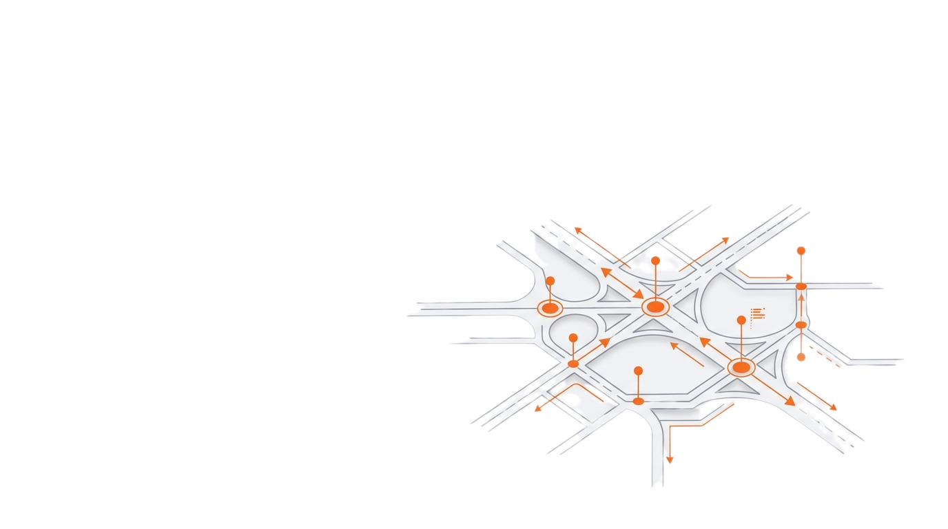
1
RoadSenseAI
Collaborative Pothole Detection & Mapping
Capstone Project - Phase A
Team Code: 26-1-D-9
Team Members:
Noa Sivan 209090034 | Eden Kantor 316138403
Advisor: Gur Arye Yehuda

Slide 2
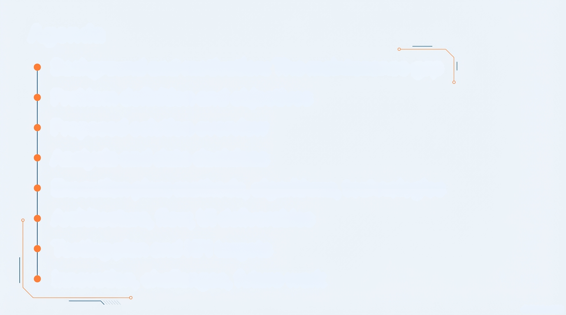
2
Agenda
Background and motivation: The maintenance gap
Problem Definition & Objectives
Proposed Solution
Project Data: Assumptions & Decisions
Pipeline Algorithms
System Architecture & Technologies
Expected Challenges & Mitigation Strategies
KPIs & Testing Plan

Slide 3

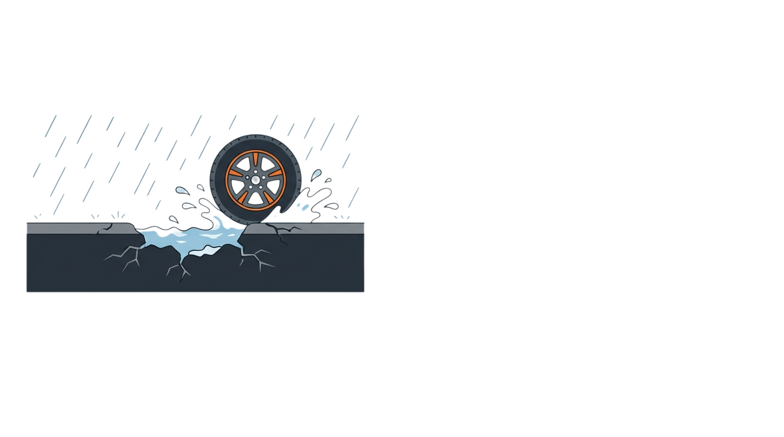

Background: The Maintenance Gap
3
The delay between defect formation and maintenance action creates safety risks.
The Reality (Citizen View)
The Bottleneck (Authority View)
Instant Hazard
Slow Response
Seasonal weather (heavy rain, heat/cold cycles) accelerates road wear and pothole formation.
Potholes can appear quickly, creating immediate safety risks and vehicle damage.
Drivers face the hazard instantly often before any official response begins.
Road-condition information arrives late and fragmented (complaints, surveys, contractor reports).
Manual verification and prioritization create backlogs, delaying repairs.
Without a real-time operational map, maintenance is reactive rather than proactive.

Slide 4



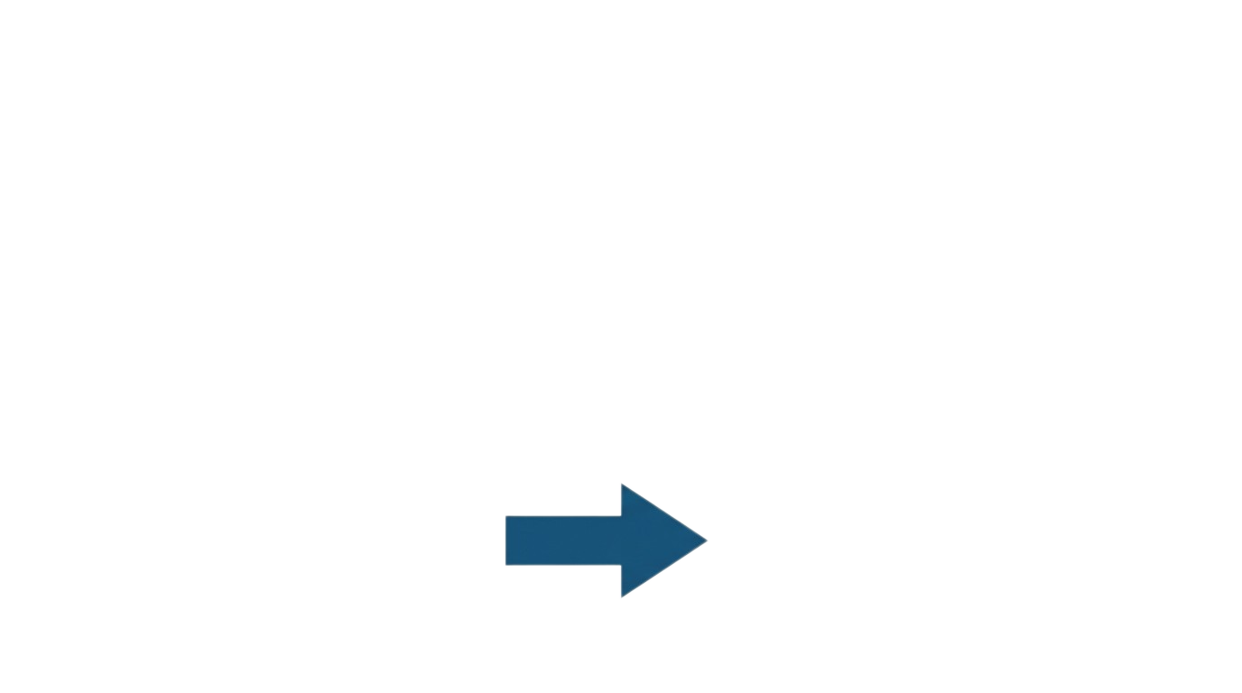
Problem Definition & Objectives
4
Problem Statement
Today’s pothole reporting is reactive and hard to scale.
As a result, hazards remain on the road longer, increasing risk and slowing repair planning.
Stakeholders:
Drivers (citizens)
Municipal authorities
Maintenance teams and contractors
Objectives
Develop a public hazard map for broad citizen awareness.
Create an authority dashboard for lifecycle tracking.
Automate detection from standard trip data.
Manual
Automated
Our solution provides: A bridge between driver observations and municipal action through automated intelligence.

Slide 5

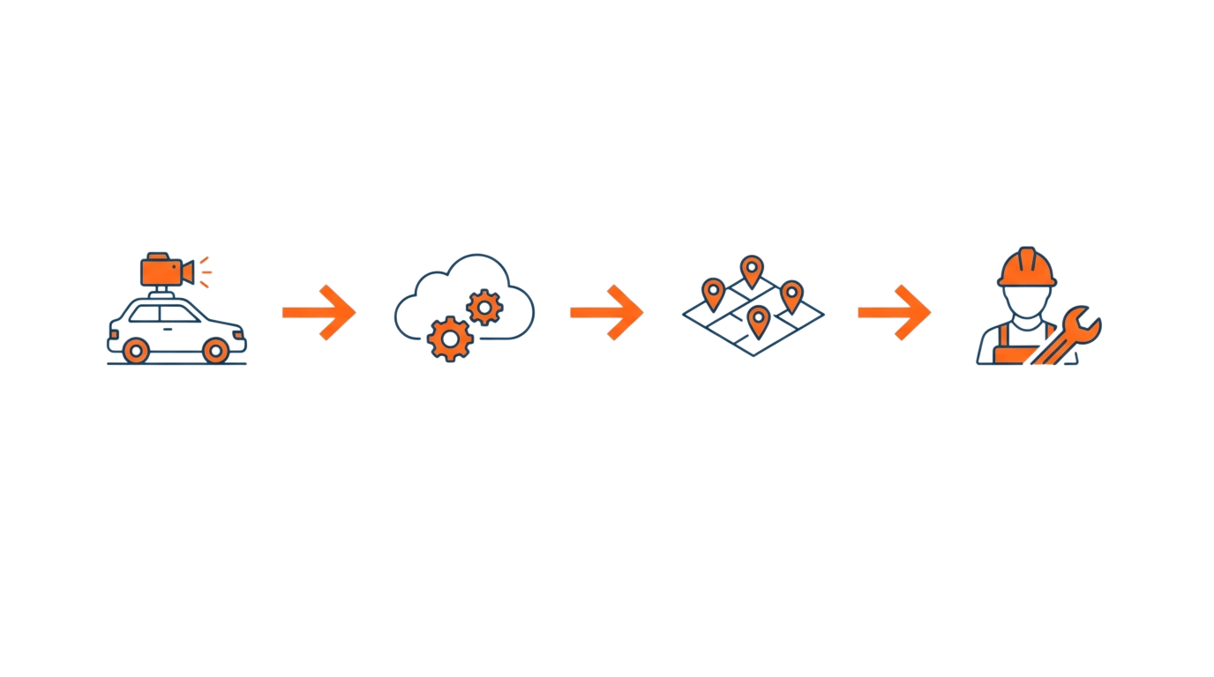
5
Proposed Solution Overview
An end-to-end platform that turns everyday smartphone trips into actionable pothole reports.
A web-based platform that connects citizens and municipal authorities.
Inputs are standardized trip recordings captured on smartphones.
The system converts raw trips into consolidated, geo-located hazard events.
The public map improves awareness and supports safer route decisions.
The authority dashboard prioritizes and tracks repairs through a clear workflow.
Capture
Process
Visualize
Resolve
Standard MP4 Video
+ GPX Telemetry
Background AI Processing
Shared Public Map
Authority Lifecycle
Dashboard

Slide 6
Existing Approaches vs. Our Crowdsourcing Strategy
6
Criteria | Manual Inspection | Crowdsourcing
Coverage | Limited to scheduled routes and inspected locations | Broad coverage across many trips and routes
Cost | High cost due to labor and dedicated survey resources | Lower collection cost by using existing devices and vehicles
Data Source | Inspector reports, photos, and periodic surveys | Trip video and GPS data aggregated into mapped events
Update Frequency | Periodic updates with limited timeliness | Continuous updates as users drive
Evidence & Verifiability | Evidence varies and often requires re-checks | Consistent evidence package per event with location and visuals
Innovation: shifting from scheduled, resource-limited surveys to continuous, evidence-backed road awareness.

Slide 7
7
Project Data – Assumptions & Decisions
Data
Source: external dashcam app (e.g., Droid DashCam)
Artifacts: MP4 video + GPX track (timestamped GPS)
Each trip is linked by a unique Upload ID
Assumptions
Post-trip processing (compute-heavy)
Daylight only + stable mounting
Short to medium trip duration
Challenge → Decision
Challenge: GPS noise/drift and sampling/FPS mismatch
Decision: align video + GPX timestamps to produce geolocated pothole events

Slide 8
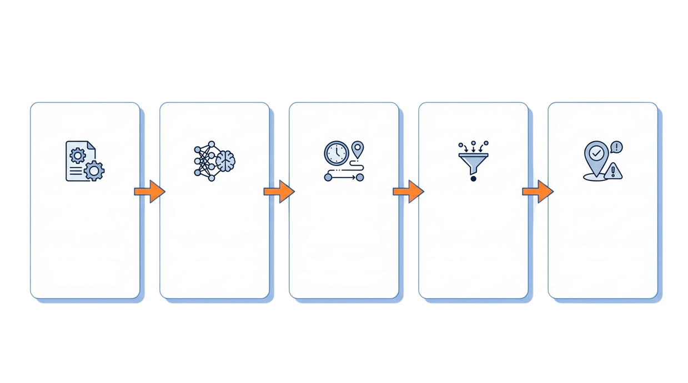
Pipeline Algorithms: From Upload to Unique Map Event
8
Input
Detect
Align
Merge
Outcome
User Upload
Object Detection
Time-Location
Data Deduplication
Unique Map Event
YOLOV8 inference
(Bounding Box +
Confidence Score)
Timestamps to
coordinates
DBSCAN clustering
merges multiple
detections.
Video (MP4) + Route (GPX)
Object Detection - Yolov8
Strong speed–accuracy trade-off for real-time video inference
Mature ecosystem: pretrained weights, tooling, tutorials, easy deployment
RDD dataset – provides labeled road-damage examples for training/evaluation
Timestamp Alignment (Video ↔ GPX)
Simple, mapping from detections to locations using time as the common key
Deduplication & Merging - DBSCAN
Density-based clustering: merges nearby detections without predefining number of clusters
Robust to noise/outliers, fits spatial “same pothole, many detections” cases
Output: store one marker per pothole event

Slide 9
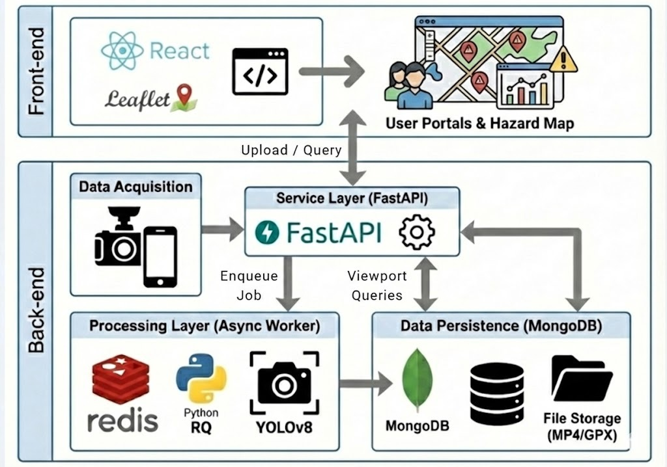
System Architecture
9
Store Raw Files
Save
Events

Slide 10
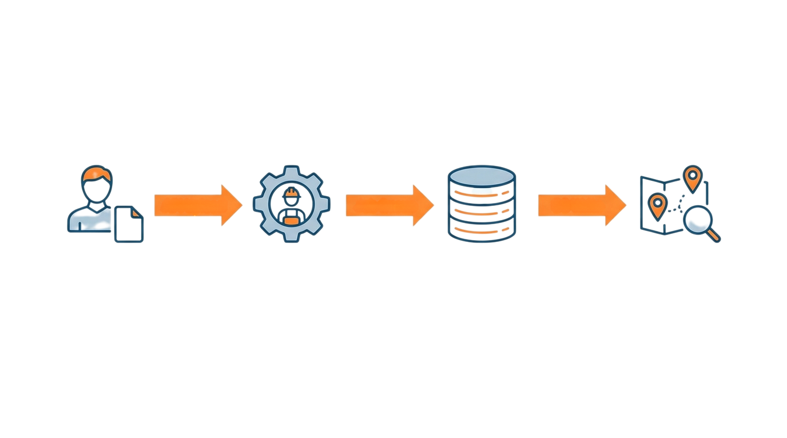
Technologies & End-to-End Flow
10
Tech Stack
Backend
Frontend
FastAPI - Upload & query endpoints
React - Web UI Citizen/Authority portals
Redis - Stores queued jobs and lightweight state
Leaflet - Renders the interactive map and markers
Python RQ - Runs heavy processing as background worker jobs
MongoDB (GeoJSON) - Stores geolocated events for spatial queries
End-to-End Flow
API Upload
Job Queue
DB Write
Upload
User submits MP4/GPX
API returns Accepted
Processing
Worker dequeues job, runs YOLO inference, aligns GPS
Storage
Raw detections aggregated into
unique 'Events' with metadata
Visualization
Client polls status, renders markers on map

Slide 11
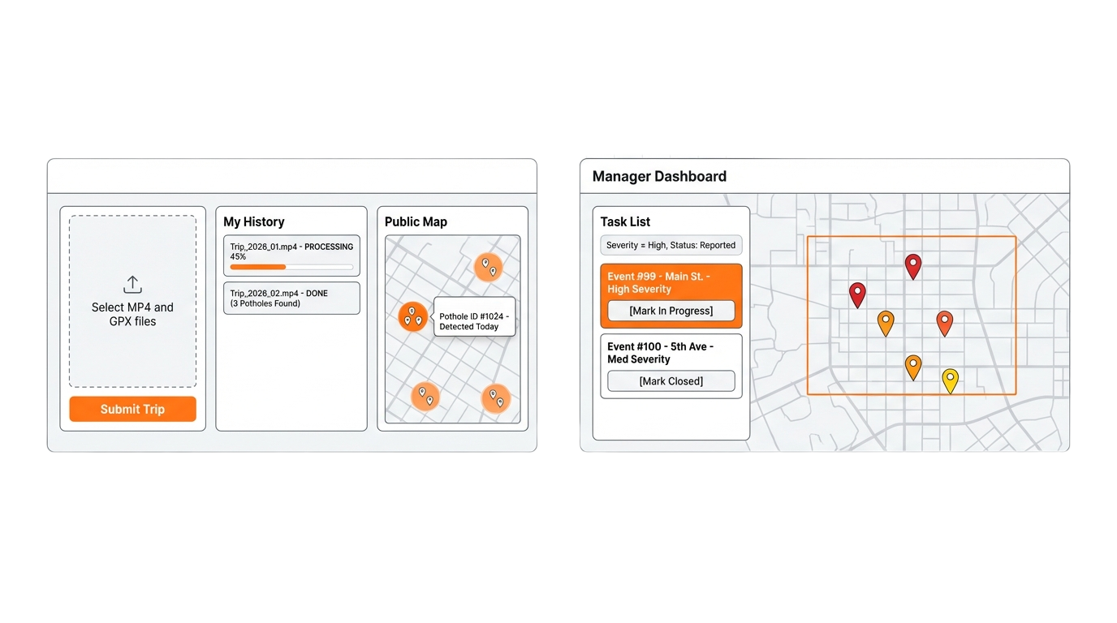
Citizen & Authority Portals (UI Concept)
11
Citizen View
Authority View
Citizen View: “My History” tracker and public hazard map
Cluster Logic: Markers group together to reduce map clutter
Authority View: Task list filtering by severity and status
Lifecycle: Transitions events from “Reported” to “In Progress” to “Closed”

Slide 12
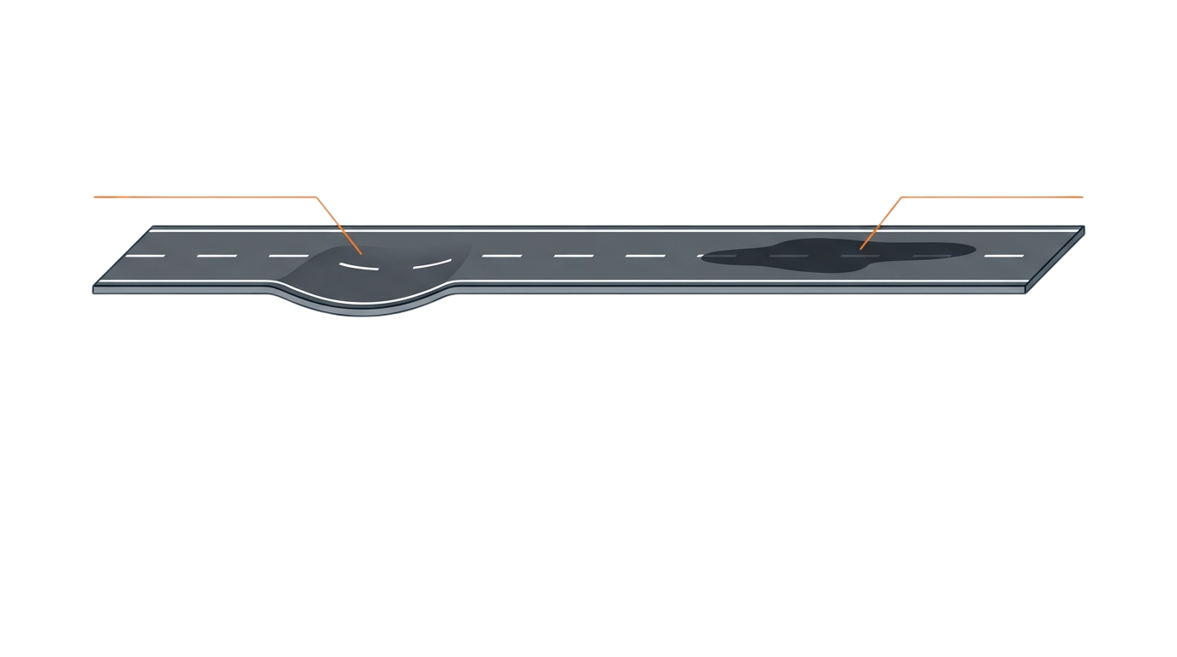



Expected Challenges & Mitigation Strategies
12
Negative Obstacle
False Positive
(Pothole)
(Shadow/ Wet Patch)
Research basis: Noisy visuals and GPS require filtering and event merging
Model Generalization
GPS Drift
API Blocking
Challenge:
Shadows, wet roads, and manholes causing false positives
Mitigation:
Confidence threshold + RDD based evaluation
Challenge:
Duplicate markers for the same pothole due to position error
Mitigation:
Timestamp alignment + DBSCAN merges nearby detections
Challenge:
Long inference times causing request timeouts
Mitigation:
Async processing with Redis + RQ workers (API returns immediately)

Slide 13
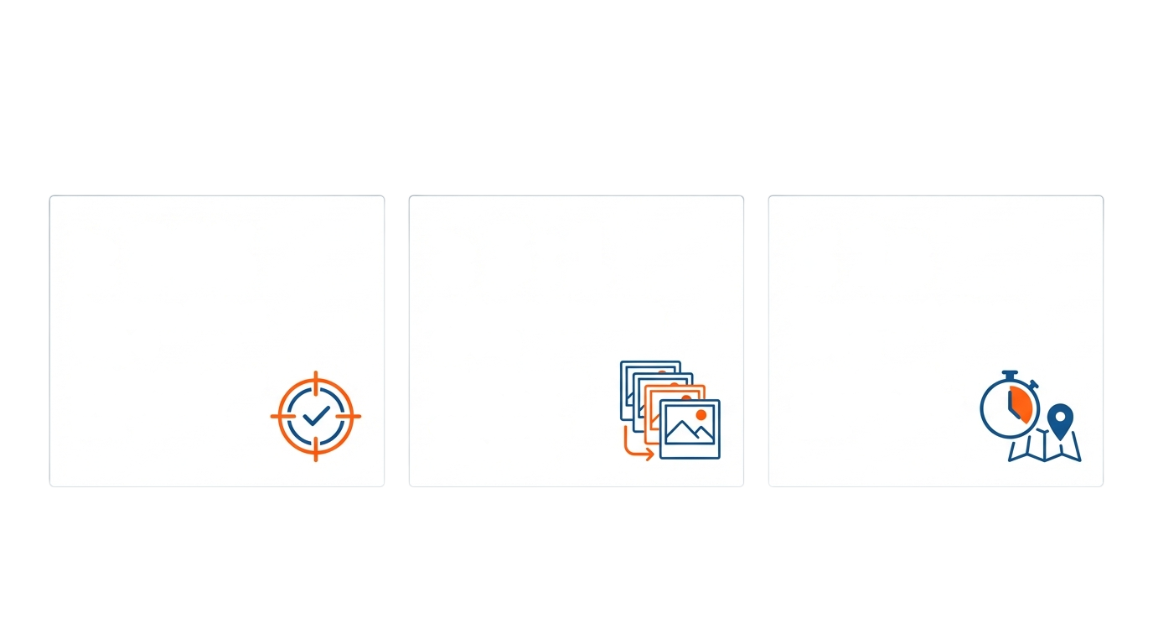
KPIs & Testing Plan
13
≥80%
≥3:1
Avg ≤1s
Precision Target
Deduplication Ratio
Map Query Latency
Minimize false alarms to build authority trust
Effectively merge
multiple frame
detections into
single events.
Ensure real-time responsiveness for users
KPIs Targets
How we test: Upload MP4+GPX → monitor job status → validate DB events → verify map rendering
Test | How we test | Expected outcome
Upload & Job Trigger | Upload MP4+GPX → verify DB + job queued | Accepted + status updates
AI Validation | Run labeled validation set → compute Precision/Recall | Precision ≥ 0.80, Recall ≥ 0.70
Event Aggregation | Compare raw detections vs final events | Deduplication Ratio ≥ 3:1
End-to-End | Upload → async processing → DB events → map query | End-to-end time: ≤ 5 min (1-min video) Map query: Avg ≤ 1s (Max ≤ 2s)

Slide 14

Thank You for Listening
Smarter Roads, Safer Cities

