Slide 1

KADIR HAS UNIVERSITY
CE517- APPLIED BIG DATA ANALYTICS
Destination Marketing Through Music Videos: Analyzing User Sentiment Towards Destinations
“Despacito”
Zemzem Selin Oruç
20121305027
Management Information Systems

Slide 2
Introduction
Use of ML
Explore the influence of music videos on destination
Use of Apache Spark within the Databricks environment
Process and analyze video comments, capturing patterns in user sentiment and intention towards tourist destinations
Provide a preliminary work to shed light for both literature and practitioners in effective destination marketing strategies

Slide 3
Methodology and Components
In DataBricks with Apache Spark;
1. Fetching YouTube Comments:
YouTube Data API
The function fetch_youtube_comments is used
The script uses two separate API keys (api_key_1 and api_key_2) to fetch comments in parallel for 20.000 comments.
Results from both APIs are concatenated into a single list (all_comments).

Slide 4
Methodology and Components
2. Filtering Comments:
The script applies several filtering steps to clean the data:
Filter Null and Empty Comments:
Removes rows where the comment is null or contains only whitespace.
Remove Short Comments:
Eliminates comments with fewer than 4 characters.
Exclude Comments with Specific Patterns:
Excludes comments containing:
Years (e.g., 1985, 2023).
URLs (e.g., links starting with http:// or https://).
Emoji-only content using a regex pattern.
Non-English characters.
Excludes comments mentioning specific keywords like "Paul Walker" or "billion".

Slide 5
Methodology and Components
3. Tokenizing Comments:
A custom function tokenize splits the cleaned comments into individual words (tokens), converting all text to lowercase.
Adds a new column, tokens, containing tokenized versions of the comments.
4. Removing Stop Words
Stop Words: Commonly used words (e.g., "the", "and", "is") that are usually filtered out in text analysis.
A predefined list of stop words is provided, and a function remove_stop_words filters them out from the tokens.
Adds a new column, filtered_tokens, containing the final cleaned tokens without stop words.
Notes:
Key Spark Functions and UDFs
User-Defined Functions (UDFs):
contains_year: Checks if the comment contains a year.
contains_url: Identifies if a URL exists in the comment.
is_emoji_only: Checks if the comment is made up solely of emojis.
is_non_english: Determines if the comment contains non-English characters.
tokenize: Tokenizes the text into lowercase words.
remove_stop_words: Removes stop words from the tokenized text.
Spark SQL Functions:
filter: Applies filtering conditions to the DataFrame.
rlike: Filters rows based on regex patterns.
col: Refers to a column in the DataFrame.

Slide 6
Methodology and Components
5. Keyword Filtering: This script is written in Python and uses PySpark to process a CSV file containing comments. The goal is to filter the comments that contain specific travel-related keywords and save the filtered comments to a new CSV file.
keywords = [
"spain", "madrid", "visit", "travel", "go to", "country", "city", "visited", "holiday", "ticket"]
• A list of travel-related keywords is created.

Slide 7
Methodology and Components
6. Application of VADER:
The VADER script performs sentiment analysis on a dataset of processed comments using the VADER (Valence Aware Dictionary and sEntiment Reasoner) sentiment analysis tool, integrated with PySpark for processing.
. Install and Import Required Libraries
VADER: Installed using pip and imported to perform sentiment analysis.
PySpark: Used for distributed data processing, with SparkSession for creating Spark DataFrames.
Pandas: Used for easier handling of CSV file operations.
UDFs: User-defined functions are created to apply Python functions in Spark.

Slide 8
Methodology and Components
6. Application of VADER:
Load Data;
Pandas DataFrame:
A CSV file named processed_comments.csv is read into a Pandas DataFrame.
The data is re-saved temporarily in /tmp/processed_comments.csv for later use.
Spark DataFrame:
A Spark session is created.
The Pandas DataFrame is converted into a Spark DataFrame (processed_df).
Sentiment Analysis with VADER;
VADER Initialization:
A SentimentIntensityAnalyzer is instantiated to perform sentiment analysis.

Slide 9
Methodology and Components
6. Application of VADER:
A function analyze_sentiment is defined to compute the compound sentiment score using VADER's polarity_scores.
Positive, Negative, Neutral.

Slide 10
Methodology and Components
7. Random Forest Classifier:
This script implements a binary sentiment analysis model using a Random Forest Classifier, focusing on data preprocessing, feature extraction, splitting the dataset, and hyperparameter tuning. Here's a detailed explanation of what is being done:
Data Loading and Preprocessing
Purpose: Load and prepare the dataset for machine learning.
Actions:
Loading Data: The dataset is loaded from the dbfs:/FileStore/oruc/ directory into a Pandas DataFrame.
Handle Missing Values:
Dropped rows where the comment column contains NaN values.
Replaced remaining NaN values in comment with empty strings to ensure all text data is consistent.

Slide 11
Methodology and Components
Feature Extraction;
Purpose: Convert textual data (comments) into numerical features that a machine learning model can process.
Tool: CountVectorizer from scikit-learn.
Actions:
Extracted up to 5,000 of the most frequent words (features) from the comment column.
Created a feature matrix (X) where each row represents a comment, and each column represents a word's frequency.
The target variable (y) is taken from the sentiment_label column, which likely contains binary labels (e.g., positive vs. negative).

Slide 12
Methodology and Components
Data Splitting;
Purpose: Split the dataset for model training, validation, and testing.
Tools: train_test_split from scikit-learn.
Actions:
Split the data into:
Training set (70%): Used to train the Random Forest model.
Validation set (15%): Used to evaluate hyperparameter tuning results during training.
Testing set (15%): Used to evaluate the final model's performance.

Slide 13
Methodology and Components
Model Definition and Hyperparameter Tuning;
Purpose: Train a model and optimize its performance.
Model: RandomForestClassifier from scikit-learn.
Actions:
A grid of hyperparameters was defined:
n_estimators: Number of trees in the forest.
max_features: Number of features considered for splitting at each node.
max_depth: Maximum depth of each tree.
min_samples_split: Minimum number of samples required to split an internal node.
min_samples_leaf: Minimum number of samples required to be a leaf node.
bootstrap: Whether to use bootstrapped samples for training.
Used GridSearchCV to:
Perform a systematic search for the best hyperparameters using 3-fold cross-validation on the training set.
The model is scored based on accuracy during this process.

Slide 14
Methodology and Components
Evaluation;
Purpose: Assess model performance using validation and test datasets.
Tools:
accuracy_score for overall performance.
classification_report for detailed metrics (e.g., precision, recall, F1-score).
Actions:
Evaluated the best model on the validation set to fine-tune hyperparameters.
Evaluated the best model on the test set to report final performance.

Slide 15
Methodology and Components
Prediction on New Data;
Purpose: Test the trained model on unseen text samples.
Actions:
Provided two new comments ("This song is amazing!" and "I dislike this video.") to the model.
Used the trained vectorizer to transform these comments into numerical features.
Predicted their sentiment using the trained model.
Output;
Accuracy and Reports:
Overall model accuracy on validation and test sets.

Slide 16
Methodology and Components
Summary of Tools and Techniques;
Data Handling: pandas for loading and cleaning data.
Feature Extraction: CountVectorizer for converting text to numerical data.
Model: RandomForestClassifier, an ensemble method that builds multiple decision trees and averages their results to improve prediction and reduce overfitting.
Hyperparameter Tuning: GridSearchCV for systematically testing combinations of model parameters with cross-validation.
Evaluation Metrics: Accuracy and classification metrics (precision, recall, F1-score).
This pipeline is designed for robust text classification, optimizing the model through systematic tuning and validation to ensure reliable predictions.

Slide 17
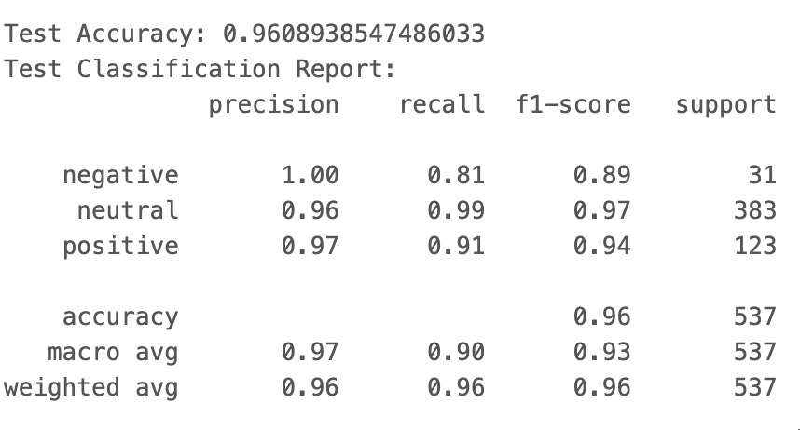
Conclusions

Slide 18
Further Questions
TF-IDF?
Better accuracy?

Slide 19
References
Apache Spark. (n.d.). MLlib: Feature extraction and transformation. Retrieved December 8, 2024, from https://spark.apache.org/docs/3.5.3/ml-features.html.
Cambria, E., Schuller, B., Xia, Y., & Havasi, C. (2017). New avenues in opinion mining and sentiment analysis. IEEE Intelligent Systems, 28(2), 15–21.
Dhapre, M. (2024). Natural Language Processing (NLP) with Spark & Python. Medium. Retrieved December 1, 2024, from https://medium.com/@mrunmayee.dhapre/natural-language-processing-nlp-with-spark-python-f67ac513616f.
Jin, S., & Zafarani, R. (2018). Sentiment Prediction in Social Networks. Proceedings of the 2018 IEEE International Conference on Data Mining Workshops (ICDMW), 656-663.
Lanius, C. (2011). YouTube Commentary: Social Interaction in Online Publics. The Eagle Feather, 8.
Lim, Y., Chung, Y., & Weaver, P. A. (2012). The impact of social media on destination branding: Consumer-generated videos versus destination marketer-generated videos. Journal of Vacation Marketing, 18(3), 197–206.
Sambhanthan, A., & Thelijjagoda, S. (2013). Implications for utilizing YouTube based community interactions for destination marketing: Investigation of a typology approach. Proceedings of the 8th International Conference on Computer Science & Education (ICCSE), 365.
Vasudevan, M. (2018). Hyperparameter tuning the random forest in Python using scikit-learn. Towards Data Science. Retrieved December 8, 2024, from https://towardsdatascience.com/hyperparameter-tuning-the-random-forest-in-python-using-scikit-learn-28d2aa77dd74.
Weidagang, G. (2024). Demystifying precision and recall in machine learning. Medium. Retrieved December 8, 2024, from https://medium.com/@weidagang/demystifying-precision-and-recall-in-machine-learning-6f756a4c54ac.
Xiang, Z., Schwartz, Z., Gerdes, J. H., & Uysal, M. (2017). What can big data and text analytics tell us about hotel guest experience and satisfaction? International Journal of Hospitality Management, 44, 120–130.
Yang, Y., Fieg, T., & Sokolova, M. (2022). Sentiment analysis of COVID-related Reddits. arXiv Preprint.

Slide 20
Thank You!
zemzemselin.oruc@stu.khas.edu.tr

Slide 21
Methodology and Components
Save to CSV:
The labeled DataFrame is saved locally as labeled_processed_comments.csv.
Outputs;
The labeled comments with sentiment scores and labels are saved for further analysis.

