Slide 1
Results

Slide 2
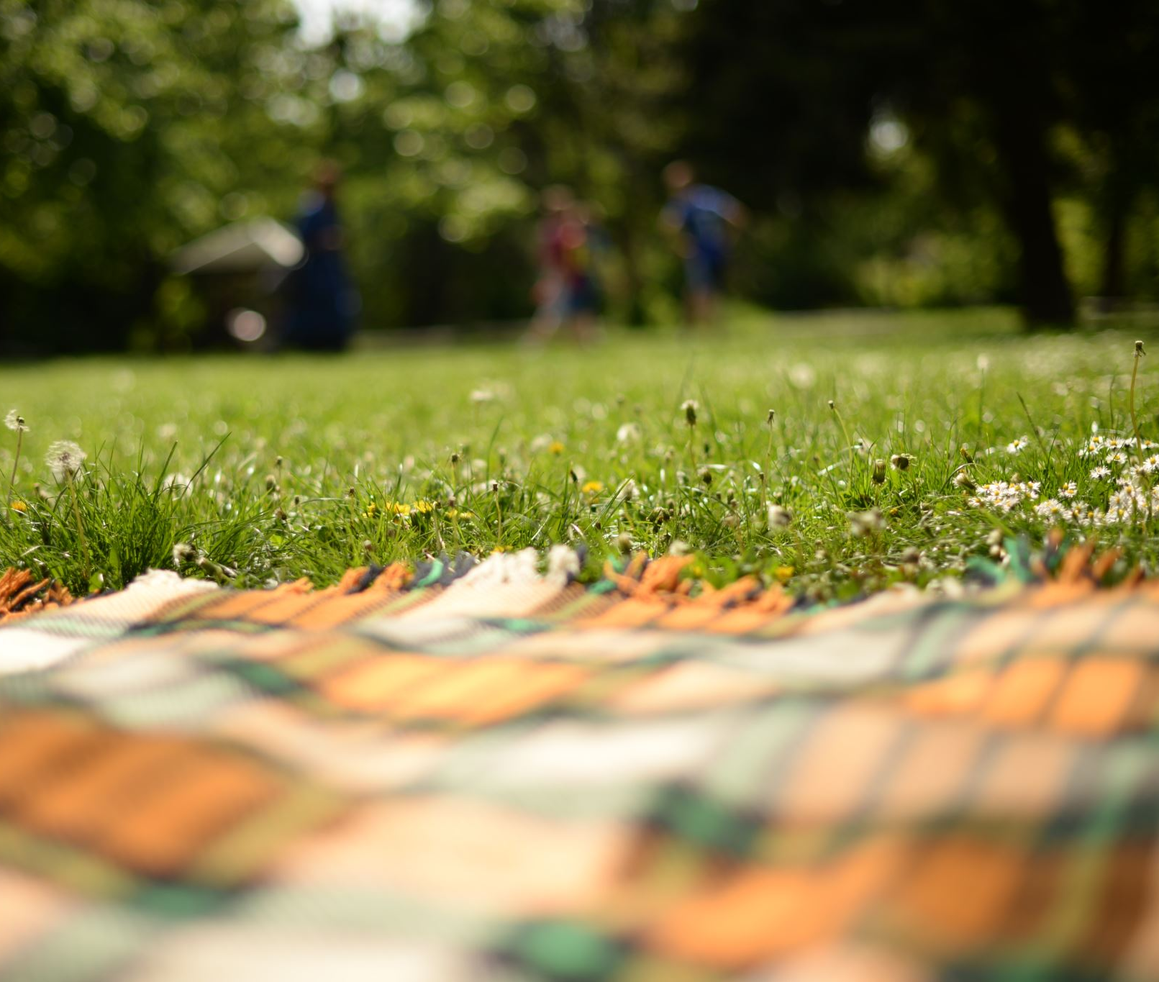
Summer results

Slide 5
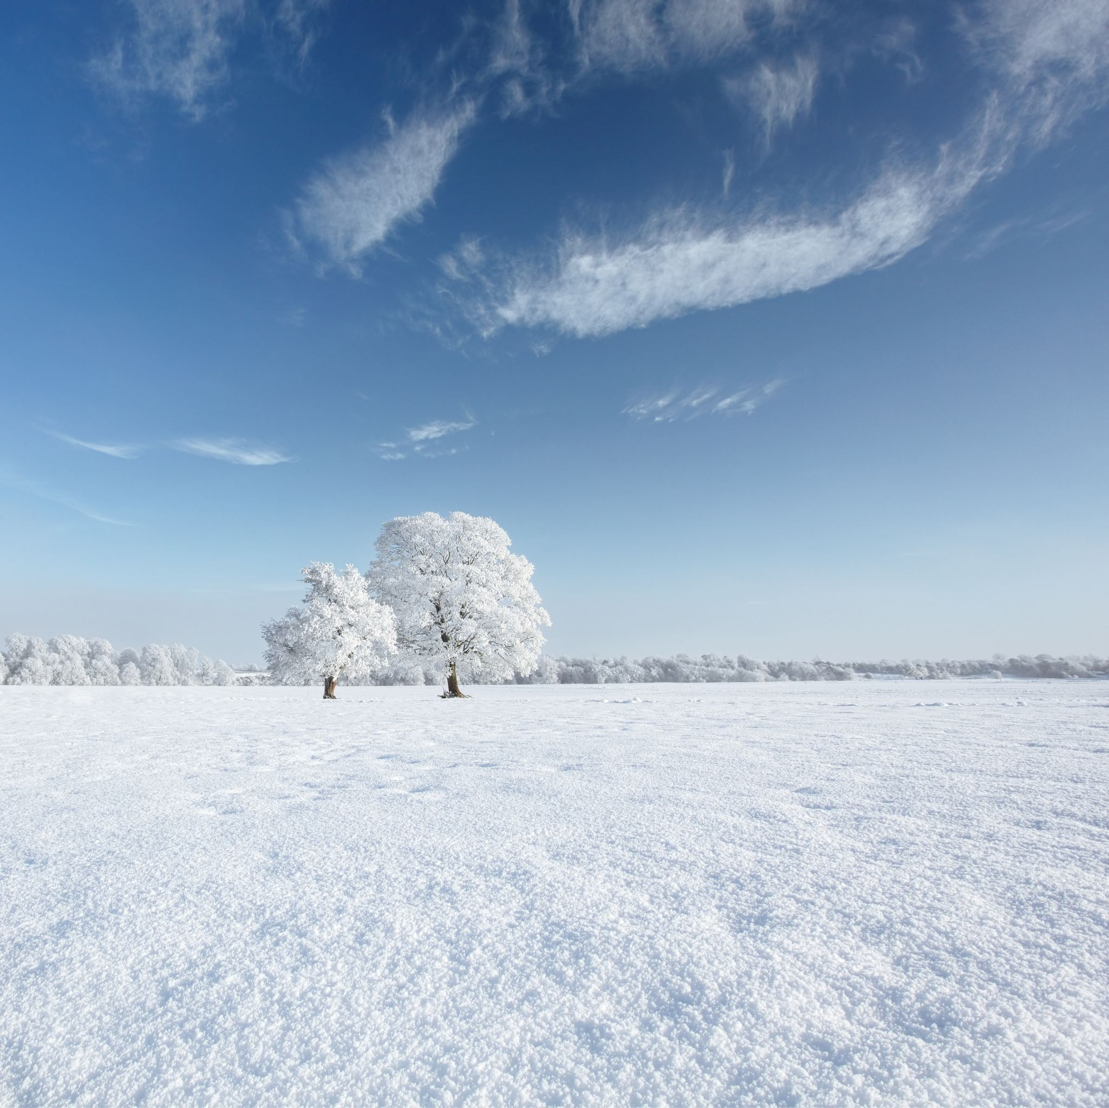
Winter results

Slide 7
Non-Optimised Results

