Slide 1
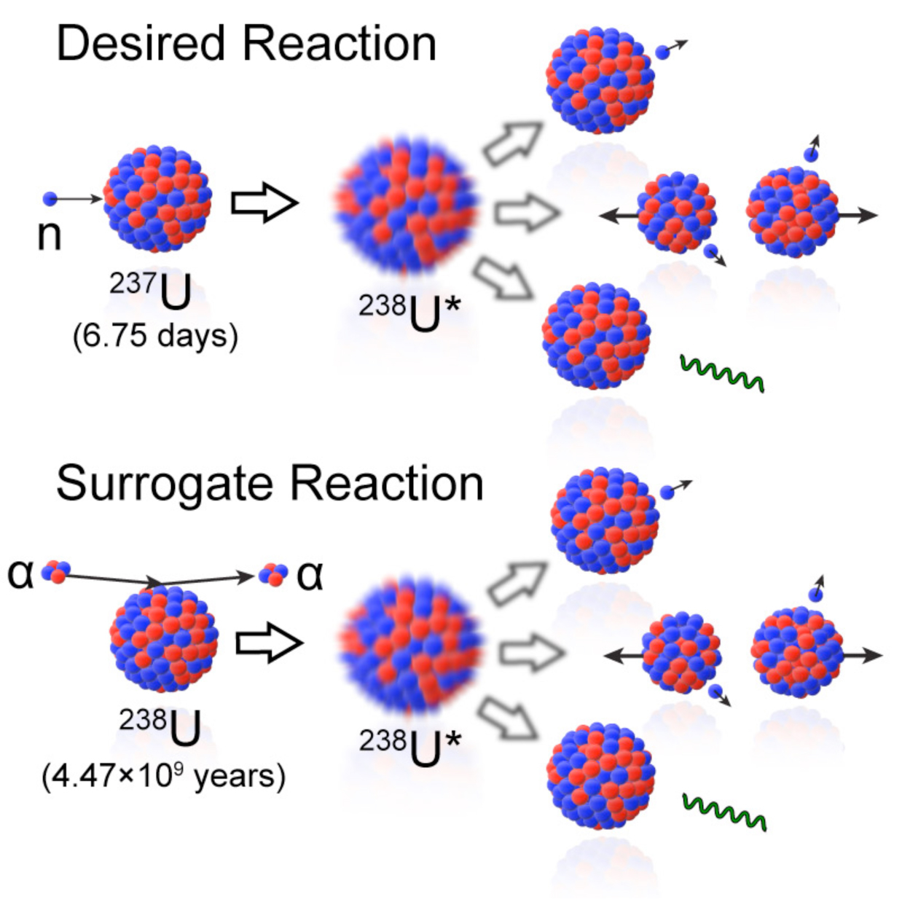
Physics Motivation: Direct & Surrogate Reactions
Shell evolution & shape coexistence
Magic numbers erode in neutron-rich nuclei; tensor NN force drives coexisting deformations
Surrogate Reaction Method
Probe via direct & surrogate reactions
(d,p) / (p,d) → C²S, J^{π}; surrogates constrain r-process (n,γ) rates
Active-target TPCs for rare-isotope beams
Gas = target + detector → thick-target luminosity, full kinematics
Bottleneck: TB-scale data per experiment
Each run produces several TB of raw data → extracting physics from this volume is a key challenge
σ(n,x) = ∑_{J,π} σ_{CN}(n+A; J^{π}) × P_{decay}(B*; J^{π})
Escher et al., Rev. Mod. Phys. 84, 353 (2012)
1 / 5
Notes:
Let me start by framing the physics motivation behind this work.
One of the most exciting frontiers in nuclear structure is the evolution of shell structure far from stability. We know that the traditional magic numbers can erode in neutron-rich nuclei, and the tensor component of the nucleon-nucleon force drives the coexistence of different nuclear shapes. Understanding this is a central question in modern nuclear physics.
How do we probe this experimentally? Through direct reactions like (d,p) and (p,d) transfer, which give us spectroscopic factors and spin-parity assignments. And through surrogate reactions, which allow us to indirectly constrain neutron-capture cross sections critical for r-process nucleosynthesis — reactions we simply cannot measure directly with short-lived isotopes.
The diagram on the right illustrates the surrogate reaction method: the desired cross section sigma of n,x is decomposed into a compound-nucleus formation cross section times a decay probability, summed over all spin-parity values. This formalism is the theoretical foundation for the surrogate approach.
Now, to carry out these measurements on rare-isotope beams, active-target time projection chambers — or TPCs — have become the instrument of choice. The gas volume serves simultaneously as the target and the detector, giving us thick-target luminosity with full kinematic coverage.
But here is the bottleneck: each experiment generates several terabytes of raw data. How to efficiently extract useful physics information from this massive volume becomes a key challenge, and this is what motivates our work.

Slide 2
The PID Problem in Active-Target TPCs
Traditional methods struggle with TPC data
dE-E: overlapping distributions at similar A/Z (e.g., ³He/⁴He, ¹³C/¹⁴C)
Bragg-curve fitting: pile-up, dynamic range across beam vs. recoil region
Hough transform mislabels ~1.5% of events (NST-2025-0958)
MATE-TPC at IMP (HIRFL-RIBLL)
GEM readout, 3,792 triangular pads (48×80), GET electronics
¹²C+¹²C commissioning data: elastic vs. fusion + 5 reaction channels
Key insight: 2D track images encode species-specific spatial signatures
Bragg peak position, track curvature, energy deposition pattern → underutilized by cuts
Our approach: CNNs on track images → the MATE-Automation pipeline
ResNet-18 backbone + CrossAttention fusion of physics features
2 / 5
Notes:
TALKING POINTS:
- Traditional PID in TPCs: dE/dx along track + integrated energy. Works well for well-separated species, but struggles for 3He/4He (Delta A/Z ~33%) and especially 13C/14C (Delta A/Z ~8%).
- Hough transform for track finding: our NST paper showed ML corrected ~1.5% mislabeled events.
- MATE detector specifics: GEM amplification (not Micromegas), triangular pad readout (48 rows x 80 pads = 3,792 pads), dual-gain for beam vs recoil.
- The 2D projection images (charge deposition + drift time) contain rich spatial information: Bragg peak location, track length, curvature -- all species-dependent features that a CNN can learn.
- This is why we convert ROOT simulation data -> HDF5 -> 2-channel 80x48 images and feed to ResNet.
- CrossAttention mechanism fuses 4 handcrafted physics features (moments of inertia Iyy, Izz, Iyz, total mass) with the CNN spatial representation.
FIGURE: Example TPC track images showing different particle species.
Figure path (embedded): D:\Something\research\MATE-Automation-V4\10_Papers-Thesis\Physics_Informed\figures\example_tracks.png
Also useful: D:\obsidian\OrbitOS\50_Resources\Physics\literature\MLforPhysics\NST-ML-12C12C-MATE\_page_5_Figure_3.jpeg (3D track displays from NST paper)

Slide 3
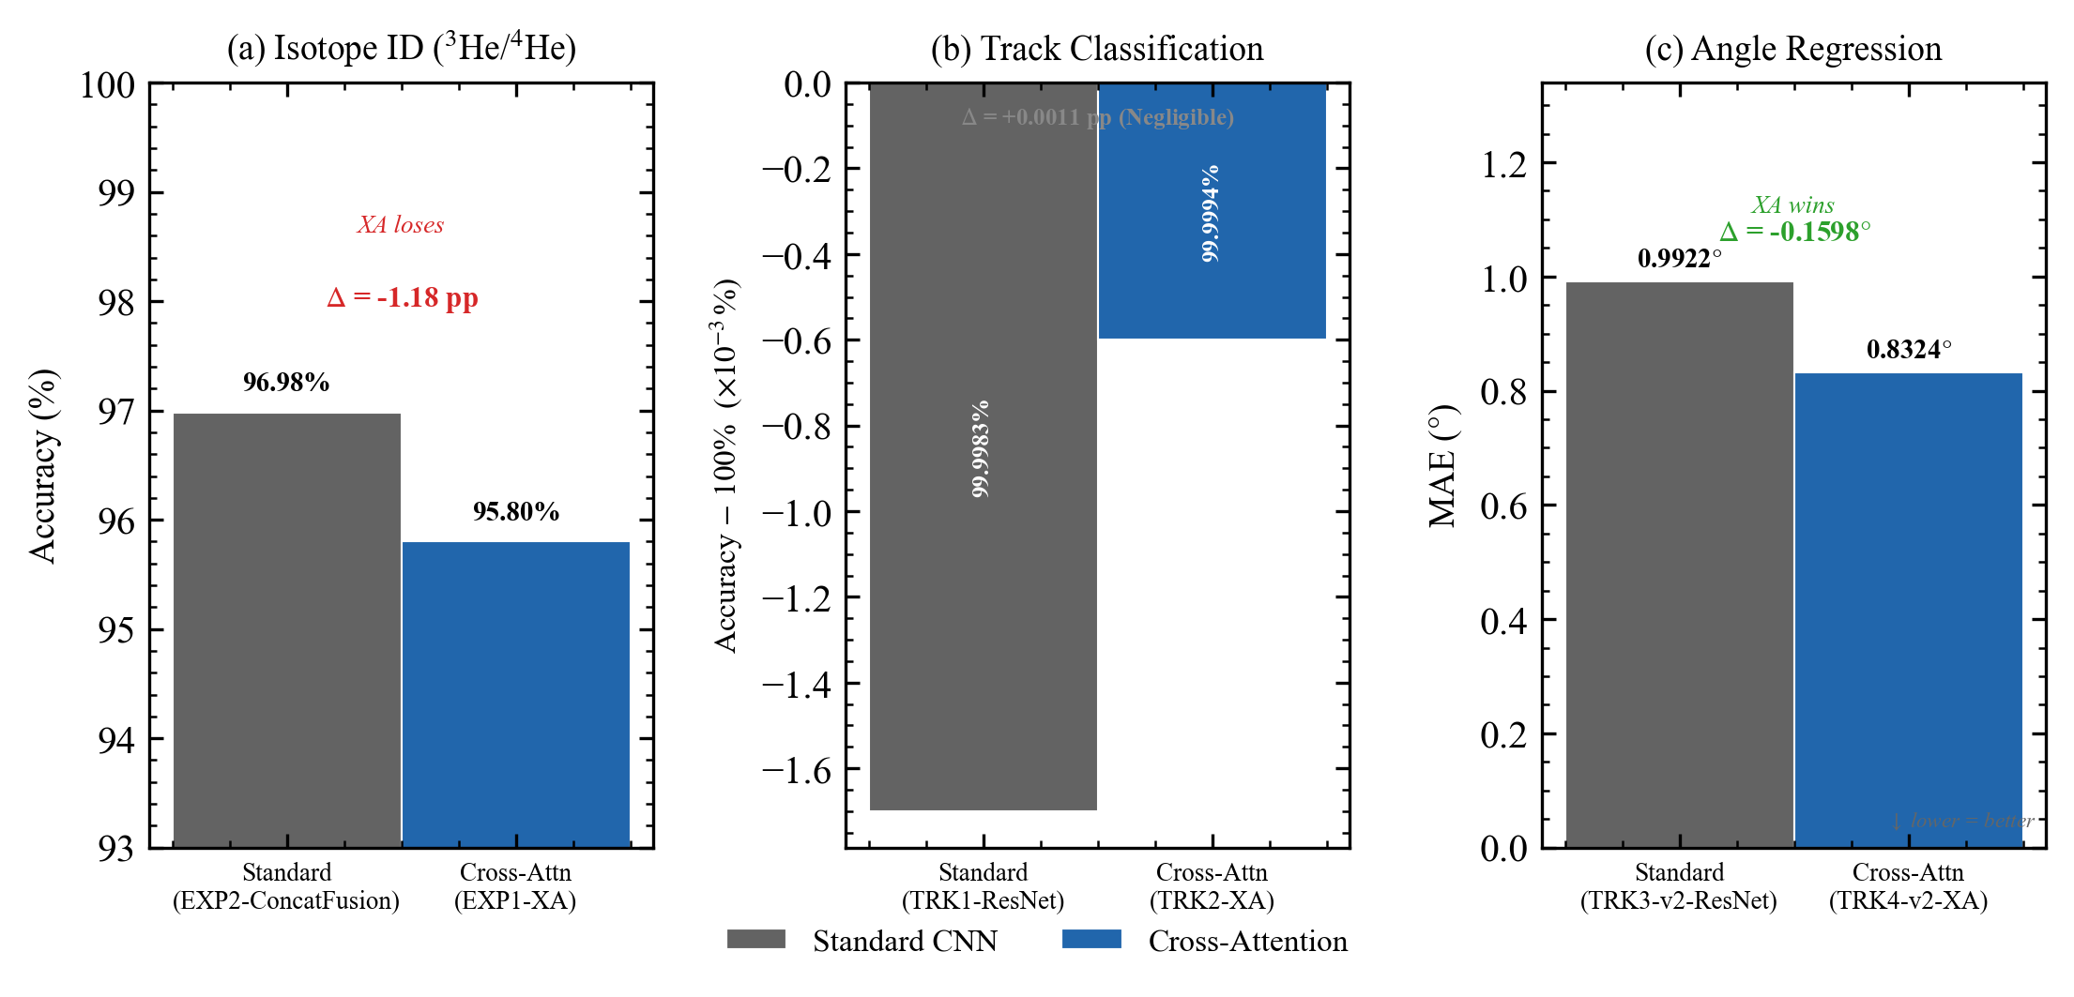
Results: Event Classification to Trajectory Reconstruction
PID Classification (NST-2025-0958, ¹²C+¹²C)
Elastic/fusion: 90–97% accuracy (ResNet-50, sim+exp)
5-channel fusion discrimination: ~95% (p, α, n, ⁸Be, 2α)
Precision 0.948, Recall 0.914, F1 0.931 on experimental data
Architecture Study (EXP1/EXP2, thesis)
CrossAtt+HC on 3He/4He: 95.80% (controlled, matched 100k)
EXP2 fusion comparison: CrossAtt vs Gated vs Concat on 13C/14C
Trajectory Reconstruction (TRK series, new)
Same framework extended to angle regression
CrossAtt reduces MAE by 16.1% (0.99°→0.83°, p<10⁻¹⁶)
High-precision fraction: 65.3%→72.9% (+7.6 pp)
Takeaway: pipeline generalizes — classification AND regression
3 / 5
Notes:
TALKING POINTS:
- Three levels of results to present:
1. Published PID results (NST-2025-0958, submitted Nov 2025): 90-97% elastic/fusion on 12C+12C, ~95% across 5 fusion channels
2. Thesis architecture study: CrossAtt+HC fusion mechanism. EXP1 showed 95.80% at matched 100k training size. EXP2 compared CrossAtt vs GatedFusion vs ConcatFusion.
3. NEW: Trajectory reconstruction (TRK series, completed April 2026). Same CrossAttention framework applied to angle regression task.
KEY NUMBERS:
- EXP1: CrossAtt+HC = 95.80% (3He/4He, 100k matched). Architecture effect is +0.024 pp vs baseline (not significant at p=0.813), BUT data scaling to 400k gives +1.77 pp (p<1e-73). This is honest -- architecture helps, but data volume matters more for PID.
- TRK: CrossAtt reduces angle MAE by 16.1% (0.992 -> 0.832 degrees, p<1e-16, CIs fully disjoint). This is the clearest architecture win.
- The generalization story is powerful: same backbone + CrossAtt fusion works for classification AND regression tasks on TPC data.
- 13C/14C is the hardest case: only 8% A/Z difference. CrossAtt gets 84.6% vs ConcatFusion 86.1% -- still challenging.
FIGURES:
- cross_task_honest_comparison.png: Three-panel comparison (Isotope ID / Track Classification / Angle Regression)
Path: D:\Something\research\MATE-Automation-V4\runs\TRK-comparison\figures\cross_task_honest_comparison.png
- paradigm_comparison.png: Two-paradigm comparison (Range-Energy PID vs ML)
Path: D:\Something\research\MATE-Automation-V4\runs\EXP1-XA-HC-100k\20260317_191552_seed42\figures\paradigm_comparison.png
- v6_confusion_matrix_grid.png: Confusion matrices across ablation variants
Path: D:\Something\research\MATE-Automation-V4\10_Papers-Thesis\Physics_Informed\figures\v6_confusion_matrix_grid.png

Slide 4
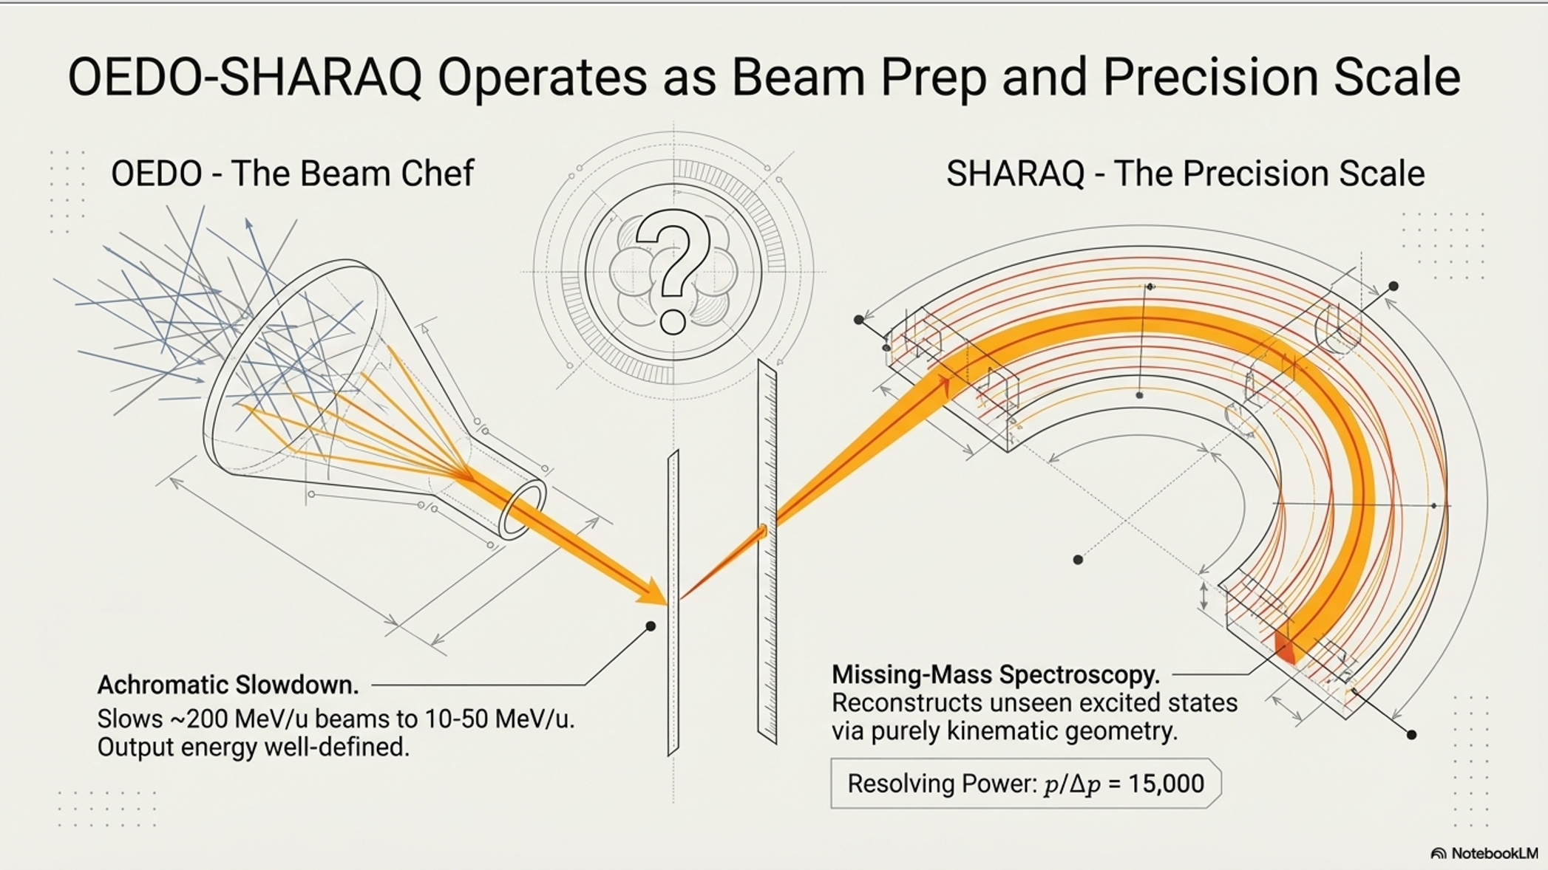
Connection: From MATE-TPC (IMP) to DONUTS (UTokyo CNS)
ML-PID for active-target TPCs maps directly to the DONUTS program
OEDO-SHARAQ: inverse-kinematics direct reactions on exotic nuclei
(d,p), (p,d) transfer reactions at 10–30 MeV/u via RIKEN RIBF
Same PID challenge: separate light recoils (p, d, α) from beam background
DG-M-THGEM active target: GEM-based, dual gain, stable to 2.5×10⁶ pps
SAKURA: surrogate (d,p) for r-process (n,γ) cross-sections
⁹⁹Se(d,p) flagship result (Imai et al., PLB 2024) → reliable PID essential
Extending to more exotic targets: ML-PID improves channel discrimination
Transferable capabilities from my work:
ResNet + CrossAtt framework adaptable to different TPC geometries
Full pipeline: simulation → image → ML inference → validated on experimental data
Track reconstruction + angle regression adds trajectory analysis capability
4 / 5
Notes:
TALKING POINTS:
- This slide is the BRIDGE -- connecting IMP research to Imai's program at UTokyo CNS.
- DONUTS group operates at RIKEN RIBF via OEDO-SHARAQ beamline: energy-degraded exotic beams for direct reactions.
- The PID challenge is identical in principle: separate light recoils from heavy beam background in an active-target TPC environment.
- SAKURA program: surrogate (d,p) reactions to constrain (n,gamma) for r-process nucleosynthesis. The 79Se(d,p) result (Imai, PLB 2024) is the flagship -- shows why clean PID matters for cross-section extraction.
- DG-M-THGEM detector (Iwamoto, Ota, Imai et al., PTEP 2023): dual-gain GEM-based active target, similar in principle to MATE. ML-PID framework transfers naturally.
- Key message: I'm not asking to replicate my thesis -- I'm bringing a validated toolkit that addresses a real analysis bottleneck in DONUTS experiments.
- Mention CAT-M detector (shared CNS infrastructure between NUSPEQ/Aoi and DONUTS/Imai groups).
FIGURE: OEDO-SHARAQ beamline schematic.
Path: D:\obsidian\OrbitOS\50_Resources\Attachments\OEDO-SHARAQ.png

Slide 5
Outlook: Next Steps and Open Questions
Extend CrossAtt-PID framework to DONUTS detector data
Adapt pipeline from MATE triangular pads → DG-M-THGEM geometry
Leverage simulation infrastructure for new target/beam combinations
Open questions for discussion
Transfer learning: how well does the model generalize across TPC geometries?
Beam conditions: different rates, gas mixtures, dynamic range at RIKEN RIBF
Complex reaction channels in SAKURA: multi-body final states, (d,pγ) coincidences
Integration with existing ATPC Flow analysis framework (Python/C++/Rust)
Broader vision
ML-augmented analysis as standard tool for next-generation RI-beam experiments
From PID → full event reconstruction: vertex, track, angle, channel ID in one pipeline
Looking forward to your guidance on the highest-impact application.
5 / 5
Notes:
TALKING POINTS:
- This is the forward-looking slide. End on a collaborative note -- invite Imai's input.
- Key question to ASK: "Given the DONUTS program's current priorities, where would ML-based PID have the most immediate impact?"
- Transfer learning is a genuine open question: MATE has 3,792 triangular pads; DONUTS detectors may have different geometries. Domain adaptation (DANN/MCD) methods are ready to explore.
- SAKURA reactions are more complex than simple binary classification -- multi-body final states may need multi-class or hierarchical classification approaches.
- Mention: the MATE-Automation codebase is modular and well-documented. Adapting to a new detector is a config change + retraining, not a rewrite.
- The ATPC Flow framework (mentioned in RCNP collaboration meeting notes) is the existing analysis software. Integration point: ML inference as a module within that pipeline.
- End with: "I'm eager to learn how this work can contribute to the group's goals, and I welcome your suggestions on the most valuable direction to pursue during the PhD."
TIMELINE CONTEXT (if asked):
- IMP graduation: June 2027
- UTokyo PhD D1 enrollment: October 2027 (primary) or October 2028 (fallback via kenkyusei)
- TOEFL iBT Attempt #1: August 30, 2026
- GRE Physics: Sept/Oct 2026
- UTokyo entrance exam: Jan-Feb 2027 (estimated)

