Slide 1

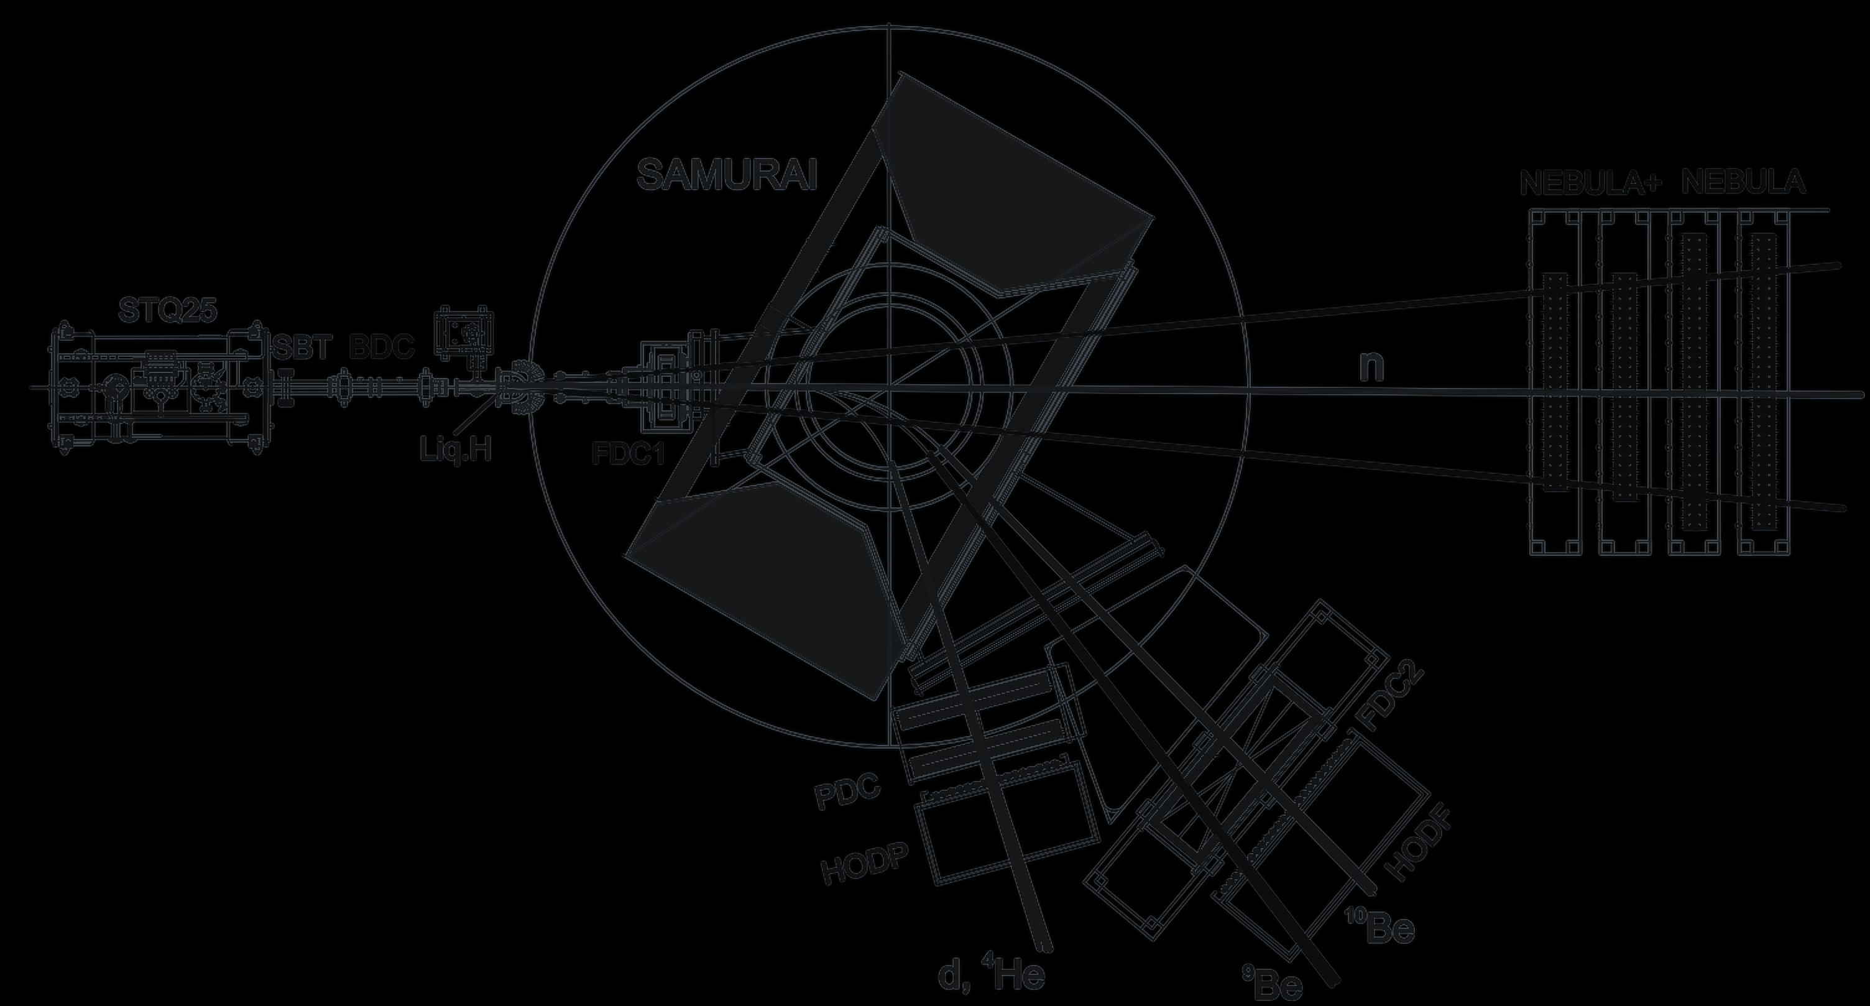
Institute of Modern Physics
Chinese Academy of Sciences
DIRECT REACTIONS WITH EXOTIC BEAMS · DREB2026
Probing Exotic Structures in ¹⁰Be
via ⁹Be + n Coincidence Measurements
with the SAMURAI Spectrometer
Near 7.3 MeV: a 1⁻, a 3⁻, or both?
Fushuai Shi
1–6 Nov 2026 · Shenzhen, China
[ co-authors · collaboration · experiment ID ]
Notes:
Keep the submitted title (it is the one printed in the programme). Say: By the end of this talk you will know what our ⁹Be + n spectrum shows near 7.3 MeV and what will decide between 1⁻ and 3⁻. The question line tells the room what to listen for: one level with a disputed spin, or two levels. From slide 2 on, coral marks the 1⁻ assignment and teal the 3⁻ assignment. Replace the bracketed line with the co-authors, the collaboration and the experiment ID.

Slide 2

Two spin assignments compete near 7.3 MeV in ¹⁰Be.
E_{x} (MeV)
IF 1⁻
7.6
Carries a large fraction of the isoscalar-dipole sum rule: strong α clustering.
7.542 MeV 2⁺ ENSDF
⁶He + α threshold 7.41
J. Chen et al., PRL 134, 012502 (2025)
7.4
7.371 MeV 3⁻ ENSDF
IF 3⁻
7.27(10) MeV 1⁻ Chen et al. 2025
Matches the 3⁻ isobaric analog at 8.898 MeV in ¹⁰B (T = 1).
7.2
±1σ
A. N. Kuchera et al., PRC 84, 054615 (2011)
7.0
7.27(10) and 7.371 MeV differ by 1σ: one level with a disputed spin, or two levels?
⁹Be + n threshold S_{n} = 6.812
6.8
DREB meeting
Notes:
Set the stakes before any method. A 2025 deuteron-scattering experiment reports a new 1⁻ state at 7.27(10) MeV. ENSDF lists a 3⁻ at 7.371 MeV, 0.1 MeV higher, which is only one standard deviation away. So the question is whether this is one level with a disputed spin or two levels. Point at the coral band touching the teal line.

Slide 3

Outline
1
Why is the 7.3 MeV assignment disputed?
therefore
2
How can a proton probe test it?
therefore
3
What does the ⁹Be + n spectrum show?
but
4
What will decide 1⁻ versus 3⁻?
Notes:
Four questions; each answer raises the next. Why is the assignment disputed? Therefore we test it with a proton probe, and therefore we look at the ⁹Be + n spectrum. But that spectrum does not resolve the levels, so the last question is what will decide.

Slide 4
¹⁰Be’s cluster bands already contain a 3⁻ and a 2⁺ near 7.3 MeV.
E_{x} (MeV)
Columns: orbitals of the two valence neutrons around the 2α core.
10
(4⁺)
10.2
4⁻
9.27
3⁻ at 7.37 MeV continues the (σπ) band.
8
2⁺
7.54
3⁻
7.37
1⁻
7.27
2⁻
6.26
S_{n} 6.81
2⁺ at 7.54 MeV continues the (σ)² band.
6
0⁺
6.18
1⁻
5.96
4
A 1⁻ at 7.27 MeV adds a state outside this scheme.
2⁺
3.37
2
Levels and configurations: W. von Oertzen et al., Phys. Rep. 432, 43 (2006). 7.27 MeV: J. Chen et al., PRL 134, 012502 (2025).
0
0⁺
g.s.
(π)²
(σ)²
(σπ)
Chen 2025
DREB meeting
Notes:
In the molecular-orbital picture the two valence neutrons occupy π or σ orbitals around the 2α core, and the levels group into bands. The 3⁻ at 7.37 MeV continues the (σπ) band; the 2⁺ at 7.54 MeV continues the (σ)² band. A 1⁻ at 7.27 MeV is not part of this scheme, so the spin of the level near 7.3 MeV decides whether a new cluster state exists.

Slide 5
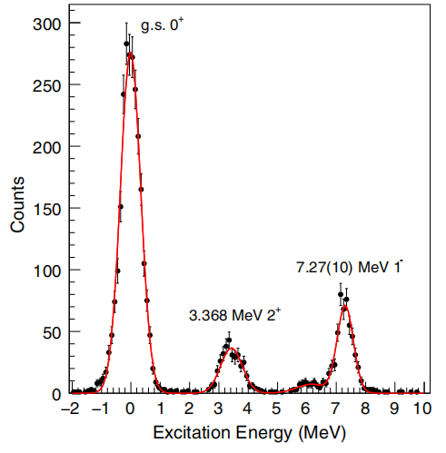
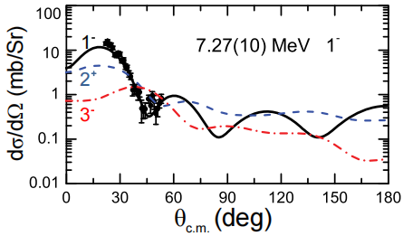
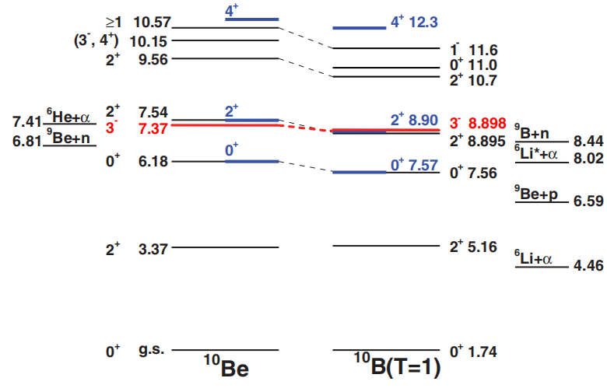
The angular distribution points to 1⁻, isobaric analogs to 3⁻.
FOR 1⁻
¹⁰Be + d → d′ + ¹⁰Be* · AT-TPC + SOLARIS
FOR 3⁻
Isobaric analogs ¹⁰Be ↔ ¹⁰B (T = 1)
Data follow the 1⁻ (L = 1) curve.
J. Chen et al., Phys. Rev. Lett. 134, 012502 (2025)
A. N. Kuchera et al., Phys. Rev. C 84, 054615 (2011); NNDC
Our test: a proton probe, ¹⁰Be(p,p′), with ⁹Be + n in coincidence.
DREB meeting
Notes:
Left: deuteron inelastic scattering on ¹⁰Be in inverse kinematics, measured with the AT-TPC coupled to SOLARIS. The angular distribution of the 7.27 MeV peak follows the L = 1 curve, hence 1⁻. Right: in ¹⁰B, the T = 1 analog of the 7.37 MeV level is a 3⁻ at 8.898 MeV, which supports 3⁻. Therefore we test the assignment with a different probe, ¹⁰Be(p,p′), and reconstruct Eₓ from the ⁹Be + n invariant mass.

Slide 6
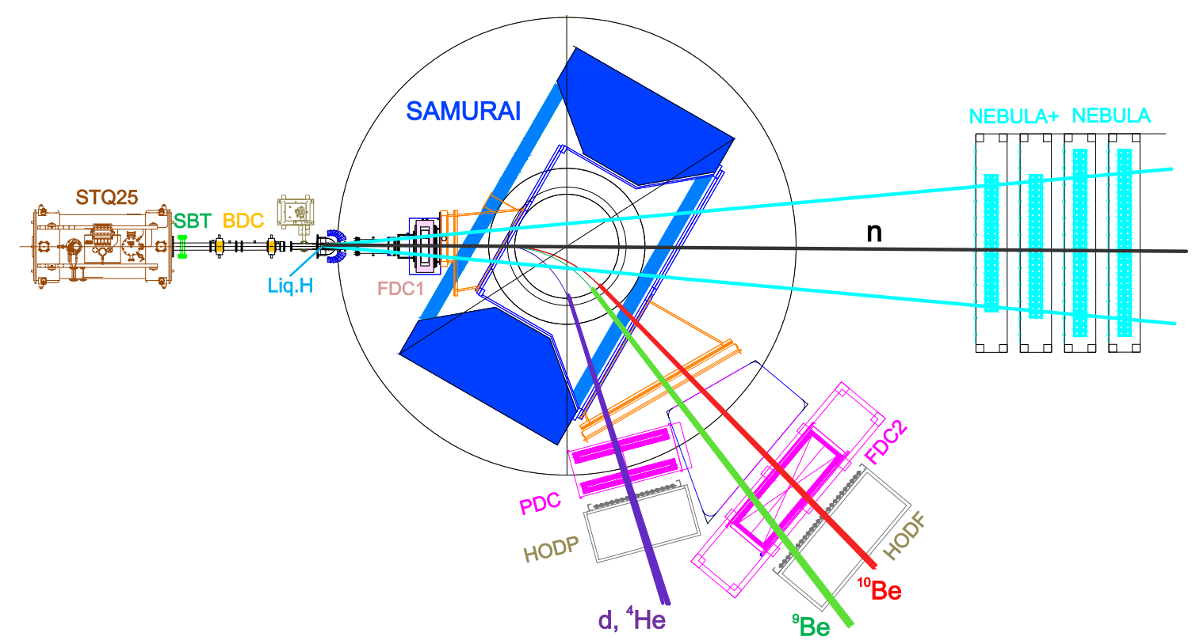
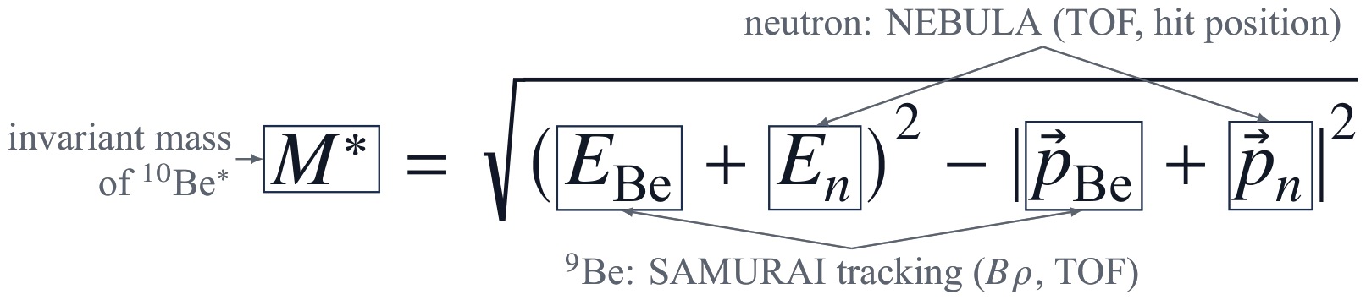
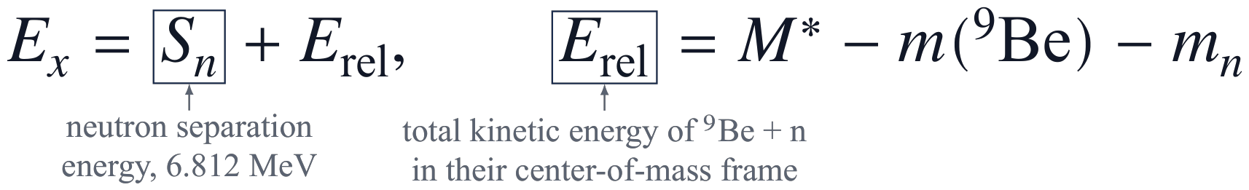
SAMURAI and NEBULA detect ⁹Be + n from ¹⁰Be(p,p′) in coincidence.
REACTION
¹⁰Be + p → p′ + ¹⁰Be* → ⁹Be + n
BEAM
¹⁰Be, 230 MeV/u, 2 × 10⁵ pps
93 % purity · ¹⁸O at 250 MeV/u on 10 mm ⁹Be
TARGET
Liquid H₂, Φ 46 mm, 140 mg/cm²
FRAGMENT
SAMURAI + FDC1, FDC2, HODF
Runge–Kutta tracking → Bρ, A/Q
NEUTRON
NEBULA + NEBULA-Plus
ε(1n) ≈ 40 %
Target: X. Wang et al., NIMA (2026) 172066
NEBULA: T. Kobayashi et al., NIMB 317, 294 (2013)
DREB meeting
Notes:
A ¹⁰Be beam at 230 MeV/u hits a liquid-hydrogen target. The proton scatters inelastically and leaves ¹⁰Be excited above the neutron threshold; the excited ¹⁰Be decays to ⁹Be and a neutron. SAMURAI bends ⁹Be into FDC2 and HODF; the neutron flies straight to NEBULA. The invariant mass of the ⁹Be + n pair gives the energy above the neutron threshold; adding Sₙ gives the excitation energy.

Slide 7
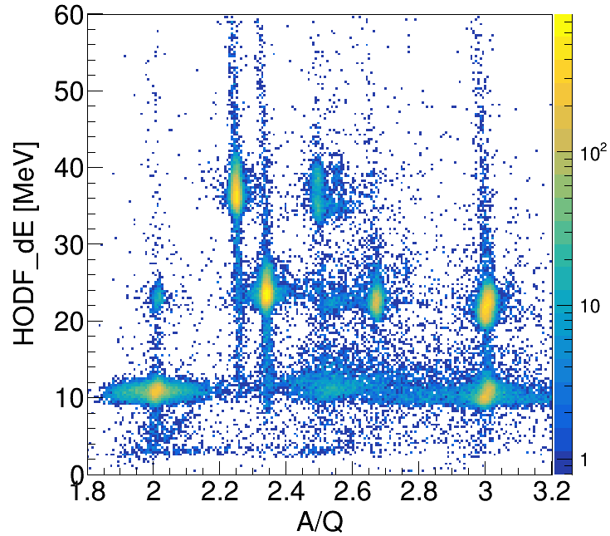
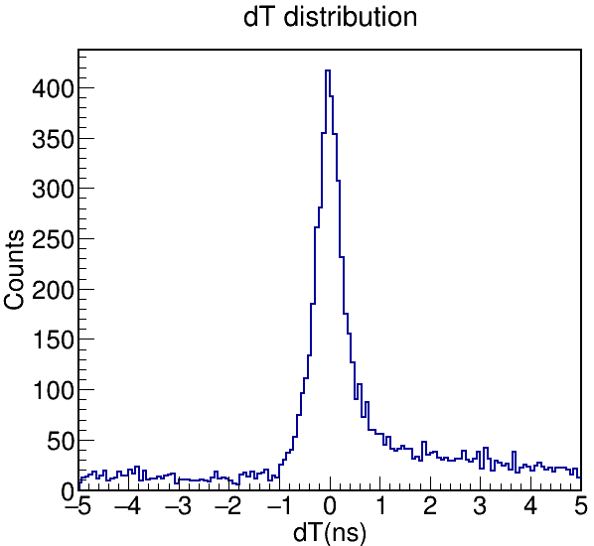
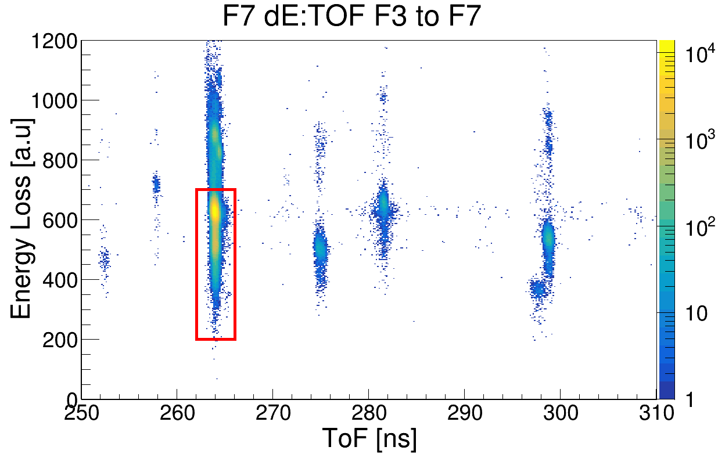
Beam ID, fragment ID, and NEBULA timing select ⁹Be + n events.
BEAM · F7 ΔE vs TOF (F3–F7)
FRAGMENT · HODF ΔE vs A/Q
NEUTRON · NEBULA timing
¹⁰Be + Cu run
⁹Be
⁷Li
⁸Li
⁹Li
¹⁰Be
¹²B
⁴He
⁶He
⁷Li
¹¹Be
⁶He
⁹Li
⁸Li
93 %
⁹Be
σ = 258 ps
of the beam is ¹⁰Be
selected in A/Q (Bρ + TOF) and ΔE
prompt γ peak after bar-by-bar alignment
DREB meeting
Notes:
Three checks, one per particle. Beam: BigRIPS ΔE versus time of flight from F3 to F7; ¹⁰Be is 93 % of the cocktail. Fragment: after Runge–Kutta tracking, ΔE in HODF versus A/Q separates ⁹Be from the lithium and helium isotopes. Neutron: after bar-by-bar alignment the prompt γ peak has σ = 258 ps. Details are in backup slides 12 to 14.

Slide 8
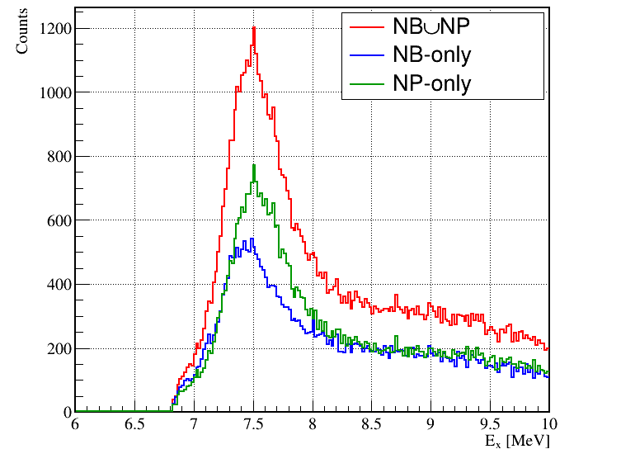
The ⁹Be + n spectrum shows one peak just above the neutron threshold.
7.371 3⁻
7.27 1⁻
7.542 2⁺
WHAT WE CAN SAY
One peak just above S_{n}.
Peak centroid:
S_{n} = 6.812
fit → MeV
Resolution at E_{x} ≈ 7.4 MeV: σ =
simulation → keV
7.27, 7.371 and 7.542 MeV are not resolved; yields are not yet extracted.
NB / NP: neutron in NEBULA / NEBULA-Plus; NB∪NP: either. Not acceptance-corrected.
DREB meeting
Notes:
Excitation energy from the ⁹Be + n invariant mass, 6 to 10 MeV. Red: neutron in either wall; blue: NEBULA only; green: NEBULA-Plus only. The ticks above the frame mark the 1⁻ assignment at 7.27, the 3⁻ at 7.371 and the 2⁺ at 7.542 MeV. One peak, no separation of the three levels at the present resolution. [Presenter: fill the centroid and σ from the fit and simulation; the histogram maximum sits near 7.5 MeV, so state how the centroid compares with 7.371 MeV.]

Slide 9
Angular distributions and a lineshape fit can distinguish 1⁻ from 3⁻.
1
2
3
Clean the spectrum
Measure dσ/dΩ
Fit the lineshape
Subtract the empty-target run; correct for acceptance and efficiency.
Angular distribution of the peak against L = 1 and L = 3 reaction calculations.
Simulated response with 7.371 MeV 3⁻ and 7.542 MeV 2⁺: is a 7.27 MeV 1⁻ term needed?
OUTCOME
L = 1 part and a 7.27 MeV term needed
→ a 1⁻ beside the 3⁻
L = 3 shape, no extra term
→ the 3⁻ alone
DREB meeting
Notes:
But the peak alone cannot tell the spins apart. Three steps will: clean the spectrum; measure the angular distribution of the peak and compare its shape with L = 1 and L = 3 calculations; and fit the lineshape with the simulated response, testing whether a 7.27 MeV term is needed on top of the known 7.371 and 7.542 MeV levels.

Slide 10
Contributions
1
A ⁹Be + n invariant-mass spectrum of ¹⁰Be from (p,p′) at 230 MeV/u: independent data on the 7.3 MeV region.
2
One peak just above S_{n}; 7.27, 7.371 and 7.542 MeV are not resolved.
3
Angular-distribution and lineshape analysis will test the 1⁻ assignment.
DREB meeting
Notes:
Leave this slide up during questions. Say: These are the three points I would like you to take away. Thank you for your attention.

Slide 11
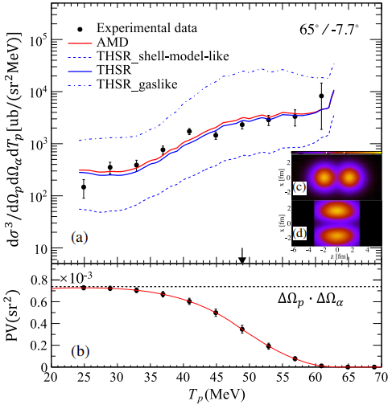
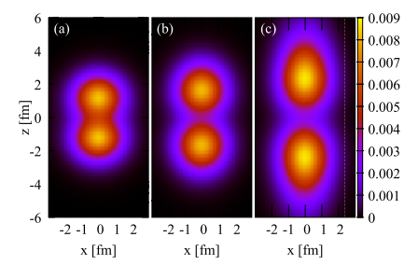
(p,pα) knockout supports a molecular-like 2α ground state.
¹⁰Be(p,pα)⁶He
BACKUP
(a) shell-model-like
(b) molecular-like
(c) gas-like
P. J. Li et al., PRL 131, 212501 (2023); M. Lyu et al., PRC 93, 054308 (2016); PRC 97, 044612 (2018)
DREB meeting
Notes:
Triple-differential ¹⁰Be(p,pα)⁶He cross section compared with AMD and THSR calculations; the data follow the molecular-like density, between the shell-model-like and gas-like limits. AMD: antisymmetrized molecular dynamics. THSR: the Tohsaki–Horiuchi–Schuck–Röpke wave function.

Slide 12
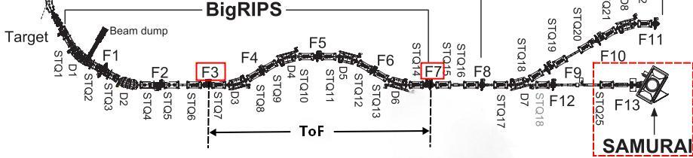
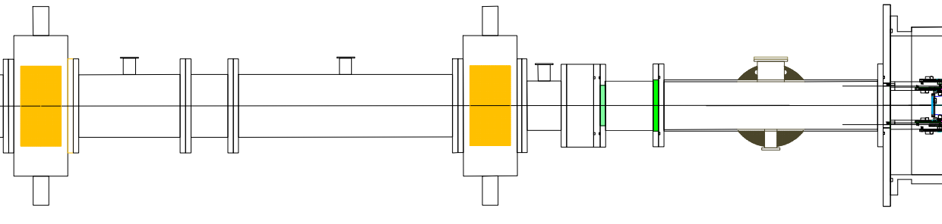
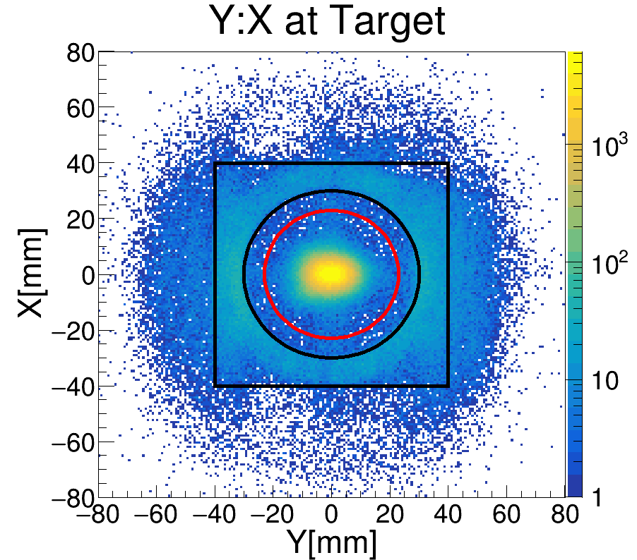
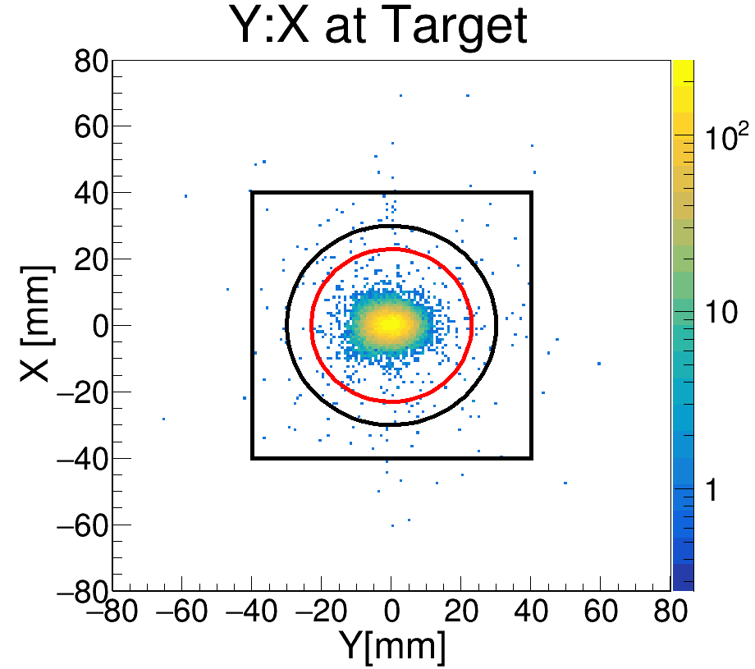
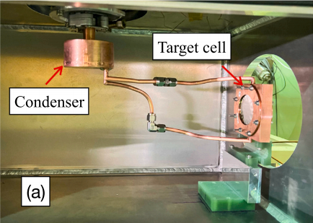
BDC1 and BDC2 track each ¹⁰Be ion to the Φ 46 mm target.
BigRIPS · F3 → F7 time of flight
BACKUP
BDC1 → BDC2 → target
Target plane · all beam
Target plane · beam trigger
Target cell: X. Wang et al., NIMA (2026) 172066
DREB meeting
Notes:
BigRIPS identifies each ion by ΔE and time of flight from F3 to F7 (slide 7); BDC1 and BDC2 track each ion to the target plane. Red circle: target cell, Φ 46 mm.

Slide 13
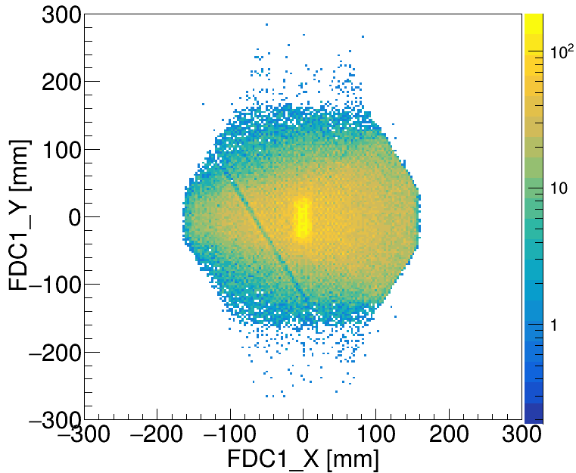
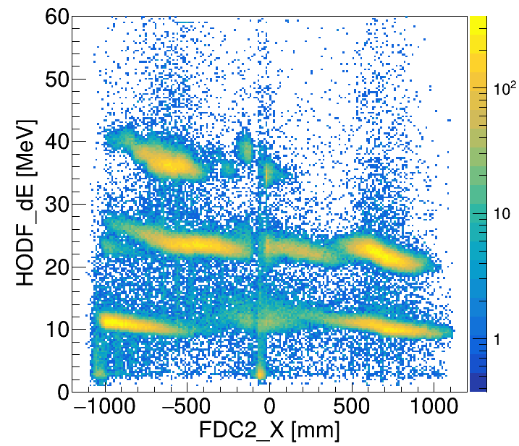
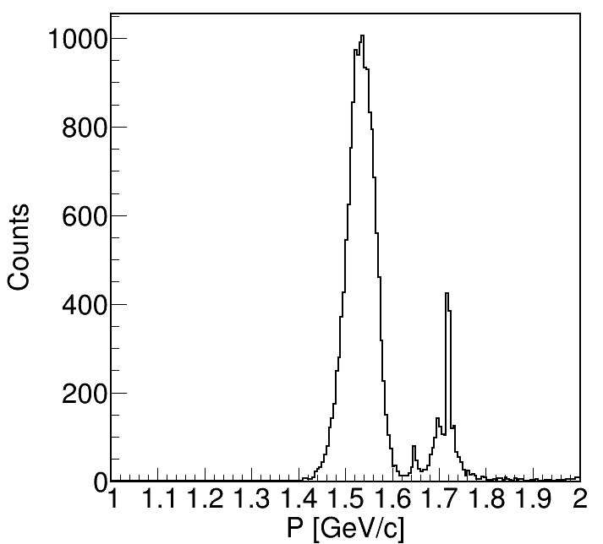
Runge–Kutta tracking through the field map gives Bρ and A/Q.
BACKUP
1
Local track fits in FDC1 and FDC2 (χ²/ndf < 3).
2
Seed at the HOD plane from FDC2: position, angle, p₀.
3
RK4 backward through the 3-D field map; fit (x, y, u, v, q = Q/p) to FDC hits by χ².
4
At the target: vertex, momentum, path length → Bρ → A/Q (with TOF).
Y:X on FDC1
ΔE(HODF): FDC2_X
Charged particle PID and momentum distribution
⁹Be
⁷Li
⁸Li
⁹Li
⁴He
⁶He
DREB meeting
Notes:
Steps: local fits in FDC1 and FDC2; seed at the HOD plane from FDC2; RK4 backward through the 3-D field map, fitting x, y, u, v and q = Q/p to the FDC hits; at the target, vertex, momentum and path length give Bρ and, with TOF, A/Q.

Slide 14
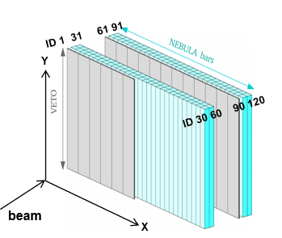
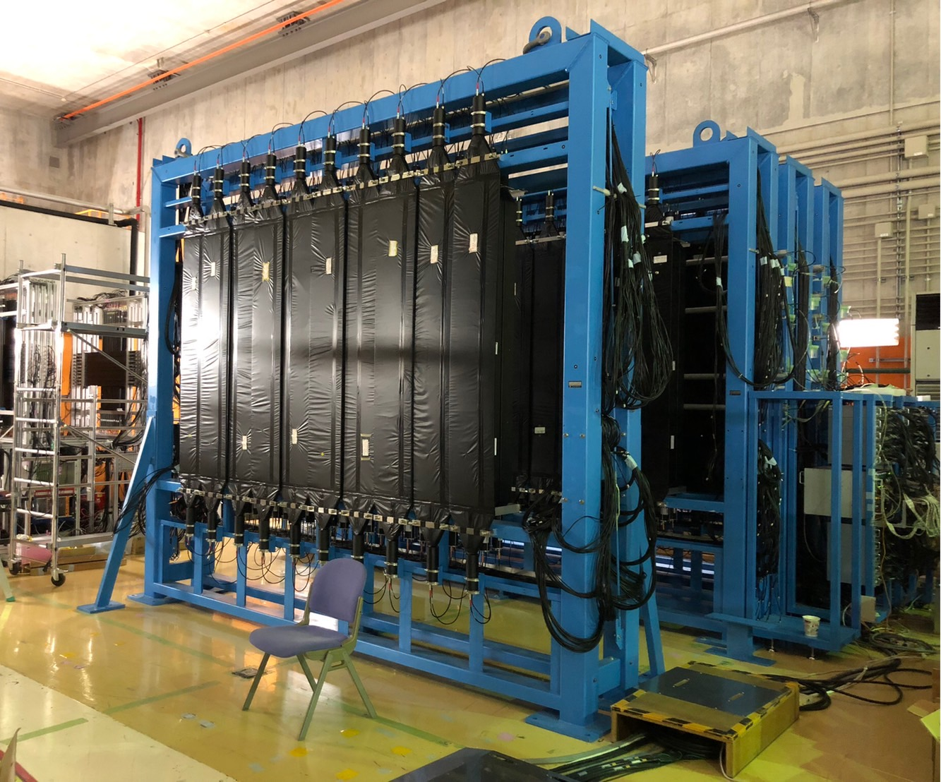
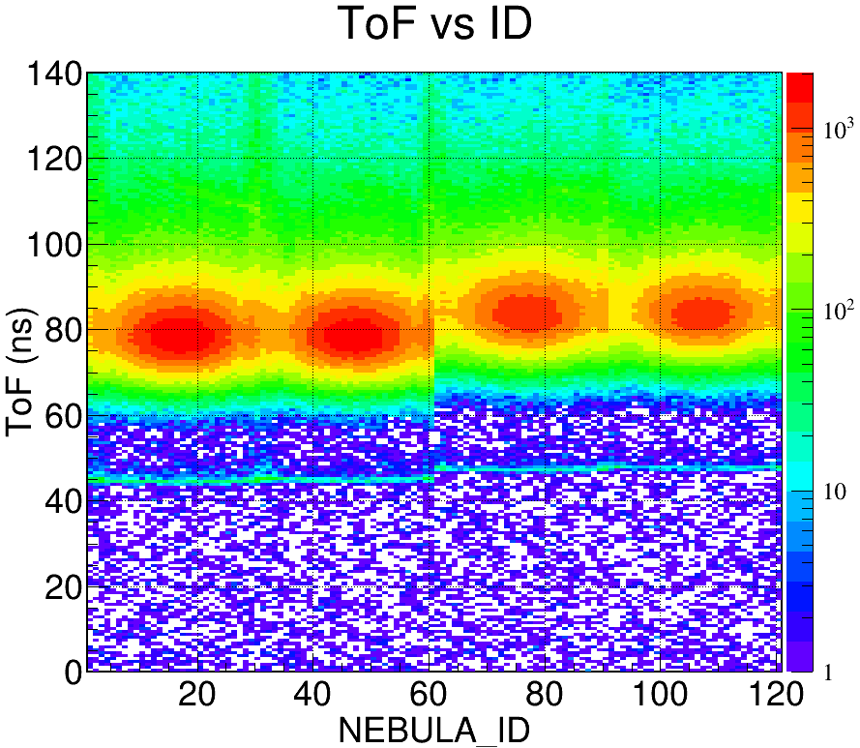
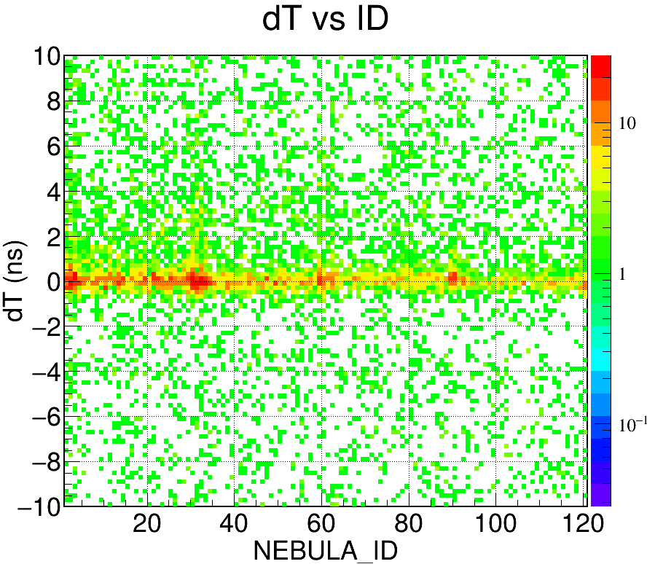
NEBULA times are aligned bar by bar to the prompt γ peak.
BACKUP
REFERENCE VALUES
THIS RUN
ε(1n) ≈ 40 %
σ(γ) ≈ 170 ps
σ(n) ≈ 340 ps
at E_{n} ≈ 200 MeV
σ(γ) = 258 ps
T. Kobayashi et al., NIMB 317, 294 (2013)
DREB meeting
Notes:
Calibration run ¹⁰Be + Cu. Time of flight versus bar ID before alignment, dT versus bar ID after alignment, and the summed dT distribution with σ = 258 ps. Reference value for the detector: σ(γ) ≈ 170 ps. [Presenter: prepare one sentence on why this run gives 258 ps.]

