Slide 1

Direct Reactions with Exotic Beam (DREB2026)
Shenzhen, China, Nov 1st-6th, 2026
Probing Exotic Structures in ¹⁰Be
via ⁹Be + n Coincidence Measurements
with the SAMURAI Spectrometer
Fushuai Shi
Institute of Modern Physics, Chinese Academy of Sciences

Slide 2

Research Background
1
Experimental Setup
2
CONTENTS
Particles detection
3
Preliminary result
4

Slide 3
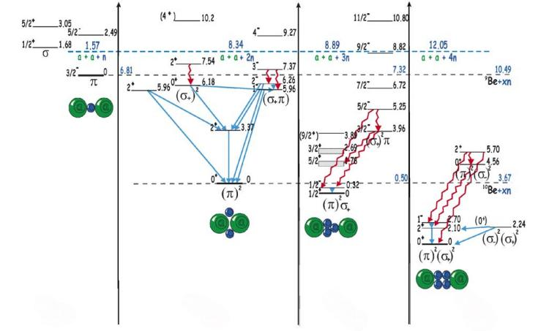
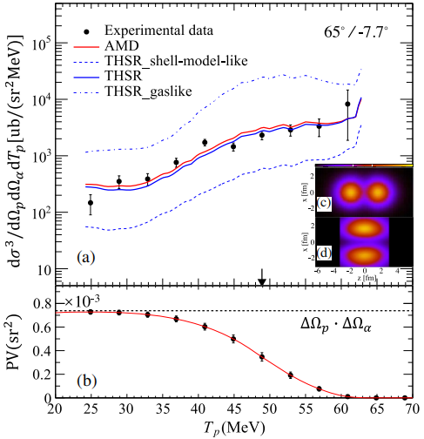
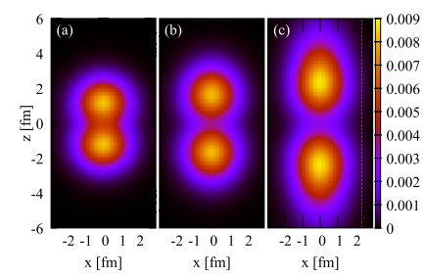
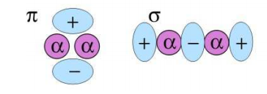
Research Background: α Clustering
¹⁰Be(p,pα)⁶He
shell-model-like
ρ_{p}
ρ_{n}
molecularlike
gaslike
⁹Be
¹⁰Be
¹¹Be
¹²Be
W. Von Oertzen,et al., J. Phys.: Conf. Ser. 863, 012066 (2017)
W. Von Oertzen, et al., Phys. Rep.432, 43 (2006).
Be: 2α+Xn, two α particles form a dumbbell-shaped core, with valence neutrons moving around the alpha core, which can be described analogously to molecular orbitals (σ, π).
P.J. Li, et al., Phys. Rev. Lett. 131, 212501 (2023).
M. Lyu, et al., Phys. Rev. C 93, 054308 (2016).
M. Lyu, et al., Phys.Rev. C 97, 044612 (2018).
The ground state distribution of ¹⁰Be consists of a 2α core with two valence neutrons occupying π-type orbitals.
DREB meeting

Slide 4
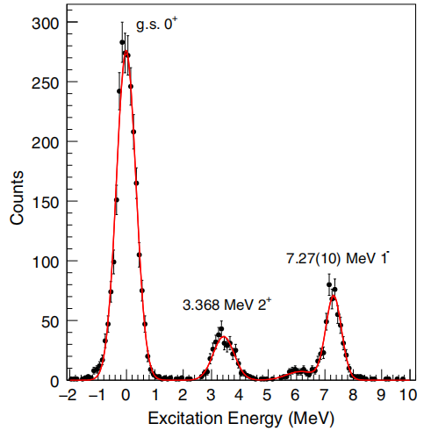
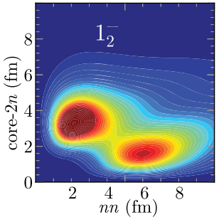
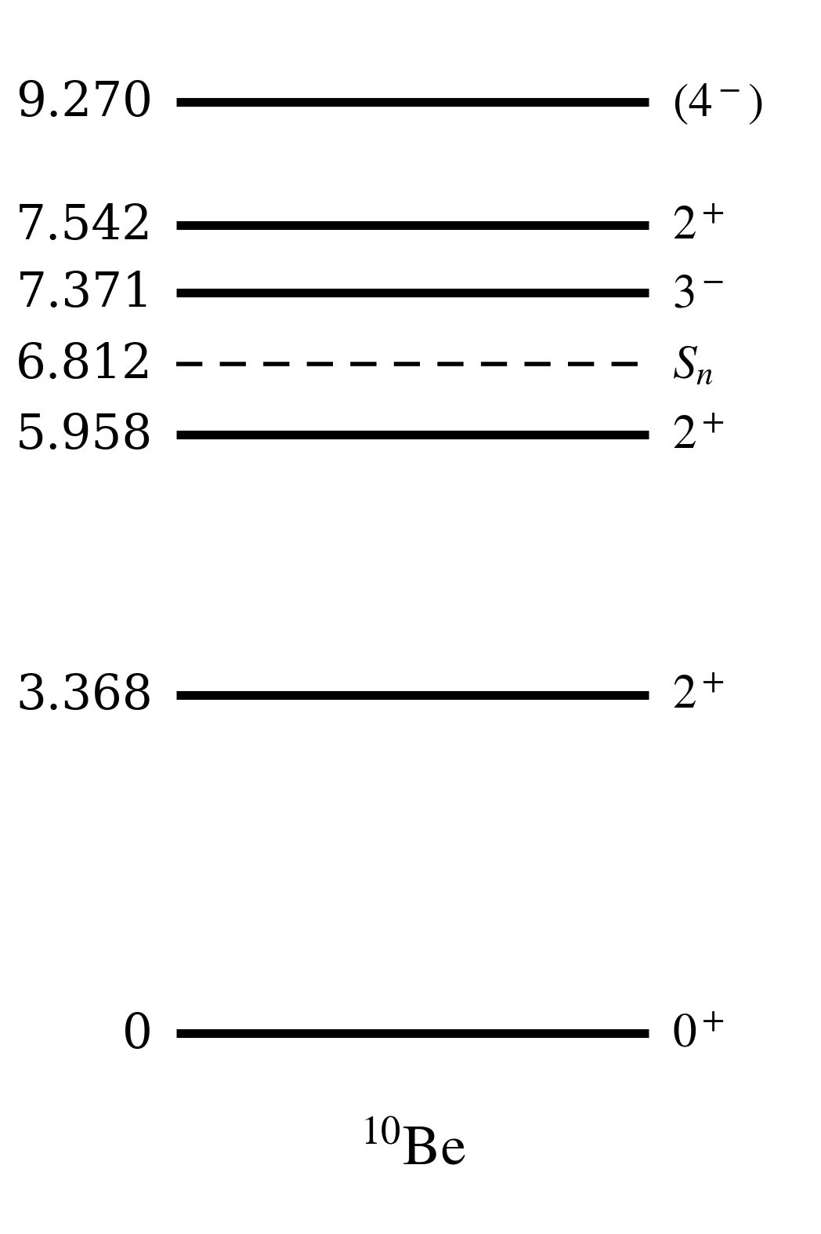
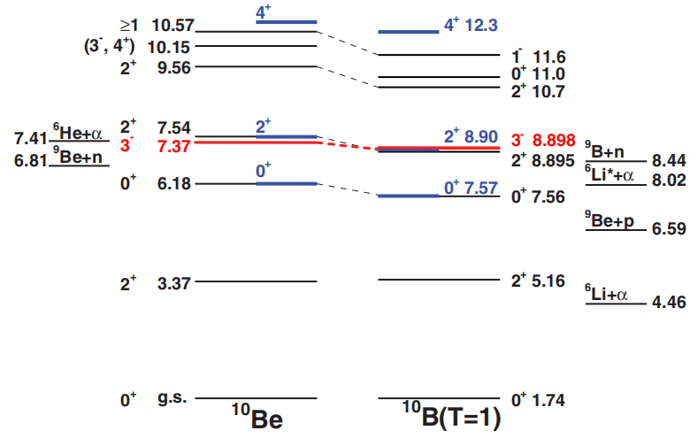
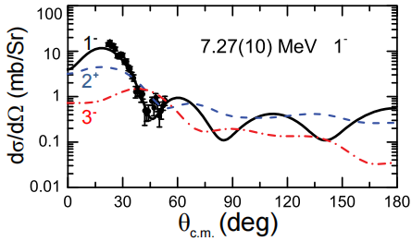
Previous experimental studies
¹⁰Be+d->d’+¹⁰Be*
7.27 MeV
https://www.nndc.bnl.gov/
J. Chen, et al., Phys. Rev. Lett. 134: 012502 (2025).
A. N. Kuchera et al., Phys. Rev. C 84, 054615 (2011).
The new assignment (7.27 MeV 1⁻) conflicts with the NNDC 7.37 MeV.
It is inconsistent with the corresponding isospin analog states in ¹⁰B.
Our experiment, 10Be (p,p’)10Be, used completely different probe (p-induced, ⁹Be+n coincidence + invariant mass) to test this specification.
DREB meeting

Slide 5
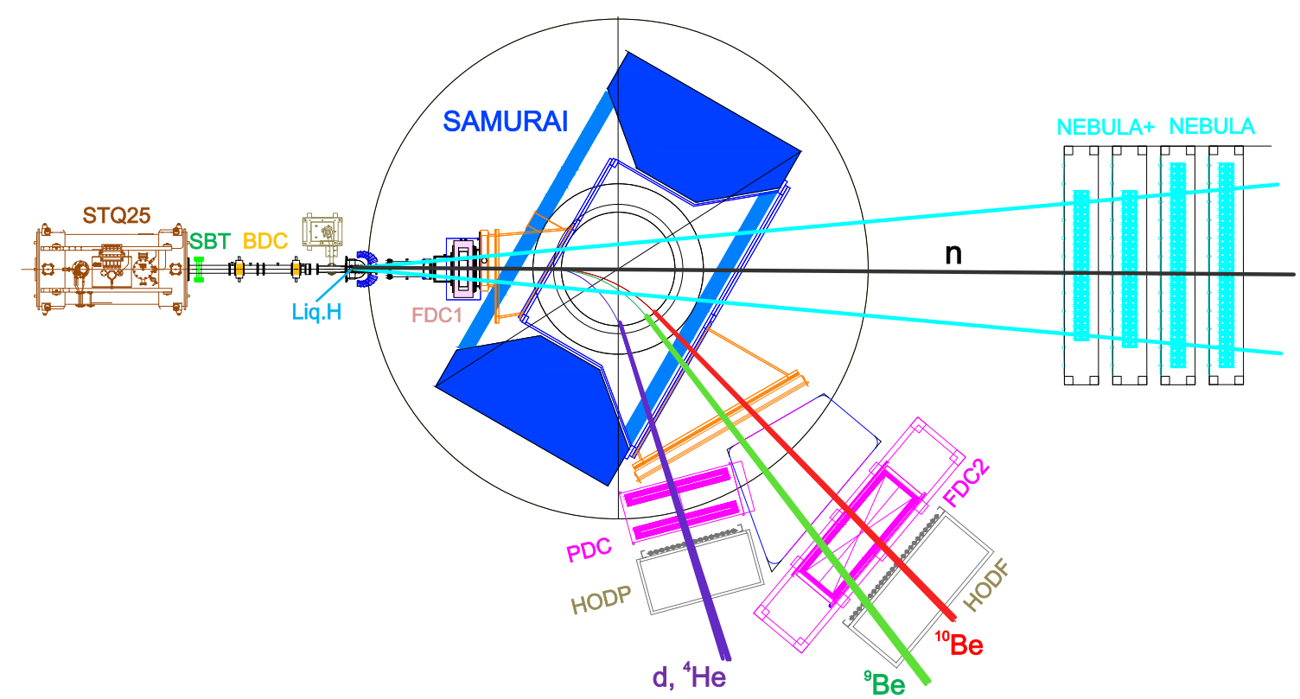
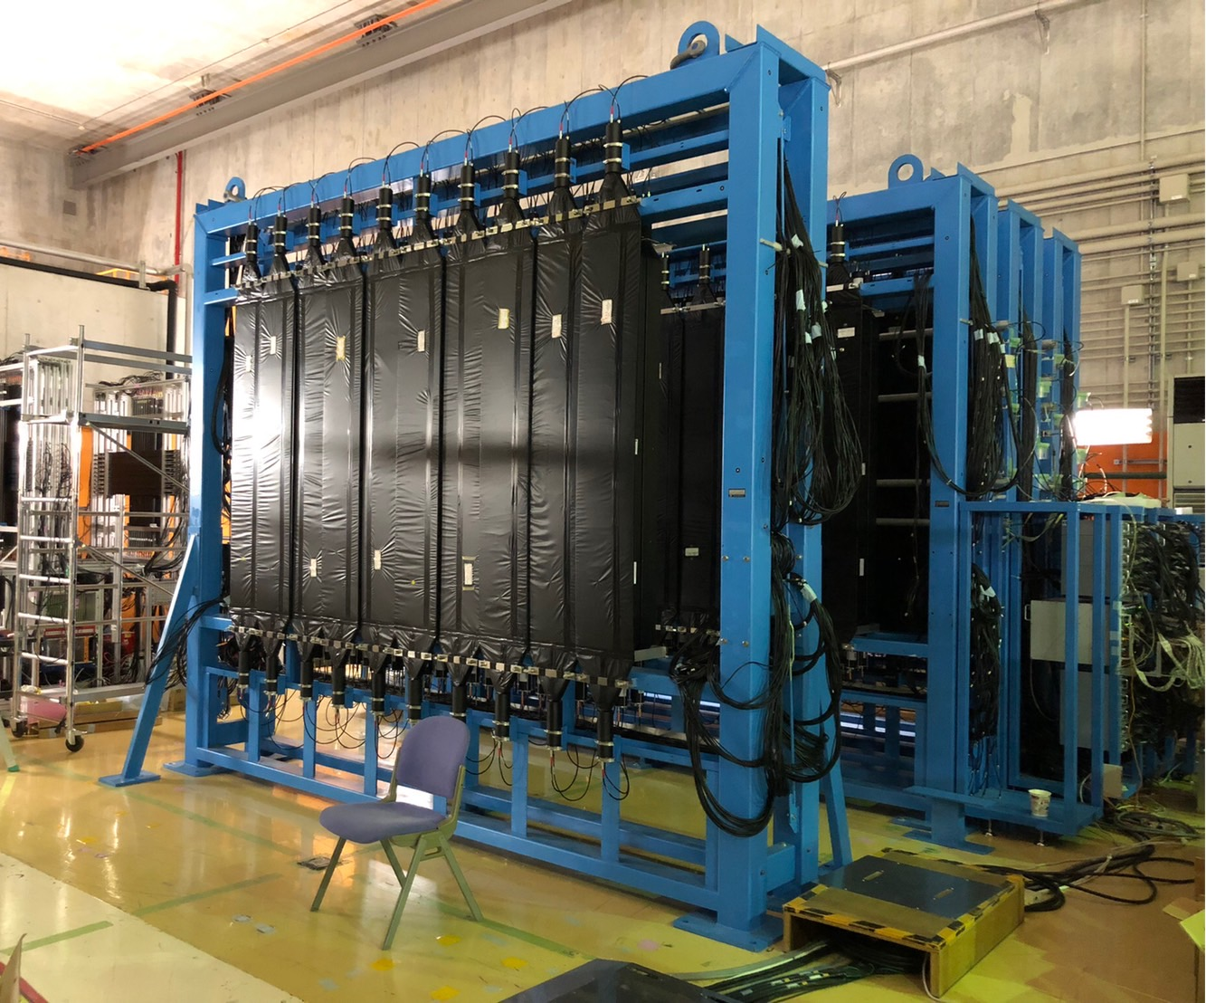
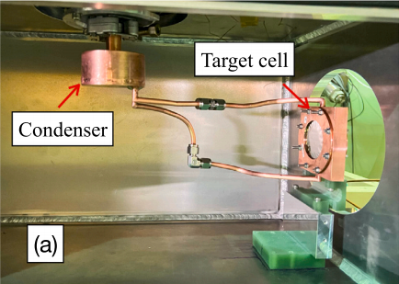
Experimental Setup
Primary Beam：¹⁸O@250 MeV/u
Production Target：⁹Be (10 mm)
Method: Invariant mass spectroscopy
high resolution
high statistics
¹⁰Be+p-> p’+¹⁰Be*-> ⁹Be+n
¹⁰Be Secondary Beam
@230 MeV/u, 2*10⁵ pps
Secondary Target: Liq.H
Φ=46 mm, T=140 mg/cm²
NEBULA
ε(1n)~40%
σ(γ)~170 ps
σ(n)~340 ps
(En~200 MeV)
Kobayashi T et al., NIMB, 317: 294-304 (2013)
X Wang, et al., NIMA, 2026: 172066.
DREB meeting

Slide 6
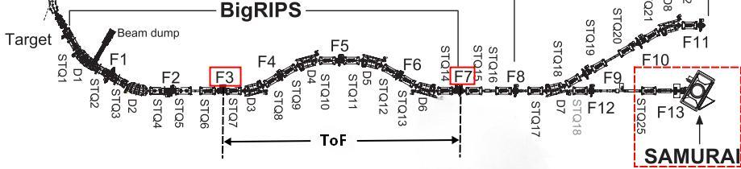
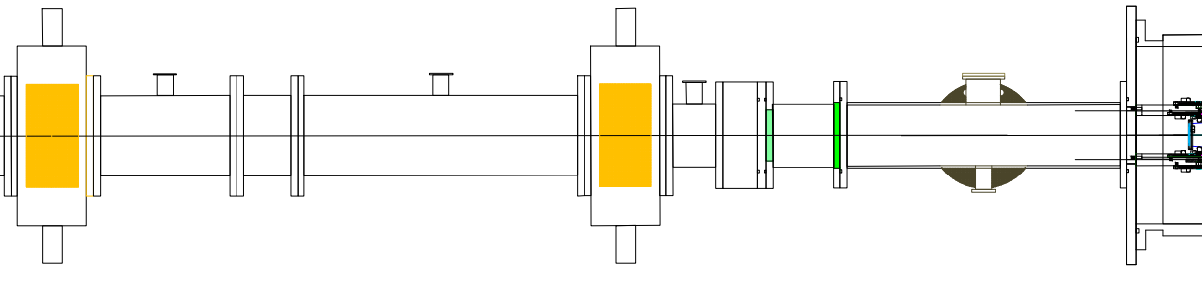
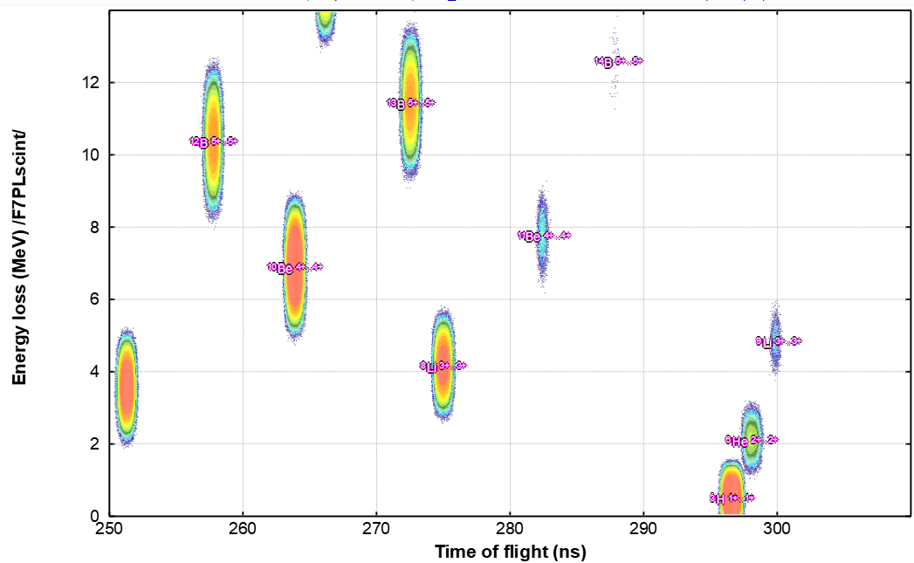
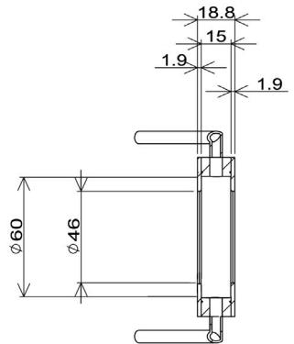
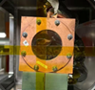
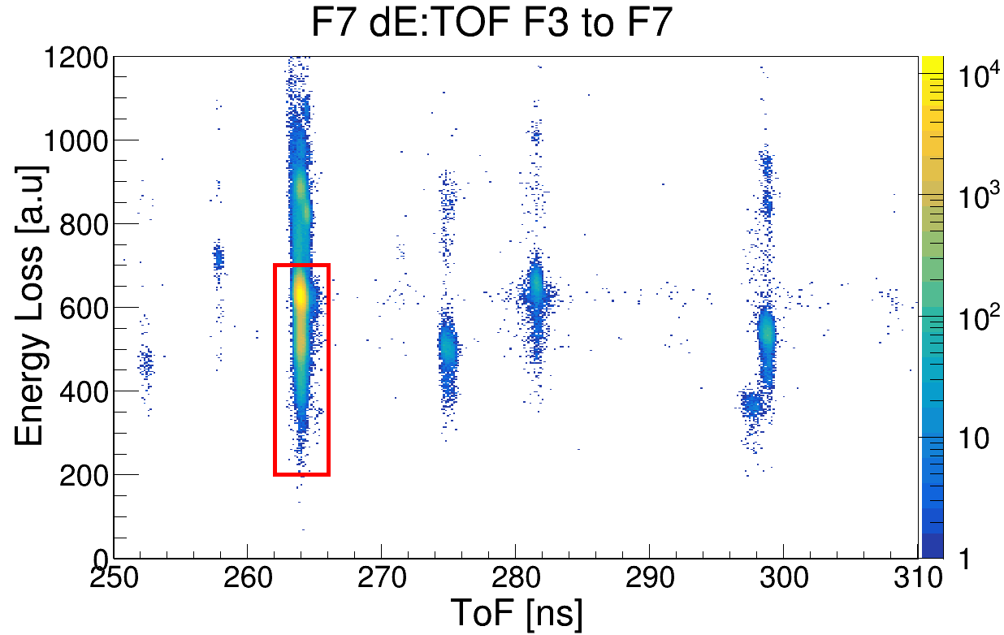
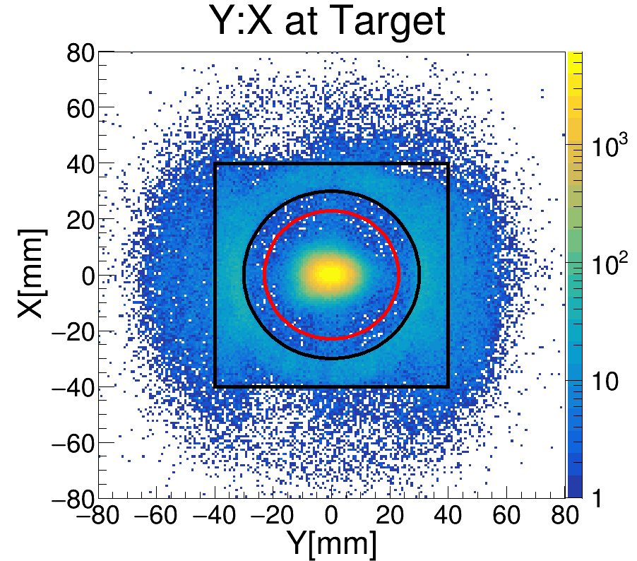
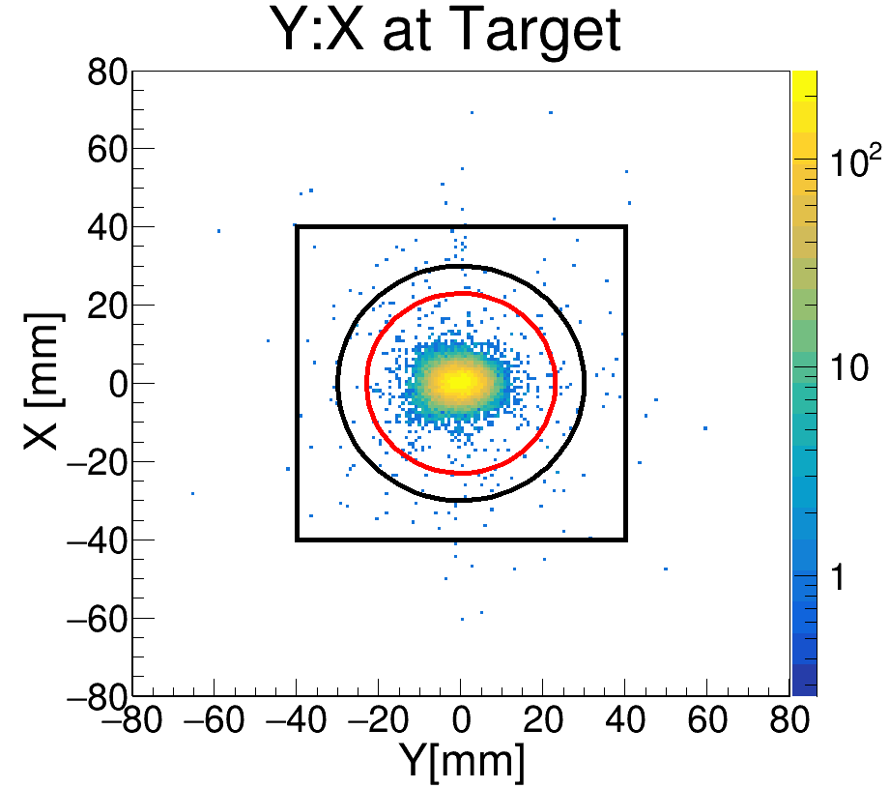
PID before Target
BDC1
BDC2
Target
Beam axis
L₁₋₂
L_{2-T}
[X₁,Y₁]
[X₂,Y₂]
[X_{T},Y_{T}]
¹²B
¹¹Be
¹⁰Be
⁹Li
⁸Li
⁶He
⁷Li
Beam trigger
¹²B
⁷Li
¹¹Be
⁶He
⁹Li
⁸Li
¹⁰Be intensity~93%
DREB meeting

Slide 7
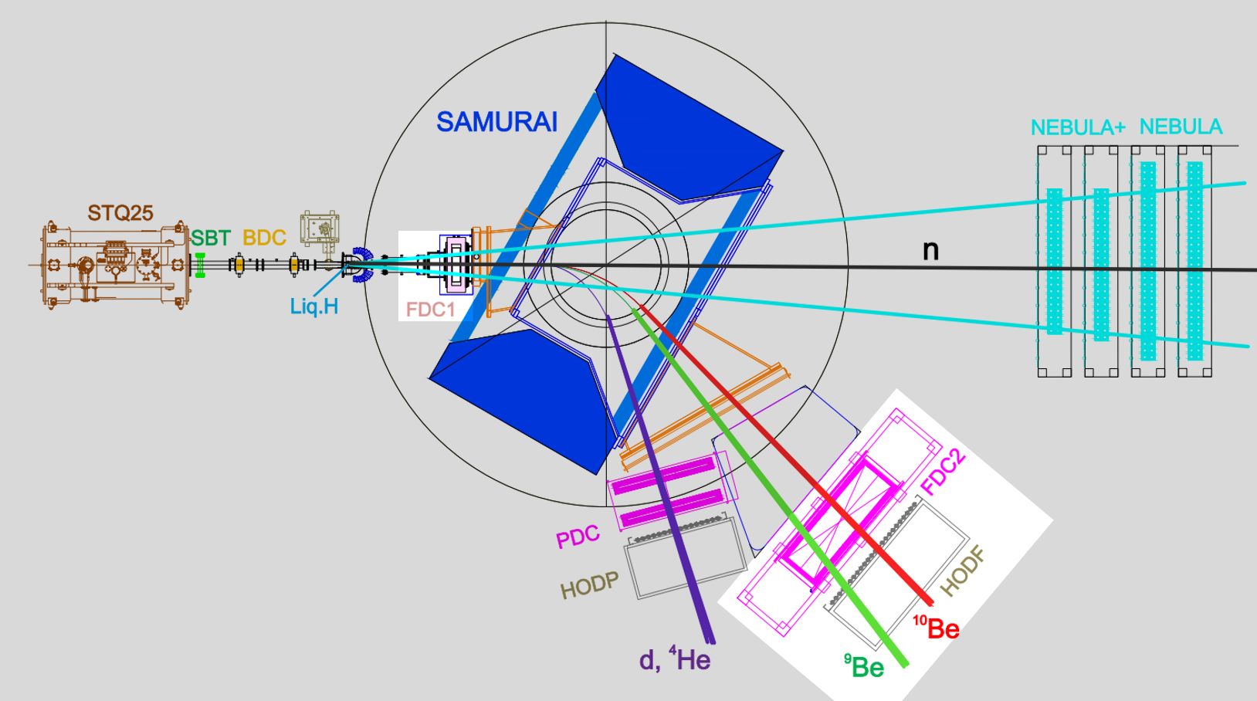
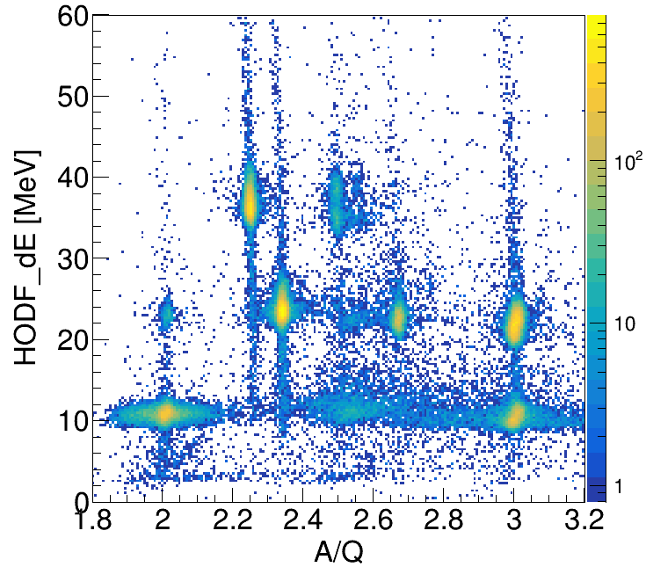
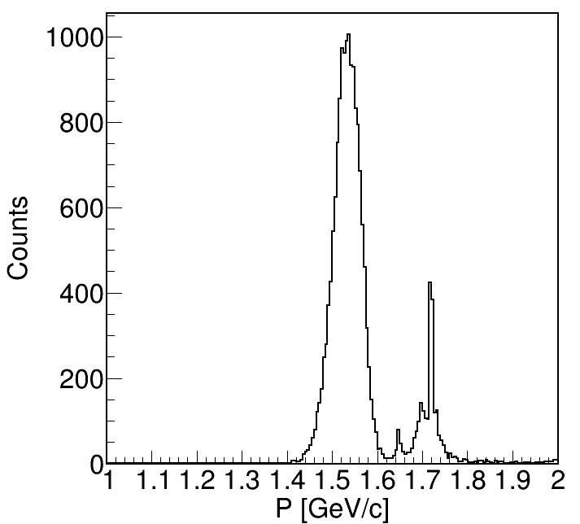
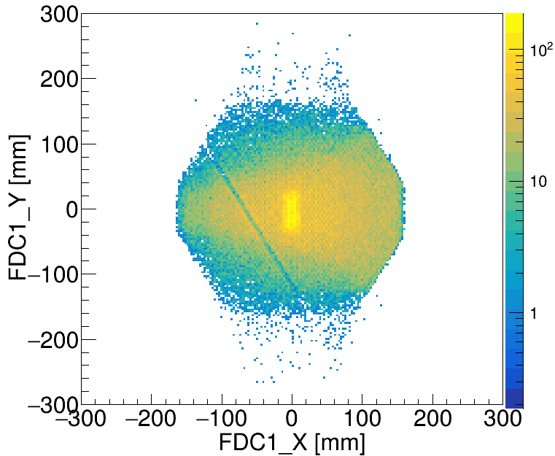
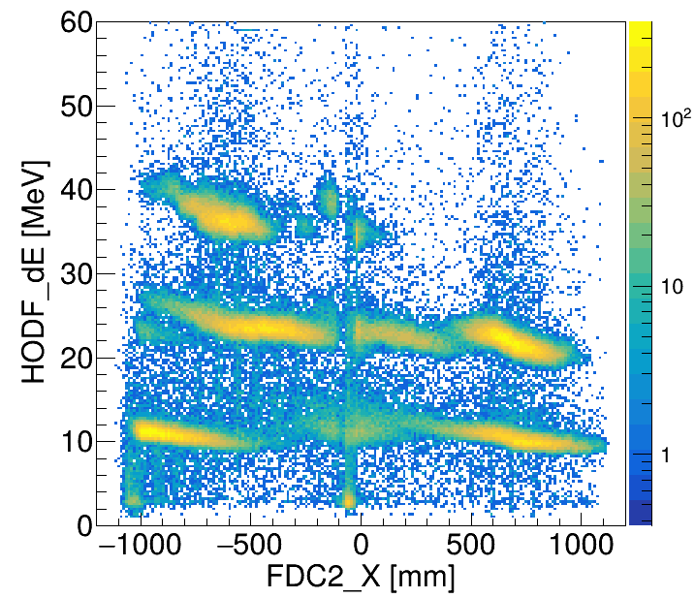
Charged Particle PID and Momentum Reconstruction
Runge-Kutta重建步骤：
Local track fits in FDC1 & FDC2 (χ²/ndf < 3)
Seed at the HOD plane from FDC2: position, angle, p₀
RK4 backward through the 3-D field map;
fit (x, y, u, v, q = Q/p) to FDC hits by χ²
At the target: vertex, momentum, path length → Bρ → A/Q (with TOF)
¹⁰Be+Liq.H
Y:X on FDC1
△E(HODF): FDC2_X
⁹Be
⁹Be
⁹Be
⁷Li
⁸Li
⁹Li
⁷Li
⁸Li
⁹Li
⁴He
⁴He
⁶He
⁶He
Charged particle PID and momentum distribution
DREB meeting

Slide 8
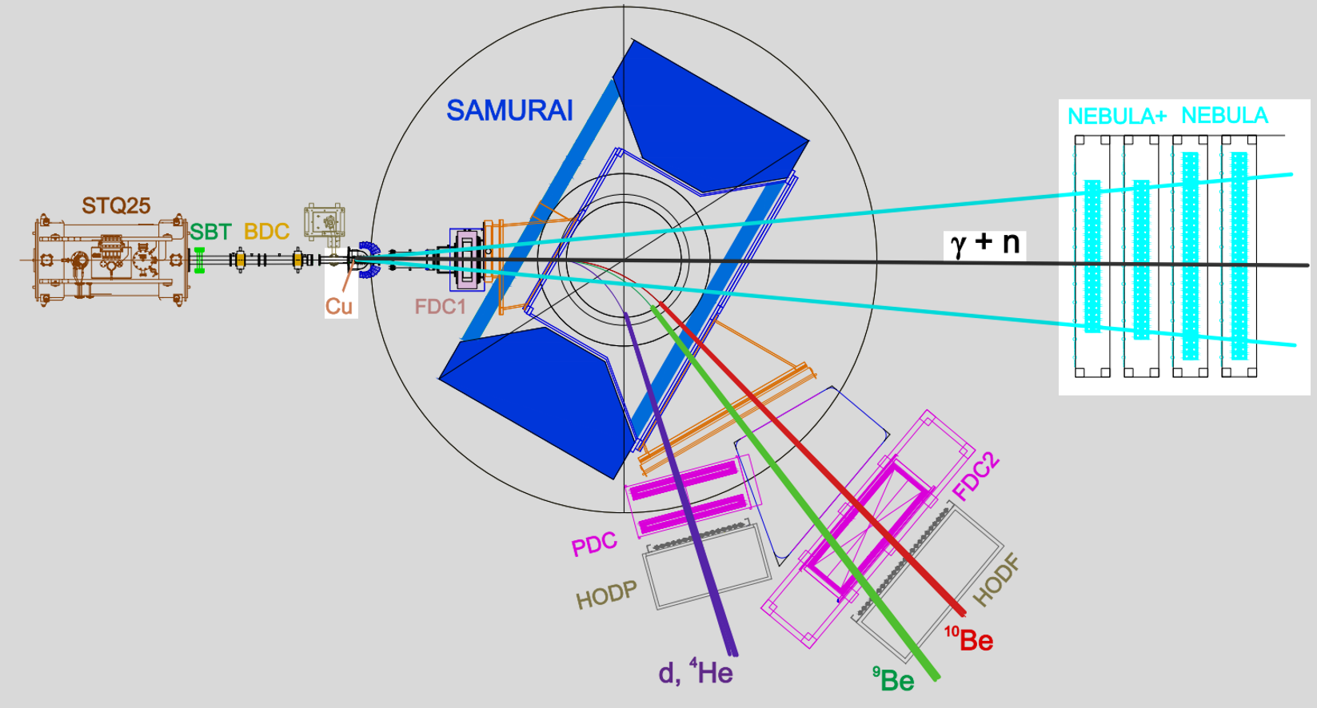
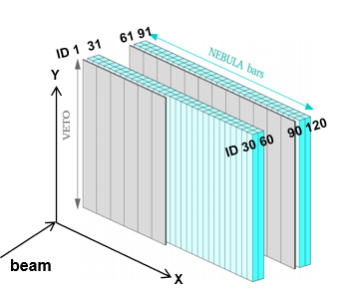
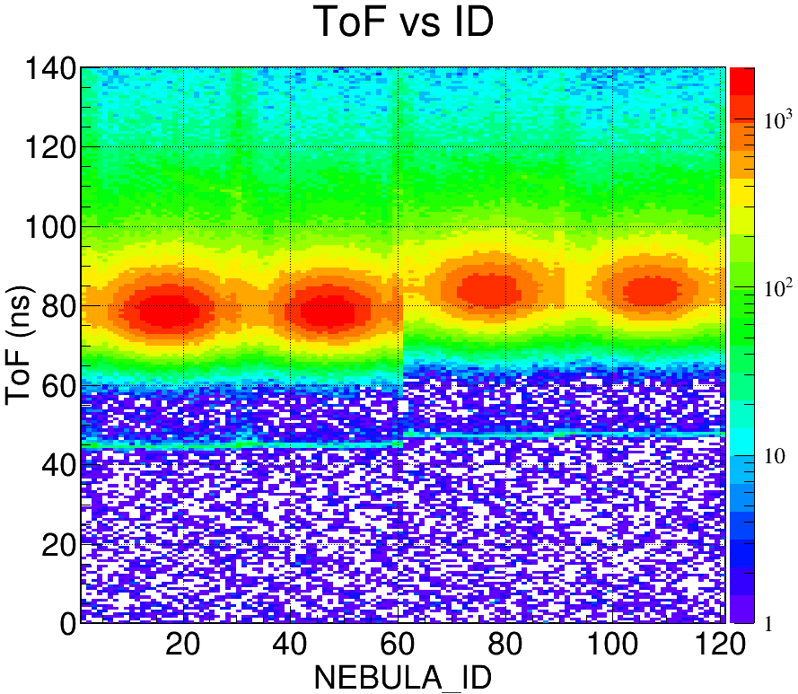
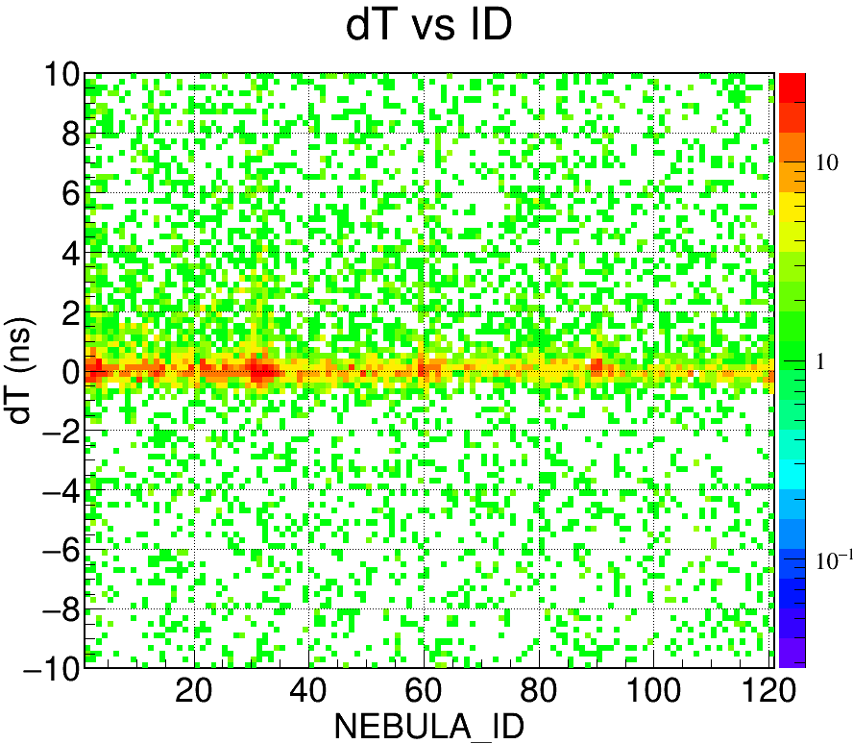
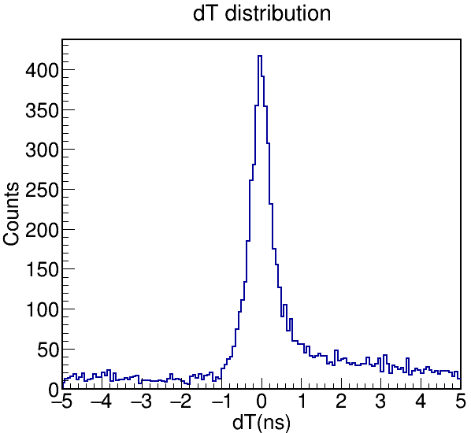
Neutron Detector Analysis
¹⁰Be+Cu
The neutron time-of-flight of NEBULA has been corrected and aligned, and the γ time resolution is σ = 258 ps.
DREB meeting

Slide 9
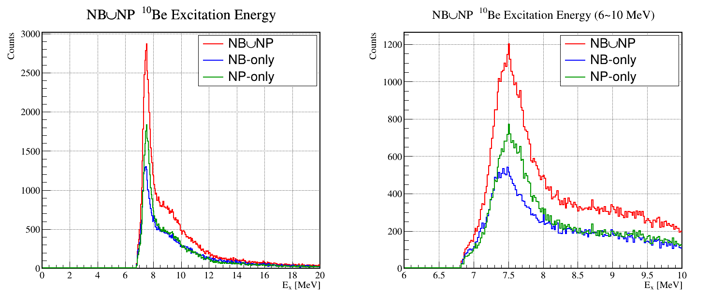
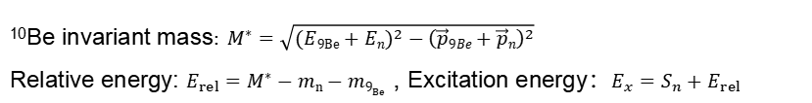
Preliminary Result: Invariant Mass Spectrum
¹⁰Be Invariant Mass Calculation
¹⁰Be invariant mass$: M^{∗}=\sqrt{{(E9Be+En)}^{2}−{\left(\vec{p}9Be+\vec{p}n\right)}^{2}}$
Relative energy: $E_{rel}=M^{∗}−mn−m9_{Be}$ , Excitation energy：$E_{x}=S_{n}+E_{rel}$
Invariant mass spectrum with ⁹Be+n
J. Chen, et al., Phys. Rev. Lett. 134: 012502 (2025).
https://www.nndc.bnl.gov/
The ⁹Be + n invariant-mass spectrum shows a single peak-like structure centred at Eₓ ≈ 7.37 MeV, with σ(Eₓ) = xx keV (FWHM ≈ xx keV).
DREB meeting

Slide 10
Summary
First ⁹Be + n coincidence measurement of ¹⁰Be above the neutron threshold — RIBF/RIKEN, SAMURAI, ¹⁰Be at 230 MeV/u (2×10⁵ pps, 93% purity) on a liquid-hydrogen target.
Excitation-energy spectrum extracted from ⁹Be + n coincidences by the invariant-mass method, Eₓ = 6.8–10 MeV.
A peak-like structure centred at Eₓ ≈ 7.37 MeV with σ ≈ xx keV: the 7.27 / 7.37 / 7.54 MeV triplet is not resolved, and the individual yields are not yet extracted.
Next: empty-target subtraction + acceptance correction → dσ/dΩ
DREB meeting

Slide 11
Thank you for your attention!

