Slide 1
ARCHITECTURAL COMPARISON · VISION MODELS
ResNet vs. Vision Transformers
From residual skip-connections to patch-wise self-attention
Reid · Master's Student, Particle & Nuclear Physics
Institute of Modern Physics, Chinese Academy of Sciences (via UCAS)
April 2026
Sources: He et al. (2016) · Dosovitskiy et al. (2021)

Slide 2
AGENDA
Outline
1
Motivation
Pre-2020 CNN paradigm and the transformer challenge
5
Empirical results
ImageNet top-1 accuracy across configurations
2
ResNet architecture
Residual learning, bottleneck block, depth scaling
6
Scaling behavior
Performance vs. pre-training data size
3
Vision Transformer
Patch embedding, self-attention, classification head
7
Compute trade-offs
TPUv3-core-days vs. accuracy
4
Mathematical formulation
Residual identity vs. Eqs. 1–4 of Dosovitskiy et al.
8
Inductive biases
What ViT must learn that CNNs bake in
9
Discussion & references
Where each architecture wins, and why
§2 Outline
2 / 12

Slide 3
§1 MOTIVATION
Motivation: Can transformers replace CNNs in vision?
Pre-2020 vision paradigm
Convolutional networks dominated since AlexNet (2012); ResNet (2016) became the canonical backbone across classification, detection, and segmentation.
Built-in inductive biases: locality, translation equivariance, and hierarchical feature composition.
The central question
Can a pure transformer—with no convolutional inductive bias—match or surpass state-of-the-art CNNs on ImageNet-scale classification?
Dosovitskiy et al. (ICLR 2021): “When pre-trained at sufficient scale, our best model reaches 88.55% top-1 on ImageNet and exceeds ResNet-based baselines on all evaluated datasets.”
Sources: Dosovitskiy et al., ICLR 2021, §1 & §4 (arXiv:2010.11929).
§1 Motivation
3 / 12

Slide 4
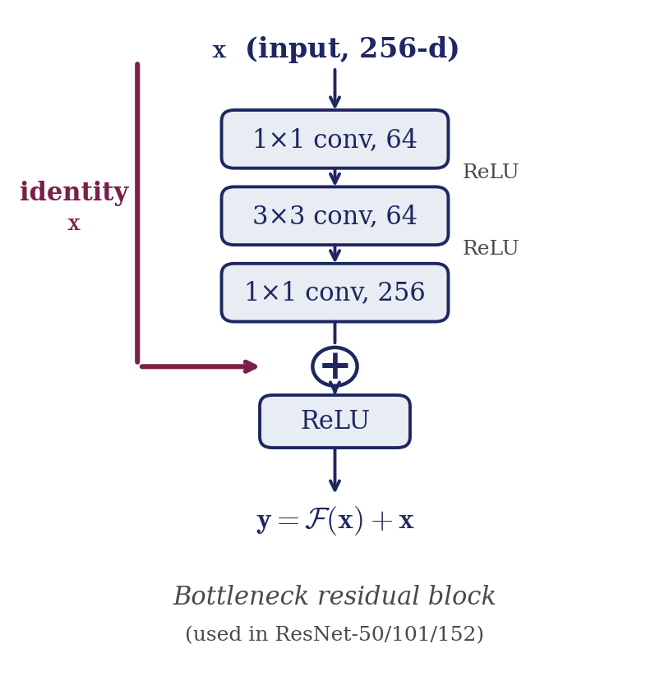

§2 RESNET
ResNet: residual learning with identity skip connections
Key innovation
Instead of fitting H(x) directly, a block fits the residual F(x) = H(x) − x and adds back the identity. Skip connections carry gradients unchanged, enabling stable optimization up to 152+ layers.
Model | Layers | FLOPs (×10⁹) | Top-1 err. (%)
ResNet-50 | 50 | 3.8 | 20.74
ResNet-101 | 101 | 7.6 | 19.87
ResNet-152 | 152 | 11.3 | 19.38
Sources: He et al., CVPR 2016, Tables 1 & 4 (single-model, multi-scale testing).
§2 ResNet architecture
4 / 12

Slide 5
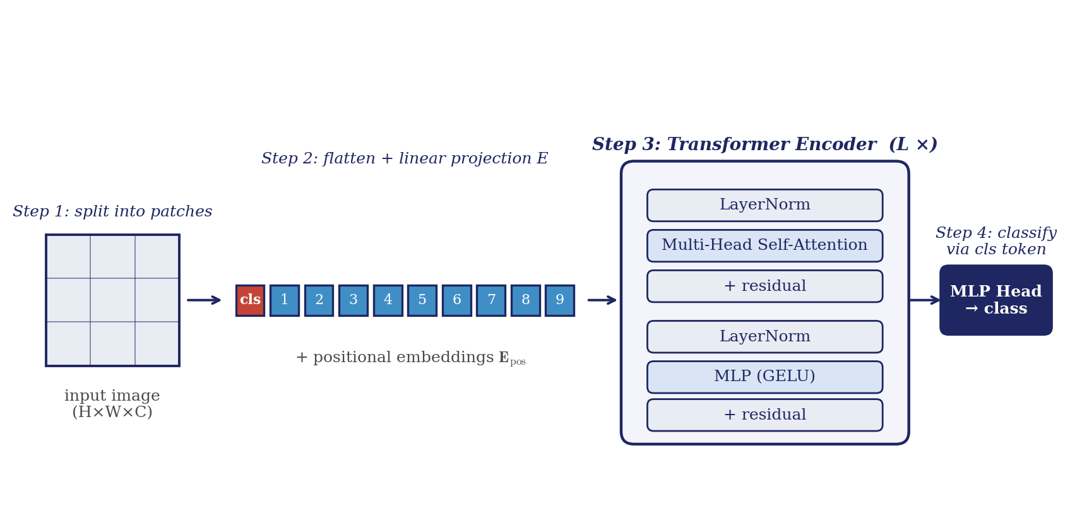
§3 VIT
Vision Transformer: image as a sequence of 16×16 patches
Variant | Layers | Hidden D | MLP size | Heads | Params
ViT-Base | 12 | 768 | 3 072 | 12 | 86 M
ViT-Large | 24 | 1 024 | 4 096 | 16 | 307 M
ViT-Huge | 32 | 1 280 | 5 120 | 16 | 632 M
No conv, no pooling.
Inductive bias beyond “2-D patch structure + position” is learned from data. Consequence: strong dependence on pre-training scale.
Sources: Dosovitskiy et al., ICLR 2021, Fig. 1 & Table 1 (model variants).
§3 Vision Transformer
5 / 12

Slide 6




§4 EQUATIONS
Mathematical formulation
ResNet — identity mapping
Vision Transformer — patch + attention
He et al., CVPR 2016 (Eq. 1)
Dosovitskiy et al., ICLR 2021 (Eqs. 1–4)
• F(x, {W_i}) is the residual mapping (2–3 stacked conv layers). • Identity shortcut adds zero additional parameters when input/output dims match. • Gradients flow through unchanged, mitigating the degradation problem observed in plain nets > 20 layers.
Input z₀ concatenates a learnable [cls] token with N patch embeddings plus positional encoding.
Sources: He et al., 2016 (Eq. 1); Dosovitskiy et al., 2021 (Eqs. 1–4).
§4 Mathematical formulation
6 / 12

Slide 7
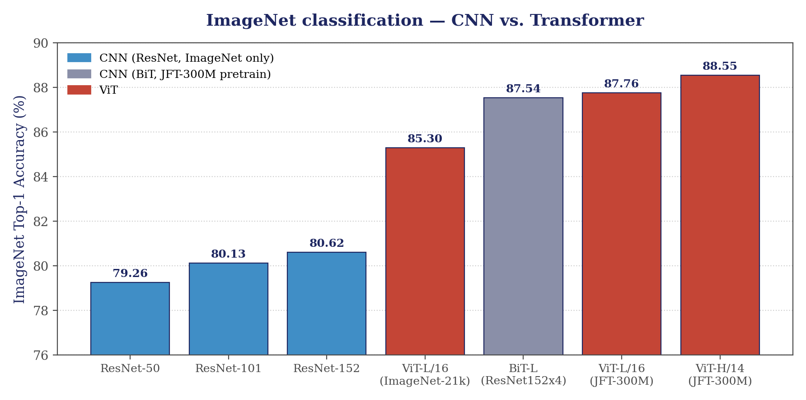
§5 BENCHMARK
Empirical results: ImageNet top-1 accuracy
Key observations
ResNet-152 (ImageNet-only training): 80.62% top-1.
ViT-L/16 reaches 85.30% with ImageNet-21k pre-training, exceeding ResNet-152 by ~4.7 pp.
With JFT-300M pre-training, ViT-H/14 hits 88.55% — above every CNN baseline tested.
Sources: He et al., 2016 (Table 4); Dosovitskiy et al., 2021 (Table 2); BiT: Kolesnikov et al., 2020.
§5 Empirical results
7 / 12

Slide 8
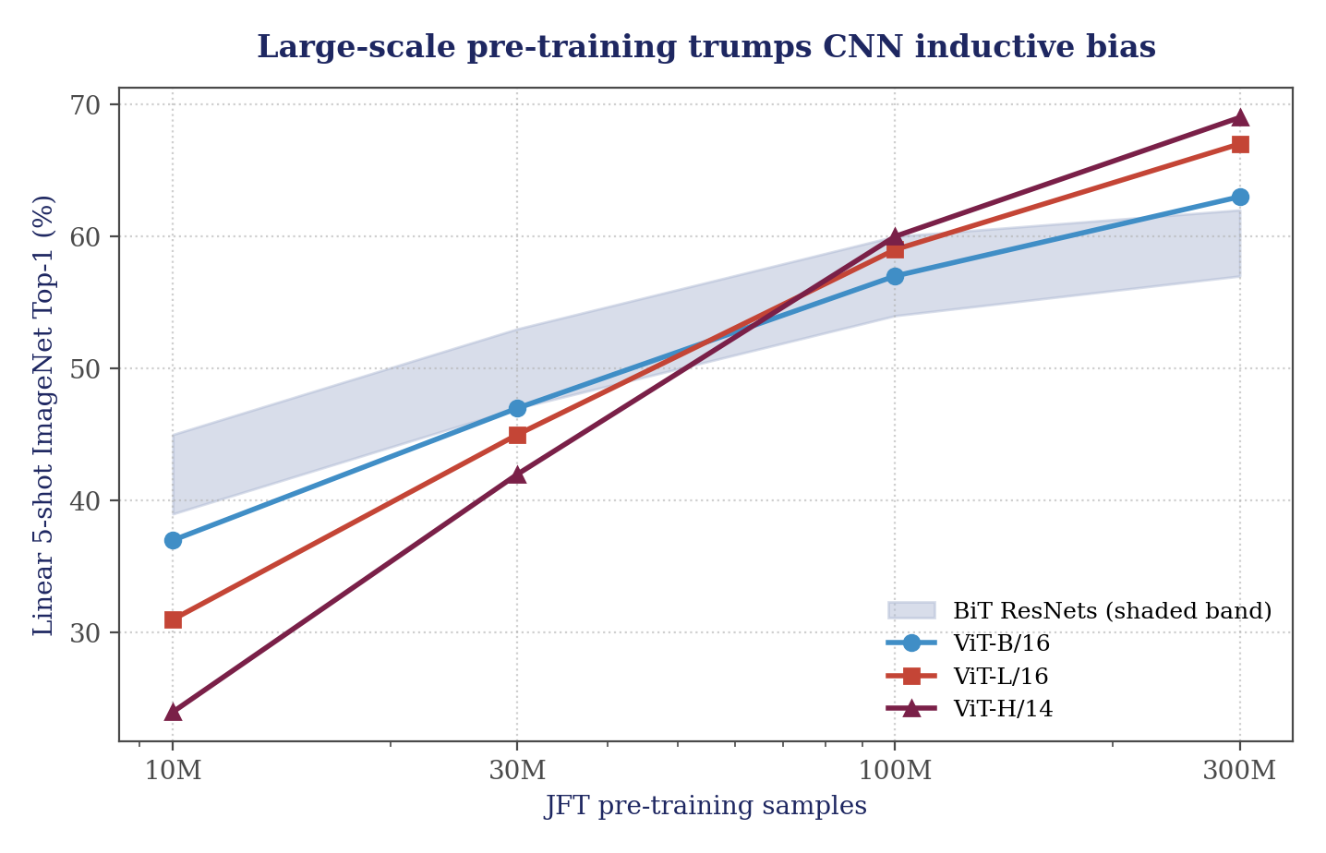
§6 DATA SCALING
Scaling behavior: pre-training data is the deciding factor
“Large-scale training trumps inductive bias.”
— Dosovitskiy et al., 2021, §1
On small pre-training sets (ImageNet only, ~1 M), ResNets still win: ViT underperforms without enough data.
Past ~100 M samples, ViT curves overtake the BiT-ResNet band and keep rising.
Larger ViTs (H/14) gain more from extra data than smaller (B/16) — consistent with the scaling-law picture in NLP.
Source: Dosovitskiy et al., 2021, Figure 3 (right panel, linear-5-shot ImageNet evaluation). Curves shown are a stylized reproduction — exact tabular values are not published.
§6 Scaling behavior
8 / 12

Slide 9
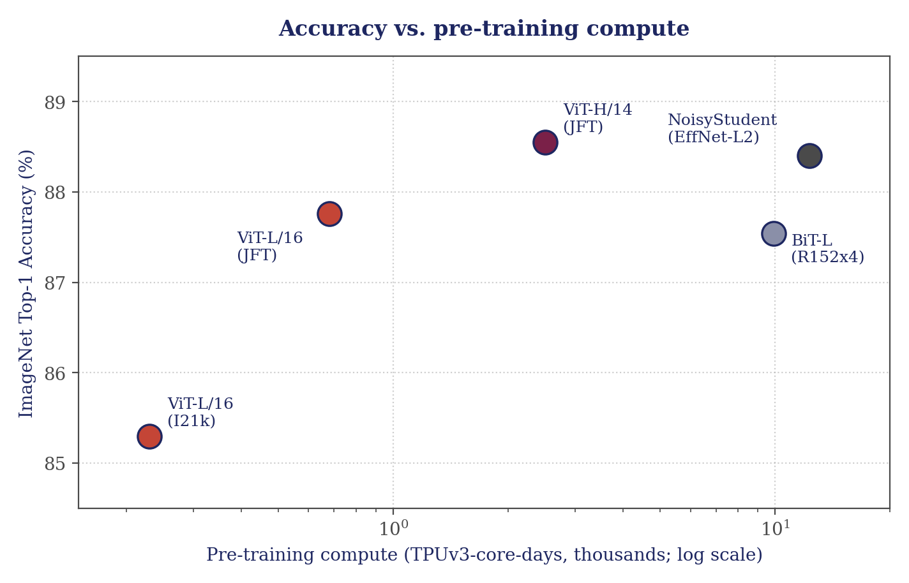
§7 COMPUTE
Compute cost: ViT is Pareto-efficient at scale
ViT-H/14 pre-training cost
2.5k
TPUv3-core-days
BiT-L (ResNet152×4)
9.9k
TPUv3-core-days
NoisyStudent (EffNet-L2)
12.3k
TPUv3-core-days
Source: Dosovitskiy et al., 2021, Table 2 (TPUv3-core-days row, thousands).
§7 Compute trade-offs
9 / 12

Slide 10
§8 BIASES
Inductive biases: what each architecture assumes
Bias / property | ResNet (CNN) | Vision Transformer | Consequence
Locality | Built-in (3×3 conv) | Absent — attention is global | CNN captures local texture cheaply; ViT can attend long-range from layer 1.
Translation equivariance | Built-in (shared conv kernels) | Only via positional embedding | CNN generalizes to shifts; ViT must learn shift behavior from data.
Hierarchical features | Built-in (strided downsampling) | Flat — constant token count across depth | CNN matches classical vision pyramid; ViT mixes global info early.
Weight sharing | Spatial (kernels) | Across tokens (attention + MLP) | Different axis of sharing; both reduce parameter count effectively.
Data efficiency | Strong on ≤ 1 M images | Weak ≤ 1 M; strong ≥ 100 M | ResNet wins small-data; ViT wins large-pretraining regime.
Framing from Dosovitskiy et al., 2021, §3.1; data-regime claim per Fig. 3 (ibid.).
§8 Inductive biases
10 / 12

Slide 11
§9 DISCUSSION
Discussion: when to choose which
Choose ResNet (or CNN-like) when...
Choose ViT when...
Training data is limited (≤ 1 M images) and no large pre-trained backbone fits the domain.
Deployment targets low compute (edge/TPU-small) and tight latency budgets.
The task benefits from explicit locality: detection, segmentation of small objects, medical imaging.
Mature transfer recipes (ImageNet pre-train + fine-tune) are already baked into the pipeline.
Massive pre-training data (≥ 100 M samples, JFT-scale) or a publicly available ViT backbone is accessible.
The task rewards long-range dependencies — scene understanding, document images, video.
You can afford pre-training compute (hundreds to thousands of TPU-core-days) or reuse foundation weights.
You plan to unify vision with other modalities (CLIP, DINO, multimodal LLMs).
§9 Discussion
11 / 12

Slide 12
§10 REFERENCES
References
[1]
K. He, X. Zhang, S. Ren, J. Sun. Deep Residual Learning for Image Recognition. CVPR 2016, pp. 770–778. arXiv:1512.03385
[2]
A. Dosovitskiy et al.. An Image is Worth 16×16 Words: Transformers for Image Recognition at Scale. ICLR 2021. arXiv:2010.11929
[3]
A. Kolesnikov et al.. Big Transfer (BiT): General Visual Representation Learning. ECCV 2020. arXiv:1912.11370
[4]
Q. Xie, M.-T. Luong, E. Hovy, Q. V. Le. Self-training with Noisy Student improves ImageNet classification. CVPR 2020. arXiv:1911.04252
[5]
A. Vaswani et al.. Attention Is All You Need. NeurIPS 2017. arXiv:1706.03762 (origin of the multi-head attention block reused by ViT)
All numerical claims in this deck are verbatim from the cited primary sources; the scaling chart (slide 8) is a stylized reproduction of Dosovitskiy et al. 2021, Fig. 3.
§10 References
12 / 12

