Slide 1


A Physical-Informed Deep Learning Approach for Data Analysis in MATE
Collaborators:
Hooi Jin Ong
Ningtao Zhang
Zhichao Zhang
Lu Li
Taisen Huang
Enqiang Liu
Institute of Modern Physics, Chinese Academy of Sciences
Zhiheng Hu
Institute of Modern Physics，CAS

Slide 2
Introduction and Physics Motivation
The Bottleneck in Standard ML Method
Physics-Informed Architecture
Validation and Results
Summary: Research Roadmap and timeline
Outline

Slide 3
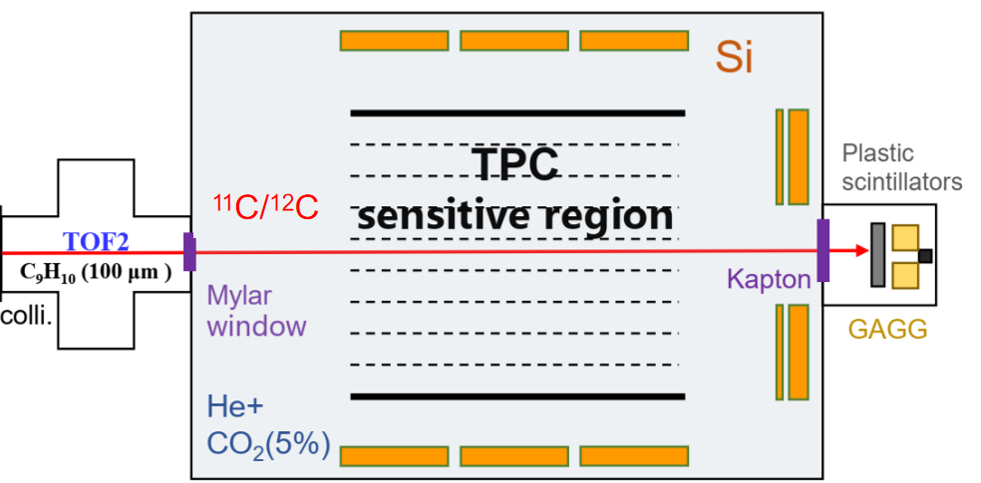
Introduction and Physical Motivation
MATE:
Multi-purpose Active-target Time projection chamber for nuclear astrophysical and exotic beam Experiments
RIBLL1@HIRFL
Challenges ：
Each experiment generates several TBs data, and how to extract useful information from this massive amount of data becomes a key issue.
High sampling rate
The subjectivity and potential biases.
Limitations of conventional tracking algorithms (e.g., Hough Transform) in low S/N environments.
Manual tuning of cut parameters leading to non-reproducible results.
Ambiguity in Isotope Identification
Intricate event topology
Notes:
Among the detection technologies, the Active Target TPC (AT-TPC) has become a game-changer. By using the detector gas as the reaction target, it achieves high luminosity and full 4-pi coverage, making it ideal for experiments with weak radioactive beams.
Specifically, the MATE detector at IMP is designed for this exact purpose—to study nuclear astrophysics and exotic beams.
However, this powerful capability comes with a challenge:
Therefore, we need to develop a new data processing paradigm—machine learning.
Machine learning is penetrating fundamental nuclear physics research , yielding many successful applications both experimentally and theoretically.

Slide 4
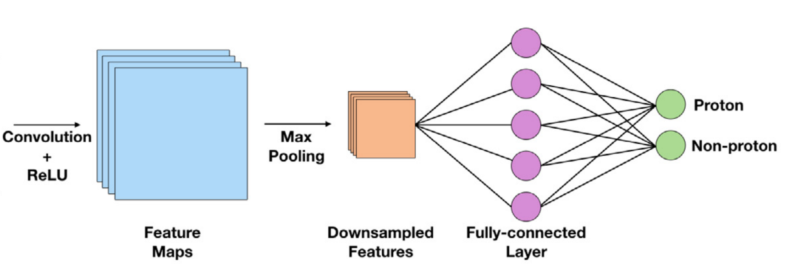
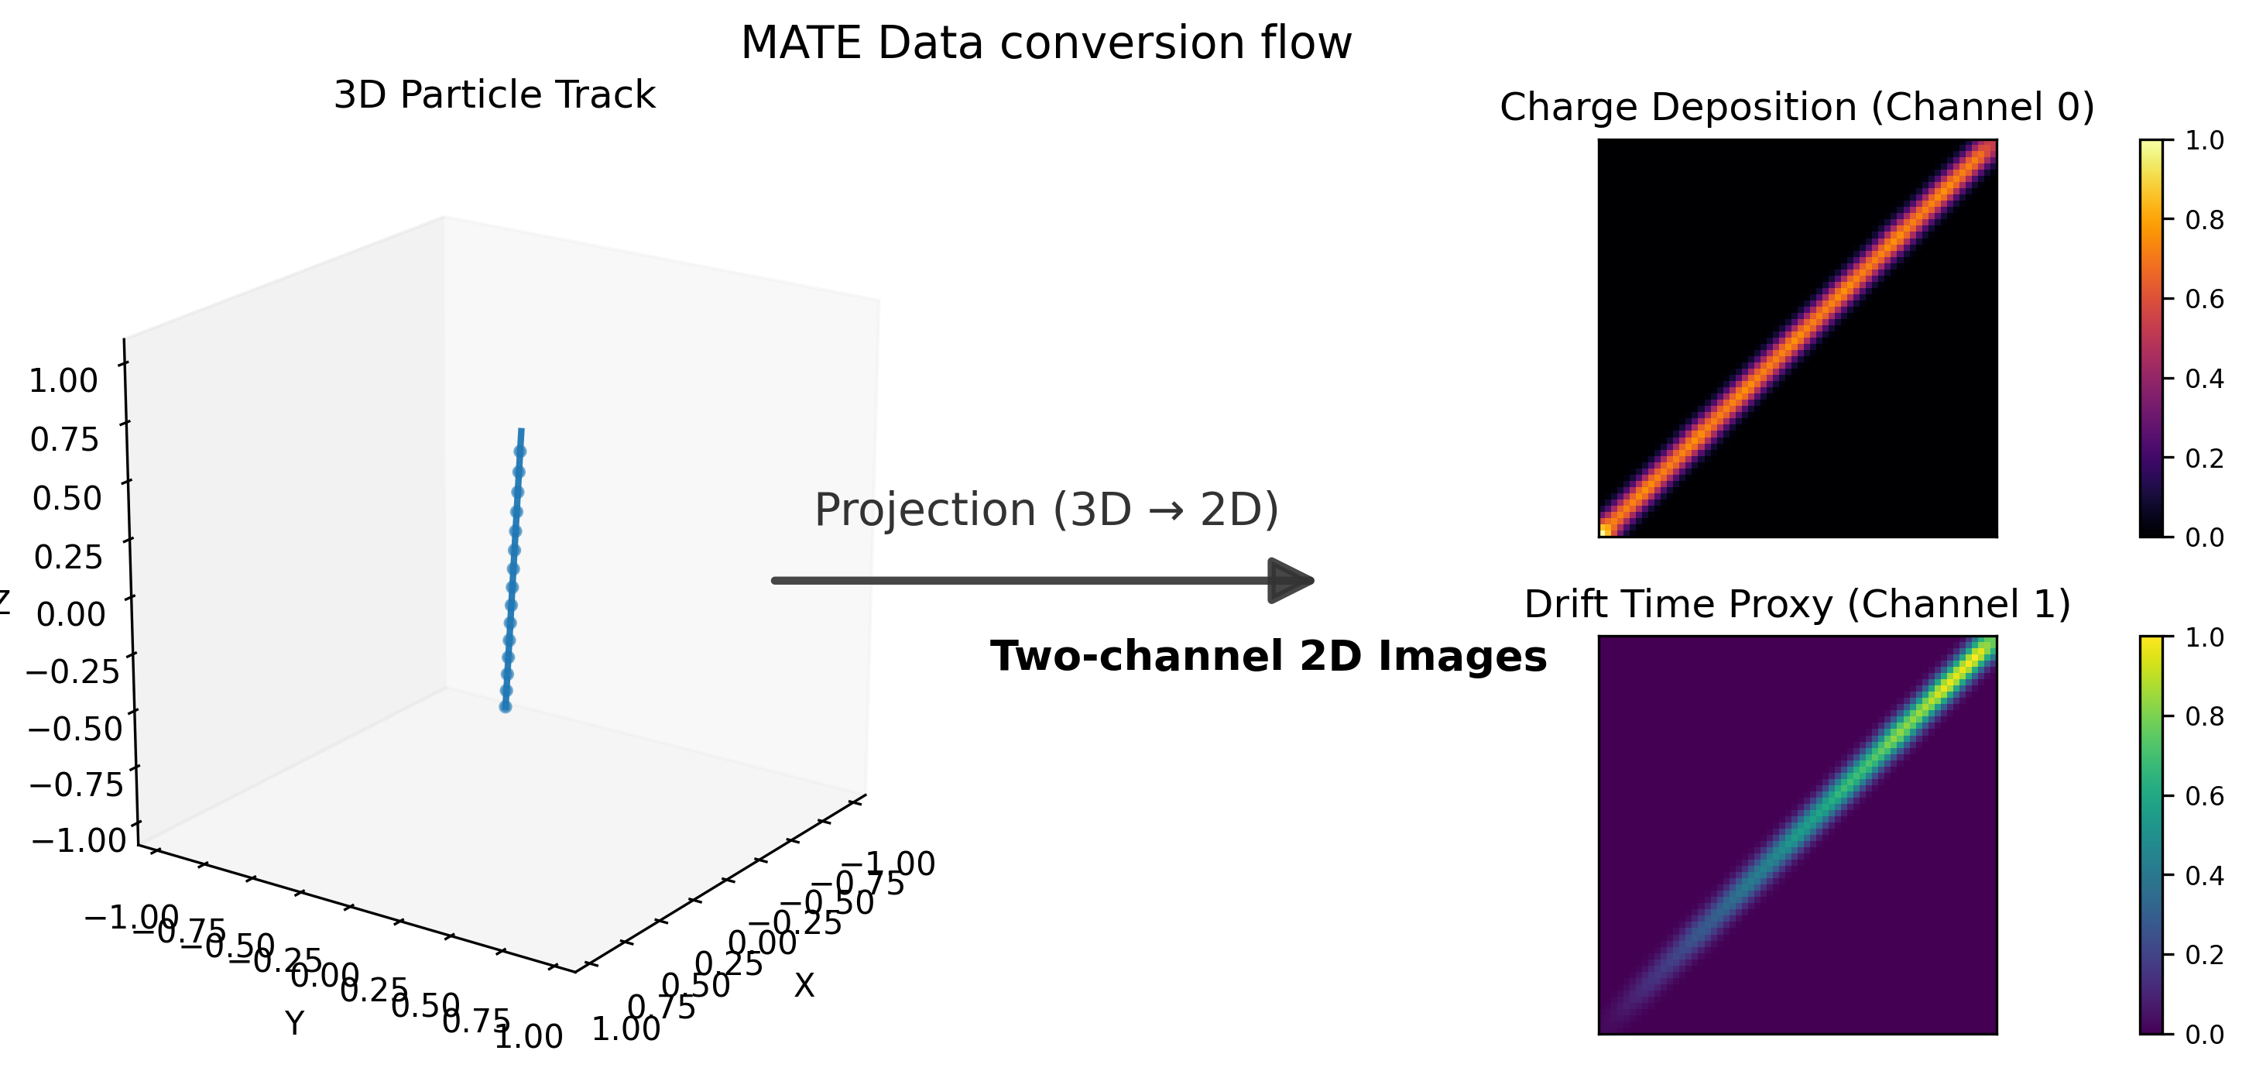
Methodology: Convolutional Neural Networks (CNN) for MATE data
CNN general architecture
  Feature Extraction
    input (pre-processing)
    layers
  Classification
Simulation Data with MATESIM toolkit
Simulated Data
  64×64 Resolution
  Geant4 Framework
3D track → 2D image
  Charge deposition
  Drift time
MATE Data (simulation) Conversion Flow
CNN Work Flow Schematic
z
FCNN
M.P. Kuchera et al. NIMA(2019)
Feature Extraction
Classification
Notes:
In our case, we use the simulation data generated from the MATESIM toolkit. And it comprises two part: 15k proton events (¹²C(p, p) ¹²C) and 15k non-proton events(¹²C(p, α)⁹B).
The data format generated by the simulation is different from the data format that the model can process. The former is point cloud 3D, and the latter is RGB 2D.
We project the complex 3D track (point cloud) into a 2D information-rich image which represents its charge deposition and drift time.
The information extracted by these layers is also used as the input of FCNN

Slide 5
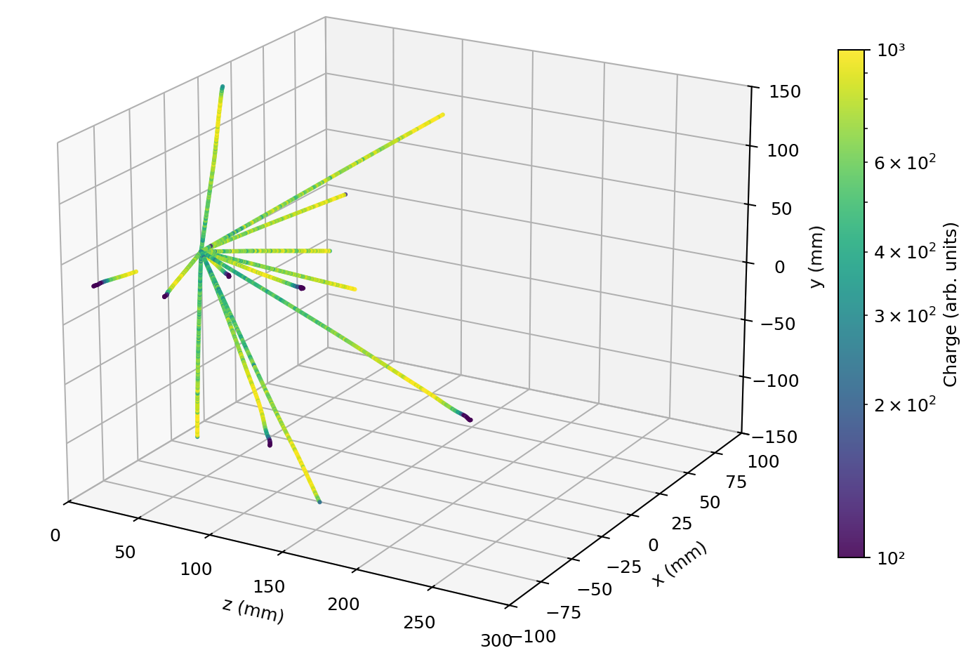
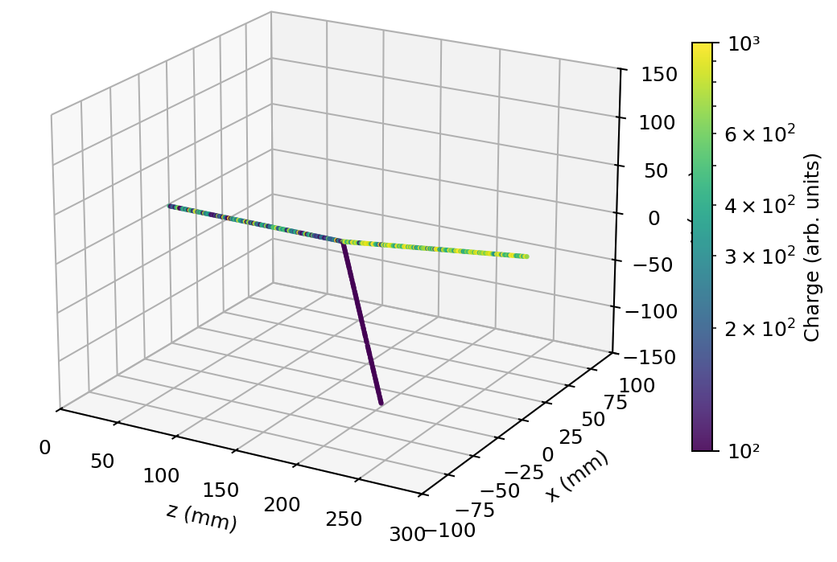
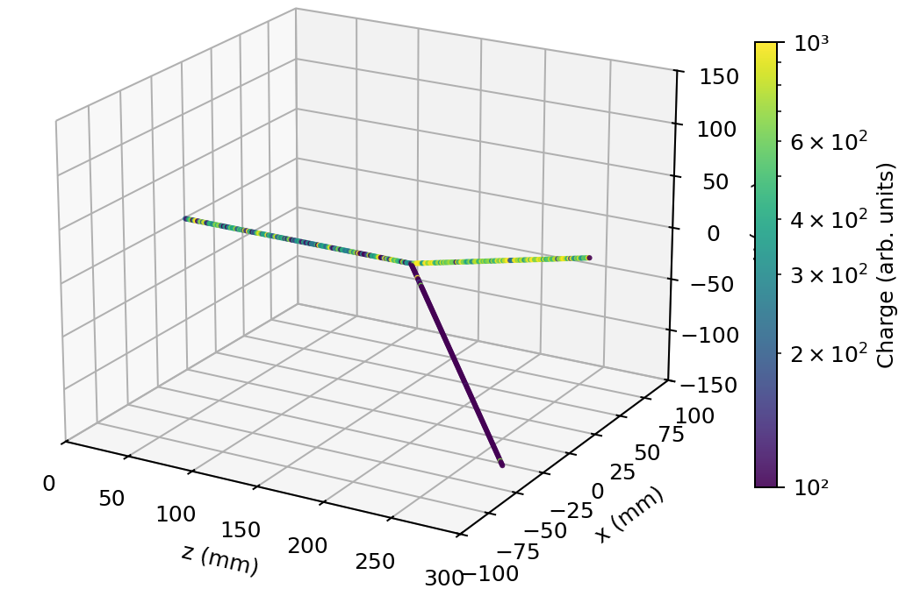
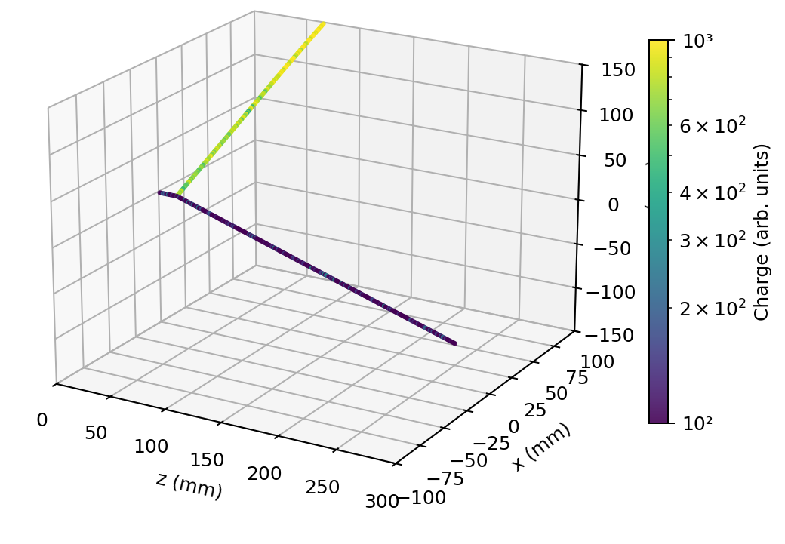
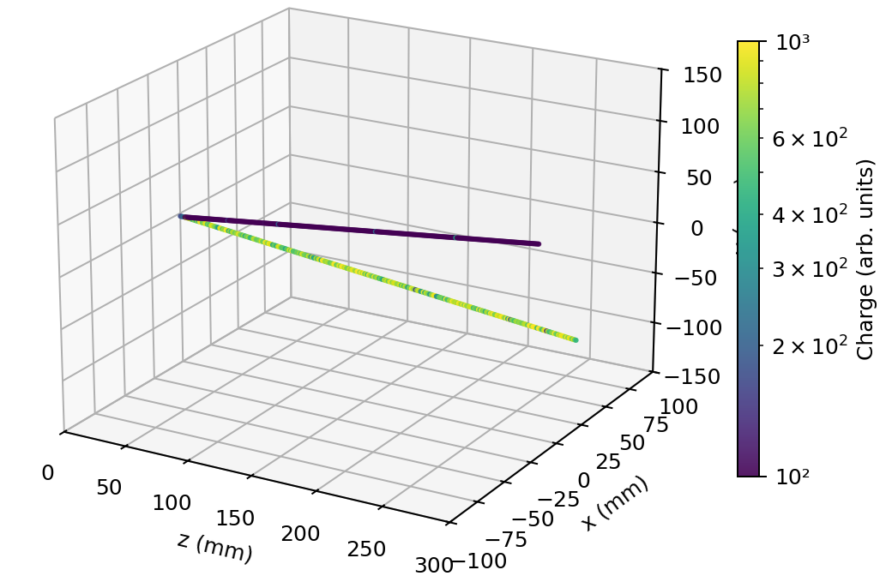
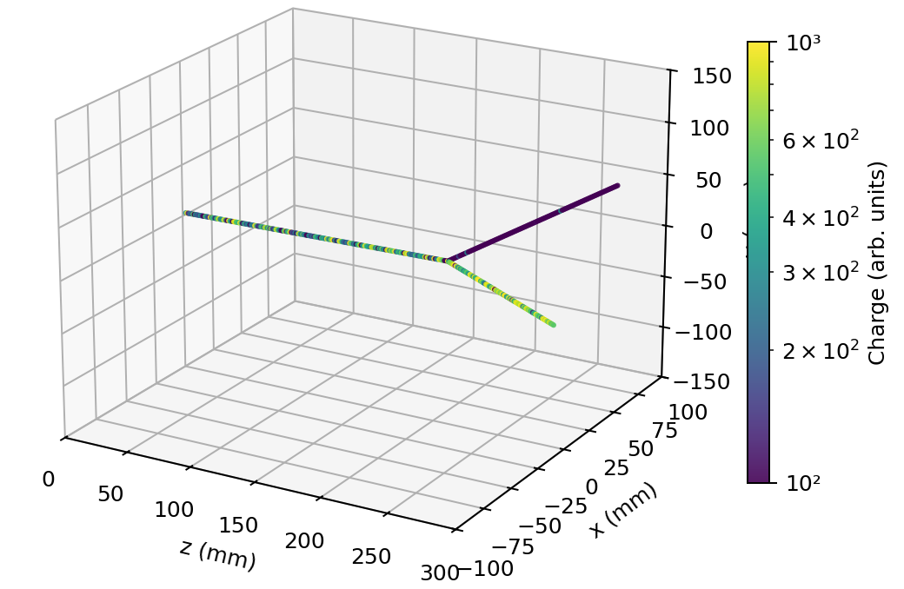
Simulation Dataset(25k per channel)
Task 1
Task 3
(a) Radioactive α Source
(b) Direct Reaction
¹²C + ⁴He→ p + ¹⁵N
(e) Direct Reaction
¹²C + ⁴He→ ³He + ¹³C
Task 2
(c) Elastic Scattering
¹²C + ¹²C→ ¹²C + ¹²C
(d) Elastic Scattering
¹²C + ⁴He→ ⁴He + ¹²C
(f) Elastic Scattering
¹²C + ⁴He→ ⁴He + ¹²C

Slide 6
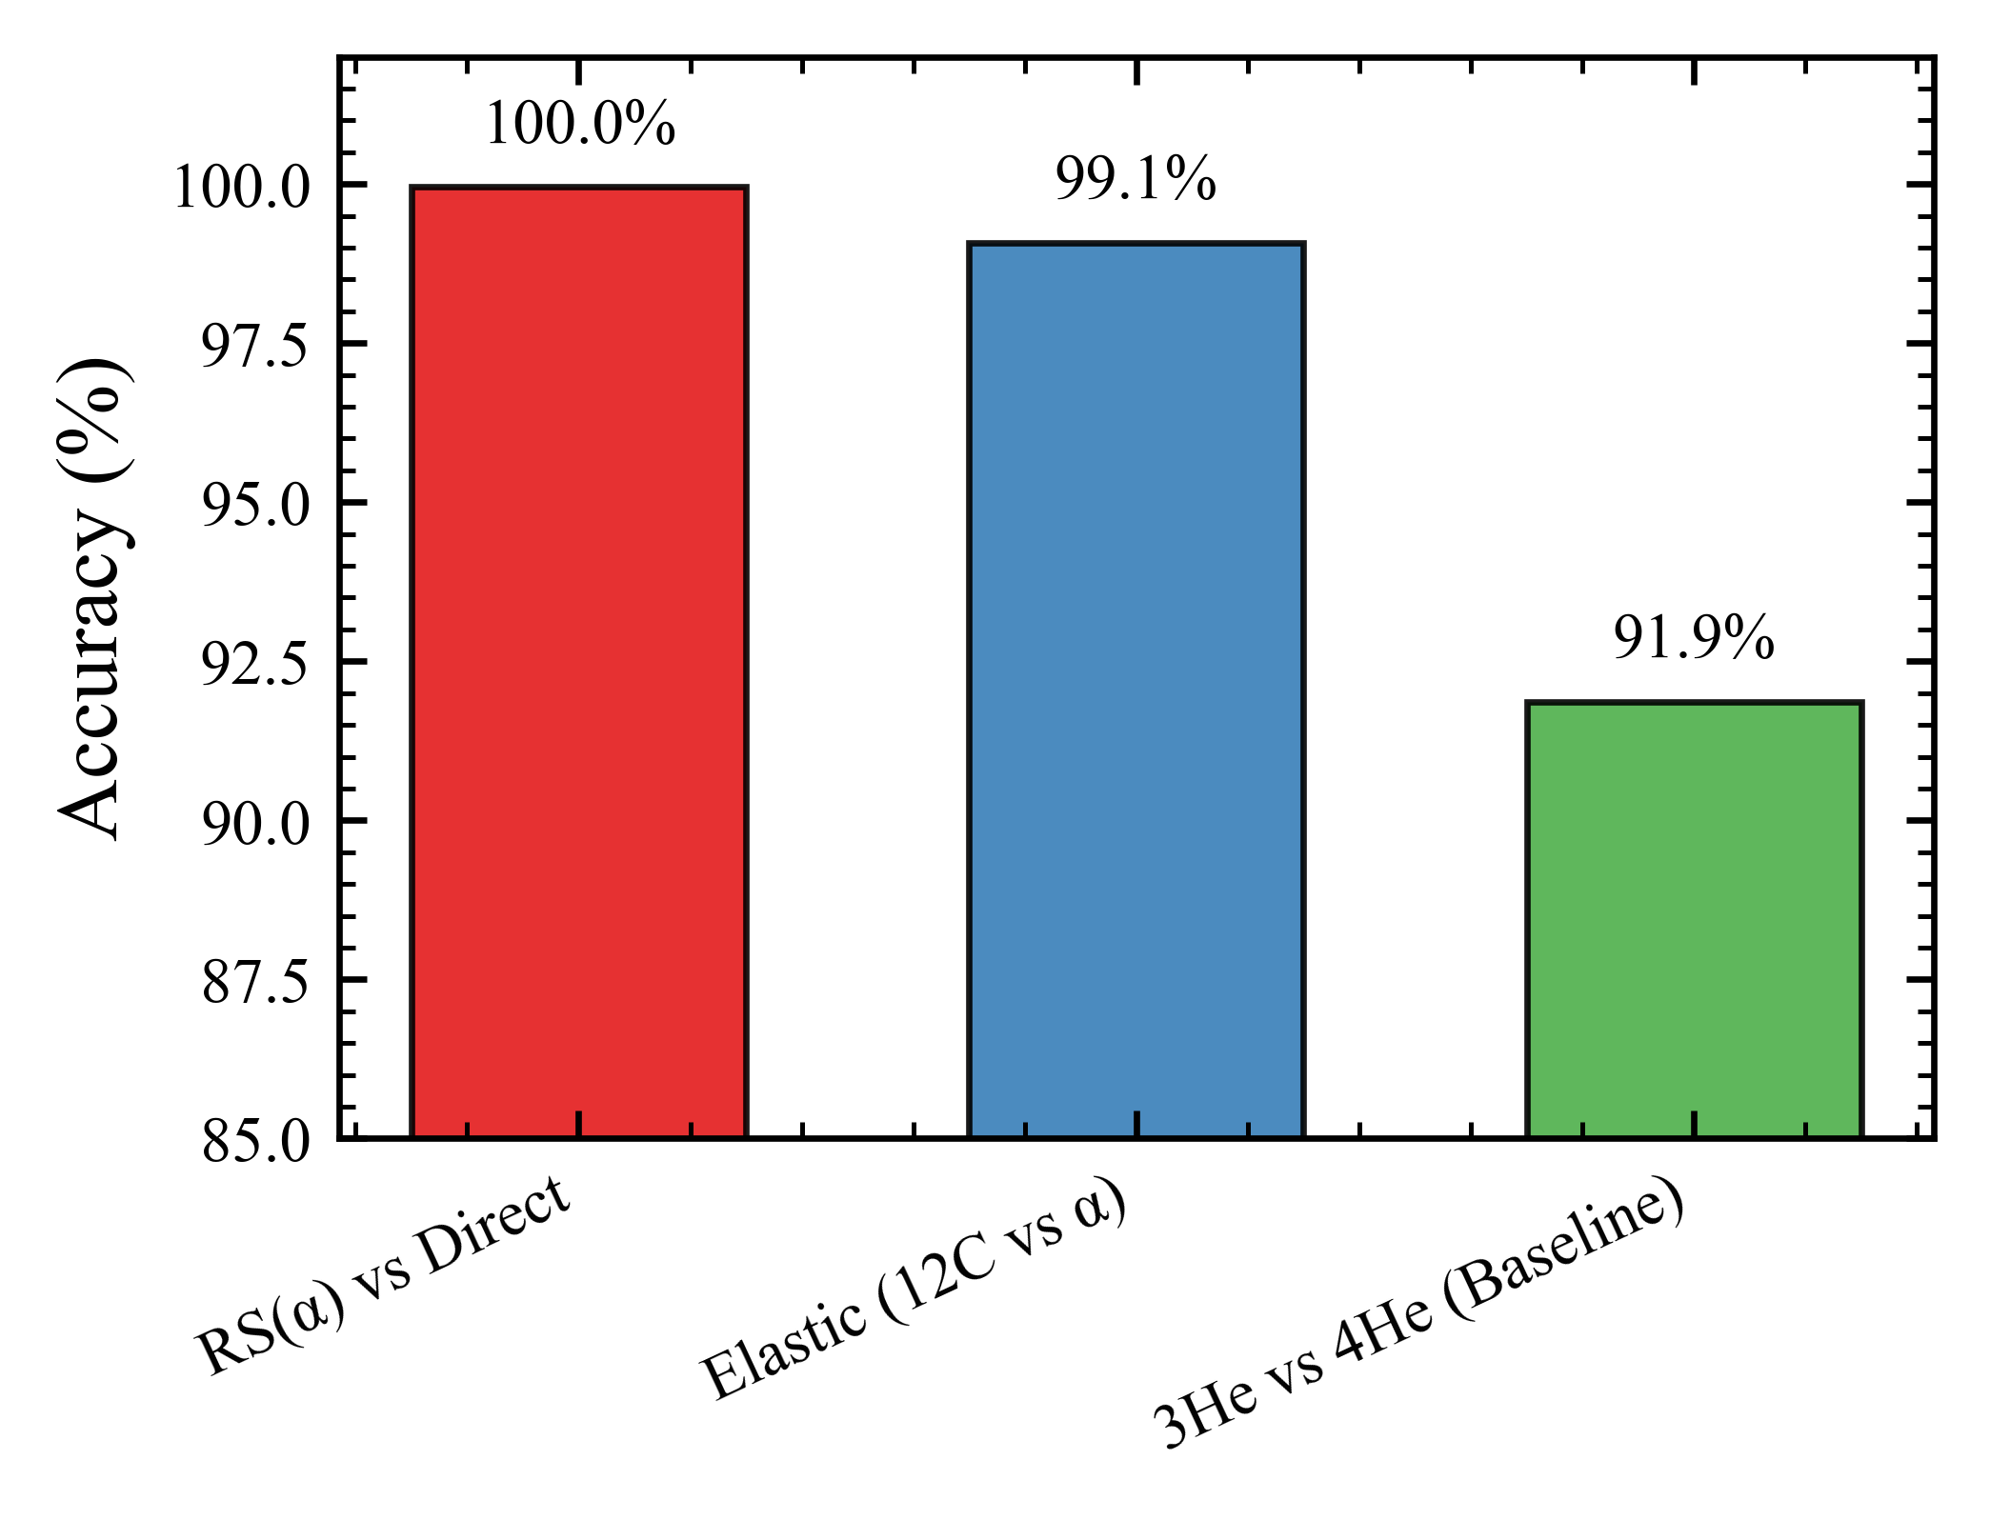
The Baseline and the Bottleneck
In MATE data analysis, the standard deep learning model (ResNet18) can easily handle tasks with large topology-distinct structures, with a high accuracy almost achieved 100%.
The Gap: When the task is transformed into fine-grained isotope identification (³He vs ⁴He), the model performance drops significantly to ~91% due to their similar dE/dx patterns and track features.
Hypothesis :
  Scale of Dataset is inadequate
  The Downsampling process of standard CNN loses vital sapatial details of energey deposition needed to distinguish isotopes .

Slide 7
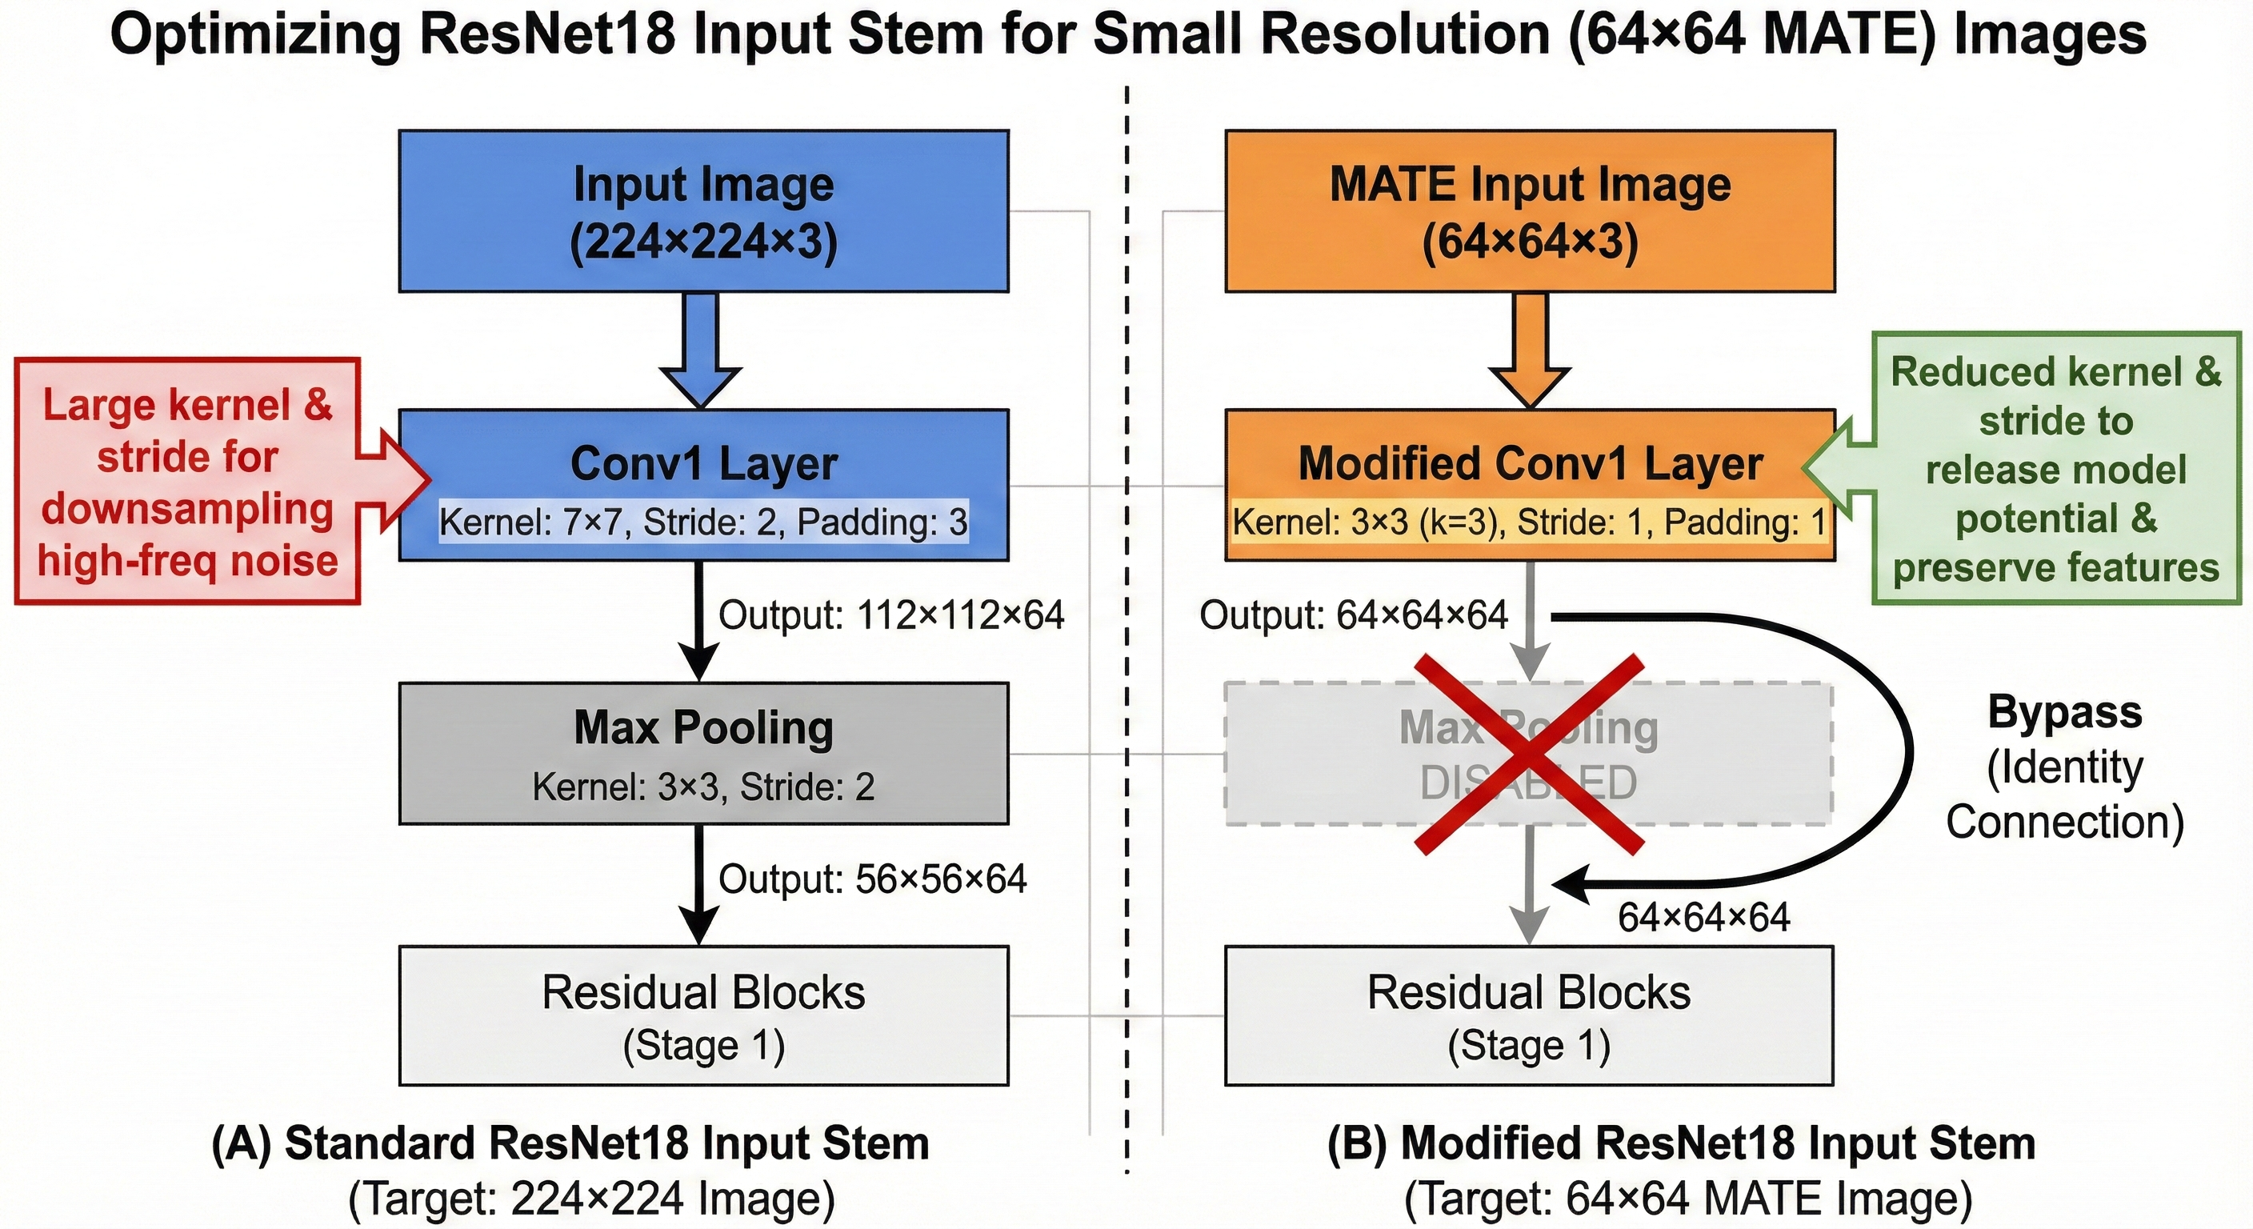
Model Architecture Modification
Standard downsampling (MaxPooling) discards the fine-grained dE/dx information needed for PID
An agressive downsampling strategy
A conservative downsampling strategy

Slide 8
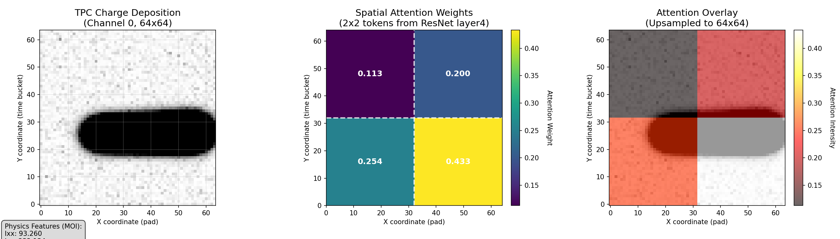
Physics-Informed Cross-Attention CNN
Value
Vector
Matrix Multiplication
Cross-Attention
Workflow Schematic
Feature Extraction
Key
Vector
Attention Score Matrix
Context
Vector
Classification
(FCNN)
Query
Vector
Feature Engineering
(MOI Tensor)
Cross-Attention
Interpretability of Attention Mechanism
0.113
0.200
0.254
0.433
Notes:
Use physical knowledge to cross-validate the features learned by the model
Compared to Gated Fusion, this approach not only fuses physical information but also inherently provides interpretability.
This interpretability comes from the fact that we can directly see where the model's gaze is.
To gain insight into the decision-making process, we can investigate the attention weights of the last attention layer, just before the final classification.
In terms of specific values, the higher the weight the model assigns to a certain area, the stronger its attention is on the corresponding area.

Slide 9
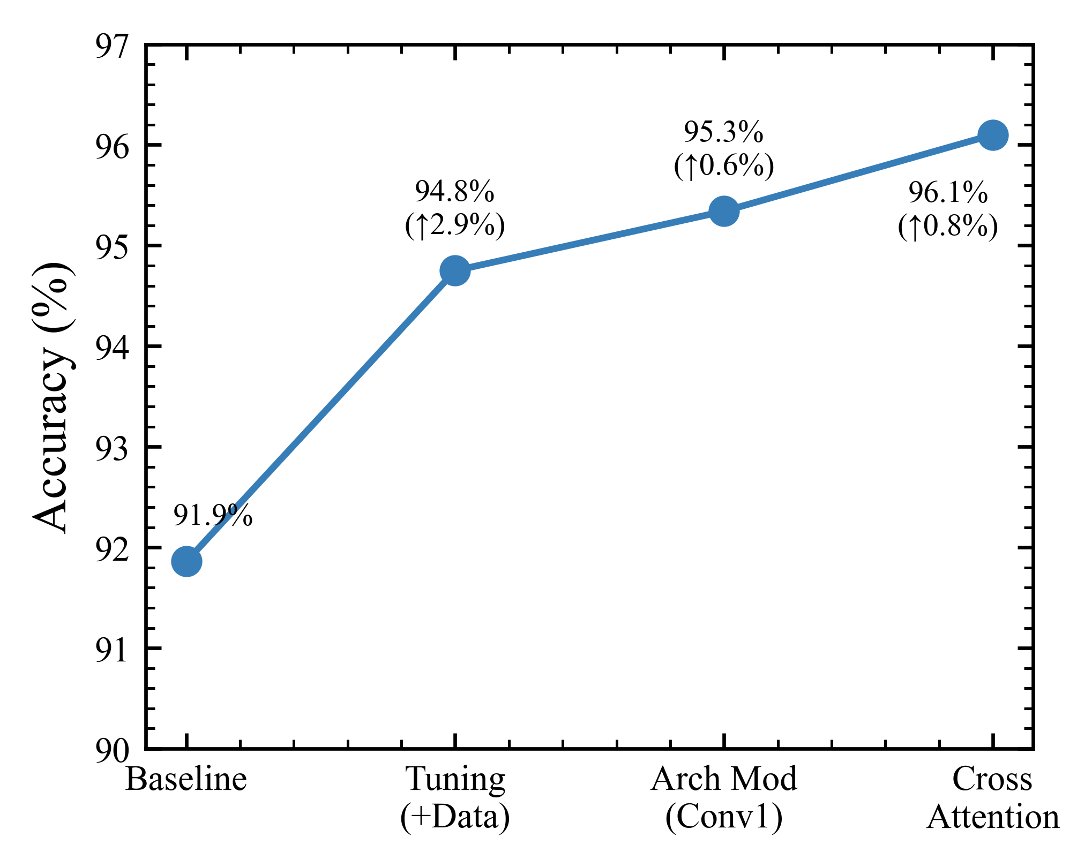
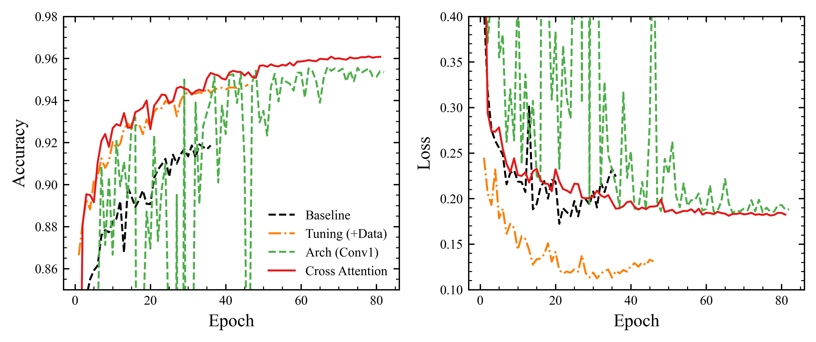
Methodological Evolution and Results
- Phase 1 (Data and Tuning) : Scaled the dataset from 25k per class to 100k per class and optimized hyperparameters.
- Result : Performance improved to 94.75%, but encountered a bottleneck.
- Phase 2 (Architecture Adaptation) : Modified Conv1 and Pooling, reduced premature compression of information
- Result : Performance improved to 95.34%, demonstrated the importance of spatial resolution.
- Phase 3 (Mechanism Innovation) : Introduced Cross-Attention mechanism, utilized physical information to query feature extracted by CNN
- Result : Achieved 96.10%

Slide 10
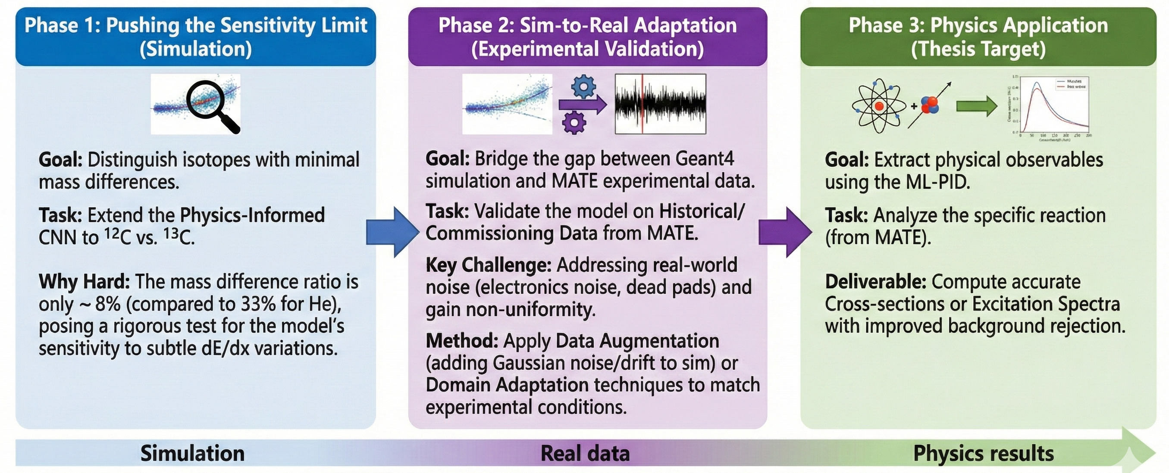
Summary:Research Roadmap and Timeline

Slide 11
Thank You！

Slide 12
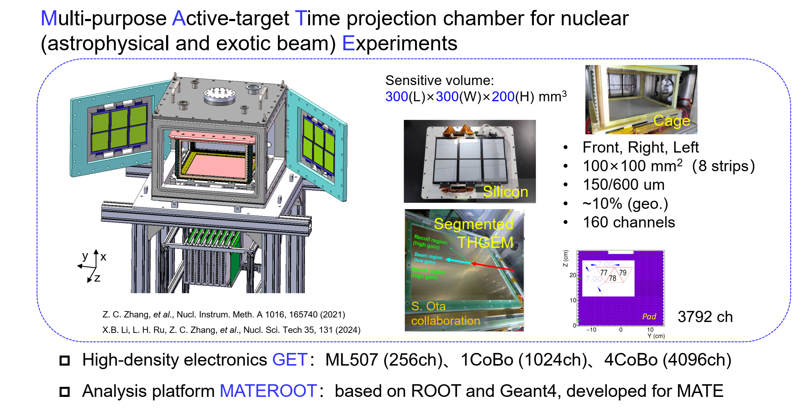
MATE: A new generation detector

Slide 13
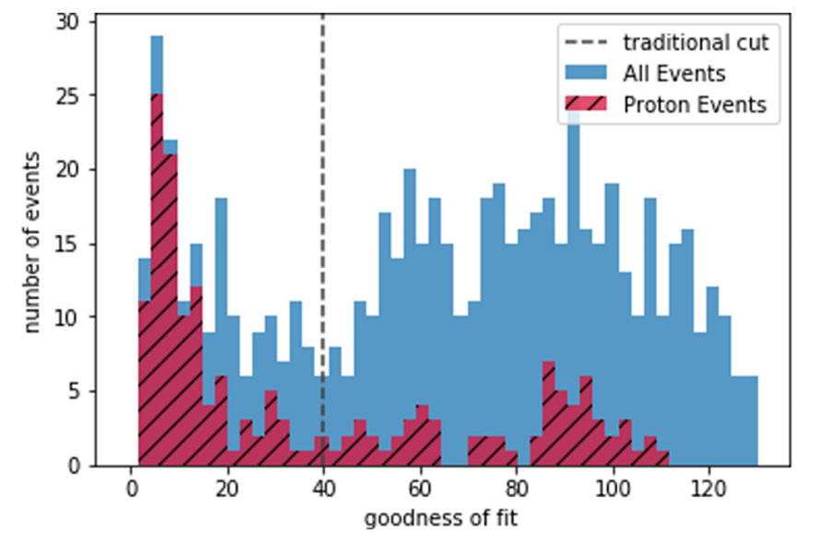
Detailed Motivation
Motivation：
The Data Challenge:
A Tsunami of 3D Point-Cloud Data
The Verification Challenge:
The subjectivity and potential biases of a "one-size-fits-all" standard.
Experiments generate massive and complex datasets.Each event is a 3D point-cloud representing the ionization trail of particles.
The sheer volume of data makes manual analysis extremely challenging.
Efficiently and accurately identifying different reaction events is a major bottleneck.
Maybe another person’s cutoff
Machine learning methods for track classification in the AT-TPC

Slide 14
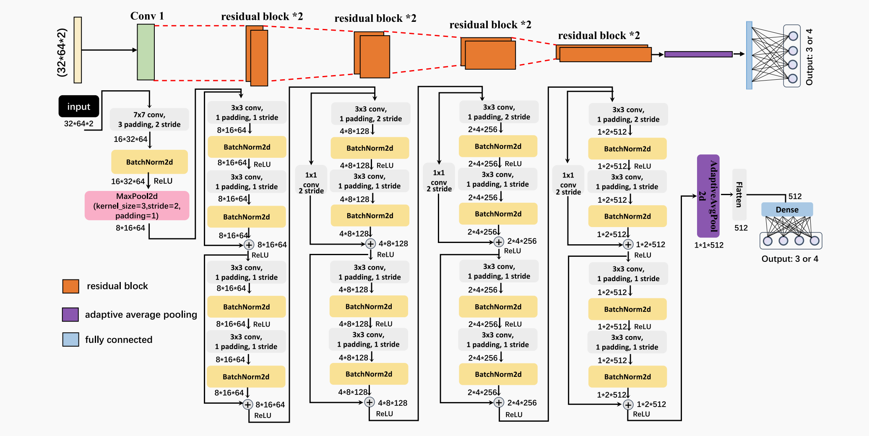
ResNet-18 detailed Structure
The ResNet-18 network architecture consists of 18 weight layers, including 17 convolutional layers and 1 dense layer.
H. Wu, Y. Wang, Y. Wang et al. Nuclear Inst. and Methods in Physics Research, A 1055 (2023) 168528

Slide 15


A Further more Motivation ：
High-Dimensional Connections
The human brain is good at thinking in two or three dimensions and can only process a limited number of variables at a time.
AI models map positional relationships and concepts into a "latent space" containing hundreds even thousands of dimensions. In this high-dimensional space, two features that appear unrelated to humans may be close together due to some deep, abstract similarities.

Slide 16
An Automated, Two-Stage Workflow
Input
Preprocessing
Model
Output
Stage 1:
The Event Filter
Project to 2D Dual-Channel Image
Charge - 0
Drift Time - 1
Raw 3D Event Data
(x,y,z,charge)
ResNet-18
Binary Classifier
EventLabel
Proton_event or other
Input
Segmentation
Identification
Regression
Stage 2:
Detailed Analysis
3D Clustering to find individual tracks
DBSCAN/
HDBSCAN
Predict Physics Parameters
Energy,Angle,Vertex
Filtered
3D events
Filetered by Stage 1
Classify each track via CNN
proton,alpha,etc.

Slide 17
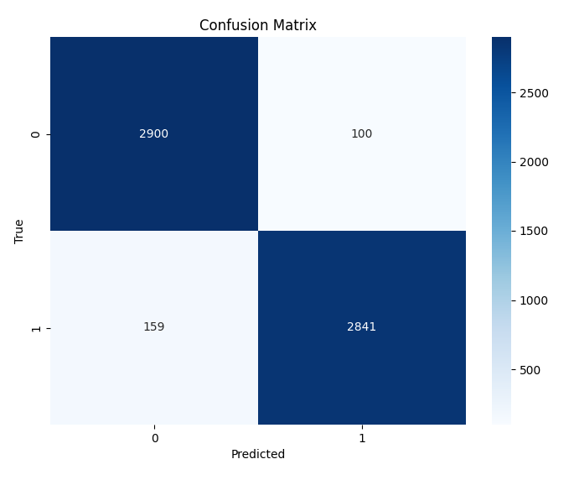
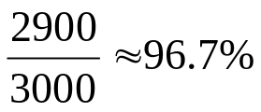
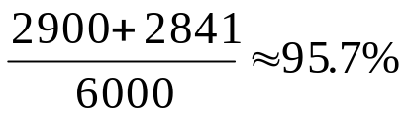
Cross-Attention Performance
Overall Accuracy reached 95.68%, surpassing all previous baselines.
Most critically, the Proton Recall—our primary physics metric—was boosted to 96.67%, a significant improvement over the ResNet-18 baseline's 87.6%.
This demonstrates that our physics-informed architecture is not just more interpretable, but also more effective.
100
proton
non-proton
Proton：
Overall Accuracy：
proton
non-proton

Slide 18
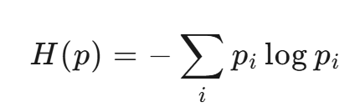
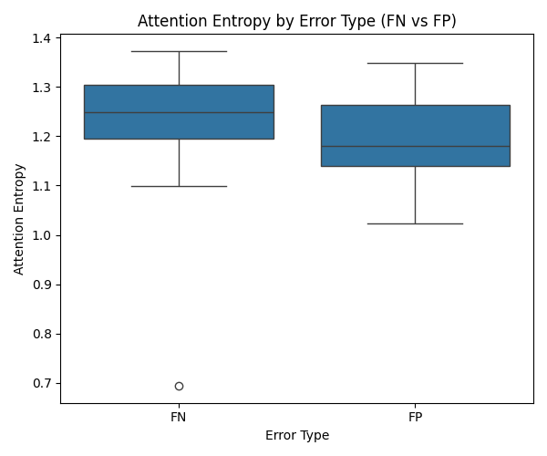

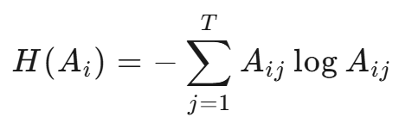
Attention Entropy
Shannon entropy for a discrete distribution p：
Assume that the attention matrix of a specific head is
Row Entropy：
Measures the concentration of attention of token i on all tokens
Physical Meaning
High entropy: Attention is evenly distributed → Model uncertainty, worth further exploration;
Low entropy: Attention is almost exclusively focused on a single token → Model certainty, but may overfit.

Slide 19
Attention Entropy
When the model handles different types of misclassified examples, its internal attention mechanism exhibits diametrically opposed "cognitive states":
- For FN examples (missed protons), the model exhibits significant "confusion." Its attention entropy is generally higher and more widely distributed, indicating that when faced with a real proton track, the model is unable to find a clear feature to focus its attention on, resulting in a false negative.
- For FP examples (falsely positive background), the model exhibits high "false confidence." Its attention entropy is generally lower and more concentrated, indicating that the model mistakenly focuses on certain local features (such as a bright cluster of pixels) and makes high-confidence judgments based on this incorrect focus.

Slide 20
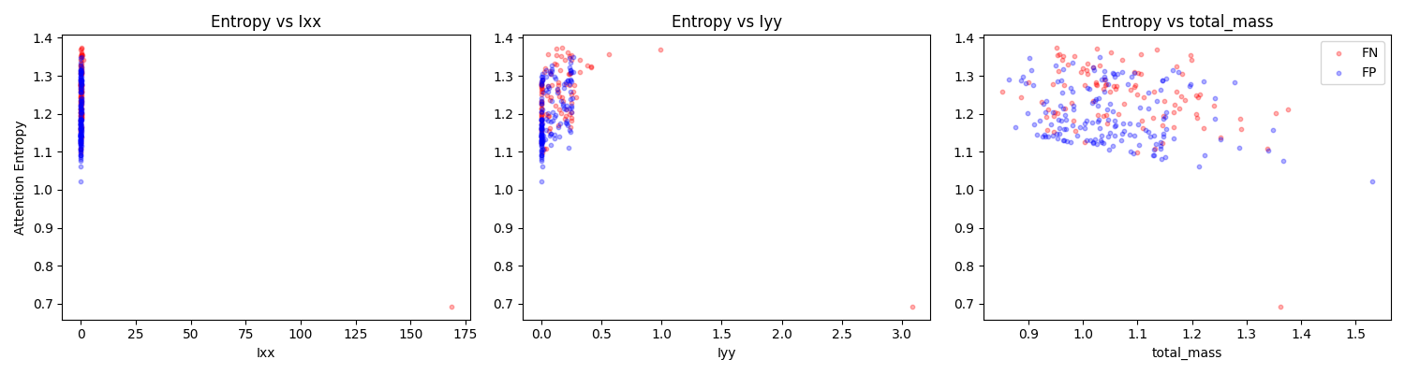
Interpretability Analysis
The model's level of "perplexity" (high attention entropy) shows a strong correlation with the physical form of the track. Specifically, when the model misidentifies a "long" background event as a proton (FP), it exhibits systematic uncertainty.
This reveals a key weakness in the model and provides a clear direction for improvement: the model's ability to discriminate long tracks must be improved, and attention entropy should be used as a reference indicator of decision confidence. When the entropy value is too high, the confidence of the prediction should be reduced.

Slide 21
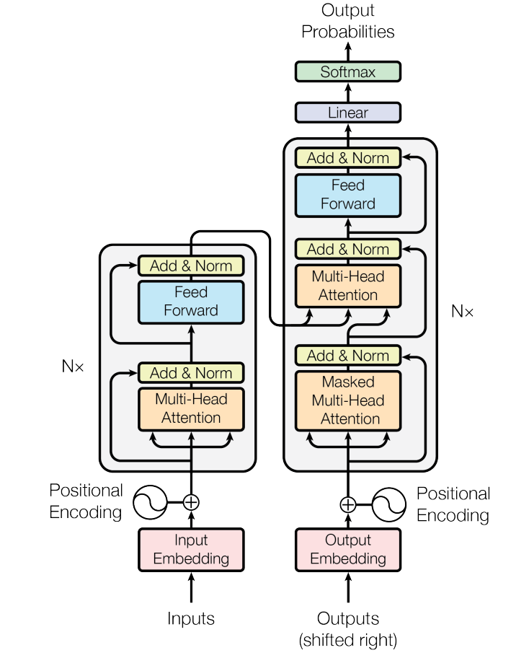
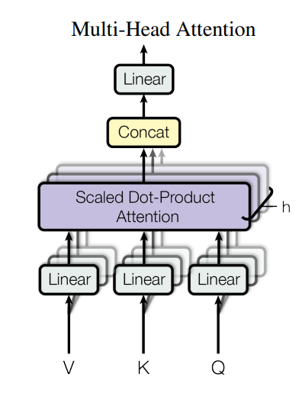
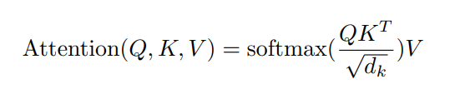
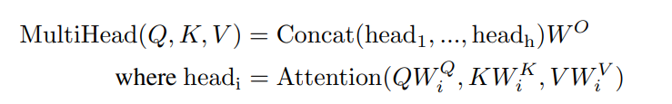
Mechanism of Cross-Attention Architecture
Transformer Architecture：
Attention is all you need

Slide 22
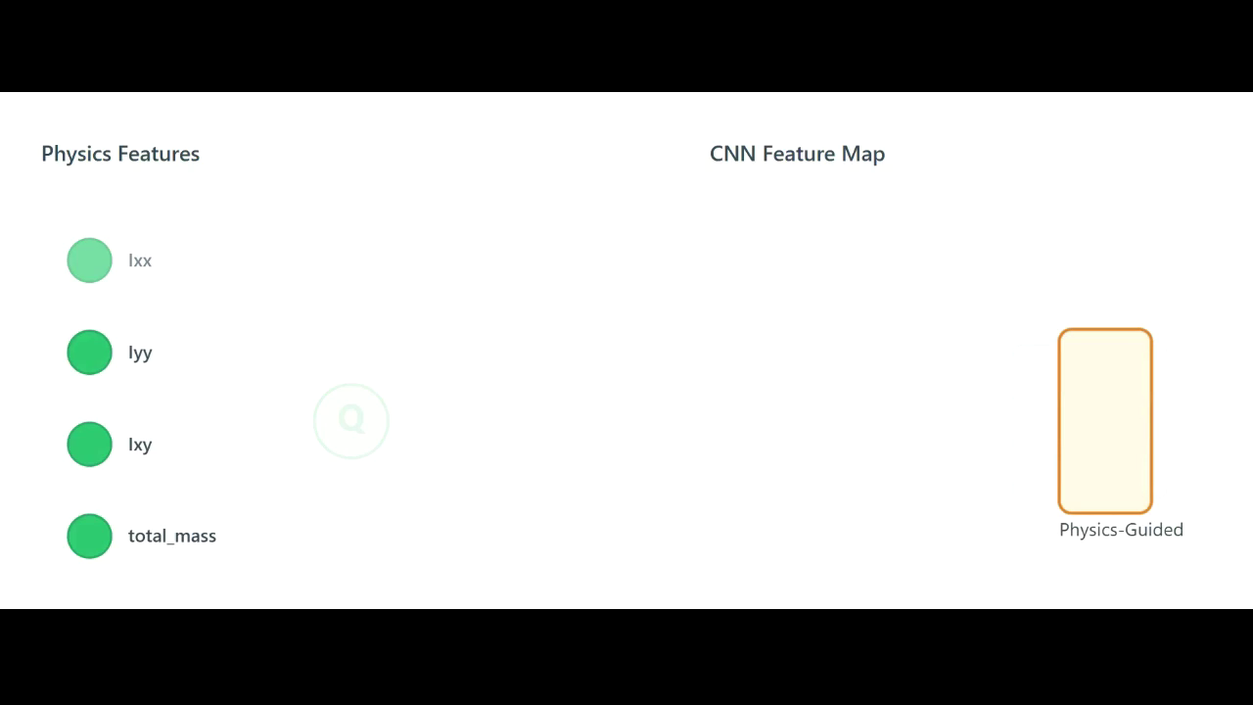
Mechanism of Cross-Attention Architecture
Moment of
Interia Tensor
Extracted by ResNet-18
Vectors:
K & V
Parameter Matrix: W^{Q}
Parameter Matrix: W^{K}, W^{V}

Slide 23
Traditional Workflow
Outlined steps:
1. Clean all events using Hough transform methods.Discard events that have fewer than some preset number of points.
2. Use naive Monto Carlo method to fit every track, assuming that each represents the desired reaction product.
3. Plot a histogram of the objective function for all events.
4.Visually determine a cutoff for a ‘‘good fit’’, or low objective function value.
5.Define all events within that cut as events of interest .
Several Disadvantages:
1. The lack of verfication
2. The subjectivity and potential biases of a "one-size-fits-all" standard.
These above degrades the efficacy of any ensuing analysis steps.
3. The prejudice raised by preceding steps.
(chain reactions)

Slide 24
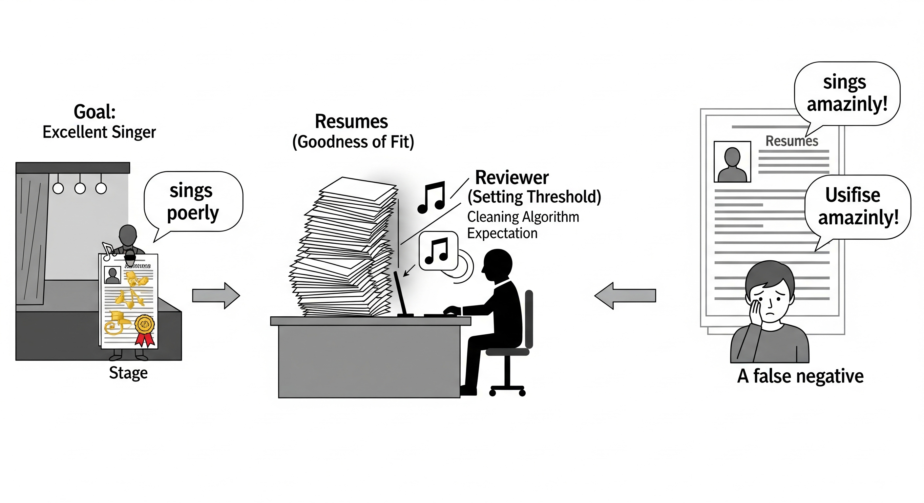
Traditional Workflow
Several Disadvantages:
1. The lack of verfication
2. The subjectivity and potential biases of a "one-size-fits-all" standard.
3. The prejudice raised by preceding steps.
Simple Imagery:
But we haven't actually heard them singing by ourselves! (corresponding to "independent verification").
amazingly
Generated by Gemini

