Slide 1
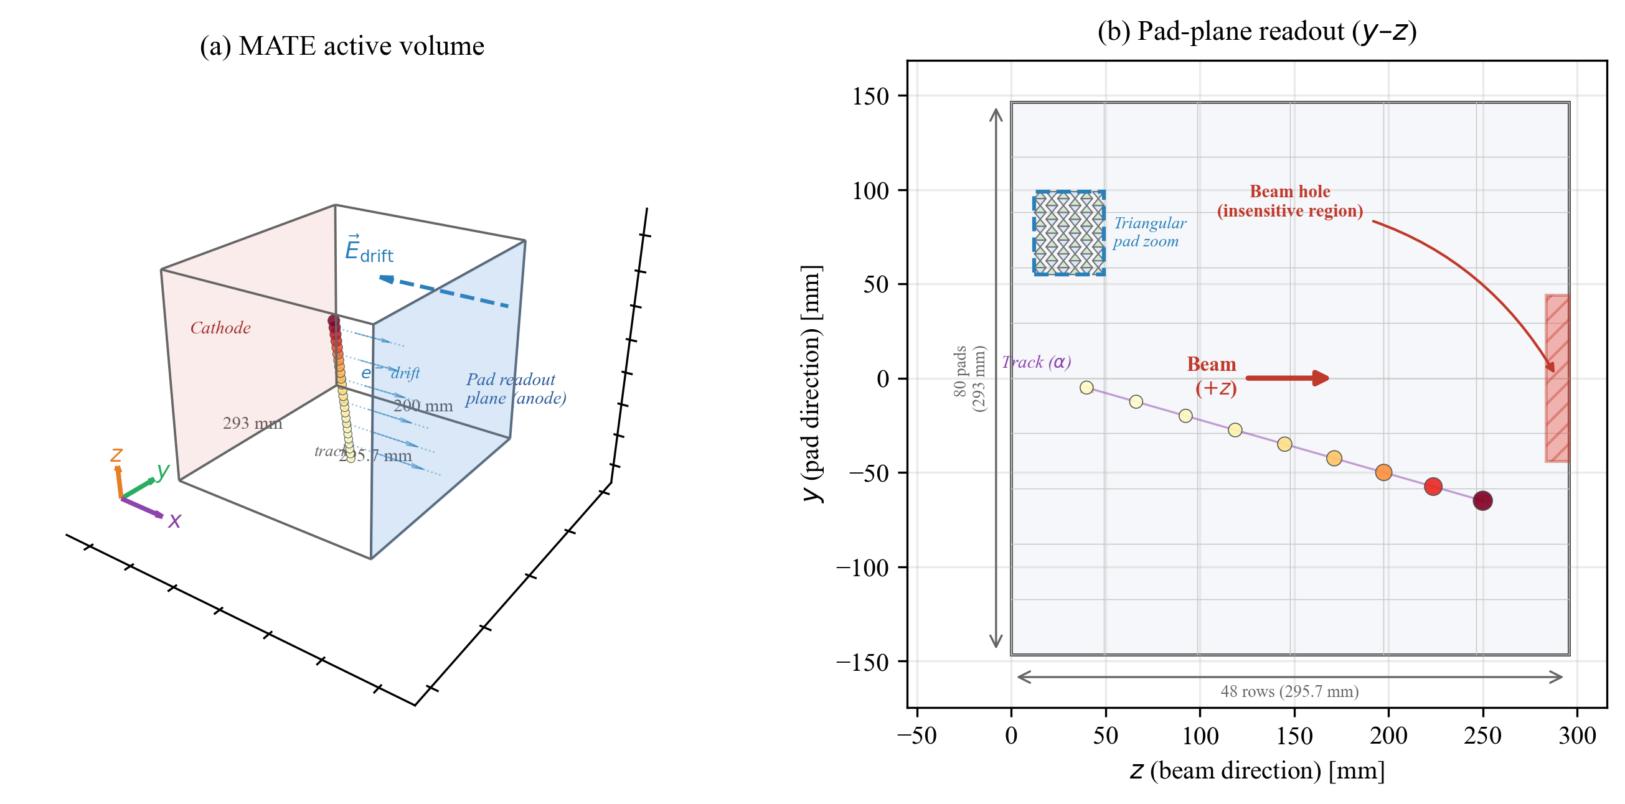
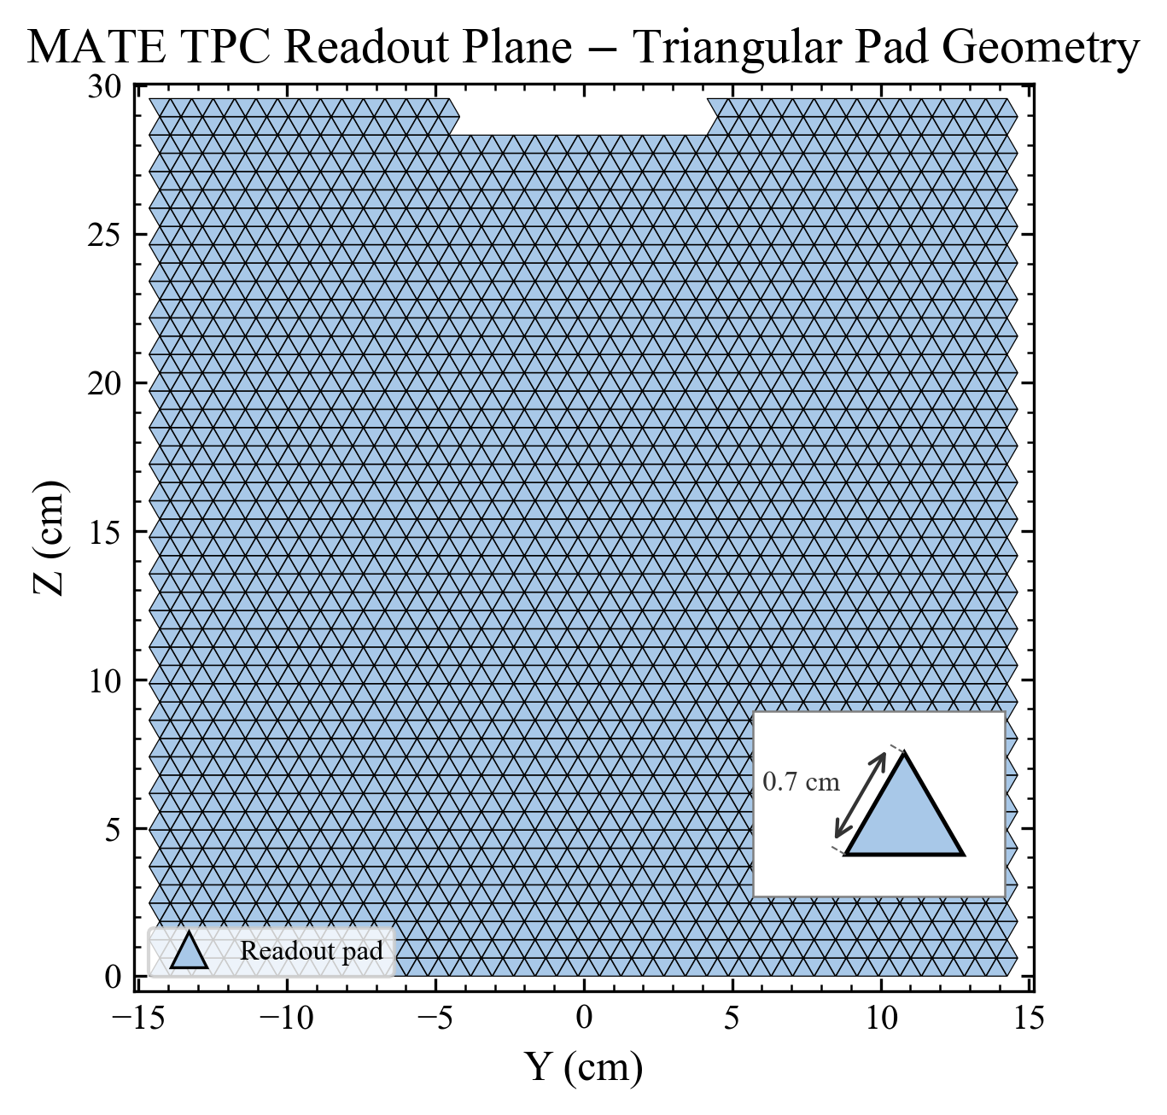
Understanding Nuclear Structure
Through Direct Reactions
Why Active-Target TPCs Need Better Particle Identification
Shell evolution far from stability
Traditional magic numbers change for exotic nuclei; tensor-force monopole reshuffles single-particle levels
Inverse-kinematics direct reactions as the probe
Transfer/knockout reactions on RI beams extract spectroscopic factors and angular distributions via DWBA
Active-target TPCs: thick target + full coverage
Gas IS the target: near-unity efficiency for short-range recoils, 4π coverage, high luminosity without degrading resolution
The bottleneck: reliable particle identification (PID)
Without clean PID, light recoils cannot be separated from backgrounds — angular distributions and C²S extraction collapse
MATE AT-TPC: GEM readout, 3792 triangular pads
ZhiHeng Hu | IMP, CAS | Meeting with Imai-sensei | 2026-04-13
1 / 5

Slide 2
What I Did
MATE-Automation: ML Pipeline for Active-Target TPC Particle Identification
Built the MATE-Automation ML pipeline
End-to-end framework: Geant4 simulation → ROOT → HDF5 → image generation → CNN training → inference
Trained ResNet family + VGG-19 on ¹²C+¹²C data
ResNet-18/34/50 and VGG-19 benchmarked on Geant4-simulated + real HIRFL-RIBLL commissioning data
Developed novel CrossAttention + HitChannel fusion architecture
Physics-informed feature injection: cross-attention fuses scalar hit-channel data with CNN image embeddings
Extended pipeline to trajectory reconstruction
Same architecture generalizes from classification to angle regression (polar/azimuthal)
Submitted paper to Nuclear Science and Techniques
NST-2025-0958: full PID classification results on elastic/fusion + 5 fusion sub-channels
ZhiHeng Hu | IMP, CAS
2 / 5

Slide 3
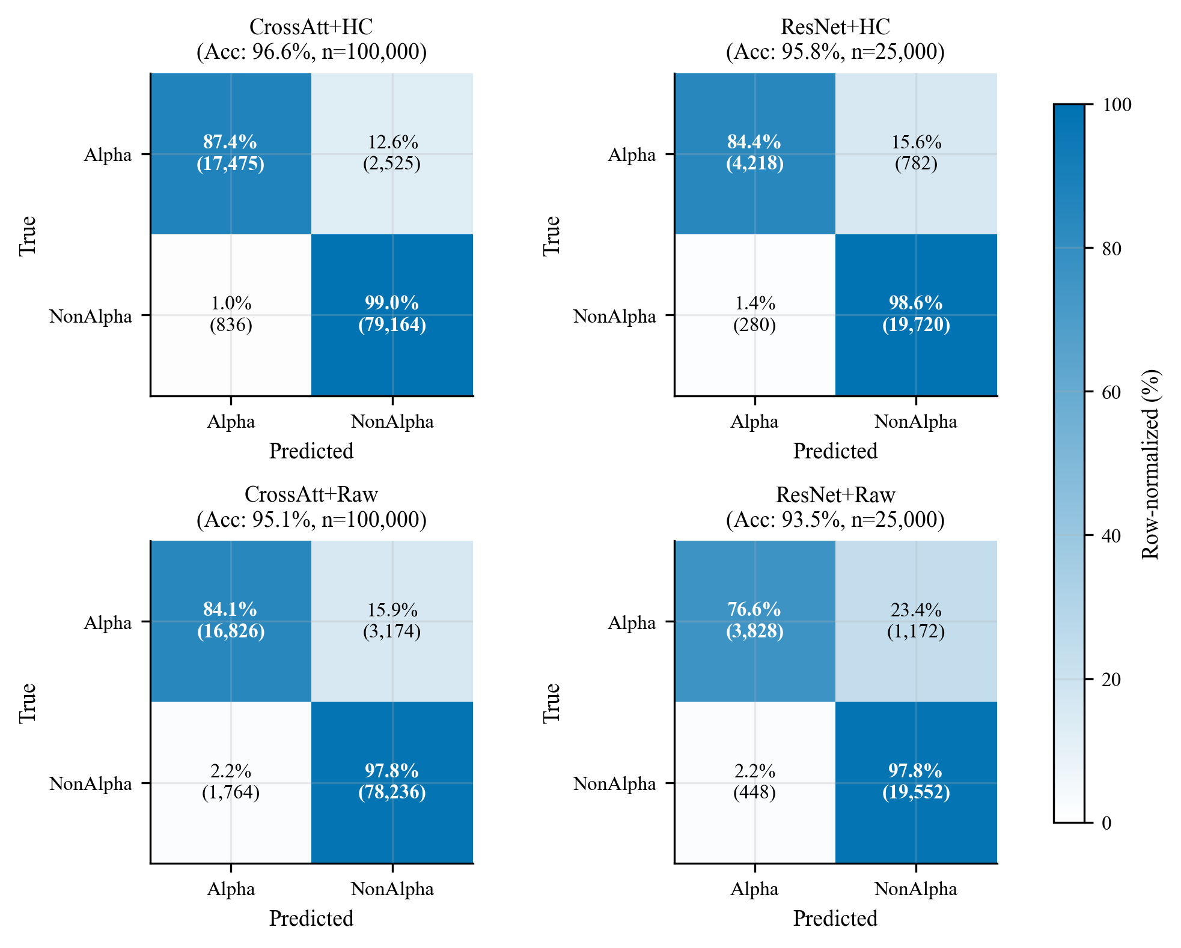
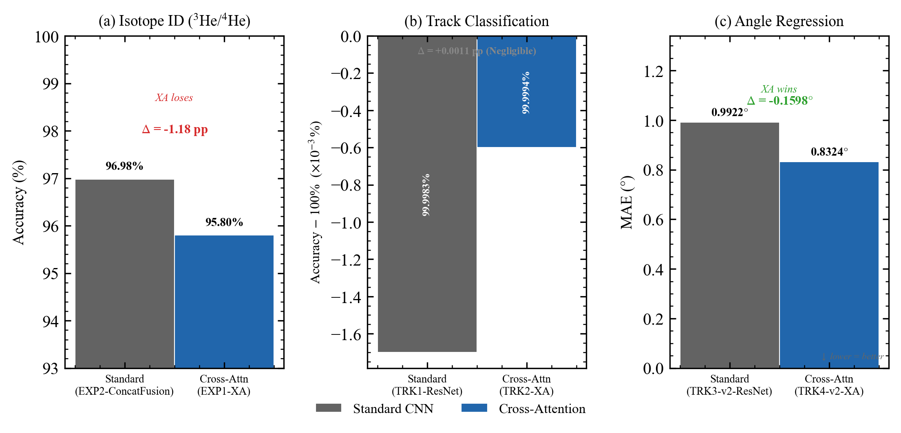
Results: From Event Classification to Trajectory Reconstruction
PID Classification
90–97%
elastic/fusion on ¹²C+¹²C
95% across 5 fusion channels
Submitted: NST-2025-0958
CrossAtt + HitChannel
95.80%
³He/⁴He binary (controlled)
Comparable to baseline (95.77%, p=0.81)
Adds interpretable physics features
without sacrificing accuracy
Trajectory Reconstruction
−16.1%
MAE: 0.992° → 0.832° (p < 10⁻¹⁶)
CrossAtt on angle regression
Same architecture generalizes
2×2 ablation confusion matrices (3He/4He)
Cross-task: Isotope ID / Track Count / Angle Regression
3 / 5

Slide 4
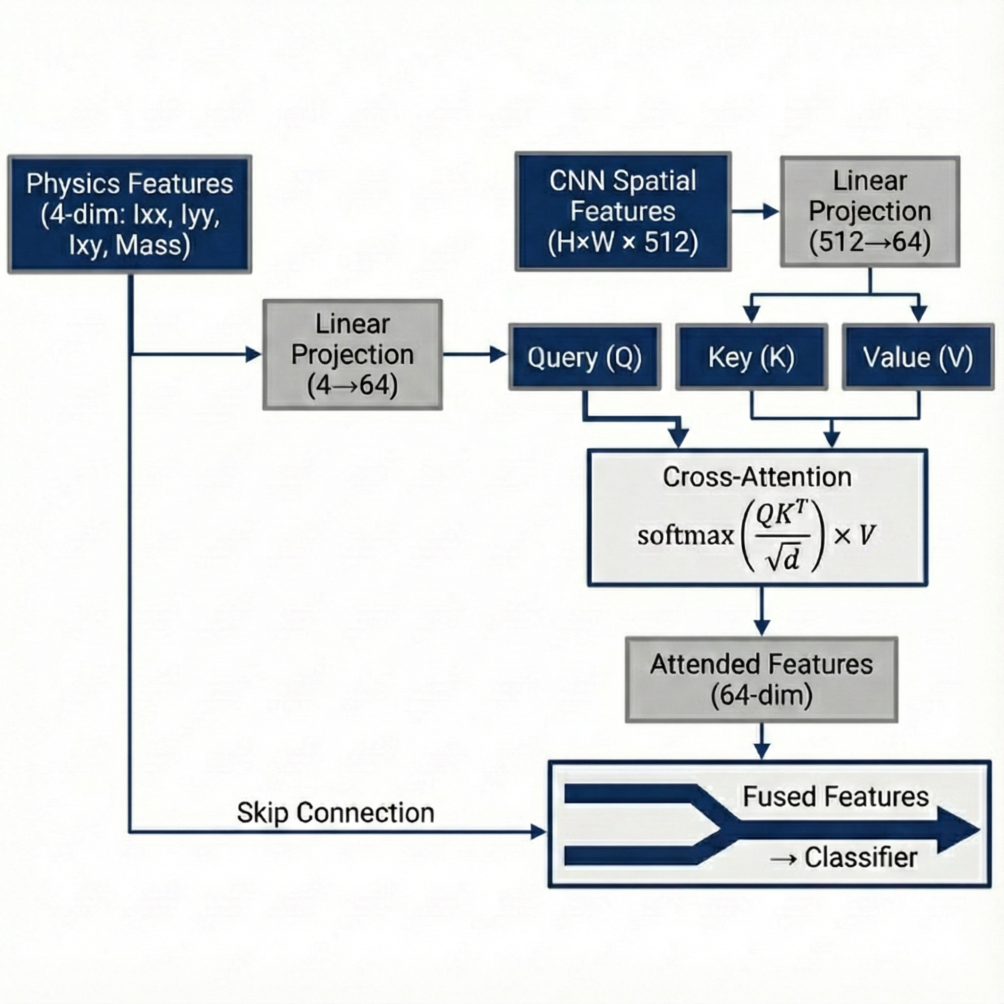
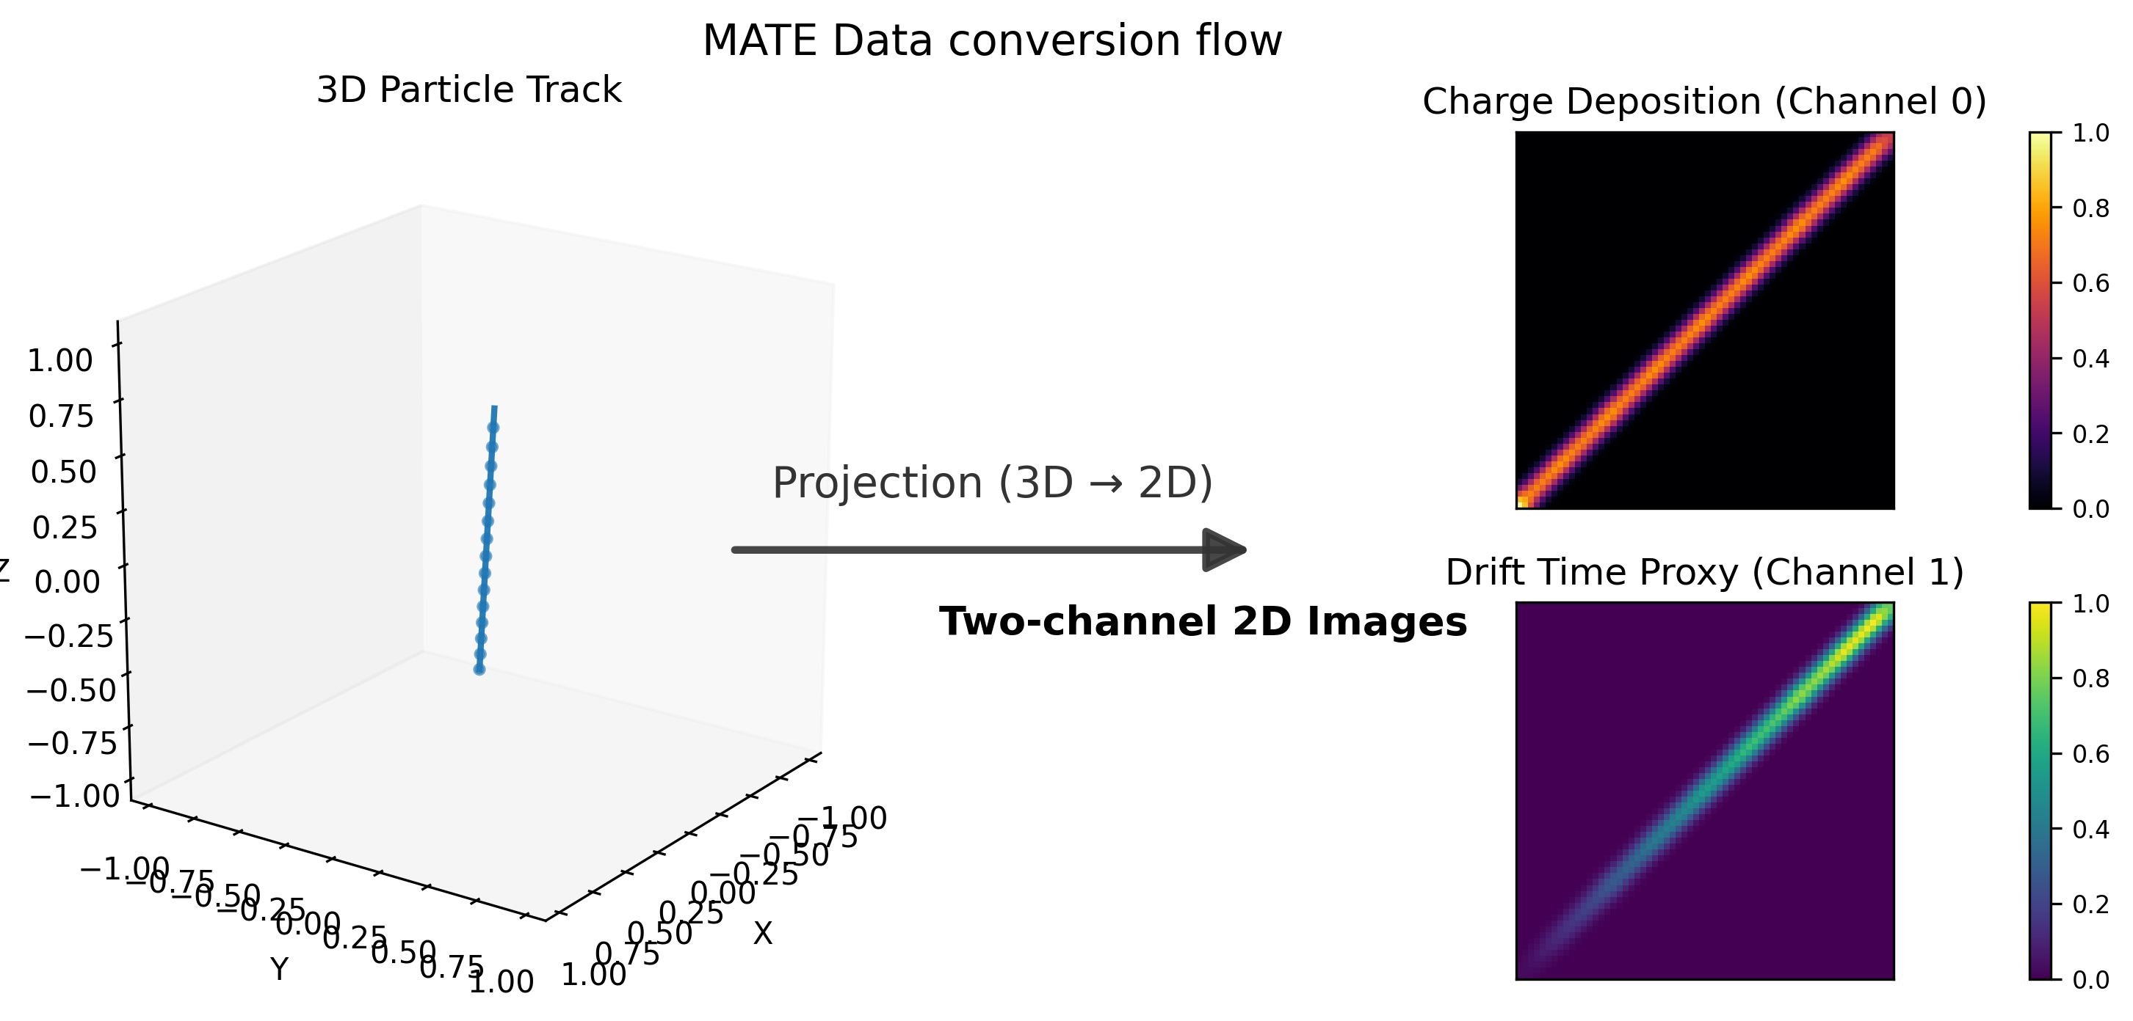
Connection: From MATE to DONUTS
The ML-PID capability maps directly to the DONUTS experimental program
OEDO-SHARAQ
Direct Reactions on Exotic Nuclei
Inverse-kinematics (d,p), (p,d) at 10–30 MeV/u with RI beams from RIKEN RIBF
Same PID challenge: separate light recoils from beam-related backgrounds
SAKURA
Surrogate (d,p) for r-Process
Proxy for (n,γ) cross-sections on short-lived nuclei for astrophysical r-process
⁷⁹Se(d,p) flagship (PLB 2024, Imai et al.) — reliable PID essential for extracting neutron-capture proxy
Shared Challenge
Active-Target TPC + PID
CAT-M (CNS) and MATE (IMP) share GEM-based AT-TPC design with dual-gain architecture
DG-M-THGEM prototype (Iwamoto, Ota, Imai, PTEP 2023): stable to 2.5×10⁶ pps
ZhiHeng Hu | IMP, CAS
4 / 5
CrossAttention + HitChannel architecture (transferable to DONUTS data)
End-to-end pipeline: ROOT → HDF5 → image → ML inference

Slide 5
Outlook & Discussion
Natural Next Steps
Apply CrossAtt-PID framework to DONUTS detector data
Adapt pipeline for CAT-M / DG-M-THGEM geometries
Extend to complex multi-particle reaction channels in SAKURA
Open Questions
How does ML-PID transfer across different TPC geometries and beam conditions?
Can domain adaptation (DANN, MCD) bridge simulation-to-real gap for exotic nuclei data?
What is the minimum training data for reliable PID on rare reaction channels?
For Discussion
Where does Imai-sensei see the highest-impact application of ML-PID within DONUTS?
Which upcoming SAKURA/OEDO experiments would benefit most from this pipeline?
How can this work contribute to a PhD thesis at UTokyo CNS?
Core message: The AFTPC pipeline generalizes across tasks (classification + regression) and can be adapted to DONUTS experimental data — let’s explore how.
ZhiHeng Hu | IMP, CAS | hu@impcas.ac.cn
5 / 5

