Slide 1
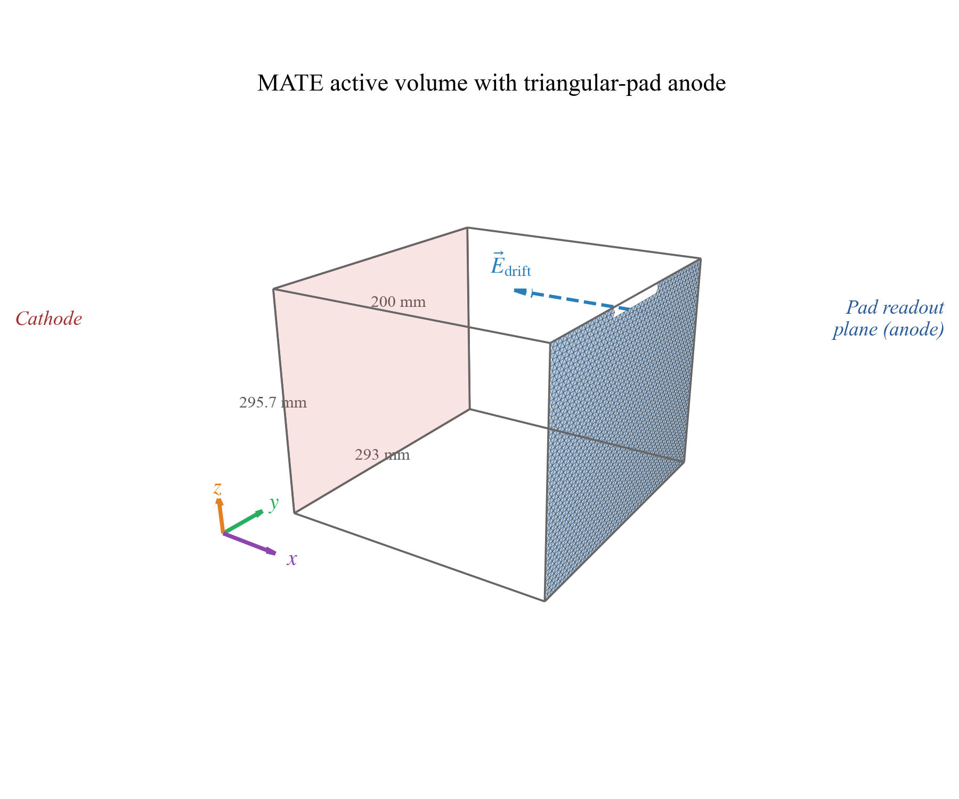
Physics-Informed Deep Learning
for the MATE
From Isotope Identification to Full Kinematic Reconstruction
ZhiHeng Hu
Institute of Modern Physics, Chinese Academy of Sciences
June 2026
ZhiHeng Hu | IMP, CAS | June 2026
1 / 18

Slide 2
ROADMAP
What This Talk Covers
1
The detector & the data challenge
MATE events as 3D point clouds — and why conventional reconstruction hits its limits.
2
A physics-informed approach
CNNs explained for physicists; injecting moment-of-inertia features via cross-attention.
3
Results across three tasks
Isotope identification → track counting & angles → kinetic-energy regression vs. classical baselines.
4
Context & outlook
How this complements ML work on real MATE beam data, and what comes next.
ZhiHeng Hu | IMP, CAS | June 2026
2 / 18

Slide 3
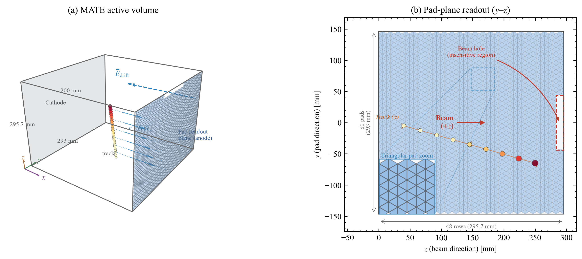
DETECTOR & DATA
MATE and Its Data Challenge
Gas is both target and tracking medium
95% ⁴He + 5% CO₂ at 500 mbar; active volume ≈ 300×300×200 mm³; near-4π coverage for short-range recoils.
Readout: 80×48 grid, 3792 triangular pads (3840 channels)
Each event → a 3D point cloud (x, y, z, q): drift coordinate, pad plane position, deposited charge.
Simulation campaign (GEANT4 / MATEROOT)
¹²C + ⁴He in inverse kinematics at 300 MeV; 7 species (p, d, t, ³He, α, ¹³C, ¹⁴C); up to 1.2M events per study.
The analysis bottleneck
10⁶–10⁸ events per experiment — reconstruction and identification must be automated, fast, and objective.
MATE geometry: active volume and triangular-pad readout plane
ZhiHeng Hu | IMP, CAS | June 2026
3 / 18

Slide 4
THE PROBLEM
Where Conventional Reconstruction Struggles
Manual cuts are subjective
Cut placement on overlapping dE/dx distributions varies analyst-to-analyst; sensitive to gain drifts and detector non-uniformity.
Same-Z isotopes are nearly degenerate
Stopping power orders species by Z²A — for ¹³C vs. ¹⁴C the separation is only ΔA/A ≈ 8%, so dE/dx curves almost coincide.
Scalar observables discard structure
Reducing a 3D track to total charge, length, or Bragg-peak amplitude throws away the spatial information that could break the degeneracy.
Geometric fitters degrade with complexity
The published RANSAC pipeline misidentifies the track count in up to 49% of short-range, high-multiplicity events.
ΔA/A ≈ 8%
¹³C / ¹⁴C separation — the hardest isotope pair
up to 49%
wrong track count from RANSAC at short range & high multiplicity (published MATEROOT pipeline)
ZhiHeng Hu | IMP, CAS | June 2026
4 / 18

Slide 5
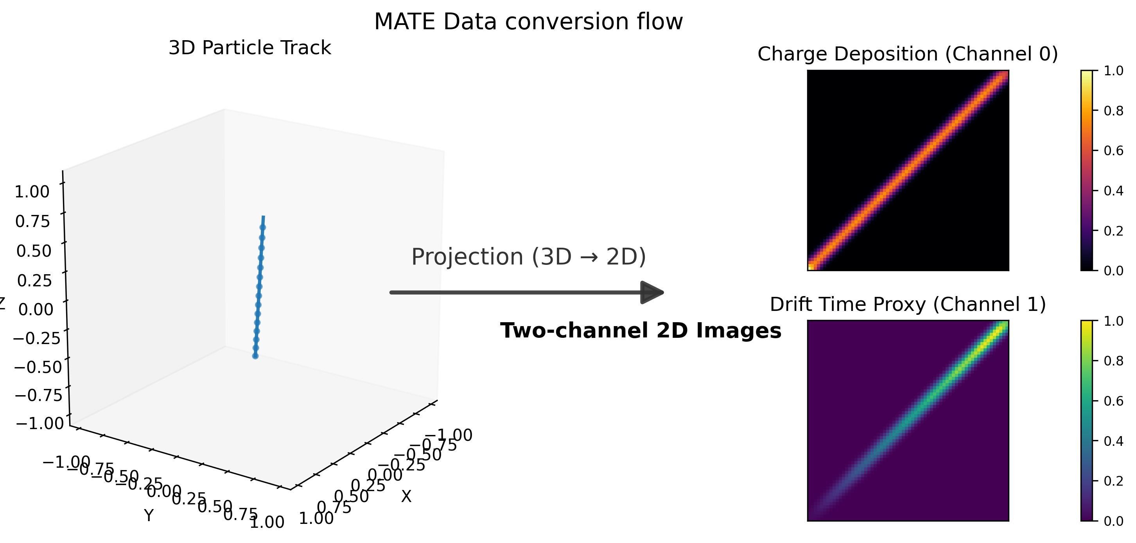
METHOD · DATA
From 3D Point Clouds to Two-Channel Images
Project onto the y–z pad plane (80×48)
Image grid matches the hardware readout one-to-one — no resampling artifacts.
Channel 0 — charge: log(1+q) per pad
Encodes energy deposition and the Bragg peak.
Channel 1 — drift time (normalized x̄)
Restores the third dimension lost in projection.
Processing chain: simulation → point cloud → projected pad-plane images
ZhiHeng Hu | IMP, CAS | June 2026
5 / 18

Slide 6
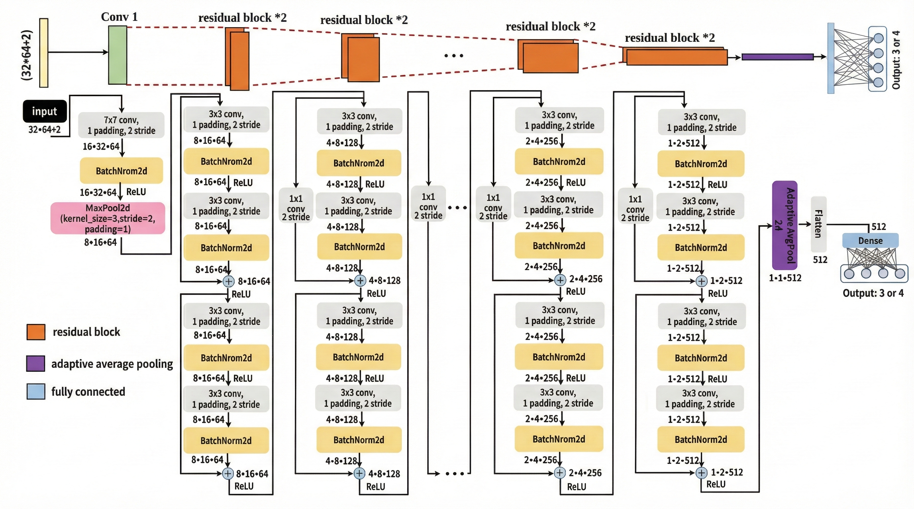
METHOD · MODEL
The CNN Backbone, in Physicist Terms
A convolution is a learned local filter
Small kernels scan the image for local patterns (track edges, charge gradients); deeper layers compose them into track-level structure.
ResNet-18: stacked filters + shortcut connections
Identity shortcuts keep 18 layers trainable — a standard, well-understood workhorse in computer vision.
Adapted to sparse MATE images
First layer changed to 3×3, stride 1, and the early max-pool removed — the 80×48 images are small and sparse, so no aggressive downsampling.
Output: a 512-dimensional event descriptor
Global average pooling turns the feature maps into one vector summarizing the whole event.
Modified ResNet-18 backbone
ZhiHeng Hu | IMP, CAS | June 2026
6 / 18

Slide 7
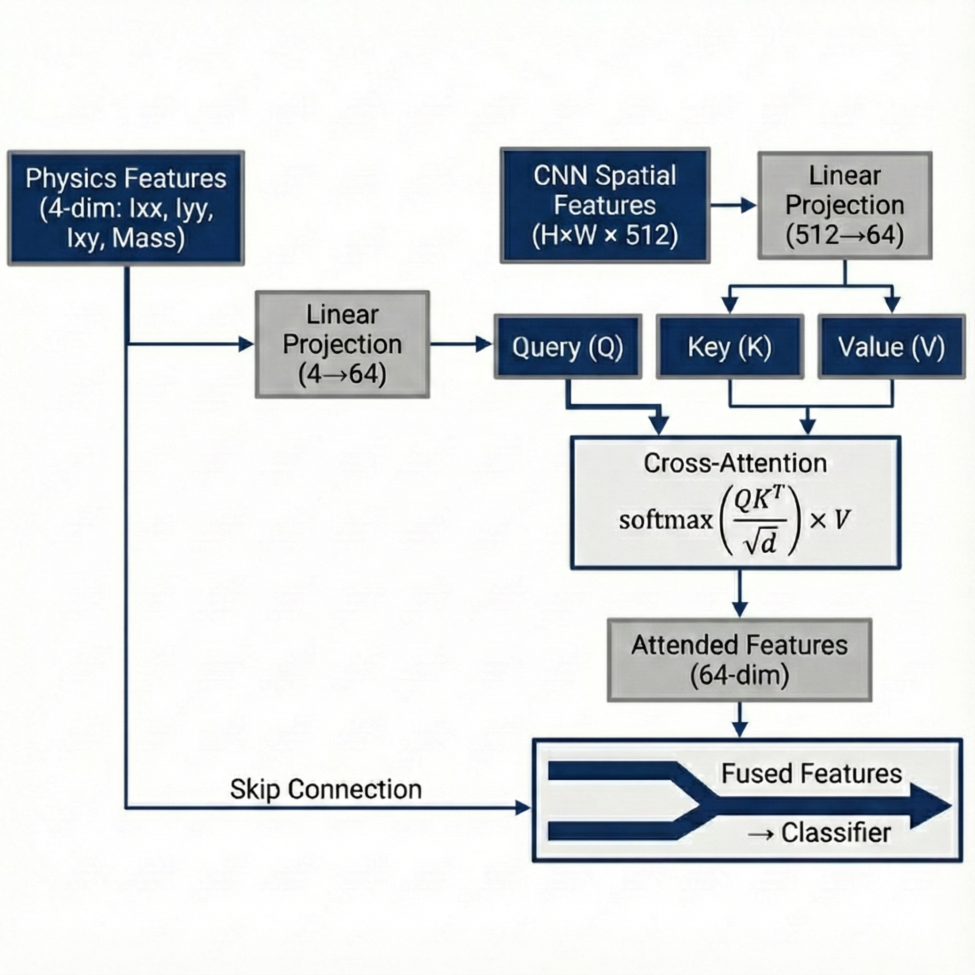
METHOD · PHYSICS-INFORMED
Injecting Physics: Moment-of-Inertia + Cross-Attention
Four physics features per event
2D moment-of-inertia tensor of the charge image (Iyy, Izz, Iyz) plus total charge M — shape and scale observables a physicist would compute by hand.
Cross-attention: physics interrogates the image
The physics features form the query; CNN spatial tokens are keys/values. The model learns where in the image to look, conditioned on event shape.
Why not just concatenate?
Attention yields spatial weighting (interpretable overlays, slide 10) and pays off most in geometric regression tasks (slides 12–15).
Cross-attention fusion of physics features with CNN feature maps
ZhiHeng Hu | IMP, CAS | June 2026
7 / 18

Slide 8
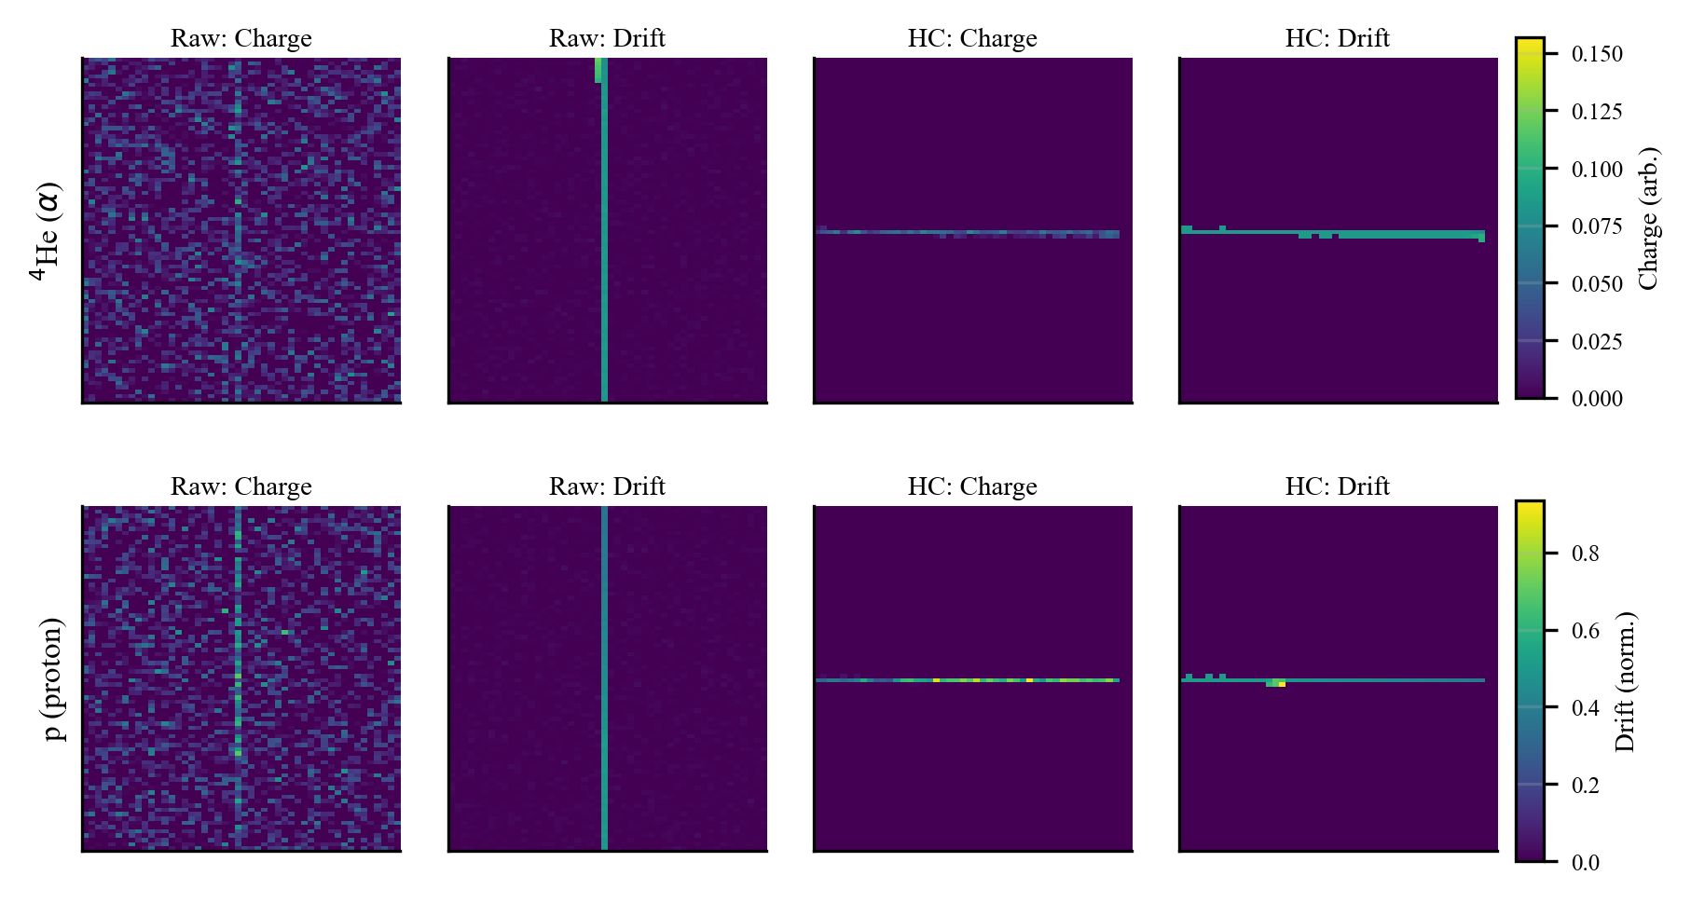
METHOD · NOISE
Robustness to Electronics Noise
Realistic noise via Garfield++ post-processing
Additive Gaussian electronics noise (ENC 800 e⁻) injected onto pad signals, emulating the GET readout.
HC denoising (Hierarchy Cluster)
DBSCAN clustering in physical units (ε = 10 mm) keeps the largest physical cluster, rejecting isolated noise hits.
2×2 ablation — architecture × preprocessing
CrossAtt+HC: 96.6% accuracy vs. ResNet+Raw: 93.5%. HC alone contributes +1.5–2.3 pp across architectures.
HC preprocessing: raw noisy event (left) → denoised (right)
96.6%
+1.5–2.3 pp
CrossAtt + HC under realistic noise
gained by HC denoising alone
ZhiHeng Hu | IMP, CAS | June 2026
8 / 18

Slide 9
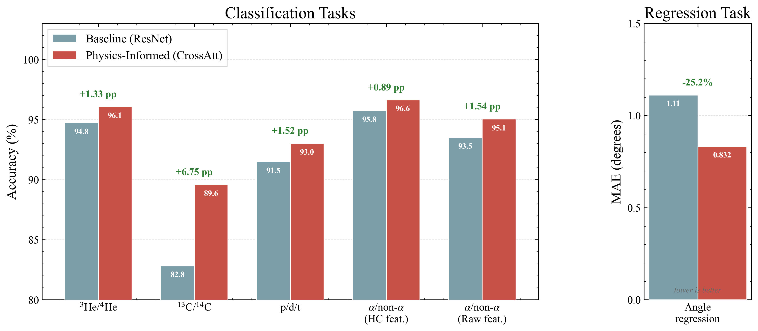
RESULTS · PID
Results I — Isotope Identification
Clean GEANT4 simulation (NimpSim), physics-informed model vs. generic ResNet-18 baseline:
96.1%
89.7%
93.0%
³He vs. ⁴He (baseline: 91.9%, +4.2 pp)
¹³C vs. ¹⁴C — hardest pair (baseline: 82.8%, +6.9 pp)
p / d / t three-class
Accuracy across identification tasks (left) and angle-regression error (right): physics-informed vs. baseline
ZhiHeng Hu | IMP, CAS | June 2026
9 / 18

Slide 10
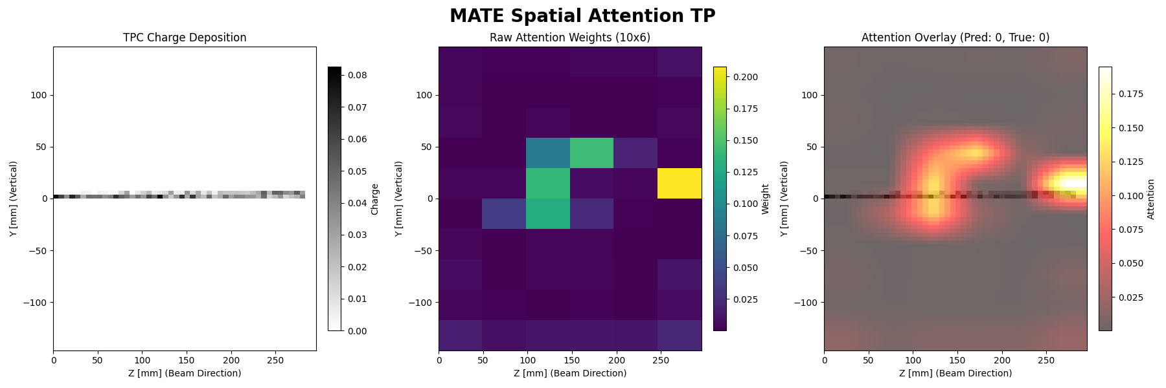
RESULTS · INTERPRETABILITY
Not a Black Box: Where the Model Looks
Attention maps are physically sensible
Weight concentrates on track endpoints and the Bragg peak — where species information lives.
A diagnostic, not just a picture
On errors, the overlay shows what the model attended to — enabling physics-level debugging.
Builds trust for physics use
Decisions can be audited against known energy-loss behavior.
Cross-attention weights overlaid on input events
ZhiHeng Hu | IMP, CAS | June 2026
10 / 18

Slide 11
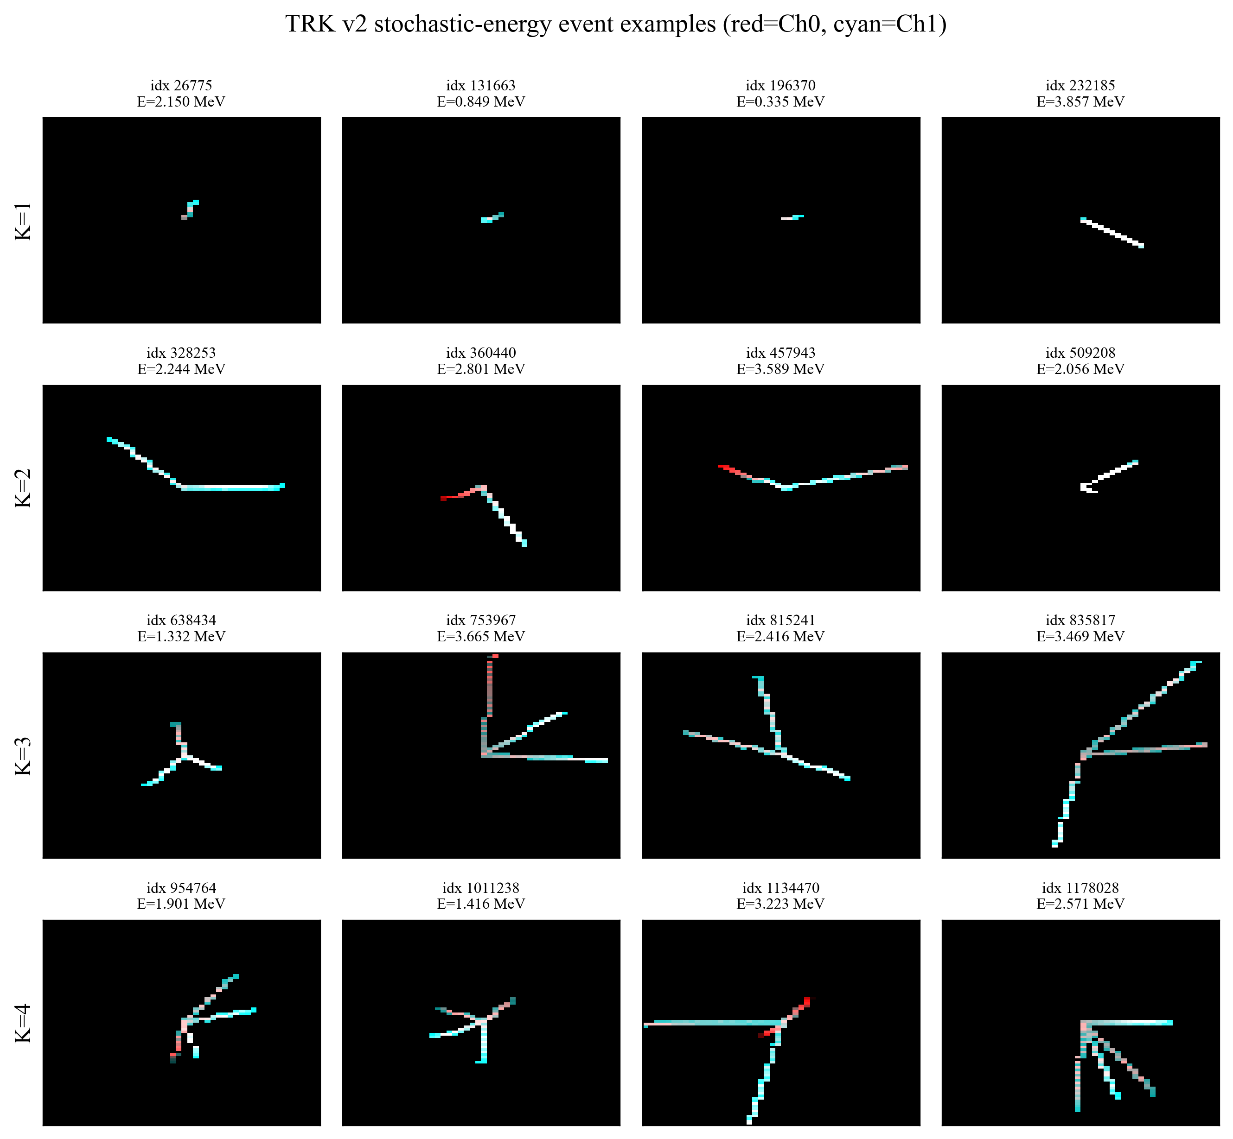
RESULTS · TRK SERIES
Beyond “Which Particle?” — Full Kinematic Reconstruction
TRK1 / TRK2
How many tracks? 4-class multiplicity classification (1–4 tracks)
TRK3 / TRK4
Which directions? Per-track polar-angle regression (4-slot masked output)
TRK5 / TRK6
What energy? Per-event kinetic-energy regression vs. 3 classical baselines
Dataset: 1.2M simulated α-source events; kinetic energy sampled uniformly in [0.3, 4.0] MeV per event; in each pair, the first model is the plain ResNet and the second adds cross-attention fusion.
Example multi-track events from the TRK dataset
ZhiHeng Hu | IMP, CAS | June 2026
11 / 18

Slide 12
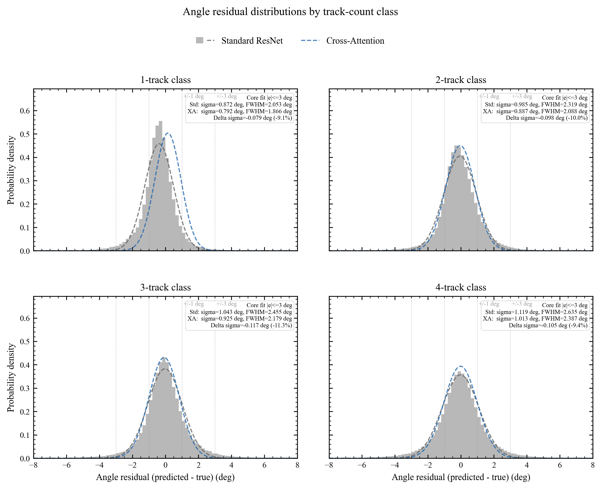
RESULTS · TRAJECTORY
Counting Tracks Is Solved; Angles Show the Gain
>99.99%
track-count accuracy, both models (3 vs. 1 errors in 180k — at ceiling)
−16%
angle MAE with cross-attention: 0.99° → 0.83°
Residual width shrinks for all track counts; the gain grows with energy.
Angle residuals by track multiplicity: plain ResNet (TRK3-v2) vs. cross-attention (TRK4-v2), with Gaussian fits
ZhiHeng Hu | IMP, CAS | June 2026
12 / 18

Slide 13
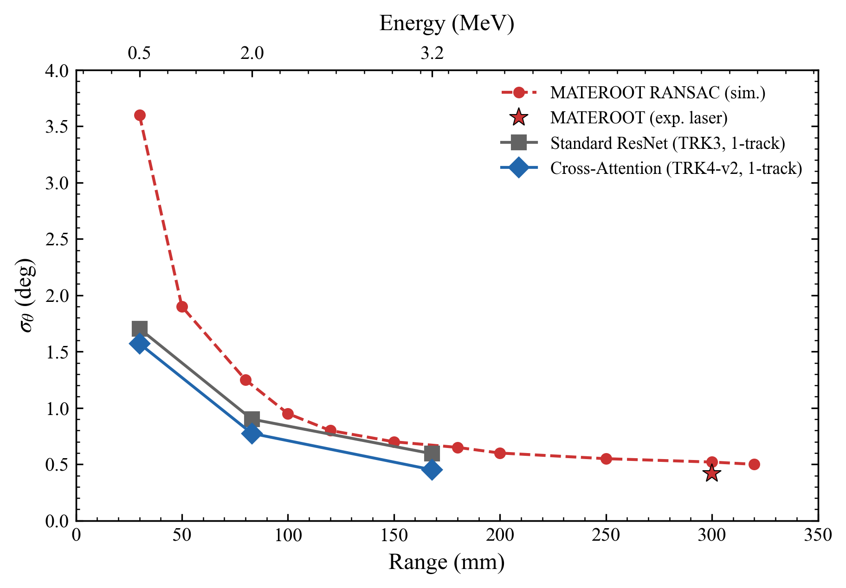
RESULTS · TRAJECTORY
Angular Resolution vs. the Published RANSAC Pipeline
CNN resolution beats the fitted pipeline at every range point
At ≈ 2 MeV (≈83 mm range): σ ≈ 0.77° (cross-attention) and 0.90° (plain ResNet) vs. 1.25° (RANSAC), 1-track events.
No per-dataset threshold tuning
Classical fitters need careful inlier-distance tuning; the trained network has no event-selection knobs.
⚠ Indicative comparison: CNN and RANSAC numbers come from different simulation campaigns; energy-to-range mapping approximate.
σ(θ) vs. particle range: CNN models vs. MATEROOT RANSAC reference
ZhiHeng Hu | IMP, CAS | June 2026
13 / 18

Slide 14
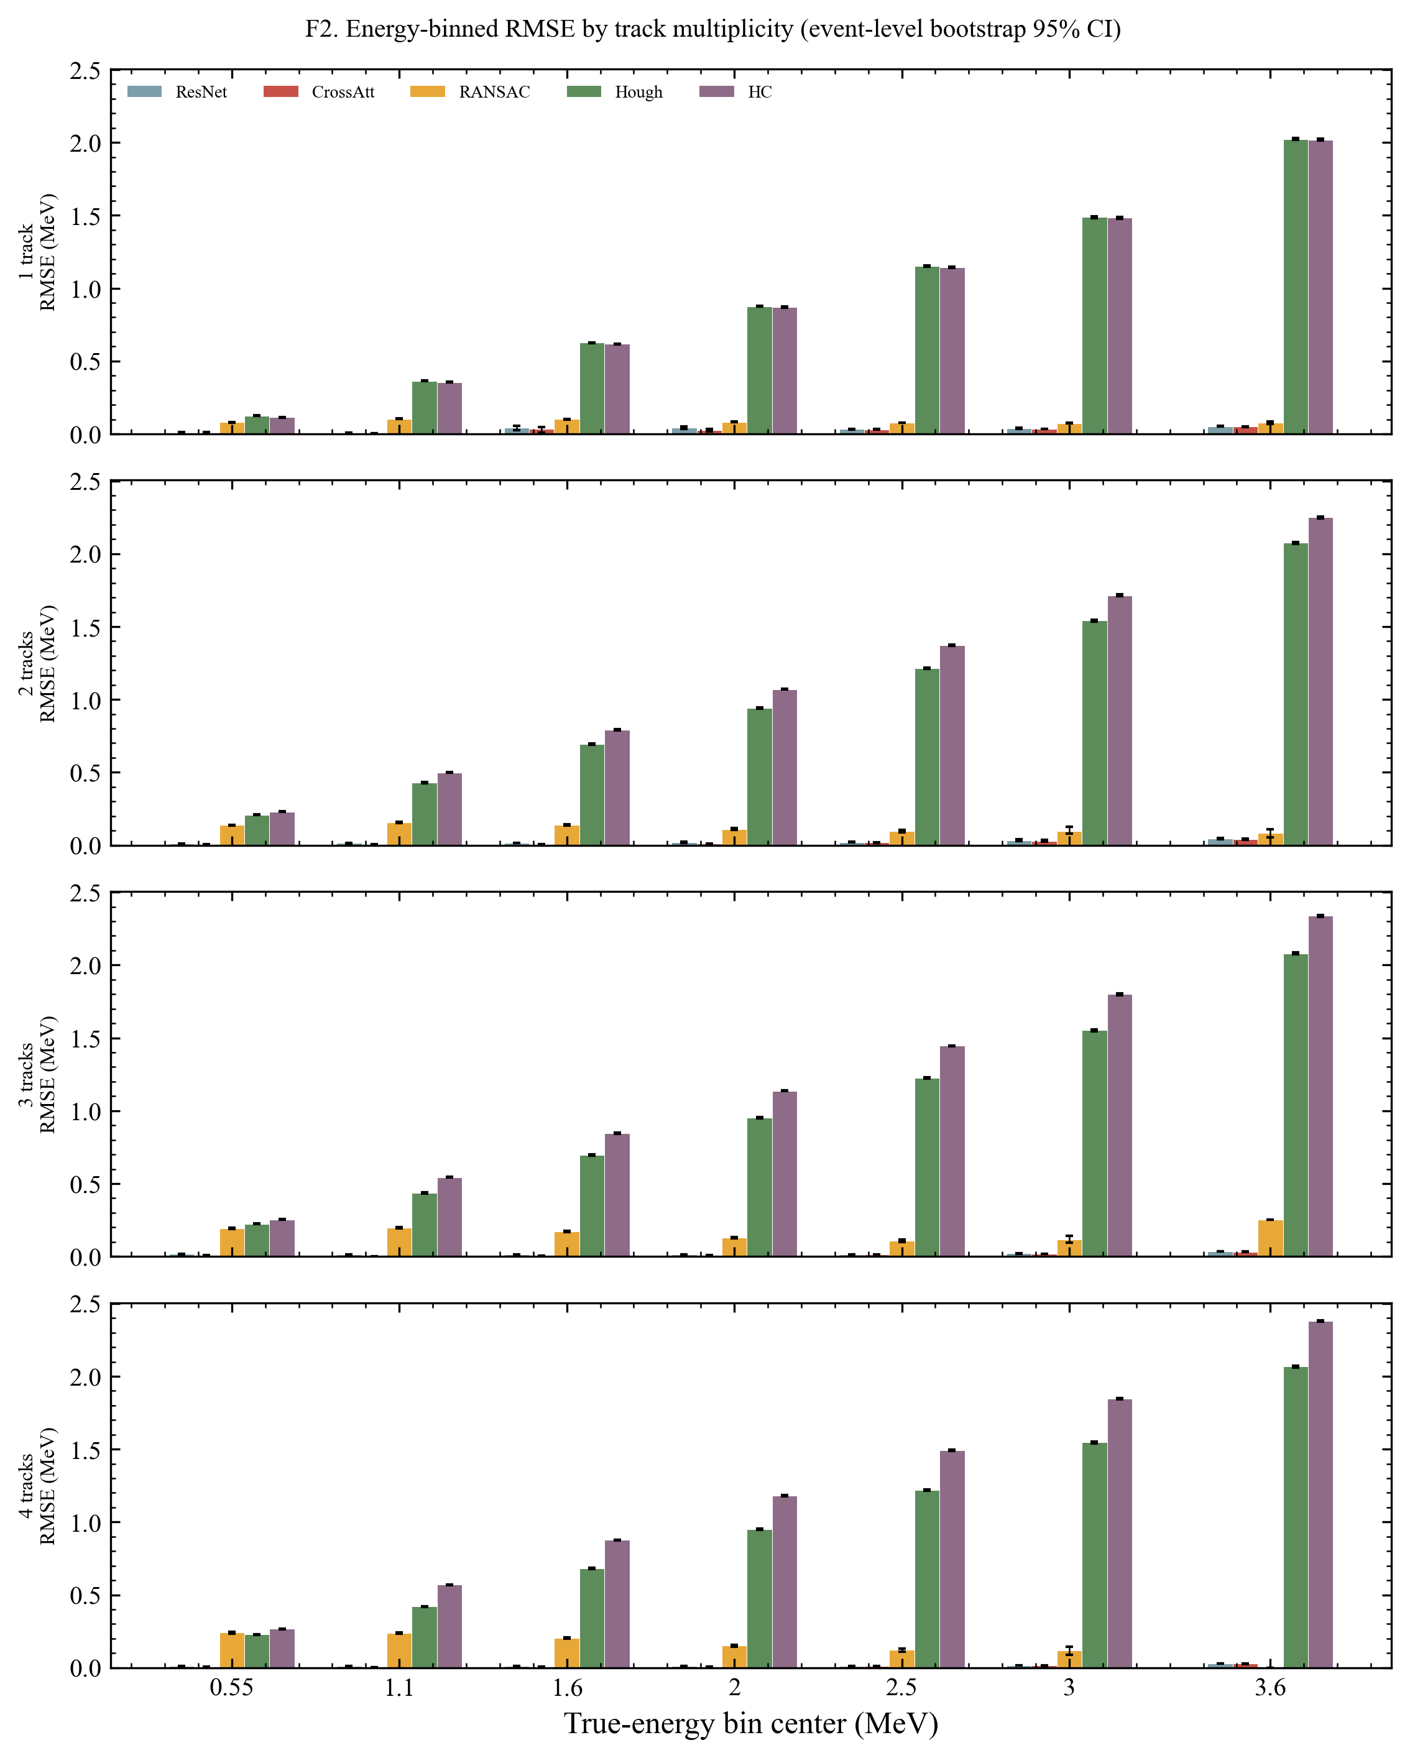
RESULTS · ENERGY
Results II — Per-Event Energy: CNNs vs. Classical Methods
Cross-attention CNN
0.019 MeV
Plain ResNet CNN
0.023 MeV
RANSAC + SRIM
0.159 MeV
Hough + SRIM
1.269 MeV
Hierarchy Cluster + SRIM
1.419 MeV
Same test set, 180k events. CNNs are ≈7× better than the best classical method (all pairwise differences significant; relative RMSE ≈ 0.9% for the cross-attention model).
RMSE vs. true energy: classical methods diverge at high energy; CNNs stay flat (RMSE in MeV)
ZhiHeng Hu | IMP, CAS | June 2026
14 / 18

Slide 15
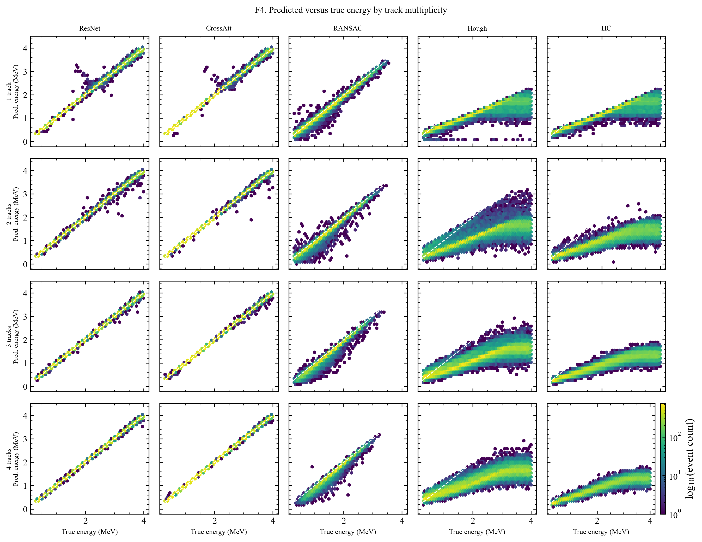
RESULTS · ENERGY
Why the CNNs Win: Clipped Tracks and Busy Events
Range clipping breaks geometric methods
Above ≈ 1.2 MeV an α can exit the active volume — 33% of test tracks are clipped. Track-length → SRIM inversion then underestimates energy systematically.
CNNs degrade gracefully with multiplicity
Classical RMSE worsens from 1→4 tracks (overlap confuses fitting); CNN error actually improves, exploiting whole-image context.
Calibration is clean
Cross-attention CNN: bias < 1 keV, median error ≈ 4 keV over [0.3, 4.0] MeV.
Predicted vs. true energy per method — classical methods bend below the diagonal once tracks clip
ZhiHeng Hu | IMP, CAS | June 2026
15 / 18

Slide 16
CONTEXT
Complementary Work on Real Beam Data
Zhang et al. (SUSTech / IMP), ML event classification & vertex reconstruction for ¹²C+¹²C with the MATE — submitted to Nucl. Sci. Tech.
Zhang et al.
This work
Task
Elastic vs. fusion sorting; vertex (x,y,z)
Isotope PID + multiplicity, angle & energy
Data
Real ¹²C+¹²C beam data @ HIRFL + sim
GEANT4 simulation campaigns
Models
Off-the-shelf ResNet / VGG, shallow CNN
Modified ResNet-18 + physics cross-attention
Baselines
Implicit (traditional pipeline labels)
Explicit: RANSAC, Hough, Hierarchy Cluster
Key result
≈97% (sim) → ≈90% (experiment)
≈7× lower energy RMSE than best classical
Together: their sim-to-real transfer (≈7 pp accuracy cost) shows real-data deployment is feasible — the natural next step for the physics-informed models presented here.
ZhiHeng Hu | IMP, CAS | June 2026
16 / 18

Slide 17
WRAP-UP
Summary
+6.9 pp
96.6%
0.83°
≈7×
on the hardest isotope pair (¹³C/¹⁴C) from physics-informed fusion
accuracy under realistic electronics noise (CrossAtt+HC)
angle MAE — 16% better than plain CNN, ahead of RANSAC
lower per-event energy RMSE than the best classical method
One pipeline, three reconstruction tasks
The same two-channel image representation and physics-informed architecture handle identification, counting, angles, and energy.
Physics in the architecture pays off
Moment-of-inertia features + cross-attention improve the hardest discrimination tasks and yield interpretable attention maps.
Rigorous, like-for-like baselines
RANSAC, Hough, and Hierarchy Cluster were optimized on the same data before comparison — the CNN advantage is not a strawman.
ZhiHeng Hu | IMP, CAS | June 2026
17 / 18

Slide 18
Outlook
Validate on real MATE beam data
Sim-to-real transfer is demonstrably feasible on this detector — quantify what physics-informed features buy under real noise and gain variations.
Extend to production physics campaigns
Deploy the pipeline for channel selection and kinematic reconstruction in upcoming measurements.
Toward online analysis
A trained network is fast at inference — a candidate for near-real-time event filtering during beam time.
Thank you — questions welcome
ZhiHeng Hu | IMP, CAS | June 2026
18 / 18

