Slide 1
MATE AT-TPC · PHYSICS-INFORMED CNN PROGRAM
Progress Beyond the Paper
A verified archive of work completed after the manuscript's last edit (main.tex, 2026-04-22) — candidate material for paper revision and thesis chapters. Every number below is checked against run logs, metrics.json, configs, specs, and figure files.
16
5
9
2
verified findings
partial (comment-only)
absent from paper
stale / contradicted
Archive summary · 2026-06-11 · source: Progress_Beyond_Paper_20260611.md

Slide 2
SCOPE
PAPER: CONTEXT
Reference manuscript & how to read this deck
The manuscript as it stands
Paper-status legend
Physics-informed CNN with cross-attention fusion for isotope identification in the MATE AT-TPC — classification only.
12 figures; no regression results, no classical-baseline comparisons, no statistical significance testing.
Lines 260–303: a 44-line commented TODO(advisor-review) block pre-registers wording for the energy-regression work but renders nothing.
Last modified 2026-04-22 — every result in this deck post-dates or extends it.
Everything here is verified against repository artifacts; candidates that failed verification are listed in the appendix.
PARTIAL
only coverage is the commented advisor-review block
ABSENT
zero coverage anywhere in the manuscript
STALE
contradicts standing paper text
Deck map
1 New experiments · 2 New baselines · 3 New analyses · 4 Methods & infrastructure · 5 Figures · 6 Presented, not published · Appendix: rejected candidates
Progress Beyond the Paper · archive summary · 2026-06-11
2

Slide 3
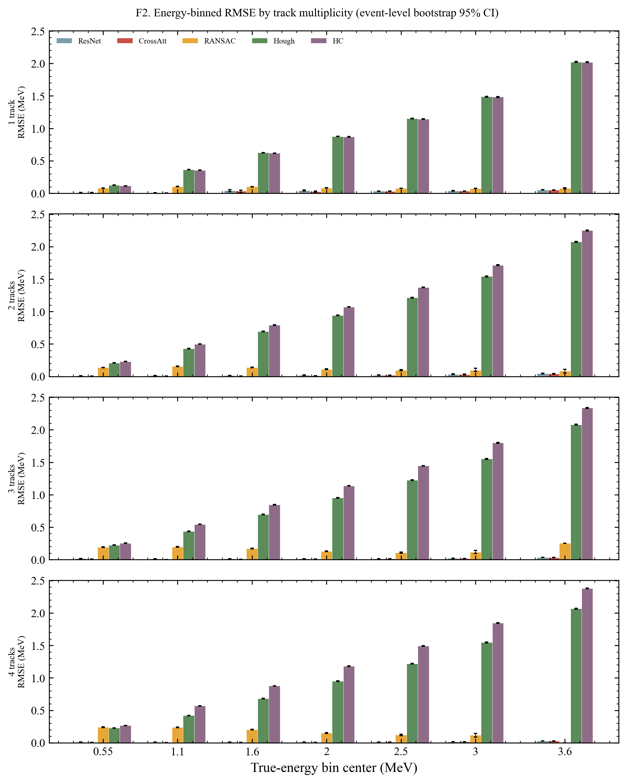
1.1 NEW EXPERIMENTS
PAPER: PARTIAL
TRK5 / TRK6 — per-event kinetic-energy regression
0.0188
0.0229
−18.0%
TRK6 (cross-attn) test RMSE, MeV
TRK5 (ResNet) test RMSE, MeV
RMSE, cross-attn vs ResNet
Regenerated 1.2M-event continuous-energy dataset, E ~ U[0.3, 4.0] MeV per event; 180k test events / 450k valid slots.
Paired per-event ΔRMSE +0.004327 MeV (CI [0.004260, 0.004396]); Wilcoxon p ≈ 0; Cohen's d 0.293.
TRK6 relative RMSE 0.873%; best bin 0.00304 MeV (0.8–1.3 MeV).
Decision gate 2026-05-14: TRK6 is the primary CNN result — claim qualified to per-event regression, 9 enumerated limitations.
Status: the single largest unpublished body of results; only the commented block mentions it — zero rendered prose.
F2 — per-energy-bin RMSE, bootstrap 95% CIs
Progress Beyond the Paper · archive summary · 2026-06-11
3

Slide 4
1.2 NEW EXPERIMENTS
PAPER: STALE
EXP2 fusion ranking — Concat > Gated > CrossAtt
Why this is STALE
Cross-attention is the worst fusion mechanism in every comparison run (single seed).
3He/4He caveat: CrossAtt cell evaluated on a 25k val set vs 35k for Gated/Concat — mismatched validation sets.
Recorded implication: shift emphasis from “cross-attention is optimal” to “physics features improve discrimination regardless of fusion strategy”.
Paper does not mention Gated/Concat as evaluated variants; new modules gated_fusion.py / concat_fusion.py.
Validation accuracy (%) — seed 42, 100k events, HC preprocessing, ~11.23M params each. Y-axis starts at 80%.
Progress Beyond the Paper · archive summary · 2026-06-11
4

Slide 5
1.3 NEW EXPERIMENTS
PAPER: ABSENT
TRK3/4-v2 — per-track polar-angle regression
0.832°
0.992°
−16.1%
Benefit grows with energy
TRK4-v2 (cross-attn) MAE
TRK3-v2 (ResNet) MAE
relative MAE, Welch p < ε
Masked 4-slot angle regression: SmoothL1, sentinel −1.0, ascending-θ slot sort (replaces Hungarian matching).
HP diagnosis: TRK3 v1's ~4.6× train/val MAE gap was a dropout-0.3 measurement artifact + over-regularization; v2 uses dropout 0.05, wd 1e-5 (v1 MAE 1.112° → 0.992°).
High-tier (<1°) fraction: 65.32% → 72.87%.
Caveats: TRK4-v1 never trained (HP vs architecture not disentangled on the cross-attn side); single seed.
Status: cross-attention's strongest measurable win — a cleaner architecture story than the confounded classification claims.
Progress Beyond the Paper · archive summary · 2026-06-11
5

Slide 6
1.4 NEW EXPERIMENTS
PAPER: ABSENT
TRK1 / TRK2 — track-count task is saturated
99.9983%
99.9994%
p = 0.48
TRK1 (plain ResNet) accuracy — 3 errors / 180,000 test events; CI [99.9951, 99.9994]
TRK2 (cross-attention) accuracy — 1 error / 180,000 test events
McNemar paired test — difference NOT significant
Documented conclusion
Phase-1 reconstruction on 1.2M isotropic alpha-source events (1–4 tracks × 0.5 / 2.0 / 3.2 MeV); trained 2026-03-21/23, metrics finalized 2026-03-25.
The task is saturated and cannot discriminate architectures — an honest ceiling / negative result.
First demonstration that the method handles multi-track events (paper covers single-particle classification only); establishes the multiplicity capability the energy and angle work builds on.
Progress Beyond the Paper · archive summary · 2026-06-11
6

Slide 7
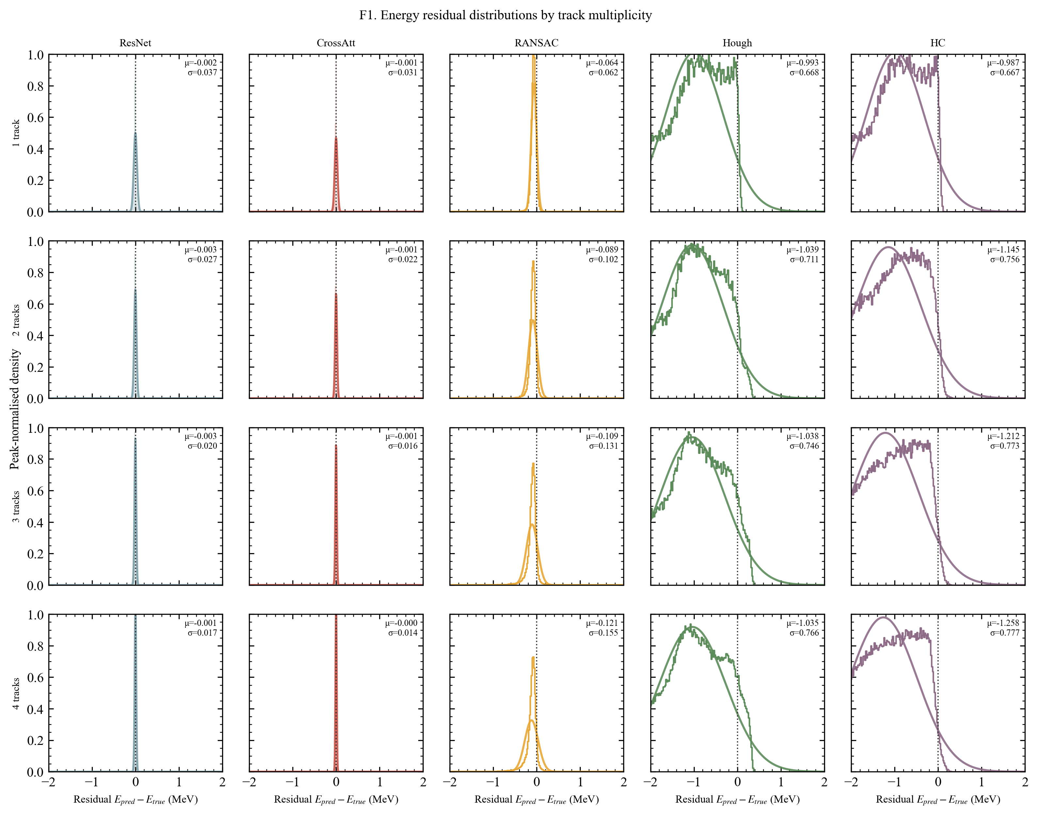
2.1 NEW BASELINES
PAPER: PARTIAL
Classical energy baselines — RANSAC, Hough, HC
Method | RMSE (MeV) | Mean err (MeV) | Missing slots
RANSAC | 1.2400 | −1.0037 | 38,386
Hough | 1.2776 | −1.0383 | 30,086
HC (Hierarchy Cluster) | 1.4269 | −1.2069 | 36
54–76×
worse RMSE than the CNNs on the identical TRK5 test split
Image-only baselines on the SHA-1-audited TRK5 split (180,000 truth events; 179,964 in error stats); track length → energy via the SRIM lookup (4.2).
All three systematically underestimate energy; HC = Hierarchy Cluster (scipy agglomerative, ward) — explicitly NOT Hough.
Gap is moderated by the LM-refined RANSAC (next slide).
F1 — residual overlay, 5-method suite (regenerated 2026-06-10)
Progress Beyond the Paper · archive summary · 2026-06-11
7

Slide 8
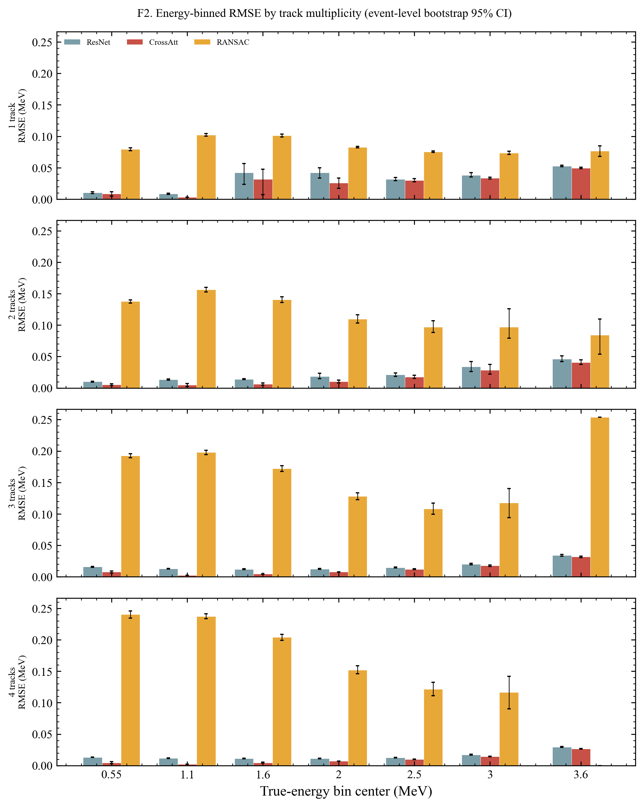
2.2 NEW BASELINES
PAPER: ABSENT
LM-refined RANSAC (June 9–10, 2026 — uncommitted)
0.159
7–8×
8.47×
LM-refined RANSAC RMSE (rel. 10.61%)
better than plain RANSAC (1.176 MeV on this set)
still worse than TRK6 (0.0188 MeV)
Re-evaluated on the NEW alpha_sim_0_20_160 dataset (59,992 events); LM-refined fit at full coverage (177,864 events; 2,861 missing of 383,935 truth slots); MAE 0.1076 MeV.
Changes the comparative narrative: CNN advantage shrinks from ~60× (plain baselines) to ~8× against the best classical method.
Cautions (must carry into any paper text)
Different dataset/split than the May comparison matrix — not directly commensurate (F7 masks these pairs).
Re-run overwrote the 2026-05-18 ransac-opt test metrics (the runs directory is git-untracked); post-dates last commit 7a92841 — uncommitted.
F2 — per-bin RMSE (RANSAC variant)
Progress Beyond the Paper · archive summary · 2026-06-11
8

Slide 9
3.1 NEW ANALYSES
PAPER: STALE
A/Z — wrong governing parameter for dE/dx PID
Paper's framing (still in main.tex)
Documented investigation (2026-03-06)
Motivation built on Δ(A/Z): abstract quotes “Δ(A/Z) ~ 8%” for 13C/14C; Table 1 quantifies A/Z.
No Tassan-Got / Z²A correction appears anywhere — the recorded decision was never propagated.
Tassan-Got identification parameter: Z²·A^μ (NIM B 194, 2002); TPC range–energy scaling goes as A/Z².
Counter-example: d vs ⁴He have identical A/Z = 2, yet Z²A of 2 vs 16 — the A/Z narrative fails cross-element.
Saving grace & required action: for same-Z isotope pairs (all comparisons in the paper) the Δ(A/Z) ranking equals a ΔA ranking, so statements are not wrong in practice — but for an NST reviewer this is a correctness risk in the central motivation. Recorded decision: soften the abstract's conventional-method critique to practical drawbacks.
Progress Beyond the Paper · archive summary · 2026-06-11
9

Slide 10
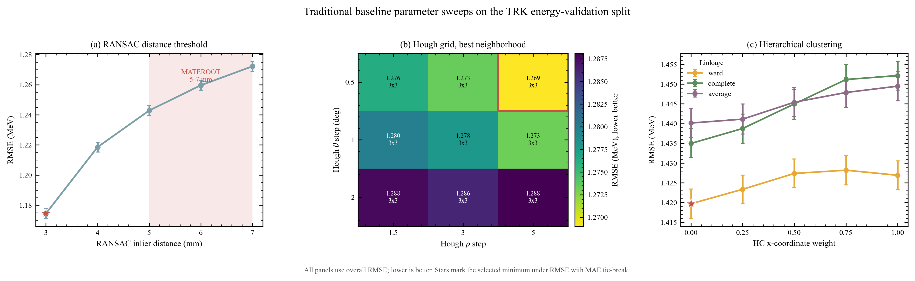
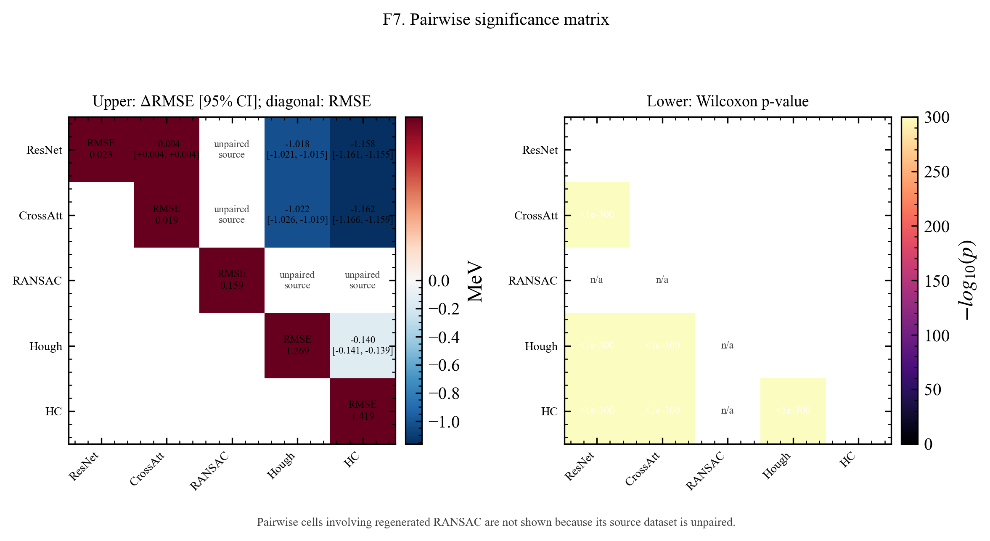
3.2 NEW ANALYSES
PAPER: ABSENT
Baseline sweeps, -opt runs & significance matrix
F7 — pairwise significance (unpaired-RANSAC pairs masked)
Validation-split grid sweeps: RANSAC 5 cfgs · Hough 27 cfgs · HC 15 cfgs (winners: 3.0 mm; ρ 5.0 / θ 0.5° / NMS 3×3; ward / x_weight 0)
-opt test re-runs moved baselines only marginally: ΔRMSE 0.0246 / 0.0179 / 0.0064 MeV — the ~1 MeV gap to TRK6 is NOT an under-tuning artifact.
All 28 method pairs Bonferroni-significant (Wilcoxon, max p = 5.1e-253; 1000 bootstrap resamples; Cohen's d recorded).
Supplies the complete statistical machinery the paper currently lacks — it has no significance testing at all.
Caveat: on-disk ransac-opt artifacts overwritten 2026-06-10; the 0.0246 delta survives only in the frozen comparison_matrix.json.
Progress Beyond the Paper · archive summary · 2026-06-11
10

Slide 11
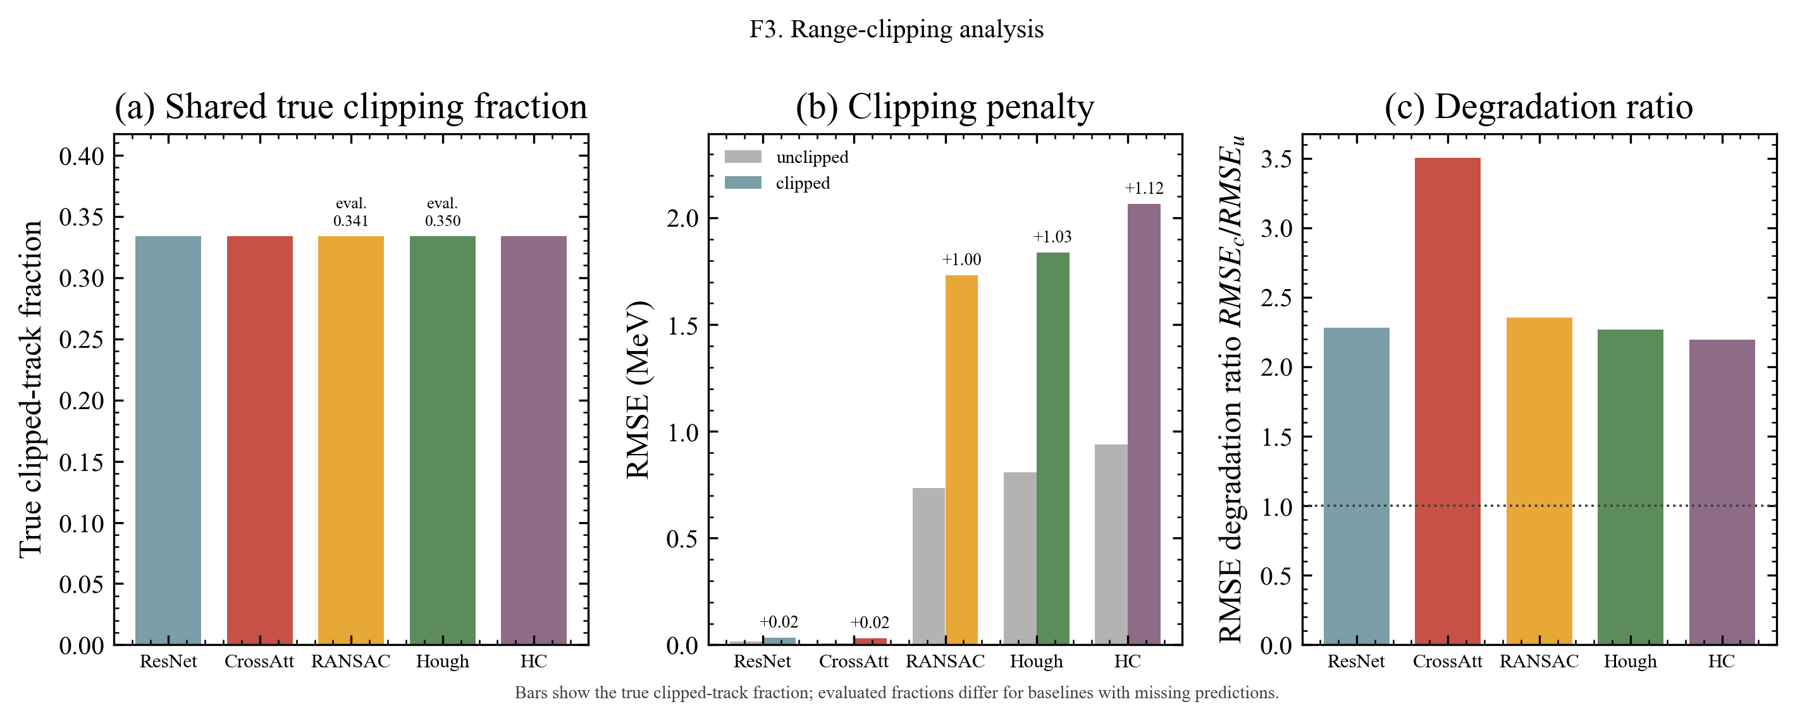
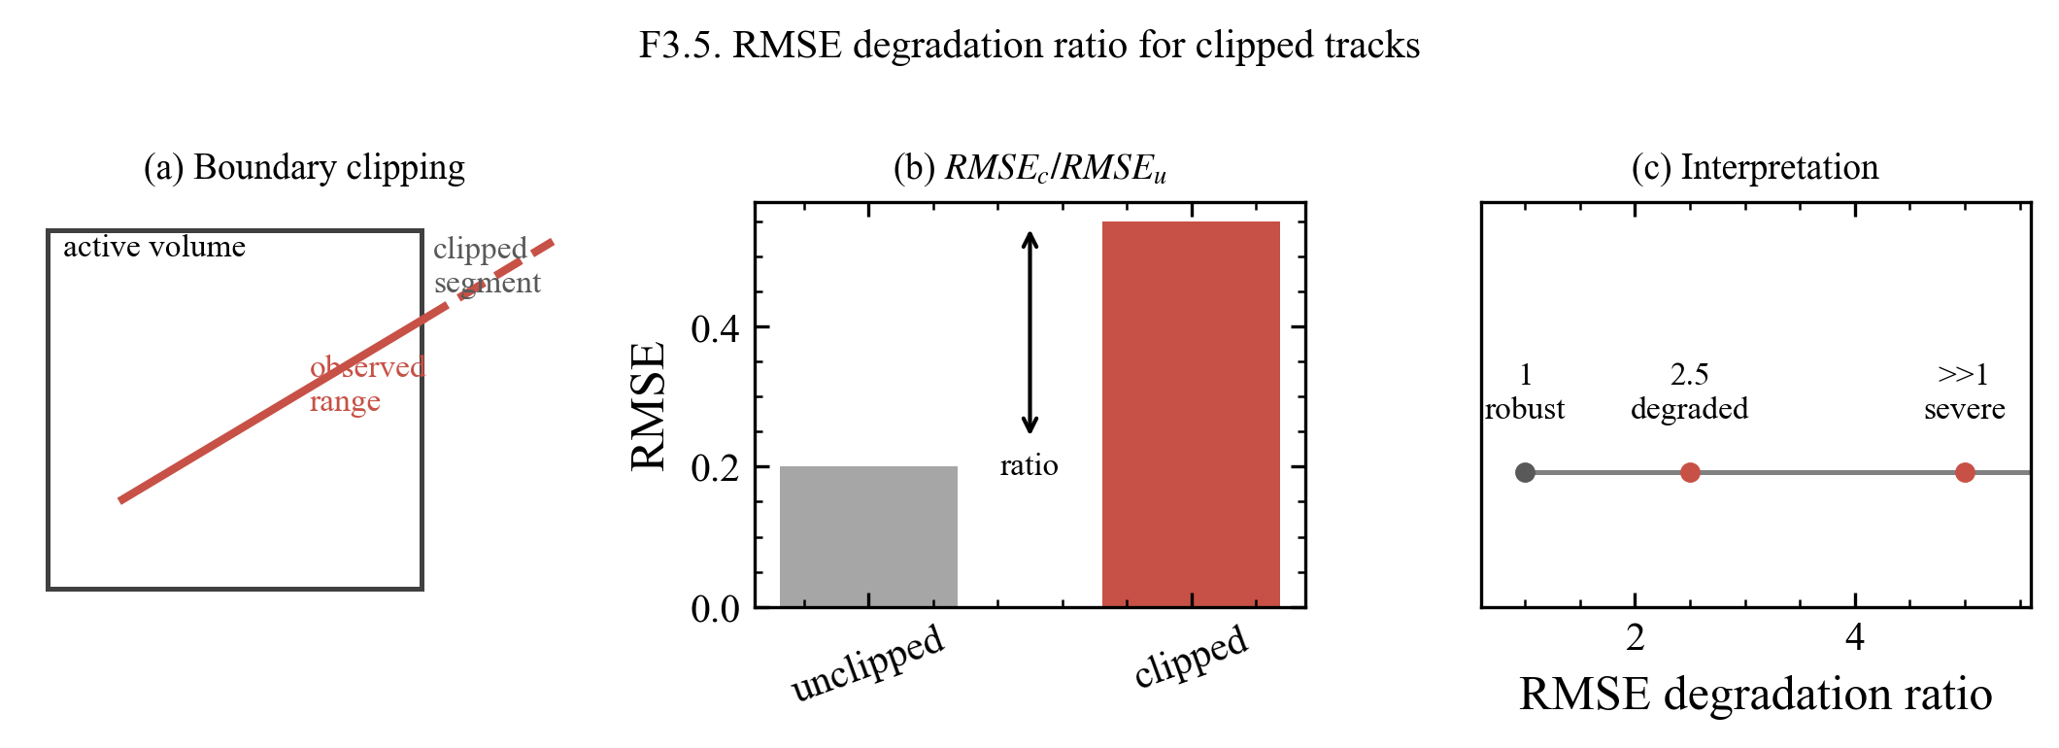
3.3 NEW ANALYSES
PAPER: PARTIAL
Range clipping — partial clipped-energy recovery
33.4%
0.030–0.034
2.28 / 3.50
of test slots are range-clipped
CNN clipped-region RMSE (MeV) vs 2.0–2.3 for plain classical
degradation ratio TRK5 / TRK6 (clipped ÷ unclipped RMSE)
Physics-rich finding: the CNN must learn more than geometric range (e.g., charge-deposition profile) to recover clipped-track energy — a natural physics-informed narrative hook.
Exception: June-10 LM-refined RANSAC reaches 0.083 MeV in the [3.3, 4.0] MeV bin (ratio 0.576) — “classical methods are crippled by clipping” no longer holds as a blanket claim.
Note: TRK6's ratio (3.503) is a larger relative degradation than the baselines' (~2.2); the recovery claim rests on absolute clipped RMSE, not the ratio.
Figures F3/F3.5 were cut from the suite on 2026-06-10; the analysis survives in both metrics.json range_clipping blocks — revisit at drafting.
F3 / F3.5 — range-clipping analysis and degradation-ratio explainer (superseded 2026-05-27 suite; both cut from the current suite on 2026-06-10)
Progress Beyond the Paper · archive summary · 2026-06-11
11

Slide 12
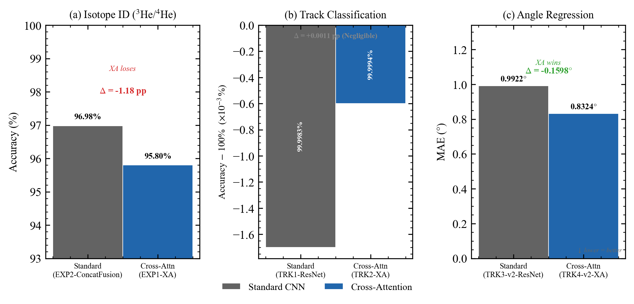
3.4 NEW ANALYSES
PAPER: ABSENT
Cross-task report & paper-ready tables TRK-T1…T6
What exists, ready to land
Standalone narrative report runs/TRK-comparison-angle/summary.md (2026-04-11).
Six compiled CSV/LaTeX tables: T1 classification · T2 energy-stratified accuracy · T3 regression summary · T4 angle error by energy · T5 cross-task verdict · T6 HP effect.
Report's own Status line: paper integration deferred — prepared but never landed.
cross_task_honest_comparison — the T5 verdict in one figure
LOSES
Isotope ID 3He/4He: ConcatFusion 96.98% vs EXP1-XA 95.80% (−1.19 pp; documented comparator asymmetry)
TIES
Track-count classification: +0.0011 pp at ceiling — task saturated (1.4)
WINS
Angle regression: −0.1599° MAE (1.3) — the defensible cross-attention claim is task-dependent
Progress Beyond the Paper · archive summary · 2026-06-11
12

Slide 13
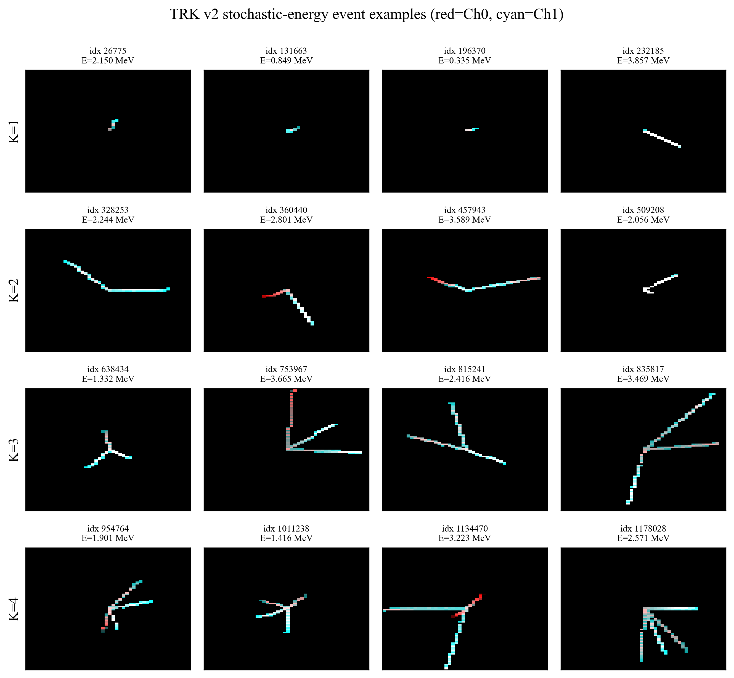
4.1 METHODS & INFRA
PAPER: PARTIAL
v2 continuous-energy dataset & 19-probe QA gate
1.2M
37 GB
18 / 1
events, 4-file v2 layout (300k each, IMP server)
uncompressed trk_all_ uncompressed_v2.h5
QA probes pass / warn — “GATE PASS WITH WARN”
Pipeline extended to emit energy_truth_mev (N, 4) with sentinel; QA levels 1–6 + level-7 verdict (uniformity χ² 43.40, KS p 0.376; θ isotropy KS p 0.579; zero NaN).
QA discovered the AC2 contract: NimpSim samples ONE energy per event, broadcast to all slots (max per-event slot std = one float32 ULP) → forces the claim narrowing to PER-EVENT energy regression.
Training-correctness fix: a hard-coded deg→rad π/180 scale would have shrunk MeV targets ~57×.
Exactly the methods-section content a regression chapter requires; broadcast contract pre-registered only in the comment block.
v2-dataset event-example gallery (K = 1…4)
Progress Beyond the Paper · archive summary · 2026-06-11
13

Slide 14
4.2 METHODS & INFRA
PAPER: PARTIAL
SRIM lookup — alpha in He:CO₂ 95:5 at 0.5 bar
R = 8.03 · E^{1.32} cm
Validation 3 / 3 PASS
Am-241-in-air anchor 40.85 mm exact (+0.00%)
Worst Bragg cross-check −5.40% at 0.30 MeV (within ±10%)
Strict monotonicity across the full table
global power-law fit (A = 8.0316, n = 1.3214); 100-row log-spaced table over [0.05, 10.0] MeV with provenance metadata + re-runnable generator/validator
Methodology: NIST ASTAR + Bragg additivity fallback (pysrim/SRIM.exe unavailable); log-log piecewise-linear interpolation.
Sole range→energy inverter for all three classical baselines (common.py srim_range_to_energy) and sole SRIM source for the range-clipping analysis (forward direction).
Straggling columns flagged as ~10×-understated analytic placeholders — excluded from baseline consumption.
Drafting caveat: AC8 item (d) pre-registers “pysrim SR (tabulation) mode”, but the executed branch was the ASTAR fallback — wording must be corrected.
Progress Beyond the Paper · archive summary · 2026-06-11
14

Slide 15
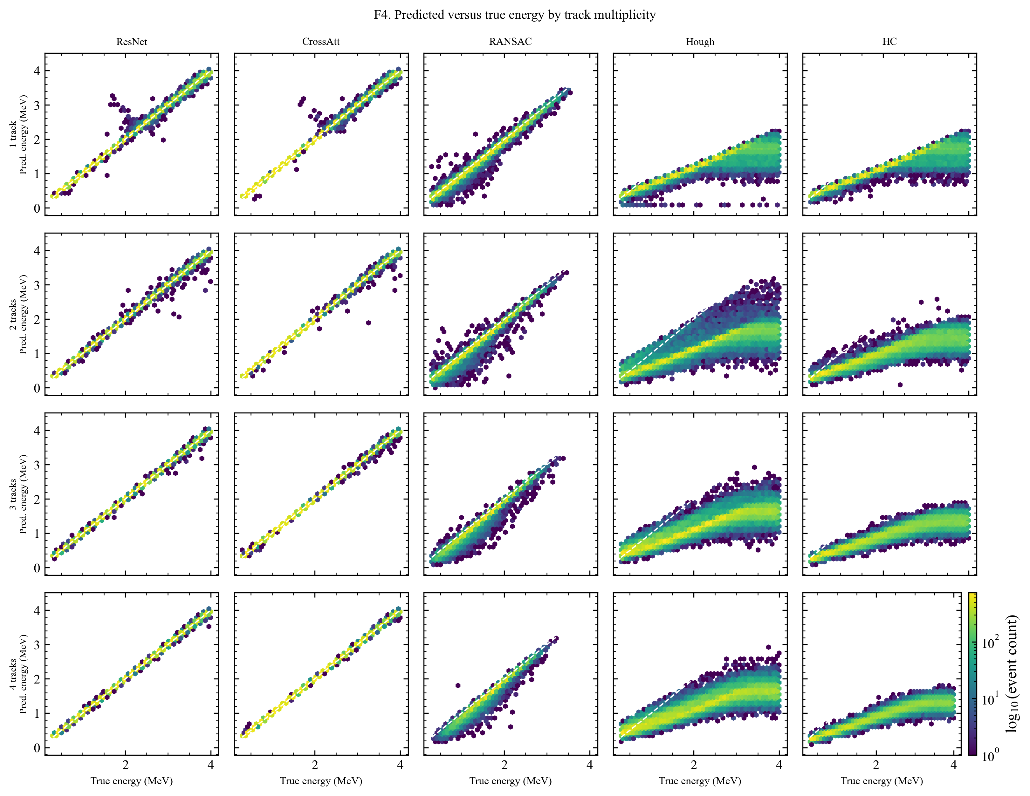
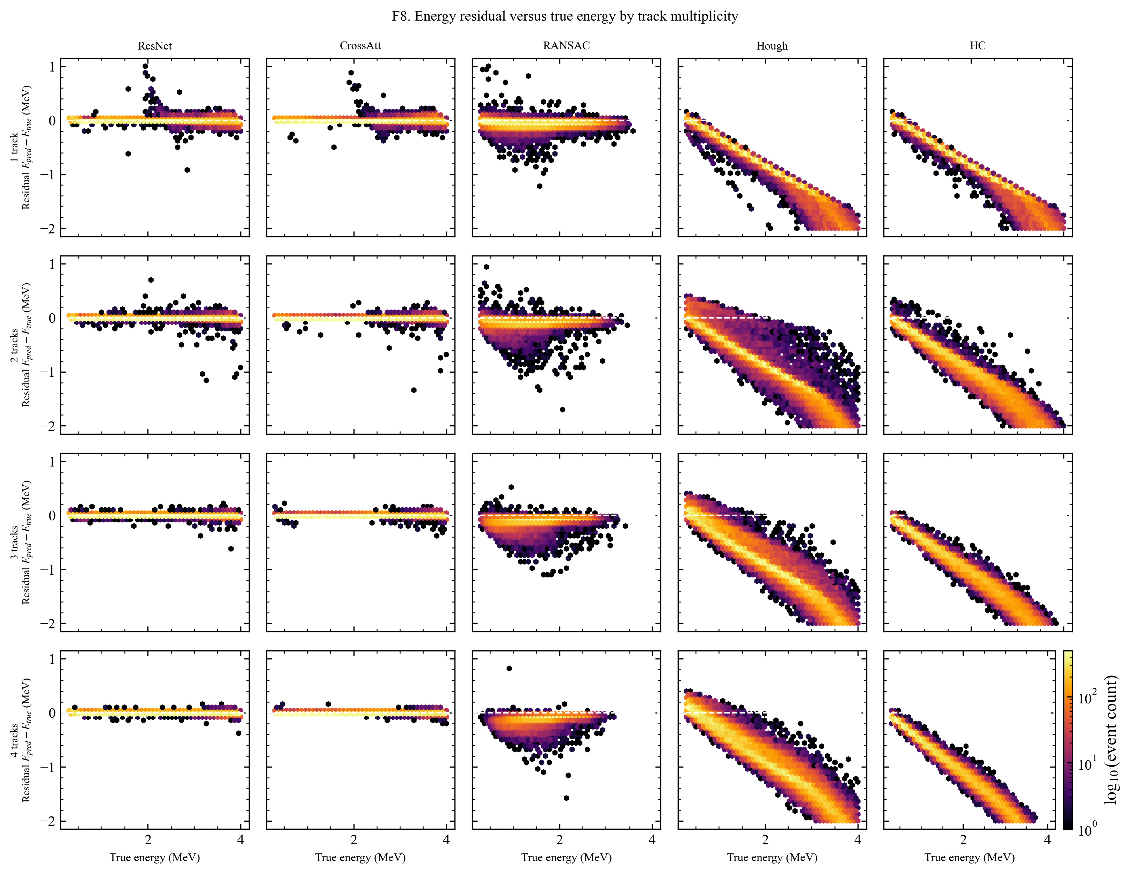
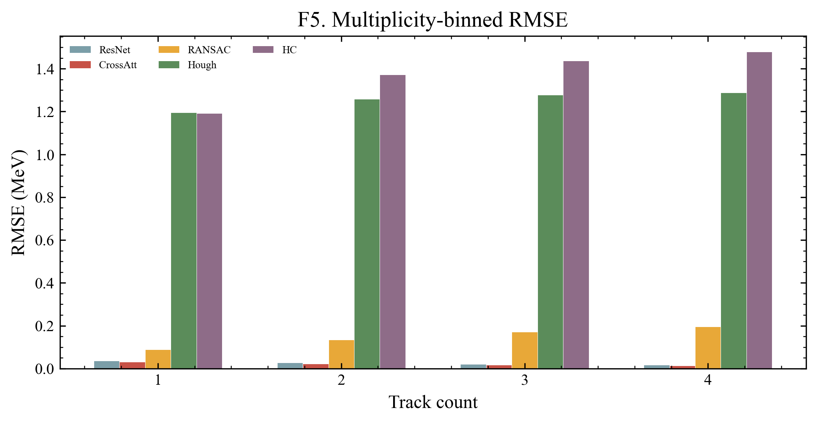
5.1 FIGURES
PAPER: ABSENT
A near-complete publication figure suite exists
Status
main.tex has exactly 12 \includegraphics — none energy-regression.
Academic-draw compliant; 5-method -opt suite regenerated 2026-06-10.
2026-05-14 predecessor suite reviewer-approved; the 06-10 regeneration not re-reviewed.
Drafting prose is the only missing step.
F1 residual overlay
F2 per-bin RMSE + CIs
F4 pred-vs-truth hexbin
F5 per-track-count RMSE
F7 significance matrix
F8 residual-vs-truth
Progress Beyond the Paper · archive summary · 2026-06-11
15

Slide 16
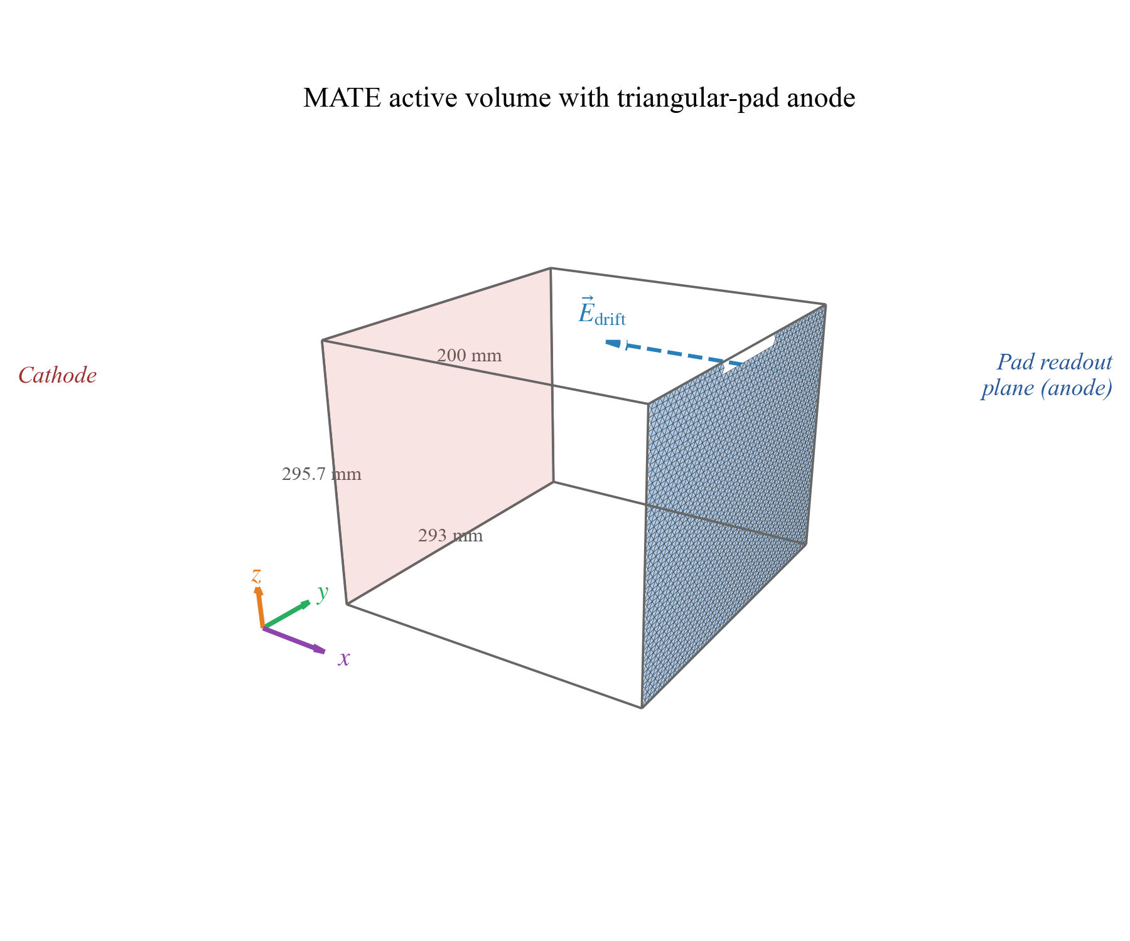
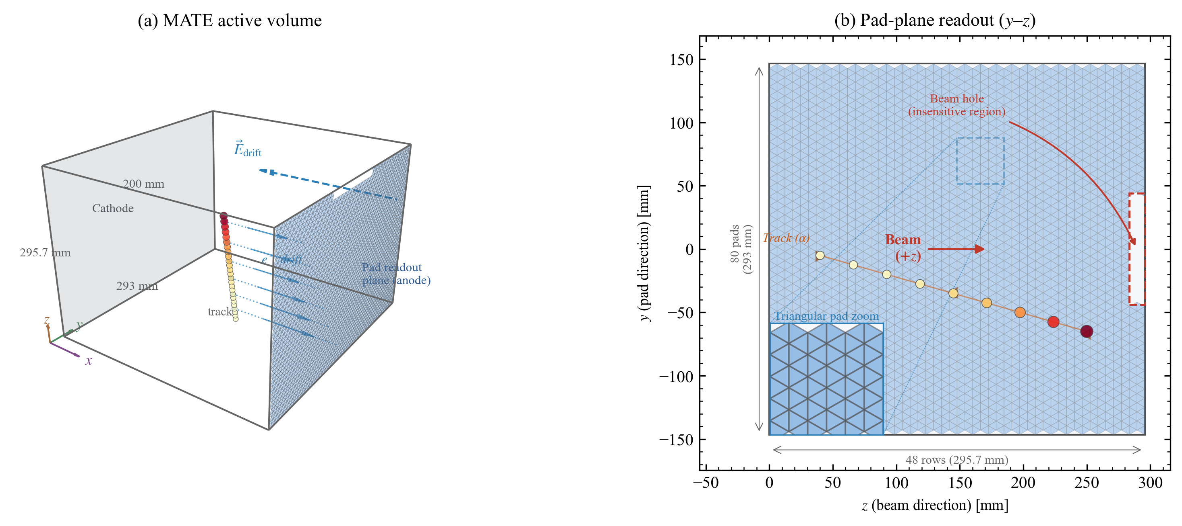
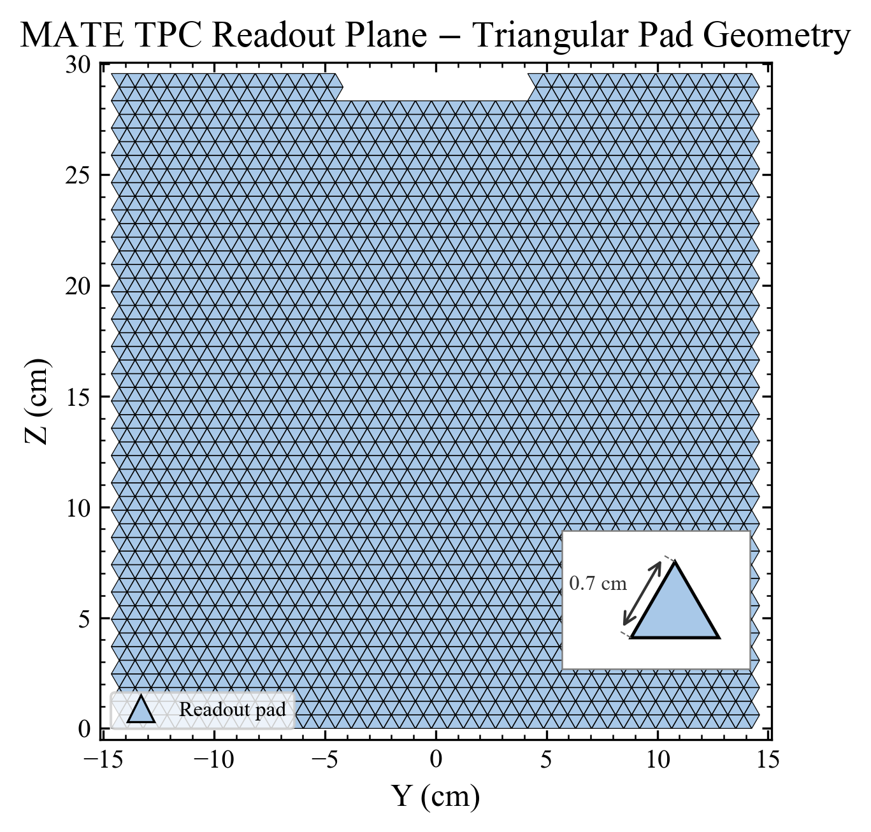
5.2 FIGURES
PAPER: ABSENT
Ready-made geometry figures the paper never references
mate_3d_schematic
mate_geometry_schema
mate_pad_geometry (3792 triangular pads, beam hole)
Low-effort integration win: all dated 2026-04-23/24 (after main.tex's last edit), with generator scripts; main.tex includes none — Section 2 currently describes the 80×48 triangular-pad geometry in text only.
Progress Beyond the Paper · archive summary · 2026-06-11
16

Slide 17
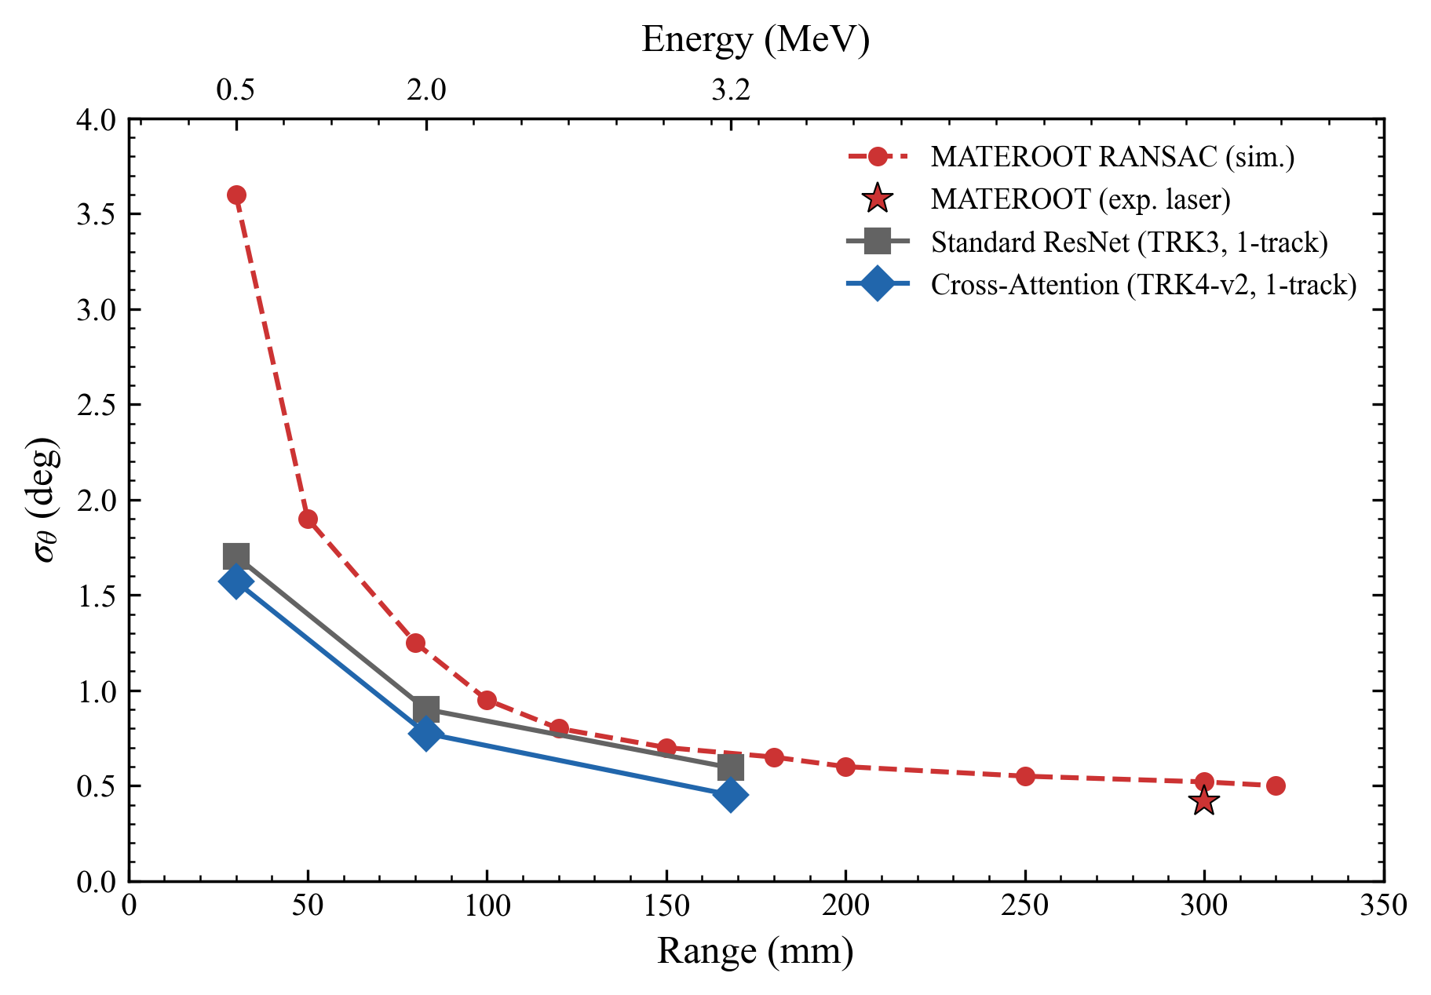
6.1 PRESENTED, NOT PUBLISHED
PAPER: ABSENT
CNN beats MATEROOT's published angular resolution
Range | CNN σθ | MATEROOT
~30 mm | 1.764° | 3.6°
~83 mm | 0.875° | 1.25°
~168 mm | 0.513° | ~0.68°
1.3–2×
49% → ~0
better than published (Lu Li et al., NST)
wrong-track-count rate, MATEROOT vs CNN
Delivered at group meeting 2026-03-26; 8 figure pairs incl. digitized overlays; RANSAC distance-parameter fragility documented.
Explicit caveat: different simulation campaigns, ~15–20% range-mapping uncertainty.
Strongest external-positioning result in the repository — a natural anchor for a trajectory-reconstruction paper or chapter.
Digitized MATEROOT Fig. 4/8 overlay vs CNN (group_meeting_20260326.pptx)
Progress Beyond the Paper · archive summary · 2026-06-11
17

Slide 18
6.2 PRESENTED, NOT PUBLISHED
PAPER: ABSENT
Institutional decks — provenance of the TRK story
Imai (UTokyo) meeting — 2026-04-13
Mid-term assessment
imai_meeting_20260413.pptx, built 2026-04-12 (PptxGenJS/Node); markdown 01–07 are assembled source material.
Covers thesis experiments, MATE NST-paper numbers (ResNet-50 90.47% exp / 97.89% sim, 12C+12C elastic-vs-fusion, F1 = 0.931), the mid-March EXP pivot, TRK pipeline shipped 2026-04-11.
Chinese-language deck 硕士中期考核_胡智恒_2026-04.pptx.
Both decks first committed 2026-05-22 (commit 7a92841).
Why it matters: minor for paper content, but useful provenance — the TRK trajectory-reconstruction story was already the project's externally presented progress narrative in April 2026 while the manuscript remained classification-only.
Progress Beyond the Paper · archive summary · 2026-06-11
18

Slide 19
APPENDIX
PAPER: CONTEXT
Checked and rejected during verification
EXP1 matched-training-size (“headline gain is data scaling”)
Advisor deck “Energy Regression Comparison” (2026-05-18)
Numbers verified, but the significance misattributes the target: it undercuts the V6-ablation +0.8 pp claim, NOT the abstract's +4.2 pp 3He/4He claim, whose confound remains unresolved. “Built the entire src/” also overstated.
Deck has 17 slides, not 19; headline paired-diff sign was flipped in source notes (correct: ResNet − CrossAtt = +0.00433 MeV); SoTA-anchor and decision-request slides exist only in the 05-19 notes version.
TRK angular-resolution supplement toolchain (June 2026)
EXP5 / EXP7 figure artifacts
“+106/+93 lines” is diffstat churn (net +62/+69); “validated end-to-end” is false — inference, ROOT conversion, and plot merge never executed; smoke test used a 3-event synthetic NPZ.
Provenance disqualifying: EXP5 figures render hard-coded placeholder data (RUN_DIRS all None); EXP7 falls back to an unmatched legacy AFTPC_V3 run (91.5%) with a reconstructed confusion matrix. No EXP5/EXP7 training ever ran.
Progress Beyond the Paper · archive summary · 2026-06-11
19

Slide 20
SUMMARY
All 16 findings at a glance
§ | Finding | Paper | One-line significance
1.1 | TRK5/TRK6 energy regression | PARTIAL | Extends the paper to quantitative reconstruction
1.2 | EXP2 fusion comparison | STALE | Concat > Gated > CrossAtt — challenges the framing
1.3 | TRK3/4-v2 angle regression | ABSENT | Strongest cross-attention win (−16.1% MAE)
1.4 | TRK1/2 track-count classification | ABSENT | Multi-track capability demonstrated; task saturated
2.1 | Classical baselines (RANSAC/Hough/HC) | PARTIAL | Conventional context; 54–76× worse than CNNs
2.2 | LM-refined RANSAC | ABSENT | Newest result; CNN advantage shrinks ~60× → ~8×
3.1 | A/Z governing-parameter correction | STALE | Correctness risk in central motivation (Z²·A^μ)
3.2 | Sweeps + significance matrix | ABSENT | Pre-empts under-tuning objection; full statistics
3.3 | Range-clipping analysis | PARTIAL | CNN recovers clipped-track energy — physics hook
3.4 | Cross-task report, tables T1–T6 | ABSENT | Task-dependent architecture narrative, LaTeX-ready
4.1 | v2 dataset + 19-probe QA gate | PARTIAL | Per-event broadcast contract — load-bearing
4.2 | SRIM range→energy lookup | PARTIAL | Methods content; pre-registered wording needs fix
5.1 | Energy-regression figure suite | ABSENT | Near-complete figure package; prose is the only gap
5.2 | Geometry schematics | ABSENT | Low-effort Section-2 integration win
6.1 | TRK vs MATEROOT comparison | ABSENT | Beats published angular resolution 1.3–2×
6.2 | Institutional decks | ABSENT | Provenance of the presented TRK narrative
Progress Beyond the Paper · archive summary · 2026-06-11
20

