Slide 1
Dos Ojos
Two eyes on every field
A text message that tells Rio Grande Valley farmers when to water, and where to look.
Satellite · Drone · Thermal camera · Text messages in Spanish and English
Notes:
Dos Ojos means 'two eyes'. One eye is a satellite that watches every field for free. The other is a drone, used only where it's needed. The farmer never opens an app: everything comes by text message, in Spanish or English. Add your name and the event here.

Slide 2
Farmers find out too late
Water costs money
Fields are too big to walk
The tools don't fit
Every watering costs water, fuel and a day's work. Too early wastes it. Too late costs the crop.
A problem in the middle of a big field can grow for weeks before anyone sees it from the road.
Most farm software means an app, a password and a dashboard, usually in English. Every farmer already has text messages.
2
Notes:
Three problems. Water: watering at the wrong time wastes money or hurts the crop. Size: nobody can walk every acre every week. Tools: most agriculture technology assumes an app, a login and English. Text messages are the one tool every farmer already uses.

Slide 3
Two eyes, one text message
Eye one: the satellite
Looks at every field about every 5 days. It's free, and the farmer needs nothing at all.
Satellite
Drone
Eye two: the drone
Zooms in only where it matters: plant by plant, the lie of the land, and with a thermal camera, hot spots that can mean pests.
The answer comes by text
In Spanish or English, on any phone.
The two circles in the corner of each slide show which eye is at work.
3
Notes:
The satellite is the everyday eye: it covers every field for free, and most farmers will only ever use this. The drone is the zoom lens, called in when something needs a closer look. Both feed into the same thing: a plain text message.

Slide 4
How a text message gets made
1
2
3
4
The satellite passes
Compare the field with itself
Keep a water checkbook
Text the farmer
A fresh picture of every field, about every 5 days.
Is it as green as it usually is on this date? The yardstick is its own past years, never a neighbour's farm.
Rain and every watering the farmer texts in go in. Sun and heat take water out.
When to water and how much. Reply WHY to see the working.
Only if the farmer wants more: send drone photos for a plant-by-plant check, or add a thermal camera for an early pest warning.
4
Notes:
Four steps, all automatic. The key idea in step 2: we never judge a field against someone else's. Soils and varieties differ, so the only fair comparison is the field's own history. Step 3 is just bookkeeping: water in, water out. The drone and the thermal camera are extras on top.

Slide 5
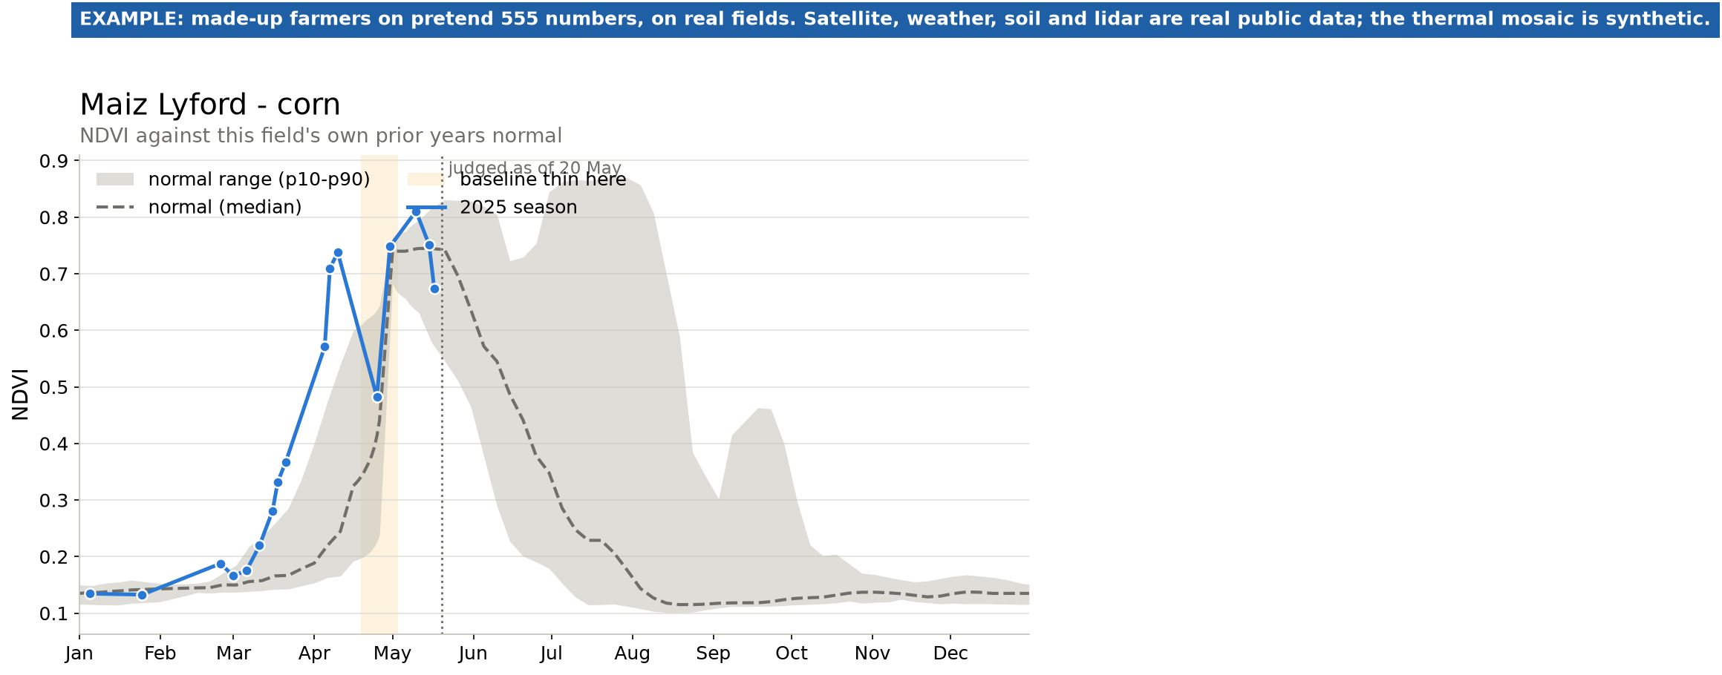
Every field against its own past
Maiz Lyford, a real corn field near Lyford, Texas. Satellite: Sentinel-2 (Copernicus), free.
The green line
How green the field is this season, measured from space.
The grey band
What this same field usually looks like on this date, in past years.
Below the band
Behind its own normal: worth a closer look.
5
Notes:
This is a real corn field. The green line is this year. The grey band is what this field normally does at this time of year. When the line drops below the band, the field is doing worse than it usually does. That's the signal to pay attention.

Slide 6
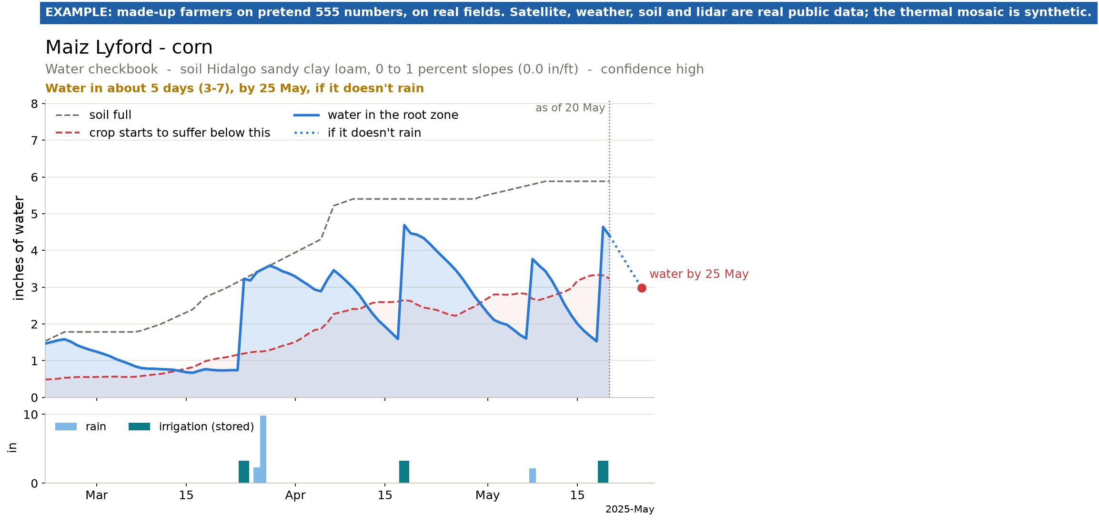
Water, kept like a checkbook
The balance
How much water this soil can hold for the roots.
Deposits
Rain, plus every watering the farmer texts in.
Withdrawals
What sun and heat pull out each day, sized to how green the crop is.
Result: water by 25 May, about 4 inches.
Same corn field. Soil: USDA soil survey. Weather: gridMET, government data.
6
Notes:
Think of the soil like a bank account for water. Rain and irrigation are deposits. Every hot day is a withdrawal. When the balance gets low enough to hurt the crop, we tell the farmer to water, and roughly how much. The dotted line on the chart is what happens if it doesn't rain.

Slide 7
DEMO
A week in the Valley
Juan, Maria and Pedro are made up. Their fields near Lyford, Elsa and Primera are real, and so is every satellite picture, weather reading and soil map behind their answers.
Every message and screen on the next slides comes from the working simulator.
Notes:
Now a demo. Juan, Maria and Pedro are made-up farmers, but their fields are real fields from public USDA maps, and the satellite and weather data behind their answers are real. Maria and Pedro grow grain sorghum. Every message you'll see was produced by the working system, not typed into the slides.

Slide 8
DEMO 1 / 5
Signing up is a text conversation
Dos Ojos text messages with Juan (made up)
No app, no password, any phone.
hola
hello
Then it asks, one question at a time:
¿Qué quiere usar? 1 Solo satélite (no necesita nada) 2 Satélite y su dron 3 Satélite, dron y camara térmica (plagas). Siempre puede cambiar con PLAN.
What the field is called
About how many acres
What would you like to use? 1 Satellite only (you need nothing) 2 Satellite and your drone 3 Satellite, drone and thermal camera (pests). Change any time with PLAN.
Where it is: a map pin
3
What's planted, and when
How it's watered
Nota: para volar un dron sobre su rancho la ley pide licencia FAA Parte 107 (examen de $175). Usted decide si la saca, si contrata a alguien o si se queda solo con el satélite.
The last time it was watered
Note: to fly a drone over your farm the law asks for an FAA Part 107 licence ($175 exam). Up to you whether to get it, hire someone, or stay on satellite only.
Option 1 needs nothing at all. Nobody is told they need a drone.
8
Notes:
Juan texts 'hola'. After his name and consent, he picks what he wants to use. Option 1 needs nothing: satellite only. He picks 3, so the system warns him, honestly, that flying a drone needs a $175 FAA licence, and that it's his choice. Then it asks about each field, one question at a time.

Slide 9
DEMO 2 / 5
One word, "AGUA", gets a plain answer
Dos Ojos text messages with Juan (made up)
The alert came first
Juan didn't have to ask. The cotton was a day from running dry.
Aviso Dos Ojos: Algodon Lyford necesitara agua en 1 dia, antes del mié 21 may. Si ya rego, mande REGUE y la fecha.
Dos Ojos alert: Algodon Lyford will need water in 1 day, by Wed May 21. If you already watered, text WATERED and the date.
Days left, with a range
Weather is never certain, so every answer says how sure it is.
AGUA
WATER
Algodon Lyford (algodon): tiene agua para 1 dia (0 a 2); riegue antes del mié 21 may, unas 3.7 pulgadas por surcos. Esta en floracion: no lo deje secar.
A date and an amount
Water by this day, about this many inches, the way he already waters.
Algodon Lyford (cotton): water for 1 day (0 to 2); water by Wed May 21, about 3.7 inches by furrows. It's at bloom: don't let it dry out.
Maiz Lyford (maiz): tiene agua para unos 5 dias (3 a 7); riegue antes del dom 25 may, unas 4.1 pulgadas por surcos.
Why it matters now
The cotton is in bloom, when running dry hurts the most.
Maiz Lyford (corn): water for about 5 days (3 to 7); water by Sun May 25, about 4.1 inches by furrows.
9
Notes:
First, an alert arrives on its own: the cotton will need water in a day. Juan texts AGUA, water, and gets both fields: how many days of water are left, a range because weather is uncertain, the date to water by, and about how many inches. The English under each bubble is what an English-speaking farmer would get.

Slide 10
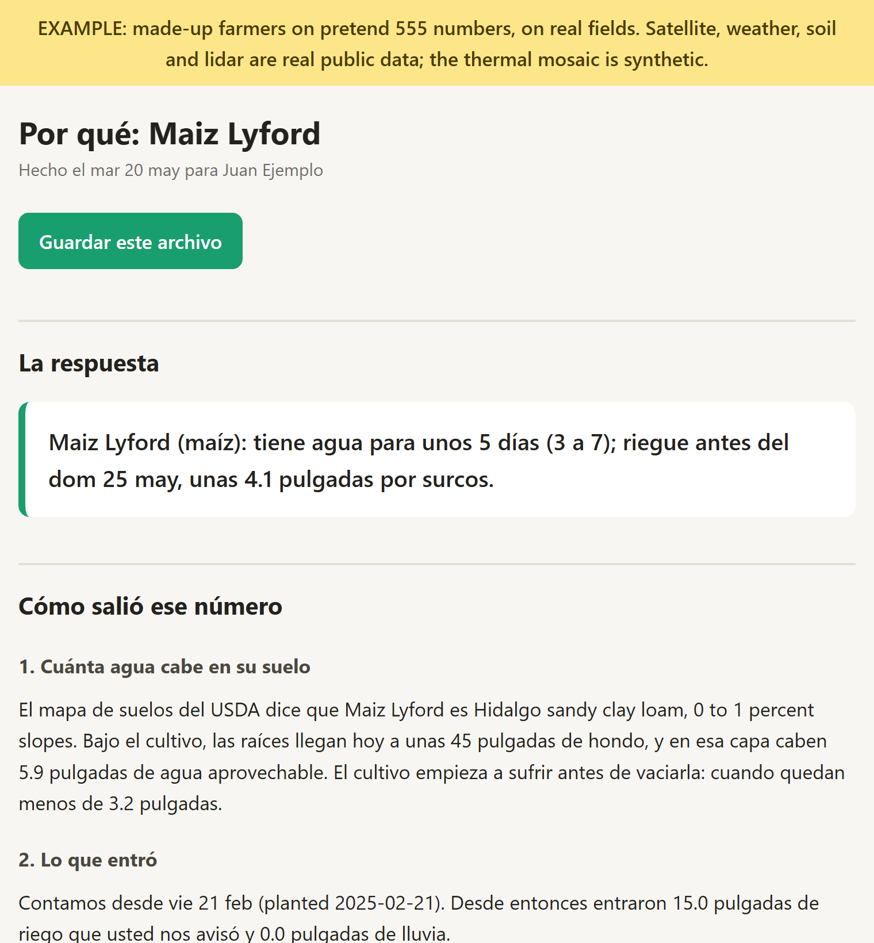
DEMO 3 / 5
Reply "PORQUE" to see the working
Dos Ojos text messages with Juan (made up)
¿Quiere saber por qué? Responda PORQUE y le mando un archivo con las graficas.
Want to know why? Reply WHY and I'll send you a file with the charts.
PORQUE
WHY
Por qué Maiz Lyford: http://localhost:8080/r/3XSppiK5N7mfIs8L . Trae las graficas del satélite, la cuenta del agua y el terreno. El enlace dura 14 dias.
Why Maiz Lyford: [link] . It has the satellite charts, the water arithmetic and the ground. The link lasts 14 days.
A farmer asked to open a valve on our say-so is owed the arithmetic.
It's always an offer, never a file nobody asked for.
The page Juan opens: the same answer, the four steps with his field's own numbers, then the charts. It works saved or offline.
10
Notes:
Every answer ends with an offer: want to know why? Reply PORQUE and you get a link to one page. It repeats the same answer, then shows the four steps with the field's own numbers: how much water the soil holds, what went in, what the sun took out, what's left. The charts are inside the file, so it works even without signal.

Slide 11
DEMO 4 / 5
Sorghum: stage and scouting by text
Dos Ojos text messages with Maria (made up), dryland near Elsa
Dos Ojos text messages with Pedro (made up), irrigated
Dos Ojos: Sorgo Elsa va en floracion. Esta semana revise pulgon amarillo y mosquita (el umbral es 1 por panoja) y mande PULGON con lo que encuentre.
PULGON 21 de 80
APHID 21 of 80
Dos Ojos: Sorgo Elsa is at flowering. This week scout for sugarcane aphid and midge (the threshold is 1 per head) and text APHID with what you find.
Sorgo Primera: 26% de plantas con pulgon, cerca del umbral de 30% en grano masoso. Revise otra vez en 3 o 4 dias.
ETAPA
Sorgo Primera: 26% of plants with aphids, close to the 30% threshold at soft dough. Check again in 3 or 4 days.
STAGE
Sorgo Elsa: va en floracion, dia 69 desde la siembra. Sigue grano masoso hacia el sab 31 may. Esta etapa decide la cosecha. Revise mosquita cada 3 dias, de 10 a 2: el umbral es 1 por panoja. Revise pulgon amarillo cada semana y mande PULGON. (Lo calculé como ciclo mediano; mande CICLO para cambiarlo.)
The right threshold for the stage
20% of plants before heading, 30% after. Past it: talk to your advisor today. No product is ever named.
Sorgo Elsa: at flowering, day 69 after planting. Next: soft dough around Sat May 31. This stretch sets the yield. Check for midge every 3 days, 10 to 2: the threshold is 1 per head. Scout for sugarcane aphid weekly and text APHID. (Worked out as medium season; text MATURITY to change it.)
No drone needed
Both use the satellite only.
11
Notes:
Two sorghum growers. Maria farms dryland near Elsa. Every week while it matters she gets a reminder to scout, and when she asks ETAPA she hears where her crop is: flowering, day 69, what comes next and when, and what to look for right now. Pedro, near Primera, counted 21 plants with aphids out of 80: 26%, close to the 30% threshold for his stage, so he's told to look again in a few days. Neither has a drone.

Slide 12
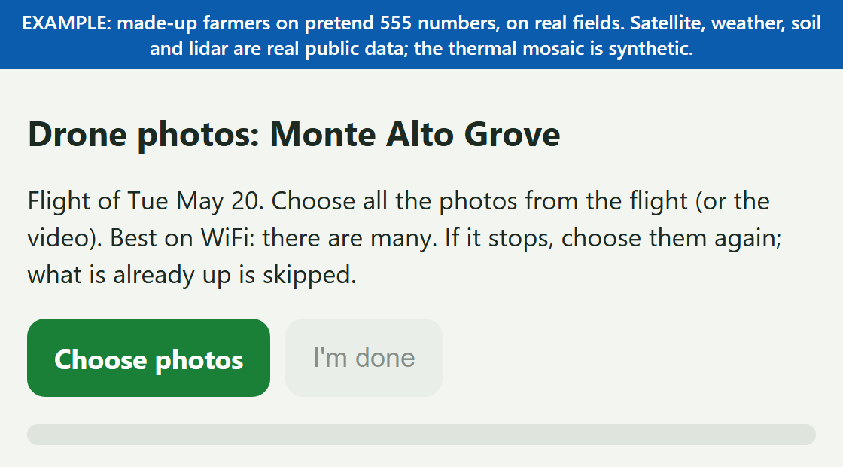
DEMO 5 / 5
Drone photos go in through a link
Dos Ojos text messages with Mary (made up, in English)
DRONE
When you flew, was Monte Alto Grove bare, with no crop? YES or NO
NO
Which day did you fly the drone over Monte Alto Grove? (e.g. today, 9/12)
The upload page Mary's link opens.
today
However the photos were taken
Flown by hand, by a drone that flies itself, or by a licensed pilot the farmer hires, the photos arrive the same way. Best on WiFi, and it picks up where it stopped.
Upload the flight photos here, best on WiFi: http://localhost:8093/u/VWEAyUg7qApUzQee . You can upload in parts; the link lasts 14 days.
12
Notes:
Mary, another made-up farmer, texts DRONE. Two quick questions: was the field bare, and which day did she fly. Then she gets a link to an upload page. Choose photos, and they go to the team to be processed. It doesn't matter who flew or how.

Slide 13
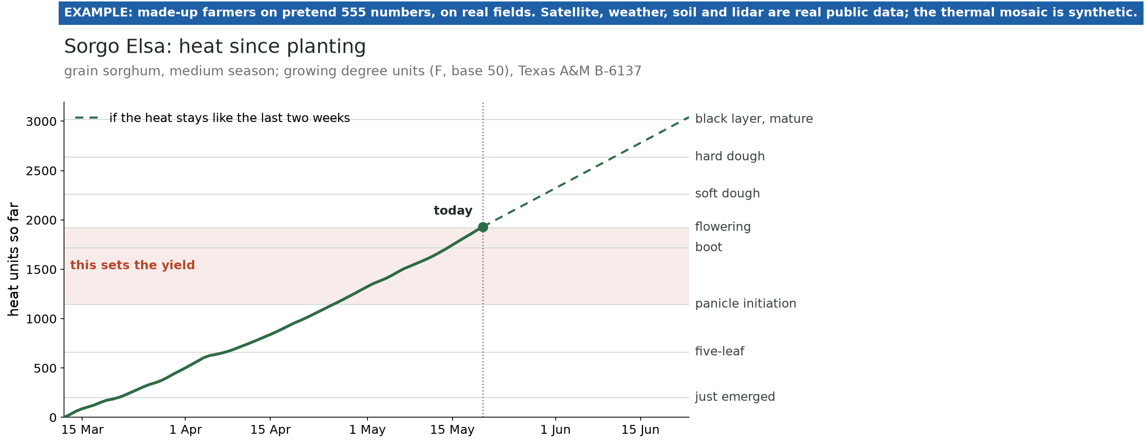
Built for the Valley's sorghum
About 410 grain sorghum fields in one search box on the 2025 USDA crop map
Maria's dryland field near Elsa, 20 May 2025. Heat: gridMET. Stages: Texas A&M AgriLife B-6137.
Stage from heat, not the calendar
Texas A&M's own method: every day's heat, added up since planting.
Water when it decides the harvest
Panicle initiation to flowering sets 70% of the yield.
Pests at the right time
Weekly aphid reminders; midge while it flowers.
13
Notes:
Sorghum is everywhere in the Valley, and it has had few tools of its own. Modern hybrids move with heat, not the calendar, so we add up every day's heat since planting, the way Texas A&M teaches, and read off the stage. The shaded band is panicle initiation to flowering, when each head decides how many grains it will fill: that's when the water warning goes out. And because we know the stage, the aphid threshold and the midge window are the right ones for that week.

Slide 14
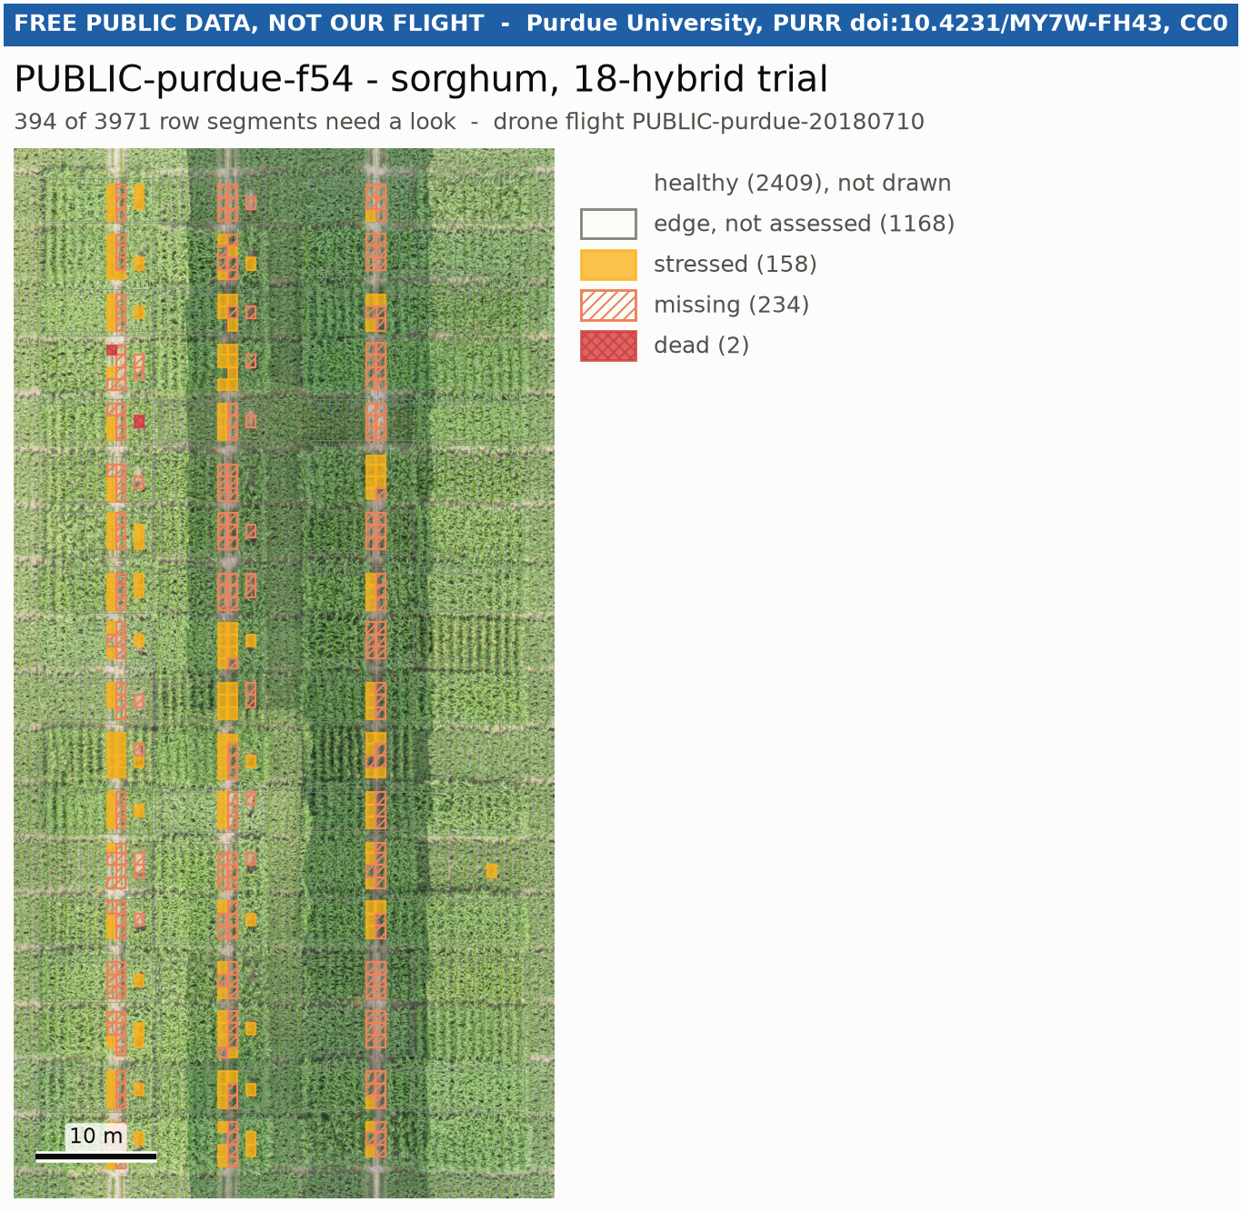
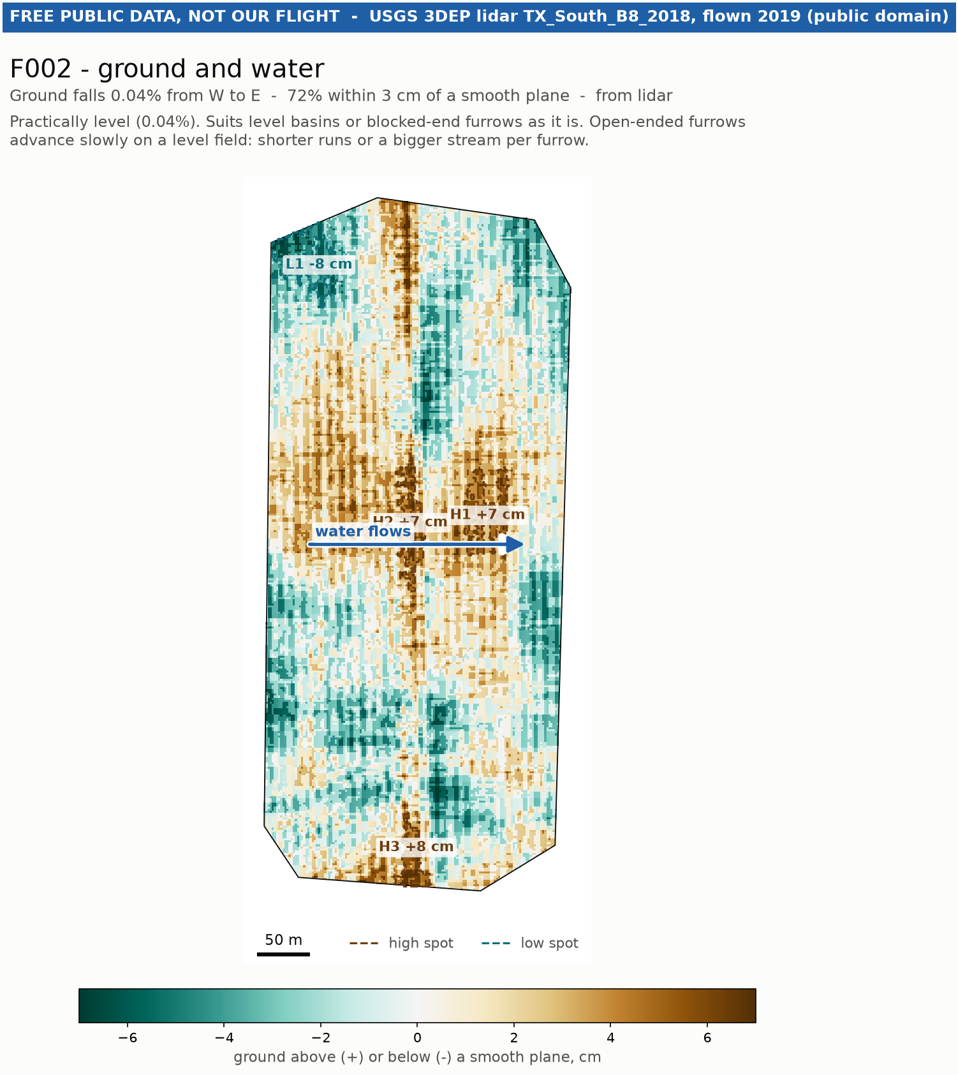
What a drone flight adds
Plant by plant
394 of 3,971 stretches of row worth a look. Sorghum trial, Purdue University.
The lie of the land
Low corners where water sits, high spots it never reaches. Government lidar.
14
Notes:
When a farmer does fly, the drone adds two things the satellite can't see. On the left, every stretch of row judged against the rest of the field: orange is worth a walk. On the right, the shape of the ground: blue is low, where water pools; brown is high, where water may never reach.

Slide 15
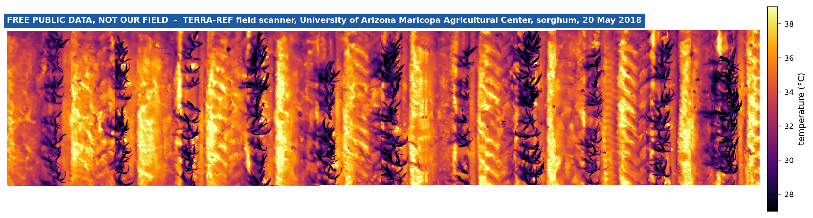
A thermal camera finds hot spots early
Healthy plants sweat to stay cool.
A patch running hotter than the rest of the field is a warning, often before anything shows to the eye.
Dos Ojos text messages with Ana (made up)
Real sorghum under a real thermal camera: the plants (dark) run about 8 °C cooler than the soil. Public research data from Arizona, not our field.
Cámara térmica: 50% de probabilidad de plaga o enfermedad en la esquina suroeste de Scanner Field (29 m2). Vaya a verlo; la cámara no sabe qué es. Hay 2 manchas más; vienen en el archivo de PORQUE.
2,719 pictures in 84 minutes
Our software stitches them into one map of leaf temperature, taking out the sun climbing while the camera worked. It found three warm patches, the biggest 29 m2.
Thermal camera: 50% chance of a pest or disease in the south-west corner of Scanner Field (29 m2). Go and look; the camera can't name it. There are 2 more patches; they're in the WHY file.
Never "certain"
Each patch is scored using the ground, the water and what the normal camera sees. The score stays between 10% and 85%.
15
Notes:
A healthy plant cools itself, like sweating. A plant that stops, from thirst or because something is eating it, warms up, often before you can see anything. This is real data: a research field scanner ran a thermal camera over sorghum in Arizona for 84 minutes and wrote 2,719 pictures, and our software stitches them into one map of leaf temperature. Two things had to be solved: telling leaves from soil with no colour camera, and taking out the sun climbing while the camera worked. We score each warm patch using everything else we know, and we never say certain: the text always says go and look.

Slide 16
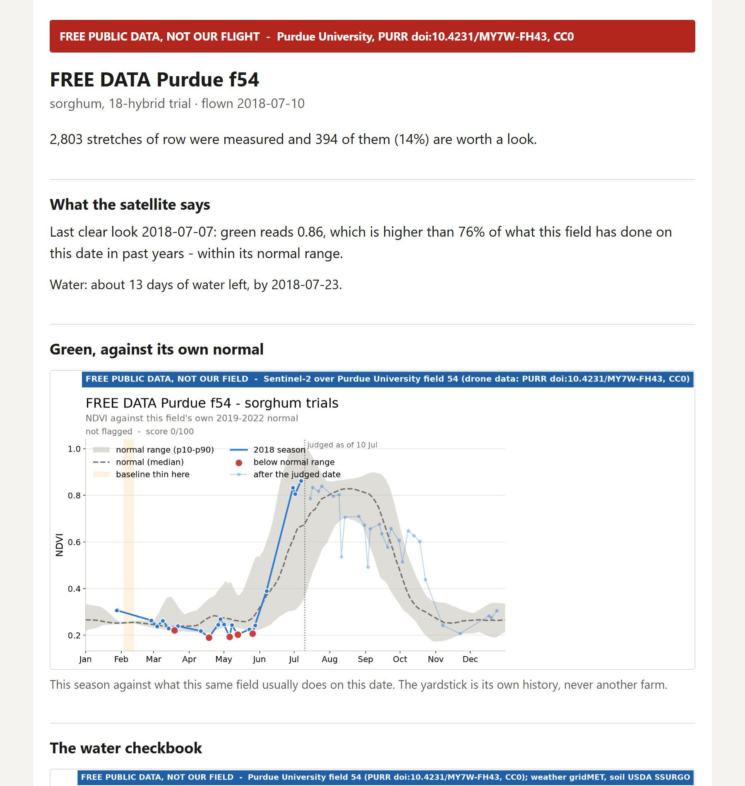
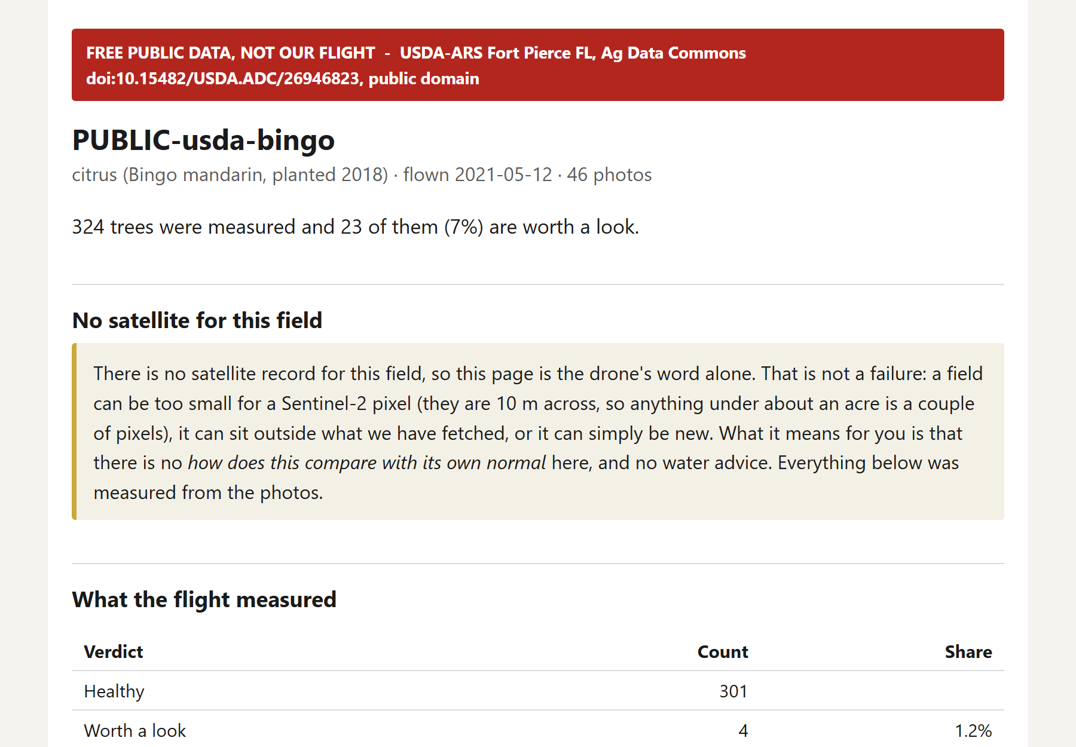
One page, with one eye or two
Both eyes satellite and drone, sorghum
One eye drone only, a small citrus grove
Too small for the satellite to see. The page says so plainly instead of leaving a gap.
16
Notes:
All of it lands on one page a farmer can save or forward. On the left, a field with both eyes: what the satellite says first, then the flight. On the right, a grove too small for the satellite. The page doesn't hide that, it says it, and shows what the drone found on its own.

Slide 17
Who flies the drone? Nobody has to.
$175
Satellite only: nobody flies
Where everyone starts, and where most farmers will stay.
The FAA Part 107 exam to fly a drone for your farm. Not thousands.
The expensive licence is Part 137, for spraying. Dos Ojos never sprays.
Fly your own
By hand, or with a drone that flies its own route. Either way, it needs the licence.
One pilot, many farms
A co-op, ag retailer, crop consultant or college drone students. The satellite tells them which few fields need a visit this week.
17
Notes:
The question we always get: do farmers need a licence? Only to fly, and it's a $175 exam, not thousands. The expensive one is for crop spraying, which we don't do. But nobody has to fly at all: satellite only is the default. And when a flight is worth it, one licensed pilot can serve many farms, sent by the satellite to the few fields that need it.

Slide 18
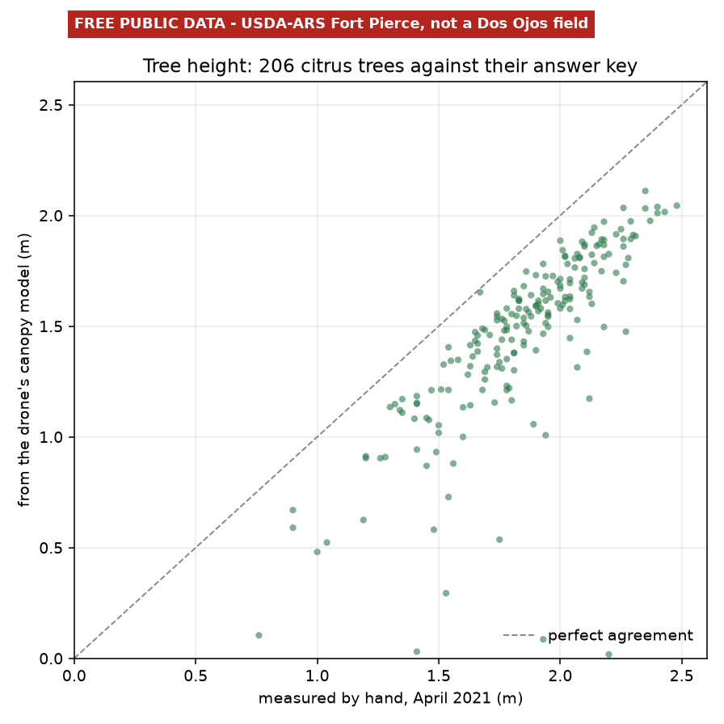
Checked against the tape measure
206 trees
measured by hand by USDA scientists, then flown with a drone and scored.
It mostly gets the order right
Taller trees read taller. Good for finding the weakest trees in a grove.
It reads heights about 21% short
Better processing already cut that from 40%. We found it because we checked.
So we say what it's good for
Comparing trees with each other, not measuring them to the inch.
USDA-ARS citrus trial, Fort Pierce, Florida. Public data.
18
Notes:
Most demos stop at a nice picture. We found a dataset where every tree had been measured by hand, and scored ourselves. Each dot is one tree: across is the real height, up is what the drone measured. The order is mostly right, but everything reads short. Better processing halved that error. We tell farmers what the numbers are good for, and what they're not.

Slide 19
What's next
All of it runs today: the satellite, the water account, sorghum stages and pests, a real drone flight and a real thermal scan, and the text messages around them — on free public data, because we have flown nothing ourselves yet.
What is left is what it takes to reach farms.
A camera in the Valley
The thermal step works on real research data from Arizona. Next: a thermal flight over a Valley field.
A real phone number
Connect the text messages to a live number.
First Valley farms
Try it with growers, in Spanish and English.
Routes for pilots
Hand a pilot a ready-made flight plan for each field.
19
Notes:
What's next. The pest warning now runs on real thermal data, but that data is from a research farm in Arizona: the next step is a thermal camera over a Valley field. After that: a live phone number, the first farms in the Valley, and ready-made flight routes for pilots.

Slide 20
Dos Ojos
Two eyes on every field.
Questions?
Public data used: Sentinel-2 (Copernicus), USDA soil survey, gridMET weather, USGS 3DEP lidar, Purdue University, USDA-ARS Fort Pierce, TERRA-REF. The farmers in the demo are made up.
Notes:
Thank the audience and take questions. The sources line is there so nobody mistakes public research data for our own farms.

