Slide 1
Web development Workshop

Slide 2
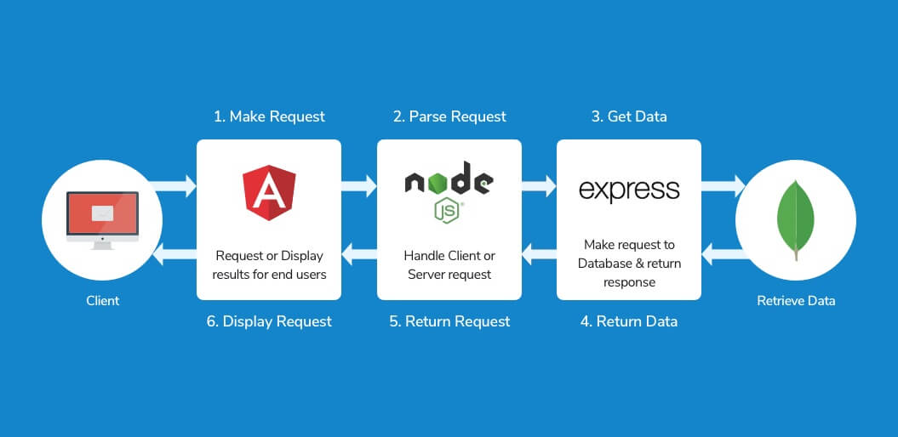
MEAN Stack

Slide 3
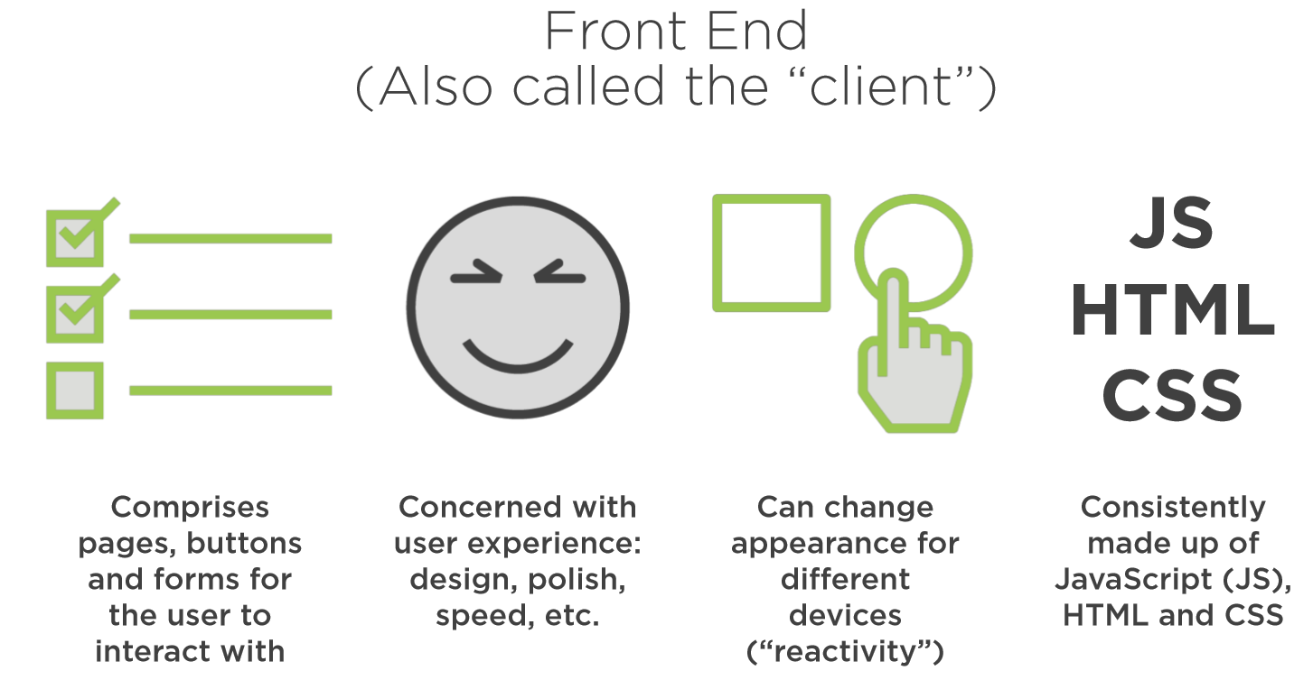

Slide 4
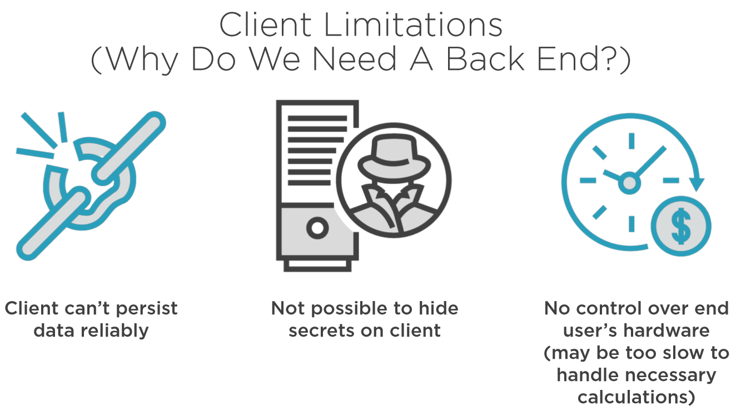

Slide 5
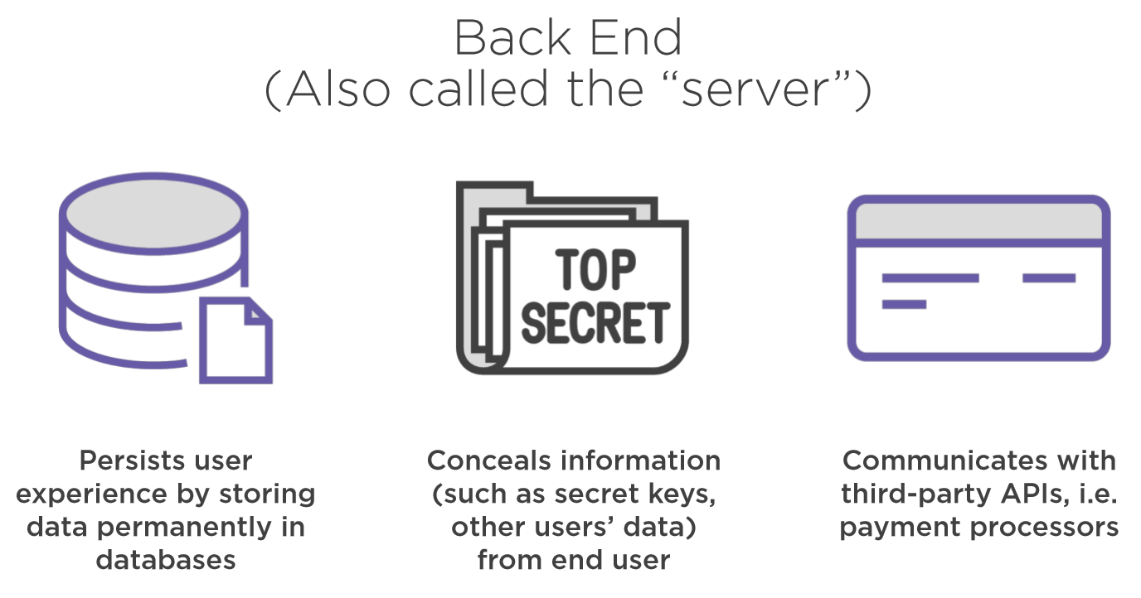

Slide 6
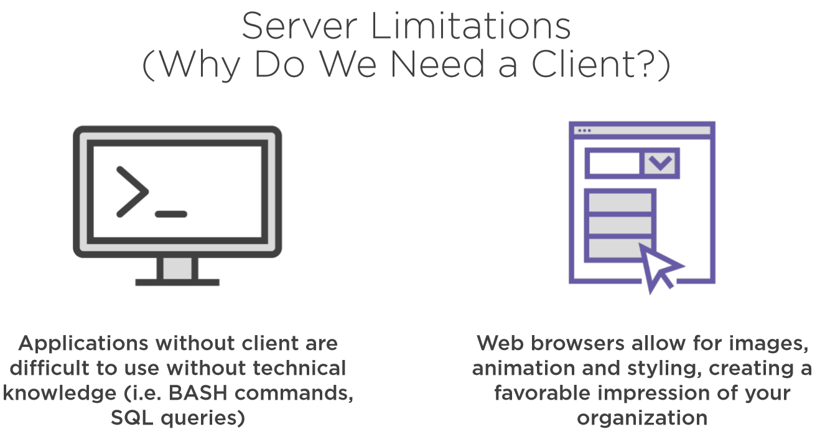

Slide 8
https://github.com/EdgarAVJ/WebDevelopmentMEAN/
https://devcenter.heroku.com/articles/mean-apps-restful-api#create-the-contact-list-template-and-component

