Slide 1

Reconocimiento de Patrones
Domingo Mery
Departmento de Ciencia de la Computación
Escuela de Ingeniería
Universidad Católica de Chile
Sparse Representations
[ Capítulo 4 ]

Slide 2
Images of different
known classes
Pattern Recognition Schema
Class 1
Feature Feature Design of
Extraction Selection Classifier
Class 2
Class n
Stage 1: TRAINING
Stage 2: TESTING
Extraction of
selected
features
InputA: Test Image
Class
Classification
Output:

Slide 3
Images of different
known classes
Pattern Recognition Schema
Using Feature Transformation
Class 1
Feature Feature Design of
Extraction Transformation Classifier
Class 2
Class n
Stage 1: TRAINING
Stage 2: TESTING
Extraction and
transformation
of features
InputA: Test Image
Class
Classification
Output:
GOAL: Classification could be easier in the transformed feature space.

Slide 4
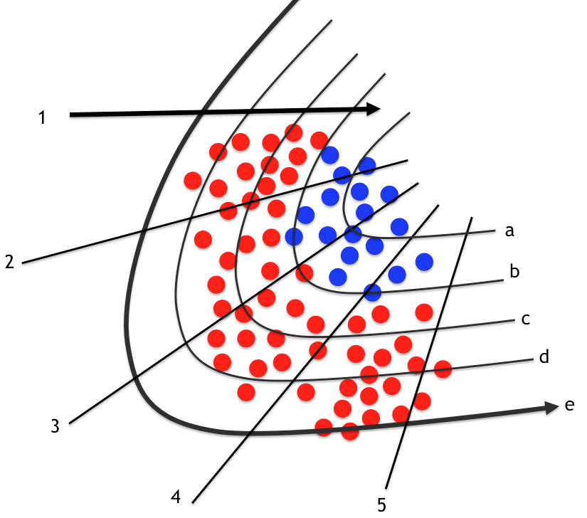
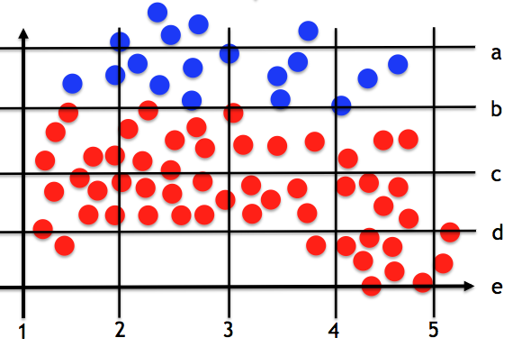
Original Feature Space Transformed Feature Space
. (new features)

Slide 5
General Linear Transformation
y = [ y₁ y₂ … y_{n} ]^{T} original features
x = [ x₁ x₂ … x_{K} ]^{T} transformed features
^{where}
x₁ = a₁₁y₁ + a₁₂y₂ + … a_{1n}y_{n}
x₂ = a₂₁y₁ + a₂₂y₂ + … a_{2n}y_{n}
:
x_{K} = a_{K1}y₁ + a_{K2}y₂ + … a_{Kn}y_{n}
x = Ay

Slide 6

General Linear Transformation
y = [ y₁ y₂ … y_{n} ]^{T} original features
x = [ x₁ x₂ … x_{K} ]^{T} transformed features
Example with K = 2
y₂
x₂
x = Ay
y₁
x₁
PCA: Principal Component Analysis

Slide 7

General Linear Transformation
y
x
n
K
y
x = Ay
x
y
y = Dx
x
Signal y can be represented as a linear combination of a set of elementary signals:
dictionary
atoms

Slide 8


General Linear Transformation: Traditional Dictionaries
y
x
n
K ≤ n
y
y = Dx
x
There are many known Dictionaries:
Name | Size | Type
Fourier | K = n | Fixed
Haar | K = n | Fixed
DCT | K = n | Fixed
Wavelets | K = n | Fixed
Gabor | K = n | Fixed
PCA | K ≤ n | Learned
Properties:
x = y

Slide 9
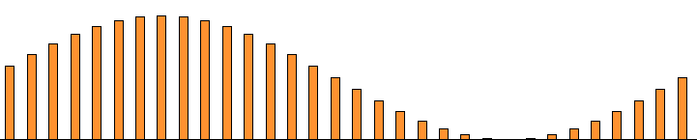
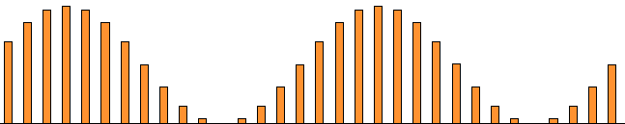
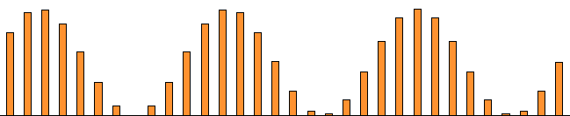
General Linear Transformation: Example Fourier (1D)
y
x
y
x
y
x
y
x

Slide 10

How can we work with 2D signals?
Column 1
(11 elements)
Column 5
(11 elements)
Column 9
(11 elements)
:
:
y =
110x90 11x9 99x1
Down-sampling Stacking

Slide 11

General Linear Transformation
y
x
n
K ≤ n
Sparse Linear Transformation
y
x
n
K>n

Slide 12
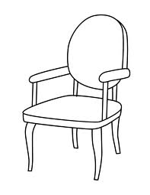
Sparse Representations – Example
What is this if we don’t have the word ‘chair’ in our dictionary?
A piece of furniture consisting of a seat, legs, back, and arms, designed to accommodate one person.
y
[ REPRESENTATION WITHOUT WORD ‘CHAIR’ ]
x
What is this?
A chair.
x
[ REPRESENTATION WITH WORD ‘CHAIR’ ]

Slide 13
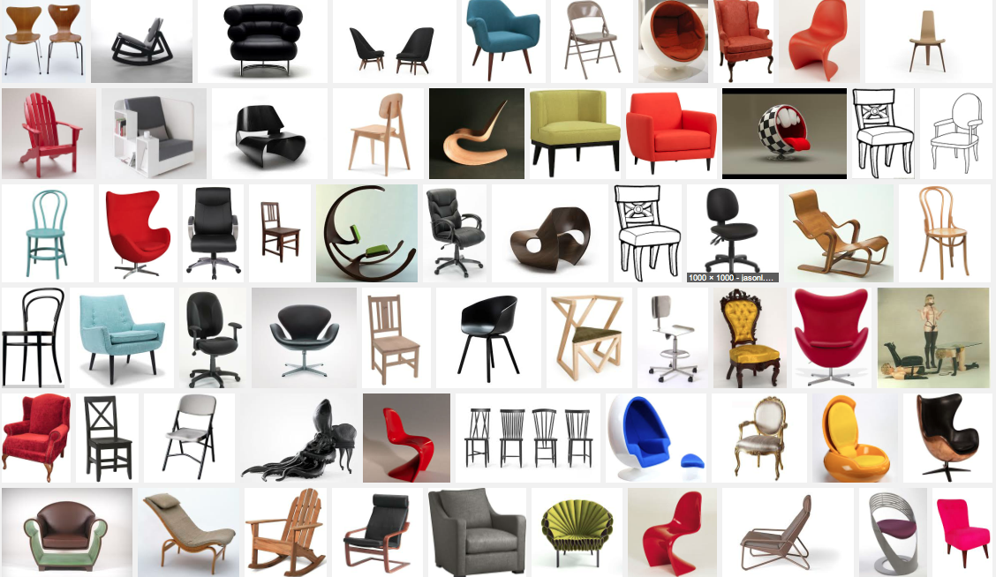
Sparse Representations – Example
However, what is this if we don’t have the word chair?
A piece of furniture consisting of a seat, legs, back, and arms, designed to accommodate one person.
y
x
What is this?
A chair.
x

Slide 14



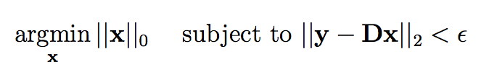
Sparse Representation Methodology
dictionary
[ 1. SPARSE DICTIONARY LEARNING ]
transformed features
(new representation)
original features
If we have a signal y and a learned dictionary D,
its sparse representation is
x* =
[ 2. SPARSE REPRESENTATION ]

Slide 15
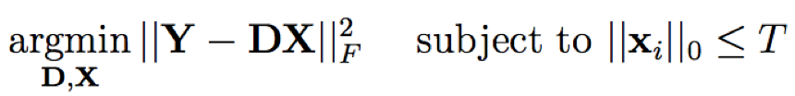
Sparse Representations – Classification – Strategy ‘A’
LEARNING
Y₁
Y₂
Y₃
Y_{k}
a) Collect signals from each class
b) Compute a dictionary for each one
D₁
i i i
i i
D₂
D₃
D_{k}
c) Concatenate all dictionaries
D = [D₁, D₂, …, D_{k}]
D =

Slide 16

Sparse Representations – Classification – Strategy ‘A’
TESTING
a) Test signal
y = ???
b) Compute sparse representation of y using D
×
y
D
x

Slide 17
Sparse Representations – Classification – Strategy ‘A’
TESTING
x
x

Slide 18
Sparse Representations – Classification – Strategy ‘A’
TESTING
x

Slide 19

Sparse Representations – Classification – Strategy ‘A’
TESTING
1

Slide 20
Sparse Representations – Classification – Strategy ‘A’
TESTING
2

Slide 21
Sparse Representations – Classification – Strategy ‘A’
TESTING
3

Slide 22
Sparse Representations – Classification – Strategy ‘A’
TESTING
k

Slide 23


Sparse Representations – Classification – Strategy ‘A’
TESTING
x
1
2
3
k
c) Compute the residuals for each class
D
d) Classify according the minimal residual

Slide 24
Sparse Representations – Classification – Strategy ‘B’
LEARNING
Y₁
Y₂
Y₃
Y_{k}
a) Collect signals from each class
b) Compute a dictionary for each one
D₁
i i i
i i
D₂
D₃
D_{k}

Slide 25
Sparse Representations – Classification – Strategy ‘B’
TESTING
a) Test signal
y = how is y represented by each dictionary?
b) Compute sparse representation of y using D_{i}
c) Compute the residuals for each class
D
x
i
i
i
i
i
×
d) Classify according the minimal residual
y
D
x
i
i

Slide 26
Face Recognition using
Sparse Representation Classification
(SRC)

Slide 27
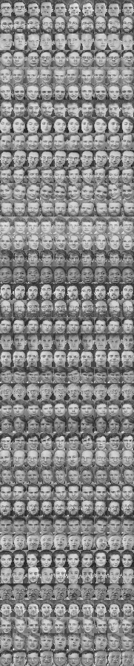
Sparse Representation Classification
LEARNING
In the training set there are k subjects.
For each subject we have n training images.
In this example there are 40 subjects with 9 images each.
Each image is downsampled to h × w = m pixels
Each downsampled image is represented as a vector d of m elements (by stacking its columns)
:
:
d =
Wright, et. Al. Robust Face Recognition via Sparse Representation. PAMI 2009

Slide 28
Sparse Representation Classification
LEARNING
For each subject i (for i=1,…k) we have a dictionary
D_{i} = [d_{i1}, d_{i2}, …, d_{in}]
We define a new matrix D by concatenating all individual dictionaries
D = [D₁, D₂, …, D_{k}]

Slide 29
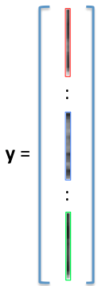

Sparse Representation Classification
TESTING
How is a test image classified?
A new test image I^{t} is represented as vector y of m elements (using the same representation of the training images)
Now, we look for a sparse representation x of y using -minimization approach:
I^{t}
We classify y by minimizing the residuals (we follow the explained algorithm)

Slide 30
SRC Example on LFW

Slide 31
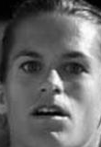
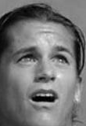
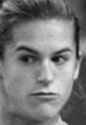
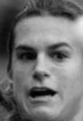
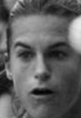
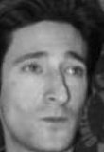
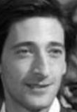
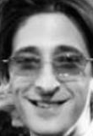

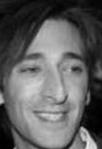
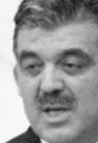

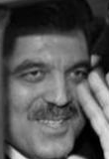

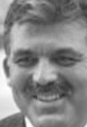
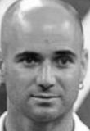
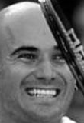
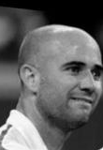
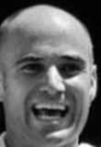

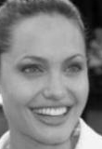
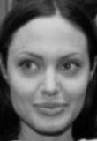
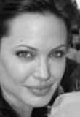
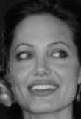
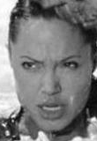
Gallery
Subject-1 Subject-2 Subject-3 Subject-4 Subject-k
. . .

Slide 32
Gallery = Dictionary
Subject-1 Subject-2 Subject-3 Subject-4 Subject-k
. . .

Slide 33
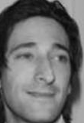
Gallery = Dictionary
Subject-1 Subject-2 Subject-3 Subject-4 Subject-k
. . .
Sparse
Representation
Query

Slide 34
Gallery = Dictionary
Subject-1 Subject-2 Subject-3 Subject-4 Subject-k
. . .
0.6
0.3
0.1
Sparse
Representation
Query

Slide 35
Gallery = Dictionary
Subject-1 Subject-2 Subject-3 Subject-4 Subject-k
. . .
0.6
0.3
0.1
Sparse
Representation
Query

Slide 36
Gallery
Subject-1 Subject-2 Subject-3 Subject-4 Subject-k
. . .
0.6
0.3
0.1
Sparse
Representation
+ +
0.3 0.6 0.1
Query
It is represented as a linear combination of few images of the gallery.

Slide 37
+ +
0.3 0.6 0.1
Query

Slide 38
+ +
0.3 0.6 0.1
Query
-
Not similar: reconstruction error is high

Slide 39
+ +
0.3 0.6 0.1
Query
-
Very similar: reconstruction error is very low

Slide 40
Query
Query is classified as this subject
In SRC, the query is classified as the subject with the lowest reconstruction error

Slide 41

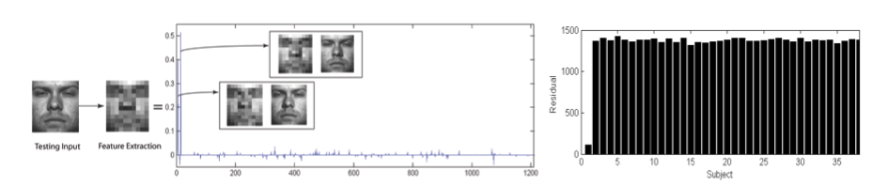
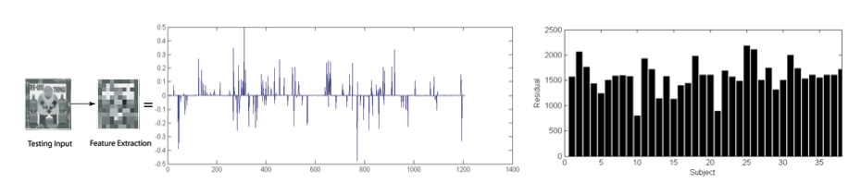
Sparse Representation Classification
TESTING
How good is the classification?
We use the Sparsity Concentration Index (SCI)
SCI = 0.8
SCI = 0.1

